Slide 1
Computer Science
https://www.calstatela.edu/cs

Slide 2
Agenda
Part 1: Transfer Student Advisement
BSCS Curriculum
Transfer Roadmap and Articulation Credits
Q & A (5 minutes)
Part 2: Introduction to Computer Science
Why choose Computer Science
Why choose Cal State LA
Project Showcase
Q & A (10 minutes)

Slide 3
Bachelor of Science in Computer Science (BSCS)
Curriculum Requirement (120 units)
General Education - 27 units
Major (CS Core and CS Electives) - 93 units
3

Slide 4
GE Requirements (48 units - 21 GE units in the major )
Block A - English Language Communication and Critical Thinking (9 units):
A1 - Oral Communication (3)
A2 - Written Communication (3)
A3 - Critical Thinking and Composition (3 units)
Critical Thinking - Met by major requirement courses
2nd Composition - Met by ENGL 2030 (3)
Block B - Natural Science (9 units):
B1 - Physical Science requirement (3) - Met by PHYS 2100 (5)
B2 or B3 - Biological science (3); or Interdisciplinary Physical-Biological science (3)
B4 - Quantitative Reasoning and Mathematical Concepts (3) - Met by MATH 2110 (4)
Block C - Arts and Humanities (6 units):
C1 - Arts (3)
C2 - Met by CS 3801 (3)
Block D - Social Science (6 units)
Block E - Lifelong Understanding and Self-Development (3 units)
Block F – Race and Ethnicity
GE UD requirements (9 units) met by the major.

Slide 5
New BS Curriculum (effective Fall 2021) – Major Requirements (93 units)
Lower Division Required Courses (44 units)
CS 1222 - Introduction to Relational Databases
CS 2011 - Introduction to Programming I (4)
CS 2012 - Introduction to Programming II (4)
CS 2013 - Programming with Data Structures (4)
CS 2148 - Discrete Structures (4)
CS 2445 – Intro to Computer Systems
CS 2470 – Network Systems and Cybersecurity
ENGL 2030 - Introduction to Technical Writing
MATH 2110 - Calculus I (4)
MATH 2120 - Calculus II (4)
MATH 2550 - Introduction to Linear Algebra
PHYS 2100 - General Physics I: Mechanics (5)
Upper Division Required Courses (31 units)
CS 3035 - Programming Language Paradigms
CS 3112 - Analysis of Algorithms
CS 3186 - Introduction to Automata Theory
CS 3220 - Web and Internet Programming (4)
CS 3337 - Software Engineering
CS 3801 - Societal and Ethical Issues in Computing
CS 4440 - Introduction to Operating Systems
CS 4961 - Software Design Laboratory I
CS 4962 - Software Design Laboratory II
CS 4963 - Computer Science Recapitulation
--------------------------------------------------------------------------
CS Electives (18 units)
6 elective courses

Slide 6
Areas of Elective Courses (in random order)
Cybersecurity
Database
AI
Data Science
Graphics
Game Programming
AR/VR
Multimedia
Data Visualization
Cryptography
Network
IoT
Robotics
…

Slide 7
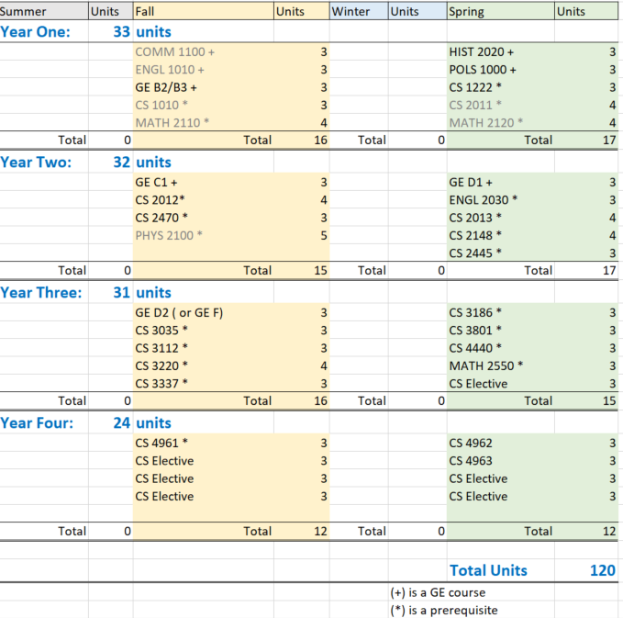
Roadmap and MSC (Major Specific Criteria)
7

Slide 8
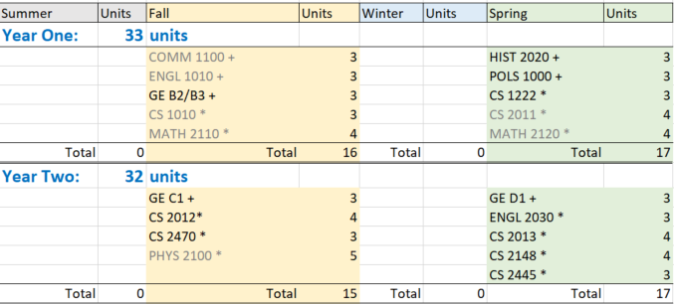
Transfer Roadmap : Articulation Map and https://assist.org/
8

Slide 9
Your Degree Plan - Example
year 2021-2022 | Summer 2021 | fall 2021 | spring 2022
 |  | CS 2012 | CS 2013
 |  | CS 1222 | CS 2148
 |  | CS 2445 | CS 2470
 |  | GE | ENGL 2030
 |  | GE | GE
Transfer orientations:
Provide individualized course work plan
year 2022-2023 | Summer 2022 | fall 2022 | spring 2023
 |  | CS 3035 | CS 3186
 |  | CS 3112 | CS 3801
 |  | CS 3220 | CS 4440
 |  | CS 3337 | CS Elective
 |  | GE D2 (GE F) | Math 2555
2 ~ 3 year academic plan toward graduation
9

Slide 10
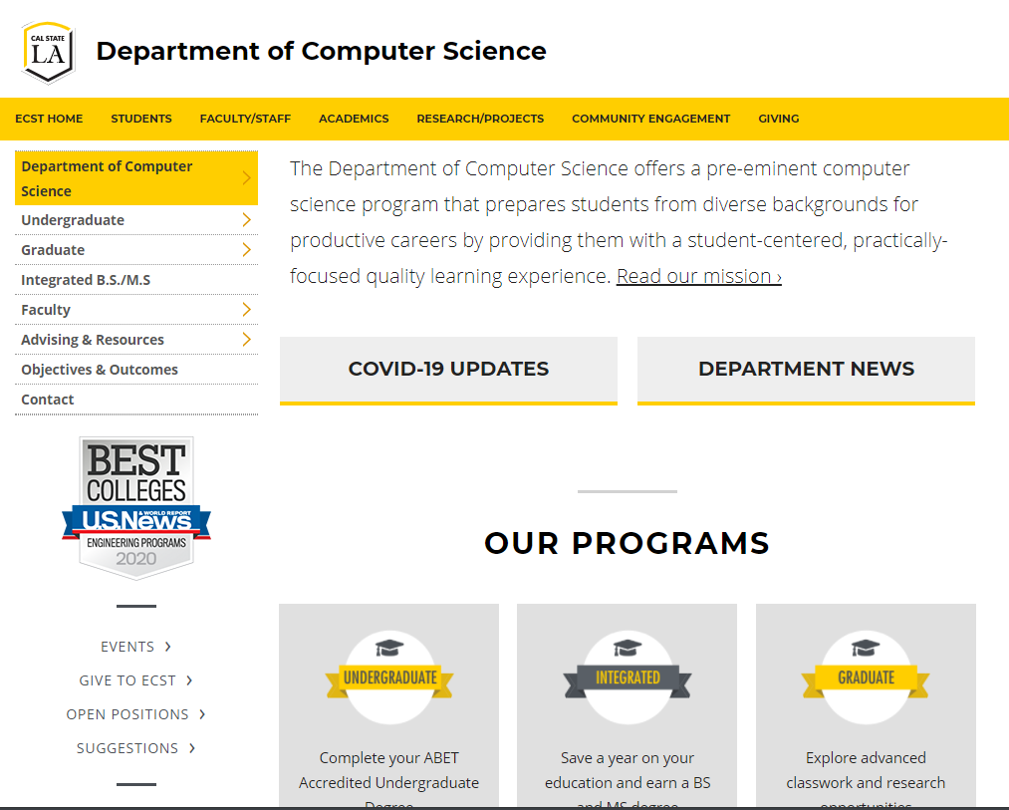
Computer Science Department
Check undergraduate curriculum requirement at https://www.calstatela.edu/ecst/cs/curriculum-requirements

Slide 11
Q & A

