Slide 1
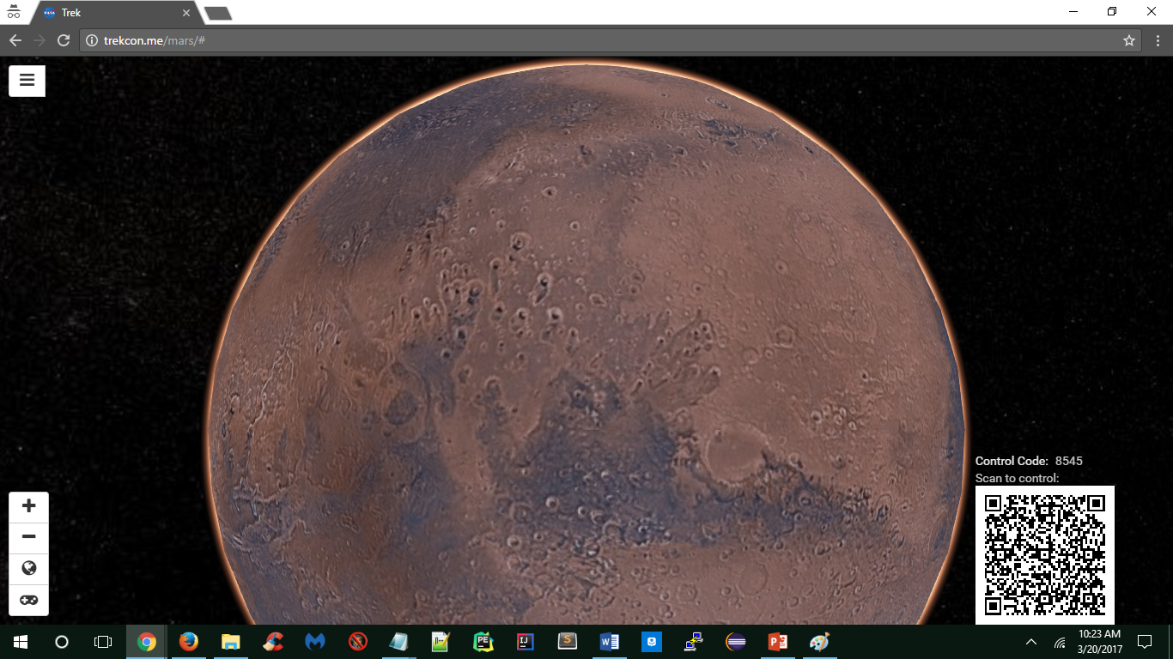
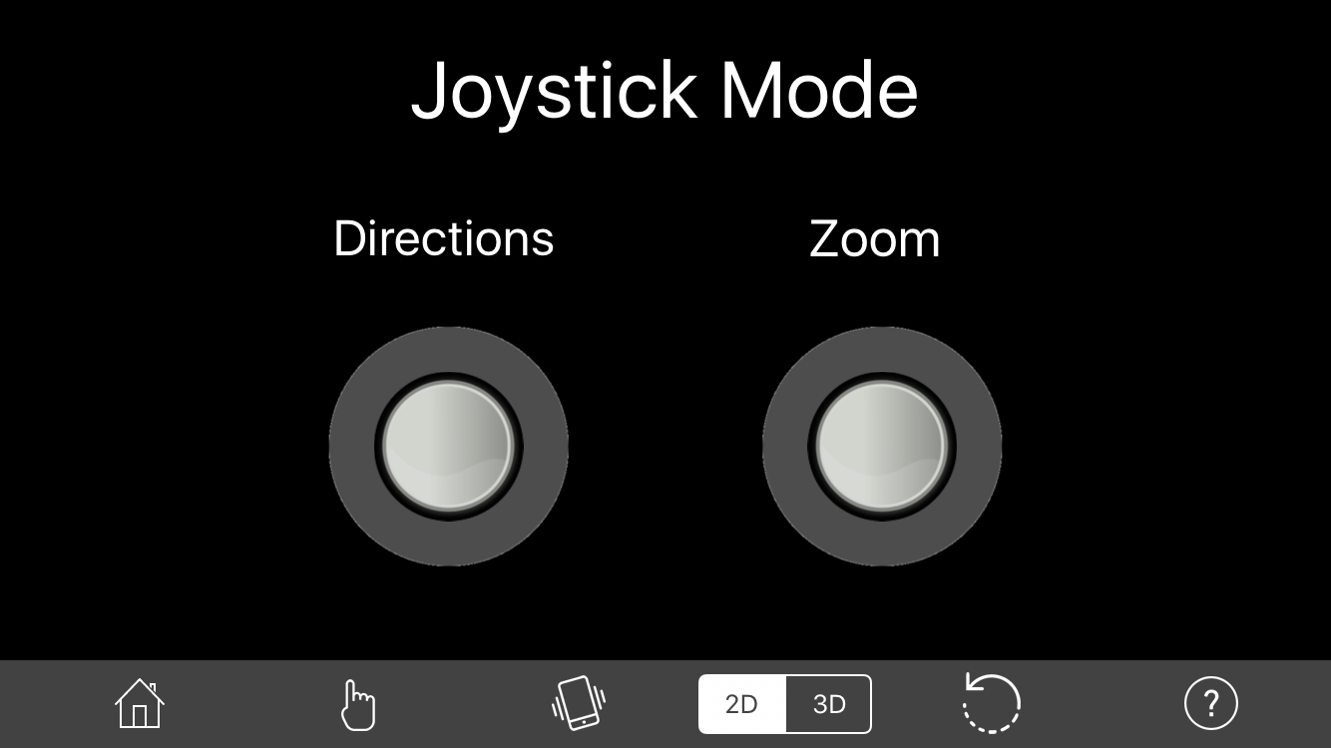
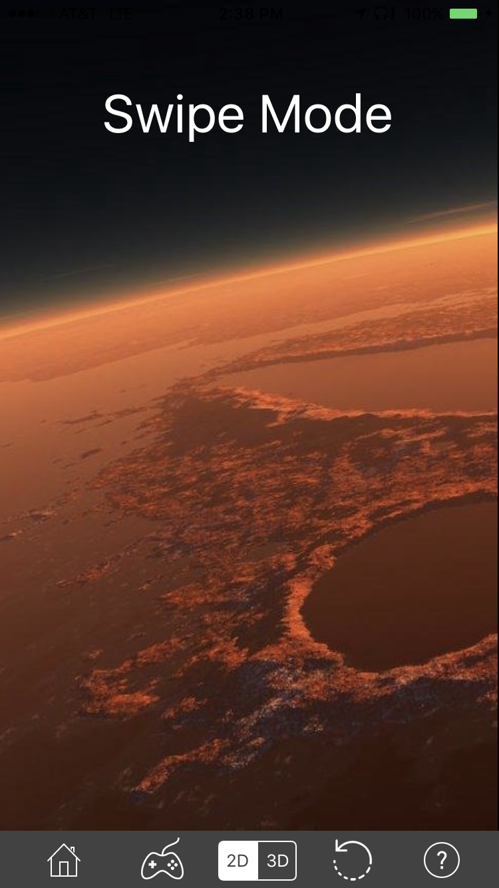
Mobile Navigation Control for Planetary Web Portals Team Members: John Calilung, Miguel Martinez, Frank Navarrete, Kevin Parton, Max Ru, Catherine Suh Faculty Advisors: Dr. Kang, Richard Cross JPL Liaisons: George Chang, Emily Law, Shan Malhotra Department of Computer Science College of Engineering, Computer Science, and Technology California State University, Los Angeles
Background & Objective
JPL's Trek Portals offer virtual mappings of Mars, Vesta, and the Moon; it allows a user to explore the surface via a mouse or keyboard.
. The objective of the project was to create Trek Controller, a mobile app that allows a user to remotely control a Trek Portal without the use of a mouse or keyboard.
Implementation
Agile Development: frequent testing periods allows for constant refining of design, features, and functionality
Multi-Platform support: iOS for Apple devices and Web App for all mobile devices
Custom Queueing system to handle multiple users with position status feedback
Asynchronous Javascript and XML (AJAX): client-side script to send the user’s move commands from the Web App Trek Controller to the Command Server
HTTP Requests: native HTTP communication protocols to send commands from iOS devices to the Command Server
Server Sent Events (SSE): uni-directional communication protocol that uses HTTP to push the user’s move commands from the Command Server to Trek Portal in real time
How It Works
4 Request specific Images
Controller Initialization
To connect Trek Controller to Mars Trek Portal, first locate the lower right corner of the browser displaying Mars Trek Portal; there is a QR-code and a Control Code.
Scan the QR-code
Start controlling in Touch-Swipe Mode
- OR -
Open TrekCon.me on your smartphone’s browser (Cookies must be allowed)
Click ‘Control Trek Portal’ or the mobile phone icon
Click ‘Press to Control Me’
Enter the Control Code
Start controlling in Touch-Swipe Mode
5 Send specific Images
Browser and Server
- the Trek Portals
Content Delivery Network - holds images
2 Push Commands
Database
– for Queue system
2 Send code
1 Request code
3 Add controllerId
2 Add code & create queue
Trek Controller
- Joystick Mode
1 Send Commands
3 Connect with Code
4 Grant access OR Send wait status
Server - hosts the Trek Controller app and the Queue system
Trek Controller
- Touch-Swipe Mode
Users can control the scene of the surface of Mars with three controller modes: Touch-Swipe, Joystick, and Motion. Swipes on the surface of the mobile device, pulling the left-hand joystick off-center, or moving the mobile device about its axes will move the camera in the desired direction. Pinching in and out, or moving the right-hand joystick in and out will zoom the camera in and out respectively. Users can toggle the 2D and 3D view of Mars or reset the view to its default center of the page with the use of buttons on the menu bar on the bottom of the page. Multiple users are handled by a custom queueing system and informed of approximate wait times.
Interaction Performance
Latency: average time to send a user’s move command from Trek Controller to the server is on average less than 20 milliseconds over WiFi
Disconnects: no extraneous disconnects reported; with usual cases, SSE automatically attempts to reconnect after an administrator-defined time
Conclusion
We’ve designed the entire communication architecture of Trek Controller and integrated it into the prototype of JPL’s Trek Portal. For the back-end, we created our own control variables to read and issue move commands by piggybacking on the existing camera movement API to control what is seen on Trek Portal. The front-end work resulted in a user-friendly mobile controller that supports 8-way movement and zoom. The Queueing system was designed using a mySQL database to keep track of users and Trek Portal instances.
Additional features we would have liked to implement are the ability to bookmark locations and save screenshots to the mobile device of what is seen on Trek Portal.
Notes:
1
** Reduce font size and pictures of trekCon and phones **
Diagram - combine the two, put descriptive captions, and move to ‘How It works’
Deliverables - how it works (sentence form)
I.e. User can control the scene of Mars surface using the following controller modes: touch-swipe, joystick, motion.
I.e. User can view the surface in 2D and 3D
I.e. what are the gestures in touch-swipe
Platform -- move to Implementation. Two implementations - iOS and web for all mobile platforms
Implementation - itemize client-side and server-side. Content doesn’t change much except moving ‘Platform’ in.
Conclusion - summarize what we’ve done and contributed (abstract level)
I.e. integrated Trek Controller with existing prototype of Trek Portal
I.e. created architecture
I.e. designed front-end and back-end
I.e. how queuing system was designed
I.e. user friendly mobile controller (8-way movement)
One to two sentences on future work

