Slide 1
QTC -
RE / TAT
Referral
ERRA
Trending
Analysis
Tool

Slide 3
Agenda
Introduction
Features
Work Environment
Data
Architecture
Visualization
Challenges/Summary
Project timeline

Slide 4
Introduction
Who is our liaison?
QTC is the largest provider of government-outsourced occupational health and disability examination services in the nation.

Slide 5
R/E TAT
● Objective
QTC needs a Trending Analysis Tool created that will use data from ERRA, weekly provider zip code report, and historical referral data to create a trending analysis that will allow them to identify areas that are missing providers and help them know when and where were their referrals assigned.
● Benefits
This tool will improve QTC Management with client and the Operations team to ensure there is better balance in their overall operations.

Slide 6
Features - Emanoel K.

Slide 7
Features
2 main features
Referral confirmation
Required provider check
Referral confirmation
Check between referrals assigned with
referrals received
Provide comparison data of referrals
Required provider check
Find providers where referrals are assigned
If no providers available mark area
Ensure coverage in all required areas

Slide 8
Work Environment -
Daniel Limas

Slide 9
Work Environment

Slide 10
Data - Xiaoye Li (Mark)

Slide 11
We are going to set up our own server
Platform: Linux Ubuntu 16.04.03
Web servlet management : apache tomcat manager
Database: mysql through phpMyAdmin
Safe.

Slide 12
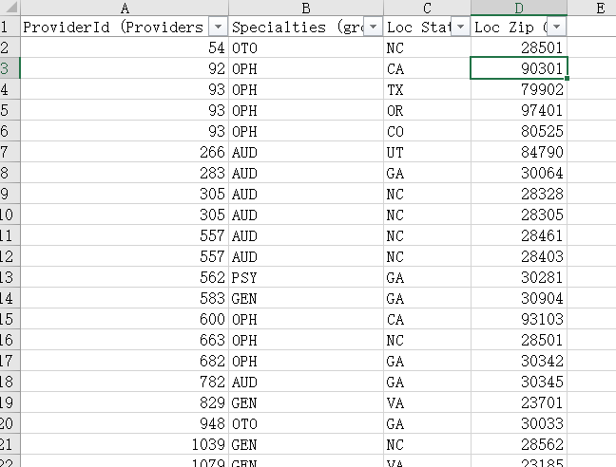
VA Provider Network List

Slide 13
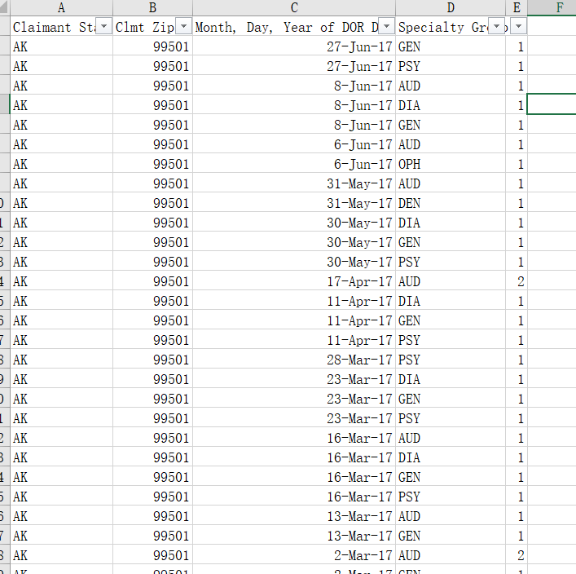
Referral data

Slide 14
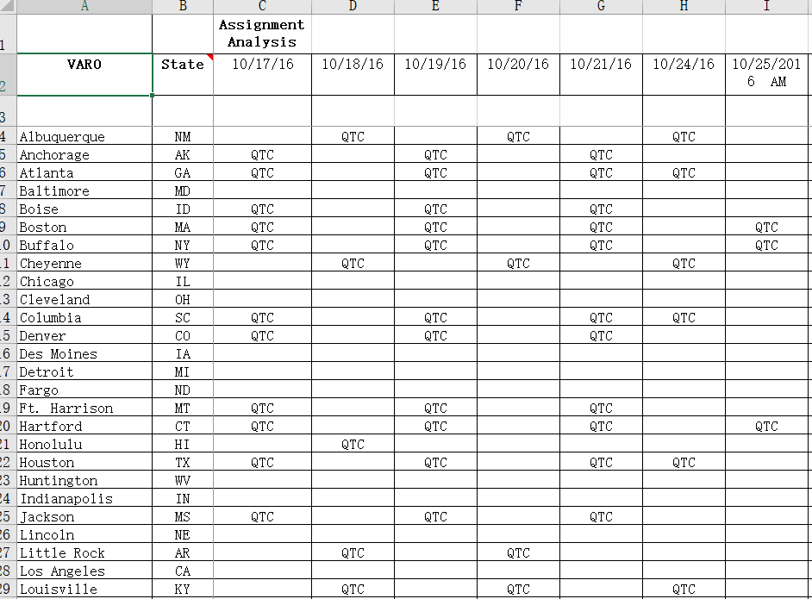
ERRA Data

Slide 15
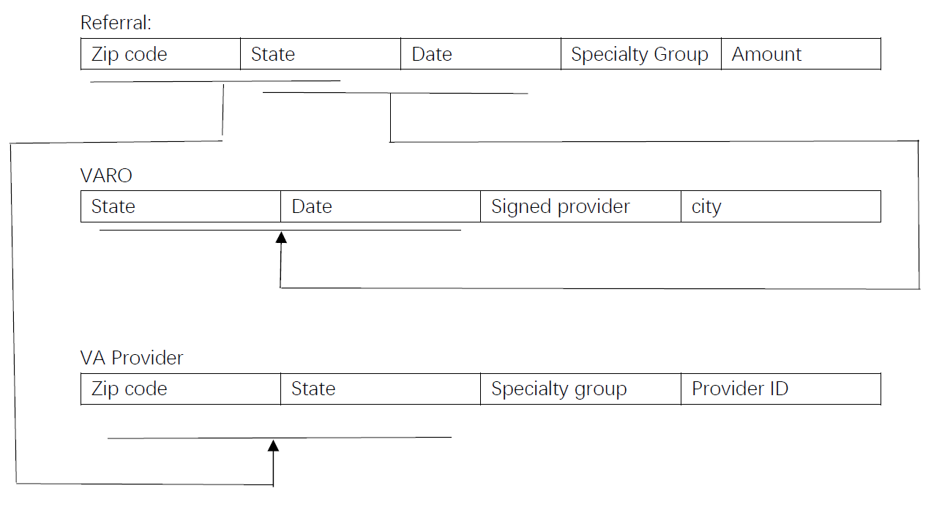
Database relationship

Slide 16
Architecture - Philip

Slide 17
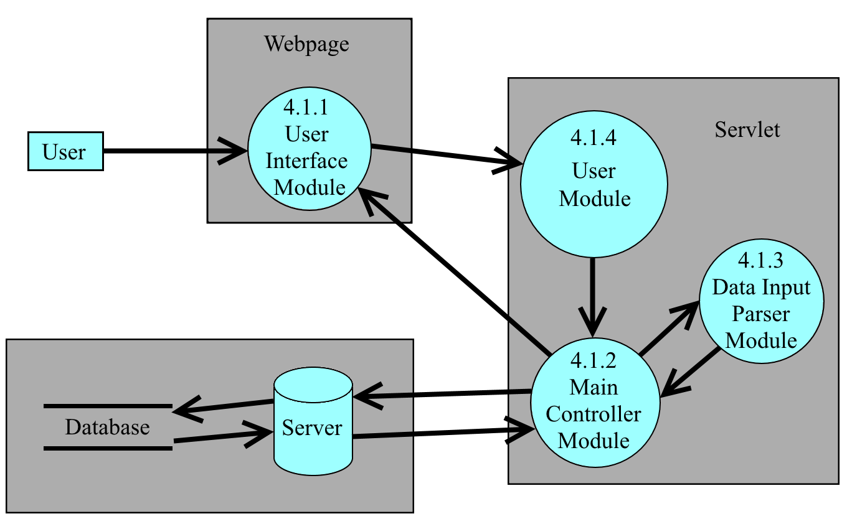
Architecture

Slide 18
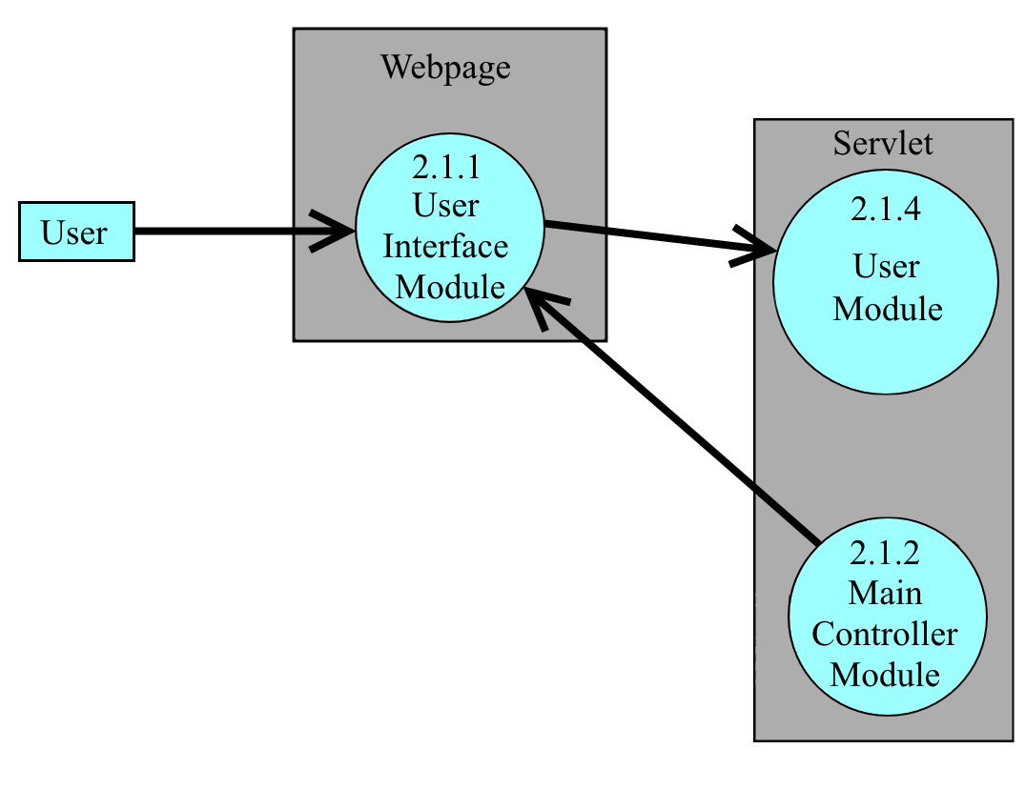
User Interface Module (UIM)
User interaction with feature
Feature Option to gather data
Display information

Slide 19
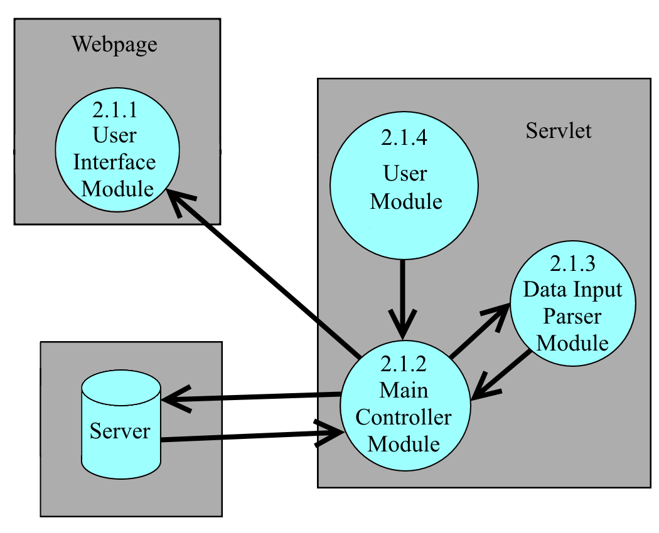
Main Controller Module (MCM)
Organize data to be displayed
Interacts with all main modules
Gather data for each features
Directs files to be parsed and store

Slide 20
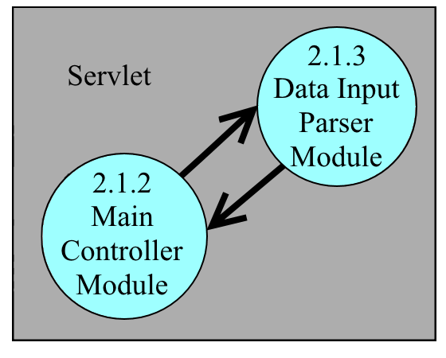
Data Input Parser Module (DIPM)
Using Apache POI
Read excel files
Interprets the excel files and formats the data in order for the system to understand
Parse three QTC excel file formats

Slide 21
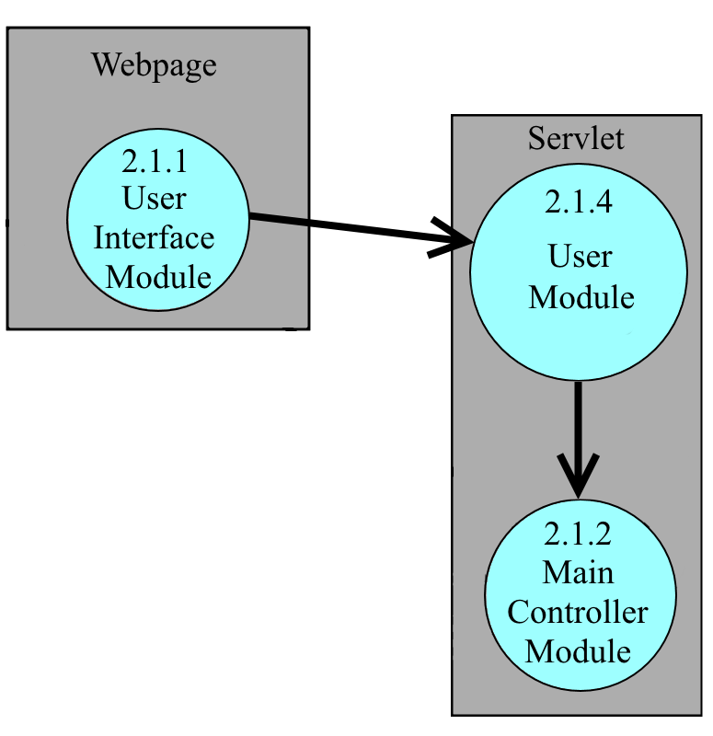
User Module (UM)
Authenticate users in the system
Validate user command and inputs
Instructs the MCM what features to do

Slide 22
Website Design - Wilson

Slide 23
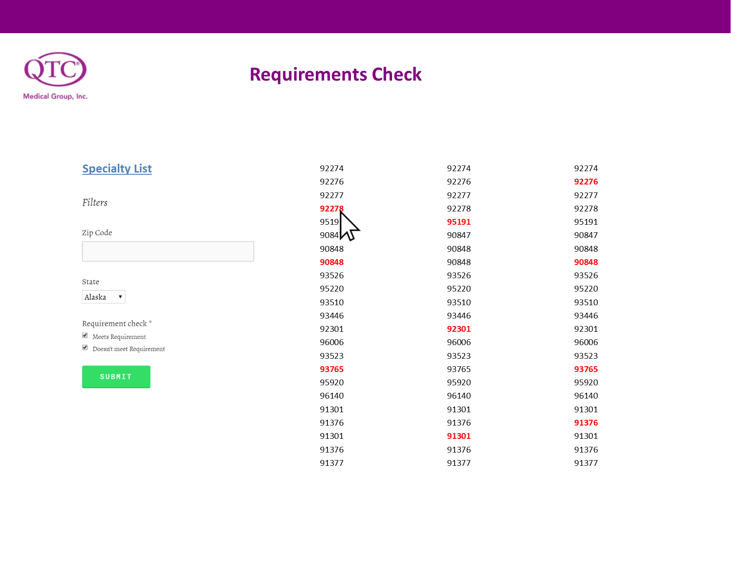

Slide 24
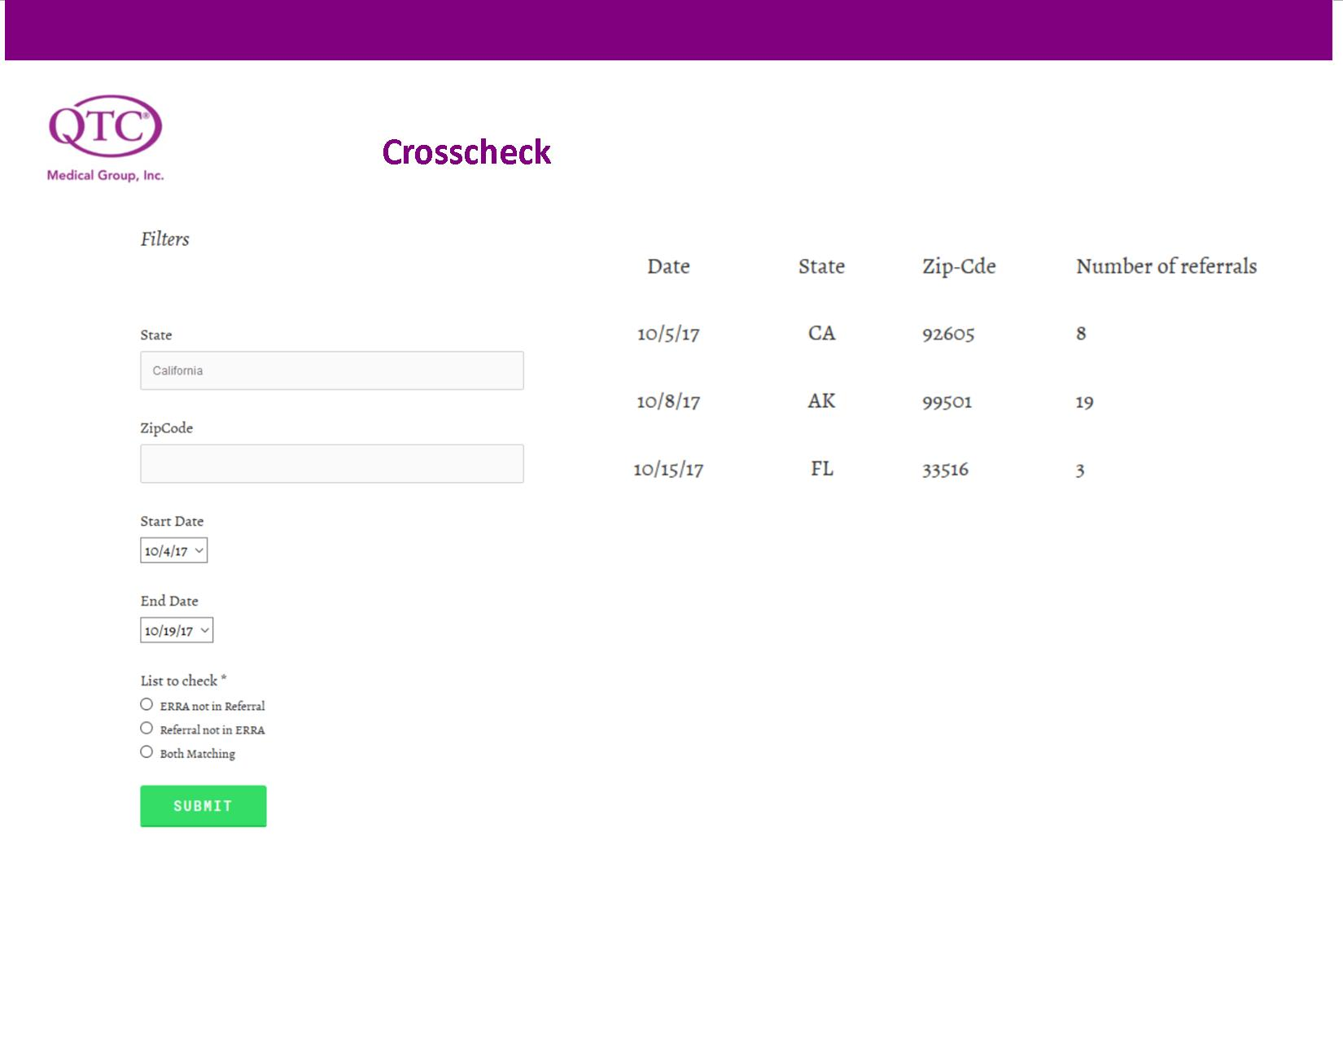

Slide 25
Challenges, Summary, & Timeline - Henry Liwag

Slide 26
Challenges
Making our own database.
Since we’re creating our own, we have limited resources.
Not enough data from the company/client.
Some data are missing.
Time complications and communication issues with QTC.
Terminology

Slide 27
Summary
Our goal is to create a convenient tool to check and compare what are the trends going on within the QTC’s referral reports and their providers.
With the two main features (referral confirmation and provider check), the tool will help them balance the work operations.

Slide 28
Projected Timeline (of Events)
Winter
March
January
May
2017
2018
1
2
3
The databases, the web pages, and the server will be done during the winter and early January.
Debugging for the whole tool will occur for two months after finishing in January. During those times, we will held demonstrations with the client.
If there are still time, we will more features to our overall tool.

Slide 29
Thank You!

