Slide 1
LA Hall of Administration Smart Board Directory Project
Team Members:
Matthew Gerlits, Jose Vega, Christopher Ly, Cedric Tong, Julius Macalutas, Chelle Cruz
Advisor:
Keenan Knaur
Liaisons:
Rony Wirtz, Amin Almuhajab

Slide 2
Project Overview
Map Directory
Microsoft Cognitive Services
ASP.NET Core 2.0
Amazon Alexa
Industry Weapon
UI Layouts

Slide 3
Map Directory

Slide 4
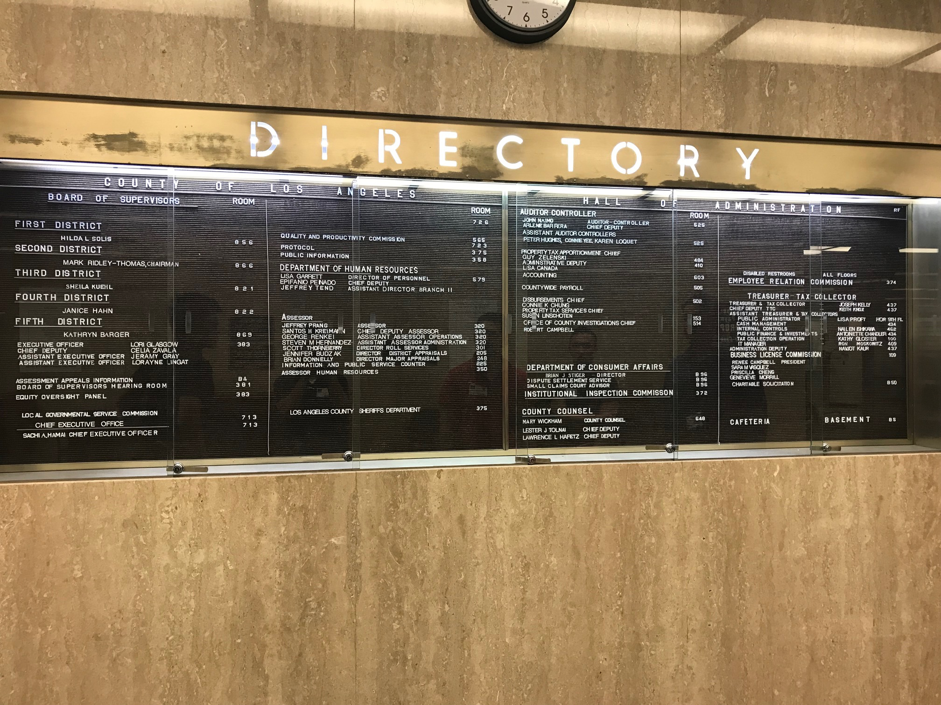

Slide 5
Goals
Display the map of the building
Provide written instructions of the route to a location
Provide a visual representation of the route to a location
Create an interactive map which displays information of each area in the building

Slide 6
Current Progress
Developed in Unity
Able to import CAD files
Working pathfinding algorithm
Prototype created as proof of concept

Slide 7
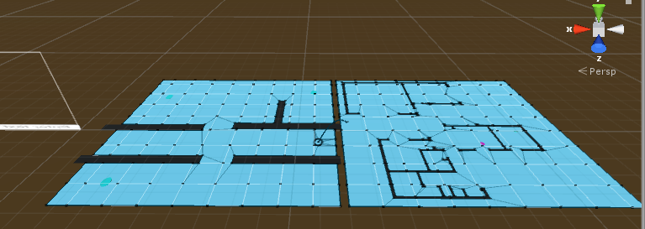
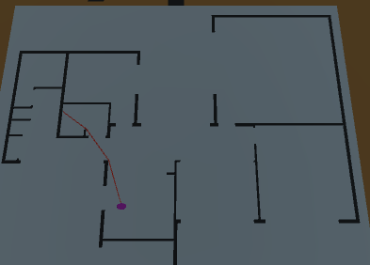
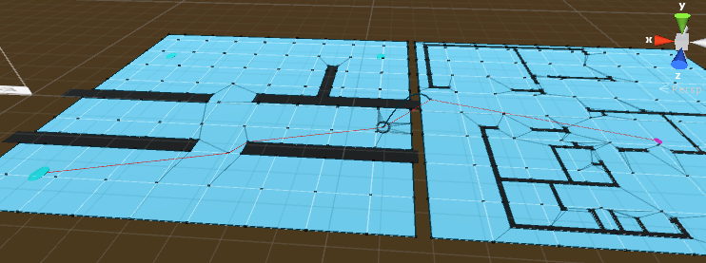

Slide 8
Microsoft Cognitive Services

Slide 9
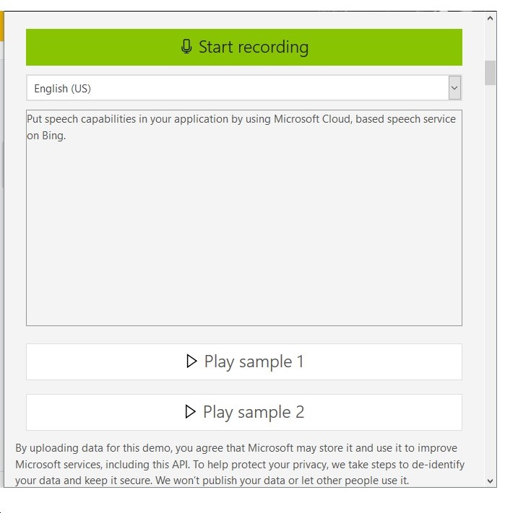
Goals
Voice directory using Microsoft Azure Cloud service
Provide an easy interaction with a user's input and the database
Find the best response to the users’ request
Incorporate speech translation

Slide 10
Current Progress
Microsoft Speech Services can be created in C# as well as other programming languages
Building LUIS (Language Understanding Intelligence Service) models
Incorporate the speech to text service with the existing Microsoft SQL database

Slide 11
ASP.NET Core 2.0

Slide 12
Goals
Integrating with other technologies used in the project
Provide a seamless streaming experience of Community Meetings on the Smart Boards
Collecting information for Frequently Asked Questions (FAQ)
Create a portal where tenants can enter their information into the DB on ASP.net Core 2.0

Slide 13
Current Progress
ASP.NET Core 2.0 is capable of search specific attributes within the Microsoft SQL Server table(s)
Enabling voice activation for both screen and voice
Implementing a search for keywords after the voice activation
Created a portal where tenants can enter their information into the DB on .NET Web Application

Slide 14
Alexa Skill
Notes:
I’m going to be introducing the Alexa Skill we have been developing.

Slide 15
Goals
Create an interactive voice directory using the Amazon Echo
Provide a new way to search for people using voice assistance
Integrate Microsoft SQL Server with the Alexa Skills Kit
Provide a seamless interaction to get queried information
Notes:
So, the requirements we gave this portion was to: create an interactive voice directory using the Amazon Echo. Doing this will provide a new way to search for people using voice assistance. In order to do this, we need to integrate Microsoft SQL Server with the Alexa Skills kit to provide a seamless interaction to get queried information

Slide 16
Current Progress
Developing an Amazon Alexa Skill
Prototype that searches for services within the building
Developing the interaction model
Notes:
Highlight the differences between alexa and microsoft cognitive services
Currently, we are developing an Amazon Alexa skill. Skills are voice-driven applications that run on an Amazon Echo or any Alexa device. Creating a prototype that searches for services within the hall of adminstration building. We are also developing the interaction model. The interaction model consists of two things: intents and utterances

Slide 17
Intents and Utterances
Intents:
Action that fulfills a user’s spoken request
Intents tell the skill what to do
Utterances:
Specific words that are mapped to the intent
Interact with the skill
Notes:
Intents are actions that happen when the user says a specific word or words and the intent that is activated tells the skill what to do. Utterances are the words used to triggered the skill it is mapped to and it is used to interact with the skill

Slide 18
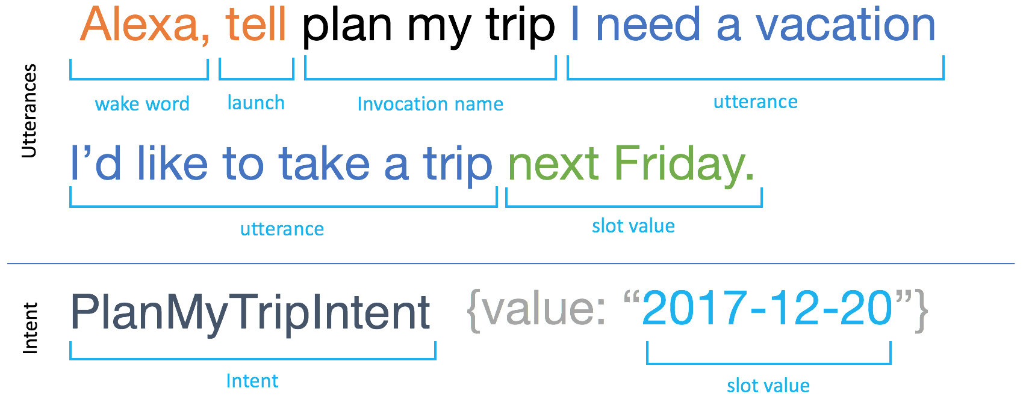
Example

Slide 19
Industry Weapon

Slide 20
Goals
Replace the old directories in the building with Smart Boards
Provide a visual interface for the other components of the project
Integrate ASP.NET Core 2.0 to work with the Industry Weapon API

Slide 21
Current Progress
Only works on Chromium
Found limitations in the Industry Weapon’s interface
Possibility of using a web application to link the Industry Weapon Software with the rest of our project
Waiting for information on Industry Weapon’s software to see how we can integrate our project
Notes:
limitations
Currently no way to test the templates

Slide 22
Basic Template

Slide 23
UI Layouts

Slide 24
Designing the Interface
Directory
Map (main)
Events
Other (ads, feeds, menus, stores near building)

Slide 26
Notes:
One of the templates created

Slide 27
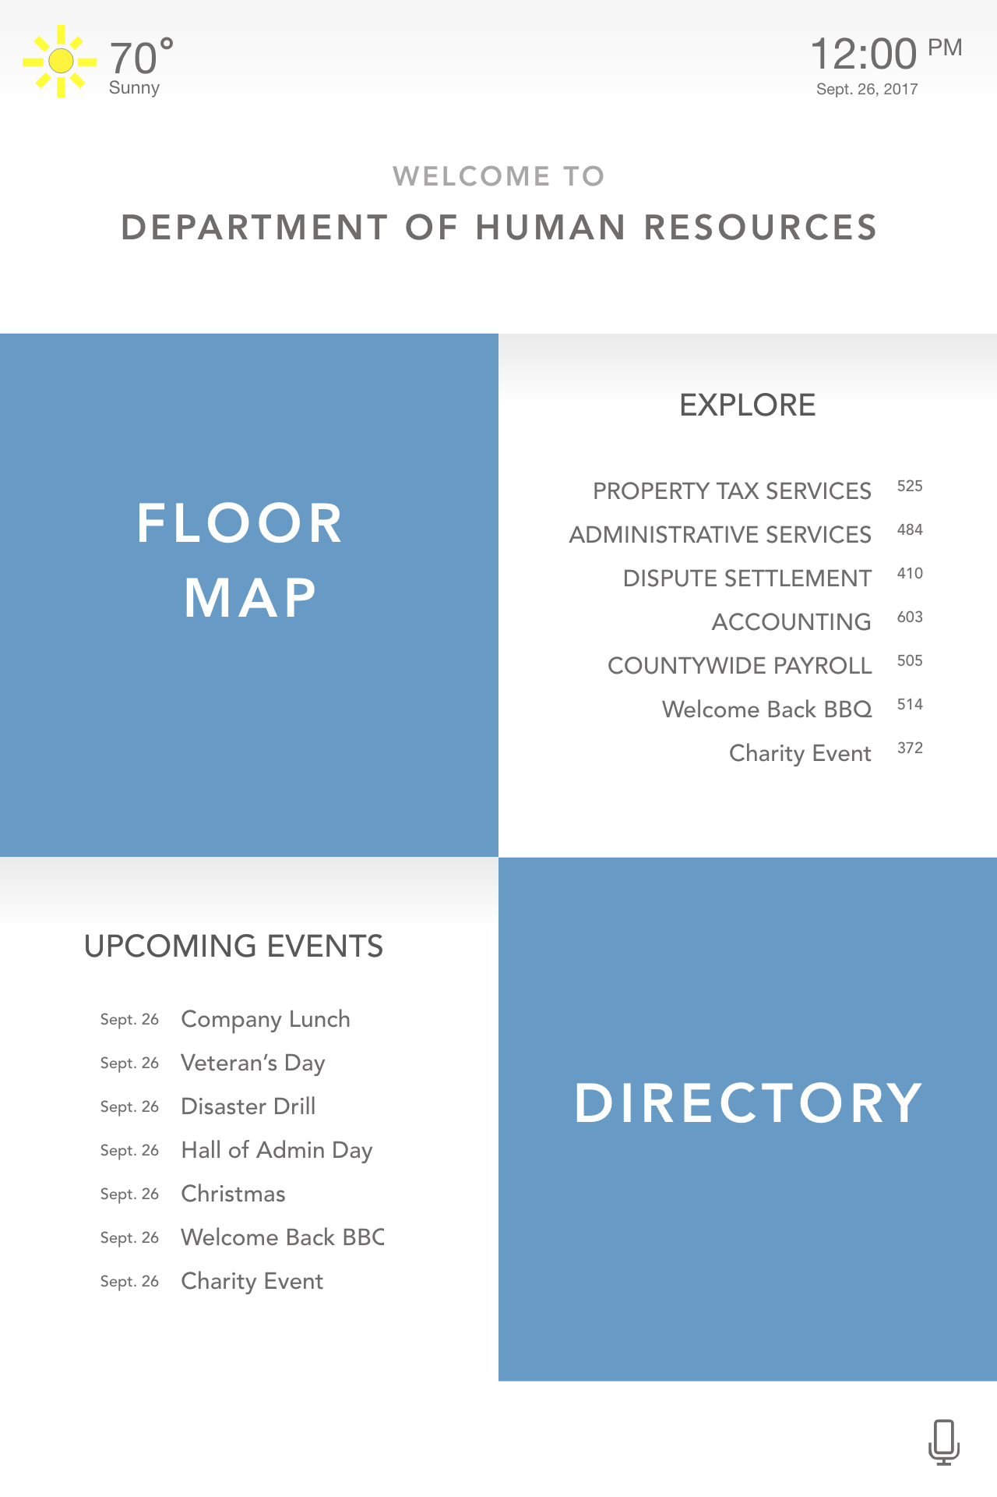
Notes:
One of the templates created

Slide 28
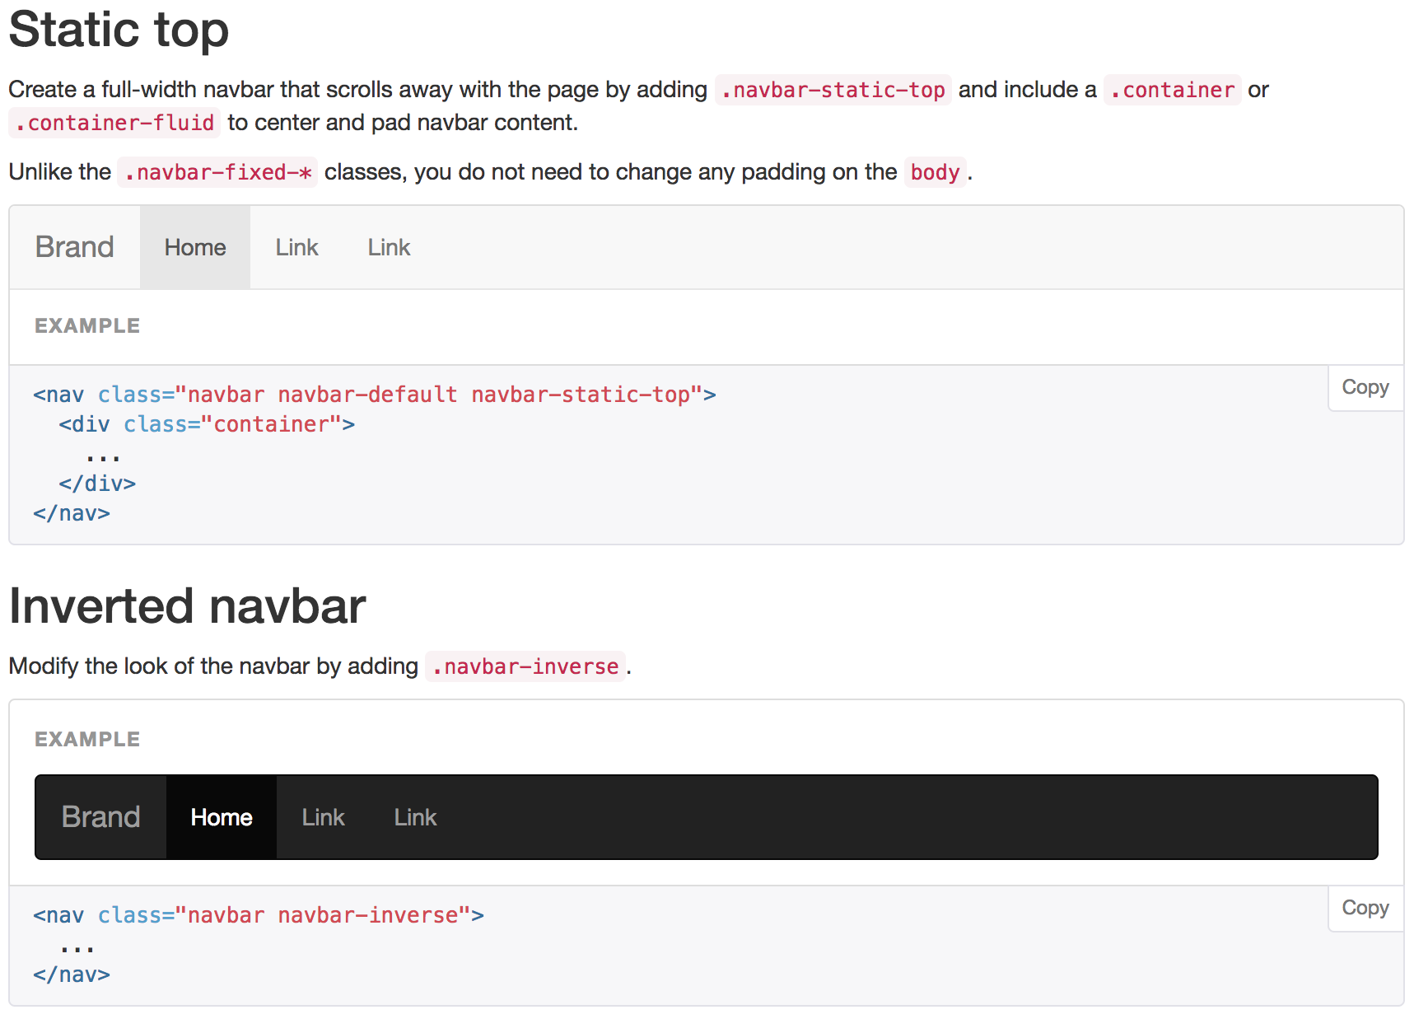
Creating the Interface (Web Page Prototype)
Bootstrap CSS
Material Bootstrap
React framework
Notes:
Bootstrap CSS is a framework used to create easy and clean HTML components such as navigation bars, grids, and inputs. These layouts can easily be created by using class names listed in the CSS files of bootstrap-min.css.

Slide 29
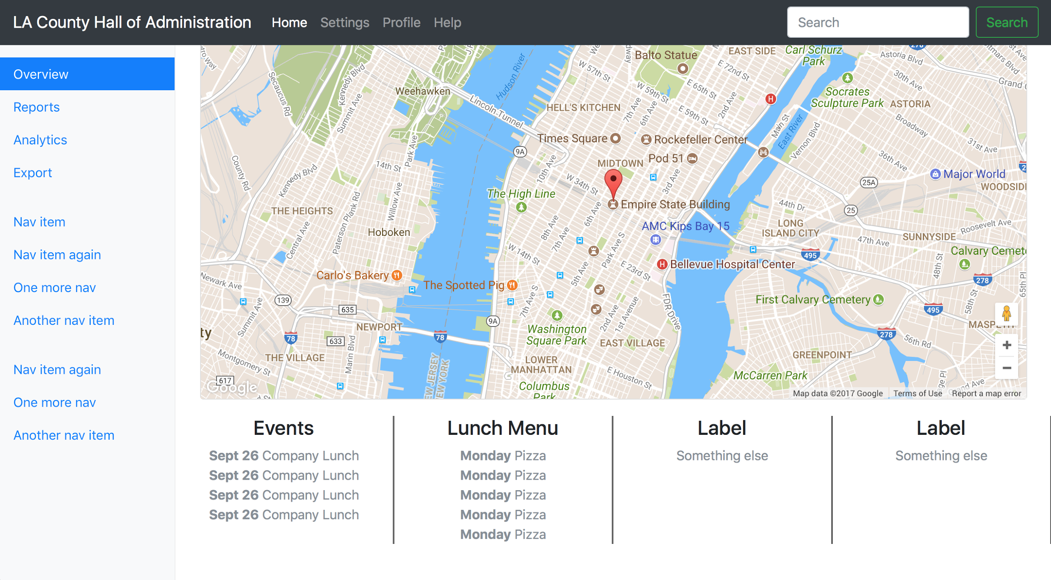

Slide 30
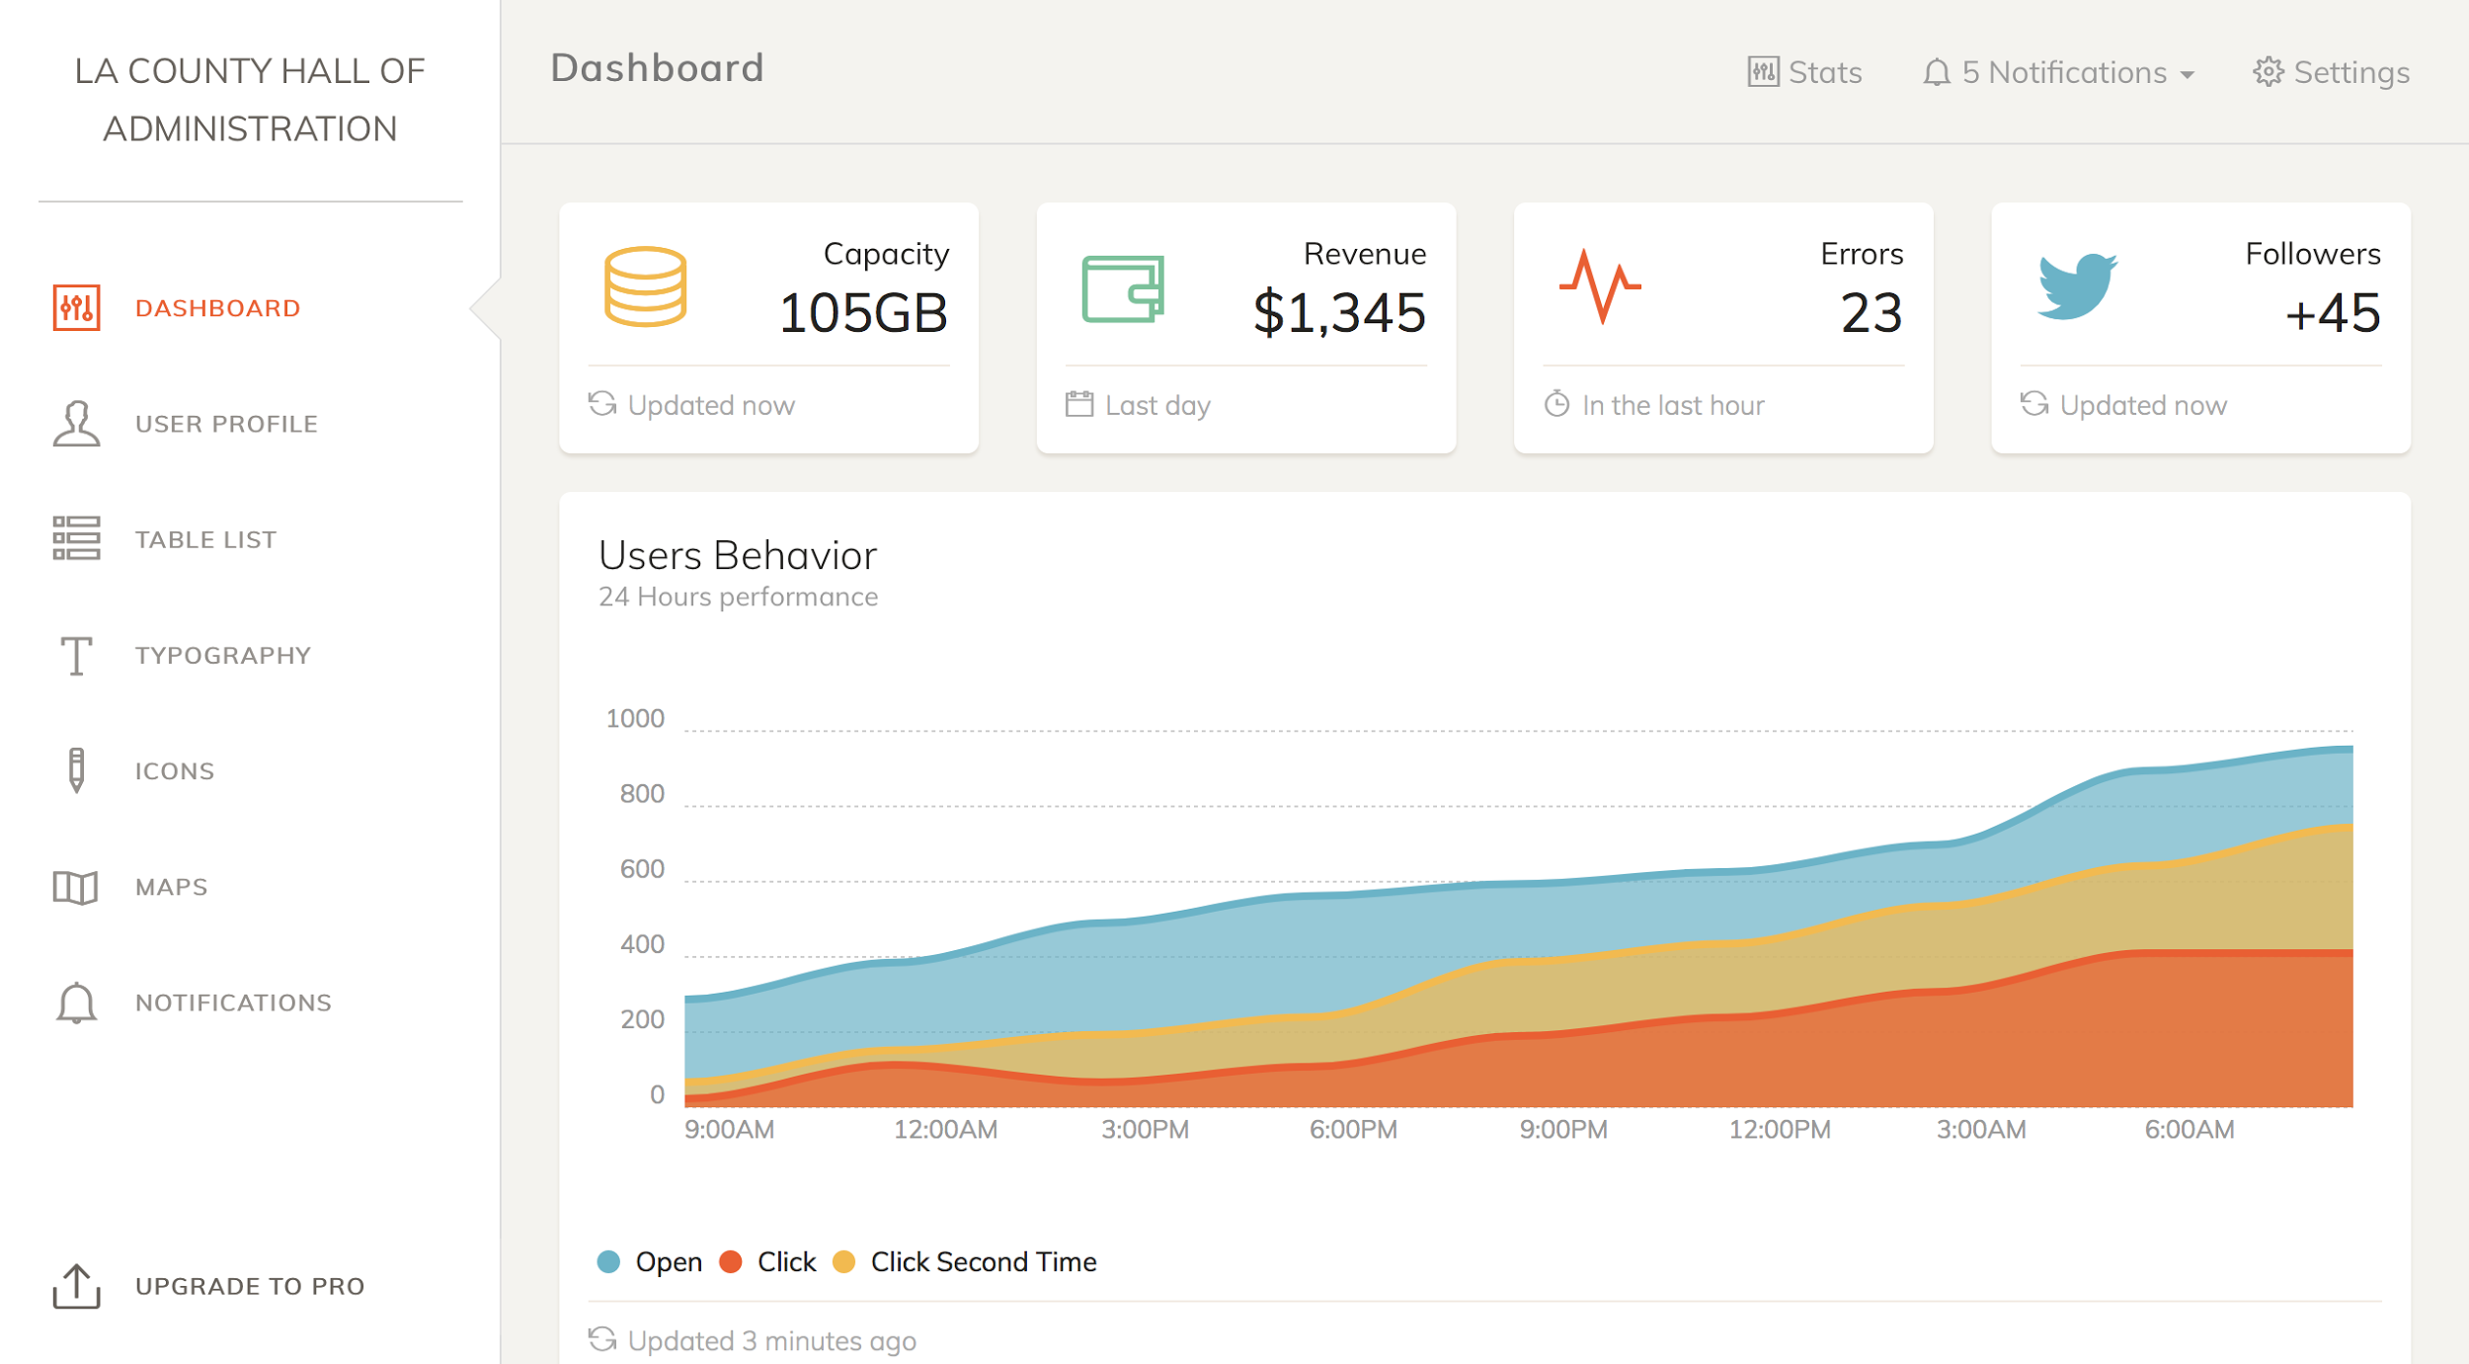
Notes:
This could be a starting template - reference taken online

Slide 31
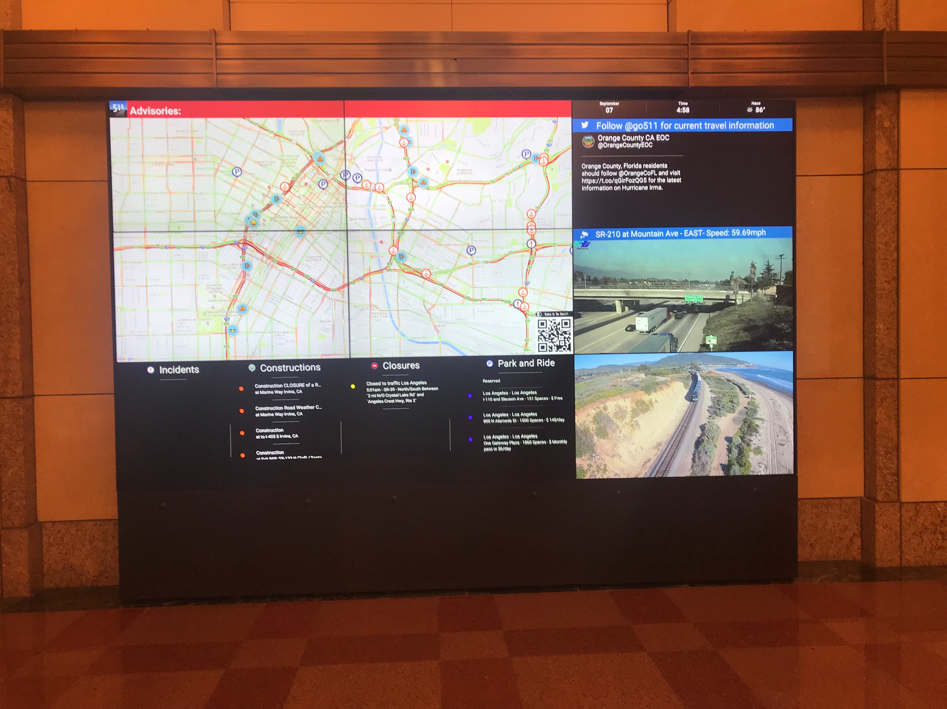
Inspiration for Creating Interface
TODO
Add date and time
Add input for possible voice recognition
More features based on liaison's request (ads)
Convert to .cshtml for ASP.NET
Metro Headquarters Directory

Slide 32
Concluding Thoughts
Currently no information on the Industry Weapon API
Working prototype of the Directory Map
Waiting for CAD file of the HOA building
No specific requirements provided by the HOA

