Slide 1
Climate Change Management System
Mission Statement: Our mission is to provide the valuable resource/information to be aware of Wildfire in California.

Slide 2
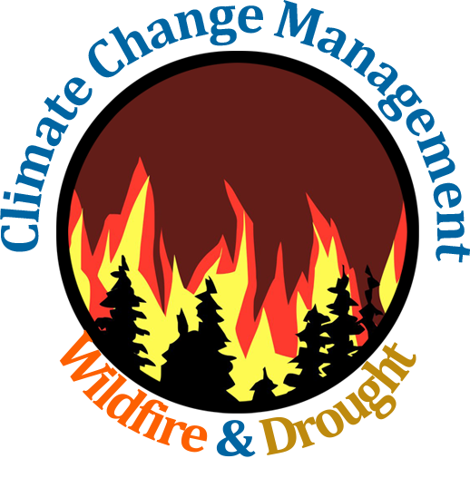
Data Science for Climate Change Management
with Focus on Drought and Wildfire in California
Team Members: Mazel Fernandez, Rayan Hyder, Victor Raj, Jennifer Serrano-Perez, Funing Yang
Project Lead: Mazel Fernandez
Academic Advisor: Mohammad Pourhomayoun
Sponsors: NASA and LA City
Grad Support: Ryan Dunning

Slide 3
Agenda/Table of Contents
Definitions
Causes of wildfires
Recent wildfires
Significance
Wildfire size predictive model
Goals of our project
Impacts
Achievements so far
Demo
Analytics and discovery
Future goals

Slide 4
Our Team and Project/Faculty Advisor: Dr. Mohammad Pourhomayoun

Slide 5
Sponsors: NASA & LA City

Slide 6
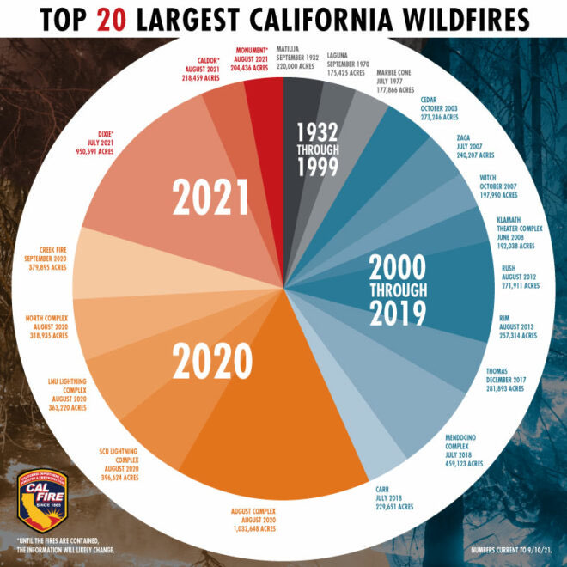
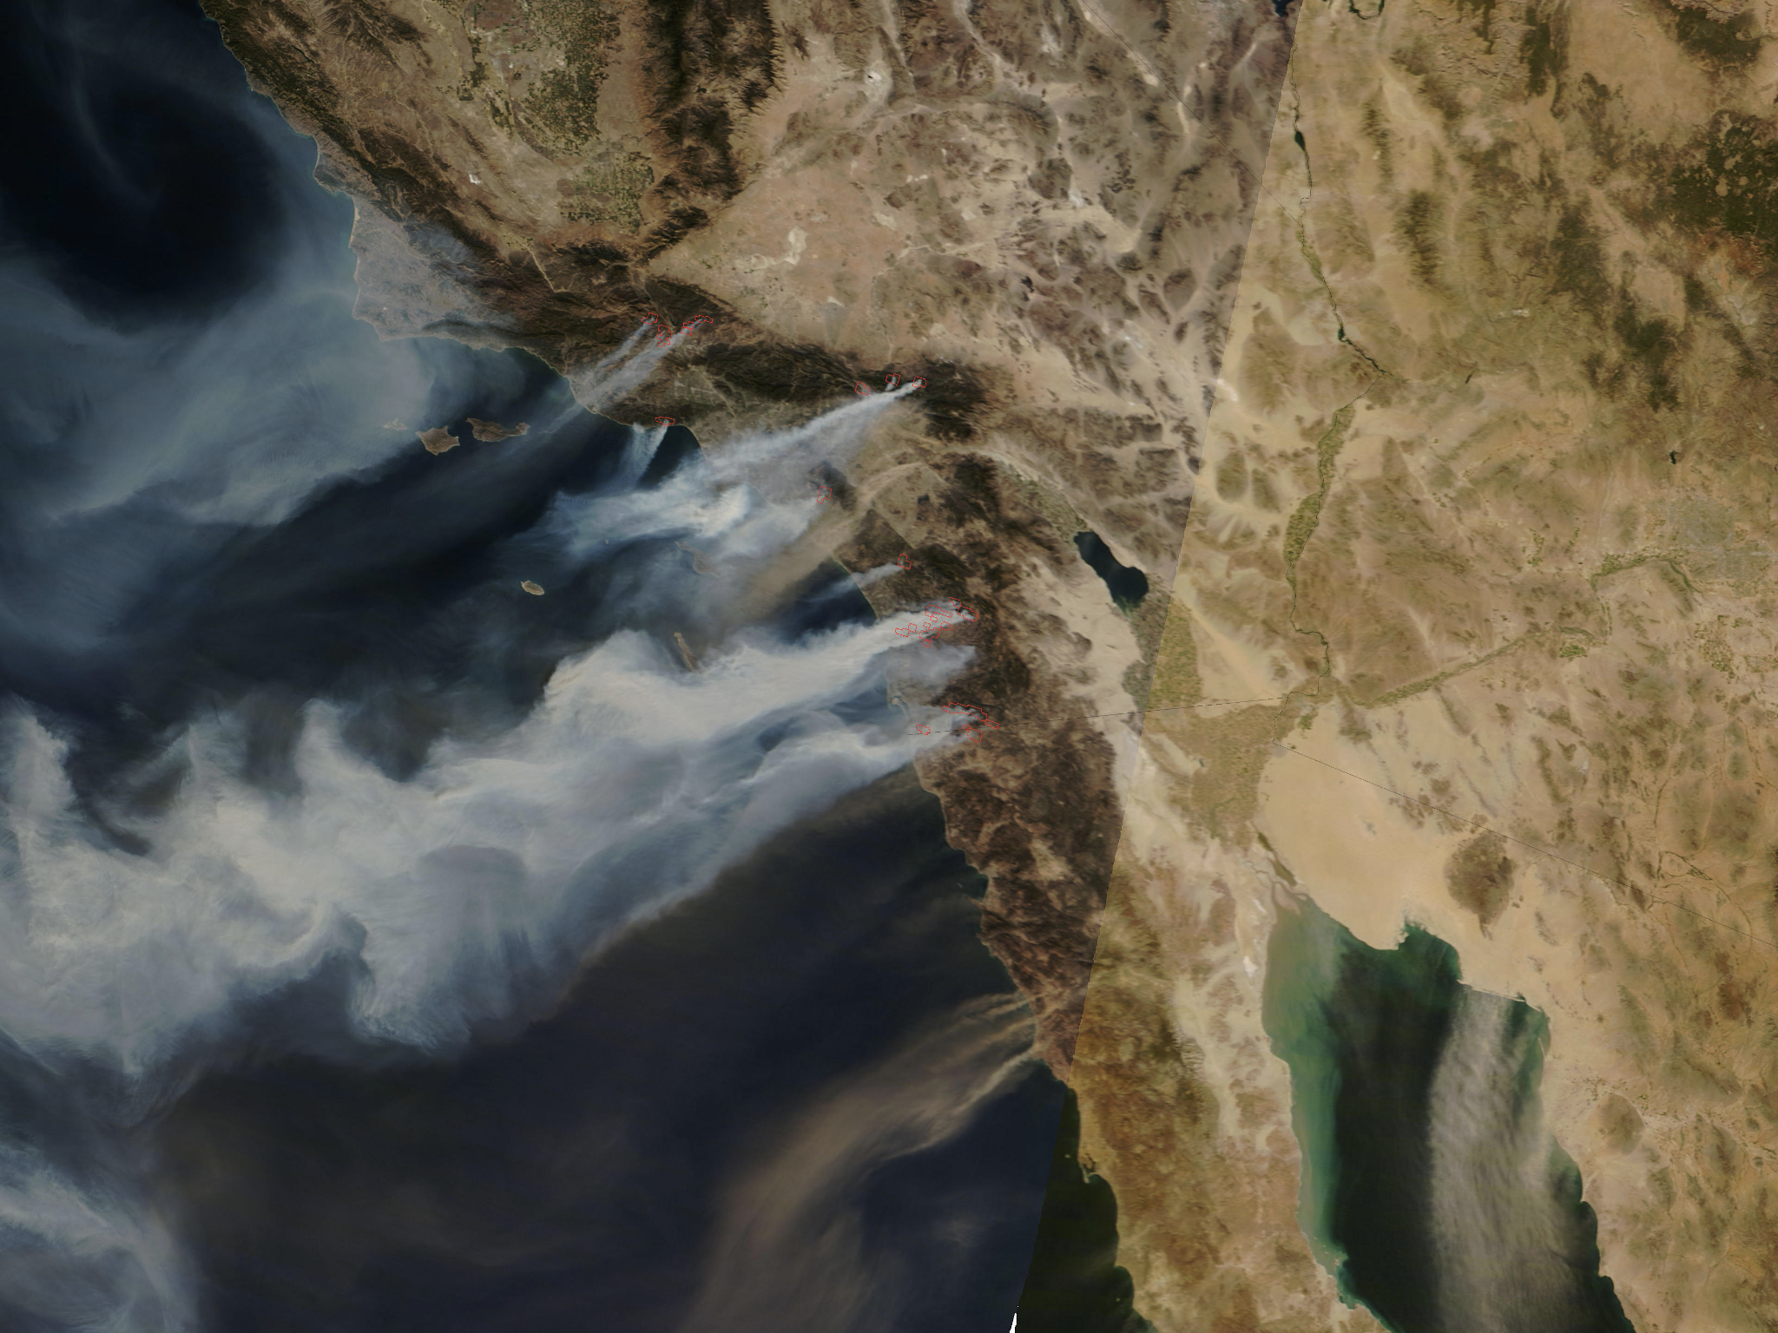
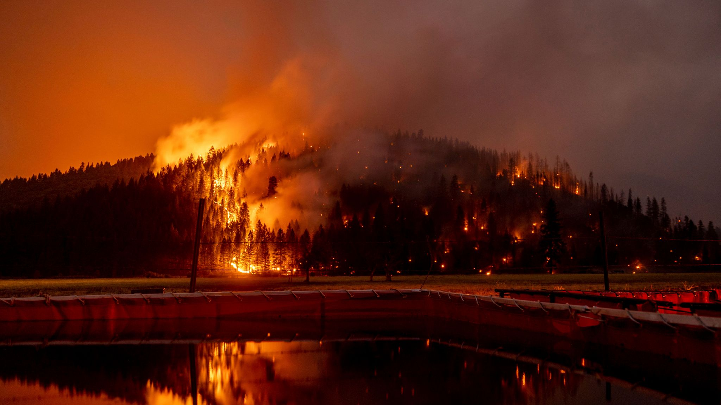
Definitions
Climate Change: a change in global or regional climate patterns, in particular a change attributed largely to the increased levels of atmospheric carbon dioxide
Wildfire: a large, destructive fire that spreads quickly over woodland or brush
Factors to consider in spread of wildfires: wind, temperature, cloudiness, moisture, and air pressure
Speaker: Mazel Fernandez

Slide 7
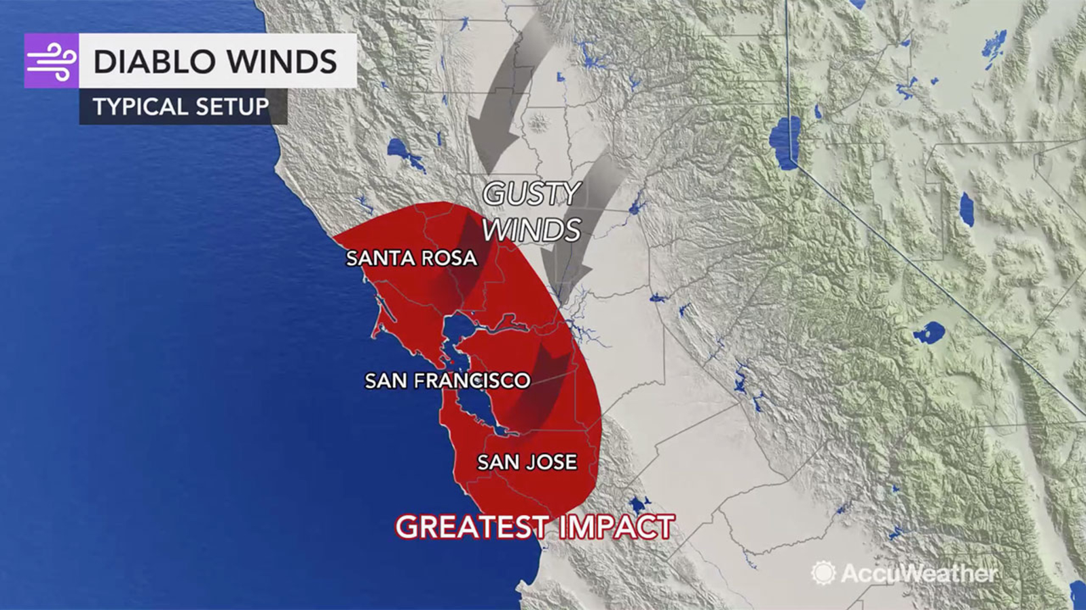
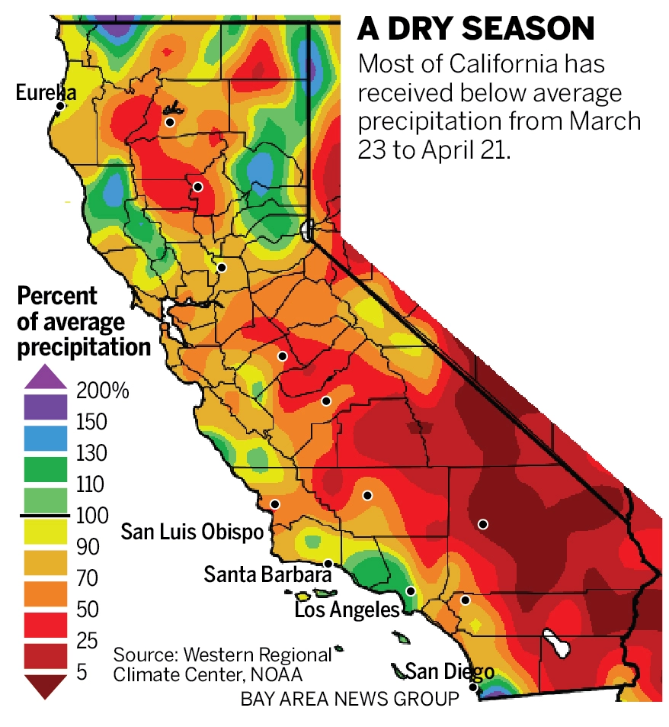
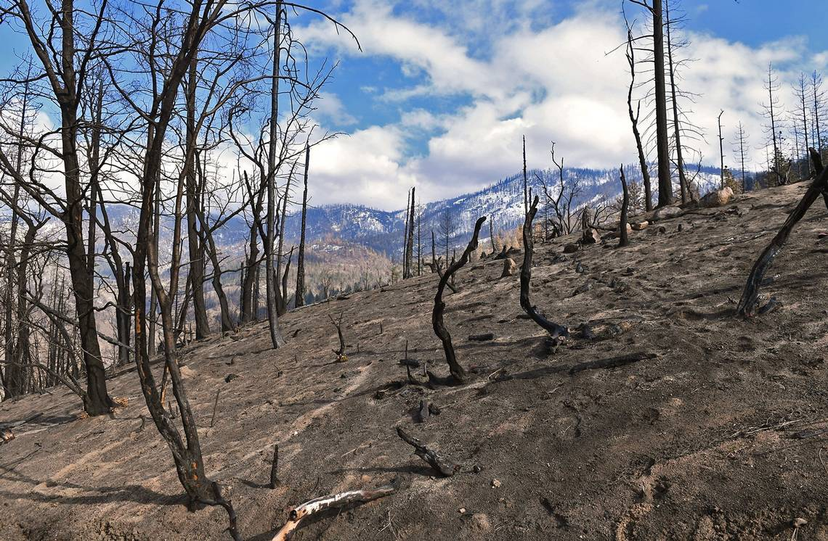
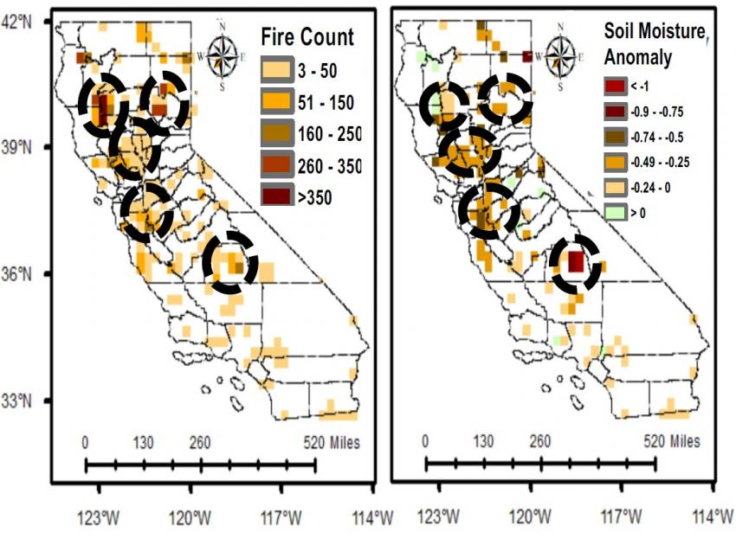
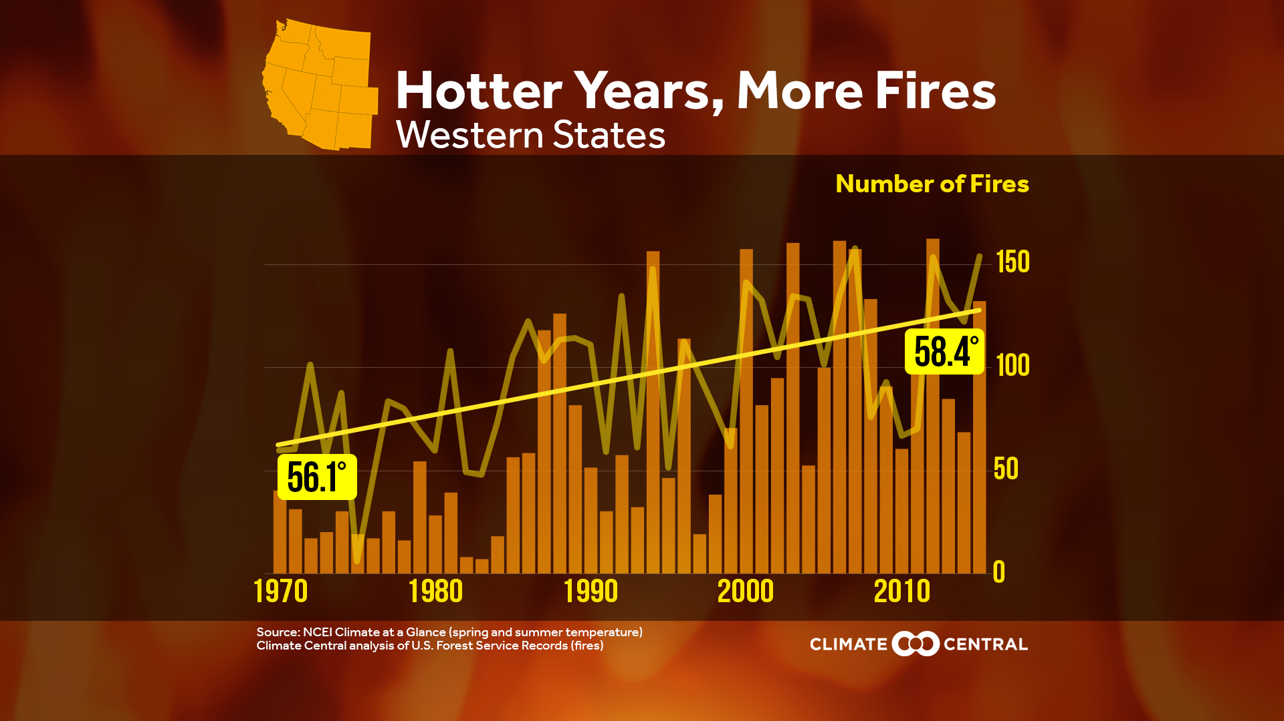
Factors that influence the spread of Wildfires
- Wind Speed
- Temperature
- Vegetation
- Soil Moisture
- Precipitation
Speaker: Mazel Fernandez

Slide 8
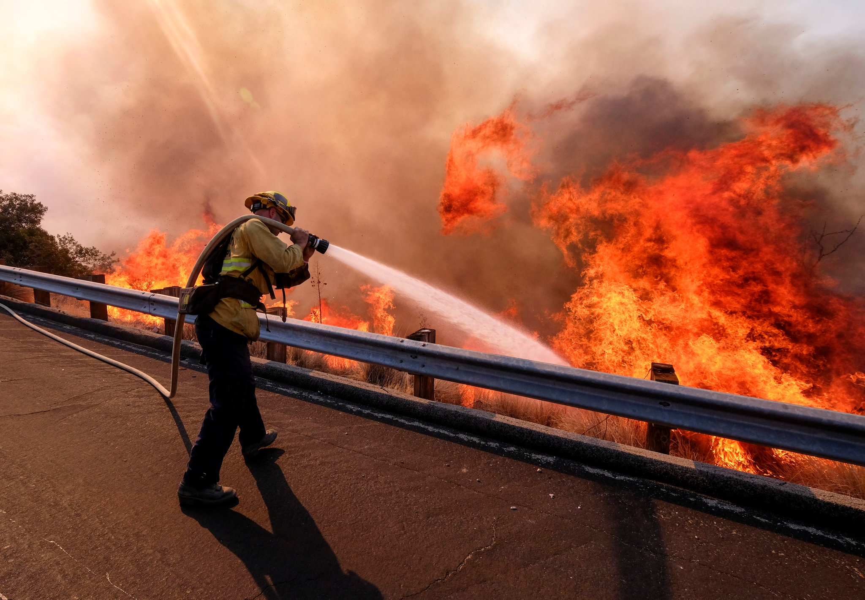
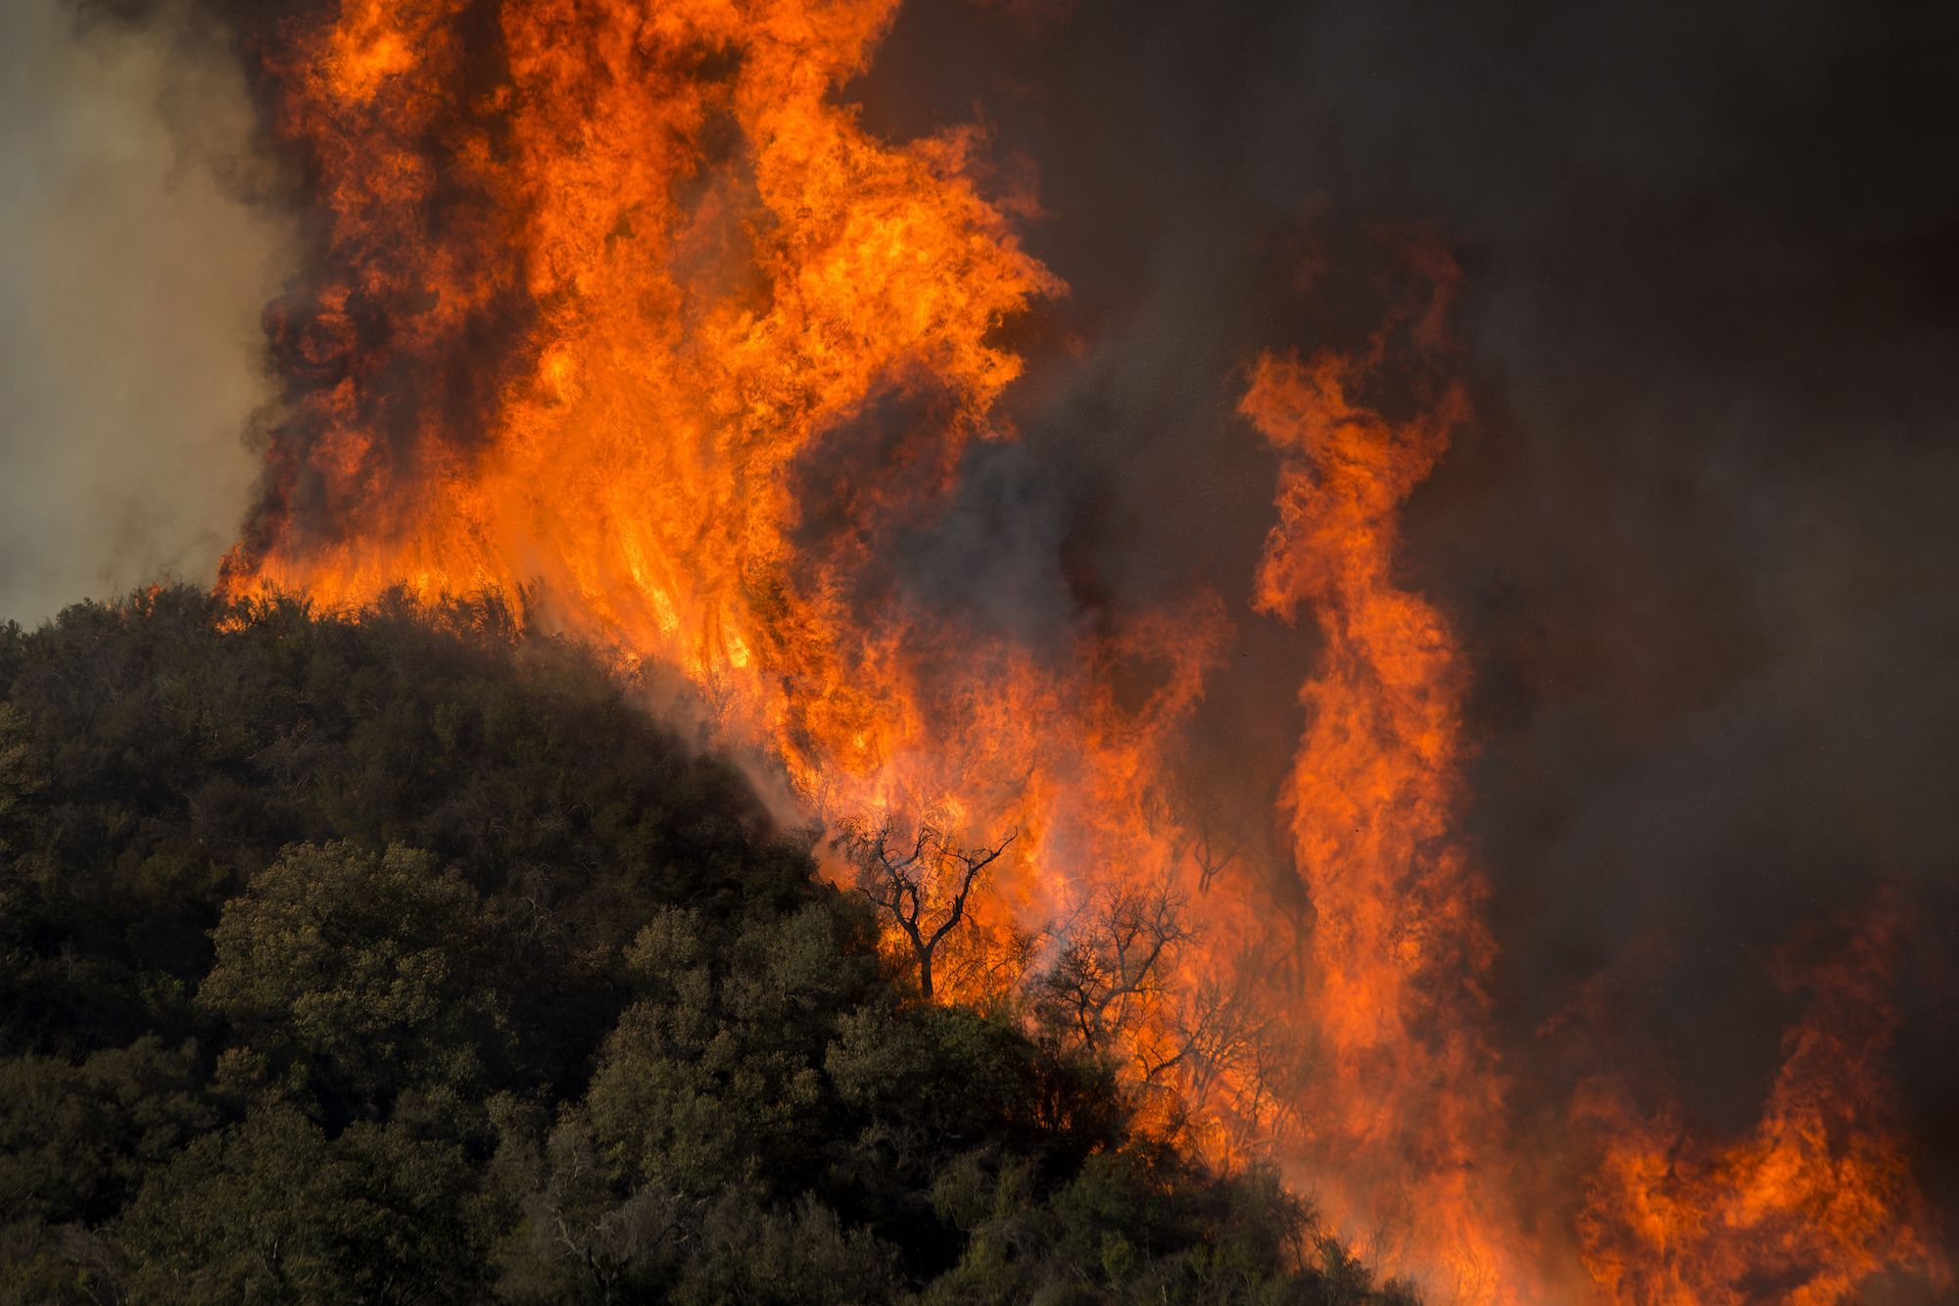
Why are wildfires hard to extinguish?
Wildfire size makes it harder to control
The climate in which fires start is incredibly dry (humidity is an enemy of forest fires)
It is impossible to place firefighting crews in the middle of the blaze (think of it like a storm)
Speaker: Mazel Fernandez

Slide 9
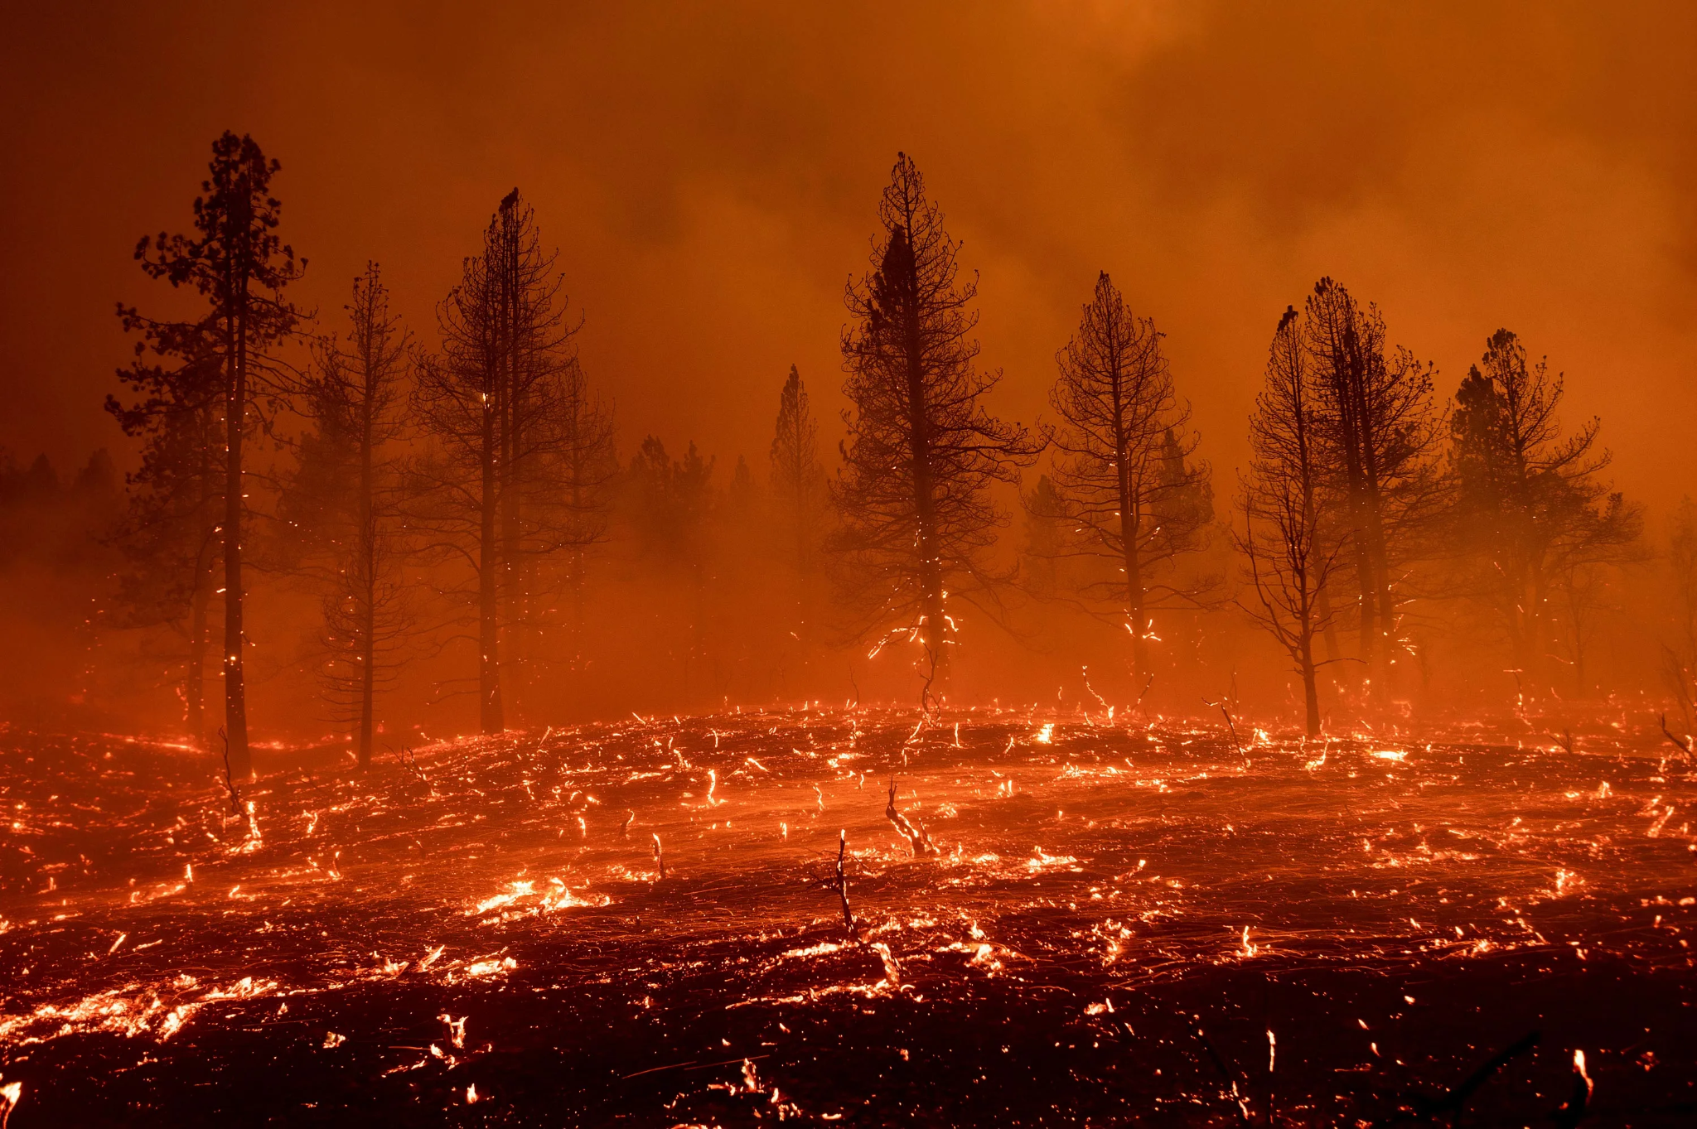
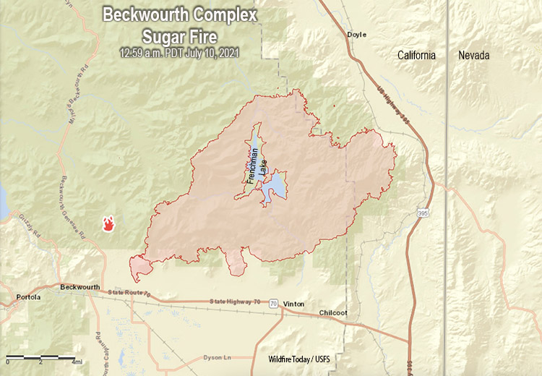
Beckwourth Complex Wildfires
July 3, 2021 - September 22, 2021
Burned: 105,670 acres
Speaker: Mazel Fernandez
Notes:
Mention length of wildfires, and containment

Slide 10
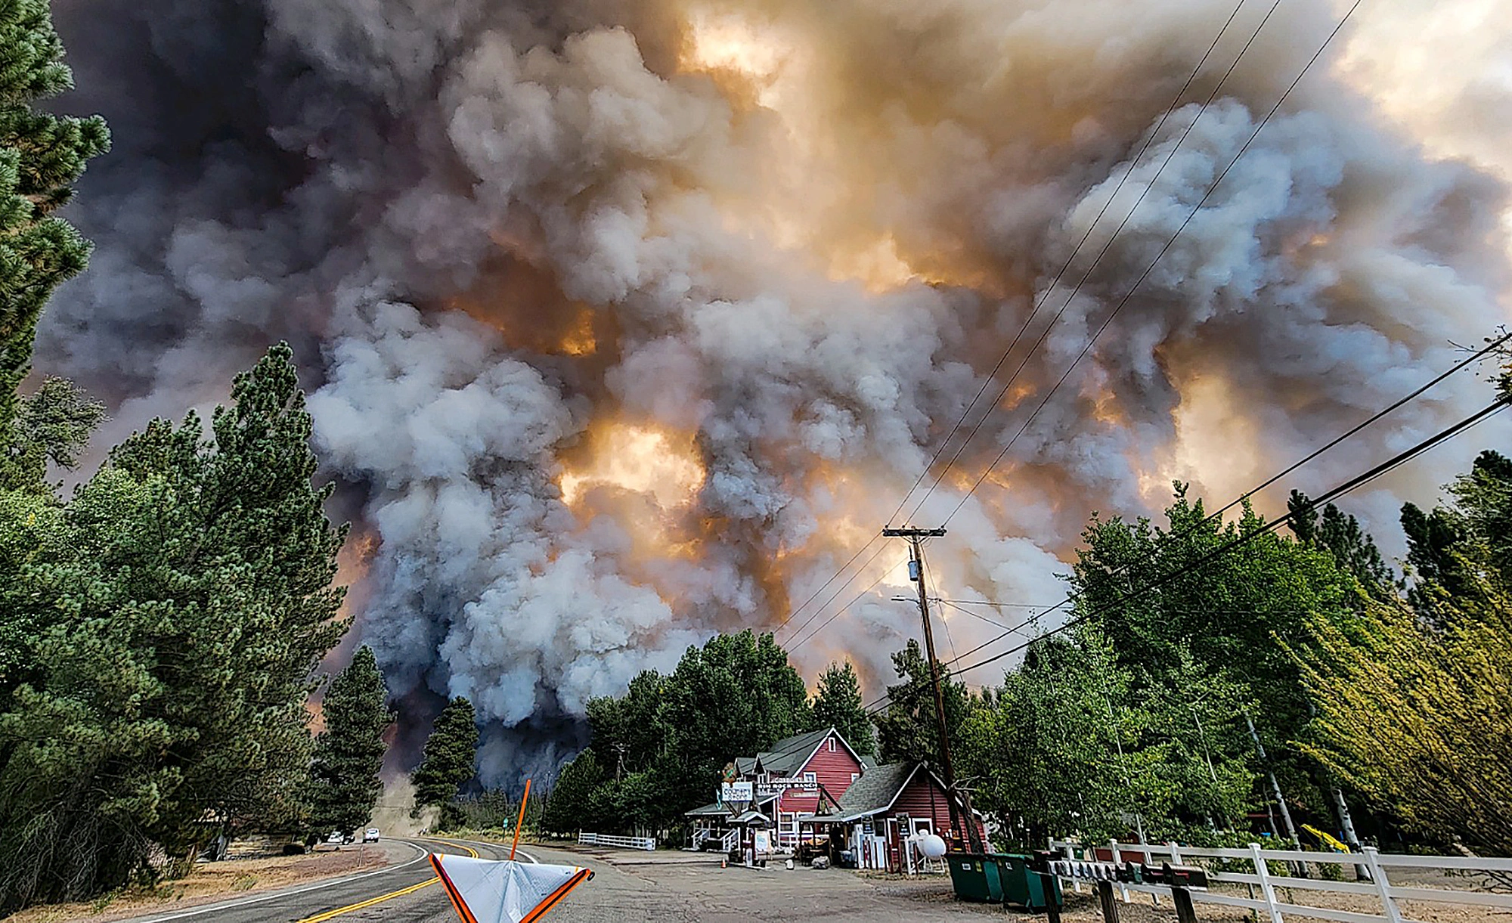
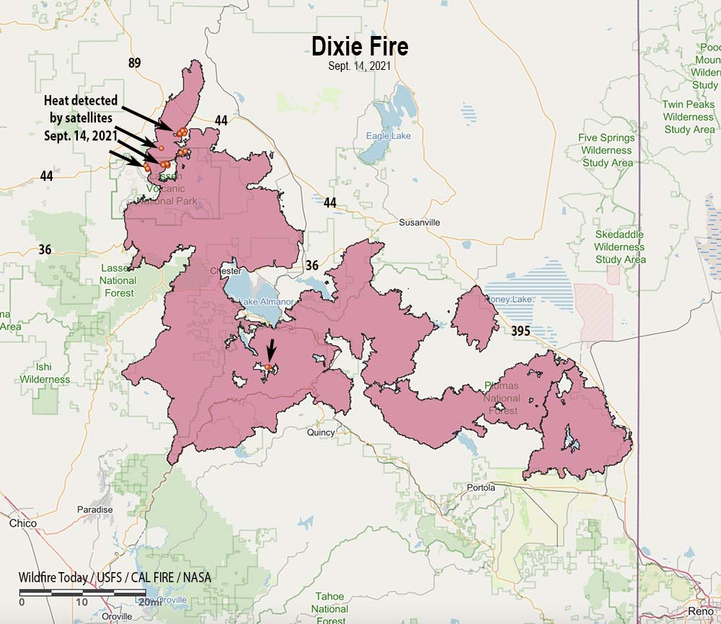
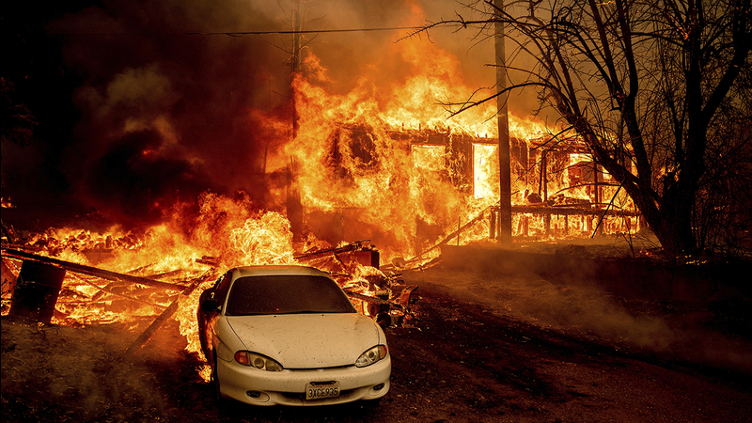
Dixie Wildfire
July 13, 2021 - October 25, 2021
(LARGEST in California’s history)
Burned: 963,309 acres
Speaker: Mazel
Notes:
Talk about it as the largest wildfire in california

Slide 11
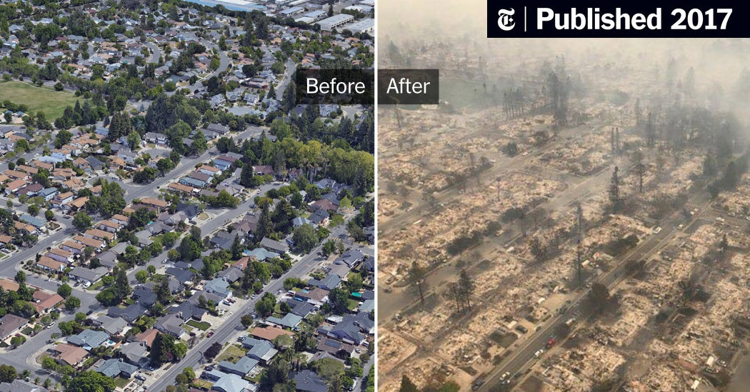
Aftermath of Wildfires
Fires destroyed an area of the Coffey Park neighborhood in Santa Rosa, Calif (2017)
Speaker: Mazel Fernandez
Notes:
Famous landmarks in ruins

Slide 13
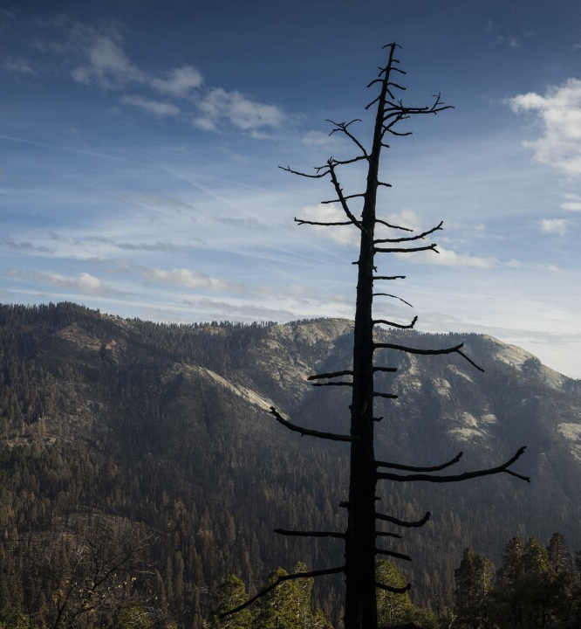
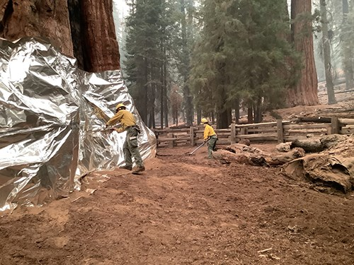
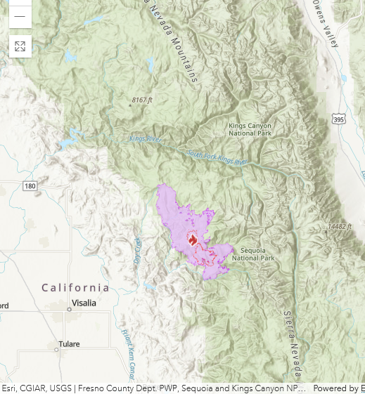
Significance
KNP Complex Fire - Sequoia and Kings Canyon National Parks
Paradise and Colony fires merged, forming the KNP Complex Fire
2,380 giant sequoias burned or are expected to die in a couple years
Speaker: Jennifer Serrano

Slide 14
Significance
High Cost: California spends an estimated $2.5 billion a year on CAL Fire firefighting
Money is being spent on putting out fires, not prevention
Only putting out fires is not enough because climate change has made it difficult to put out
Loss of Wages: Farmworkers in Northern California in 2020 were estimated to have lost an average of $5,500 in wages due to fires.
Speaker: Jennifer Serrano

Slide 15
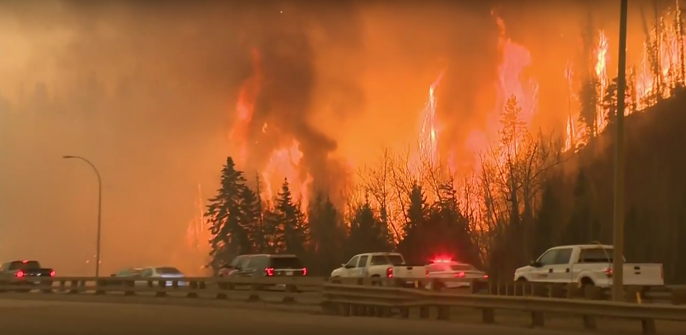
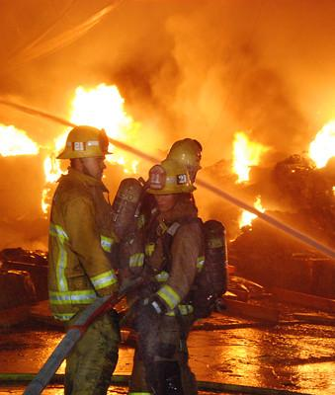
Significance
Fire seasons are starting earlier and ending later each year
Problems with evacuation in California
An investigation found that only 22% of high-risk communities have evacuation plans
Evacuating from wildfire zones is difficult
Difficult for people in wheelchairs, health conditions to evacuate
Speaker: Jennifer Serrano

Slide 16
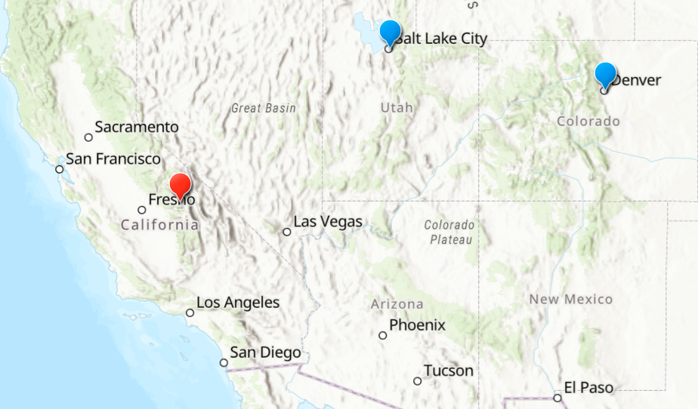
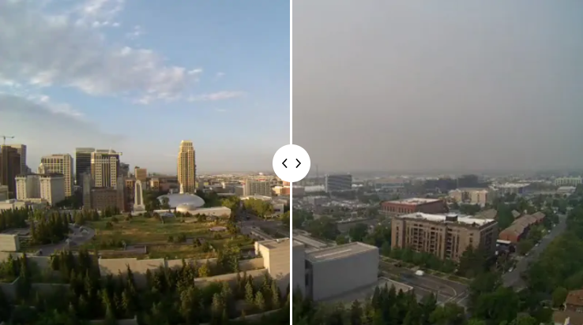
Significance
Smoke travels very far
Smoke from California fires and other parts
of the west reached Colorado and Utah
Air quality in Denver and Salt Lake City were
among the worst in the world
Health Issues
Smoke from wildfire is unhealthy and can impact
children, older adults, citizens with respiratory diseases, etc.
Children breath more air, including air pollution
Wildfires can trigger mental health conditions
Salt Lake City, Utah
Speaker: Jennifer Serrano
Skyline before the Dixie Fire.
During the Dixie fire

Slide 17
Wildfires in California
According to the California Department of Forestry and Fire Protection...
2,568,948 Acres Burned
8,835
Incidents
3
Fatalities
3,629
Structures Damaged
2021 Fire Season.
Speaker: Jennifer Serrano

Slide 18
Wildfire Size Predictive Model
Can use AI + ML to monitor and control wildfires because of computational powers and a lot of wildfire-related data has been gathered over the years.
Features used to predict wildfire size: temperature, wind speed, precipitation, acres burned, discovery date, etc.
Random Forest & SVM
C: 10-99.9 acres
D: 100 -299.9 acres
E: 300- 999 acres
F: 1000-4999 acres
G: 5000+ acres
10 Acres
Class C
328 Acres
Class E
15,000 Acres
Class G
Speaker: Jennifer Serrano

Slide 19
Goals of Our Project
Goals:
The KISS principle ("Keep it simple stupid!")
The Software has a mandatory delivery date that must be met.
Emphasis on speed versus memory use
The product should work, look, or "feel" like an existing product
The data gathered from ArcGIS’s Living Atlas should be accurate
The GUI should be user-friendly
The application should be able to effectively extract knowledge of climate change and wildfire data for users
To create a dashboard with data analytics models includes data science models in the back end to correlate the cause and effect of wildfires
Speaker: Rayan Hyder
Notes:
Covers the goals of our visualization dashboard, the first goal is to keep it simple and clear
There is a delivery date that needs to be met in order to avoid any irrelevance or handle any errors
Also need to have some care on the speed of the website against memory usage
The research should show that it has relevance to the topic which important in catching the eye of the audiences.
Data from arcgis and the apis that has been implemented must be accurate for positive user experience
The GUI must be user friendly so that users stay connected with the information
The most fundamental objective is to effectively extract knowledge of climate change and wildfire data for users.
And to establish a dashboard with data analtics models that include data science in the back end to correlate the cause and effect of wildfire.

Slide 20
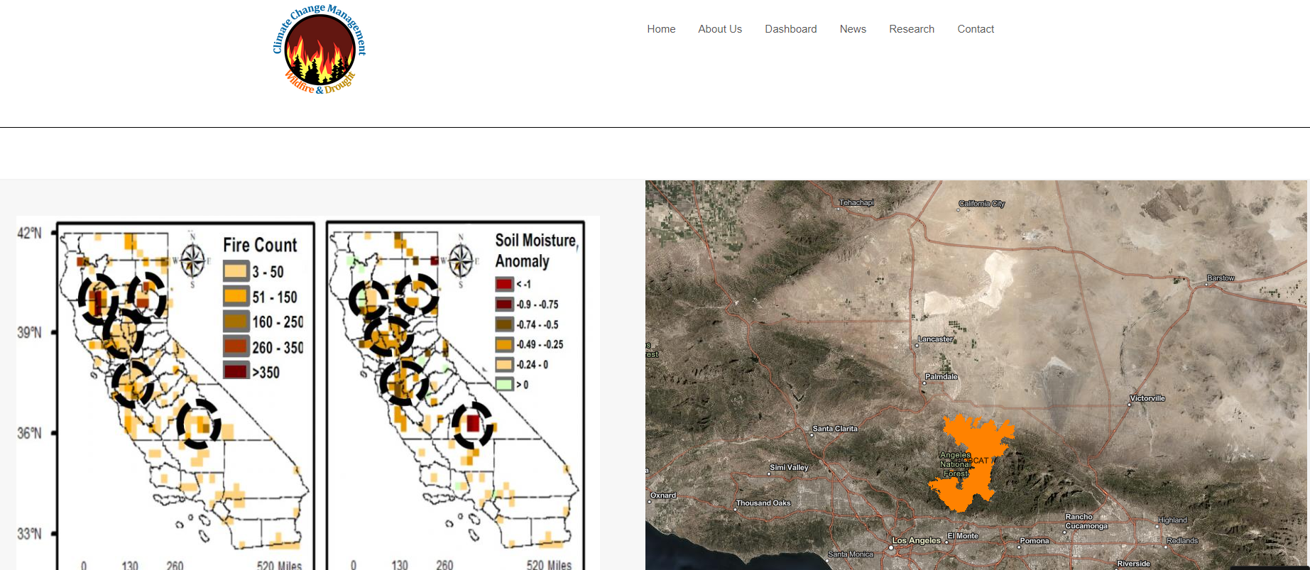
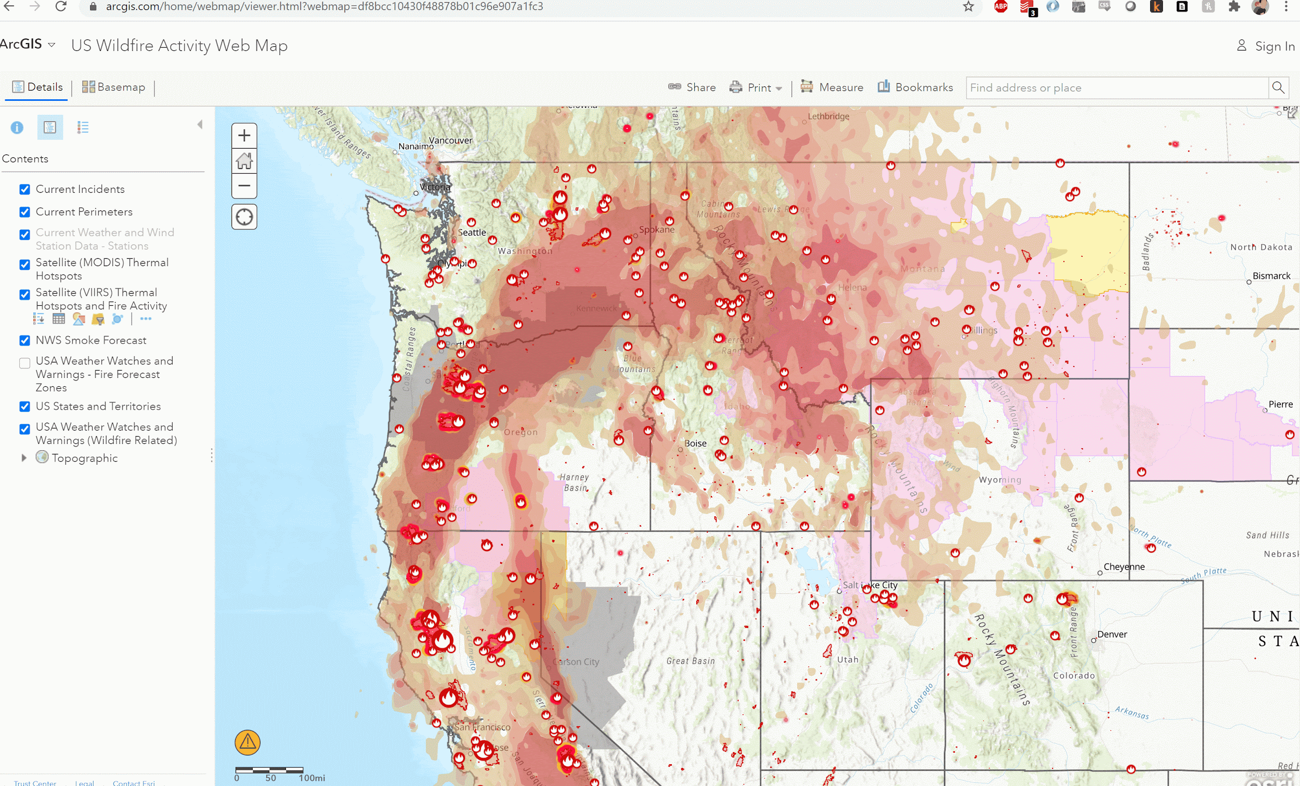
Purpose of our project
To create a user-friendly dashboard with data analytics models to help understand the cause and effect of wildfires, thus bringing more awareness to fire readiness, and other factors such as climate change.
Illustrate prescient models or administrations that will give the fundamental data around fire climate, fire danger/fuels, an intelligence/resource status data that fire directors got to expect critical fierce blaze movement and decide where to position firefighters, motors, air ship and other rapidly spreading fire concealment resources to reply to it.
dddd
Speaker: Rayan Hyder
Notes:
THe main purpose of the research is to create a user friendly dashboard with data analytic to help understand the correlations of wildfire, while brining the awareness ot fire readiness and factors like climate change.
As u can see on the side the mseesage that is being relayed corresponding ot the significance of widlfire and soil moisture in aspect
Additionally the research will provide info aobu fire weather fire fuels and intelligence status info that fire managers may need to antuciatea significant wildfire anctivity and prepare for ways to respond to it
On the side we can see a acrGIS map that demonstrates the places of evacuation plan by FIre fighters

Slide 21
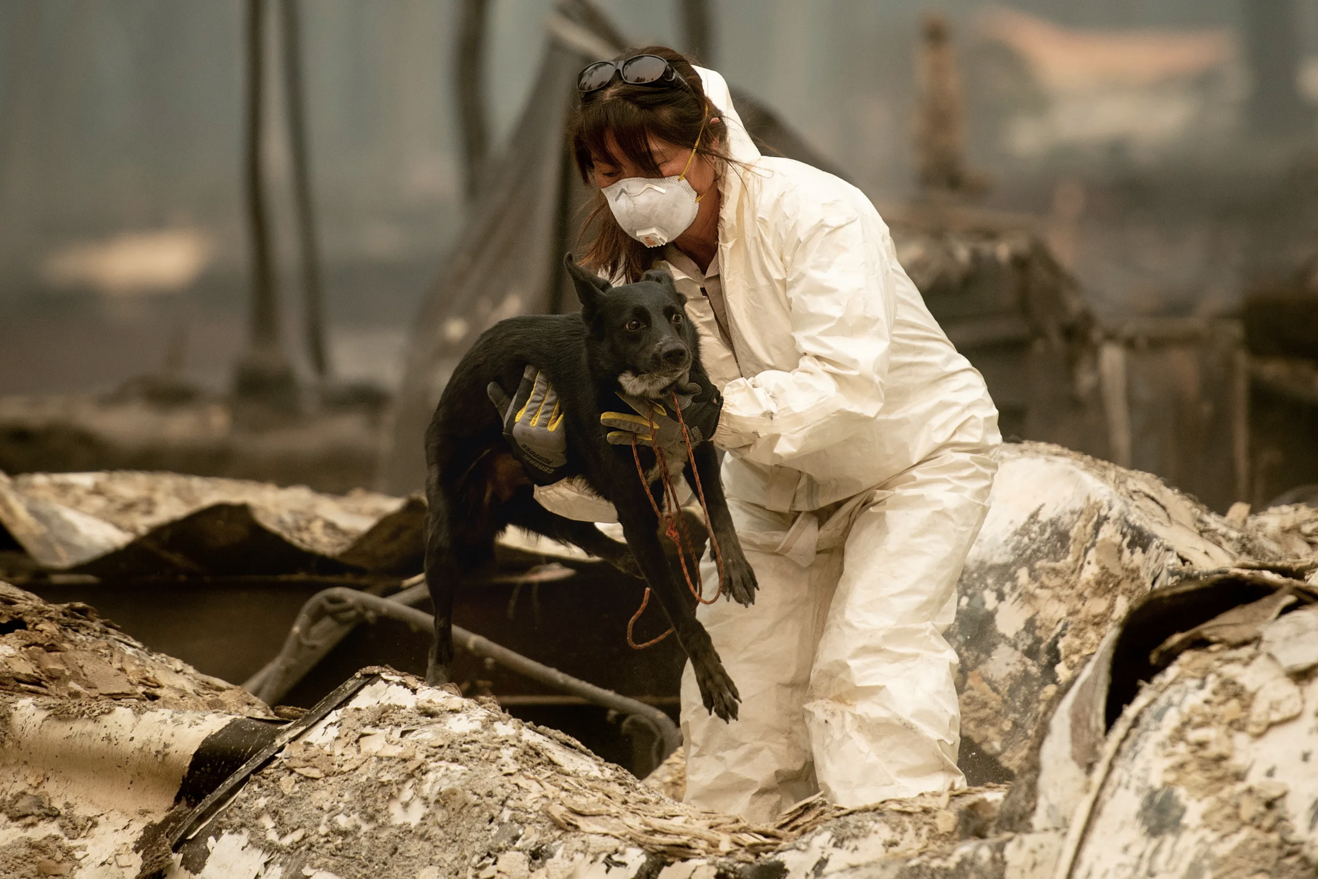
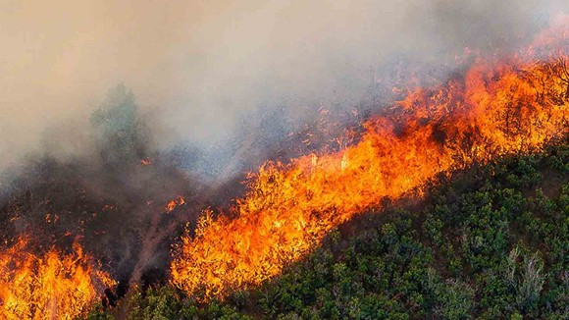
Impact on Ecosystem
Some scientists claim that intrusive weeds and grassses might surpass local plants and bushes, making soil disintegration more likely which may lead to indeed more visit fierce blazes within the future, concurring to CBS.
The effect on creatures will depend on the species. Littler creatures, such as rabbits and a few birds, might have inconvenience surviving within the confront of the misfortune of local vegetation on which they depend, according to CBS piece said.
Depending on the environment, different process, such as extended lodging advancements and the utilities they require, fire exclusion/firefighting, and timber gathering, within the past a few decades have made it easier for fires to urge out of control, concurring to the USFS.
Speaker: Rayan Hyder
Notes:
More specifically, according to scientists, invasive weeds and grassses could overtake native plants and shrubs, making soil erosion more likely which could lead to even more frequent wildfires in the future, relating to CBS.
The impact on animals will depend on the species. Smaller animals, such as rabbits and some birds, might have trouble surviving in the face of the loss of native vegetation on which they rely, the CBS piece said.
Depending on the ecosystem, various practices, such as expanded housing developments and the utilities they require, fire exclusion/firefighting, and timber harvesting, in the past several decades have made it easier for fires to get out of control, according to the USFS.

Slide 22
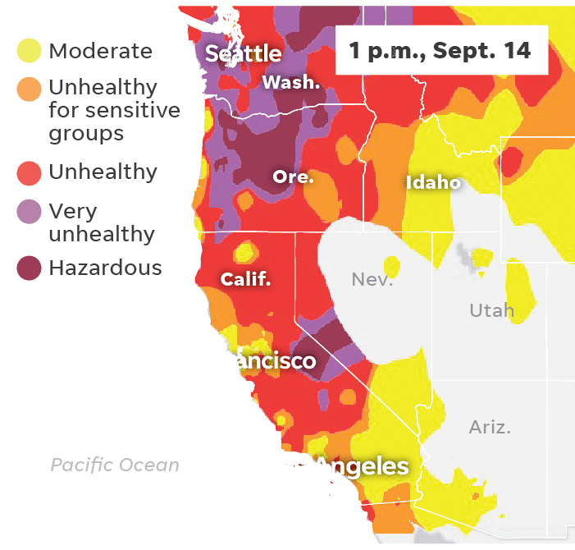
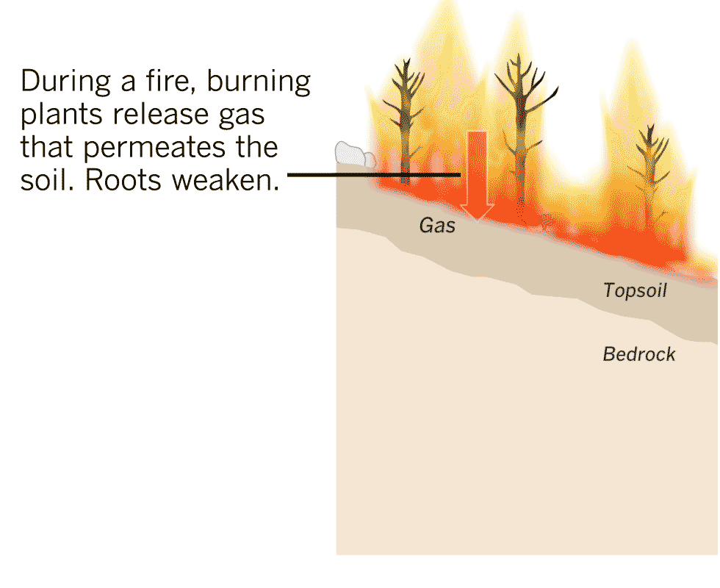
Impact on health
The poisonous smoke has as of now caused air quality to fall to unsafe levels in California, Oregon and Washington in addition to poisonous air, there is also debris and ash that covers some neighbourhoods toxic to humans and animals alike.
Another enormous concern for inhabitants is the danger of avalanches. Fierce blazes can char soil and enliven the probability of disintegration, which when matched with an attack of flooding precipitation makes however another catastrophe inhabitants must confront. When fire burns up vegetation, it annihilates what keeps soil steady. At that point when it downpours intensely, the water washes all of that soil absent with ease
Speaker: Rayan Hyder
Notes:
in addition to wildlife habitats, and timber, they’ve released toxic smoke in the air that pollutes the environment. This toxic smoke has already caused air quality to plummet to dangerous levels in California, Oregon and WashingtonIn addition to toxic air, there’s also the debris and ash that covers charred neighborhoods. The ash is the aftermath of everything that was burned up, which includes anything in a home, including chemicals, plastic, and paint, all of which can be toxic to humans and animals.
On the side the map shows a brief undertanding of how the impact of unhealthy air quality is moving constantly
Another big concern for the residents is the threat of landslides. Wildfires can char soil and quicken the likelihood of erosion, which when paired with an onslaught of flooding rainfall creates yet another disaster residents must face. When fire burns up vegetation, it destroys what keeps soil stable. Then when it rains heavily, the water washes all of that soil away with ease.
On the side we can see how the landslide is occuring due to wildfire, the fire burning the plants causing the release of gas which permeates the soil and the roots weeken.

Slide 23
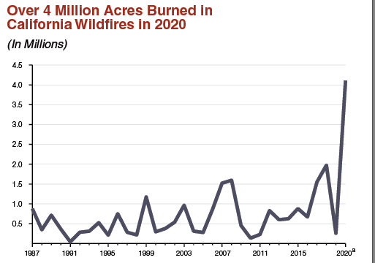
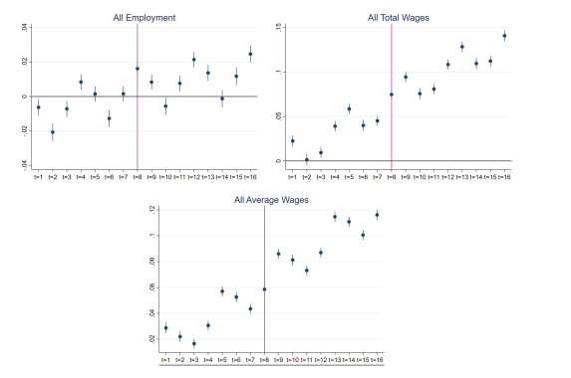
Impact on Economy
In 2020, for example, a team of researchers studied the nationwide impact of California’s 2018 wildfire season, and estimated that its economic damage totaled $148.5 billion.
As rapidly spreading fires gotten to be a more noteworthy chance around the world, it's imperative to consider the ways that fires and fire season influence the economy. An financial think about has assessed that each extra day of smoke presentation from a rapidly spreading fire diminishes profit in a community by around 0.04% over two a long time
Speaker: Rayan Hyder
Notes:
Catastrophic wildfires take a large economic toll on communities through property losses, decreased tourism, even changes in the long-term structure of the local economy.
In 2020, for example, a team of researchers studied the nationwide impact of California’s 2018 wildfire season, and estimated that its economic damage totaled $148.5 billion.
As wildfires become a more significant risk around the world, it's important to consider the ways that fires and fire season affect the economy. An economic study has estimated that each additional day of smoke exposure from a wildfire reduces earnings in a community by about 0.04% over two years
On the side it has a graph of millions of acres of lan being burned causing the earnings in many potential businees to also reduce according to the point graphs at the bottom
Overall, the human and natural environments on the west coast have been devastatingly altered and will take years to return to normal even with the financial support and decrease in many wealth of companies.
Now I am gonna hand it to yang explaining the technologies that are being used. Thank you for hearing.

Slide 24
Technologies Used
Speaker: Funing Yang
Notes:
Python, Scikit learn, Pandas, Numpy

Slide 25
Achievements So Far
A user-friendly dashboard :
Main map for wildfires
Detailed research maps
Correlated the causes and effects of wildfires through case study and analytic models
Up-to-date News
Speaker: Funing Yang

Slide 26
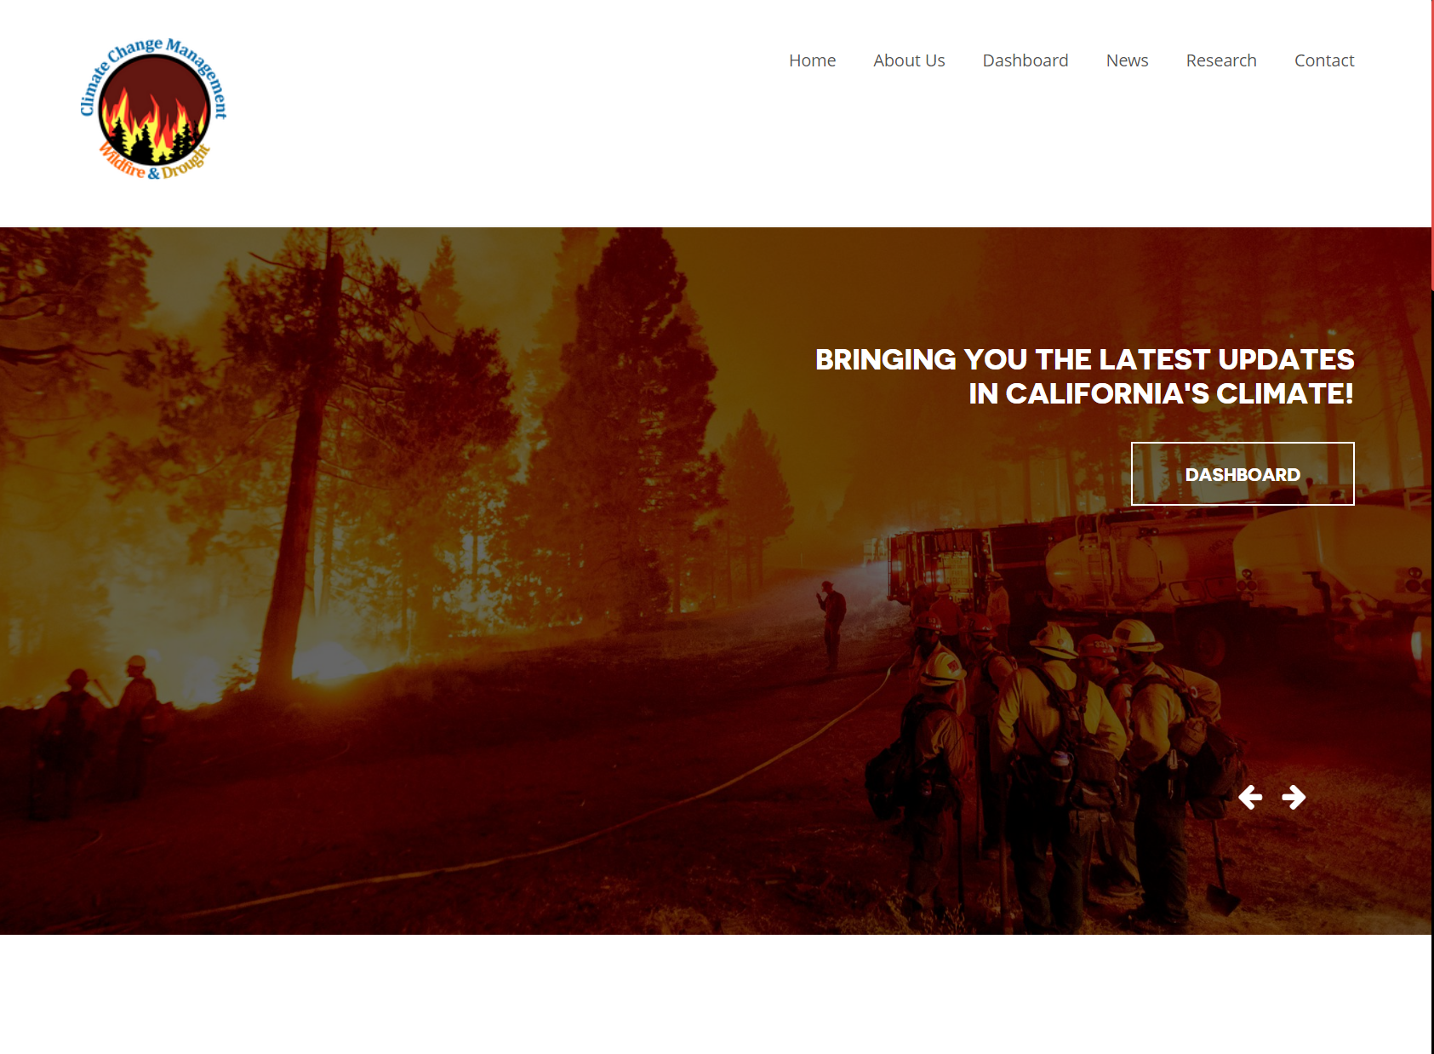
Home Page
Speaker: Funing Yang

Slide 27
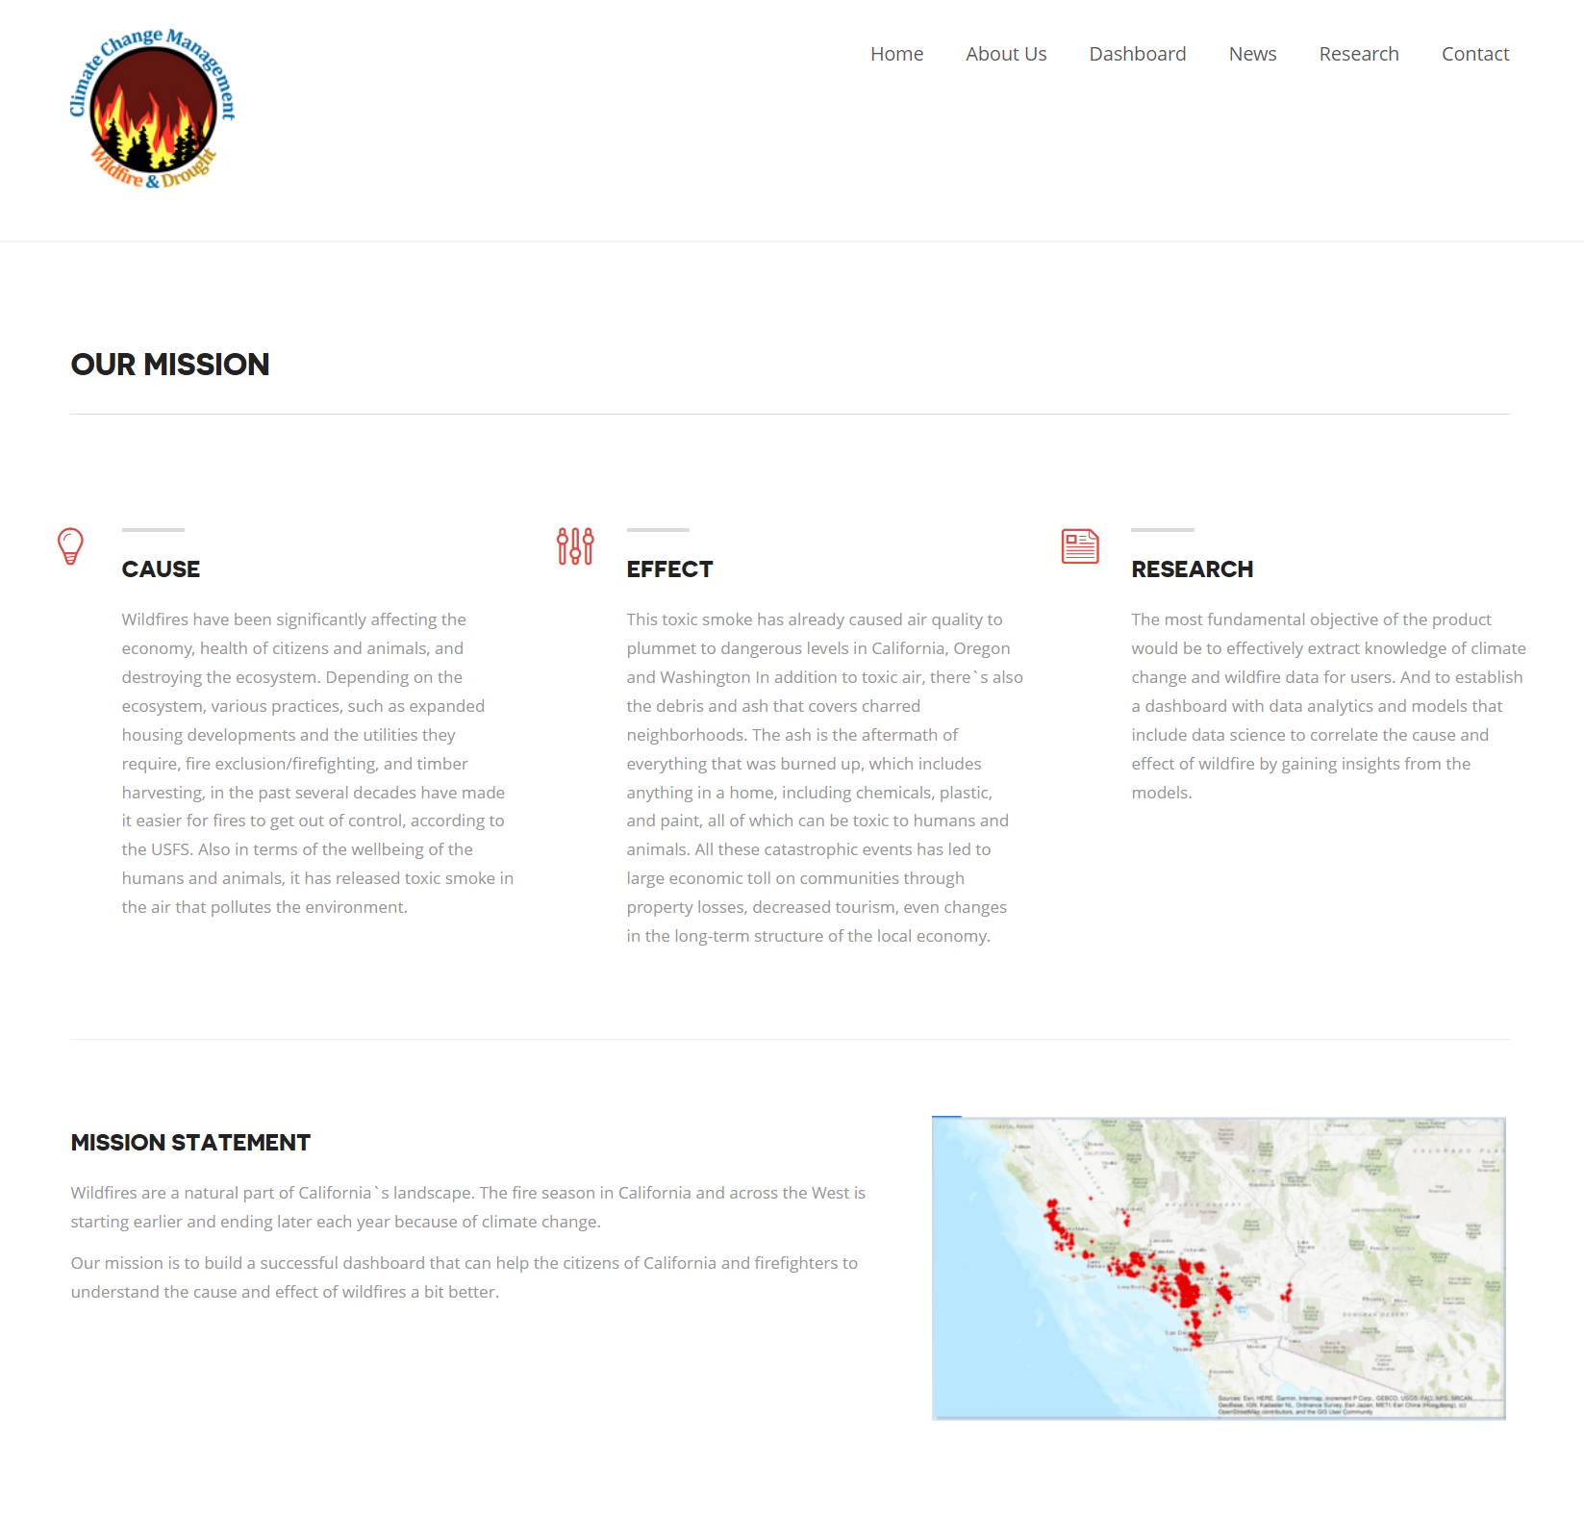
Our Mission
Speaker: Funing Yang

Slide 28
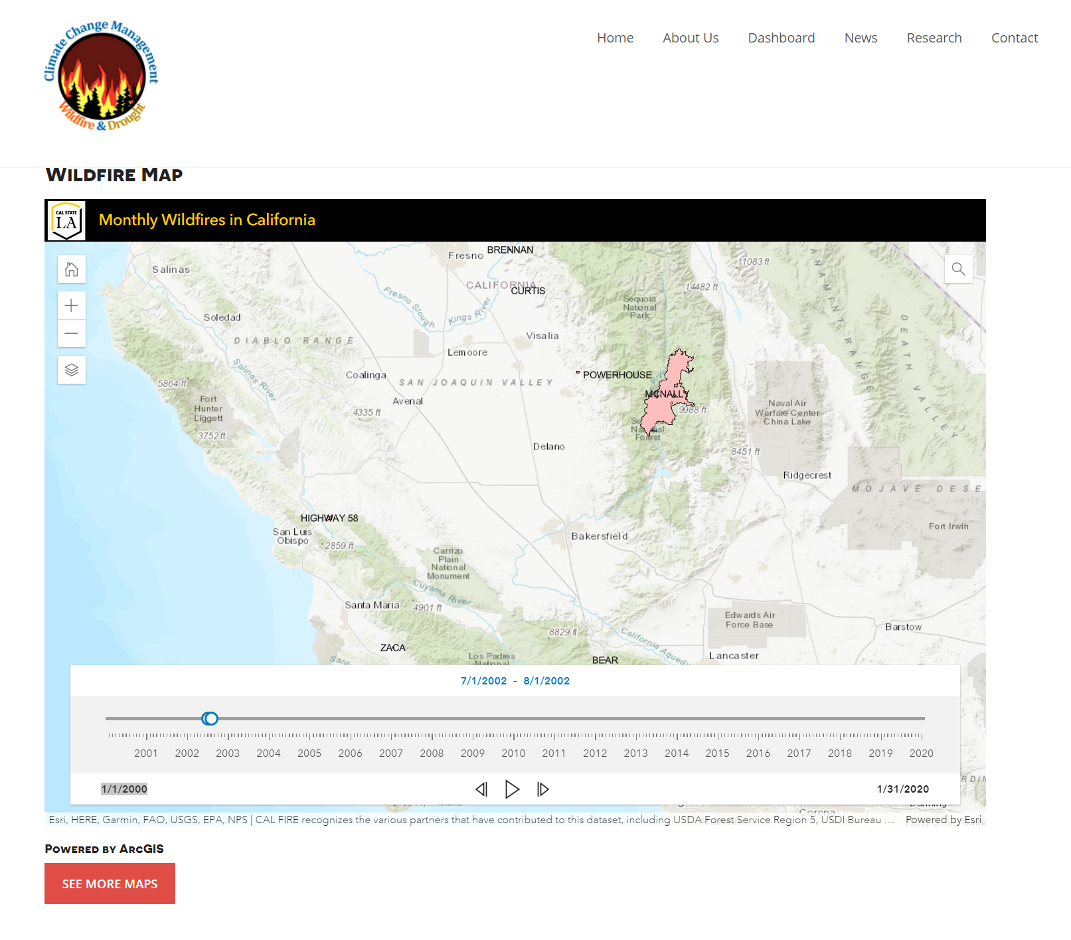
Dashboard
Speaker: Funing Yang

Slide 29
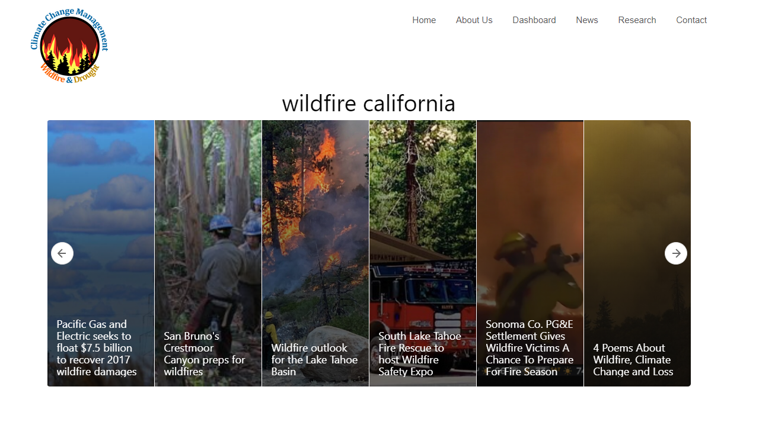
News Page
Speaker: Funing Yang

Slide 30
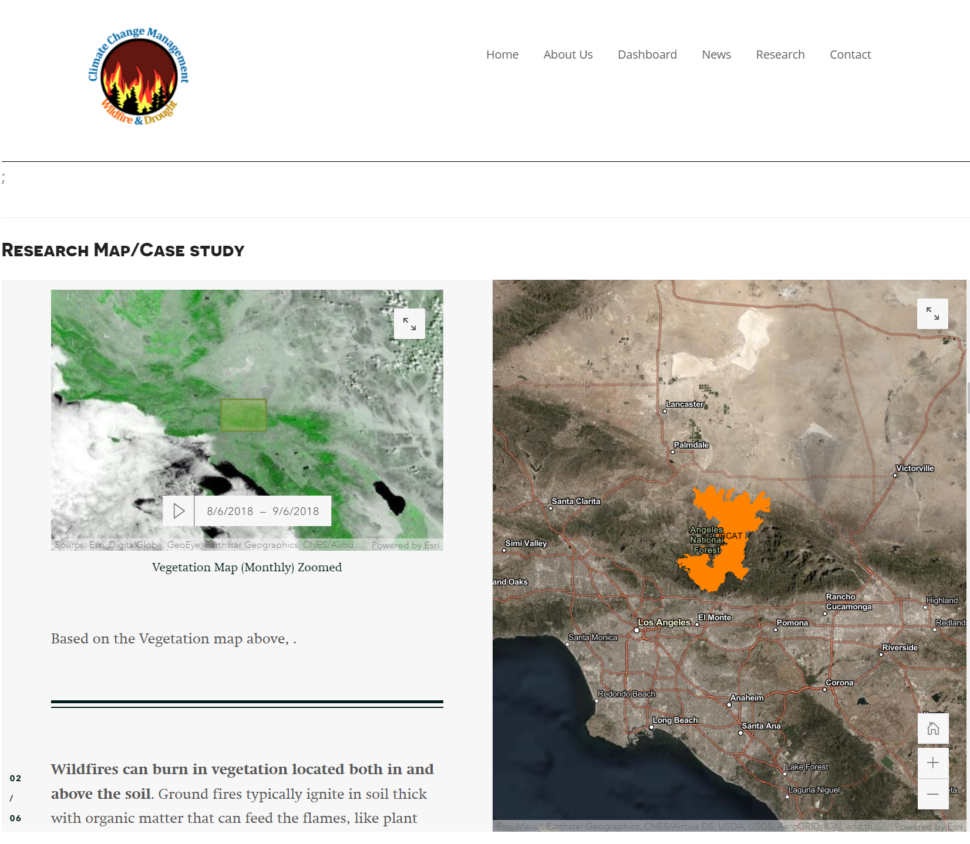
Analytics and Knowledge Discovery Page
Speaker: Funing Yang

Slide 31
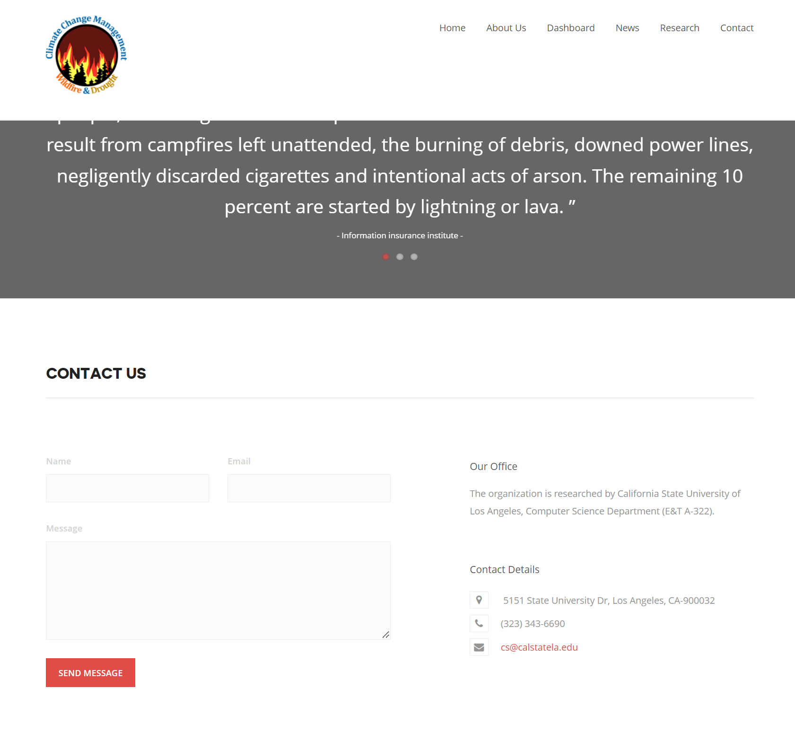
Contact
Speaker: Funing Yang

Slide 32
DEMO
Speaker: Funing Yang

Slide 33
ANALYTICS & DISCOVERY
Speaker: Mazel Fernandez

Slide 34
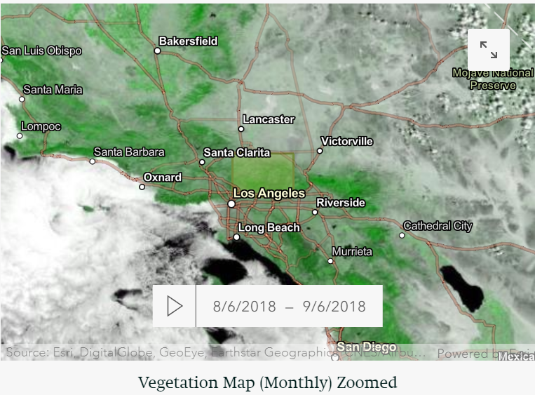
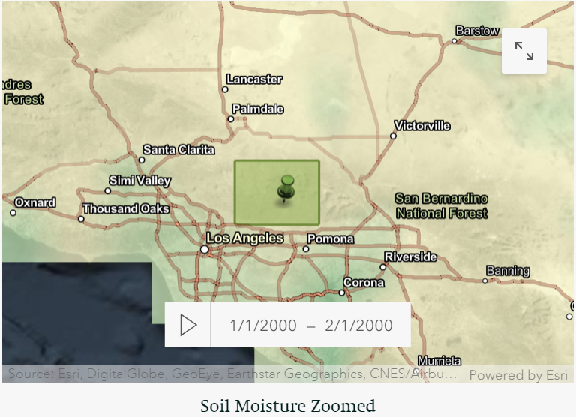
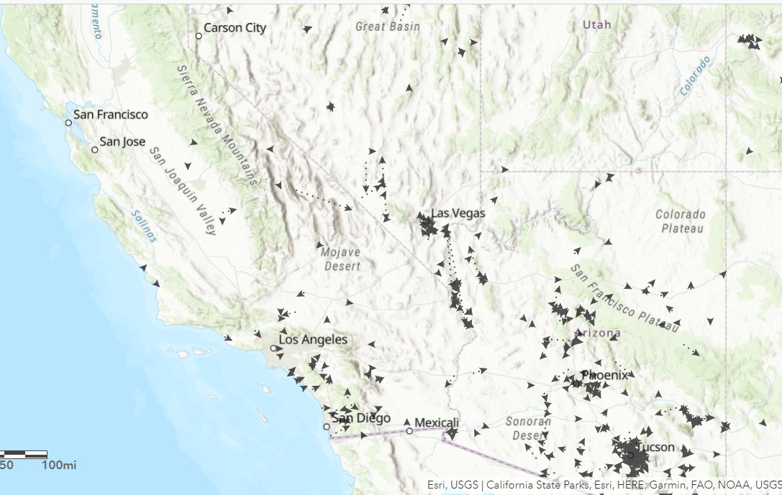
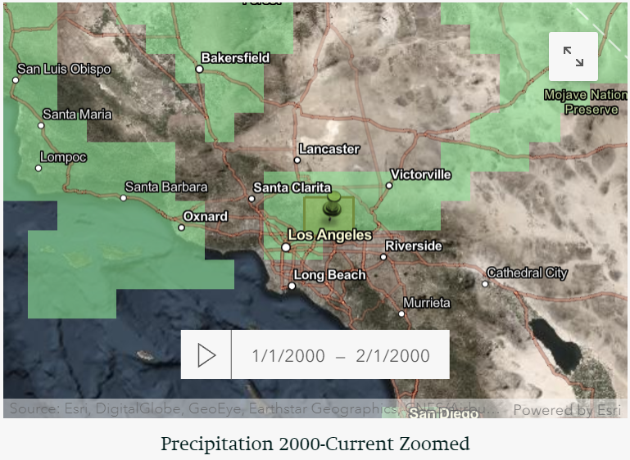
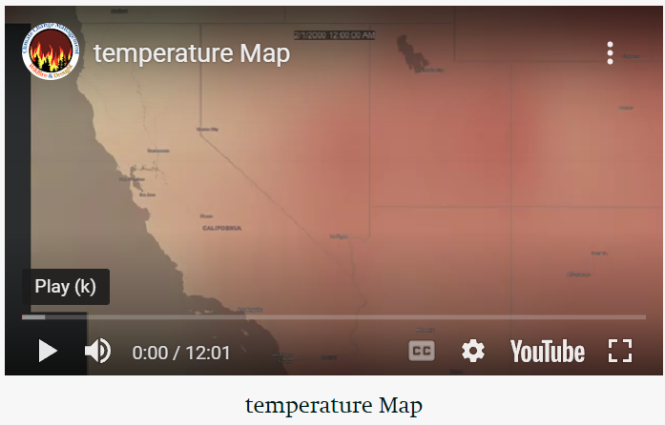
Speaker: Mazel Fernandez

Slide 35
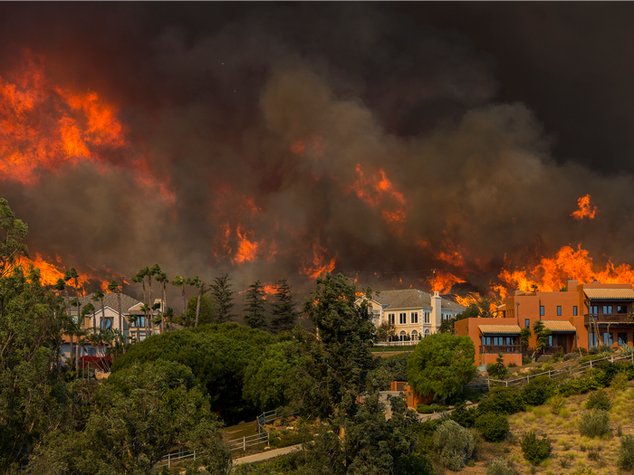
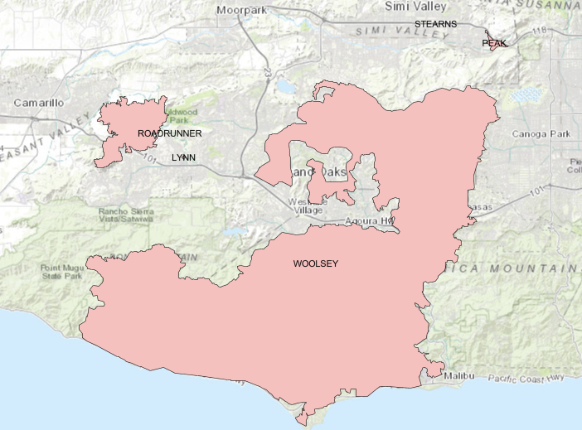
Woolsey Fire
Location: Los Angeles and Ventura Counties of California
Burned: 96,949 acres
Date(s): November 8-21, 2018
Non-fatal injuries: 2 civilians; 3 firefighters
Speaker: Mazel Fernandez

Slide 36
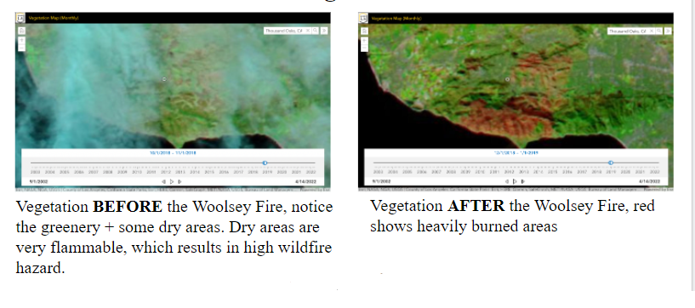
Vegetation
Speaker: Mazel Fernandez

Slide 37
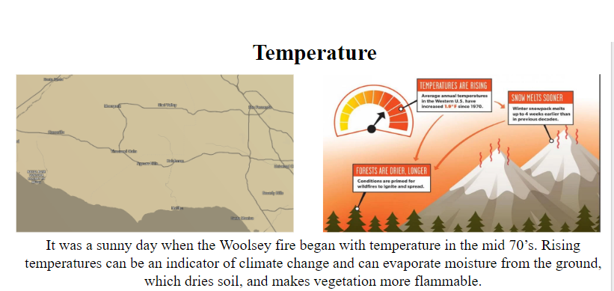
Temperature
Speaker: Mazel Fernandez

Slide 38
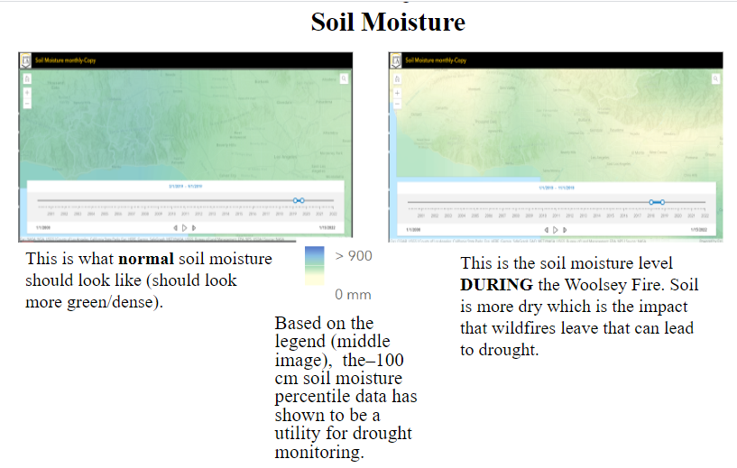
Soil Moisture
Speaker: Mazel Fernandez

Slide 39
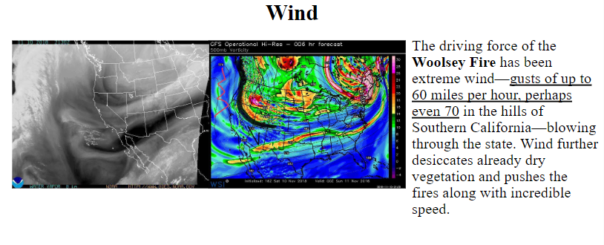
Wind
Speaker: Mazel Fernandez

Slide 40
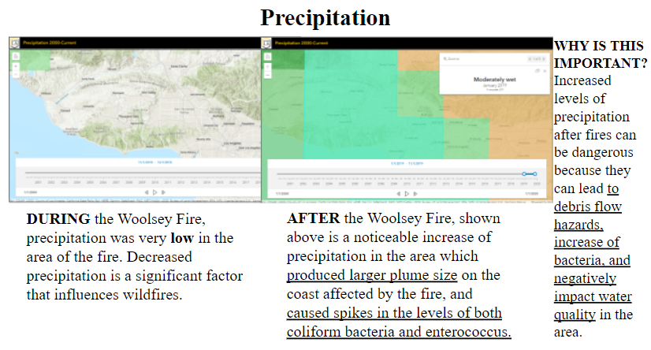
Precipitation
Speaker: Mazel Fernandez

Slide 41
Future Goals (Dashboard)
Add more data
More detail
More live data
Air quality
Live data
Prediction data
Predictive Models
High Accuracy
Usefulness
Speaker: Victor Raj

Slide 42
Future Goals (Project - Long Term)
Add More GUI Elements:
Side by side comparisons
In depth information of specific points
Mobile Application
Speaker: Victor Raj

Slide 43
Links/Works Cited
https://n2yxp.csb.app/
https://idahofirewise.org/fire-ecology-and-management/wildfire-ignition-behavior-and-effects/
https://earthobservatory.nasa.gov/images/148789/climate-change-pushes-fires-to-higher-ground
https://www.c2es.org/content/wildfires-and-climate-change/
Wildfire Watchers website

Slide 44
Contact Info

Slide 45
THANK YOU!

Slide 46
Q/A

