Slide 1
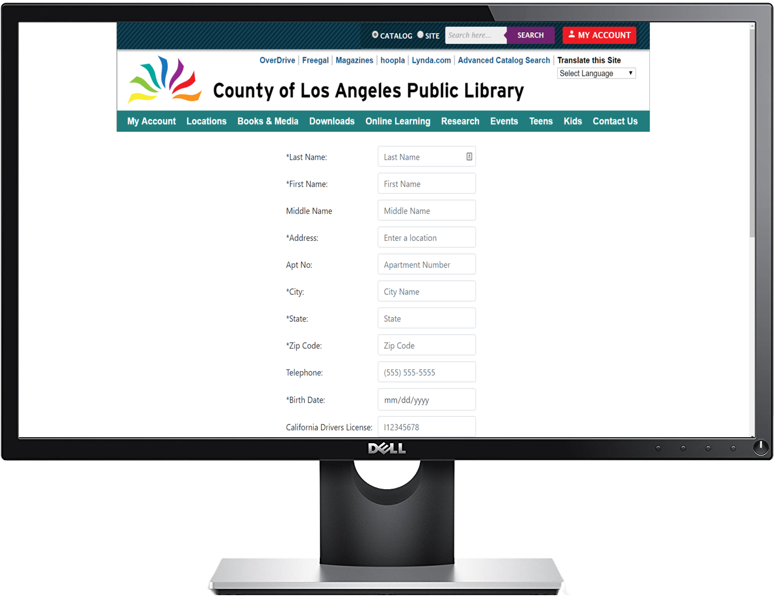
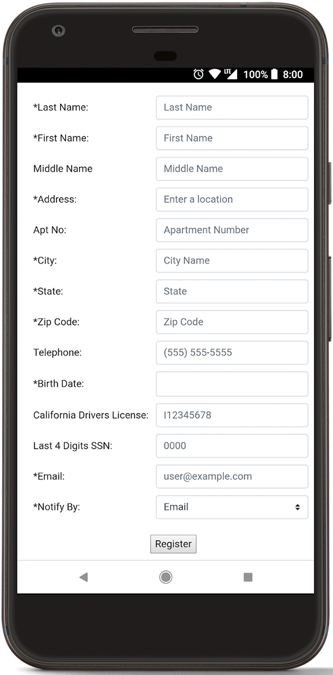
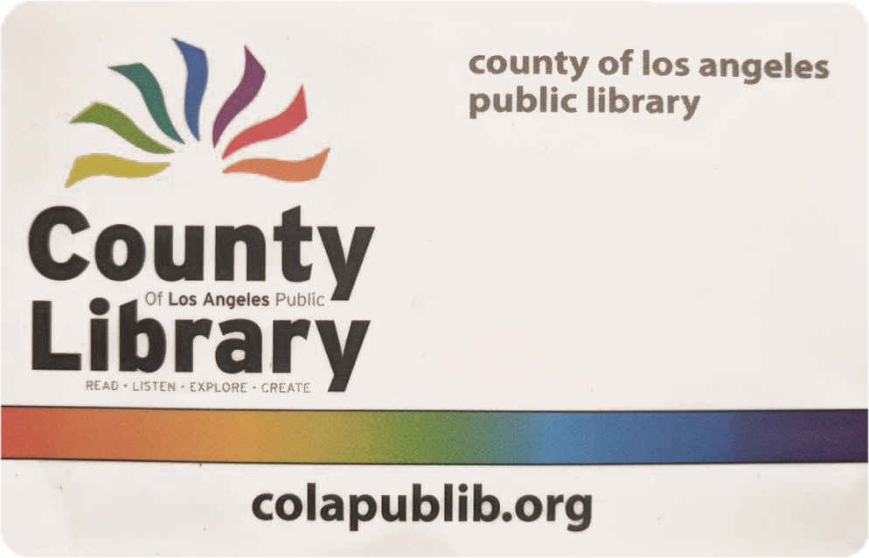
Library Card Registration System Team Members: Maurice Mejia, Alvin Tsui, Jose Aparicio, Brent Hamada, Christopher Lee Faculty Advisor: John Hurley County of Los Angeles Public Library Liaisons: Michael Oey, Allan Padilla Los Angeles Public Library Department College of Engineering, Computer Science, and Technology California State University, Los Angeles
The County of Los Angeles Public Library has many free online services, including e-books, audiobooks, and more
Access to these services requires a library card, which is currently obtainable only by completing paper forms at a library branch
Our project provides instant access to online library services by implementing online registration.
Project Background
Provide responsive web page design
Offer convenient ways to register
Support visually-impaired users and those who require translation
Validate user input
Objectives
Web application for library card registration that allows users to sign up by typing, scanning a driver’s license, or using voice. Validates user’s California address and uses Recaptcha and email validation to avoid abuse.
Deliverables
User Flow Diagram
Tech
Notes:
‹#›
Have students check that the logo is the appropriate one to use.

