Slide 1
Artificial Intelligence for Smart Cities
Sponsors: TOYOTA and LA City
Advisor: Mohammad Pourhomayoun
Team: Jason Fan, Luis Gonzalez Gutierrez, Edgar Hernandez, Gunjan Kc, Lynne Tien
California State University, Los Angeles - Capstone Senior Design Virtual Expo - May 3-7, 2021
Notes:
Insert a picture to every slide

Slide 2
Agenda
1. What is Vision Zero and how does it relate to our project?
2. Statistics?
Users
3. Algorithms/Methods designed
Circle algo
Bucket algo
Polyline algo
4. UI/UX - Design
Demo: Android / iOS
5. Future Plans - Next Semester
Patent pending
Applicant: The Trustees of California State University
Notes:
Hi everyone, thanks for joining in on this recording. If you’re here it is because
1. You’ve gotten approval from our advisors to watch this video
2. You’re the next developer for this project
3. You want to know the outcome, the culmination of the project as it is currently.
Here is the agenda,
What is vision zero and how does it relate to our project ….

Slide 3
Notes:
Jason
sponsor:

Slide 4
What is Vision Zero?
Vision Zero is a global initiative whose goal is to reduce severe injuries and deaths in roadway collisions.
One principle from Vision zero is, traffic deaths are preventable and unacceptable.
Using all the “E’s” engineering, education, enforcement, evaluation, and equity.
Notes:
Jason- what is vision zero, Multidisciplinary approach to making the streets safer.

Slide 5
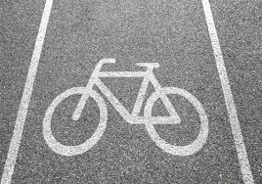
Vision Zero's Principle
Traditional road design models tend to facilitate faster movement of cars.
The Vision Zero philosophy calls for reordering the priorities to make roads as safe as possible.
Particularly for more vulnerable street users like cyclists and pedestrians.
Strategies:
Wider sidewalks
Narrowed car lanes
Added bike lanes
Improved street signals
Notes:
Jason - how is related to the project, produce app to reduce accident for people

Slide 6
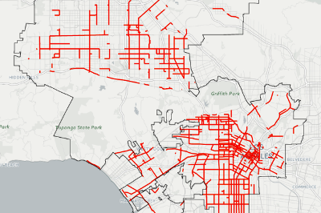
How is Vision Zero implemented in L.A.?
The Los Angeles Department of Transportation has collected data on traffic crashes in the city.
Identified a network of street segments with the highest share of serious and fatal crashes, which it calls the "High Injury Network."
The department has been holding community meetings across the city to gather feedback on proposed road changes.
Notes:
Jason

Slide 7
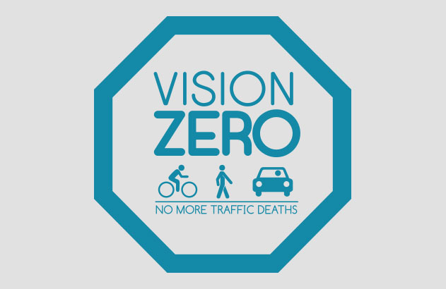
How does Vision Zero connect to Our App
By connecting Vision Zero to our application:
Knowing accidents happened in specific area
Avoid high risk(injuries/deaths) roads
Calculate and determine the safest route

Slide 8
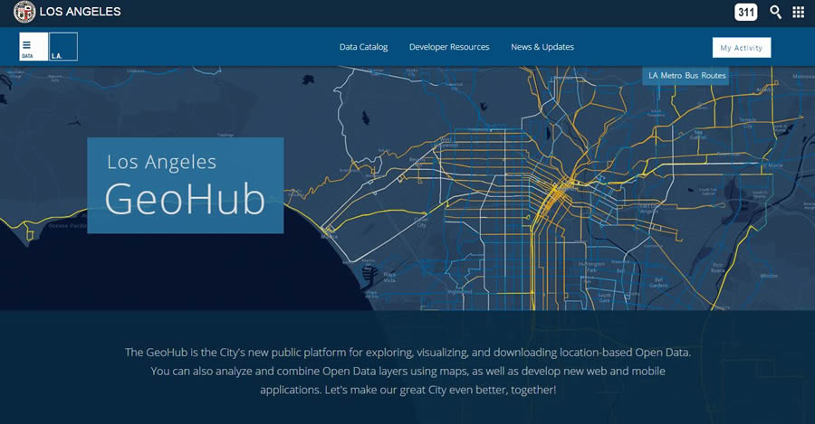
LA City Geohub Data
The City of Los Angeles has been monitoring and collecting data on traffic collisions for some time.
For now our project will be using “Los Angeles Collisions 2014 through 2019” dataset.
The dataset contains updated historical collision data with specified details of the collisions.

Slide 9
Why Our Application?
A lot of prominent app’s exist in the market – Google Maps, Waze, Apple maps.
These apps provide various features like turn by turn navigation, satellite view, terrain view, traffic conditions and many more.
However, none of these apps prioritizes safety, rather the fastest and the most convenient path to the destination.
There are very few apps in the marketplace that has a safety functionality.
Notes:
Jason

Slide 10
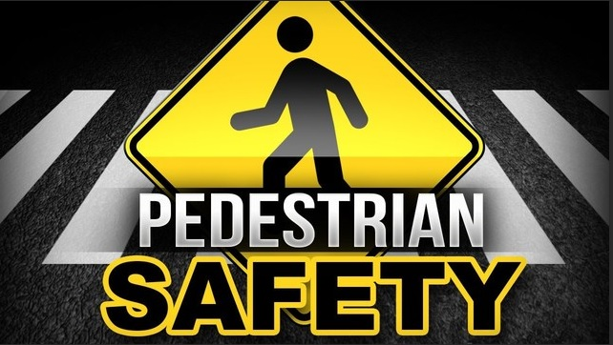
SafeWays
A navigation phone app that provides the safest path to the destination.
Target audience for the app are pedestrians and cyclist.
Prioritizes safety over the fastest directions.
Notes:
Jason

Slide 11
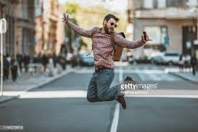
Target audience
• This app can be used by drivers, pedestrians and bicyclists.
• However, extreme safety caution should be taken by users, during turn by turn by navigation, and the users are recommended to keep their eyes on the road at all times.

Slide 12
Data driven
Unlike other map navigation apps which does not rely on previous data to show and predict directions, our app utilizes previous data of recorded accidents and fatalities to predict/choose direction for the safest path.
The safer a particular path, the higher probability that the path will be included in the future prediction of final navigation.
Notes:
Jason

Slide 13
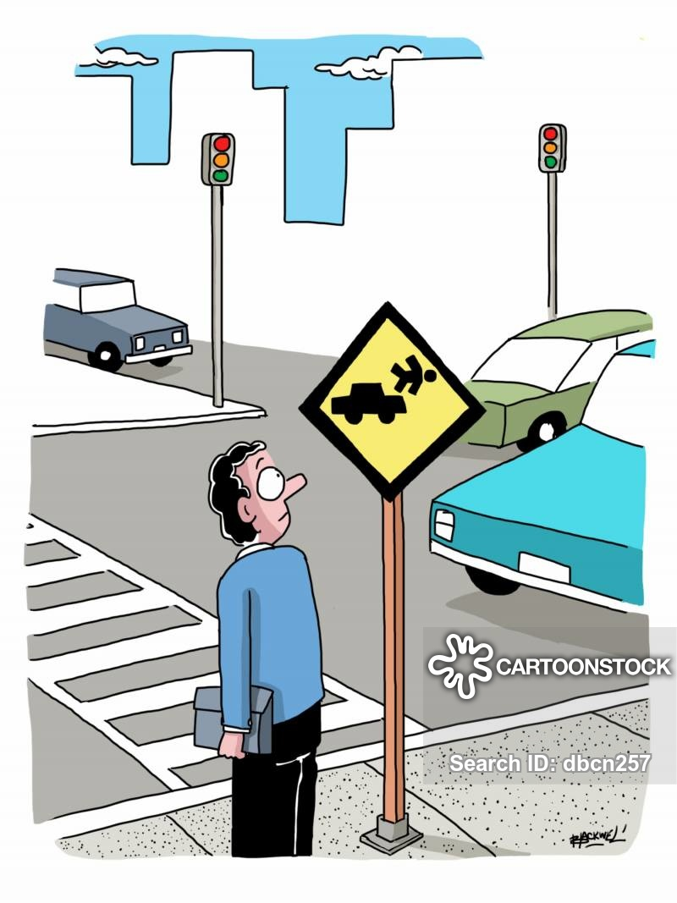
Pedestrian Fatalities
Pedestrian fatalities have risen sharply in the united states in recent years.
In fact, in the last 10 years, from 2009 to 2018, pedestrian fatalities increased by a total of 53 percent.
However, all other traffic fatalities fell by 2 percent.
For example, In 2019, total pedestrian fatalities was 6,590, highest recorded since 1988.
That is about about one fatality every 88 minutes.

Slide 14
US Pedestrian fatalities in last 30 years

Slide 15
Pedestrian Fatalities Breakdown
Pedestrian accidents are quite dependent on different environment characteristics like land use, pedestrian location, lighting conditions and seasons(months) and time of the day.
More pedestrian fatalities occurred in urban areas (80 percent), than rural areas (20%)
Only 18 percent of the fatalities occurred at intersection
75 percent of pedestrian fatalities occurred in the dark, 21 in daylight, 2 percent in dusk , and 2 percent in dawn

Slide 16
Cities with the highest number of pedestrian fatalities were Los Angeles, followed by Phoenix and NY. (but some have high population)

Slide 17
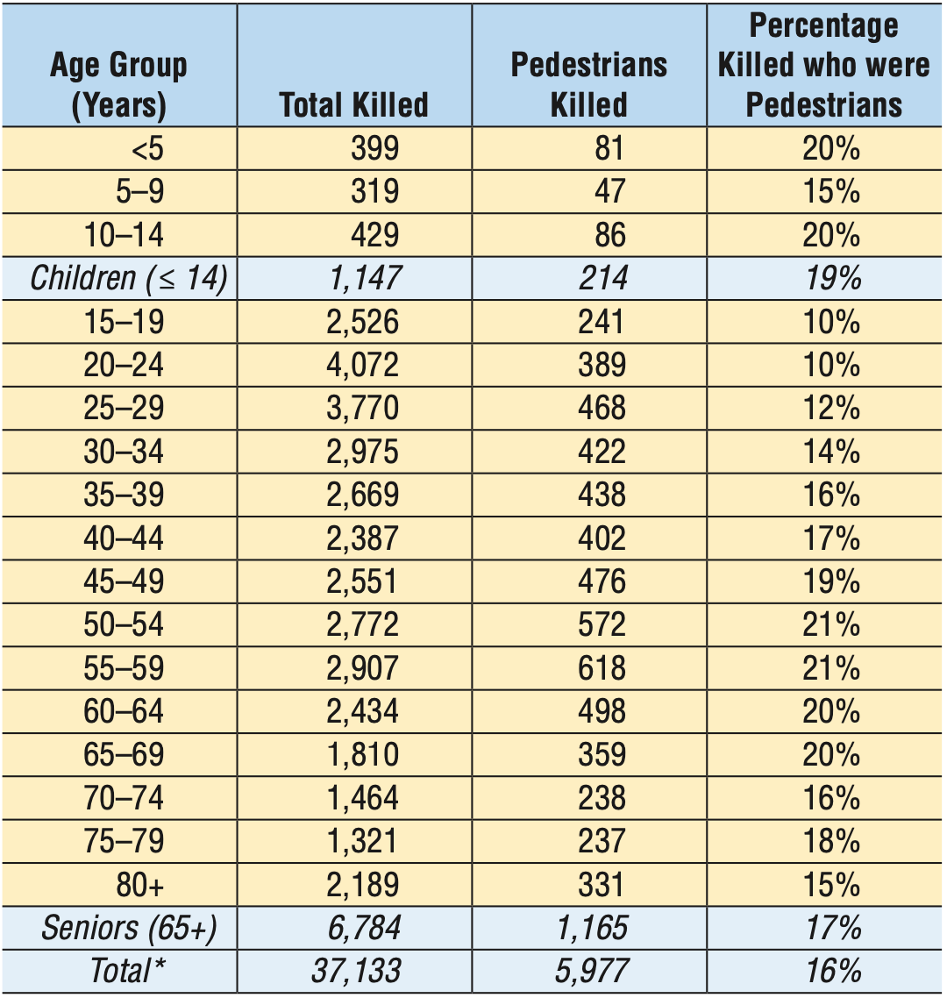
Pedestrian Fatalities by Age
The highest percent of age group involved in pedestrian traffic fatalities were people in their 50s (21 percent)
The lowest percent of age group involved in pedestrian traffic fatalities were young children (5-9 years old)
The average age of pedestrian killed were of age 47.
70 percent of the pedestrian killed in traffic accidents were male.

Slide 18
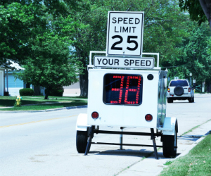
What are the main causes
Alcohol, about 47 percent of the traffic crashes that resulted in pedestrian fatalities involved alcohol.
Distracted driving , walking (phones, talking, etc)
Speeding
Lack of visibility at night time.
Failing to yield and follow rules by both pedestrians, drivers.

Slide 19
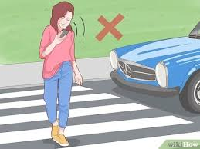
Important safety recommendations
For bicyclist, sidewalks are also recommended if no bicycle lane is available.
Using electronic devices like phones, music players by both pedestrians and drivers should be abstained.
Using reflective and bright clothes helps pedestrians more visible to drivers and other people in the road.
Using drugs, alcohol , medicine that impairs your driving should be avoided at all costs.

Slide 20
Goal of SafeWays
To save computational time and increase path safety by moving demanding CPU intensive tasks (boxed in red) to a outside server which can be called like any other api.
Directions
Activity
Start Up
Metro
Bike
Share
API
Send Translated Google Maps API DATA
API CALL
Maps
Activity
Translate API Data
Google Maps & Directions API
User
Profile
Activity
API CALL
Translate Direction API Data
READ and Translate Collision Data
LA Collision Data
Station
Activity
Send Translated Metro BIke Share API Data
Calculate Safe Path Using Collision Data and Direction API Data
Safest Path Polyline Algorithm
Notes:
edgar

Slide 21
SafeWays App Implementations
Home Page
API CALL
Metro Bike Share API
Page Directory
Read Metro Bike Share API Data
Read Metro Bike Share API Data
History Page
Navigation Page
Metro Bike Share Stations Page
Info/Tips Page
Paths Page
Store destination data to be stored in history
Send origin and destination data to Paths for api call
Notes:
edgar

Slide 22
SafeWays App Implementations
We make one API call to our custom server with the data given by the Paths Page
Custom API Server
Paths Page
API Call
LA Collision Data
API Call
Collision Data Fed to Algorithm
Google Directions API
Safest path data returned ready to be displayed in Paths page
Bucket - Circle - Polyline Algorithm
Paths Data Translated
Paths Data Fed to Algorithm
Notes:
edgar

Slide 23
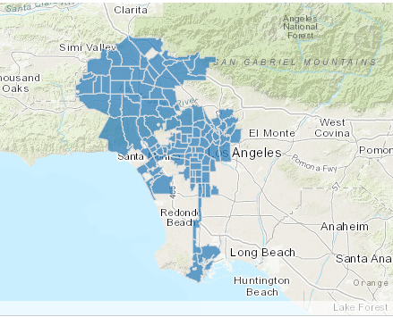
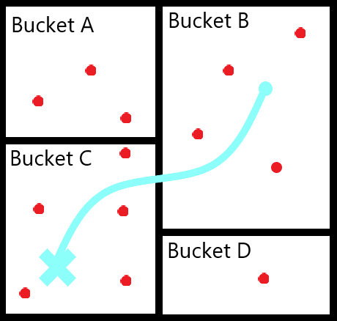
Bucket Algorithm
All of the accidents are sorted using buckets.
Each bucket is a neighborhood of LA City.
Instead of checking to see which accidents are close to our path. We check which buckets our path crosses.
All accidents inside the crossed buckets are sent to the Circle Algorithm.

Slide 24
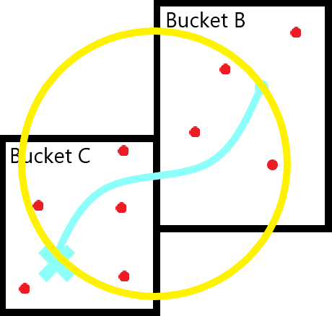
Circle Algorithm
A circle is “drawn” around our path.
All accidents that fall inside the circle are then sent to the Polyline Algorithm.
All other accidents that are not within the circle are ignored.

Slide 25
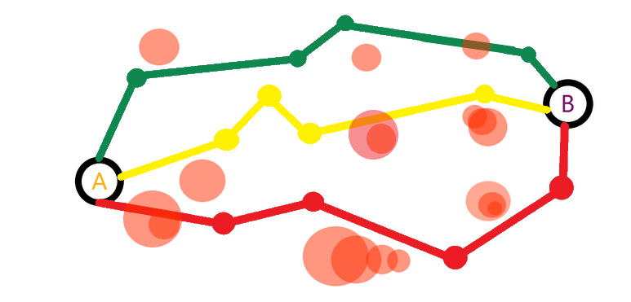
Safest Path Polyline Algorithm
Path is made of polyline (sections of path)
Algorithm adds weight to each polyline if the polyline is a certain distance from an accident
Weight is calculated based on collision severity, collision deaths and injuries.
Path with the lowest weight will be the safest path.

Slide 26
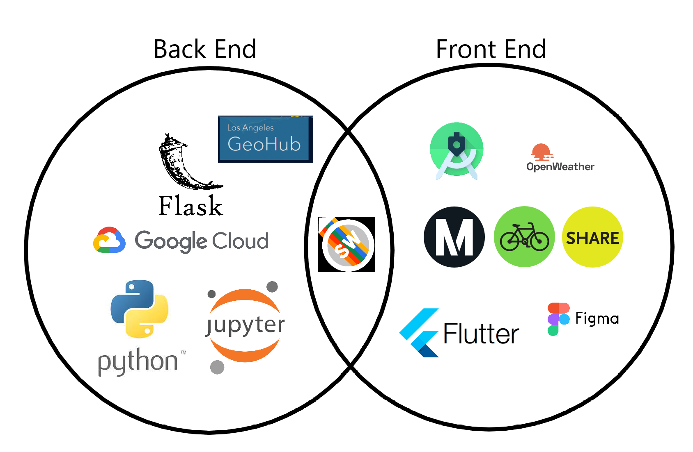
App Technologies
Notes:
LUIS

Slide 27
Applications Development
Flutter/Dart:
● Expressive and flexible UI
○ Large built-in widget catalogue
○ Complete customization and fast rendering
● One codebase
○ Looks the same on every version of Android and iOS
● Hot reload
○ No need to recompile, just save and preview the changes live
● Fast development time
Notes:
LUIS

Slide 28
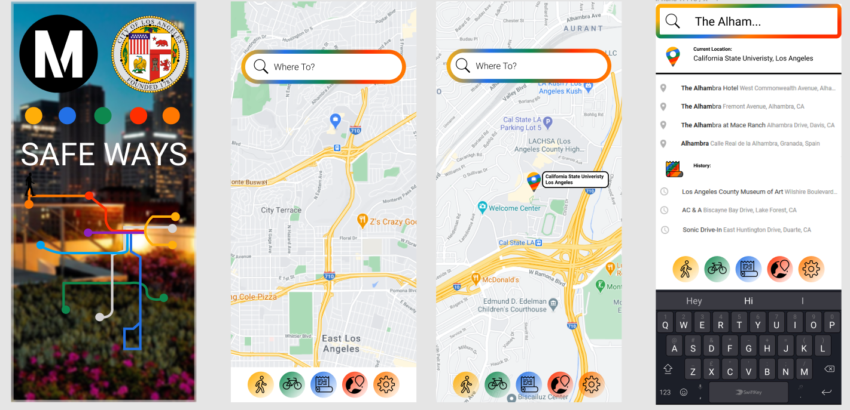
Figma
Our ideal design:
Notes:
LUIS

Slide 29
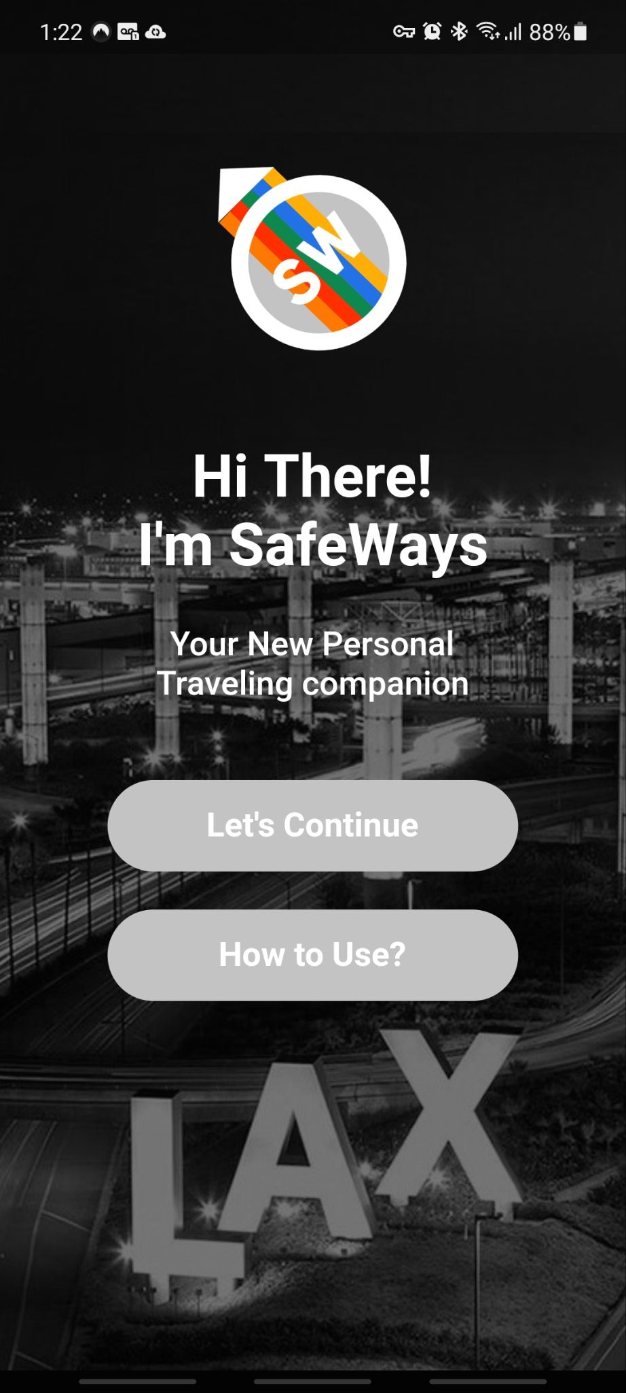
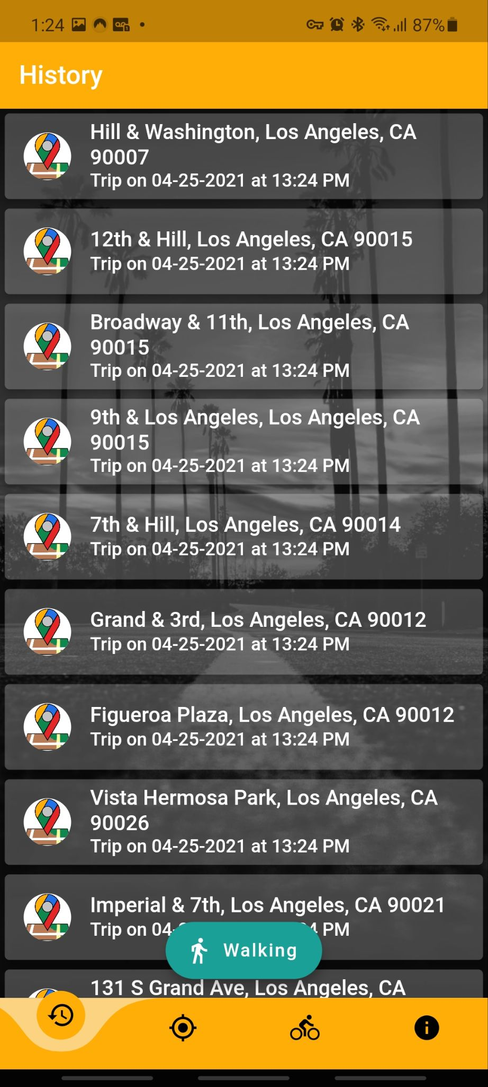
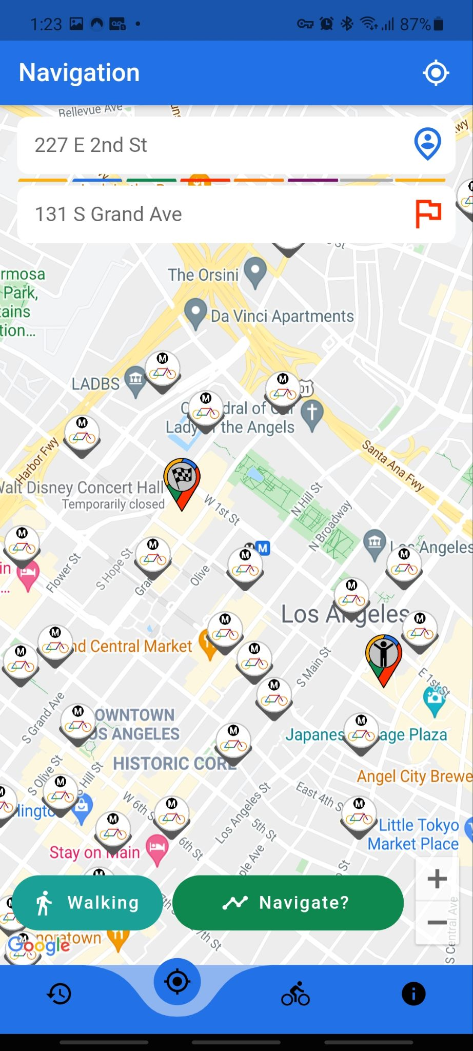
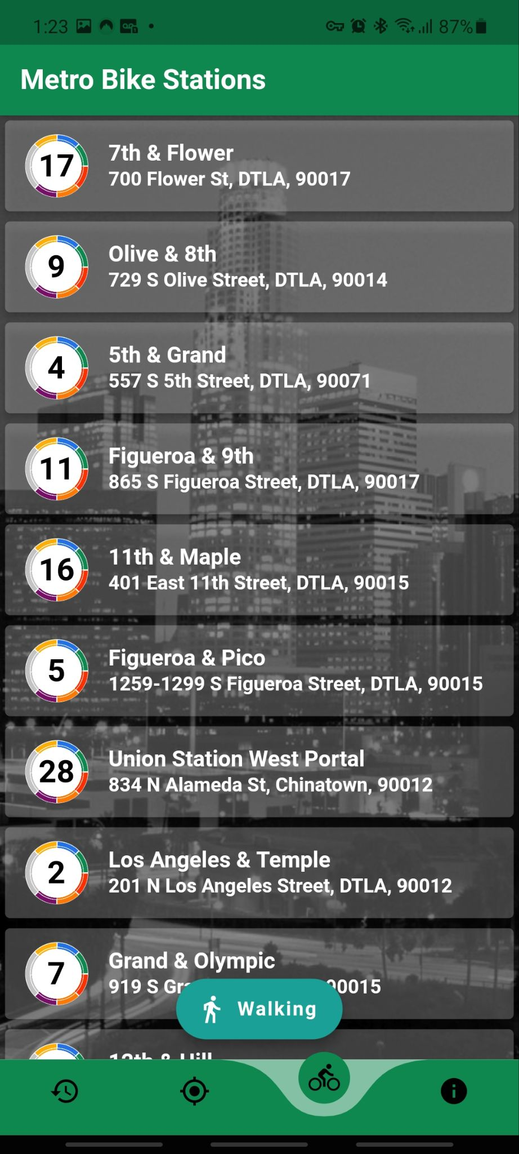
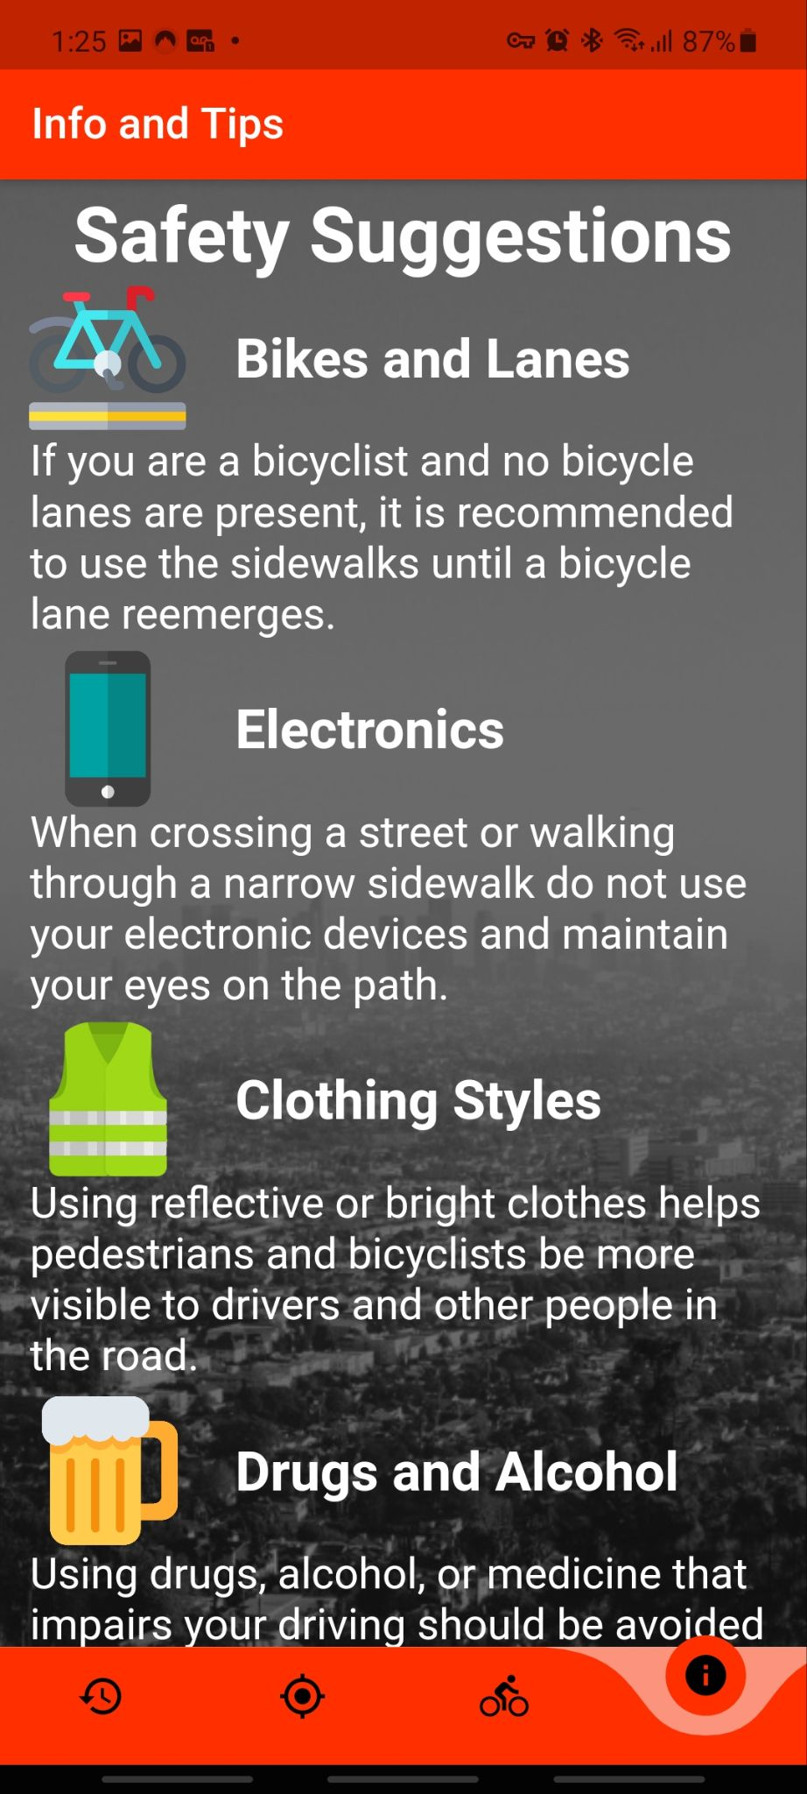
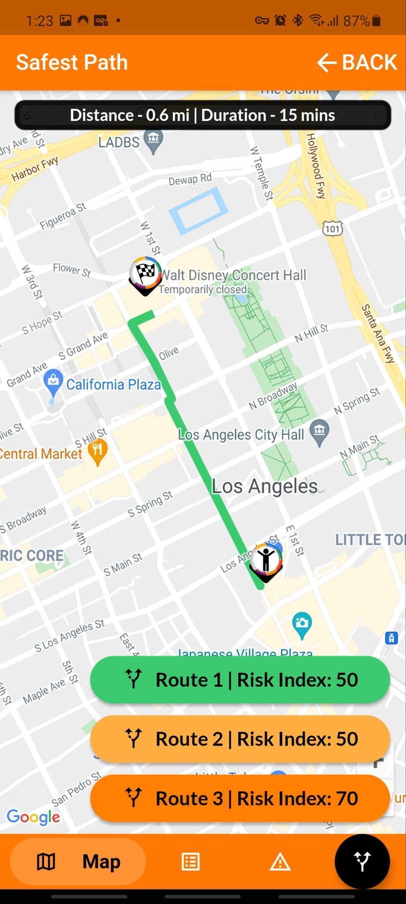
App Design
The app is meant to be as simple as possible to the end user
Notes:
LUIS
-Design of app to be as simple as possible
-Wanted to incorporate the feel of other navigation apps to make the transition to Safeways as smooth as possible -[EXPLAIN EVERY PAGE IN LIGHT DETAIL] -To reduce complexity we have separate every element of the application to its own page to give more screen real estate to every element and reduce clutter

Slide 30
Demo
Current status of the application
https://youtu.be/n9NVr9mT08E
Notes:
LUIS
Show demo???

Slide 31
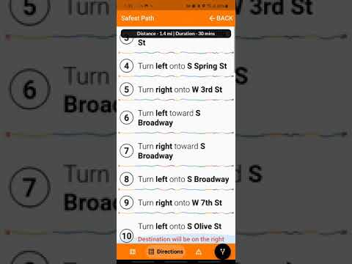
Notes:
LUIS

Slide 32
Future Implementations:
- Continue Software Patent pending/IRB process with the Cal State LA’s Office of Research, Scholarship, and Creative Activities (ORSCA).
- Testing process: review outcome, results provided by the algorithms
- Compare and work with other data to various data sets from different departments in the City of Los Angeles or transportation agencies.
- Mobile application linked with the web application to collect users routes decisions and choice to identify the optimal routes as well as problem areas, it may be necessary to conduct an assessment of the physical environment surrounding the routes.
Notes:
Lynne
Android App - Have a different map for pedestrians and bicyclist - Multiple safest path - Metro bike share compatibility - Review/feedback - Dangerous index color code - - nearest bike shop for issues. -
-
- Notification features of busy intersection Android App - Have a different map for pedestrians and bicyclist - Multiple safest path - Metro bike share compatibility - Review/feedback - Dangerous index color code - - nearest bike shop for issues. -

Slide 33
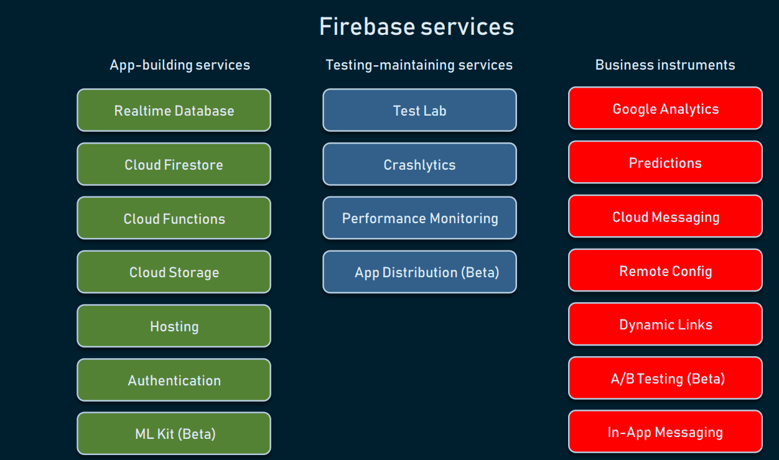
Storing user information
Databases - Firebase Realtime Database
Firebase Authentication is a Google Authentication feature tailored for apps
Machine learning capabilities - This product is currently in beta.
Notes:
Lynne Marking feature to revisit - Notification features of busy intersection

Slide 34
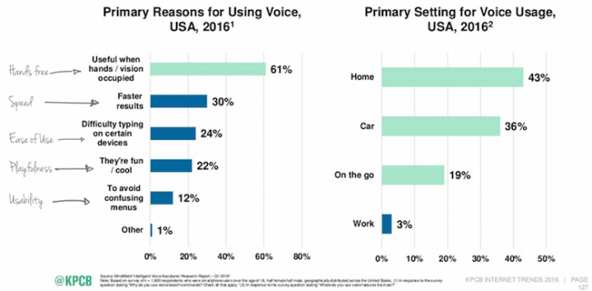
Voice navigation
Consider the pros and cons of voice interfaces
Keep the balance between graphical and voice navigation features.
Notes:
Lynne Day by day, people are conducting more of their searches through voice at a rapidly growing rate.
In a voice interface, confirming tasks and marking errors with the possibility to correct them might even come across as more essential than in a visual interface. When designing a VUI, always plan ahead and write the lines of the possible conversation for these events! https://uxstudioteam.com/ux-blog/voice-navigation/

Slide 35
Thank you!
Questions?
Please Contact:
Mohammad Pourhomayoun mpourho@calstatela.edu
Lynne Tien ltien@calstatela.edu
Edgar Hernandez ehern251@calstatela.edu
Gunjan Kc gkc@calstatela.edu
Jason Fan jfan14@calstatela.edu
Luis Gonzalez Gutierrez lgonz192@calstatela.edu

Slide 36
References
National Highway Traffic Safety Administration. Traffic Safety Facts 2017 Data: Pedestrians. U.S. Department of Transportation, Washington, DC; 2019. Available at https://crashstats.nhtsa.dot.gov/Api/Public/ViewPublication/812681. Accessed 15 October 2019.
Centers for Disease Control and Prevention. WISQARS (Web-based Injury Statistics Query and Reporting System). Atlanta, GA: US Department of Health and Human Services, CDC; 2015. Available at http://www.cdc.gov/injury/wisqars. Accessed 15 October 2019.
Notes:
http://help.leaderboarded.com/knowledgebase/articles/613299-relative-scoring-vs-absolute-scoring-explained

