Slide 1
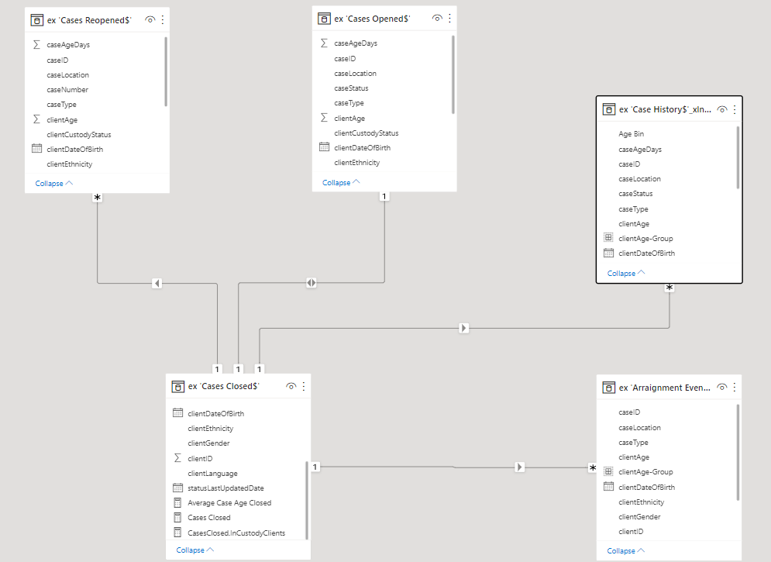
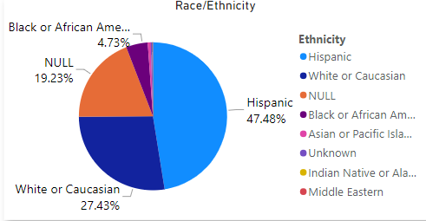
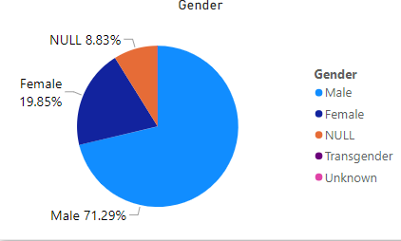
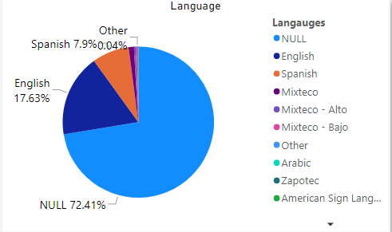
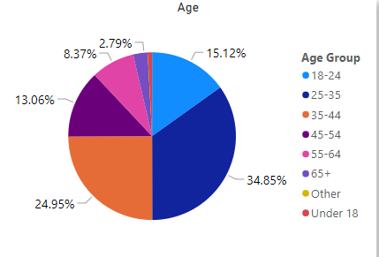
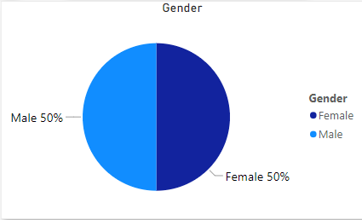
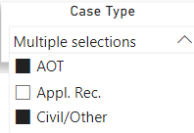
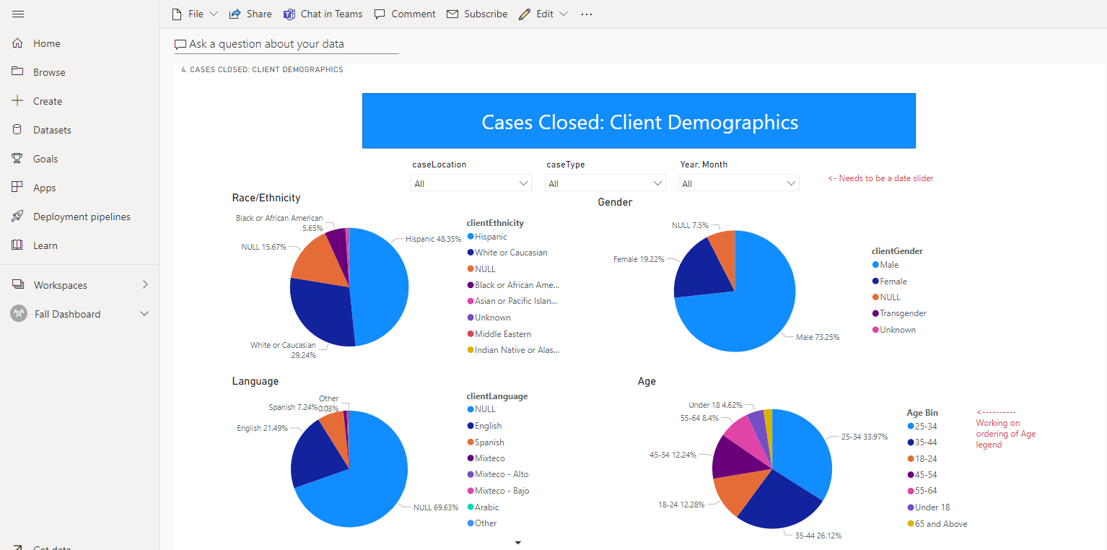
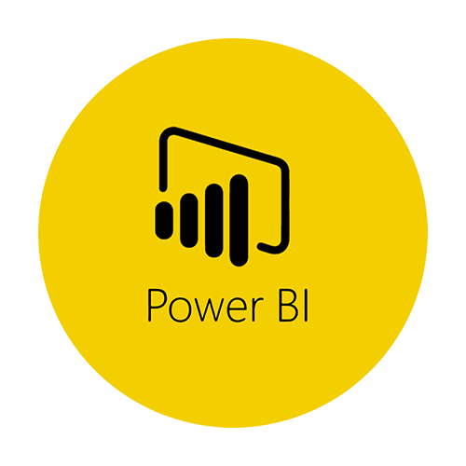
Power BI Data Analytics Dashboard Team Members: Alvin Truong, Deqing Liang, Edwin Lugo, Elton Lin, Jevon Fan, Jiajun Gu, Markneil Cruz, Suresh Ghimire, Tommy Ly, Winston Pham, Yara Ajjawi Faculty Advisor: Dr. Chengyu Sun Santa Barbara County Liaisons: Deepak Budwani, Sarah Rothschild, Bryan Burzon, Angella Stokke, Aidan Basset Department(s) of Computer Science College of Engineering, Computer Science, and Technology California State University, Los Angeles
Santa Barbara Defense Offices is looking for a new tool to manage and organize their attorney cases. We developed multiple Power BI data visualization dashboards that allow the Santa Barbara team to make critical and precise decisions for the persons in Santa Barbara county.The objective of this project is to provide an understandable and accessible dashboard that allows the users to monitor the data flow.
Background and Objective
Project Summary
To achieve the plan, we need to transform the public defense database into a Power BI query and model. As required, we used visualizations, fields, and filters to design unique interactive charts. Export the dashboard to Power BI service and posted it to public or private parties.
[Data Source]
[Power BI Query & Model]
Extract
[Visualizations]
Transformation
Transform
[Filters]
Publish
[Results]
Users are allowed to select one or multiple selections to filter specific fields for more accurate results.
Power BI Pro users are able to subscribe to emails of the published report pages that matter most to them. Once they subscribed, the Power BI will regularly send screenshots of the report pages directly to their inbox whenever the data changes.
Tools &
Technologies
Notes:
Have students check that the logo is the appropriate one to use.

