Slide 1
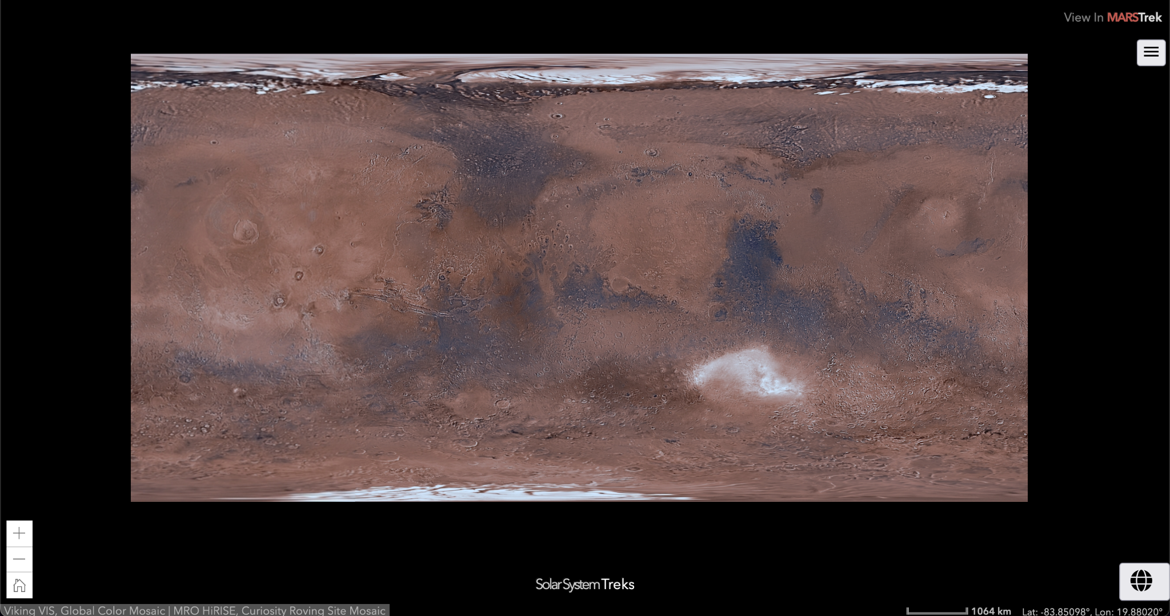
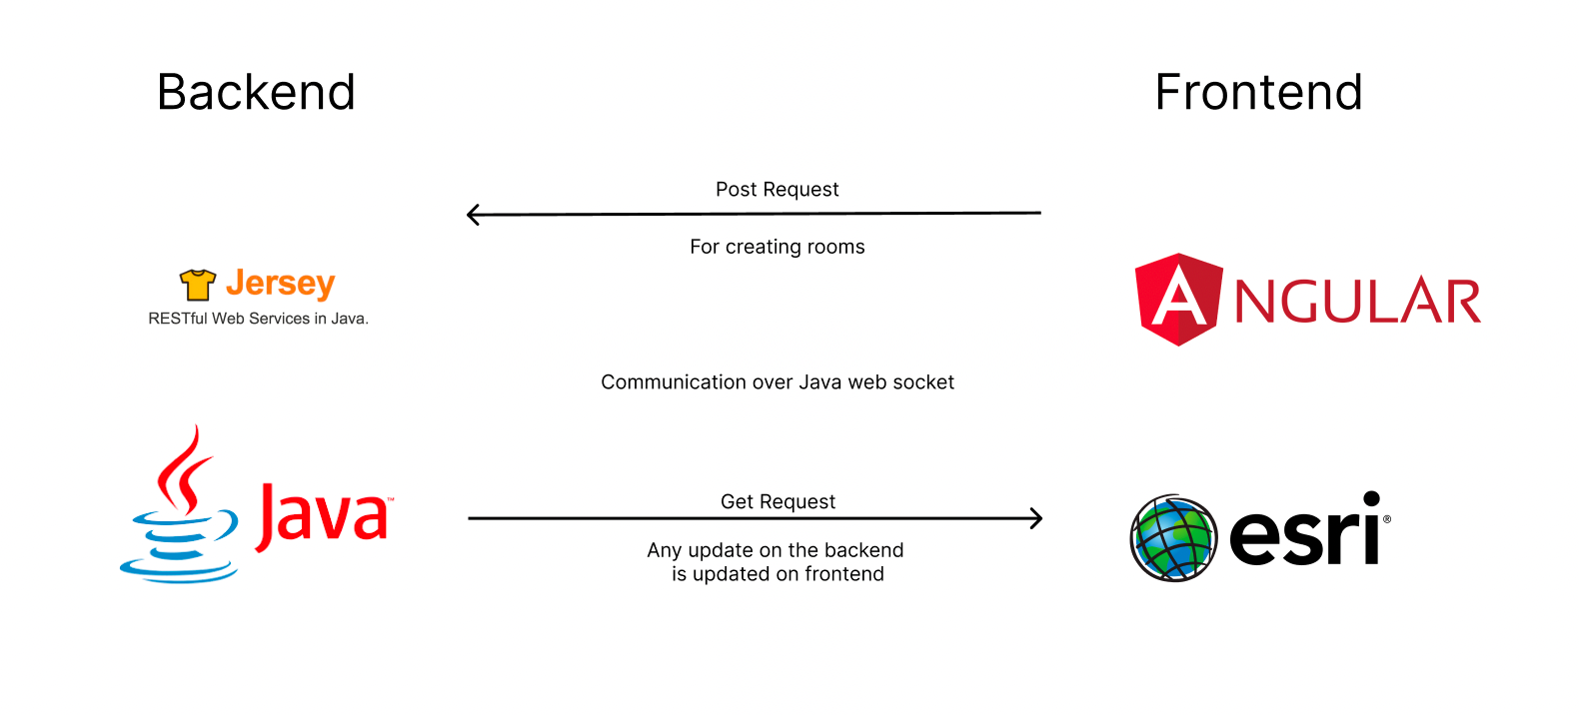
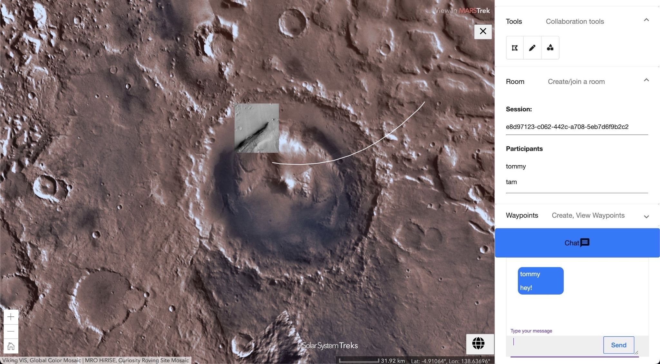
Moon-Trek Team Members: Aldo Gil, Alex Sahakian, Allen Marquez, Andy Tsan, Anna Yesayan,
Jian Wu, Sean Chung, Srivats Venkataraman, Tam Nguyen, and Tommy Lay Faculty Advisor: Dr. David M. Krum NASA JPL Liaison: Emily Law Department of Computer Science
Trek
Technology
Moon Trek is a software that works under a much bigger software called Solar System Trek. In essence, Moon Trek allows users to interact with a photo or 3D terrain of cosmic bodies: planets, moons, etc. This is possible since NASA georeferenced the actual surface of the planetary bodies and converted them into data that Trek users can use for interaction and modeling.
Jet Propulsion Laboratory (JPL) manages the Solar System Treks which are browser-based portals that allow one to visualize, explore, and analyze the surfaces of other worlds using real data returned from a growing fleet of spacecraft.
Objectives
Data Flow
The goal of our project is to implement
collaborative features to the current Moon Trek web application allow multiple users to collaborate in a session. We will also be changing parts of the codebase to fit the requirements needed by JPL. The objectives are as follows:
Implement collaborative features.
Transition parts of the codebase from one technology to another.
Transition from Dojo Toolkit to using Angular for the frontend and UI
Transition from a NodeJS based backend to Java-based backend.
Creating a WebSocket server for collaboration.
Created a backend web socket server along with multiple API endpoints to help keep data updated real-time amongst users that are connect
User sends data
whether it’s in the form of a drawing, or a chat message
Video Demos
USER 1
Backend receives data, processes it and sends data back to all clients that are connected
If you would like to get a better understanding of our results, scan the QR code below:
USER 2
Conclusion
Acknowledgement
We learned a lot of new frameworks and technologies such as Angular, EsriJs, Jersey, also how to work between a production and development environment
We have better knowledge on how to create architecture that supports real-time communication between users
We would like to give special thanks to the NASA JPL team for sponsoring us with this project work and also supporting us through our endeavors.
These individuals include Emily Law, Eddie Arevalo, George Chang, Richard Kim, Shan Malhotra
Or visit https://tommylay1902.github.io/SeniorDesignDemo/
Notes:
‹#›
Have students check that the logo is the appropriate one to use.

