Slide 1
Project Update
Want 2 Remember App
powered by We2Link ®

Slide 2
Our Team
Antonio Campos | Project Co-Lead
Alec Kaczmarek | Project Co-Lead
Amy Guttman | Documentation Co-Lead
Alexandra Strong | Documentation Co-Lead
Vincent Li | Engineer
Saiyang Liu | Engineer
Ricardo Marroquin | Engineer
Miguel Nonoal-Garcia | Engineer
Jonathan Sum | Engineer
Edwin Zapata Minero | Engineer
Zilong Ye | Faculty Advisor
Kevin Benavente | We2Link Liaison
Michael Malone | We2Link CEO
Amy

Slide 3
Purpose
Want2Remember is an app that lets you invest in yourself!
We are helping to build an app to help those with memory issues - whether they are from brain injuries, Alzheimer’s, or other cognitive impairments.
The app provides the user templates to log memories, passwords, to-do lists, interactions, appointments, and other important things the user wants to remember. The user can record past, present, and future events and reminders.
The goals of Want2Remember are to assist in independent living and return to work, promote social interaction, increase work efficiency, relieve caregiver burden, provide greater personal safety, and improve medical support.
Amy

Slide 4
Presentation Outline
Scope Of Work
Our Stack
Redux Flow
Detailed Overview of our Application Screens
Video Demo & Other Features
Future Goals
Conclusion
Amy

Slide 5
Scope Of Work To Date
Clear the Backlog
Fix known bugs
Implement New Features
Color Customization
Native Calendar Integration
Integrate Back End Technologies
Google Cloud User Authentication
Firebase
Alec

Slide 6
Our Stack
Alec

Slide 7
Redux Flow Introduction
What is Redux?
Redux is a tool to manage and update an application's state
How is Redux used?
Redux has three core components: state, view, and actions
Why Redux?
It allows the developer to manage the current state throughout the entire application
Antonio

Slide 8
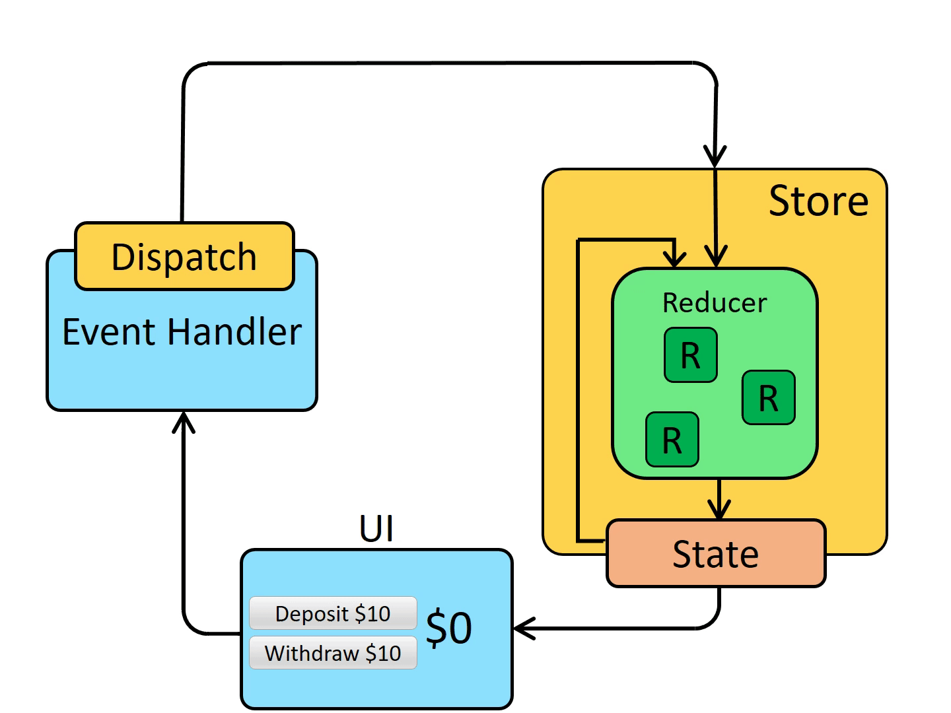
Redux Flow
Initial states can be found on our various screens throughout the app
In order to update information in our app we have an event handler that sends an action request.
Once action is processed it gets sent back to our initial state to get processed by our reducers and updated in our app
After this is completed the app displays the new state to the UI
Antonio

Slide 9
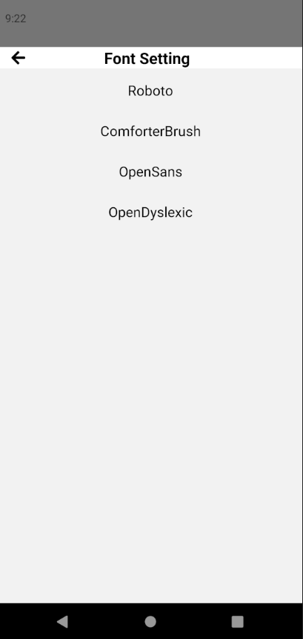
Redux Flow in want2remember
We register our reducers before we can use them for development
In our Font Setting page, we initialize our state as the font Roboto
Event handler like button would trigger different actions and will go to the requested reducer
Once the action is processed through the reducer the state is updated
Saiyang

Slide 10
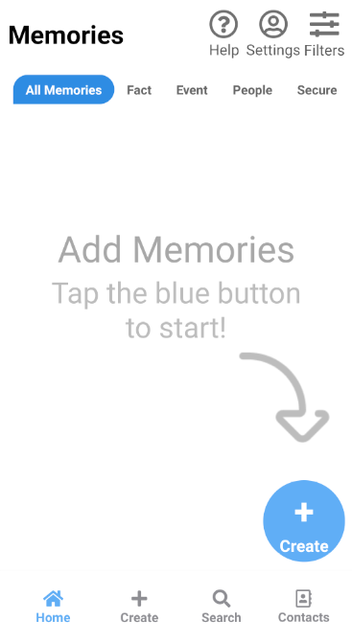
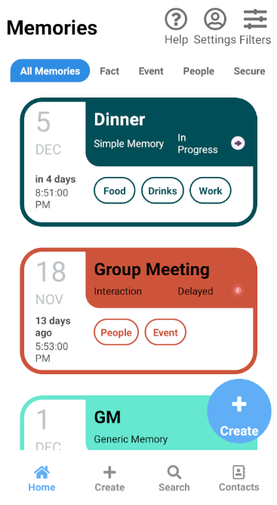
Home Screen
Features/Functionalities
Brief overview of all existing memories
Filter memory categories
Navigation to other sub screens
Sub screens
Details
Help, Settings, Filters
Contacts, Search, Create
Vincent

Slide 11
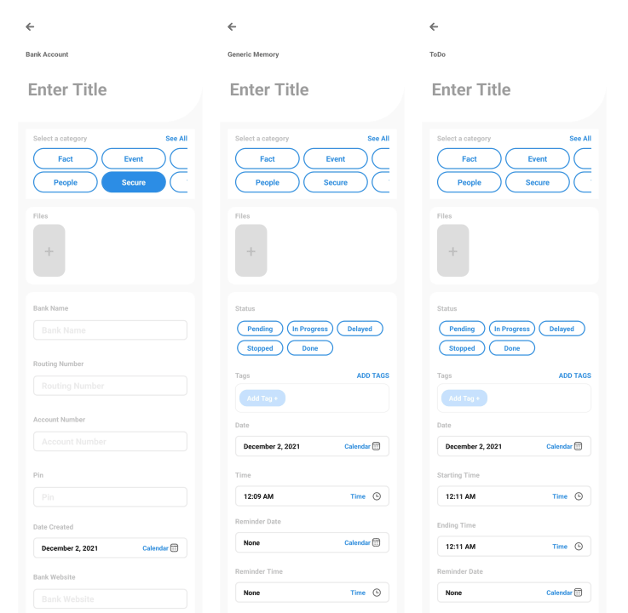
Create Screen
Used for both for editing memories and creating them
Layout unique for each unique premade memory template
Capable of keeping track of
Title
Categories
Files
Status
Tags
Date and Time
Location
Reminder Time
Relevant Contacts
Reoccurring Event
Description
Emoji
Ricardo
Notes:
The create screen is used for both creating and editing memories. The layout of the screen’s contents differ depending on the type of memory template that was selected. It is able to keep track of a variety of things entered by the user such as the given title of the memory; any categories that the memory belongs too; files such as pictures, videos, pdf, etc.; status of the memory such as pending, in progress, done; tags which are similar to hashtags where you can use them later to help find a group of memories; and date and time of when the memory was made as well as the date and time the user gives the memory like for example, if the user needed to remember an upcoming birthday and wrote it down in the app, the day and time of when they entered the birthday will be saved along with the actual birthday date. Some other notable things that can be saved are an emoji that the user can associate with the memory. This so they can perhaps associate a feeling or emotion to the memory. How often a memory should reoccur can also be saved which is especially useful if the memory is related to an event or a daily task like taking medications. Most memory templates have their own custom fields as well like the credit card template has some fields to enter in your credit/debit card information and the ToDo template lets you add in multiple tasks that you need to do along with a date for each task. Some of the more complicated fields that require the user to do more than just enter text have a sub screen that can pop out. For example, when entering a date, a calendar will pop up for the user to select a date, for time, a clock will pop up, and for location, a new screen will pop up that lets the user search for a location, use their current location, or enter an address. Most of the stuff in the screen was already there when we got started on the project, but we have been working hard on fixing things and adding new features to improve the user experience. One big thing that was recently added to the create screen is that it now lets the user have their memory saved in their phone’s calendar and if you go back later to edit the memory, the changes made are also updated in the phone’s calendar.

Slide 12
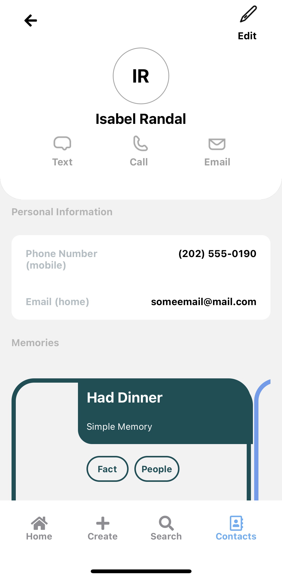
Contacts Screen
Create and/or add existing contacts to the application
Stores the following contact information:
Contact Photo
First name, Last name, and Company
Phone Number
Email
Address
Dates
Displays memories attached to the Contact's page
View More displays Personal information listed above and several memories with a scroll-view
Edwin

Slide 13
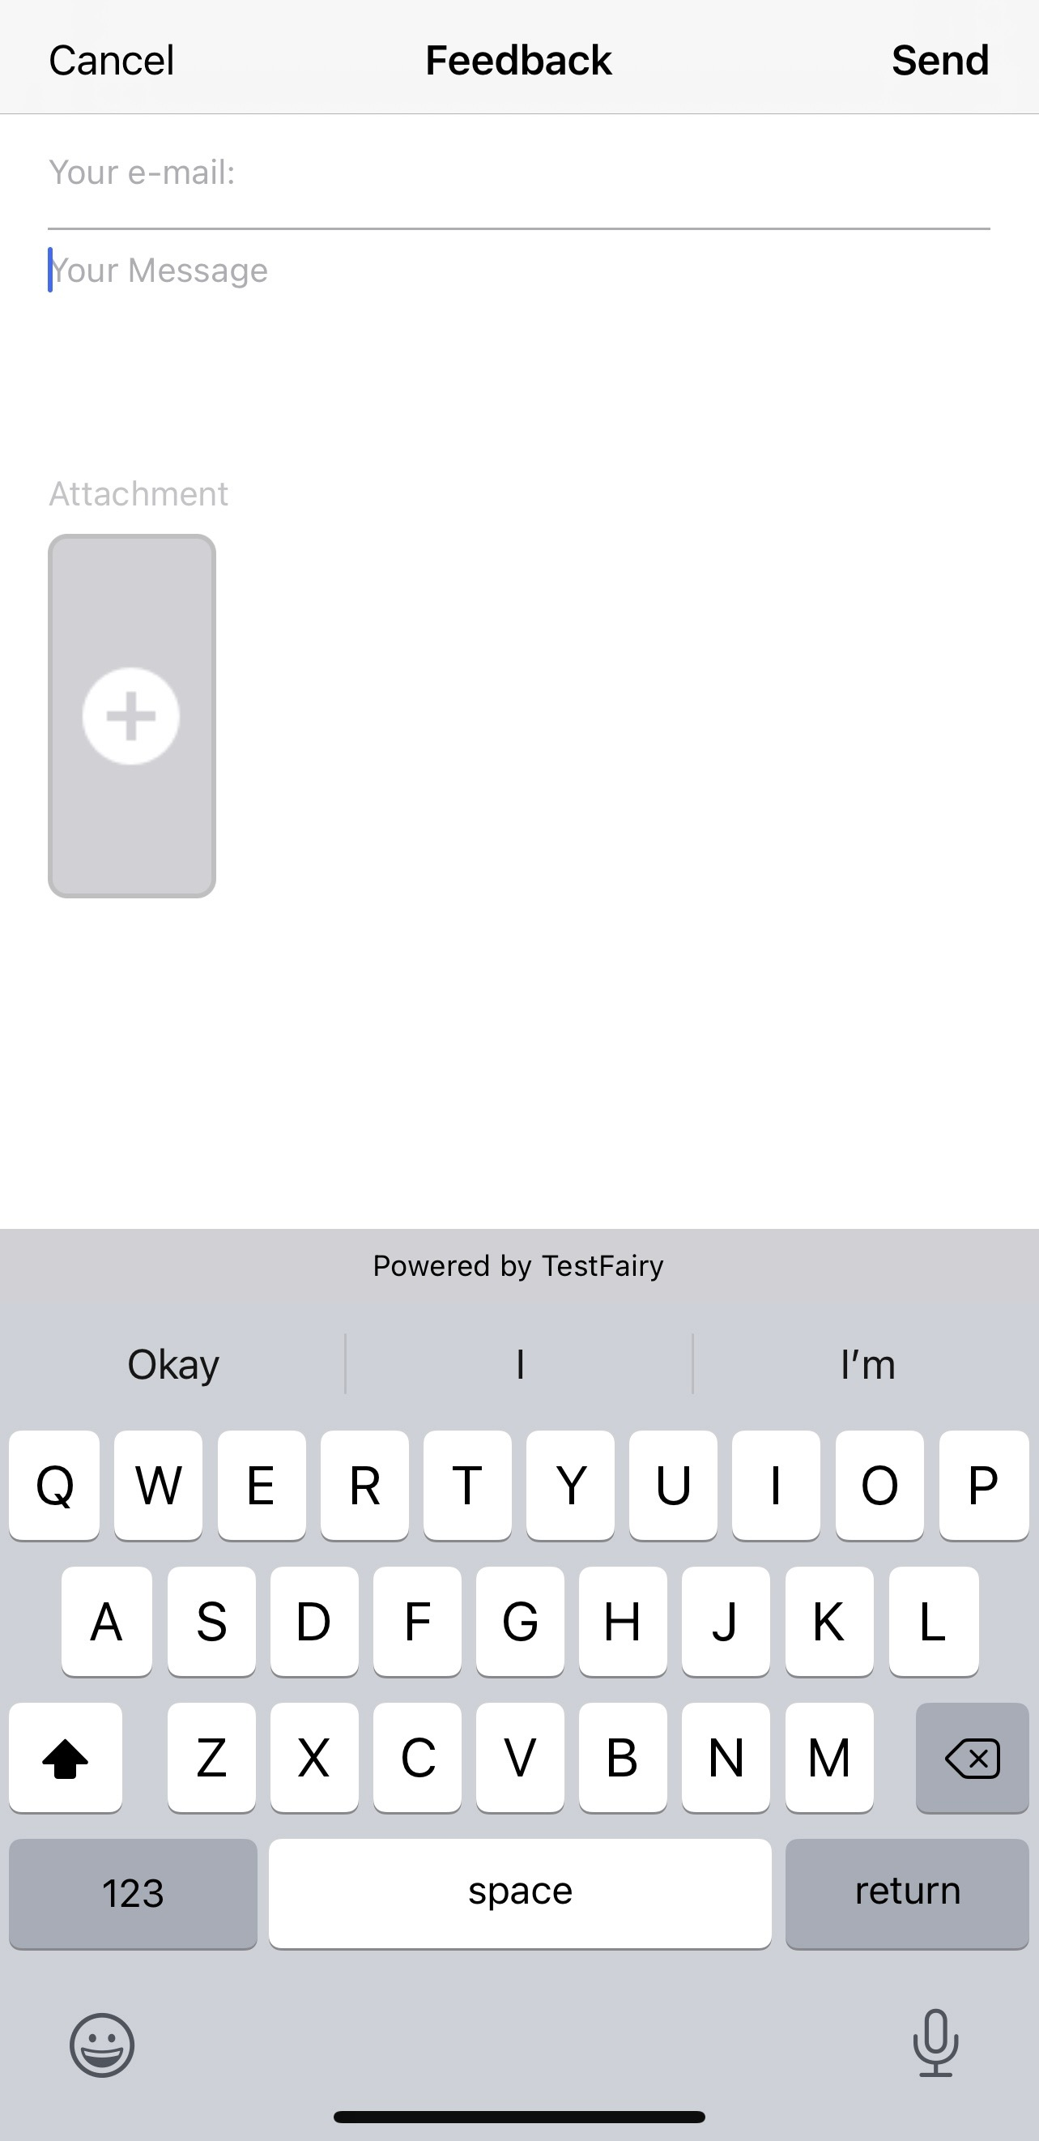
Settings screen & help screen
Importing Memories
Exporting Memories
Create and Edit App Reminders
Creating a Secure Pin
Feedback
Help Screen
Miguel
Notes:
The create screen is used for both creating and editing memories. The layout of the screen’s contents differ depending on the type of memory template that was selected. It is able to keep track of a variety of things entered by the user such as the given title of the memory; any categories that the memory belongs too; files such as pictures, videos, pdf, etc.; status of the memory such as pending, in progress, done; tags which are similar to hashtags where you can use them to find specific types of memories; and date and time of when the memory was made as well as the date and time the user gives the memory like for example, if the user needed to remember an upcoming event, they can input the day and time of the event. Some other notable ones are emoji where the user can associate a specific emoji to the memory so they can perhaps associate a feeling or emotion to the memory and reoccurrence where the user can set how often their memory is supposed to reoccur. Most memory templates have their own custom fields as well like the credit card template has some fields to enter in your credit/debit card information and the ToDo template lets you add in multiple tasks that you need to do along with a date for each task. Some of the more complicated fields that require the user to do more than just enter text have a sub screen that can pop out. For example, when entering a date, a calendar will pop up for the user to select a date, for time, a clock will pop up, and for location, a new screen will pop up that lets the user search for a location, use their current location, or enter an address. Most of the stuff in the screen was already there when we got started on the project, but we have been working hard on fixing things and adding new features to improve the user experience. One big thing that was recently added to the create screen is that it now lets the user have their memory saved in their phone’s calendar and if you go back later to edit the memory, the changes made are also updated in the phone’s calendar.

Slide 14
SEARCH Screen Functions
Allows the user to search with keywords
Shows the search result
Johnathan

Slide 15
SEARCH Screen Actions
The upper screen for searching with keywords
The lower screen is scrollable to see the results and select one of them.
Johnathan

Slide 16
Demo
Alec

Slide 17
Future Goals
Registration/Sign on
Customization
Change font, color palette, templates
Caregiver support
Caregivers, multiple caregivers, multiple people supported
Medication Tracker template
Mobile ads
Alexandra

Slide 18
Conclusion
Purpose:
Improve daily lives of those with cognitive impairments
What we've accomplished
Refactoring
Calendar Integration (Android/iOS)
Color Palettes for Color Blindness
Fonts to Support Those with Dyslexia
What's next?
Customization
Mobile Ads
Caregivers
Medications
Release
Alexandra

Slide 19
Image Sources
https://1.bp.blogspot.com/-YIfQT6q8ZM4/Vzyq5z1B8HI/AAAAAAAAAAc/UmWSSMLKtKgtH7CACElUp12zXkrPK5UoACLcB/s1600/image00.png
https://raw.githubusercontent.com/kristerkari/react-native-svg-transformer/HEAD/images/react-native-logo.png
https://miro.medium.com/max/2560/1*MuVcoMPyJcq8G4qf5s3HGQ.png
https://img1.pnghut.com/2/23/2/r7P3sJfQMW/brand-javascript-library-state-management-singlepage-application-text.jpg
Thank you We2Link for allowing us to use images of Roger, our Want2Remember fox!

