Slide 1
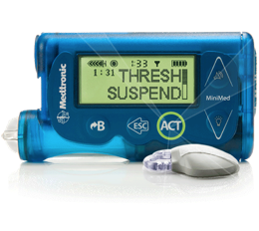
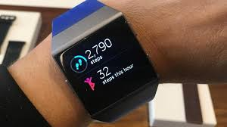
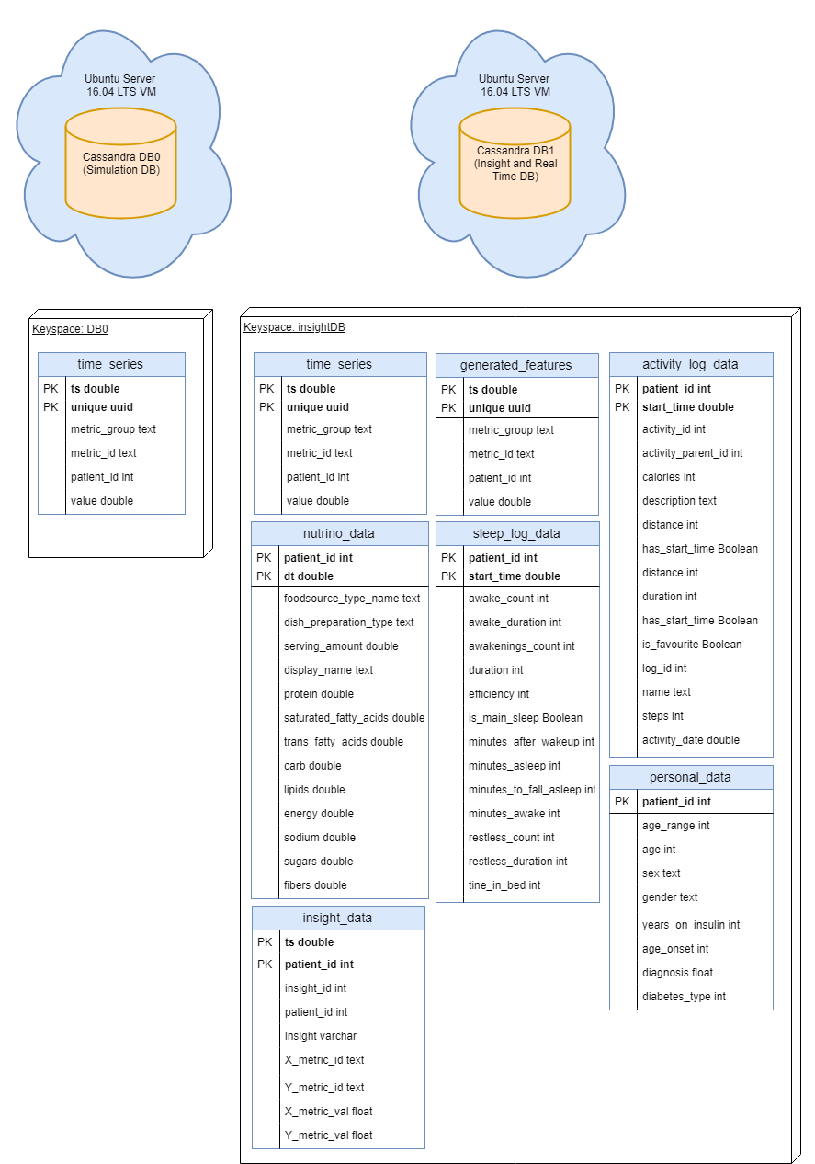
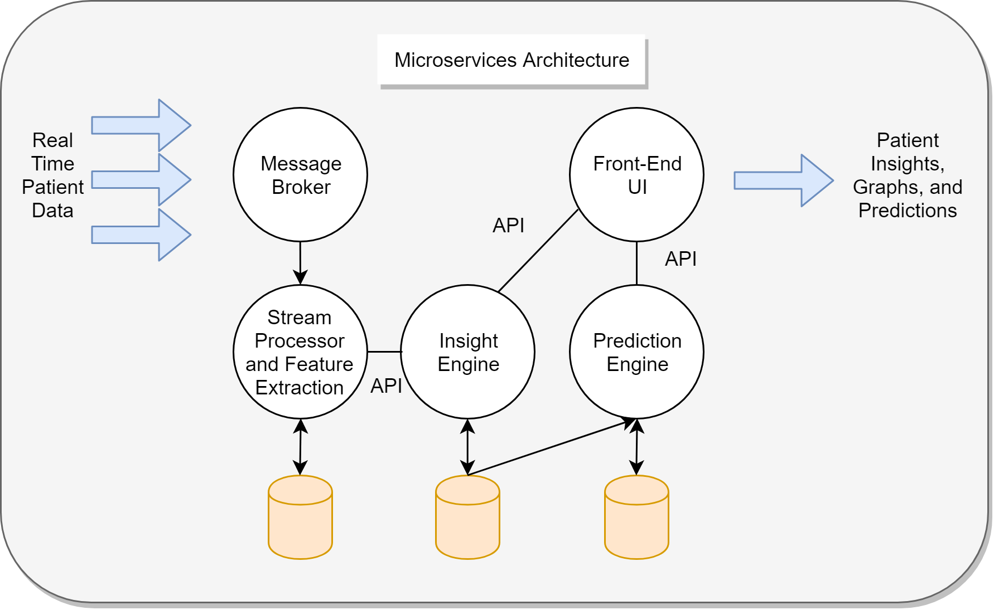
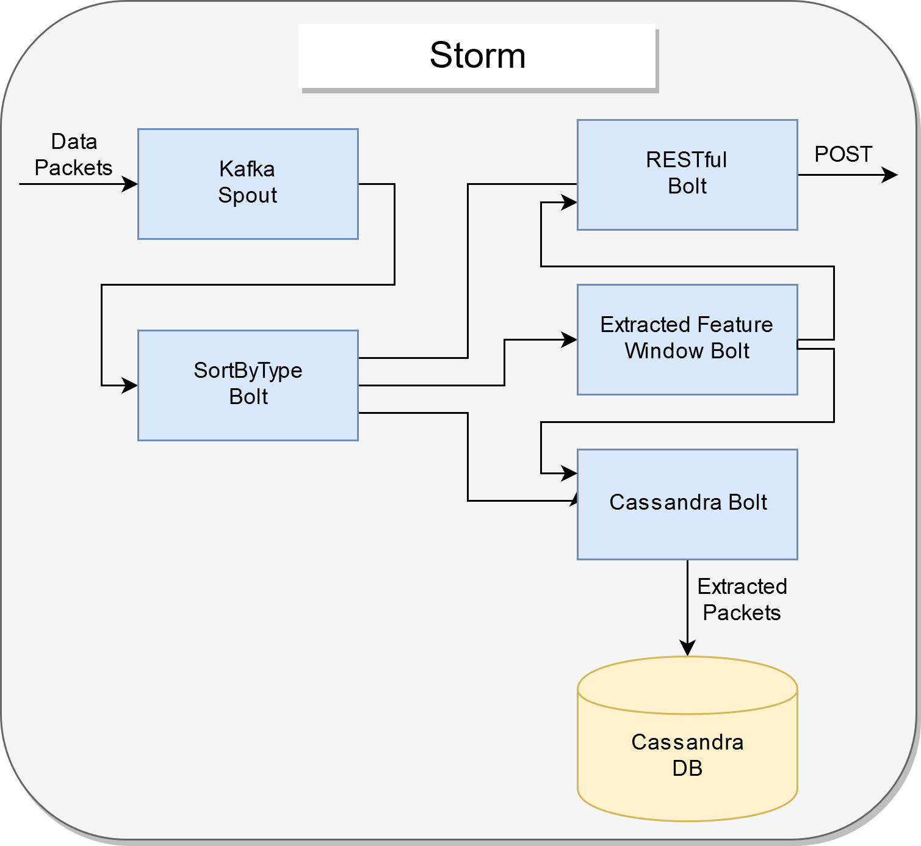
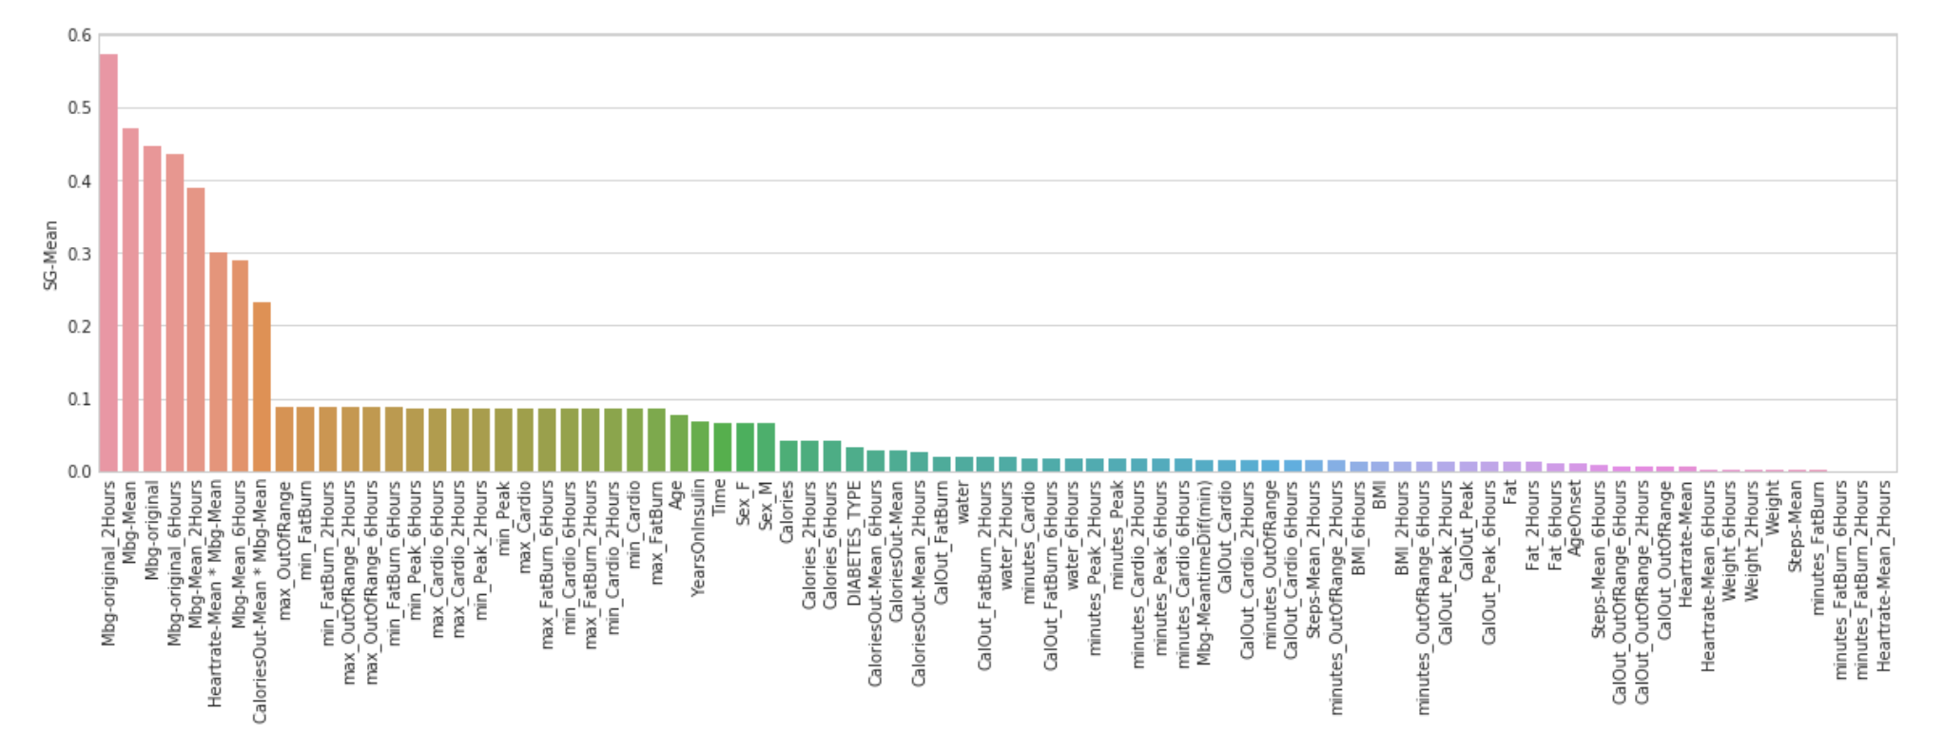
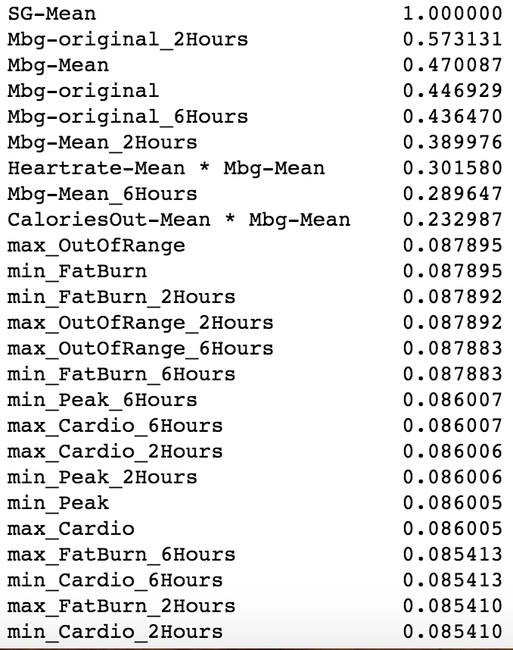
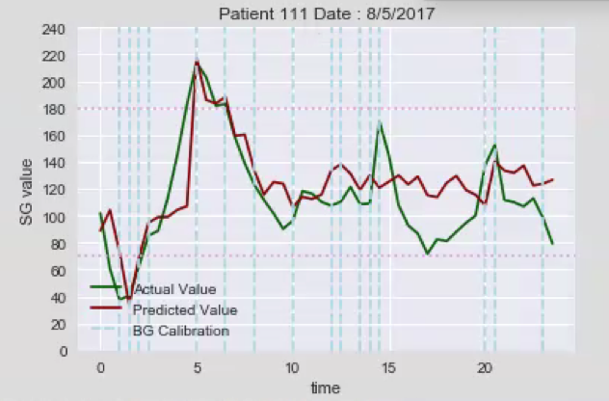
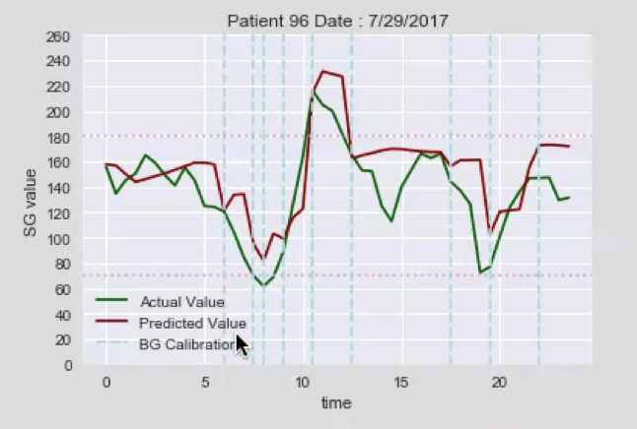
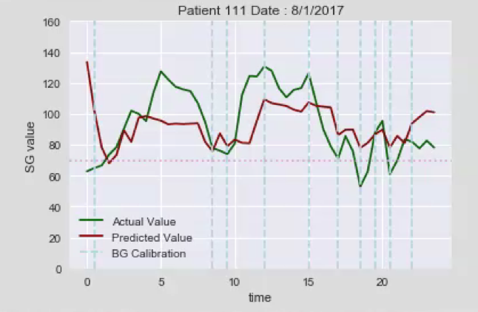
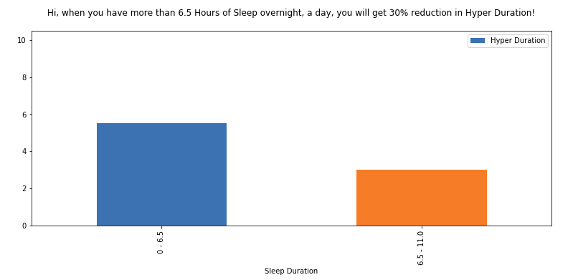
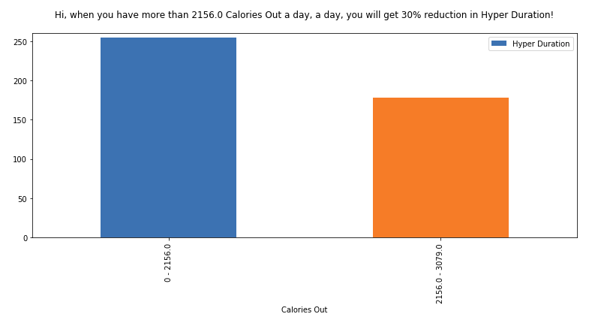
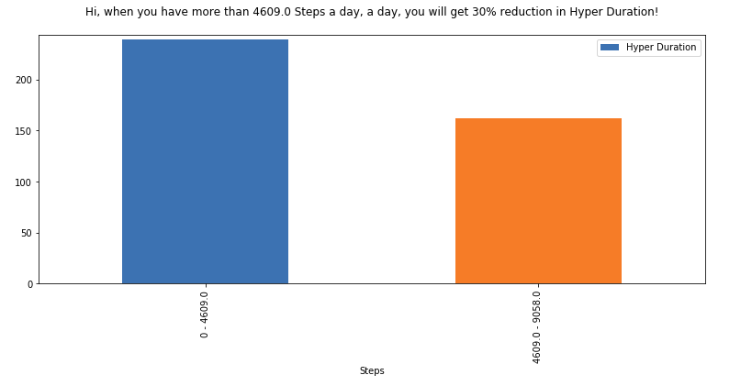
Diabetic Patient Monitoring and Management using Machine Learning Team Members: Yosep Kim, Christopher Fong, Wun Woo,
Koenrad MacBride, Andrew Padilla, Mohammad Reza Faculty Advisor: Dr. Mohammad Pourhomayoun Medtronic Liaison: Alex Zhong, Sameer Kulkarni College of Engineering, Computer Science, and Technology California State University, Los Angeles
Background
=
Overview
Project Background
A continuous glucose monitoring (CGM) system is a device that logs glucose levels. Medtronic has provided CGM data for 93 patients along with FitBit activity metrics.
The scope of the project is to develop a back-end platform based on data analytics and data science algorithms for predicting the continuous glucose levels of diabetic patients, provide patients with insight and recommendations, and display to each patient in real time.
Real Time Data
Microservices architecture provides scalability to allow for dynamic growth for accommodating higher throughput of incoming patient data.
All modules run on cloud based virtual machines
Prediction Engine
Data preprocessing and missing value imputation, feature extraction, feature selection, and dimensionality reduction
Predictive analytics based on machine learning algorithms including: Random Forest and Neural Network.
Insight Engine
Takes in Sensor Glucose data, Fitbit data, and nutritional data as JSON objects
Processes the data, creating insights and recommendations for each individual patient
Insights are displayed as a suggestion, accompanied with a graph, helping each patient monitor sugar levels better.
Hi, having at least 6.5 hours of sleep overnight, your Hyper Duration will be reduced by 30%!
Hi, having at least 2156 calories out a day, your Hyper Duration will be reduced by 30%!
Hi, when taking at least 4609 steps a day, your Hyper Duration will be reduced by 30%!
Notes:
‹#›

