Slide 1
Aquila
Process Management System for UAS

Slide 2
Project Team
California State University, Los Angeles
Faculty Advisor:
Dr. Chengyu Sun
Team Members:
Bryan Bravo
Barry Boayes
Sasha Nicole Cisneros
Jurelly Tello
Jessica Palacios
University Auxiliary Services, Inc.
Alma Sahagun
Ernesto Argumaniz
Lynne Duong
Maria Nunes

Slide 3
WHAT IS UAS?
Non-profit organization
Primary purpose:
Administer contracts and grants
Commercial enterprises
Externally funded projects
Financial support services
Etc.

Slide 4
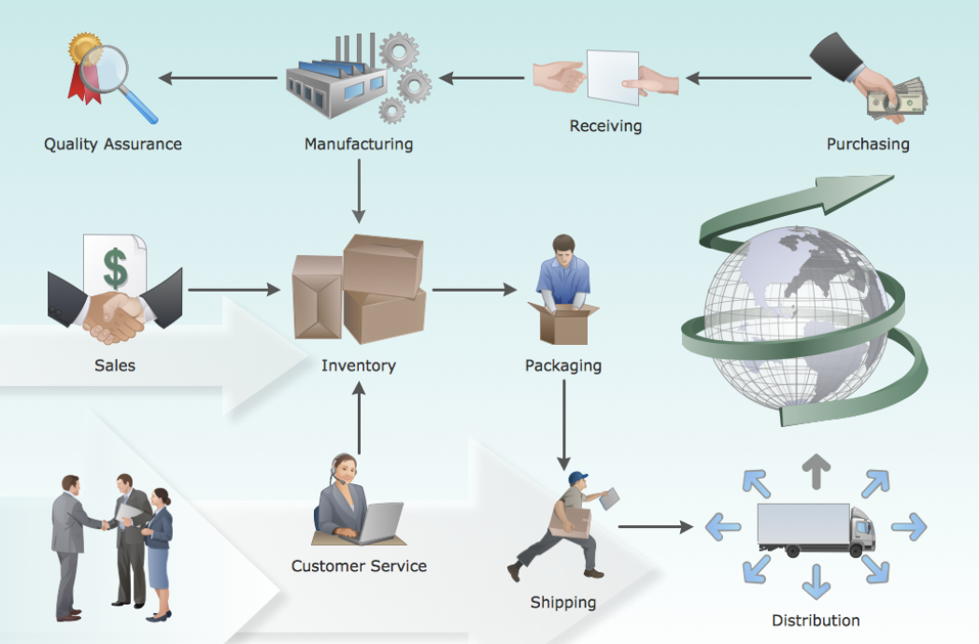
WHAT IS A PROCESS?

Slide 5
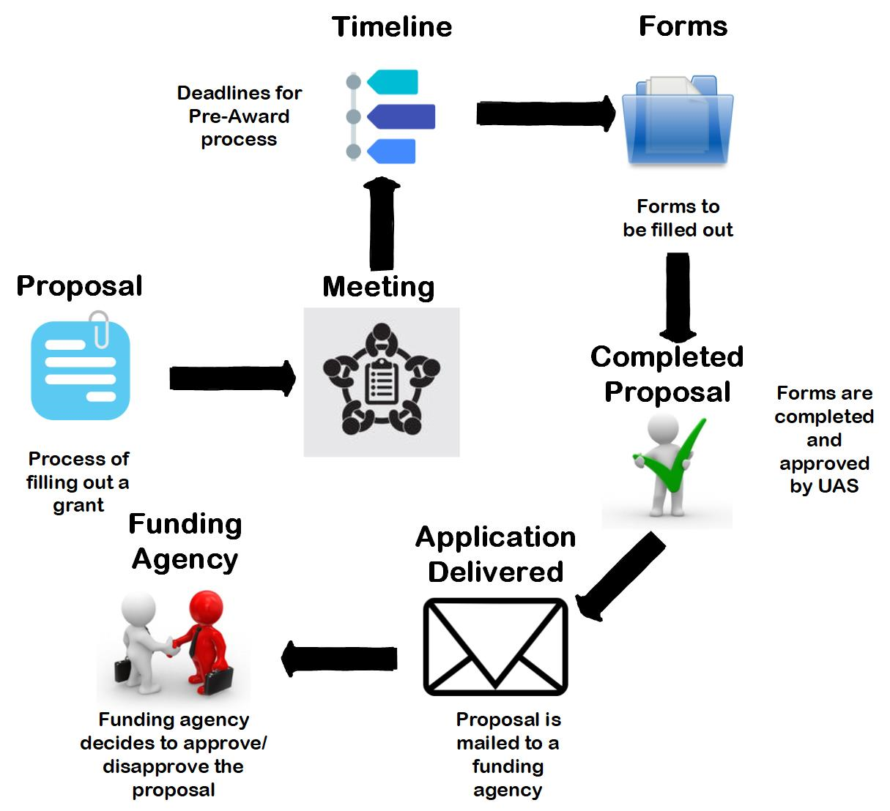
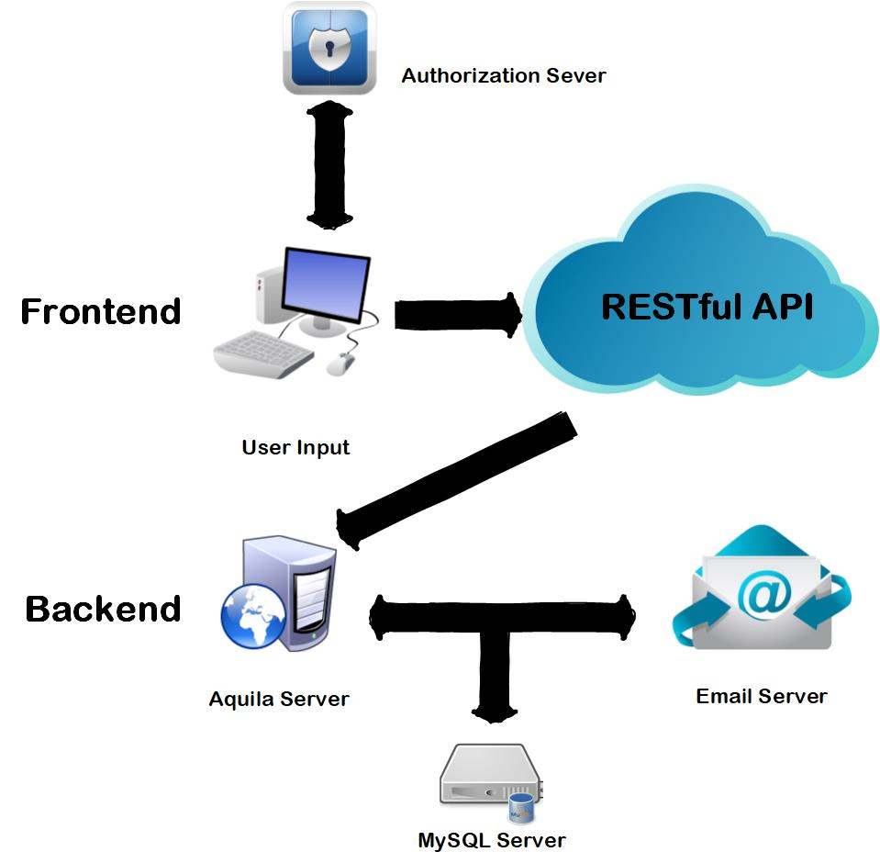

Slide 6
PROCESS ISSUE
Paperwork
Unknown state of project
Miscommunication
Lost paperwork
Deadlines Forgotten
Process Delayed

Slide 7
OUR SOLUTION:
Web based application
Digitizing the entire process
Manage projects
Help keep track of status
Email Notifications
Deadline Reminders

Slide 9
Why This Design?
Server: RESTful API
Front-End: Single Page Application
Independent Development
Debugging / Testing

Slide 10
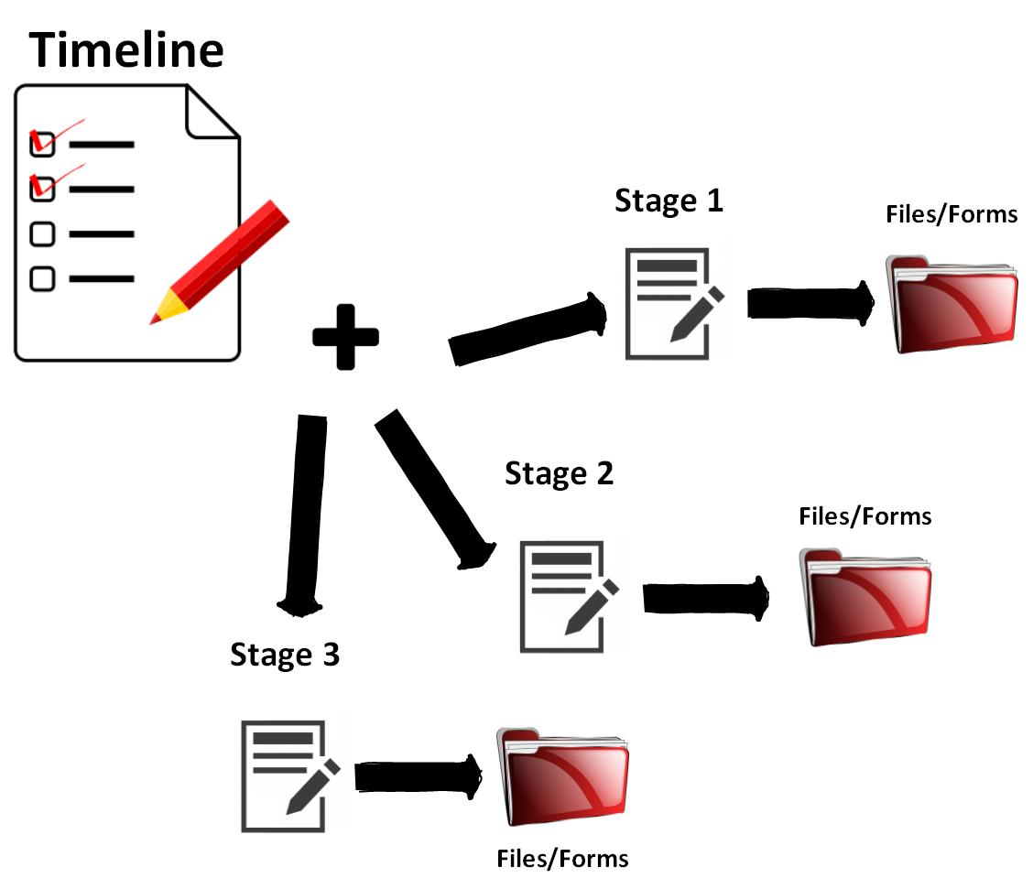
Modeling The Processes
Forms, Files, Timeline, Stages
Dynamic
Flexible
Example: Timeline
May have many Stages
Deleted, Added, Reordered
Requirements
One Stage may have many Files and Forms
Email Component
*APPROVED/DENIED
*APPROVED/DENIED
*APPROVED/DENIED

Slide 11
DEMO
Notes:
-get rid of these subtitle slides

Slide 12
Notes:
-get rid of these subtitle slides

Slide 13
DIFFICULTIES
Backend
Object Relational Mapping
Hibernate Annotations
Frontend
Aesthetic Design
Workflow/Dataflow
Notes:
add in future accomplishments: digital signatures, saml, postaward and human resources processes

Slide 14
SUMMARY
Fall 2017 - Spring 2018
Software Requirements
Design Requirements
Learn New Technologies
Preliminary Design
Frontend
Backend
Future Goals
Digital Signatures
SAML
Post Award Process
Other Processes
Notes:
add in future accomplishments: digital signatures, saml, postaward and human resources processes

Slide 15
THANK YOU!

