Slide 1
Migration to Azure SQL Database & New Hire Onboarding Web Application
Team Members: Ryan Lee, Ismael Valenzuela, Joshua Perez, Norberto Gomez Rosales, Fabio Quintana, Simon Mai, Albert Chen, Shahram Mehri Kalantari, Wilfredo Paz, Michael Loria

Slide 2
LA County Public Defender & CSULA Senior Design Partnership
Michael
Sponsor of 2021/2022 CSULA Computer Science Senior Design
Advisor: Dr. Chengyu Sun
Liaisons: Mohammed Al Rawi, Bridgette Bates,
Gratia Dsouza
Notes:
Emphasize the number of employees/ attorneys and cases they take

Slide 3
LA County Public Defender & CSULA Senior Design Partnership
Michael
Provide affordable legal services to individuals who can’t afford a private lawyer.
32 office locations throughout the county. Integral to supporting the department’s mission is a team of more than
1,200 employees
700 attorneys
A good IT infrastructure is crucial for the
success of their mission
Notes:
Emphasize the number of employees/ attorneys and cases they take

Slide 4
Project Overview
Michael
Build Upon Employee/Staff digital management applications with Public Defender IT team
1st Project Requirement: Migrate sharepoint list to Azure SQL cloud database
PDGO
HelpDesk
2nd Project Requirement: Redesign a web application that digitizes new hire onboarding process
Notes:
the team is working on two different projects(make it stand out) highlight we are doing two projects.

Slide 5
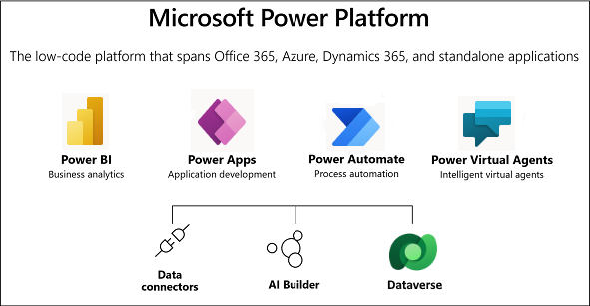
Microsoft Power Platform
Michael
Public Defender uses the Microsoft 365 environment (Sharepoint, Outlook, Teams) and PowerApps for their current web and mobile employee & staff management processes

Slide 6
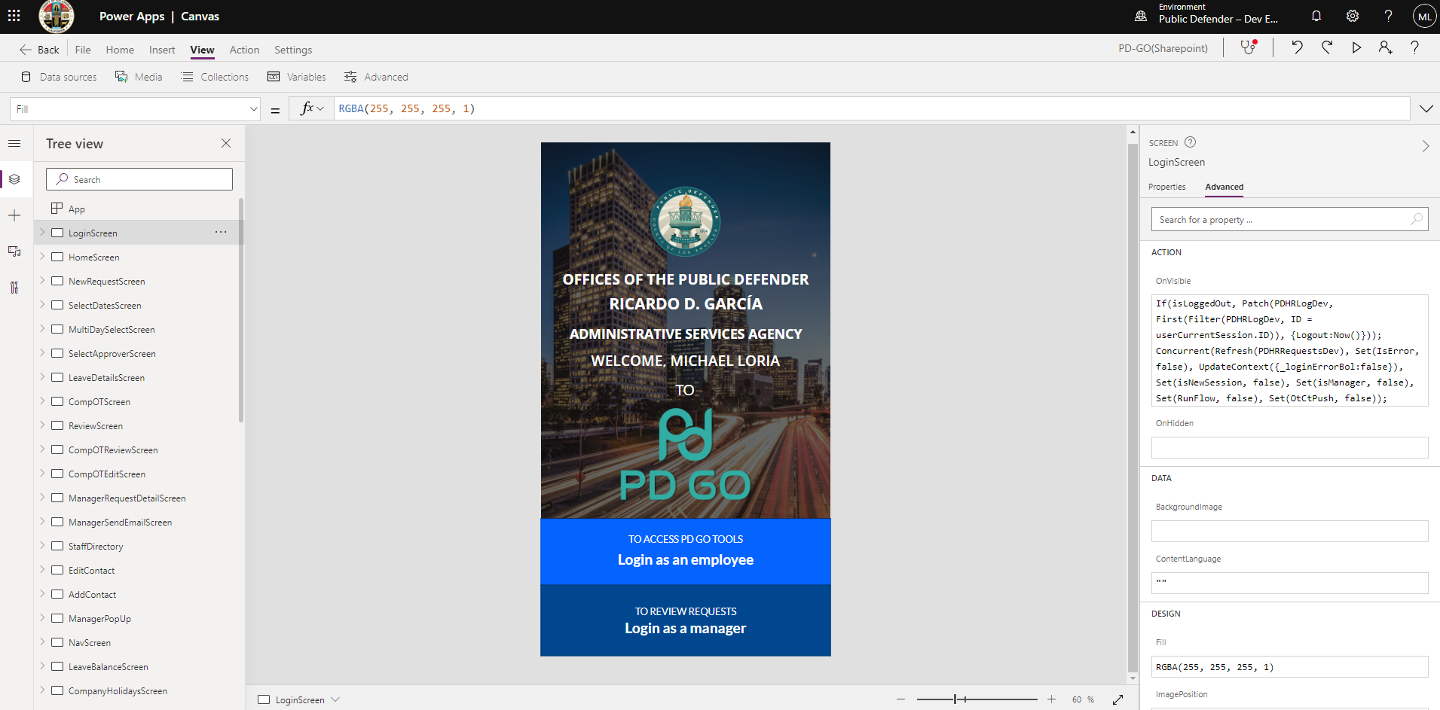
Power Apps
Michael
Power Apps, included in Power Platform, is a combination of apps, services, and connectors, as well as a data platform, that provides a swift development environment to build custom apps
Power Apps allows you to quickly build custom apps that connect to your data without having to write too much code

Slide 7
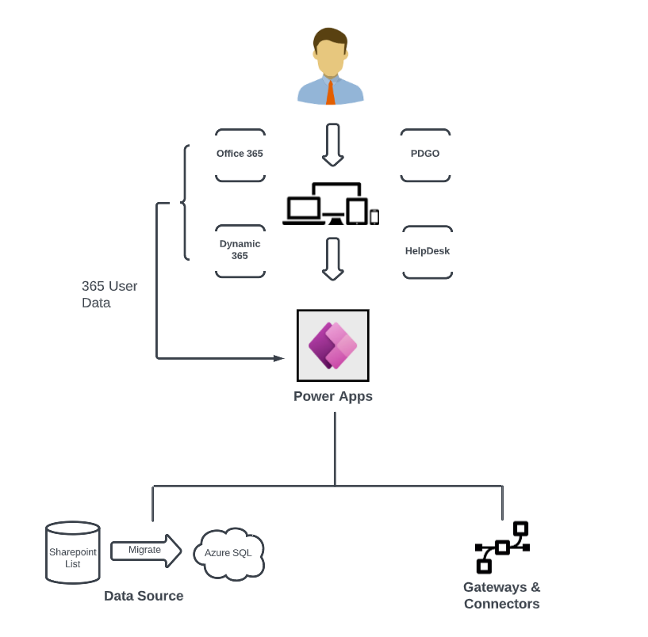
LACPD (Web & Mobile) Power Apps
Simon
PDGO
HelpDesk

Slide 8
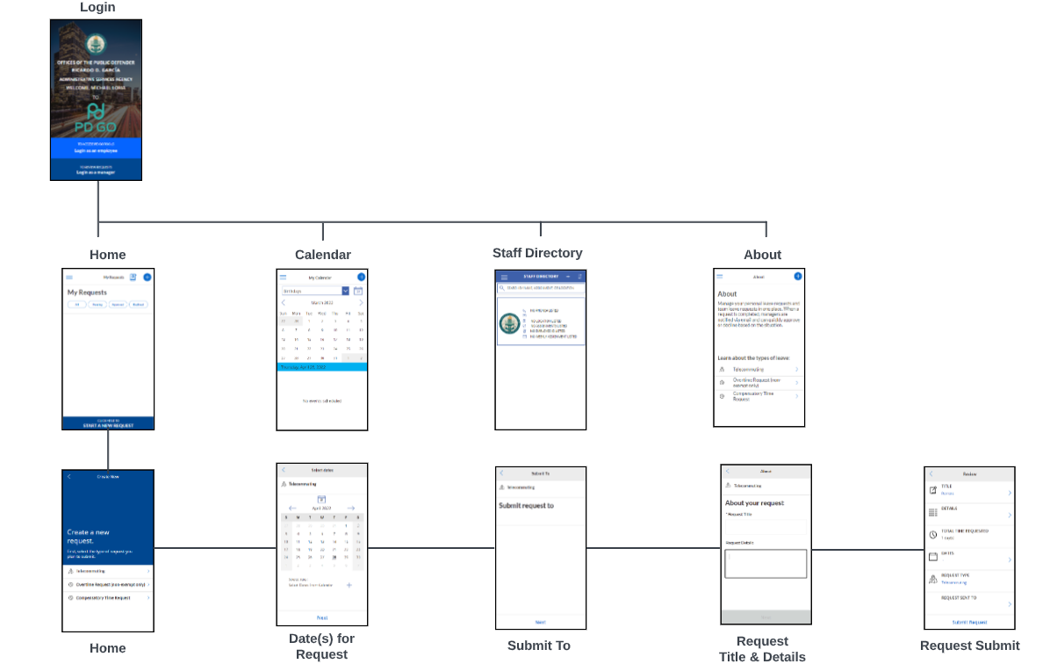
About PD-GO
Simon
PD-GO is a Power app that staff uses at LACPD to
Request time off
Request overtime
Compensatory time requested
Business calendar
Mobile convenience
Manage your personal leave requests and team leave requests in one place. When a request is completed, managers are notified via email and can quickly approve or decline based on the situation.

Slide 9
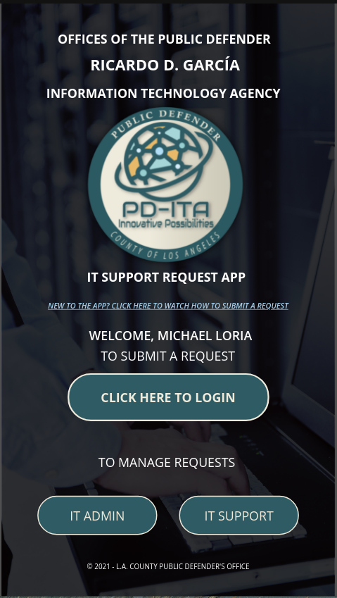
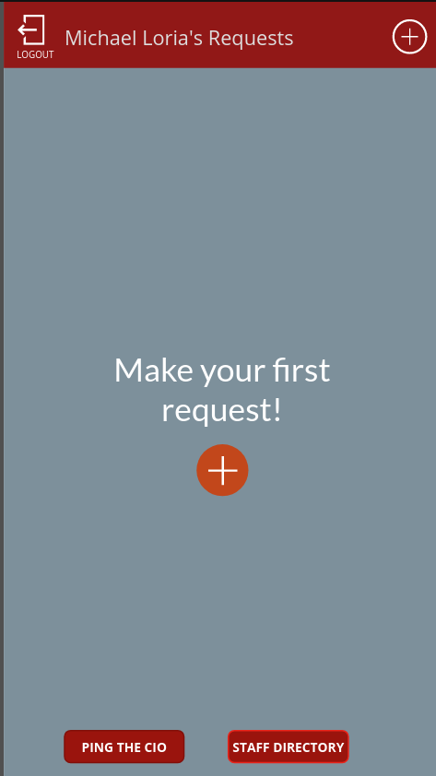
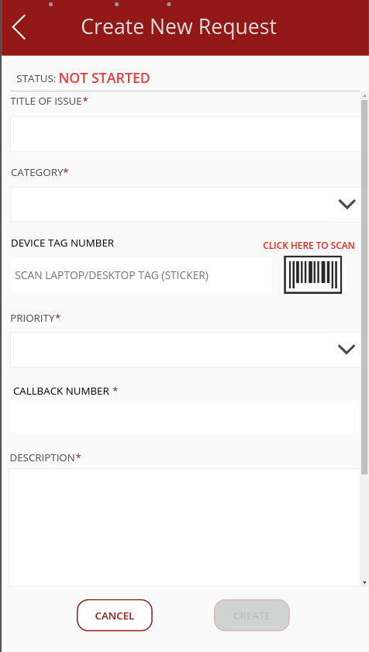
About Helpdesk
Simon
IT Support Request app
LACPD employees submit IT
help requests
Updates the progress on the
issue

Slide 10
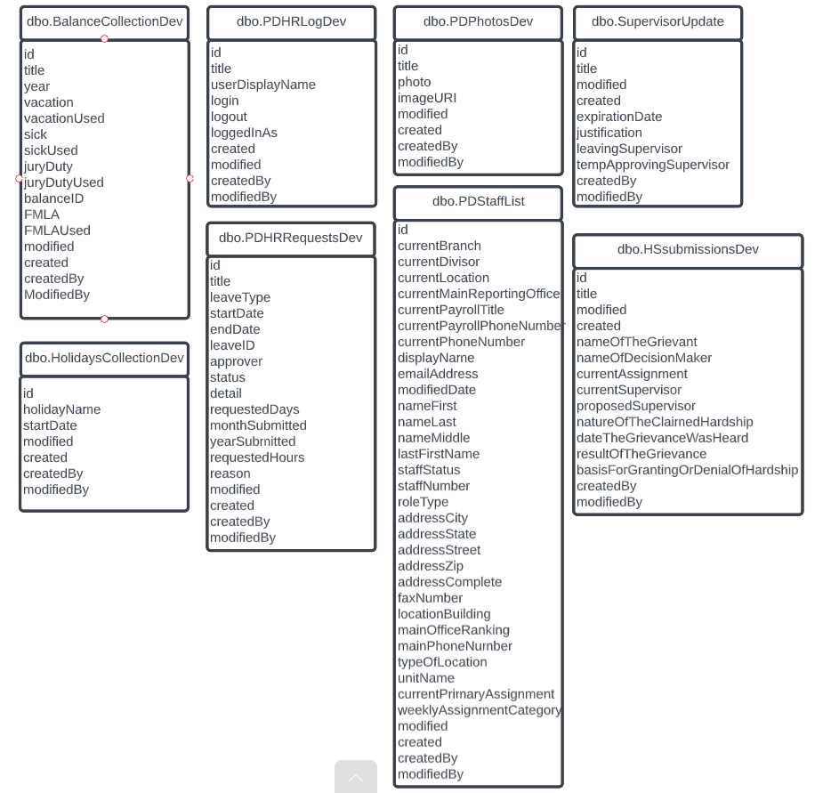
Power Apps Project Requirements
Simon
Database migration for both PowerApps
Migrate Sharepoint lists over to Azure SQL database.
Using Azure Cloud Services will open a host of new tooling for developers
Increase data reliability and availability

Slide 11
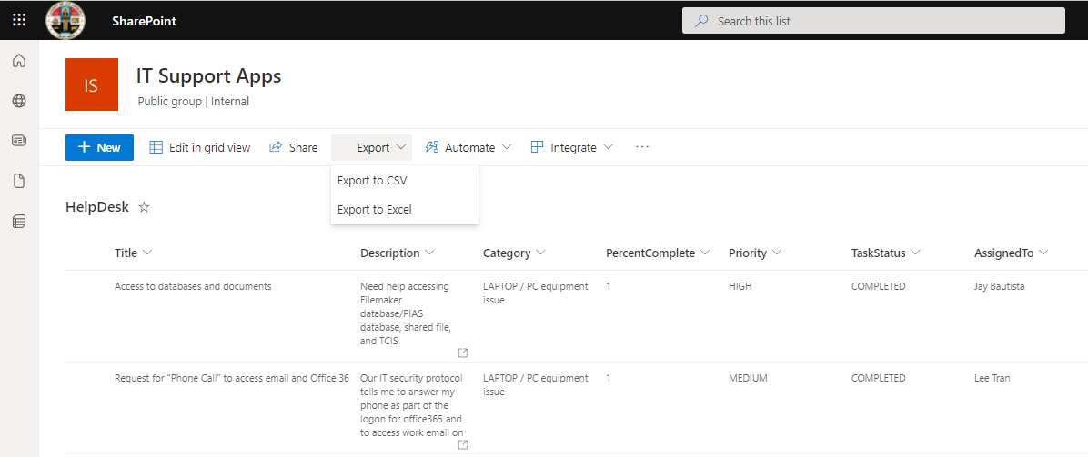
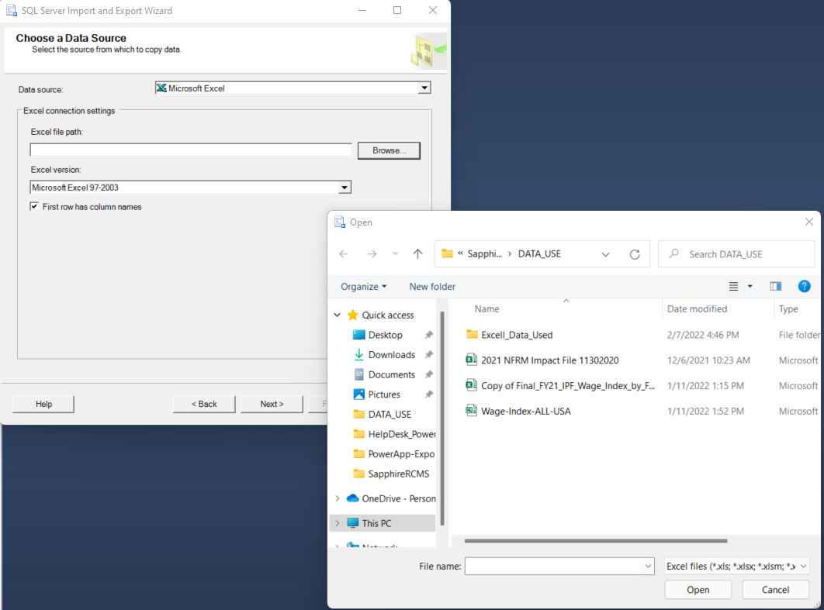
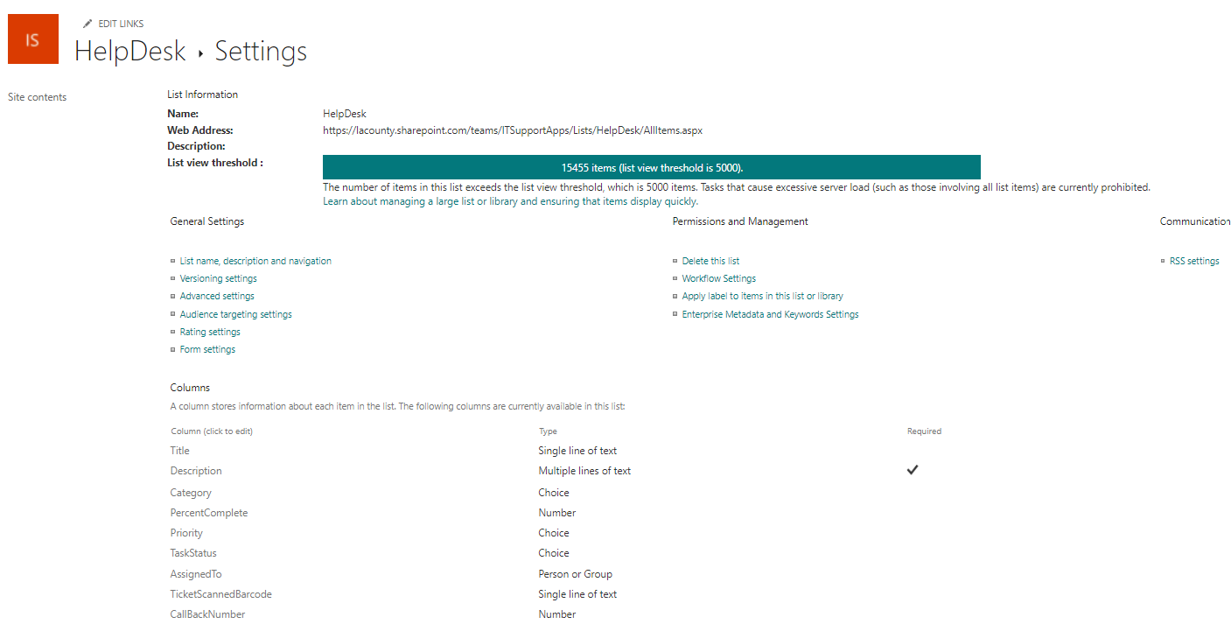
Power App Tasks
Shahram Mehri Kalantari
Export the SharePoint lists
Import the excel as SQL Data table
SharePoint list Data Types
Person or Group
Choice

Slide 12
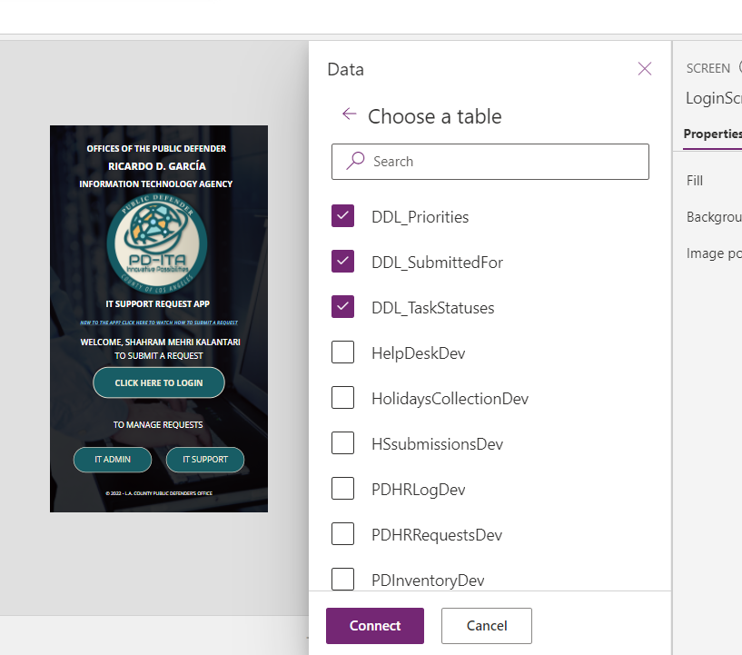
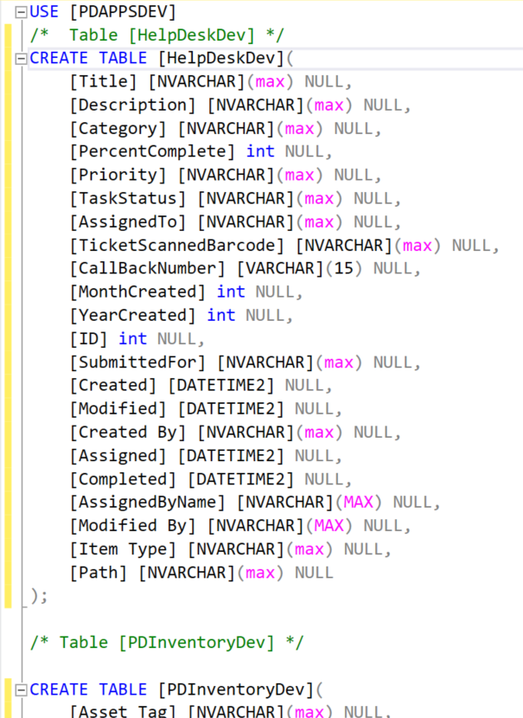
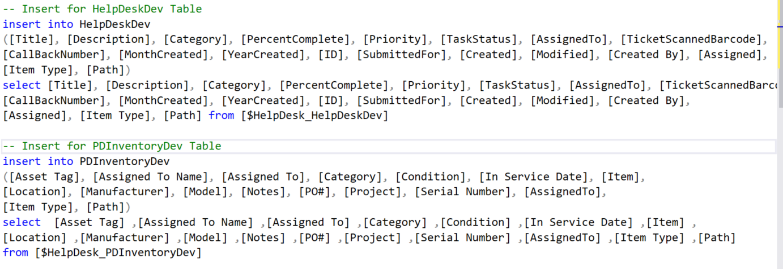
Power App Tasks
Shahram Mehri Kalantari
. Create a Database table
. Import data
. Added Hidden Columns
. Disconnect the SharePoint list
. Connect Azure Database
. Fixing the Errors
. Convert office 365 function to SQL Server
Notes:
Export Sharpoint list
Hidden columns in sharpoint
Sharepoint columns that don’t work with SQL
additional code to query user data since it is not implied in SQL

Slide 13
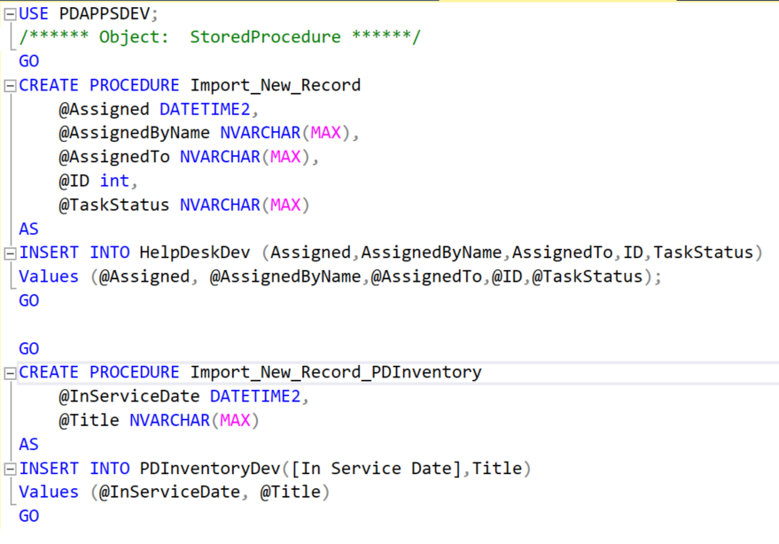
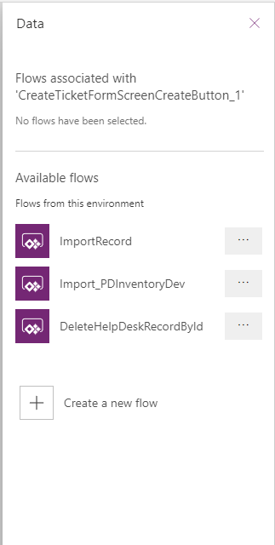
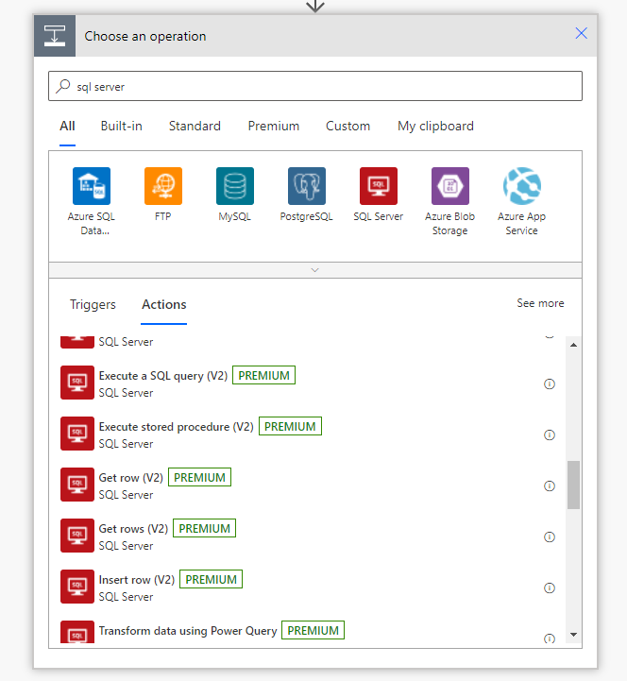
Additional Access Requirement
Shahram Mehri Kalantari
. Create Flows
. Create a stored procedures:
. Remove()
. Patch()

Slide 14
Enrollment App
Norberto
The Enrollment App allows Admins to fill in new employee information and save the information on a form sent to the back-end for an additional procedure. When completed, the software should allow for admin and assigned approvers to efficiently onboard the new employee with the ability to get status updates without public access to the software.
Notes:
Description of the app and main function

Slide 15
Enrollment App Project Requirements
Norberto
Admin that are registered can now only access the Enrollment App.
Admin can change current password and add new admins.
Enrollment App development uses Angular for specific form information.
Forms must be prefilled/prepared by Admin and saved to the database.
Allow admin to review, add approvers to the forms, and submit to Adobe Sign.
Once all signers have signed, upload to Box.com folder.

Slide 16
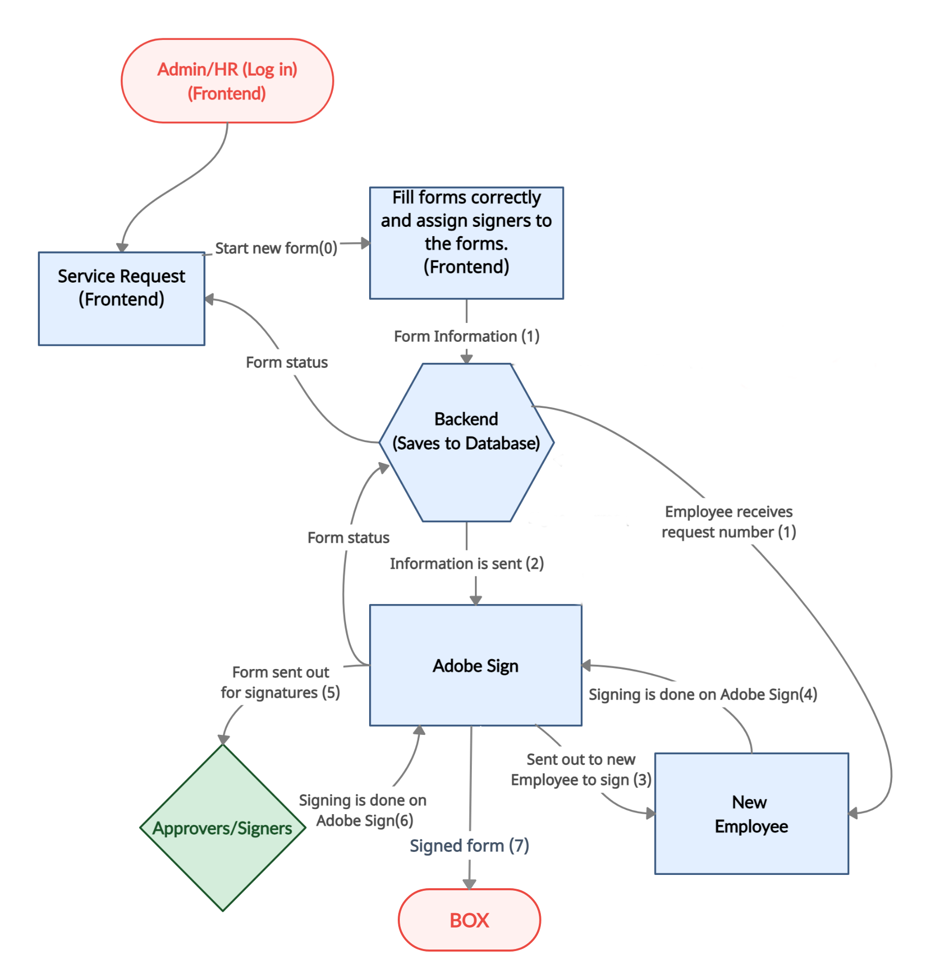
Enrollment Application Project
Norberto
Admin is required to log in.
Redirect to Service Request (homepage).
Able to navigate the app with the provide navigation bar.
Angular application is to submit employee/contractor form request.
Admin fills in the information of the applicant.
Backend retrieves and stores request information in the database.
The employee/contractor is added to the Database.
The employee/contractor receives a request number through email.
Notes:
What are the new requirements and why
Ismael
The LACP had concerns over last year enrollment application, particularly with security; ultimately however,it needed to be revised in order to meet their requirements

Slide 17
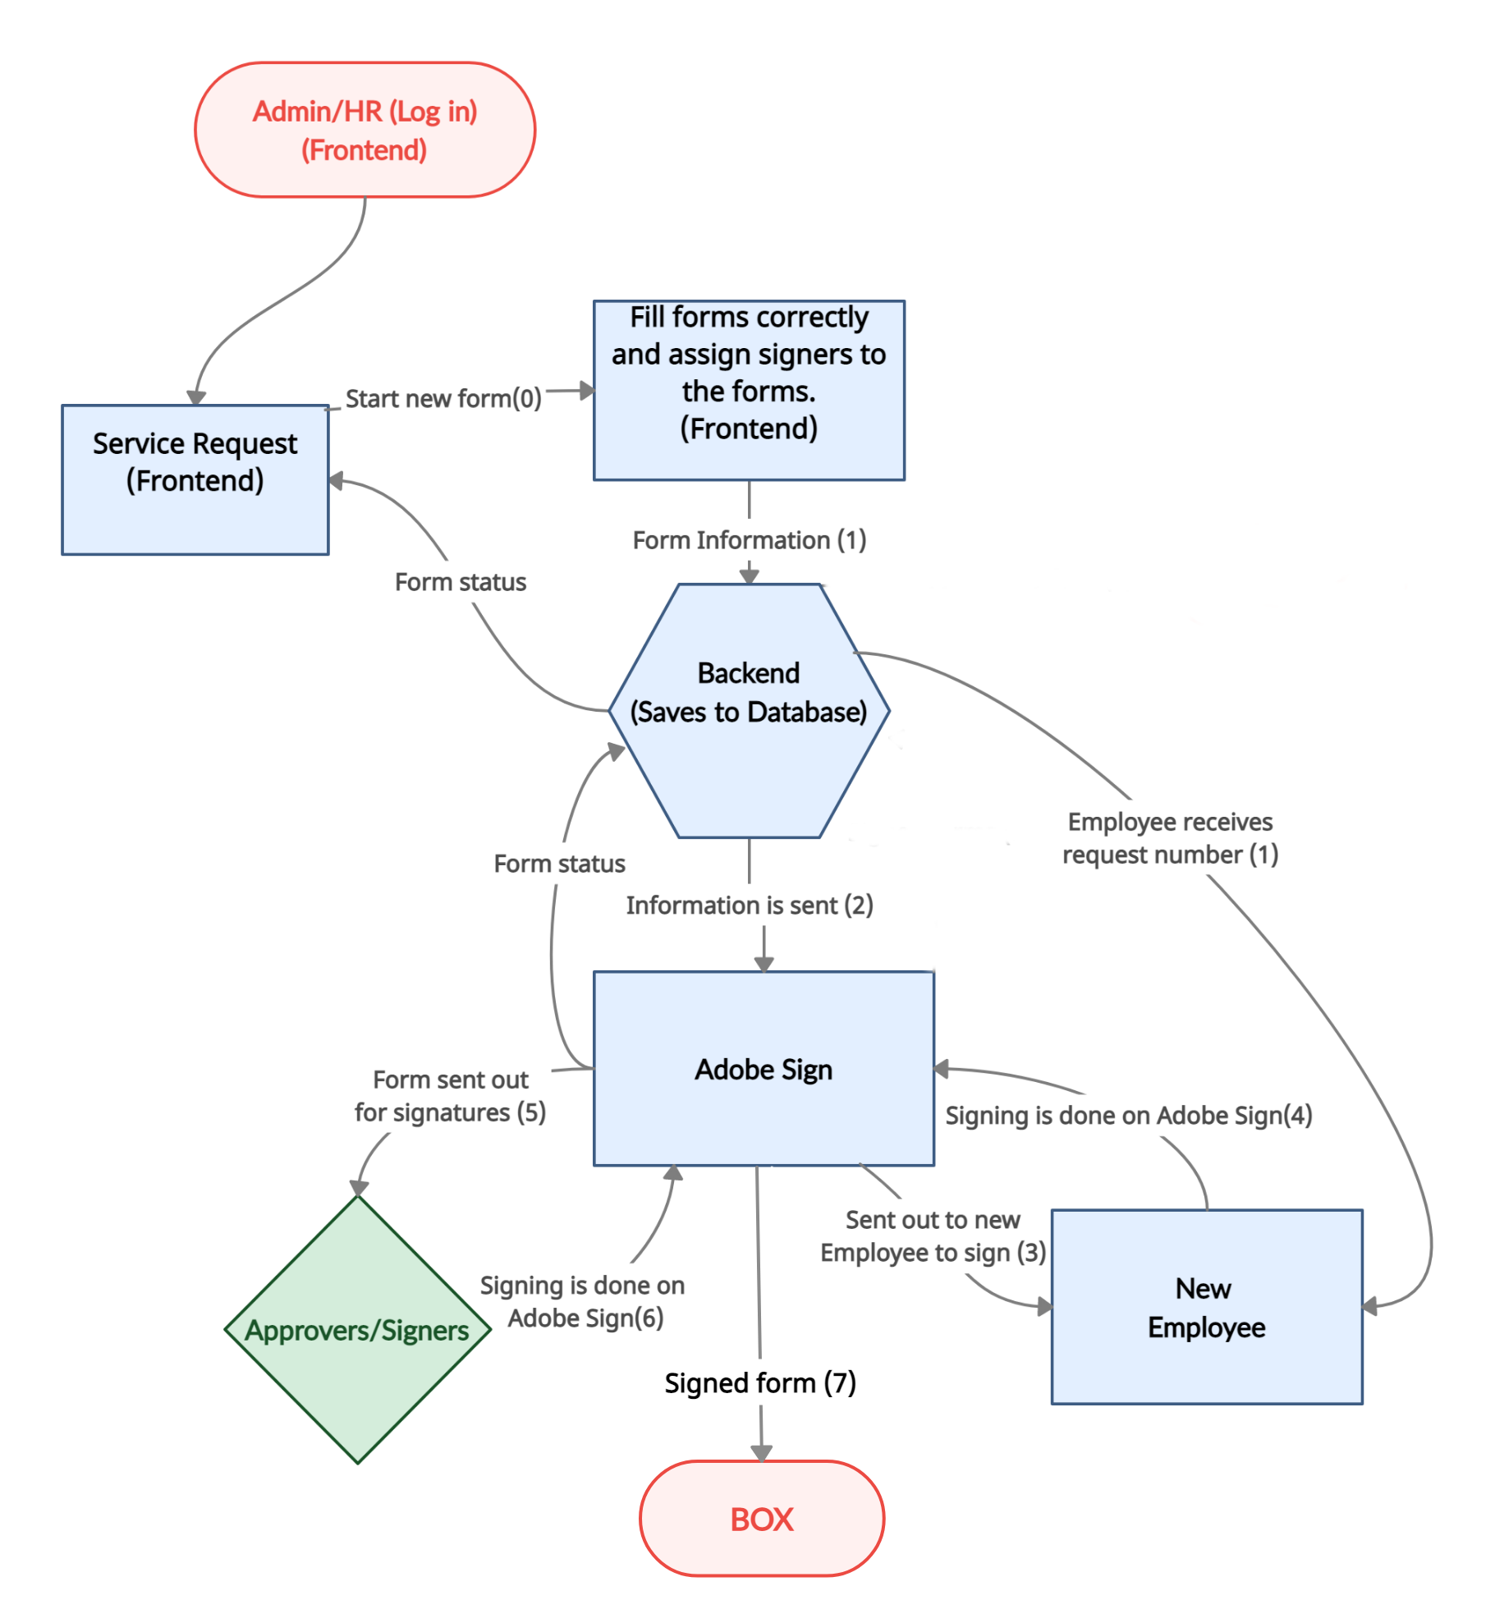
Enrollment Application Project
Norberto
Admin will now see the form request on the homepage and be able to review and submit it to Adobe Sign.
The forms are generated within Adobe Sign and filled with Admin's corresponding information.
The forms are sent to the employee/contractor to sign the form.
The signing of the form is done within Adobe Sign.
The form is sent to appropriate approvers/signers for review and signature.
Lastly, the form has all the signatures, the form is then sent to Box from Adobe Sign.
Form status changes to complete.
Notes:
What are the new requirements and why
Ismael
The LACP had concerns over last year enrollment application, particularly with security; ultimately however,it needed to be revised in order to meet their requirements

Slide 18
Frontend
Wilfredo
The LACPD Enrollment App Front End consists of an Angular Framework
Angular is a Typescript framework for building scalable web applications.
Developed by Google
Released in 2016

Slide 19
Backend
Wilfredo
The backend uses Java Spring Boot and MySQL as the database.
Spring Boot is an open source, microservice-based Java web framework.
Spring Boot makes it easy to create stand alone, applications that can be ran easily.

Slide 20
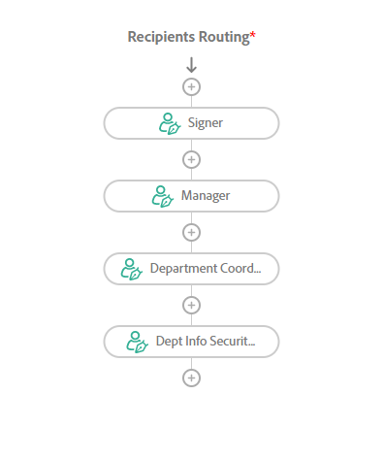
Adobe Sign
Fabio
Adobe Sign is a cloud based e-signature service that allows users to send, sign and manage agreement forms.
Allows us to sign forms for the Los Angeles County Public Defender’s Office through the enrollment application.
Design our own workflows for the forms.

Slide 21
Box.com
Fabio
Box is a secure cloud storage platform
Many businesses use Box to store their data
Box was founded in 2005
Used by 97,000 companies and 68% of the Fortune 500 companies use Box.com

Slide 22
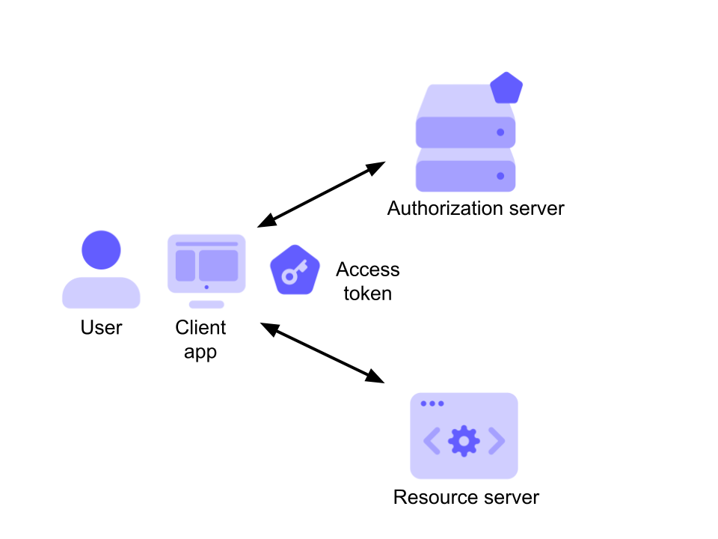
Box Client Credential Grant
To have our application connect to Box, we need to generate an access token with OAuth 2.0
Box needs this so that they can authorize the correct user and allow access.
We used a client credential grant to connect to a box accounts folder. The credential needs a client_id and a client_secret to work.

Slide 23
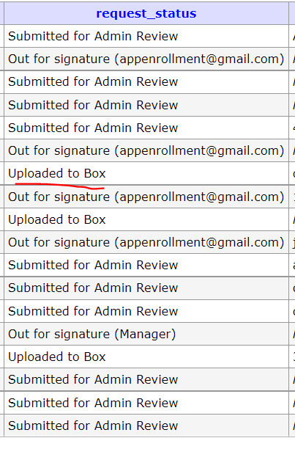
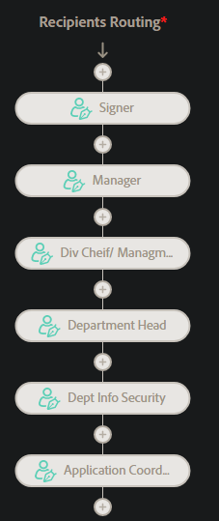
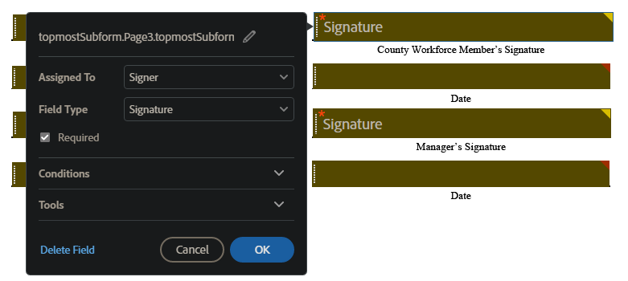
Current Progress (Enrollment App)
Ismael
Able to create form templates
Assign certain form field to specific Members
Signature fields can only be filled by endorser
Capable of creating workflow to send form for filling and signing
Full process can be completed currently but Admin/HR will have to work within the Adobe sign web application
Created a new UI design for the Front end
We were able to run the Enrollment Application, generate new access tokens, and upload signed forms to Box.com.
Added a way to create new admin accounts
Notes:
Elaborate on components in individual slides; demo after

Slide 24
What we accomplished
Power Apps
Migrate backend of two powerapp
Recreated sharepoint lists into SQL tables
Created power apps dev environment
Gained proper access
Enrollment App
Navigate through Adobe Sign and API
Using PDF libraries to fill out PDF forms.
Create workflows to send the forms to employees and Company(HR,Manager…)
Signed forms are automatically uploaded to Box.com
Updated UI
New Admin Features

Slide 25
Live Demo
https://youtu.be/TAMZ3WJH5zE
Ryan, Albert, Joshua

Slide 26
Thanks for Listening!

