Slide 1
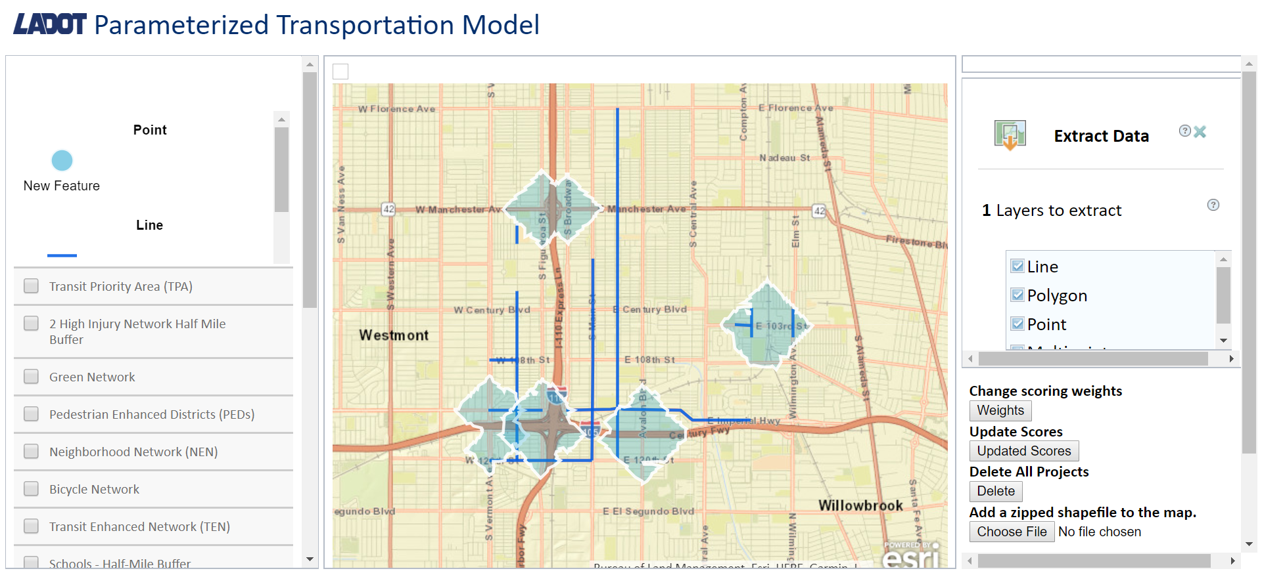
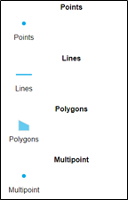
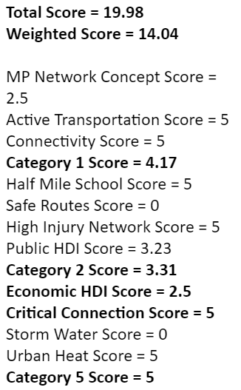
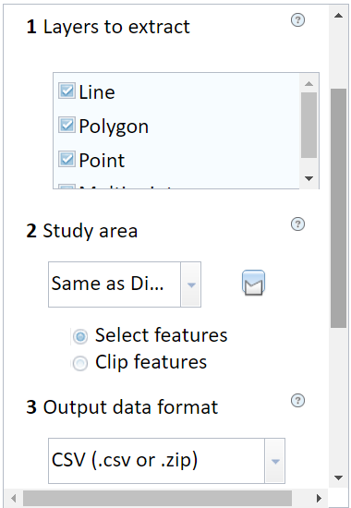
Team Members: Kevin Gamboa, Kevin Lam, Alvin Nguyen, Elizaveta Sokolova Faculty Advisor: Dr. Pourhomayoun City of LA / LADOT / DSF Liaisons: Karina Macias, Hunter Owens, David Somers Department of Computer Science College of Engineering, Computer Science, and Technology California State University, Los Angeles
Parameterized Model for Active Transportation
Objectives
Develop a web map with the following features
Automated scoring process based on project overlay with multiple map layers
Allow users to add new projects through a drawing tool
Importing and exporting of existing projects
Create a machine learning model to predict vehicle collision reduction within 35 ft of a proposed project location
Drawing Tool
Project Attributes
Future Plans
Determine priority weights using machine learning models.
Runtime scalability to increase capacity of project uploads.
Integrate collision reduction prediction into the UI.
Enables users to add projects onto the map
Contains project information and the scoring for each ranking data category
Conclusion
The Param Model increases safety in the city of LA through the scoring feature and collision reduction machine learning model.
Automated Scoring
Importing / Exporting
Calculates score for all data categories based on project location
Allows users to bulk upload past projects for scoring and export scored projects
Publication
K. Macias, D. Somers, H. Owens, J. Holm, E. Sokolova, A. Nguyen, K. Gamboa, K. Lam, M. Pourhomayoun, “Parameterized Model for Mobility Project Scoring and Estimation of Benefits”, Esri Conference, 2018.
Technologies
Notes:
1
Add MLpart
City LA Logo, ITA (done)
Add Accepted paper
K. Macias, D. Somers, H. Owens, J. Holm, E. Sokolova, A. Nguyen, K. Gamboa, K. Lam, M. Pourhomayoun, “Parameterized Model for Mobility Project Scoring and Estimation of Benefits”, Esri Conference, 2018.

