Slide 1
City Pave
Developed by:
Adrian Flores, Allen Atienza, Andrew Gonzalez, Bryan Chu, Christian Esqueda, Christopher Ortega, Justin Nim, Kayleen Ponce, Mark Kalaiji, Omar Juarez
Academic Advisor:
Dr. Negin Forouzesh
Liaison:
Dr. Mehran Mazari
Notes:
Mark

Slide 2
What is City Pave?
Purpose:
The purpose of city pave is to update the way that we do calculations for pavement design and bring it to the present day of how we make calculations.
Notes:
Justin

Slide 3
Continued
How is this accomplished:
Making User experience easy and simple
Enjoyable/professional website experience
Creating forms for calculations
Basic Pavement Design Tool
Overlay Design
Life-Cycle Cost
Pavement Design database
Notes:
reducing the amount of iterations needed to do a specific function.
By being consistent with following a style guide that was design by cal state la using color theory.Colors & Typography | Cal State LA

Slide 4
How does this differ from other programs?
Current programs do not make it easy to understand what going on and have a lot of clutter.
Functionality the program will run more smoother then other when it comes to dynamic tabs
The program can be accessed over your phone as long as you have a internet access and a web browser application
Information is stored in database and be accessed remotely
Notes:
Justin

Slide 5
Technologies
Javascript - Node.js
NPM
Vue.js
Buefy
mySQL
Sequelize
ZOHO
Google domains
Heroku
GitHub
Notes:
Mark

Slide 6
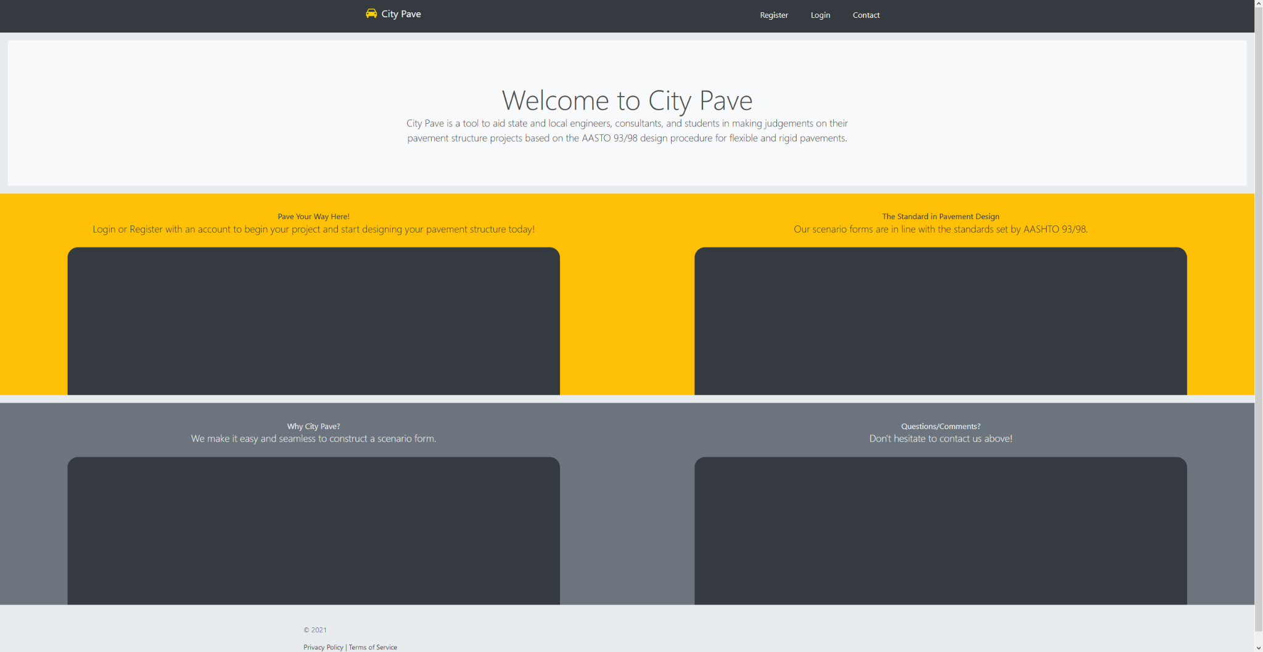
Front End - Home Page

Slide 7
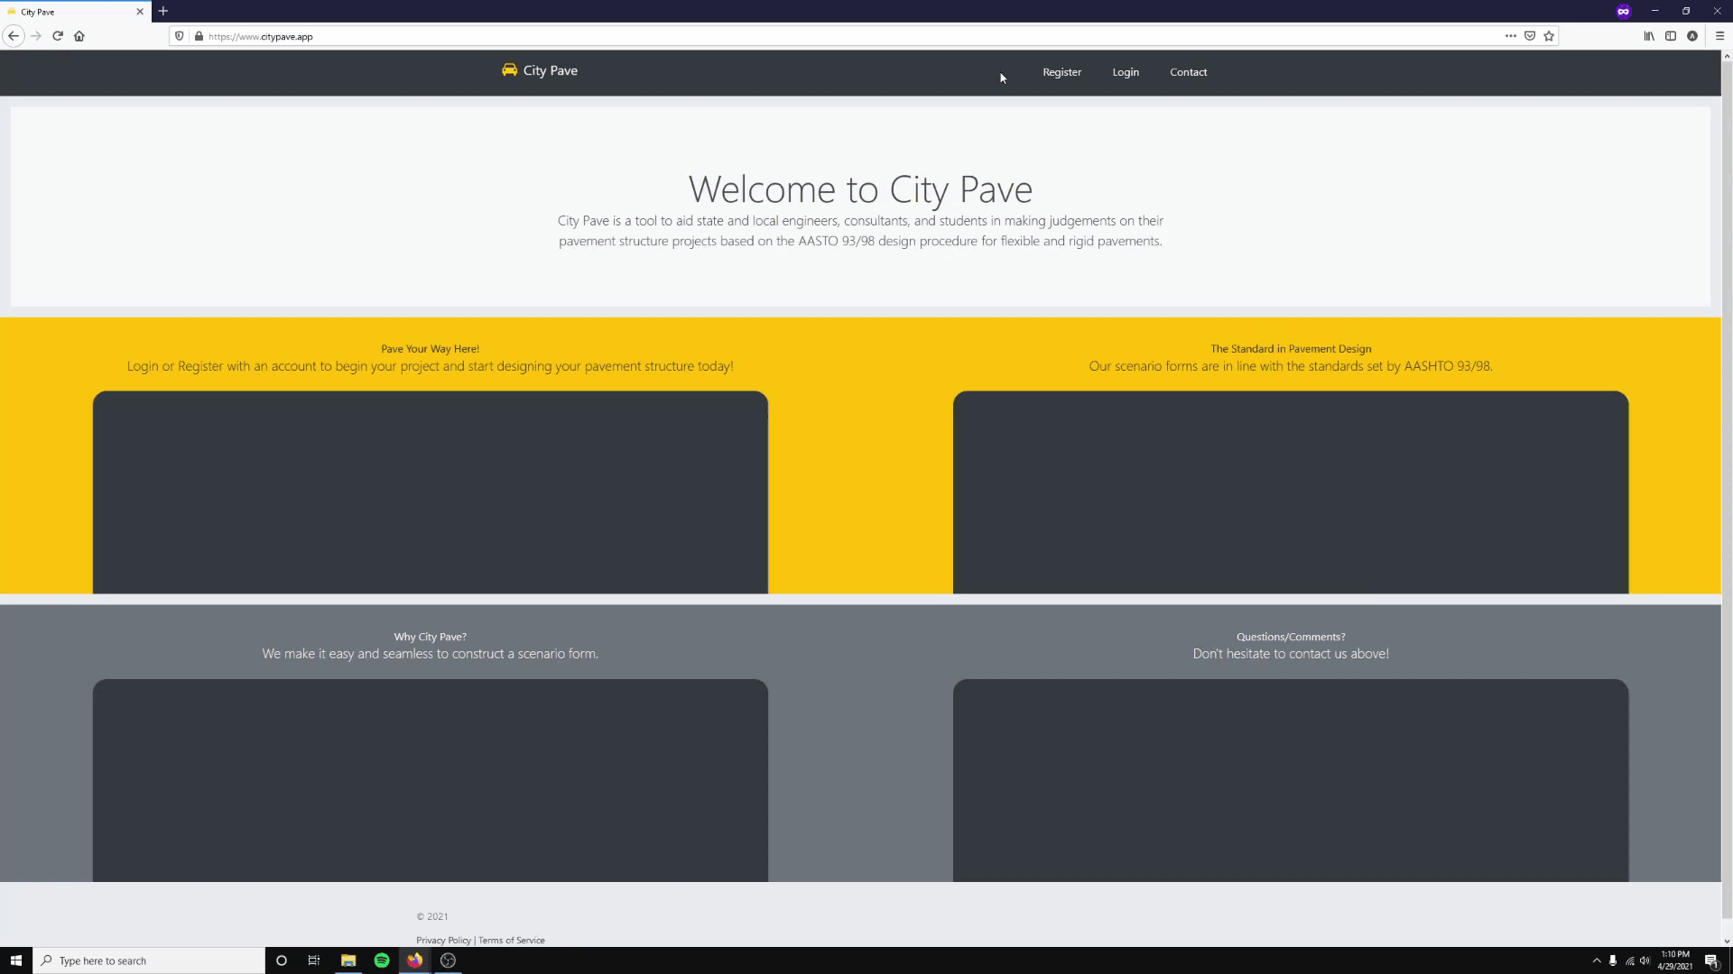
Front End - Login

Slide 8
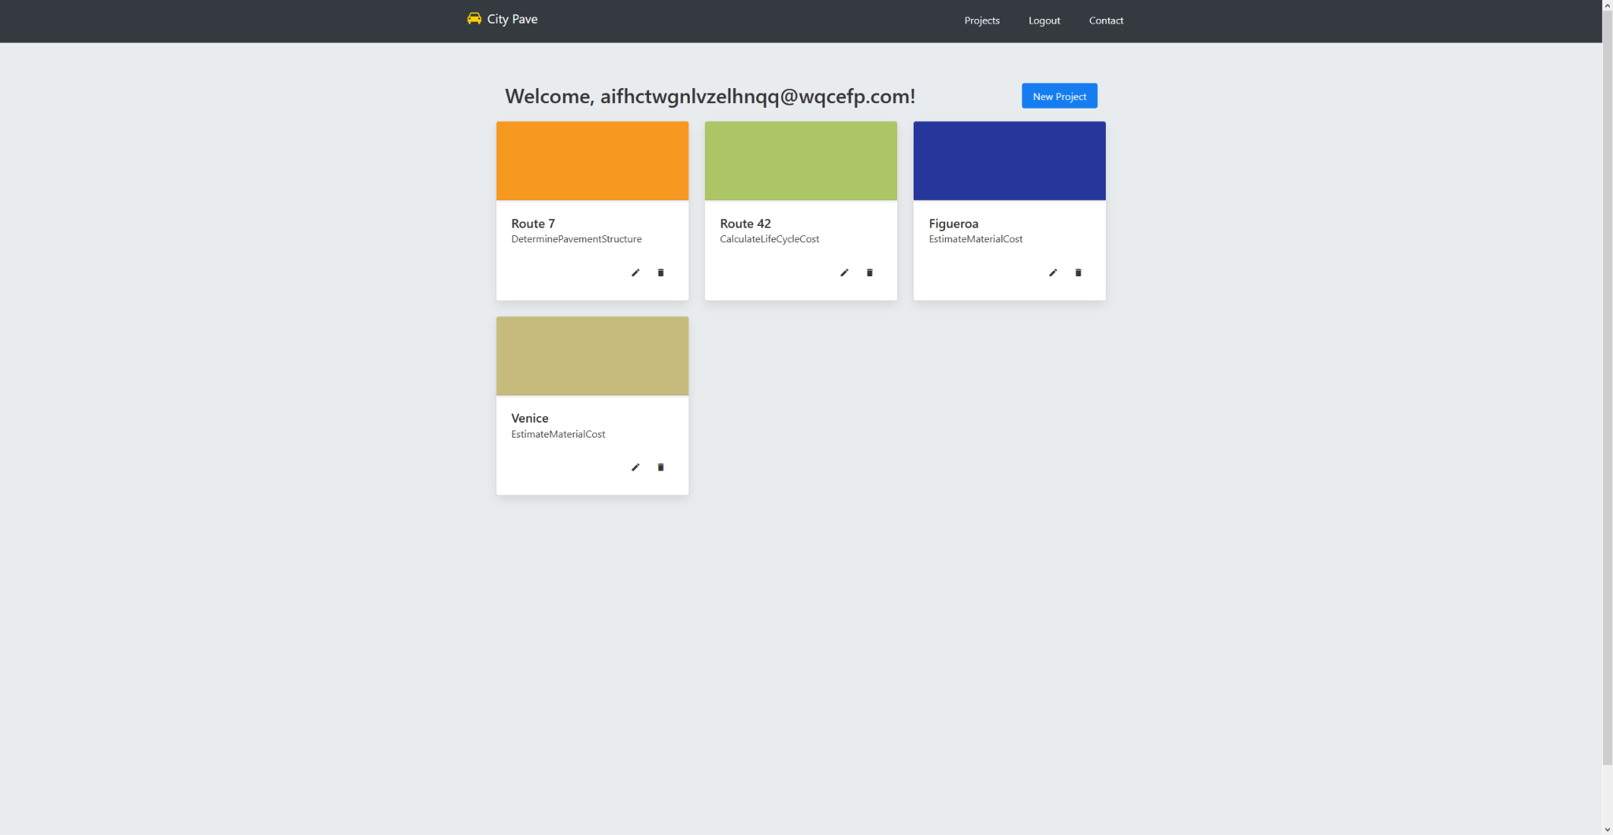
Front End - Project Page

Slide 9
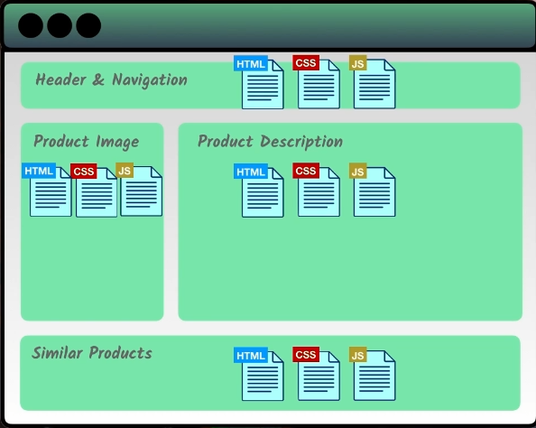
Vue/ Vue-form wizard to Buefy
A javascript front end framework used to help with the organization of the javascript
Similar to Angular and React
Approachable, Versatile, Performant, maintainable, and testable
Buefy allowed enhanced speed, responsiveness, navigation and a clean UI design fit for easy user navigation
Notes:
Vue with the addition of Buefy, has helped lead this project to success. To begin, Vue is a an organizational front end framework used to help organize javascript within the website. As seen on the image to the right, every section created for the website is allowed to have their own html, css, and javascript associated with it allowing for individual design, functionality, and separation of concerns based on the necessary parts of the website. Buefy, helped with user friendly UI, as well as easily usable libraries for creating sections on the website

Slide 10
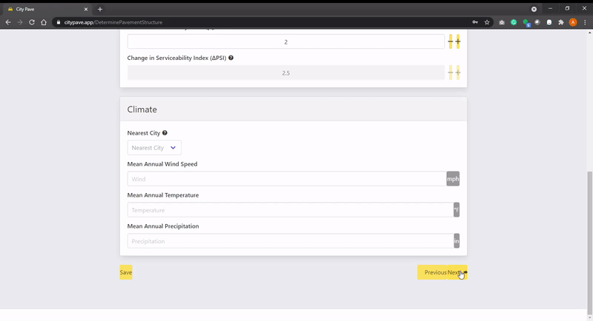
Validation and Input Ranges
Both necessary for consistency and accuracy throughout the program
Input ranges aid in the validation process
Vue’s input ranges allow for specified lengths of strings and specified ranges of number values
Validation process is done in most part behind the scenes in real time as well as once the user submits a form or attempts to move onto the next page
Notes:
Validation and input ranges were essential when pertaining to the calculations and user inputs. The validation and input ranges allowed the group to control what could be inserted to certain fields such as strings and numbers and the range in which they are accepted. Certain fields required only positive numbers, entering a negative number or one out of the range would destroy the foundation of the calculations. Most of the validation was done in the background using vues built in validation functions and triggered when the user unfocuses from a field or attempts to move beyond the current page

Slide 11
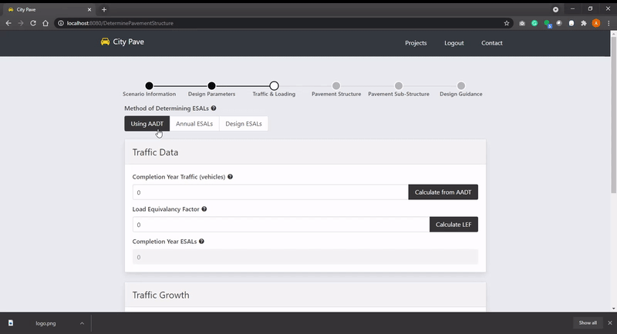
Dynamic Tabs
Allows the user to actively switch between different methods and scenarios
Minimizes the amount of pages necessary for the application

Slide 12
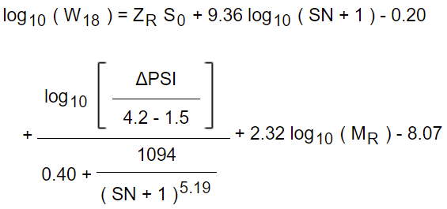
Calculations - Asphalt
Minimum Required Structural Number
Structural Number
1993 AASHTO Design Method
Notes:
Bryan

Slide 13
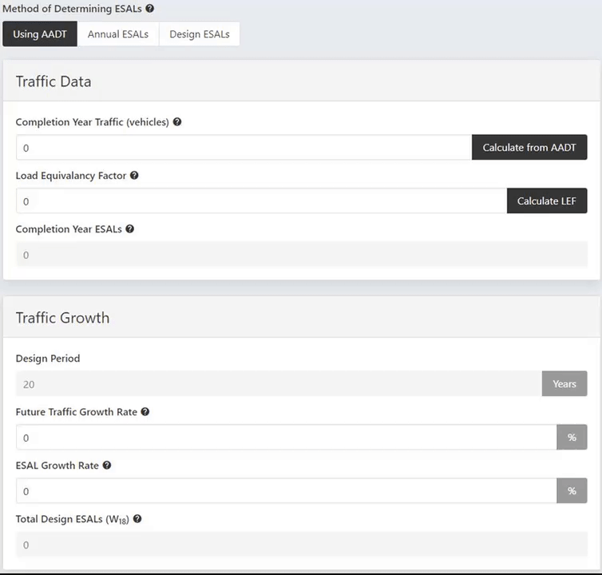
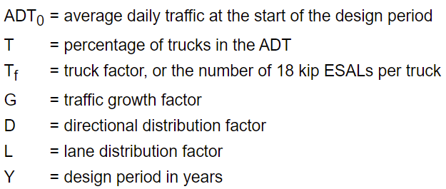
Calculations - Total Design ESALs (W18)
Equivalent Single-Axle Loads
Notes:
Bryan

Slide 14
Calculations - ZR Table
Notes:
Bryan

Slide 15
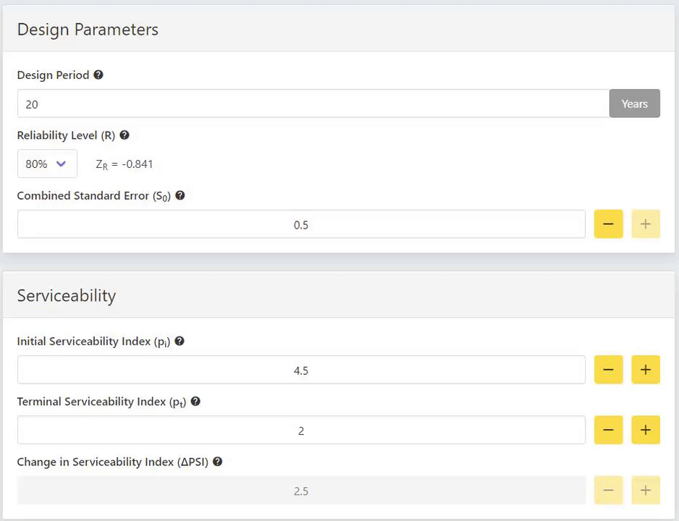
Calculations - ZR, S0, & ΔPSI
Notes:
Bryan

Slide 16
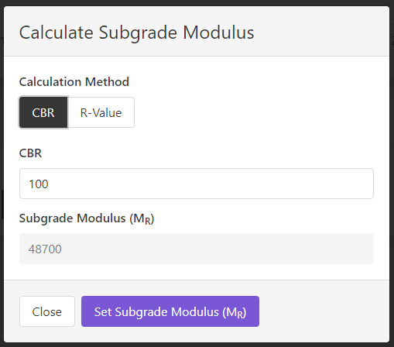
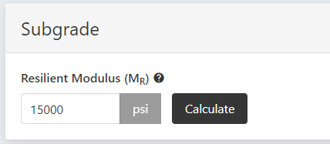
Calculations - Resilient Modulus (MR)
Notes:
Bryan

Slide 17
Calculations - Asphalt
Minimum Required Structural Number
Structural Number
1993 AASHTO Design Method
Notes:
Bryan

Slide 18
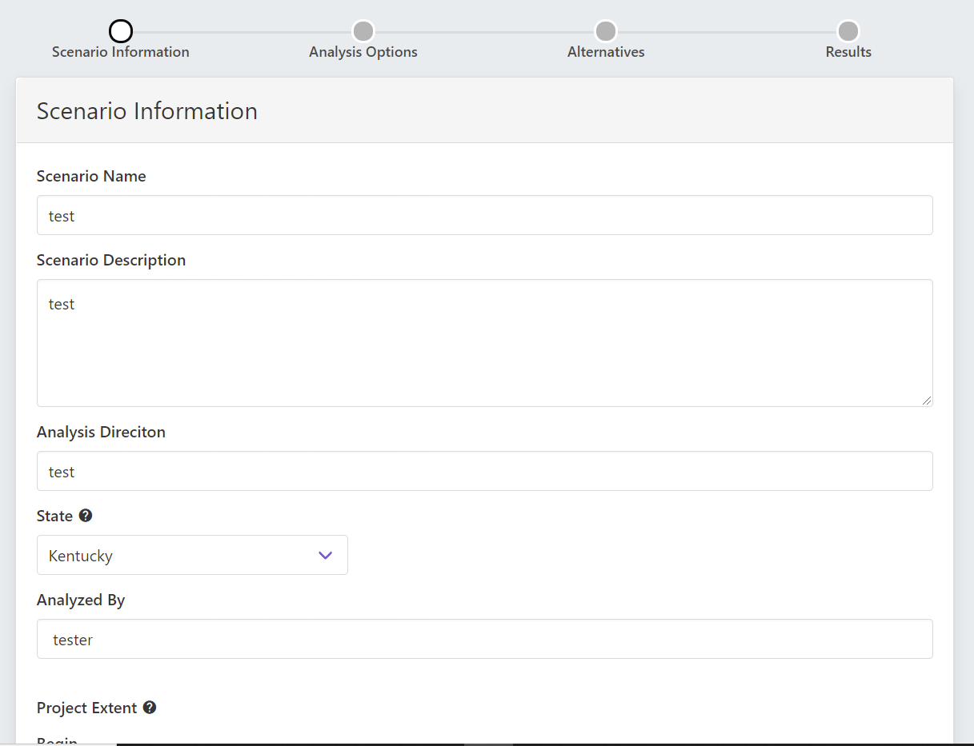
Database Tables
Notes:
omar

Slide 19
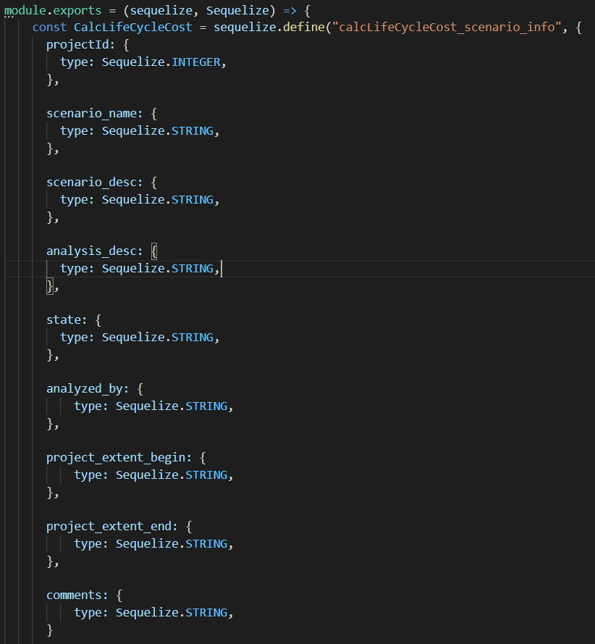
Continued
Sequelize
Notes:
Omar

Slide 20
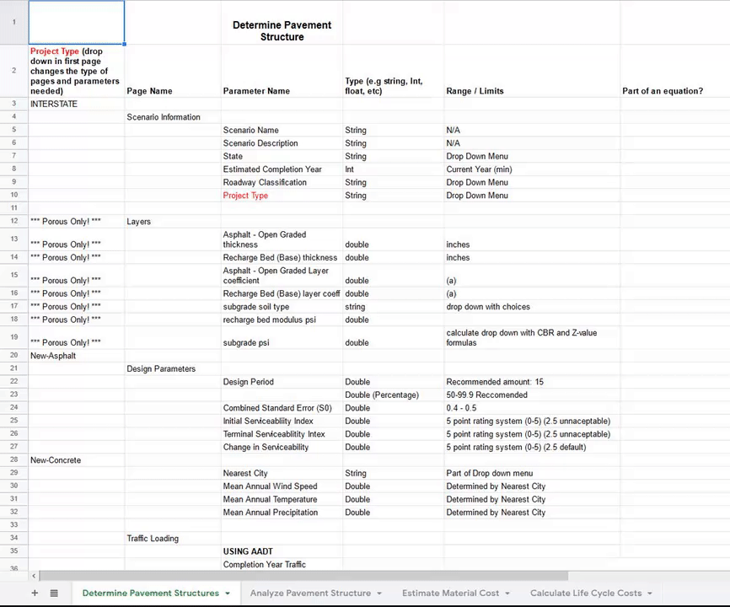
Planning the tables
Notes:
Allen

Slide 21
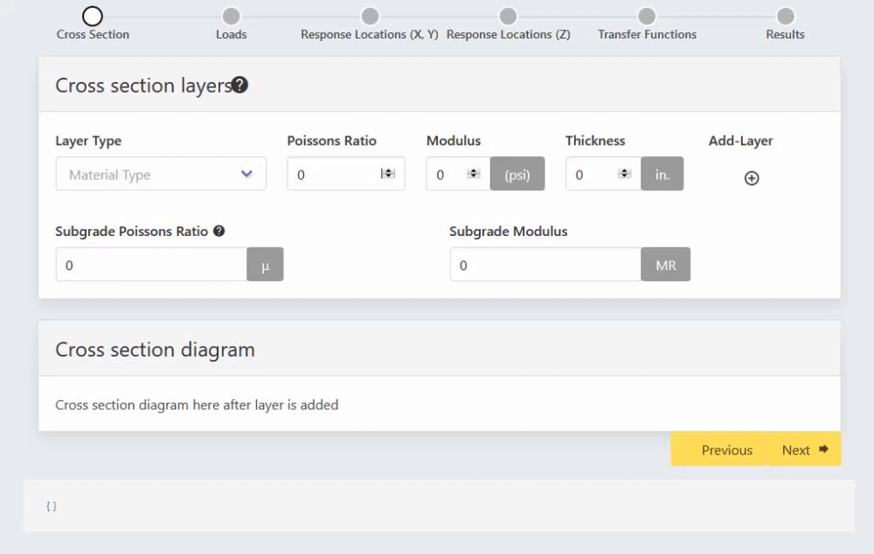
Nested or not?
Notes:
Allen

Slide 22
Implementation
Notes:
Allen

Slide 23
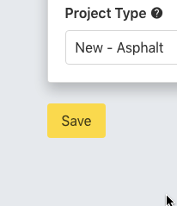
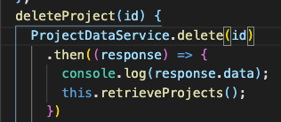
Additional API Calls
CityPave uses API calls to facilitate communication between the client-side and server-side
Functions include Read, Update, and Delete.
Notes:
Christian

Slide 24
ProjectId
All database tables that are a part of a particular project reference the project’s primary ID as a foreign key.
This relationship between the project and other tables is what makes the API calls function without difficulty.
Notes:
Christian

Slide 25
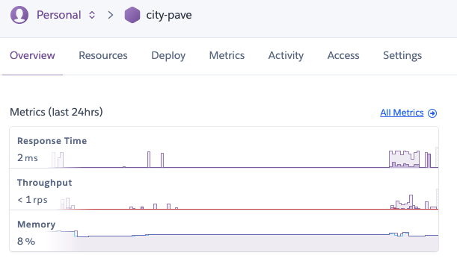
CityPave is deployed to the web using Heroku
Heroku is a container-based cloud Platform as a Service (PaaS).
Notes:
Christian

Slide 26
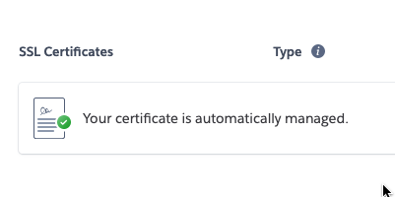
www.citypave.app is the official web address of our web application and it was purchased using Google Domains.
The application uses an SSL Certificate to provide an end-to-end encryption to protect all web requests and to make sure information is transmitted securely.
Notes:
Christian

Slide 27
Demo
Presented by Christopher Ortega

Slide 28
Accomplishments and Road Blocks
JS and Vue
Designing the Web Application
Calculations
Staying Organized while Online
Notes:
Kayleen

Slide 29
Future Plans
ReCAPTCHA box, Password recovery, Map view
Calculations
Graphs to Display Calculations

