Slide 1
Augmented Reality for Hydrology Version 2

Slide 2
Team Members
JPL Liaisons
Dr. Elaine Kang - Advisor
Mher Oganesyan - Team Lead
Leonardo Obay
Anthony Soto
Refugio Arroyo-Martinez
Gilberto Placidon
Shan Malhotra
Michael Rueckert
Natalie Gallegos
George Chang
Emily Law

Slide 3
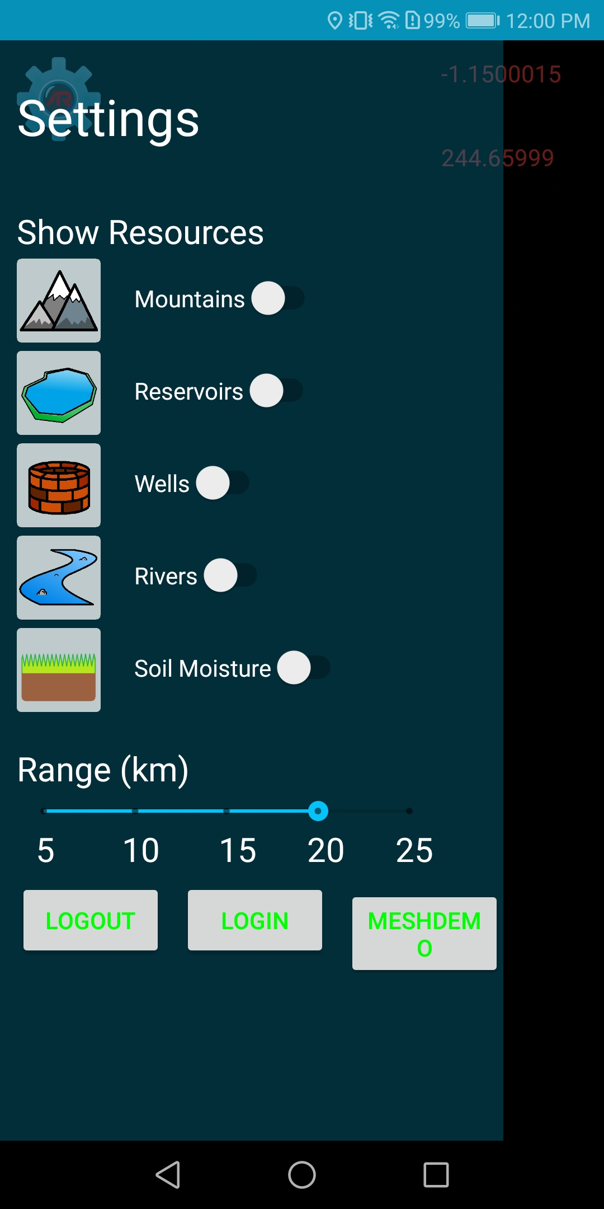
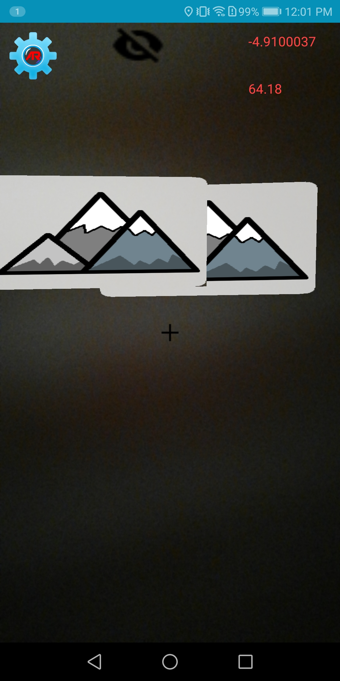
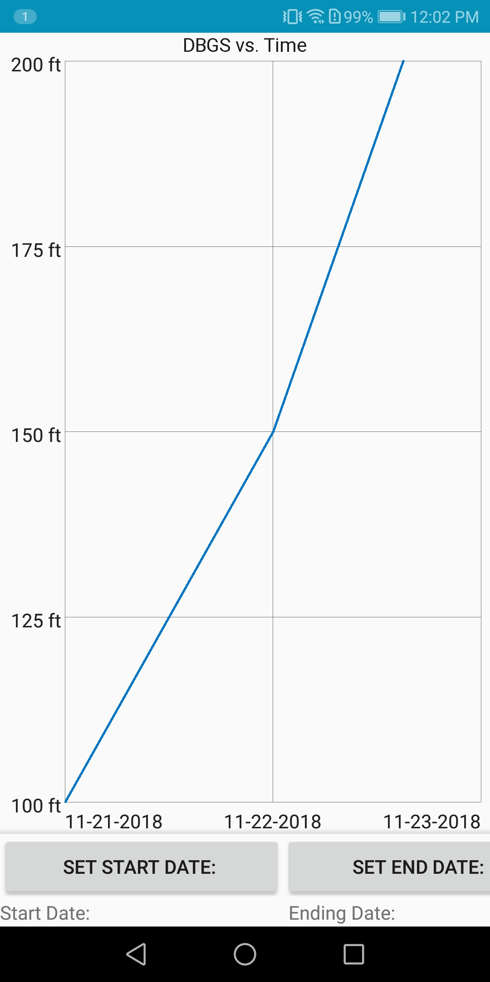
What is our objective?
Create an application for Android devices with the implementation of last years augmented reality framework that allows the user in the Western United States to understand hydrological data.
Presenter: Mher Oganesyan

Slide 4
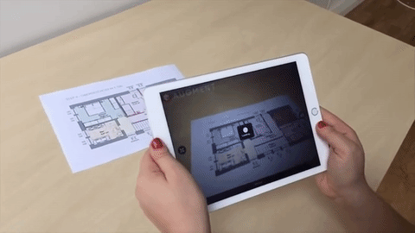
Augmented Reality and its components
Use of computer generated graphics to alter the users perception of the real world
Device
Computer Generated Graphics
Track Movement of Device
Presenter: Mher Oganesyan
Notes:
Movement of the deivce needs to be precisouly tracked

Slide 5
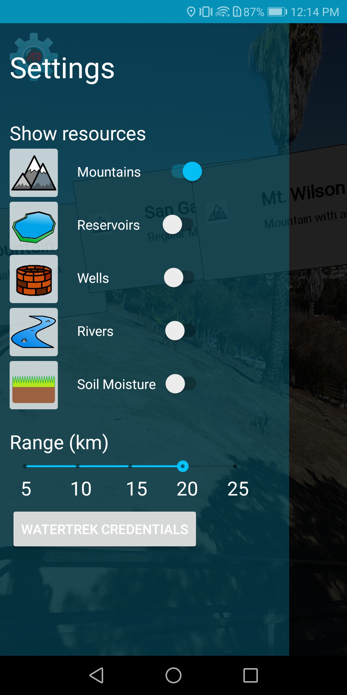
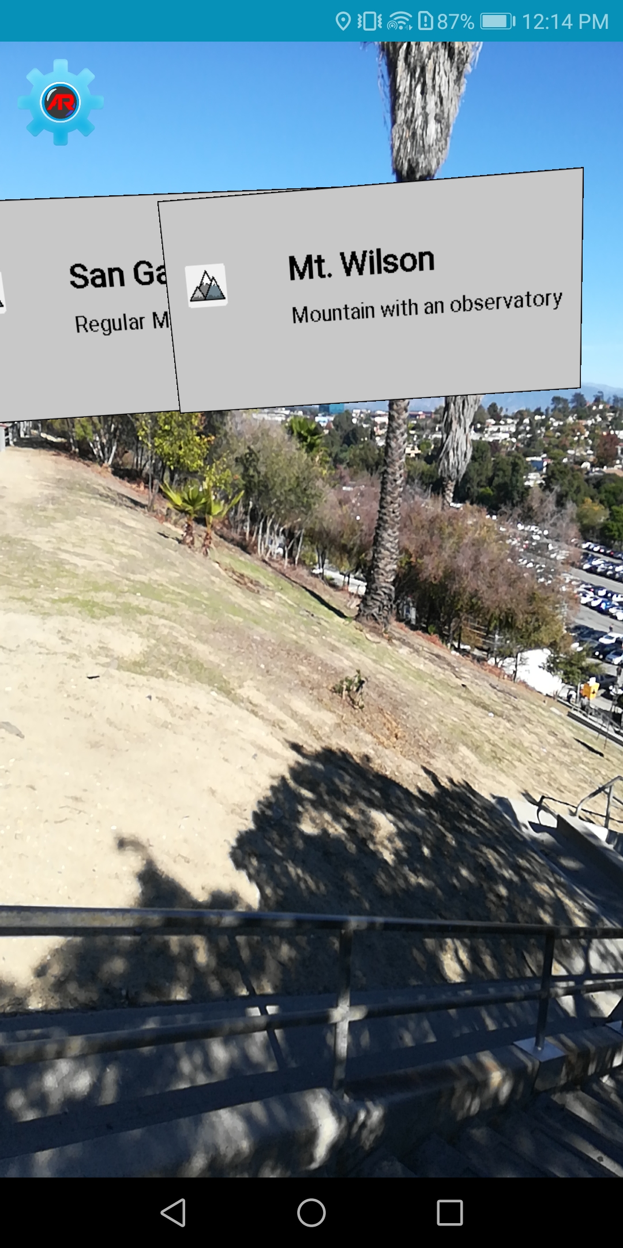
Version 1 of Application
Provided us with a framework for augmented reality and an application that:
Supports Android 5.0+
Uses gyroscope and GPS to figure out where the user is and where the device is pointing
Uses OpenGL to render objects to live camera feed
Handles network calls to the JPL servers
Handles internal database queries/storage
Presenter: Mher Oganesyan

Slide 6
Why make this product?
Availability on mobile devices allows for access on the go
Interactive way of learning about hydrology in users local area
AR technology extends what the user can see
Providing data to the user using graphs helps with understanding the data
Presenter: Mher Oganesyan
Notes:
The purpose of our project is to take what last years team provided and expand and improve on their application while implementing their framework. We are doing this to…..
The AR technology will extend what the user can see, for example, one might not be able to see a well since it is underground or be able to visualize soil moisture since it is not something that is clearly visible. And the AR aspect of the app will help by putting into perspective what we normally cannot see.

Slide 7
Version 2 of Application
Using the hydrological dataset provided by Jet Propulsion Laboratory
Refine the interactive user interface that visualizes datasets in the field of view of the camera
Present data in a graph format for clearer interpretation
Allow user the ability to filter data by specifying a range in time
Superimpose terrain mesh onto actual terrain through the camera
Provide line-of-sight information
Use implementation of maps to help guide user to a point of interest
Presenter: Mher Oganesyan

Slide 8
System Components
AR Framework
Handles AR object rendering and positioning
User Interface
Process user interaction, sends data requests and displays returned calls.
Mesh
Rest Call
SQLite Database
Generate desired terrain mesh from digital elevation map.
Various network calls that allow us to retrieve data and manipulate information with code
Creates stores and updates various Points of interest datatypes in order to help organize data.
Presenter: Mher Oganesyan
Notes:
USE example to explain

Slide 9
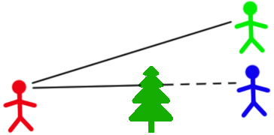
Line of Sight
What is line of sight ?
We will use line of sight in order to retrieve various height elevations
Presenter: Leonardo Obay

Slide 10
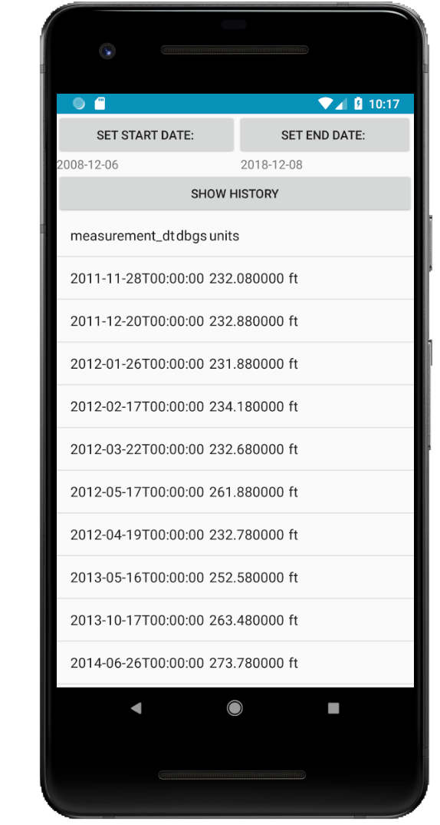
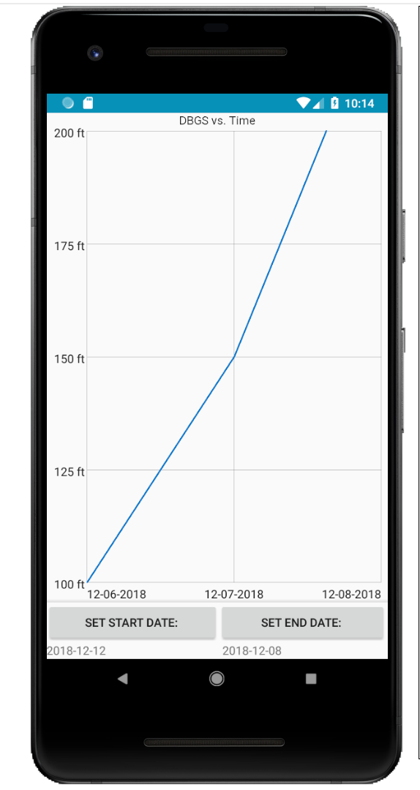
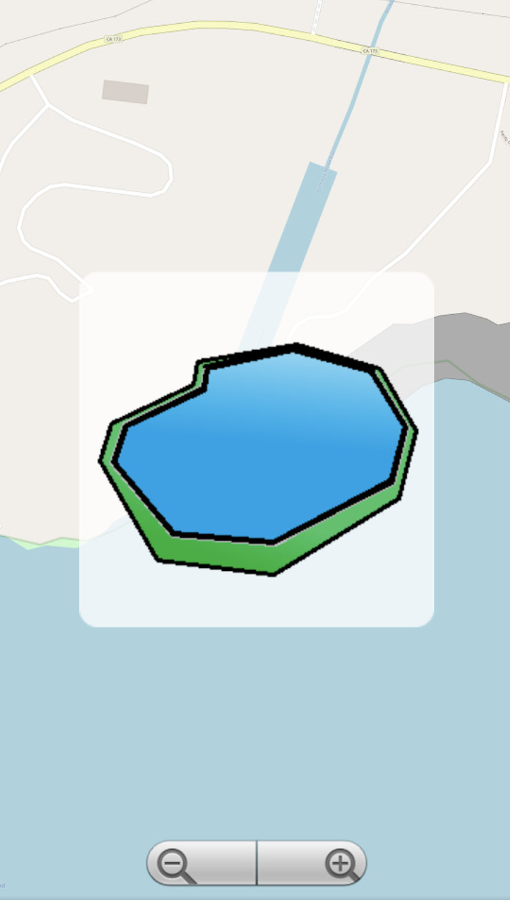
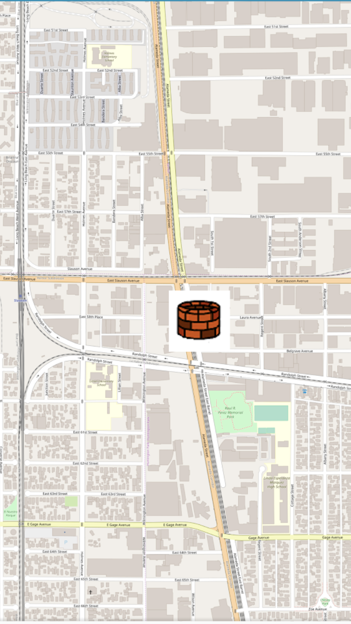
Map View
Lets users view nearby (POI)
This feature was implemented so the user can have access to (POI) without accessing the camera or AR aspect of the app
Presenter: Leonardo Obay

Slide 11
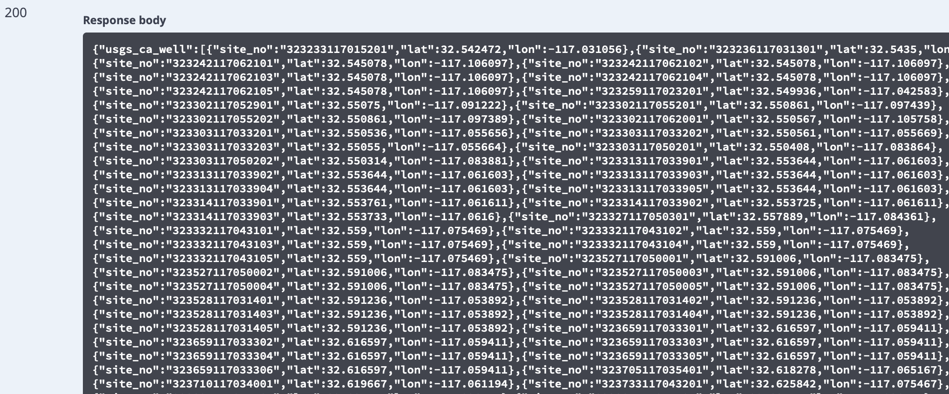
Rest Calls
Network calls that provides of data of various (POI)
Due to the data size being so massive Network calls were ideal
Presenter: Leonardo Obay

Slide 12
SQLite
Stores data from JPL’s servers locally on android
We use it in order to increase performance or pulling up POI data and in implementation of an offline mode as well.
Presenter: Leonardo Obay

Slide 13
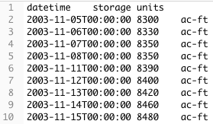
Datasets
Hydrology Data:
Reservoir
Well
SoilMoisture
Snotel
River
Mountain data:
Peak
REST call for listing Reservoir sites:
REST call for a specific site_no:
Presenter: Anthony Soto
Notes:
So, what data are we storing and utilizing in our application?
We are primarily working with hydrological datasets.
These include Reservoir though River datasets which are provided by JPL restful services.
To the right is an example of a rest call to retrieve a list of reservoir sites.
We get a text file that represents a table with various fields.
The fields are.
site_no which represents a unique number.
description to that site.
longitude and latitude for location.
max and min datetime which corresponds to the max and min units of reservoir.
What are these units?
Well the second call below is displaying a REST call for a specific site_no.
Which includes a datetime along with storage units in ac-ft. Which represents the volume of water in a reservoir.
This schema structure is displayed throughout the other datasets each with their specific site number, location, and units.
The well dataset includes dbgs which is the amount of water in a well.
The soil moisture is the amount of water for specific area of land.
Similarly the snotel units display the snow water equivalent which is the depth of water in an area of snow.
The River data units measure flow rates at various points throughout the length of a river.
In addition to jpls datasets we include mountain data which can store the height of the mountain or other hydrological datasets.

Slide 14
Representing Numerical Data
RecyclerView used to display a list of data. Numerical data such as:
min
max
mean
GraphView used to display data in a line graph. Useful when representing:
variables over a continuous time
standard deviations
Presenter: Anthony Soto

Slide 15
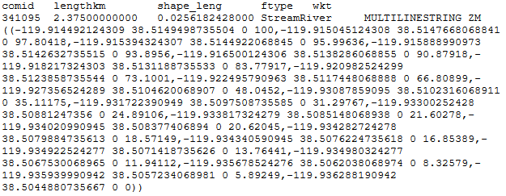
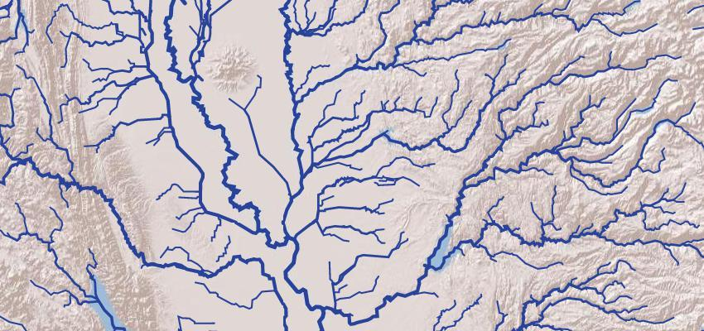
Why a mesh?
Fits well in an AR environment
2 ½ dimensional model
Can be used to represent terrain
Easier to visualize large area data, such as:
River networks
Snotel
Presenter: Refugio Martinez
Notes:
How do we represent this data?
Since, we are working with android we use a recycler view to store various elements.
The first image on the right demonstrates a recycleview with elements from a specified range in the wells dataset.
The recycler view can also be used to display a single element such as the minimum, maximum, or average value.
The last image on the right displays a graph.
This was implemented using graph view. An external library in android to display the data varying over time.
This can also be used to display standard deviations in a chart.

Slide 16
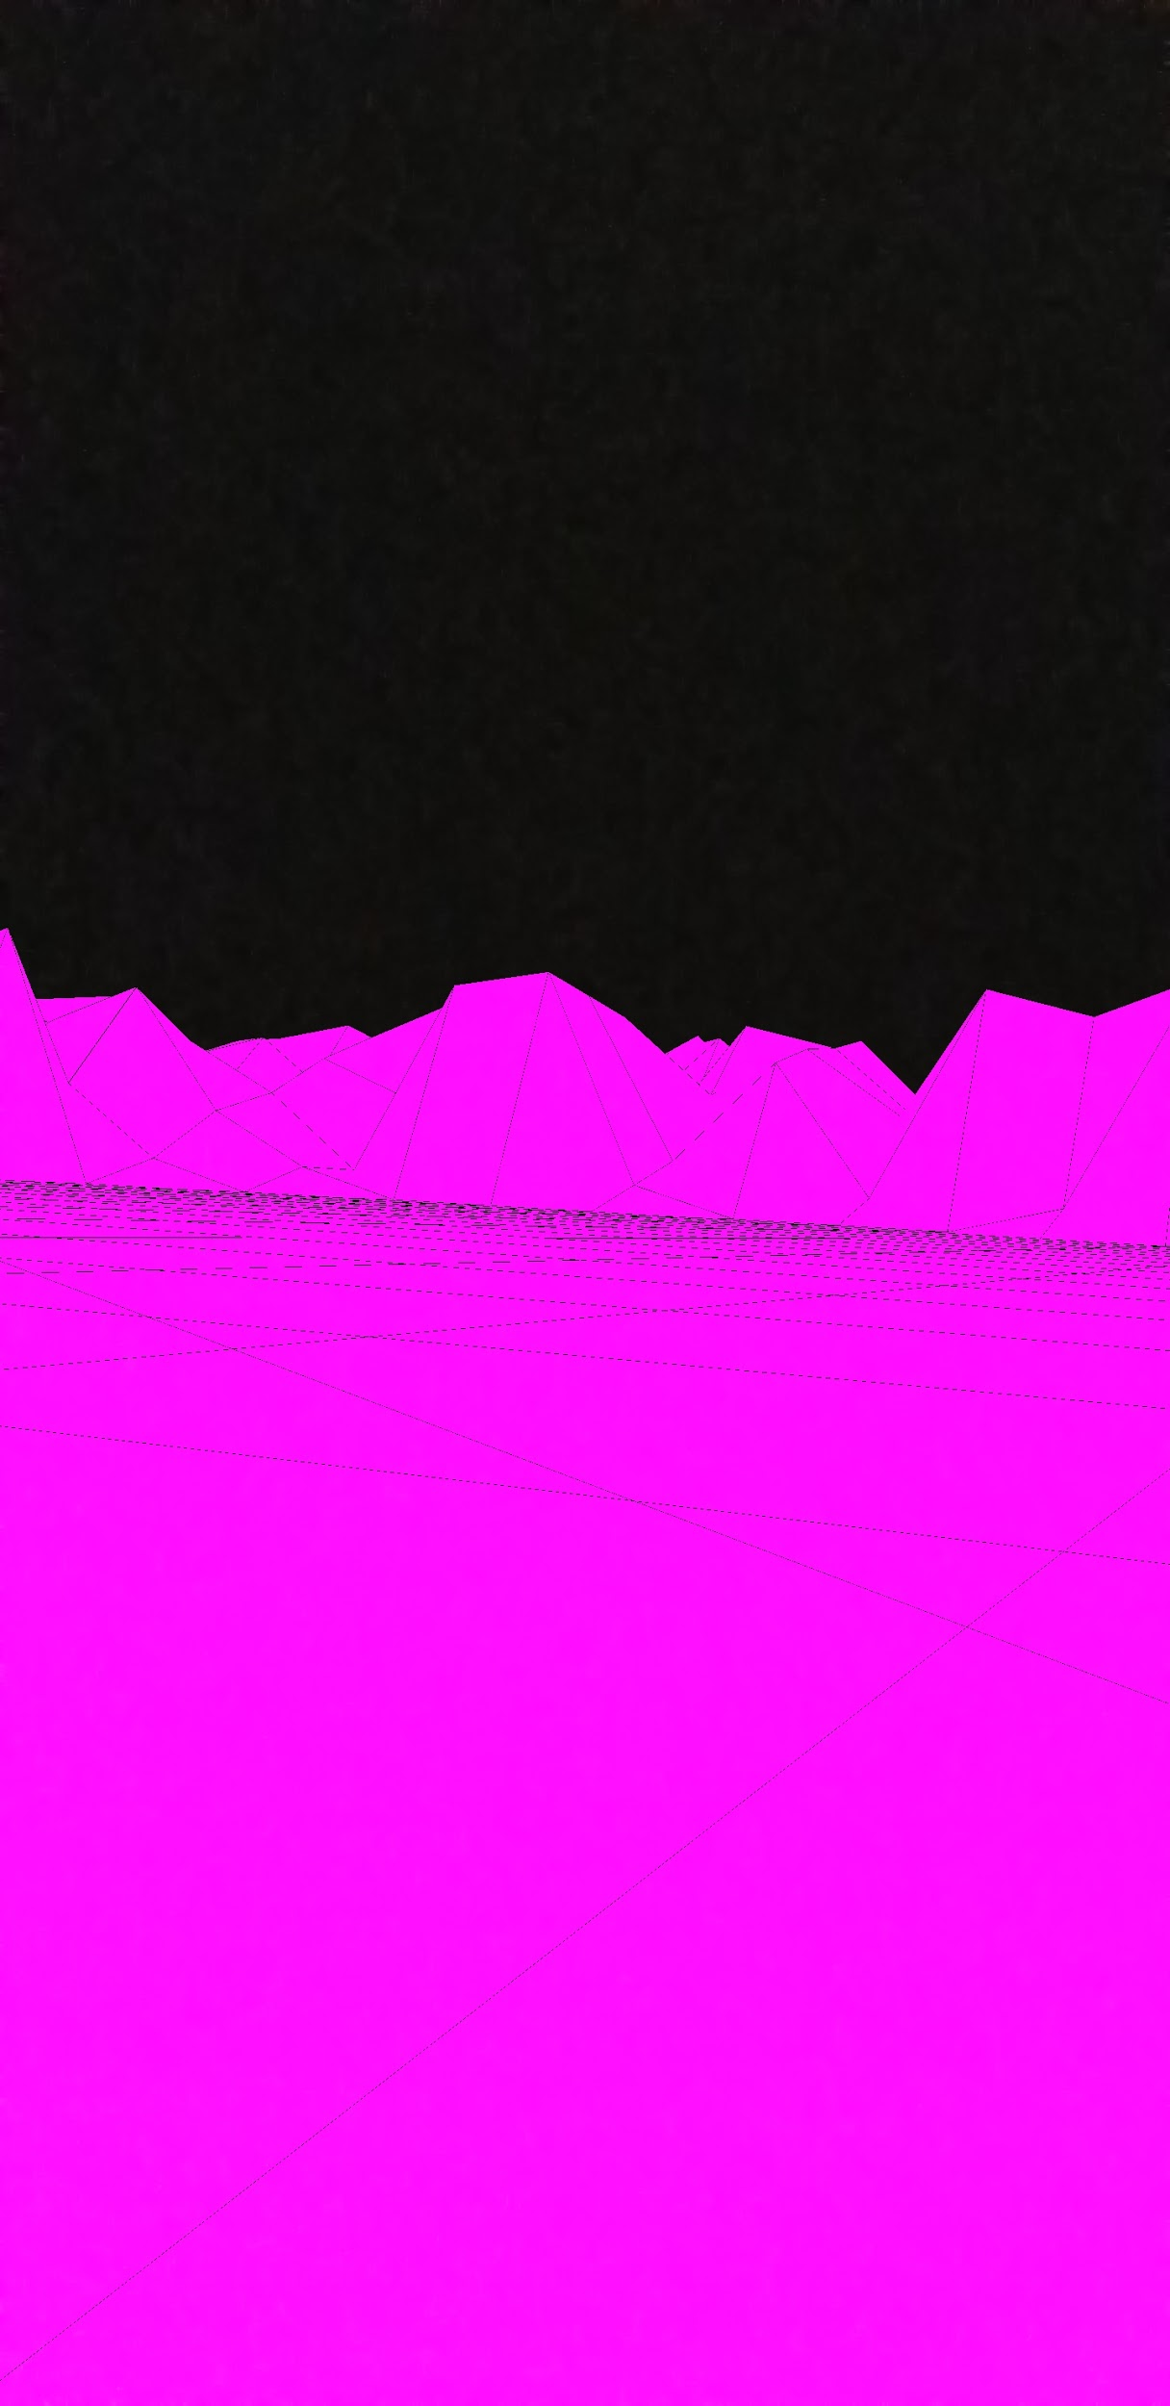
Mesh from Digital Elevation Map (DEM)
What is a mesh?
A collection of polygons that make up a 3D object
DEM service from jpl returns tiff file of specified area
Presenter: Refugio Martinez

Slide 17
Challenges Solutions
Heavy computation:
Drains device’s battery
May take a few seconds to complete the work load
Scaling and rotation:
Mesh needs to align with the real world environment
Downsampling for less computation but similar results
Have computation done on app startup
Use of a map to properly scale mesh to its real world version
Use of device’s gyroscope to rotate mesh into position
Presenter: Refugio Martinez
Notes:
Alternative approach

Slide 18
Demo Video
Presenter: Gilberto Placidon

Slide 19
Continued Work
Improve user interface design to make it more intuitive and user friendly
Implement remaining datasets provided by JPL into application
Align the mesh with the video input
Better implementation of maps that can be useful to the user (e.g. display multiple point-of-interests in given area)
Presenter: Gilberto Placidon

Slide 20
Thank You!
Questions?

Slide 21
References
AR Gif: https://www.google.com/url?sa=i&source=images&cd=&cad=rja&uact=8&ved=2ahUKEwjnoe6duorfAhXCIjQIHQeAAbMQjRx6BAgBEAU&url=https%3A%2F%2Fwww.chocolatemilkdonuts.com%2Faugmented-reality%2F&psig=AOvVaw2VUv9l4lcvroKIen8QUMDT&ust=1544159954170047

