Slide 1
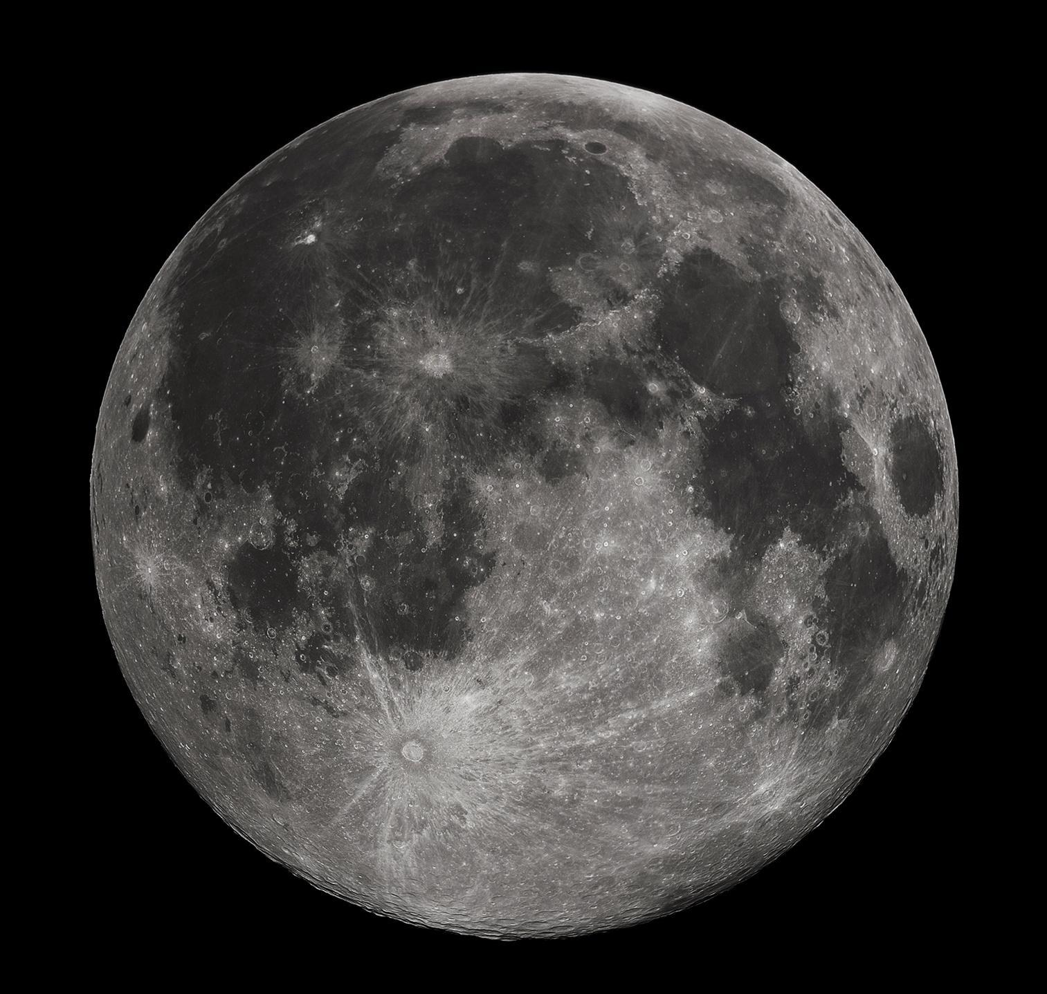
Lunar Image Processing Feature Detection
Natalie Gallegos,
Tony Liang,
Marvin Mendez,
Raul Ornelas,
Alberto Serrano
Sponsor: Jet Propulsion Lab (JPL)
Advisors: E. Kang, R. Cross
Liaisons: E. Law, S. Malhotra, G. W. Chang

Slide 2
Objective Lunar Image Processing – Feature Detection
A user highlights a region on the moon. An application downloads a set of LRO images from PDS. The images are taken at varying aspect angles with various illumination angles.
(a) Develop an algorithm to detect lunar rocks in the images. For each rock an estimate is made of its geolocation and an estimate of its dimensions. The algorithm can take advantage of multiple images from different orbits as well as the stereo pairs available from the NAC camera.
(b) Develop an algorithm to detect lunar craters. An estimate is made of the shape of the crater, it's size, depth. Again multiple images taken at different illumination angles should be used in the detection. Output should include a shapefile.
(c ) Develop algorithms to detect lunar Riles, Maria, Lava Tubes.

Slide 3
Motivation
Why detect craters?
Crater detection and avoidance is critical for spacecraft landings and mapping of lunar terrain.
JPL has developed algorithms that are able to detect craters and rocks, however the source code is proprietary, and not readily available. JPL would like to have an open source algorithm that they can modify and use openly as needed.
Resources for crater detection are limited, new approaches are always welcome.

Slide 4
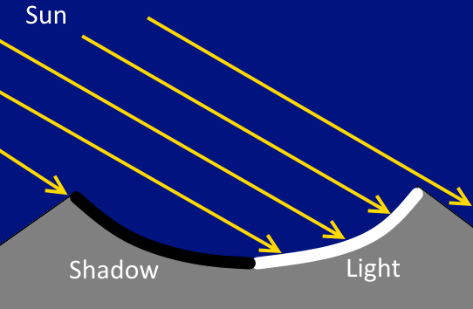
What is a crater?
Crater side view
Crater top view

Slide 5
Research for Crater Detection
[Kamarudin 2012] Crater Detection using the Ellipse Bounding Algorithm
[Tamililakkiya 2011] Crater Detection using Circular Hough Transform
[Clayden] Diameter and Depth Calculation

Slide 6
Detection of Craters
Ellipse Bounding Algorithm
Albert Serrano
Raul Ornelas

Slide 7
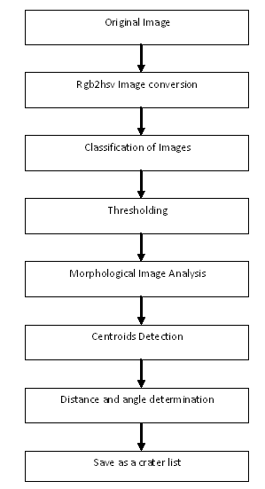
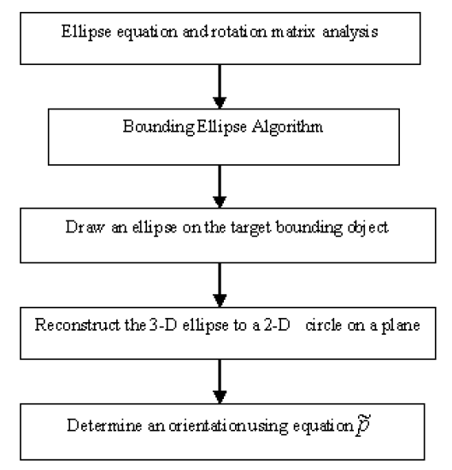
Detection of Craters
and Its Orientation on Lunar
[Kamarudin 2012]
Optical image and morphological analysis methodology employed by Nur Diyana Kamarudin, Kamaruddin Abd. Ghani, Siti Noormiza Makhtar, Baizura Bohari and Noorlina Zainuddin in “Detection of Craters
and Its Orientation on Lunar”

Slide 8
Ellipse Bounding Algorithm
Lunar Image
Erosion and Dilation of Image
Centroids Detection
Rgb2Hsv
Thresholding
Distance and Angle Determination
Lunar Image
and list of Detected Craters
Save as a crater list
Ellipse Fitting Method
Draw Ellipse on Craters

Slide 9
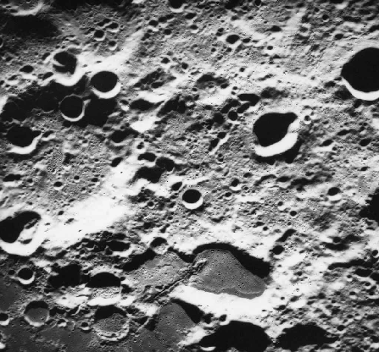
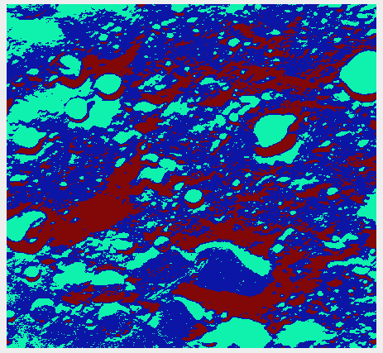
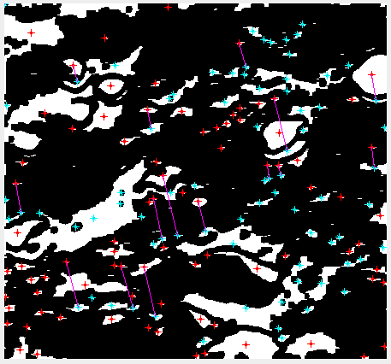
Thresholding
image
Ellipse Bounding Algorithm - Image Preprocessing
Lunar image
We performed some preprocessing to the crater images. These methods help us with:
Retrieving brightness from the image
Retrieving location of each light and dark patch
Eliminate extra unwanted noise
Make potential craters more visible
Centroid
Detection
[Kamrudin 2012]

Slide 10
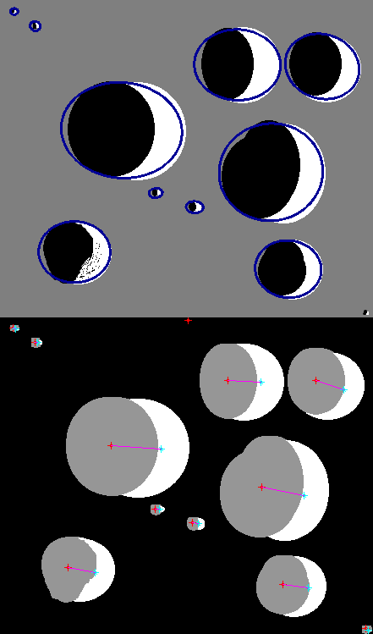
Ellipse Bounding Algorithm - Ellipse Fitting
After image processing, we proceed on to fitting the ellipses
-We partnered light and dark patches which had the best match together
-Used ellipse fitting methods to draw ellipses around the potential craters
-We save the craters into a list

Slide 11
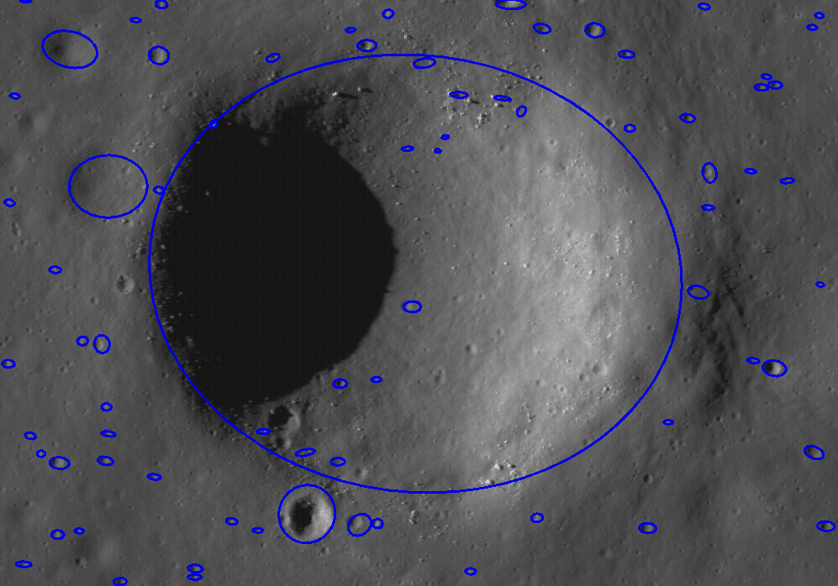
Ellipse Bounding Algorithm - Preliminary Results
[LROC]M1142546992LE

Slide 12
Crater Detection
Circular Hough Transform
Marvin Mendez

Slide 13
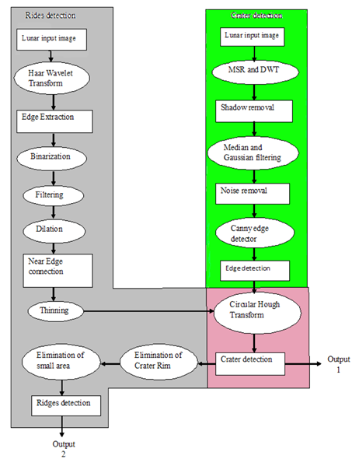
Crater Detection-Circular Hough Transform
Proposed methodology in “Linear and Non-Linear Feature Extraction Algorithms for Lunar Images” by Tamililakkiya V, Vani K, Lavanya A, and Anto Michael

Slide 14
Crater Detection - Circular Hough Transform
Current progress pipeline:
Lunar Image
With Detected Craters
and list of Crater information
Median and Gaussian Filters
Canny
Edge Detector
Circular
Hough
Transform
Lunar Image
SSR

Slide 15
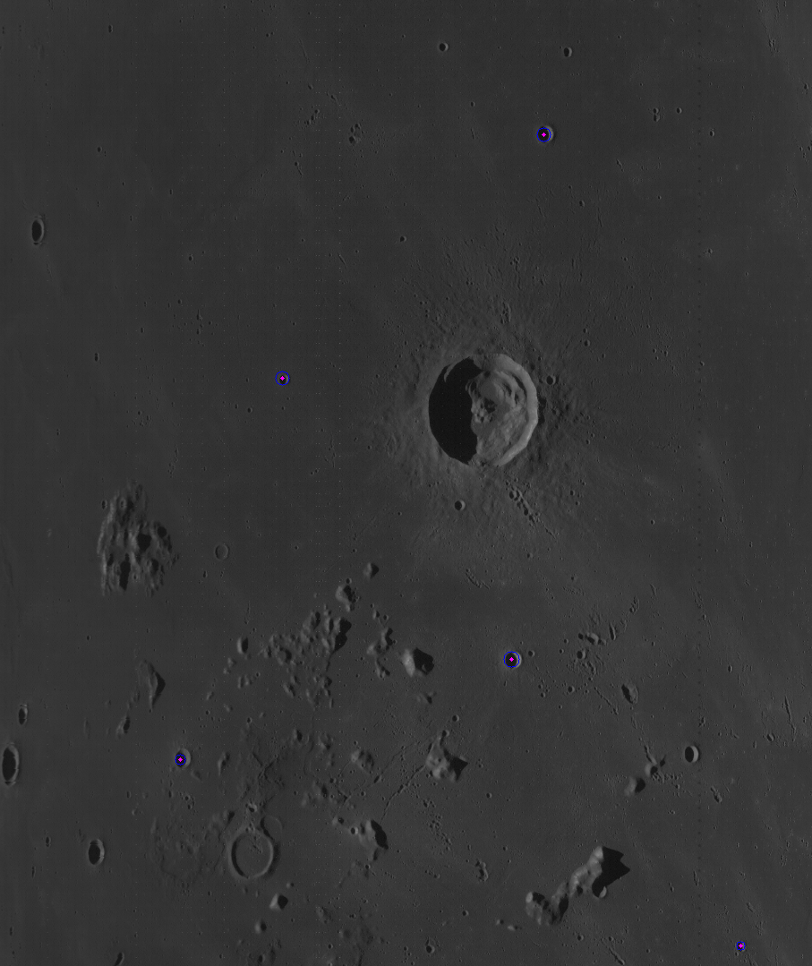
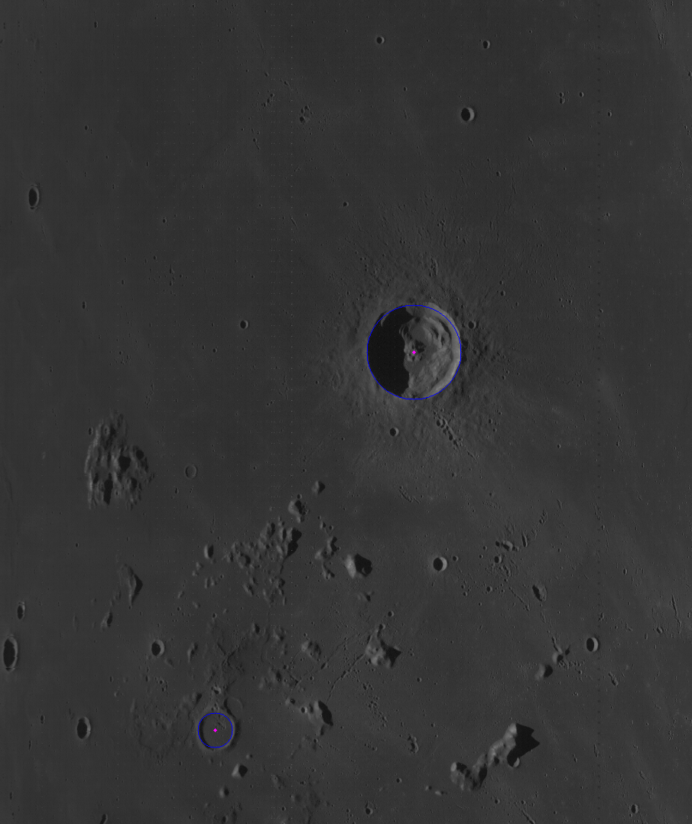
Circular Hough Transform Preliminary Results
Circular Hough transform with radii range 5 - 20 on image [LROC]M102350129
Circular Hough transform with radii range 21 - 80 on image [LROC]M102350129

Slide 16
Crater Depth and Diameter
Natalie Gallegos
Tony Liang

Slide 17
Crater Data Extraction
Teamed up with Tony Liang, our goal is to use illumination techniques to find the diameter and depth of a crater.
Finding the depth and size of a crater first requires crater detection. Therefore we began implementing our method later in the quarter and are still in the beginning stages.

Slide 18
Crater Data Extraction - Incidence Angle
From [Antonenko 2013]
Goal: Calculate the depth of a crater by measuring the lengths of shadows at different sun angles.

Slide 19
Crater Data Extraction Gathering Data for Illumination: ~18 IMG Files
Incidence Angle: 71.96⁰
Incidence Angle: 46.24⁰
[LROC] M1096580495LC
[LROC] M152959737RC

Slide 20
Crater Data Extraction - Measuring Diameter
Tony and I reviewed an approach for measuring the depth and diameter of a crater off of a image [Clayden].
Given an image of a crater, the diameter of the crater can be calculated using the following data:
The exact time the image was taken.
Longitude and latitude of crater’s location.
Distance from the moon to the earth at the time the image was captured.

Slide 21
Crater Data Extraction - Preliminary Results
Input Image: “Alan Crater”
Output Image: Craters with diameters
Diameters in red and yellow for detected craters
[LROC] M181208790RC

Slide 22
Progress Summary
Fall Quarter 2014
Tony Liang

Slide 23
Goals
Read and analyze papers on crater detection using an ellipse bounding algorithm and circular hough transform, lunar crater size and depth calculations, and lunar crater illuminations
Collect test lunar crater images
Crater detection
Well illuminated
Newer rims
Clusters of craters
Crater illuminations
For each lunar crater, multiple images are to be collected with different illumination angles

Slide 24
Goals Continued
Create two prototypes of the crater detection using the ellipse bounding algorithm and circular hough transform respectively
Add improvements to the prototypes
Produce preliminary results
Began the lunar crater illumination implementation
To calculate the depth of a crater, sun angles at the exact time these images were captured are needed.
Tasked with pulling this metadata from the images.

Slide 25
Progress
Read and analyzed papers on crater detection and the [Clayden] website on lunar crater size and depth calculations
Necessary formulas and data are collected
Gathered lunar crater images
Crater detection testing
Extracted metadata for lunar crater size and depth calculations
Sun angle
Created an ellipse bounding algorithm that uses a single lunar image
Created a circular hough transform crater detection prototype that uses a single lunar image
Prototype refinements

Slide 26
Progress Continued
Begin testing of lunar crater size and depth calculations with a single lunar crater image
Produce lunar crater size calculations
Wrote a program that can pull metadata from our TIFF images, however the only data we could use was a time stamp.
A helpful result from our metadata reader:
<Item name="PRODUCT_CREATION_TIME">2013-11-16T18:54:29</Item>

Slide 27
Project Management Progress
Set up working environment
GitHub, GDAL, OpenCV, Eclipse IDE, JAVA
Began implementing ideas from our research
Began research for Rock Detection
Document Software Requirements
Updated CSNS project page
Team Updates
Individual Updates
Meeting minutes

Slide 28
Crater Detection and Recognition by Template Matching and Machine Learning
Approach
Prelim result
Use a pure image processing algorithm “Template Matching” to detect all crater candidates.
Use a machine learning algorithm to recognize craters from non craters among those candidates.
[LROC]

Slide 29
What’s next?
Quarterly Plan - Winter 2015 and Spring 2015
Develop an efficient and hybrid algorithm that combines multiple approach to increase crater detection rate and extracts the shape information of each crater.
Improve and refine crater diameter measurements for better accuracy.
Implement shadow measuring methods to our code to estimate depth of each crater detected in an image.
If time permits, continue researching rock detection algorithms, and begin implementing them.

Slide 30
References
[Tamililakkiya 2011] “Linear and Non-Linear Feature Extraction Algorithms for Lunar Images” by Tamililakkiya V, Vani K, Lavanya A, and Anto Michael
[Clayden] “Diameter and Depth of Lunar Craters” by Andre James Clayden
[Antonenko 2013] “Effects of Incidence Angle on Crater Detection and the Lunar Isochron System: Preliminary Results from the Cosmoquest MoonMappers Citizen Science Project” by I. Antonenko, S.J. Robbins, P.L. Gay, C. Lehan, and J. Moore
[Kamarudin 2012]”Detection of Craters and Its Orientation on Lunar” by Nur Diyana Kamarudin, Kamaruddin Abd. Ghani, Siti Noormiza Makhtar, Baizura Bohari and Noorlina Zainuddin
[LROC] Lunar Reconnaissance Orbiter Camera <http://lroc.sese.asu.edu/>

Slide 31
Q & A

