Slide 1
First Generation
College of ECST
College of Arts & Letters
Joseph Crisolo
Daniel Arroyo
Alisha Shahbazian
Ashley Vo
Maximiliano Barragan
Jung Hwan Park
Faculty Advisor: Dr. Elaine Kang
Notes:
SERIOUS PRESENTATION
Kang as Faculty Advisor
Sponsored by CSULA college of arts and letters and ECST

Slide 2
CS
ART
Game Design
Project Liaison:
Prof. Sylke Rene Meyer
Faculty Advisor:
Dr. Elaine Kang
Animation Faculty Advisors:
Prof. Sarah Beeby
Prof. Jim Ovelman
Senior Design
Programming Team
Lead Game Design:
Megan Reynolds
Student Artists / Animators
Lead Programmer:
Joseph Crisolo
Lead Artists:
Ilan Conrado
Angelica Conde
Create art assets:
2D Sprites
3D Models
Animations
Implement Game with Art Assets
Notes:
Collaborative Project (slightly different from other senior design projects)
Venn Diagram: ECST & Art (animations?)
Main responsibilities for each
List lead faculty for each
Venn diagram explains collaborative project
Introduce liaison
Working with college of arts & letters
Created game design team at beginning of the year
Lead programmers, artists, and designers discuss game design & create template
Art team create assets
CS team implement game/prototypes with created art assets

Slide 3
Outline
Project Overview
Game Demo
Game Design and Requirements
Software Tools
Summary
Future Plans
Notes:
Joseph - Project Overview (What is project? What is it about? Main Gameplay?)
Show demo video
Data Flow Diagram
Max - 3D Visual Asset Management & NPC Movement Controller Sam - Scene Management, Mini-Map & Player Movement Alisha - Dialogue & Decision Making Ashley - User Interface & Heads Up Display Daniel - Audio Management Controller
Software tools
Summary
Future Plans

Slide 4
Project Overview
Notes:
What is the game?

Slide 5
Purpose
Assist First - Generation College Students
Gameplay Design Overview
3D Mobile RPG
Role-Play the life of a college student
Resource Management: Money, Energy (Stamina)
Game Progression: Sleep
Quests
GOAL: Create a unique college experience for each player
Notes:
Say Purpose of Project - Sylke Meyer
Create a mobile RPG aimed towards upcoming first generation college students that prepares them for future college challenges.
The player will create a unique college experience depending on each choice made in the game while at the same time navigating the social and academic challenges typical college students face on a daily basis.
Summarize Game Design (Use design template)
What is the game?
RPG as college student: simulate
Like a real-life college student: Player core mechanics: stamina and money
Manage stamina/money per day (Need stamina for every game action)
if run out can buy food to increase
Going to sleep resets stamina
Money goes down per day
If run out of money, then you lose bc you can’t go to college
Going to sleep goes onto next day - 5 days per week
Different set of quests per week
Quests to have enough money / keep college score from going down
Quests/interactions allow you to affect NPC and college in unique way
Goal is to create a utopian college experience and by the end of the game the college and your score will be a reflection of your decisions made throughout the game
What does the user experience? What does the user gain from it?
Show game demo first after game design
Implementation after
Long slide at the end for software tools

Slide 6
( Insert Game Demo Video Here )
Notes:
Let them know that this is currently a prototype, not final product

Slide 7
Game Design & Requirements:
3D Visual Asset Management
&
NPC Movement Controller
Notes:
3D Visual Asset Management
Type of Art?
Separate titels

Slide 8
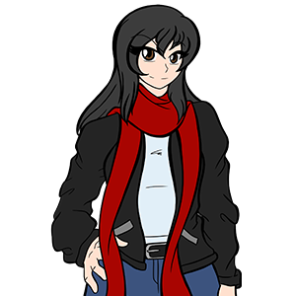
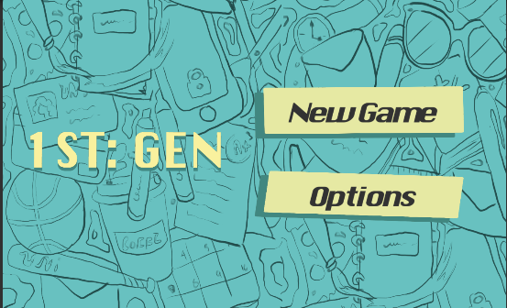
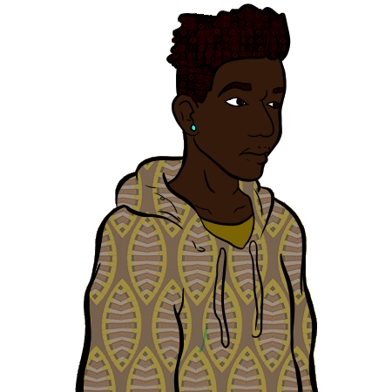
Art
Cartoon-style
Simple and colorful
Notes:
Game Design Mood / Art style
Why game designed this way artistically?
Game Design team decided to pursue this art style because we thought it would be more appealing to our target audience.
Add environment images

Slide 9
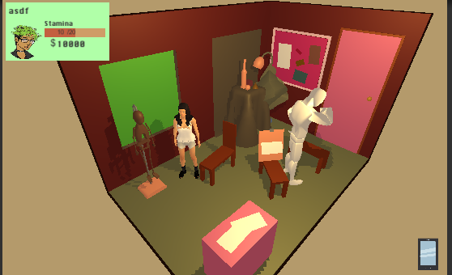
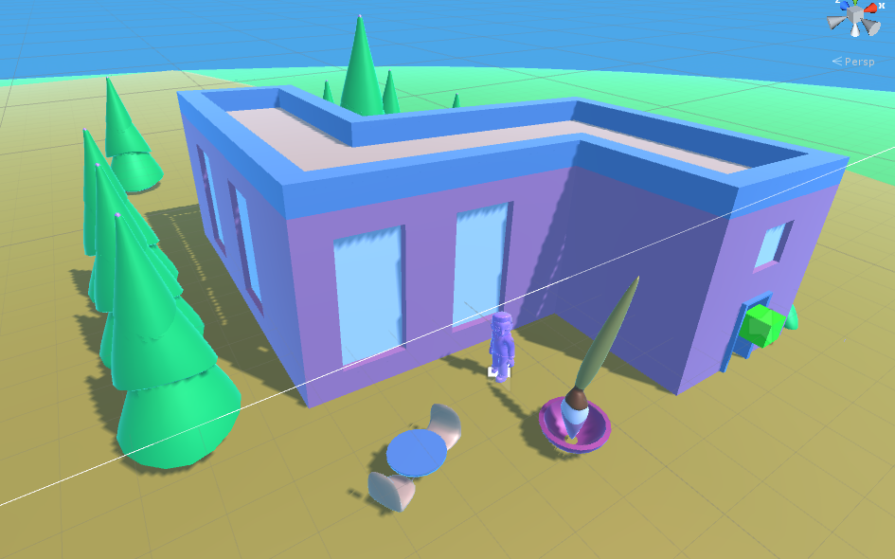
Art
3-D environments
Notes:
Science Building, Music Building, Language Arts Building, History/Social Sciences, Math Building, Financial Aid Building, Library Building, Gym/Physical Education Building, Student Store, Administration Building, Student Health Building

Slide 10
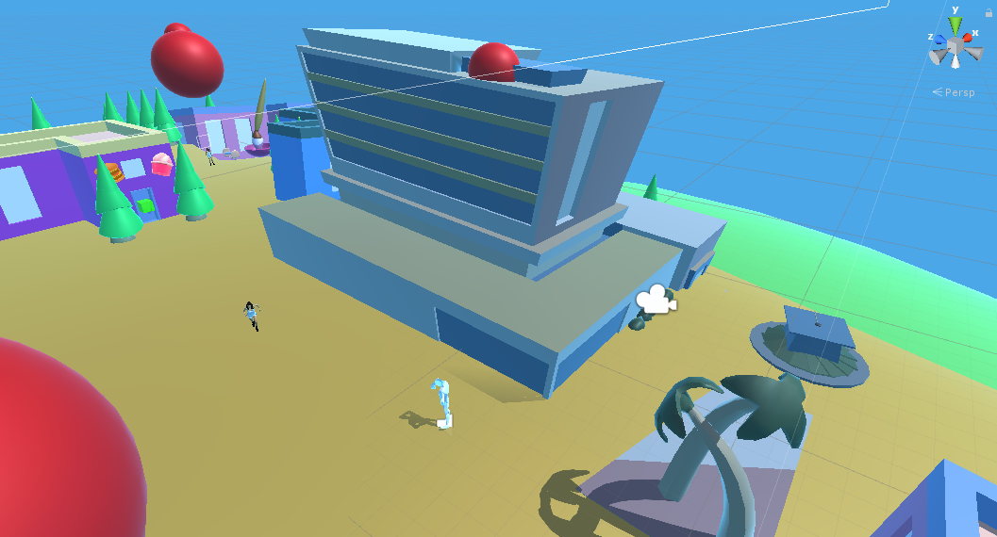
Financial Aid building

Slide 11
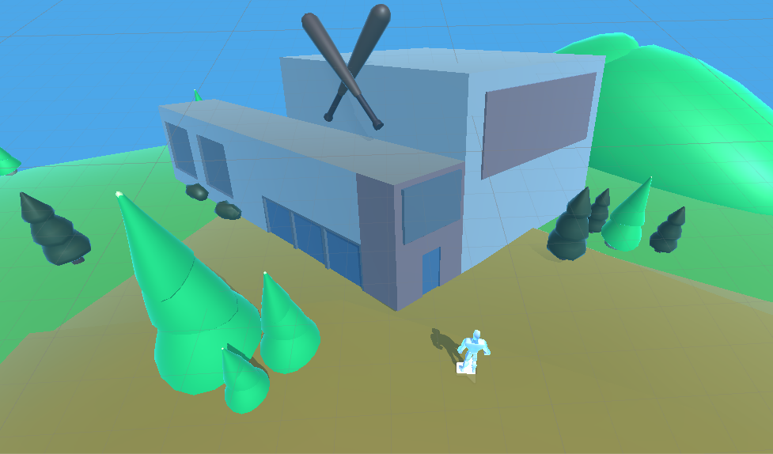
Gym Building/Physical Education Building

Slide 12
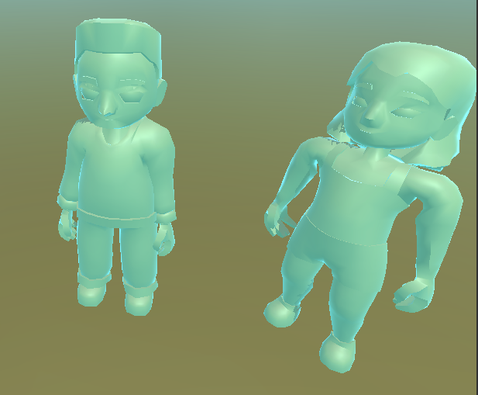
Art
3d Models
Animation

Slide 13
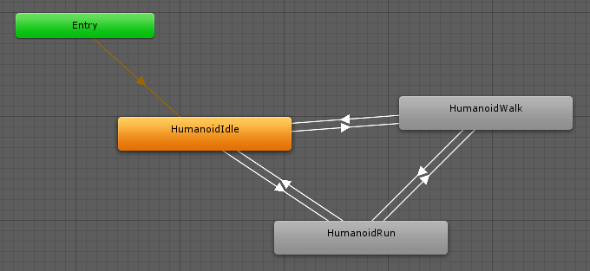
Art
Animator Controller

Slide 14
Npc Controller
Idle
Walk
Run

Slide 15
Game Design & Requirements:
Scene Management, Mini-Map
& Player Movement
Notes:
Game View

Slide 16
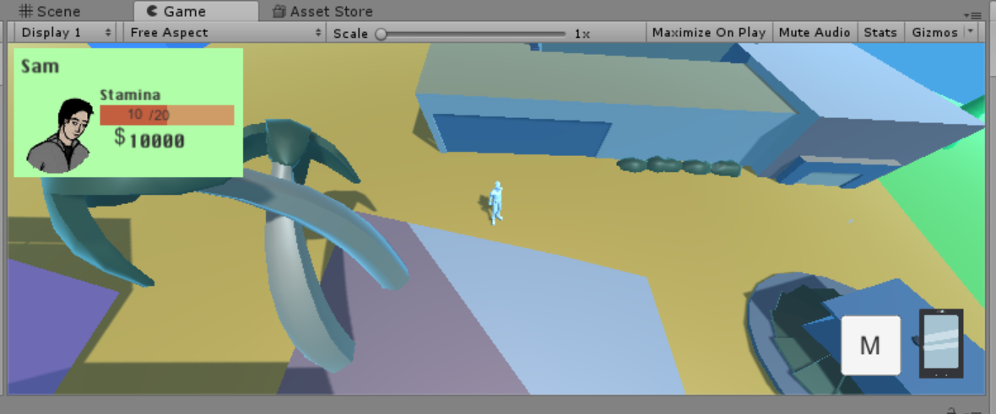
Player Movement
Touch Screen Movement To Navigate around the Map
Why use touch screen instead of joystick Control?

Slide 17
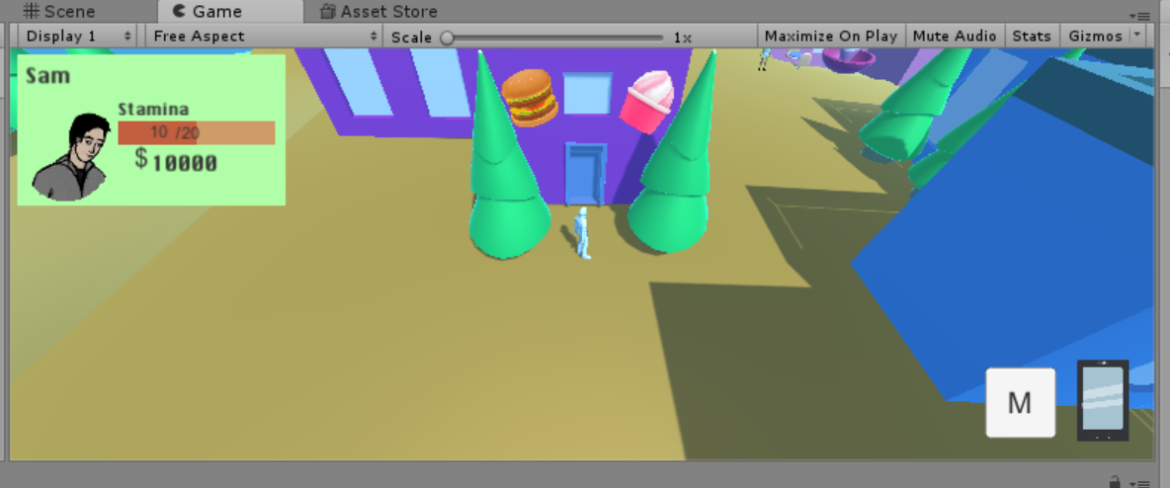
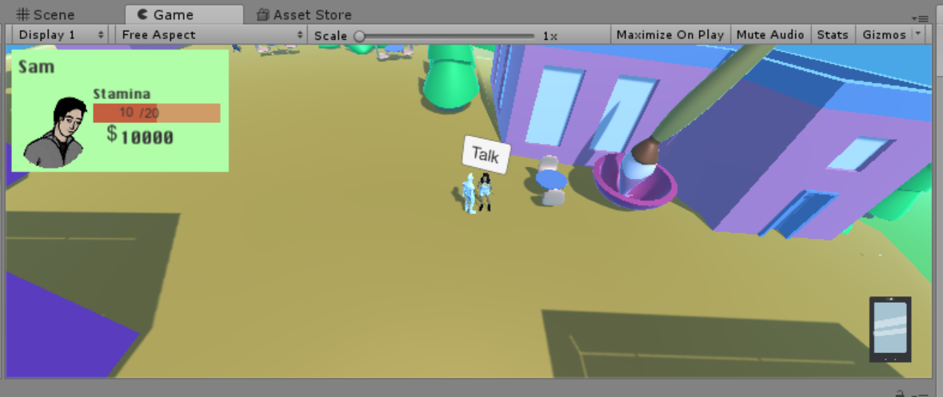
Player Movement

Slide 18
Scene Management
Why use the Scene Management?

Slide 19
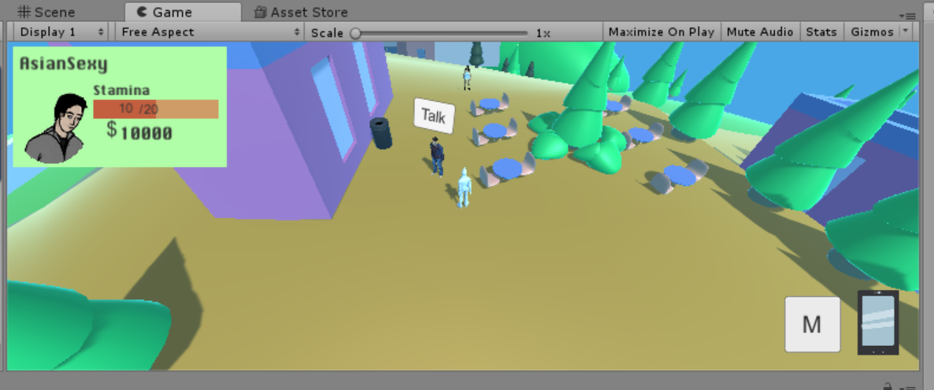
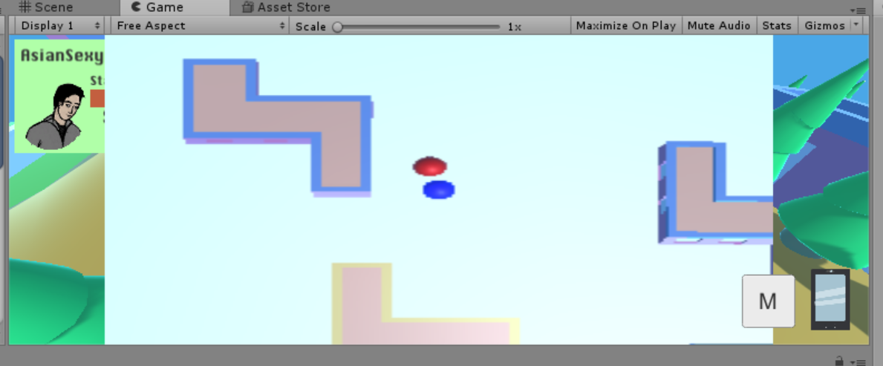
Mini-Map
GamePlay View
Mini Map View
Button for Mini-Map
What is Mini-Map?
Why we implemented the Mini-Map?

Slide 20
Game Design & Requirements:
User Interface ( UI )
&
Heads Up Display ( HUD )
Notes:
UI at the end

Slide 21
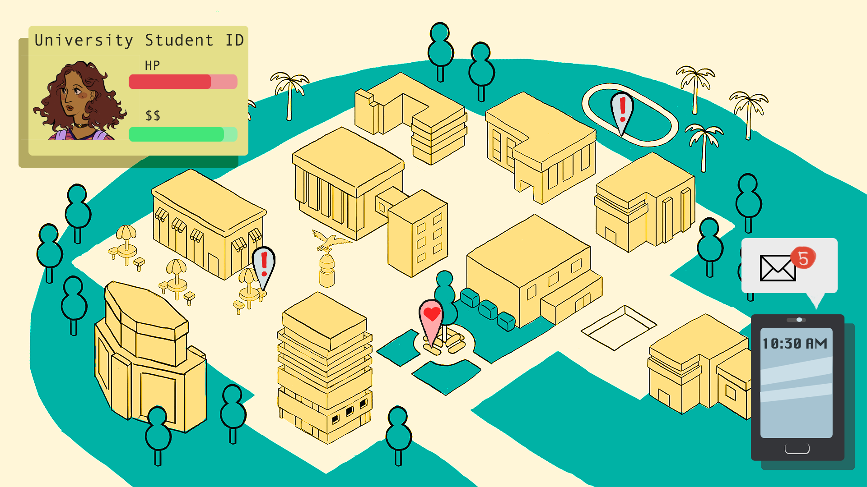
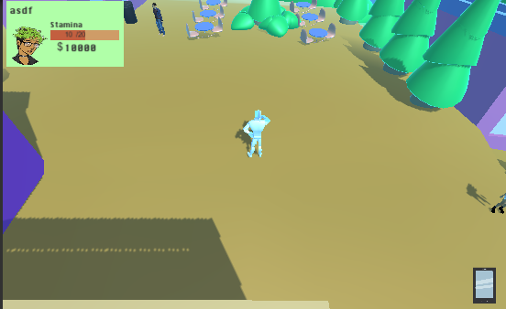
HUD
Provide basic information
Cannot clutter the screen too much

Slide 22
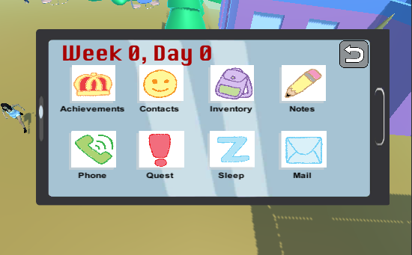
Phone Menu
Simple, Bold, Clear

Slide 23
Game Design & Requirements:
Dialogue
&
Decision Making
Notes:
Player / College / NPC Stats

Slide 24
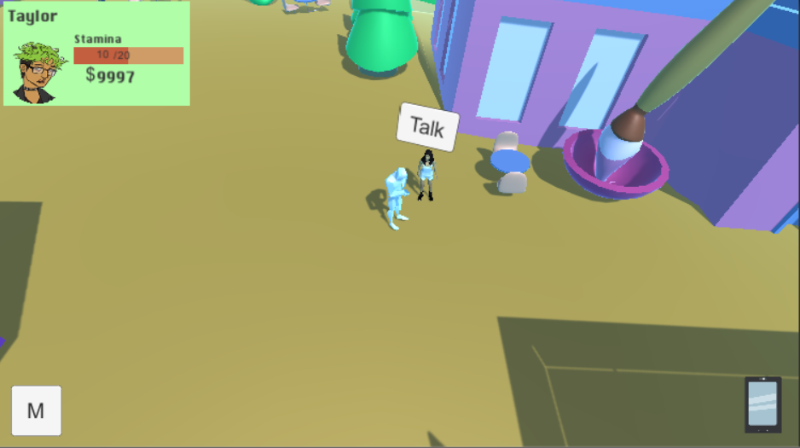

Slide 25
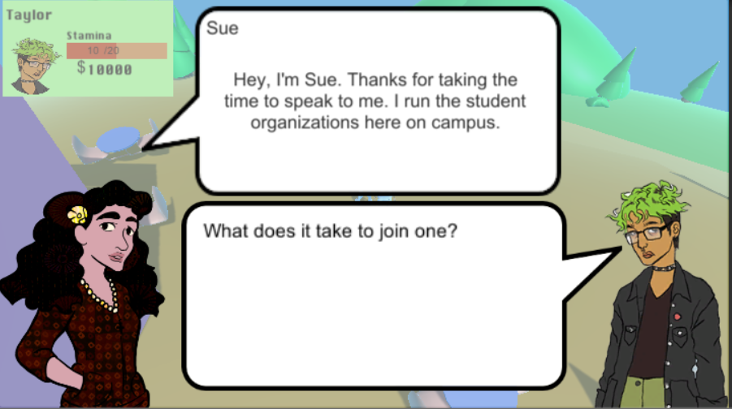

Slide 26
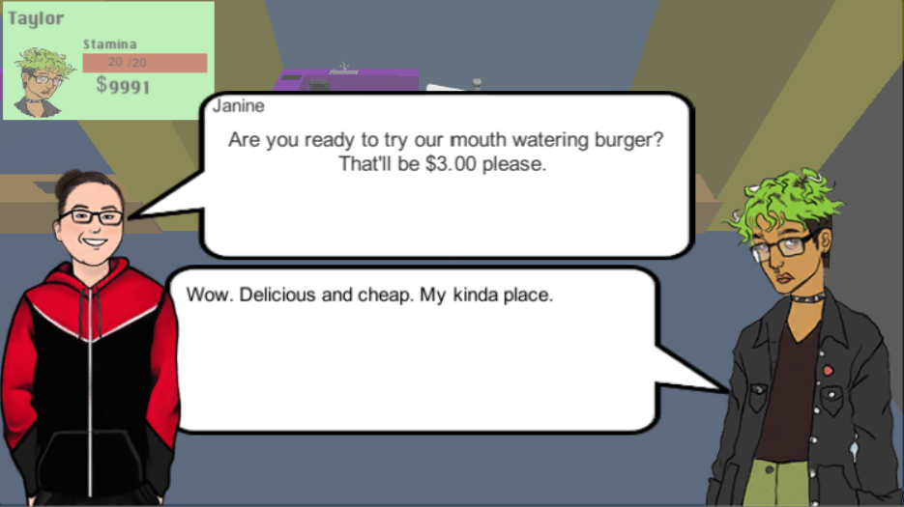

Slide 27
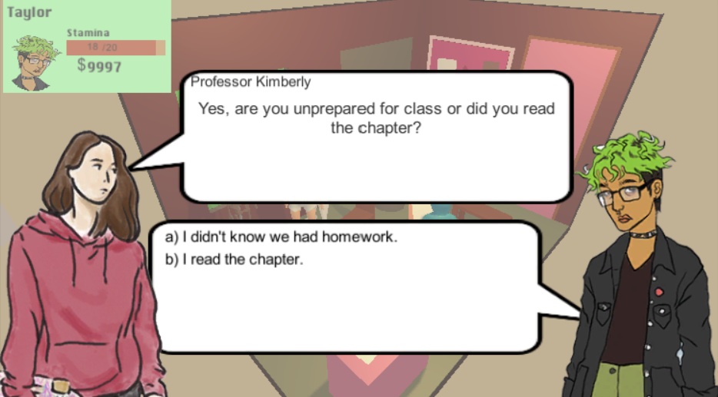

Slide 28
Game Design & Requirements:
Audio Management
Controller
Notes:
Composing Music
What software?
Style?
Move mini-map section to Map section

Slide 29
Video Games NEED Music and Sound

Slide 30
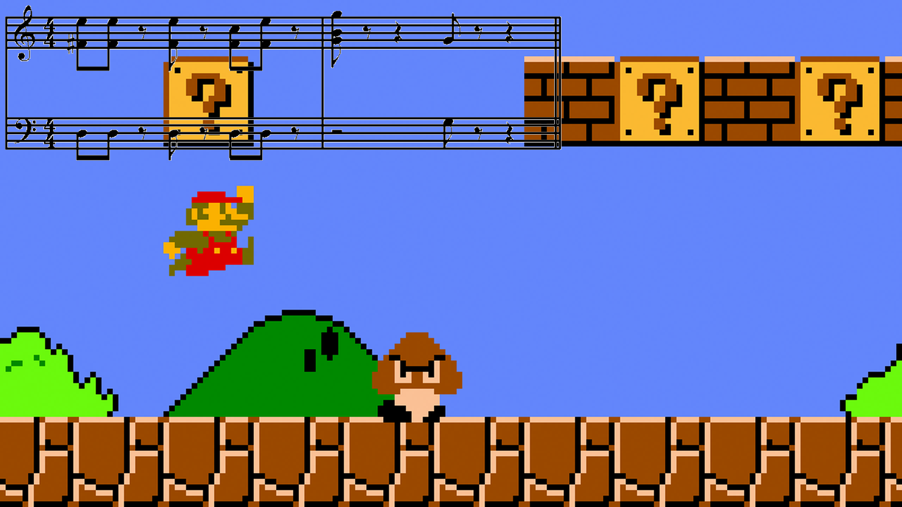

Slide 31
MuseScore 2

Slide 32
Software Tools
Music and Sound
MuseScore 2
Freesound.org
Team Communication
Slack
Discord
Google Docs
Unity 3D
C#
Collaborate
Maya
Animation
Modeling
Adobe Photoshop

Slide 33
What We Have So Far
&
Future Plans
Notes:
So far working on core game mechanics
Detailed Storyline still in progress
Plan to make 8 levels
First full level completed by start of Spring Semester
Cell Phone Functions
Player Achievements / Buffs / Perks
Finish core mechanics in next few weeks
One slide for software tools before conclusion
Summarize what has been achieved so far
Achievable future plans

Slide 34
