Slide 1
Improve the WiFi Coverage and Quality in Cal State LA
Daniel Xu
Steven Castro
Albert Ting
Jorge Lima
Paul French

Slide 2
Acknowledgements
Advisor
Dr. Guo
Liaisons
Jason Solis
Michael Lee
Edmund Gean
Cal State LA Computer Science Department

Slide 3
Agenda
Introduction
Requirements
Framework
Frontend
Backend
Difficulties
Solutions
Future milestones

Slide 4
Introduction
Background
WIFI Coverage at Cal State LA
Blind spots, Poor speeds, Connection issues
Eg. Salazar Hall, Food Court
Why do we need this?
Improve user experience
Crowdsourced WIFI reports
Minimize maintenance
Optimizing infrastructure
Notes:
We can assume wifi is an important part of our lives as students. We use for a variety of reasons be it for entertainment reasons like Netflix or youtube or research purposes like searching for answers on google or chegg. Whatever the reason is, if the wireless internet suddenly stopped it could mean the difference between passing or failing a class. About a month ago, the school’s WIFI was down for a whole day and

Slide 5
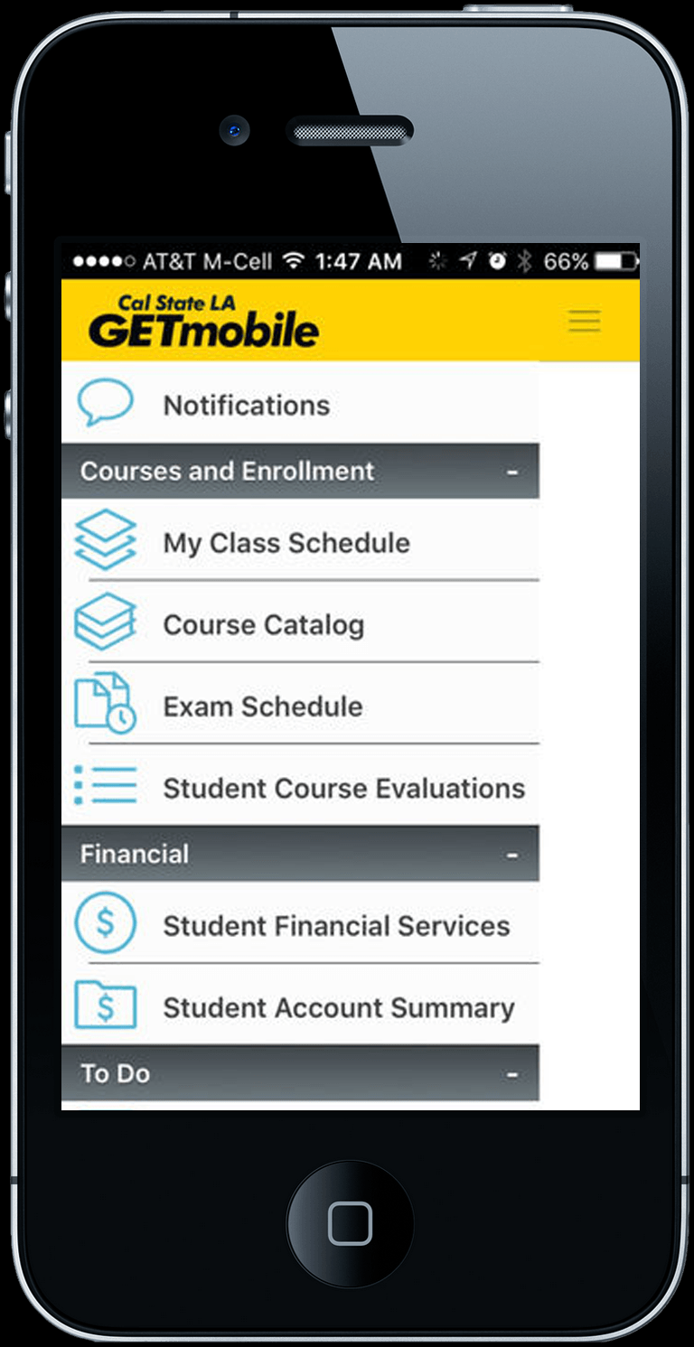
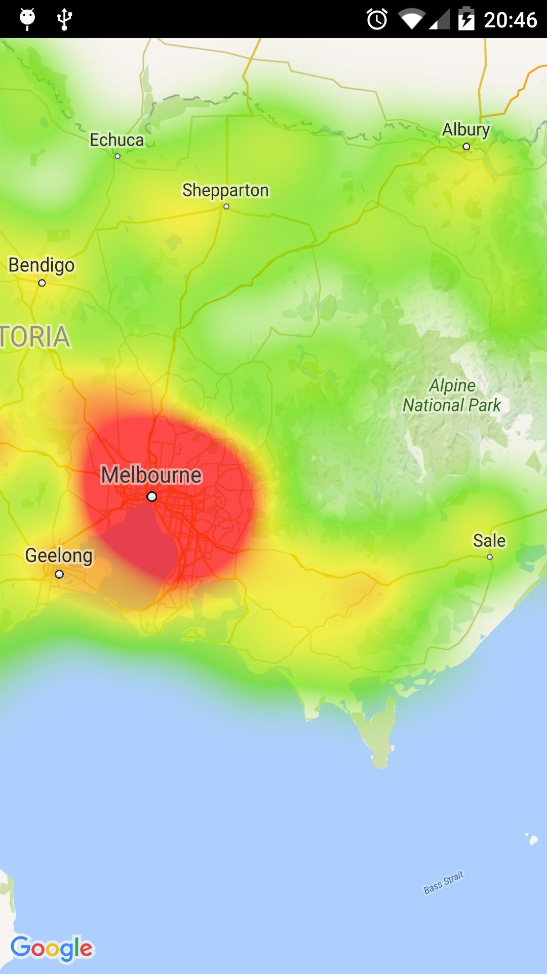
Introduction continued….
How will we do this?
Integrate our web app into GETmobile
Allow client to submit data
Create heatmap based on data
Mission Statement:
To improve the WIFI coverage and quality in Cal State LA and to optimize and reduce the number of WIFI infrastructure used

Slide 6
Requirements Gathering
Weekly meetings to gather requirements for the project
Initial weeks dealt with the scope of the project.
Database
Separate Servers
IOS/Android/Web based
Reporting Forms
Following weeks dealt with platform for the project
Web based (dropped IOS/Android platforms for a web-based approach)
Database setup
GPS for location through web

Slide 7
Core Features
The functions of IWCQCSLA are as follows:
Provide a link within the CSULA GET mobile app to access the IWCQCSLA module.
Show a heatmap of reported Wi-Fi outages within the CSULA campus.
Provide a form for a user to report a Wi-Fi outage within CSULA. The form will have been partially completed if location (via GPS) is given permission by the user.

Slide 8
Front End (Android)
APIs
Android Location API
Coordinates
Determine location
Google Maps Android API
Graphical depiction of current location
Android Wi-Fi API
wifiInfo class
BSSID
SSID
IP Address (of Android device)
RSSI (Received Signal Strength Indicator)

Slide 9
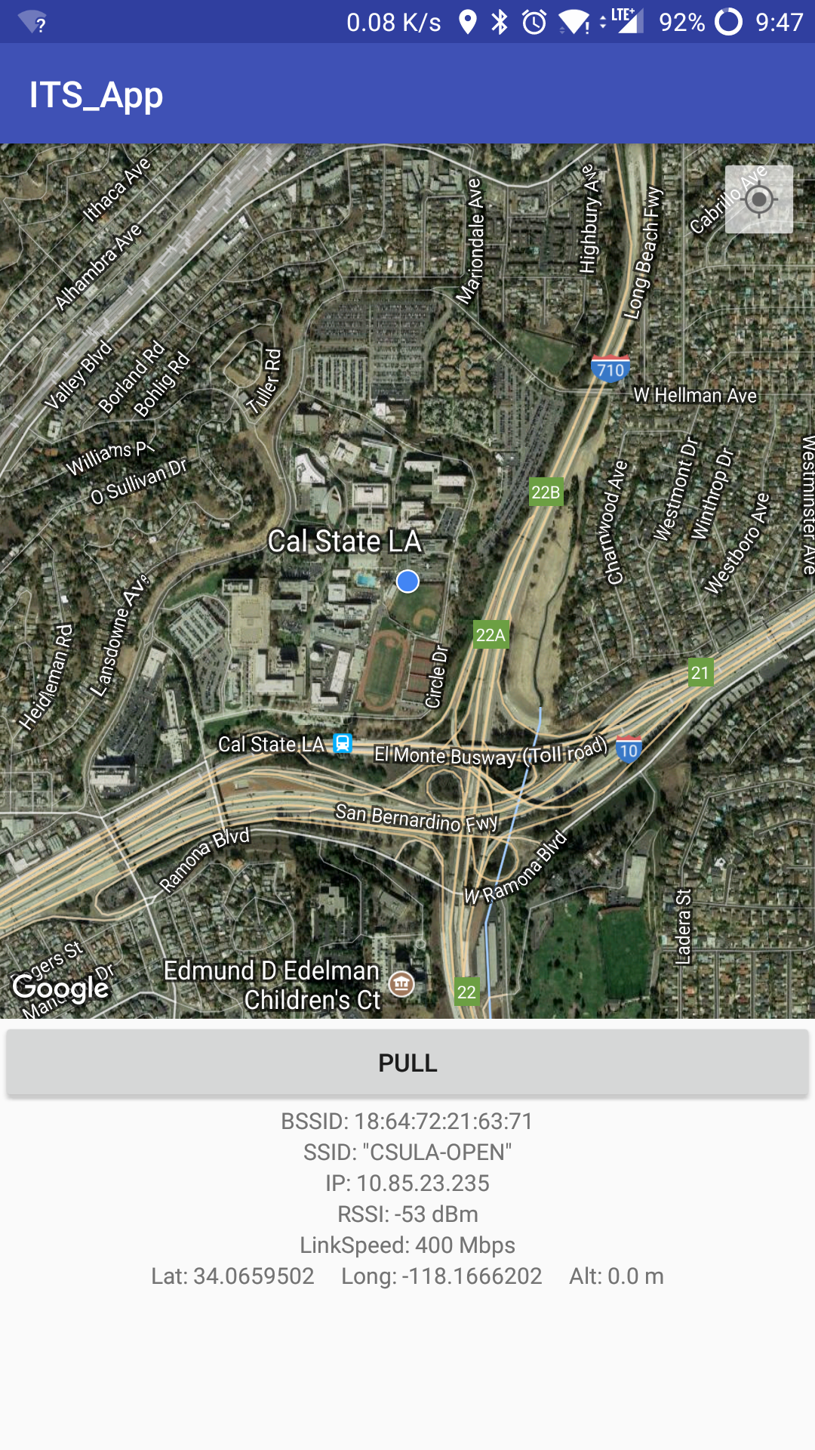
Front End (Android)
Connecting to the database
PostgreSQL JDBC driver during testing phase
Eventually utilize a REST web service for security

Slide 10
Front End (Web Application)
Created with PHP and Javascript
PHP
Prepared statements
Javascript
Autofill fields
APIs
HTML5 Geolocation
GPS coordinates(if available), otherwise wi-fi + cell tower
Scripts
Latency

Slide 11
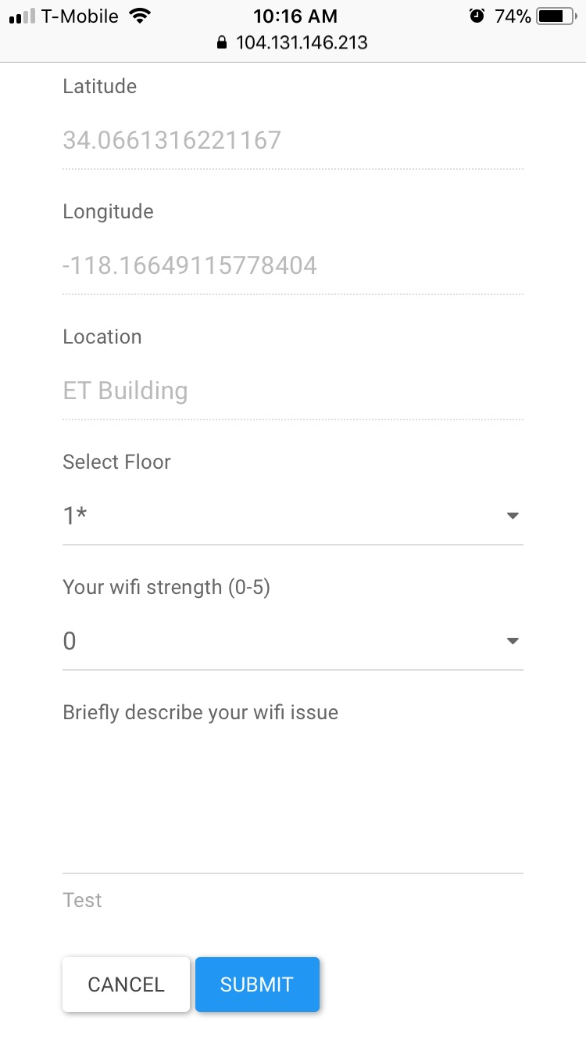
Front End (Web Application)
Autofilled data
Coordinates
Date
User agent header
Browser and OS information
App version
Browser version info
Ping
Public IP
Building location
Preset coordinate ranges stored in DB

Slide 12
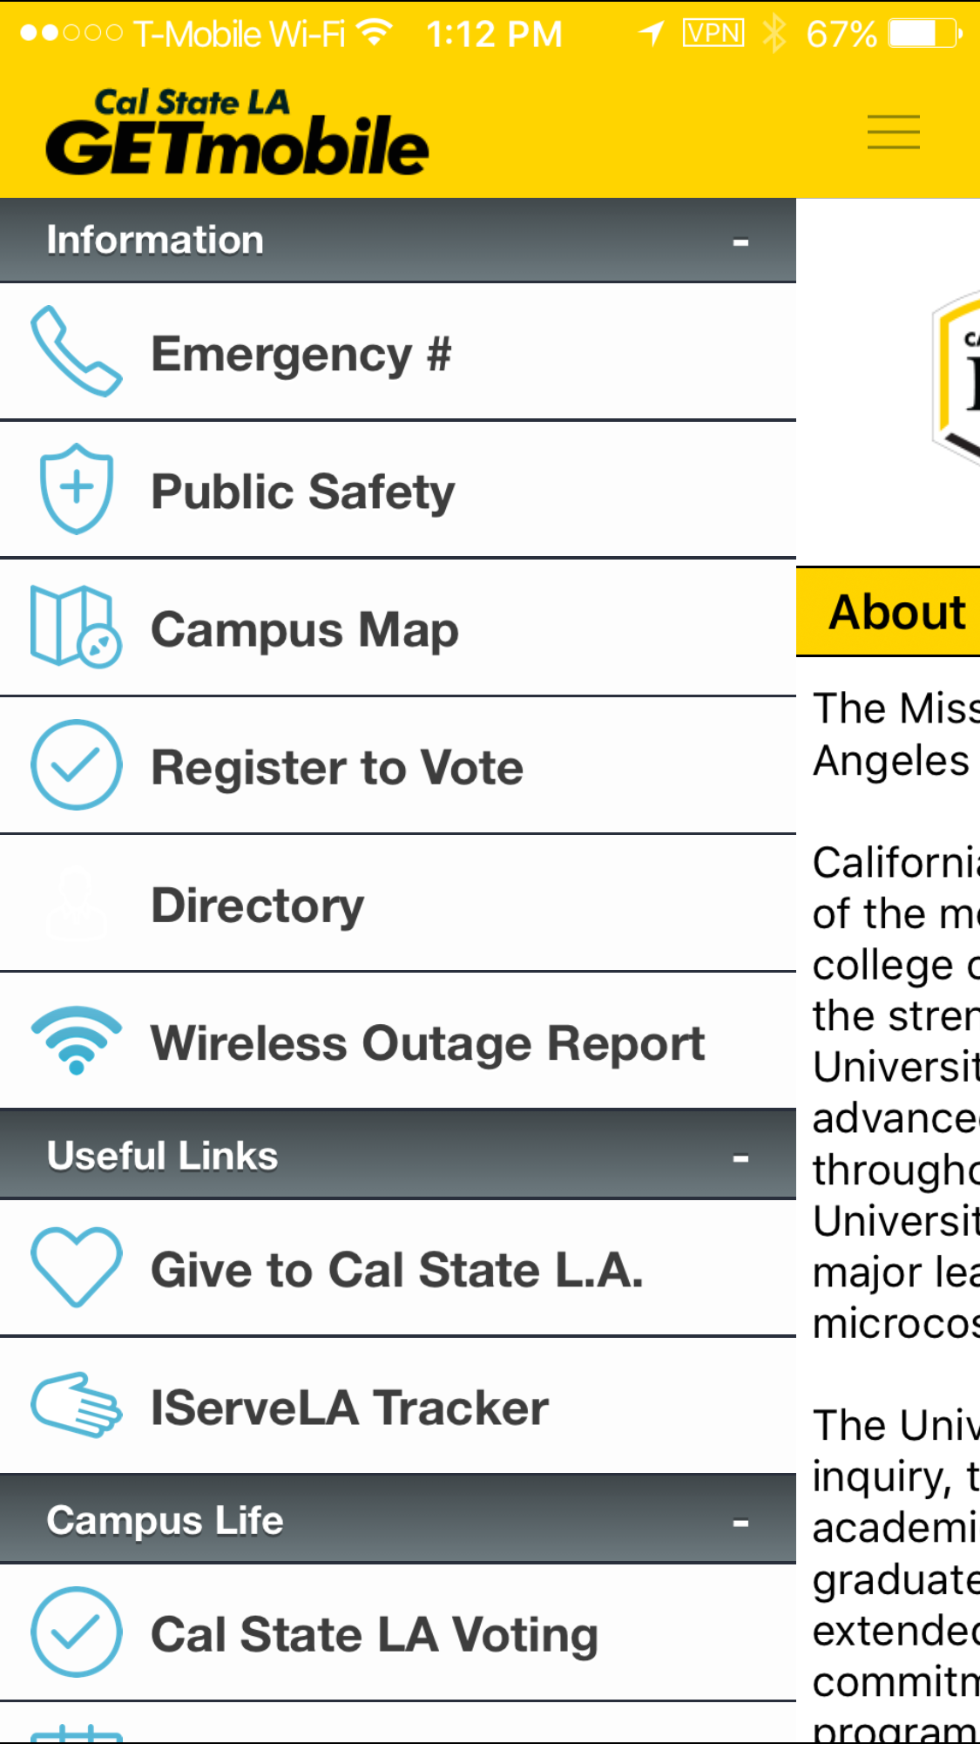
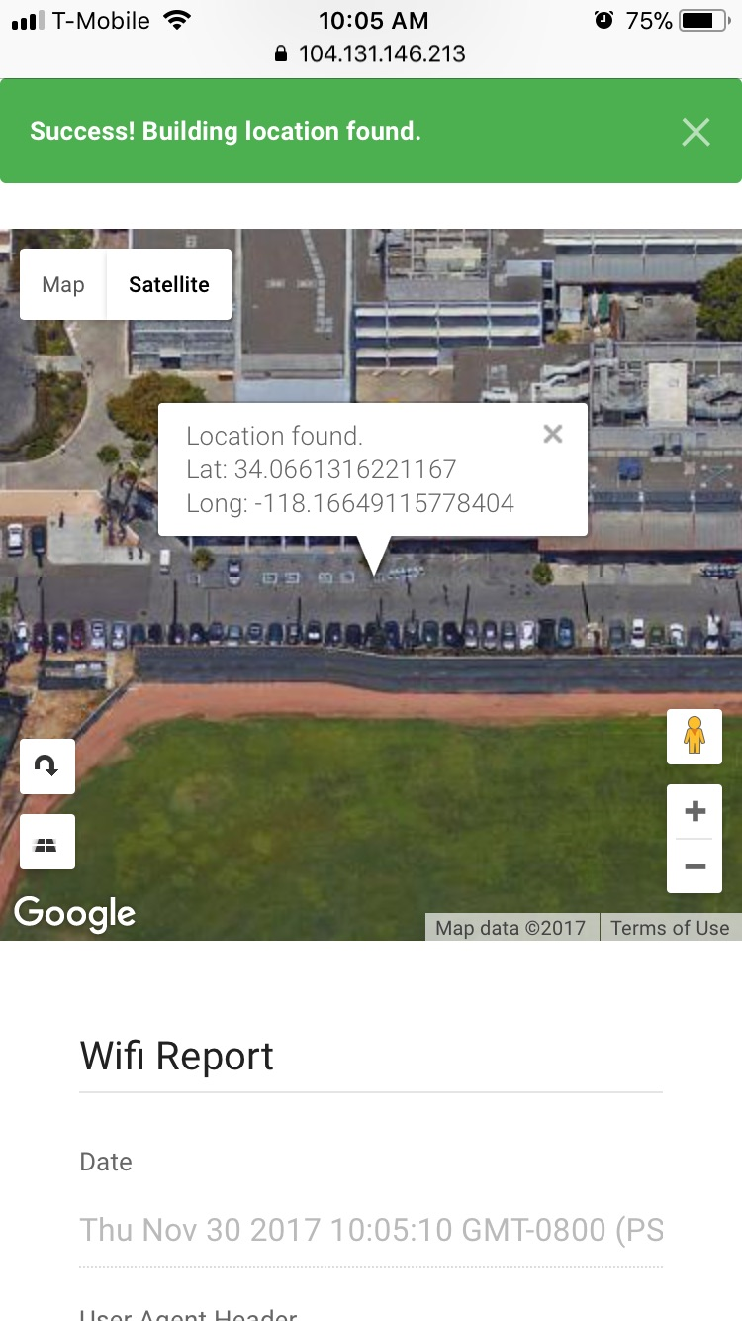
Front End (Web Application)

Slide 13
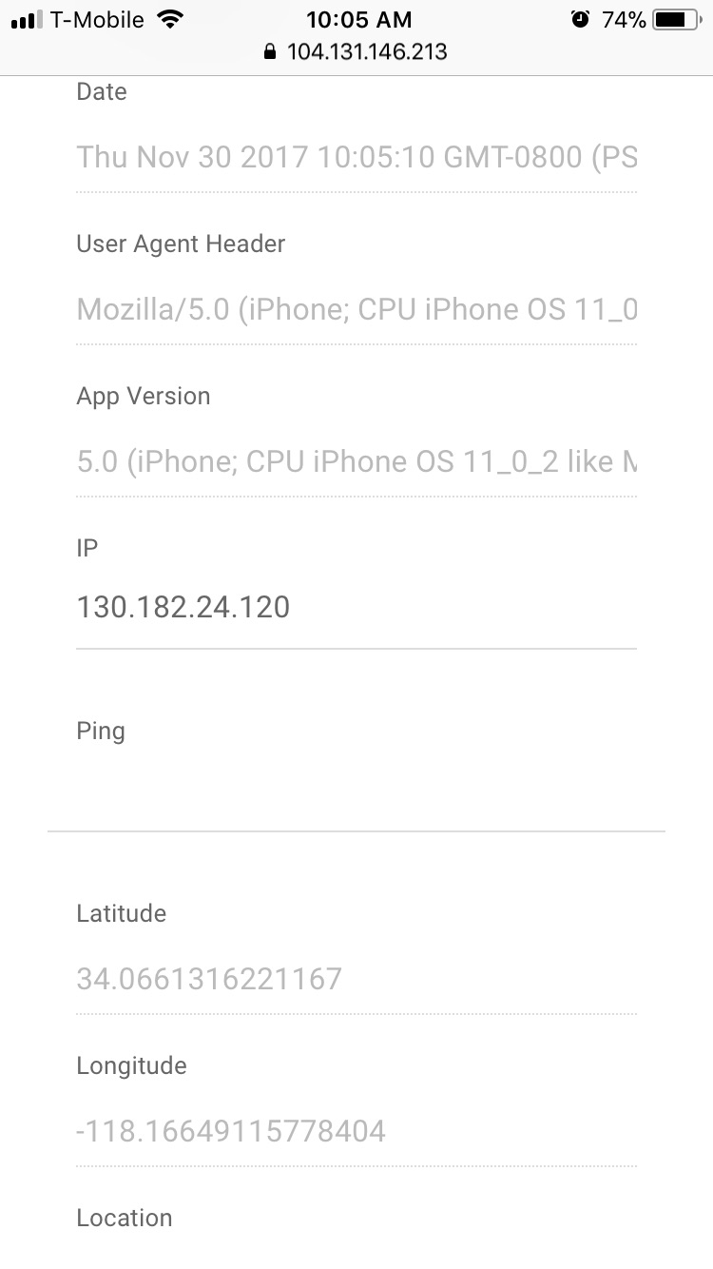
Front End (Web Application)

Slide 14
We chose to develop the Web Application
Front End (Summary)
Native | Web
Pros More detailed and accurate reports Private vs. public IP BSSID RSSI Cons Difficult to incentivise users to download and utilize the app No access to iOS devices No access to an Apple Store Developer account | Pros Streamlined GETmobile integration Cross-platform access 70% iOS Upgradability - can be instantly updated Reach more users vs native Cons Reliant on self-reported user forms

Slide 15
Back-end
Foundation of the project
Logic of database and front end interactions
Database setup
Systems Administrator duties

Slide 16
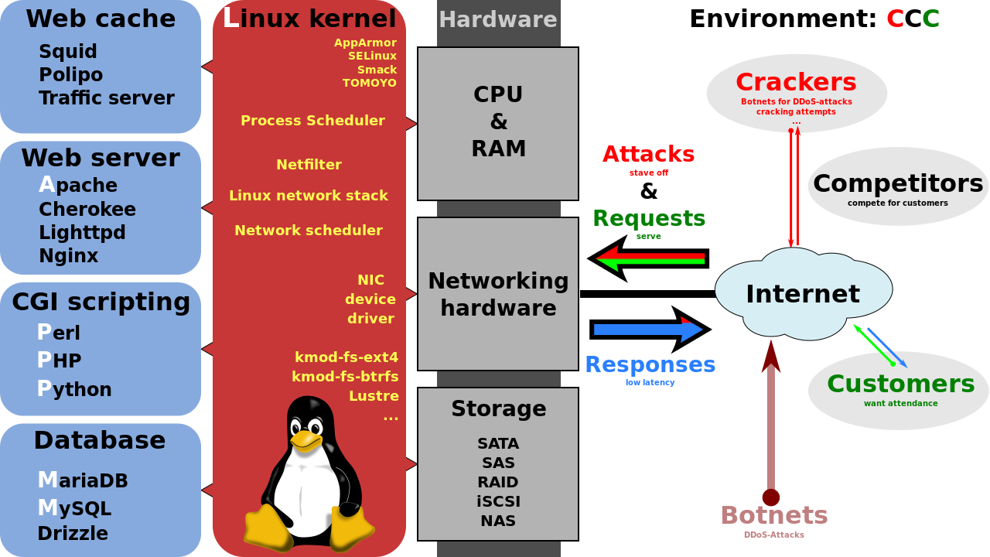
High level view of webstack

Slide 17
LAPP Stack
Stability
Adaptability
Scalability

Slide 18
Database Setup (Native)
Native APIs give access to a plethora of data points
Could be cross referenced with AP Data for fine-grain location gathering.

Slide 19
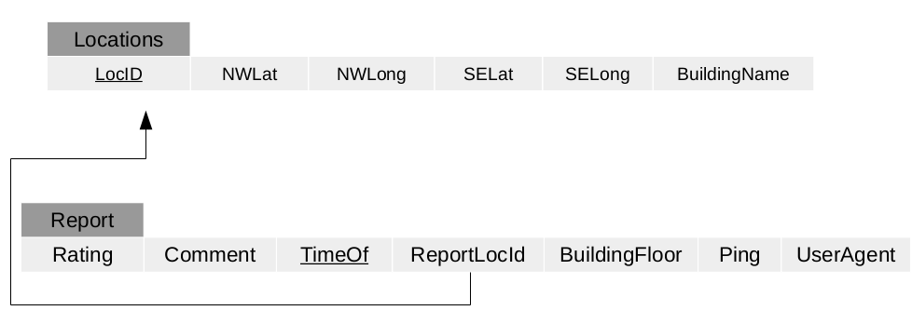
Database Setup (Web Application)
Browser sandboxing restricts amount of data we have access to.
Total installs the GET Mobile App has (35K) makes up for that discrepancy.

Slide 20
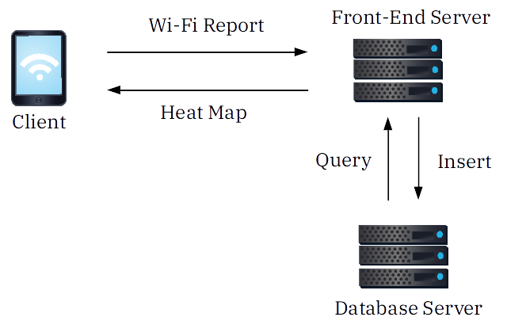
High Level Diagram of Client/Servers Interaction

Slide 21
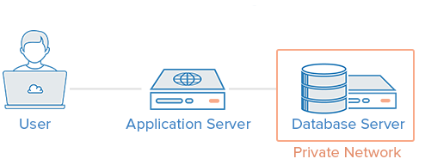
Connecting Front and Back Ends
Submitting Form to Backend
Uses POST method
Sends a PostgreSQL command to fill the database

Slide 22
Difficulties
The Push for an Android App to Add More Accuracy
Limitations of Web-Based app
Difficulty sending values of form inputs that are prefilled with javascript to the database (still a work in progress)
Difficulty coming up with times to meet up
Difficulty juggling classes with the project

Slide 23
Solutions
Reaching 35K GETmobile app users
Used a Form on the Website
Further Research to Send Form Data Via JavaScript
Use of Zoom Meeting Application to Meet

Slide 24
Future Milestones
Back-end:
Maintain data security and integrity via HTTPS cert and validation of data given, along with other methods.
Stress testing the back-end to meet possible demand.
Migrating off-campus testing server to on-campus hardware.
Front-end:
Improve mobile UX and UI
Drop down forms
General
Improve security to prevent attacks from malicious users

Slide 25
Thank you!!!

