Slide 1
QTC – CSULA: Helix (Formerly “Exam File Manager”)
Senior Project 2021-2022
May 5th , 2022

Slide 2
Agenda
Team, Advisor, & Liaison Introduction
Who QTC is
Background
QTC’s Needs
QTC’s Current Solution
Project Requirements
Technologies Used
Project Overview
Frontend
Backend + APIs
Challenges
Retrospective
Achievements
Demo

Slide 3
Team Introduction
CSULA Advisor
Keenan Knaur
CSULA Team Leaders
Norman Avery
Josh Mermelstein
CSULA Team
Abdullah Alwabel
Dean Baquir
Daniel Ibanez
Sameen Khan
Noe Lopez
Jeffrey Lum
Jose Mierzejewski
Wilson Tobar
QTC Liaisons
Francisco Guzman
Luis Arcantur
Julian Gutierrez

Slide 4
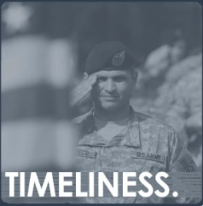
QTC Overview
Part of Leidos company ($10B+ technology solution provider)
The largest provider of government-outsourced occupational health and disability examination services in the nation.
Process 4 million+ pages of medical records daily
“Examinations for America’s Heroes”

Slide 5
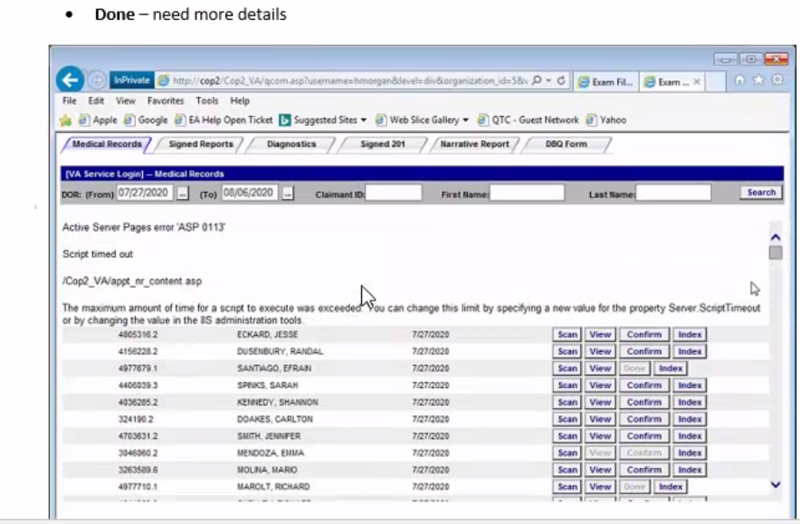
EFM - What is it?
Web Application
Document Repository of Medical Exams
Used by government agencies, medical professionals
Used to qualify people for additional services, such as medical benefits.

Slide 6
QTC's Business Needs
Scalable and customizable web application
Operations - View | Search | Update
Medical Records
Signed Report
Efficient onboarding | Quick turn around time

Slide 7
Background EFM (Previous Version)
Currently it is not extensible and scalable for adding/deleting/modifying features
Does not have the flexibility to add new LOB's (Lines of business)
Data access for current functionality is currently inline in classic asp and will be moved to stored procedures
Procedures allow business to change their own backend logic without stopping the running application

Slide 8
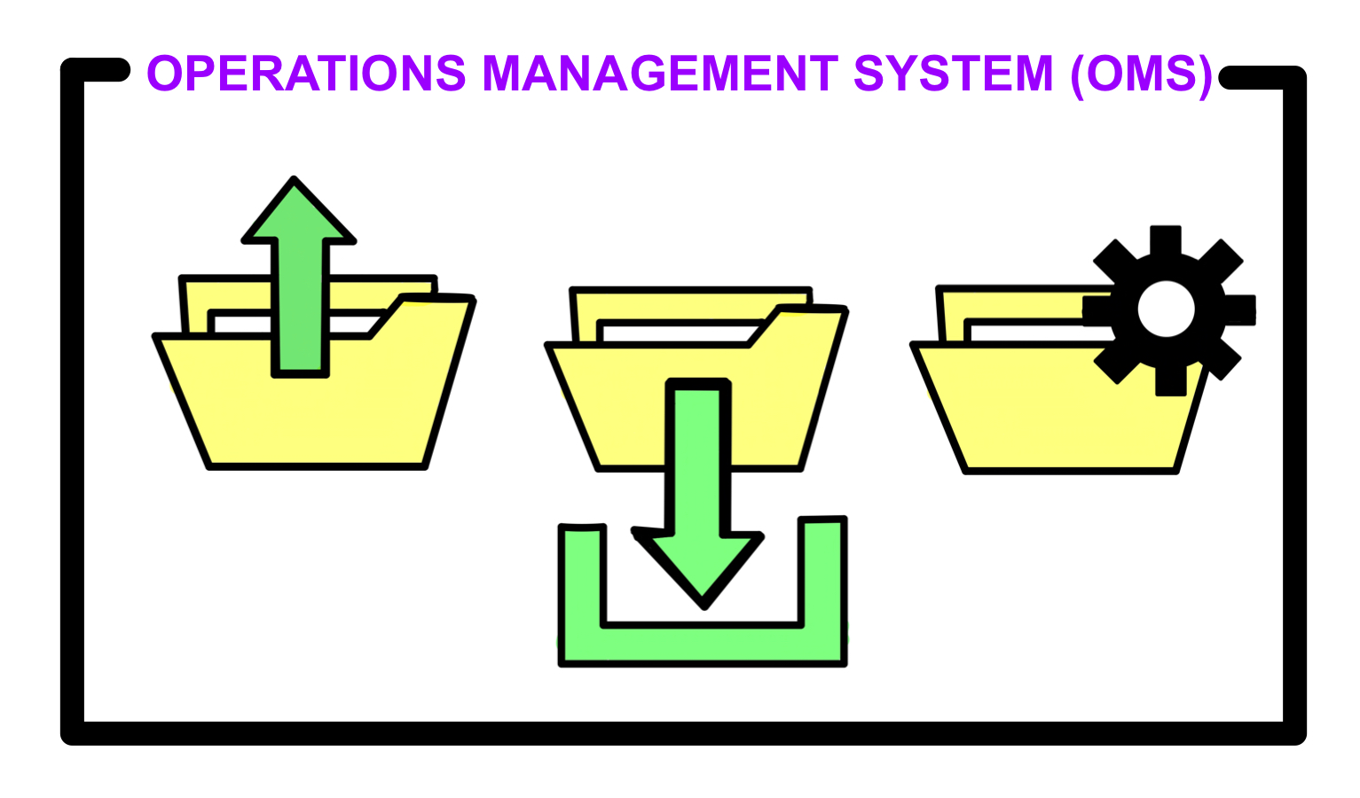
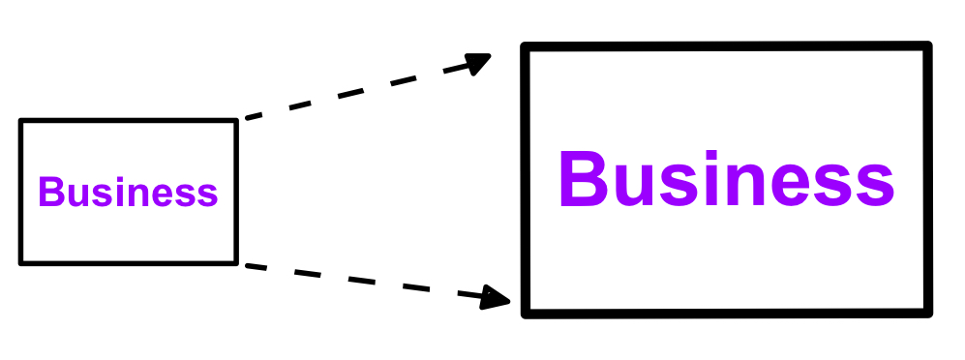
Why QTC Needs an Exam File Manager
Operations Management System (OMS)
A collection of processes in a program or website that enables efficient day-to-day business management practices such as:
Taking files
Managing them
Storing Files (i.e., repository)
Extensible structure
Easier to modify existing code with clearer, more extensible code
Currently uses if else logic
Architecture is not currently created for long-term useability
As a result, hard maintainable
Services configured by the plugin and injected into the program via Dependency Injection
Improve functionality of the core features
Fig: ENABLED EXTENSIBILITY
Fig: DELAYED MODIFICATIONS

Slide 9
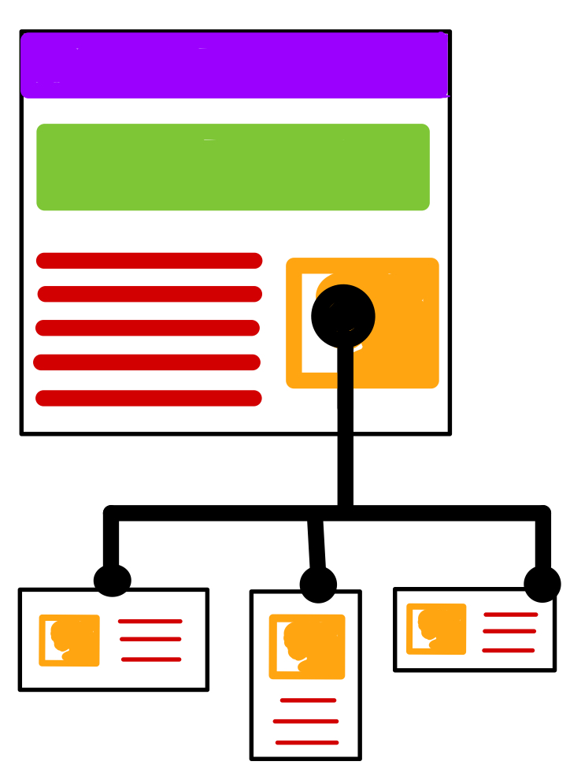
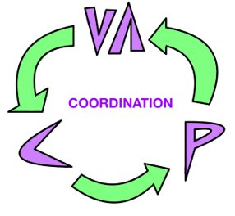
Why QTC Needs an Exam File Manager (Continued)
Intended actions:
Insurance benefits determination processes as per the case and the parties involved in that specific case
Dealing with Federal Entities such as the Department of Labor and Secret Services etc.
Juggling through multiple lines of businesses with common resources (database and functionality) and yet be able to handle the respective tasks that each line of business intends to handle
Expected End Result:
Needs to work efficiently regardless of the volume of the content and activities on the website
Should be able to coordinate between the claimants, the Veteran Benefits Administration, and the providers (appointment scheduling, diagnosis, and feedback)
Intended actions:
Insurance benefits determination processes as per the case and the parties involved in that specific case
Dealing with Federal Entities such as the Department of Labor and Secret Services etc.
Juggling through multiple lines of businesses with common resources (database and functionality) and yet be able to handle the respective tasks that each line of business intends to handle
Expected End Result:
Fig: CONTENT VOLUME
Fig: COORDINATION BETWEEN PARTIES

Slide 10
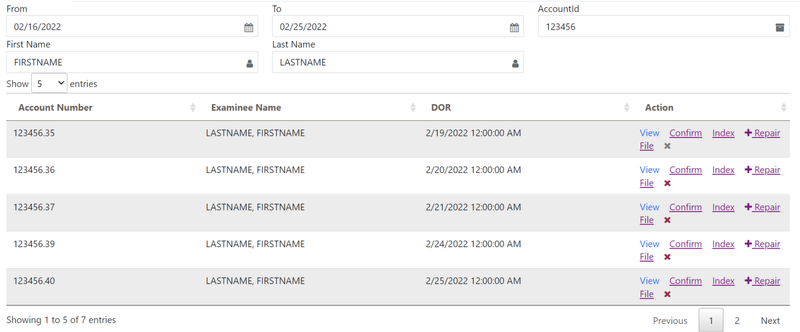
Project Requirements Medical Records Requirements
Dynamic Tabs
Pagination
Search
Date picker
Interfaces
Notes:
Components
Dynamic Tabs (GUI)
Loaded from SQL, authenticated by Authentication Module
Working Interfaces
(Complete, Index, Repair, View, Delete)
Front-end pagination
Search implementation
Extensible via compiled DLL plugin
Date picker
Javascript/Jquery

Slide 11
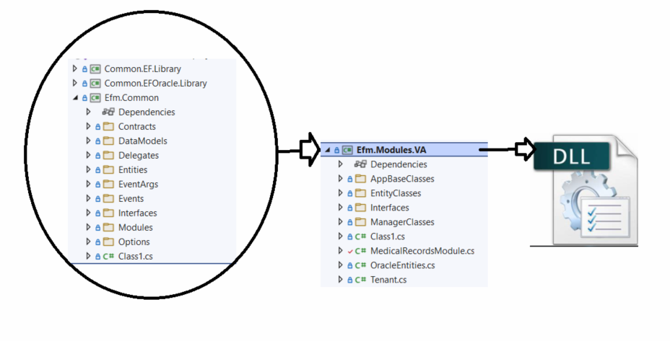
Project Requirements – Scalable and Extensibility
Overview
Organizations need to be easily added to app
Additional organizations are added to application via compiled plugin
Web application is made aware of new organization’s features

Slide 12
Project Requirements – Extensibility Four Main Components to Achieve Extensibility
(1x) Interfaces – Itenant
Encapsulated Object that contains everything that the GUI needs to display data
(1x) Interface - IMedicalRecordsModule
Custom Implementation of Medical Records Search – Unique to each Line of Business
(1x) Object – GenericRecordsObject
Generic Collection of Records
(1x) Method – ExecuteFeature
Generic Implementation and Execution of Features
Notes:
Components
Dynamic Tabs (GUI)
Loaded from SQL, authenticated by Authentication Module
Working Interfaces
(Complete, Index, Repair, View, Delete)
Front-end pagination
Search implementation
Extensible via compiled DLL plugin
Date picker
Javascript/Jquery

Slide 13
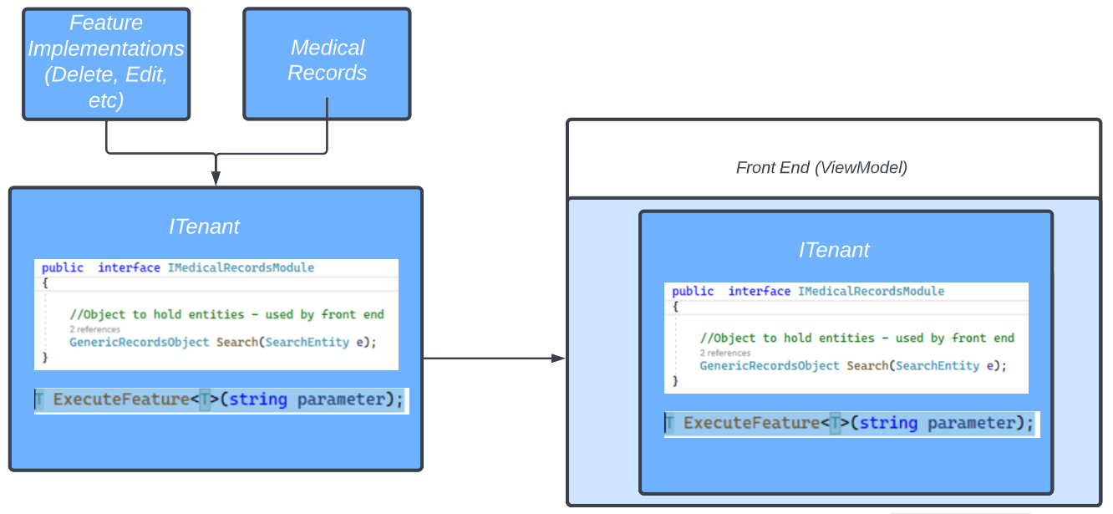
Project Requirements – Extensibility Four Main Components to Achieve Extensibility
Notes:
Components
Dynamic Tabs (GUI)
Loaded from SQL, authenticated by Authentication Module
Working Interfaces
(Complete, Index, Repair, View, Delete)
Front-end pagination
Search implementation
Extensible via compiled DLL plugin
Date picker
Javascript/Jquery

Slide 14
Project Requirements – Decoupling
Adding New Lines of Business
Other Lines of Business will not be affected
Changes to Lines of Business
Programmed Logic can be updated without affecting the web application
Storage
Each line of business can implement their own data storage requirements
Bugs
Application bugs within a line of business do not affect the web application overall

Slide 15
Project Overview Helix (Formerly EFM)
The new approach will benefit the users without compromising the infrastructure of the entire application.
The following will be interacting with the web application:
External File Repositories
Database
Assembly Plugins
File Systems

Slide 16
Project Requirements Helix (New Version)
Helix will load all the plugins at startup
All the implementations for all tenants will be injected after loading all the assemblies
The library assembly interface will contain all the required class members and function declarations that will be used to extend common functionality
Each object will be created and injected as a service at runtime

Slide 17
Technologies Used
C#
.NET 6 MVC
Razor Pages
Entity Framework
JavaScript
jQuery
AJAX Calls
Bootstrap and CSS
Buttons and Styling
Oracle DB
VA Implementation specific
Medical Records
SQL
Buttons
Tabs
Permissions and Roles

Slide 18
Frontend
Users can search by filtering using
(First Name, Last Name, Date From, Date To, Account ID)
These Fields are REQUIRED
Date picker is frontend only allowing dates with max range of 10 days from Date From
Frontend Pagination

Slide 19
Project Overview - Frontend
Each file has a set of actions that may be performed
Actions are dictated by User Permissions (Roles)
View – View indexed pages
Confirm – Disables Index modification
Delete – Soft Delete

Slide 20
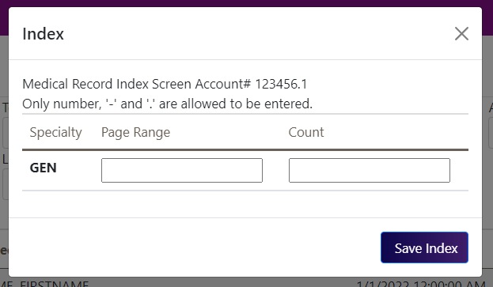
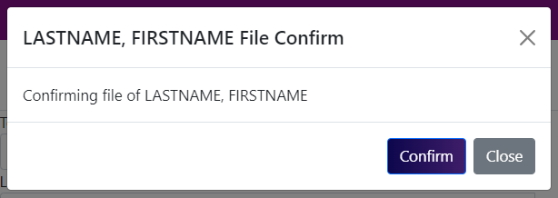
Project Requirements Index
Index using page range or specific pages
Examples
[1-10] - 10 pages
[1,5,6] - 3 pages
[1-5, 7, 9-10] - 8 pages
Once user is satisfied with indexed ranges, they can confirm and will no longer be able to modify indexed values

Slide 21
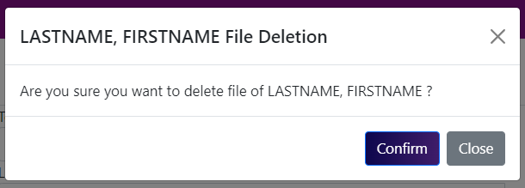
Project Requirements Delete
Considered a soft Delete
Will rename the file to a convention in which it will not show when searching from the database.
(the record will disappear from frontend but will still be stored in the database)
The user uses a Modal in order to confirm.
This action IS reversible

Slide 22
Project Requirements Backend
One Main Controller
One Main Method ("IActionResult")
Used for search, index, confirm, and all other actions
View Is in Main EFM controller, as IActionResult
Returns a FileStream using a file path retrieved from database
Logic is implemented in Line of business (DLL)
This allows business to implement their own logic while using the QTC structure

Slide 23
Challenges
New Technologies
Project scale
New frameworks/languages
Lots of open-ended research
Communication Barriers
Large group
Many points of contact
Group Organization
Coordination struggles
Equal participation
Technical issues

Slide 24
Challenges
New Technologies
Finding the right resources
Putting the time in
Willing to work unusual hours
Communication Barriers
Good leadership
Wide range of experiences
Group Organization
General enthusiasm to learn
Notes:
Social Challenges
This project involves familiarizing ourselves with advanced web programming concepts
Elementary level of web programming
Programming in HTML and CSS
Top it off with Model-View-Controller for a clear view
Learning new paradigms
Often shifting focus
New technologies
Learning from online documentation that was hard to follow (Microsoft documentation)
Technical Challenges
Learning new technologies
Figuring out where to get answers to questions
Debugging and Logic
Being realistic with solutions
Software requirement priorities
NOTE
Builder slide: first part shows issues, second part shows solutionss
WRIT:

Slide 25
Retrospective
What went well
Implementation of core features
LOBs have been decoupled
Graphical user interface
We learned various advanced techniques
Team collaboration & communication
What didn't go well
The solution of our implementation aren't exactly what is needed
Worked only on Medical Records
A lot of time was spent understanding the project
What can be improved
Improve functionality of the core features
Created some features that differed from QTC's specification.

Slide 26
Achievements
Application was redesigned for extensibility with modern back-end frameworks.
Application has the capability to be dynamically configured.
Configurations were implemented based on plugins (assemblies) executed at run time.
Application can interact with external systems and additional services.
User interface was redesigned with modern front-end frameworks.
Interfaces were created to implement application features.

Slide 27
Demo

Slide 28
Feature Implementation - Search

Slide 29
Feature Implementation - View

Slide 30
Feature Implementation - Index

Slide 31
Feature Implementation - Confirm

Slide 32
Feature Implementation - Delete

Slide 33
Thanks to QTC and CSULA!

