Slide 1
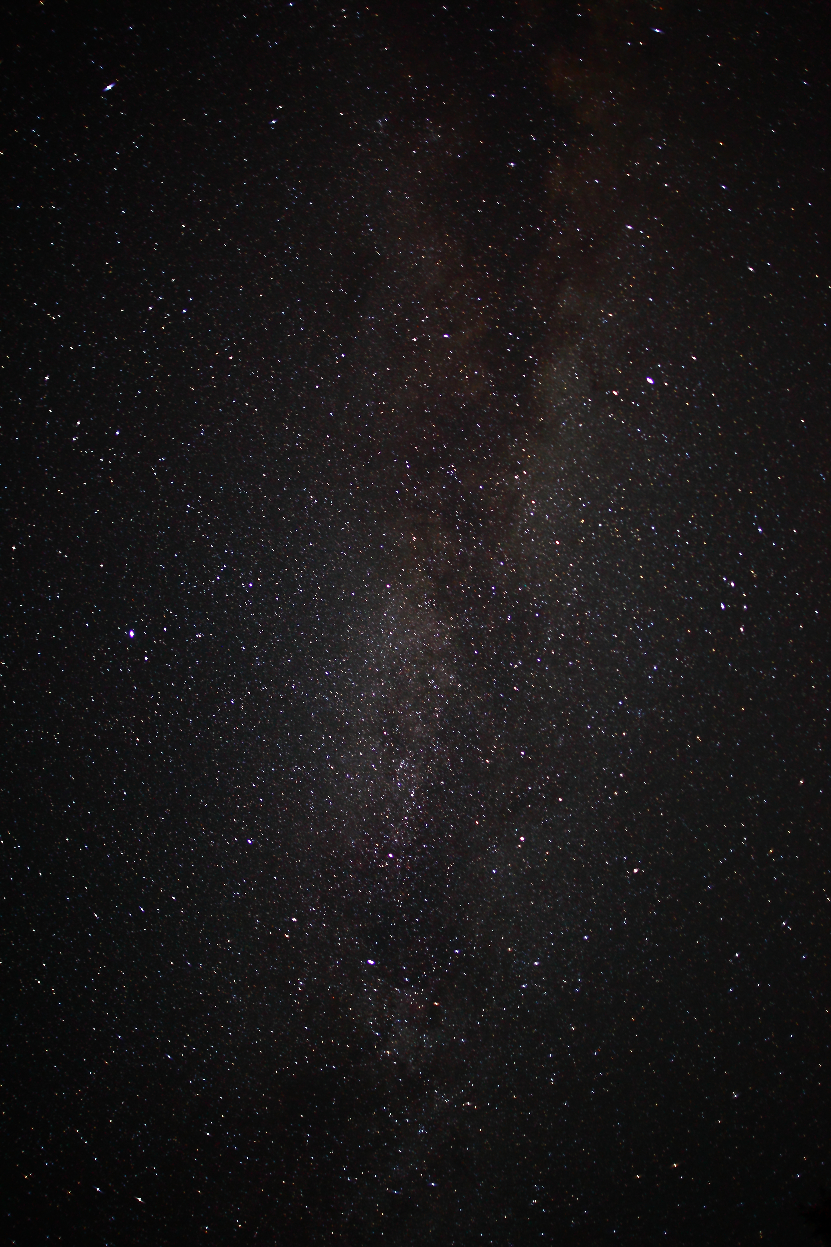
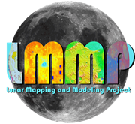
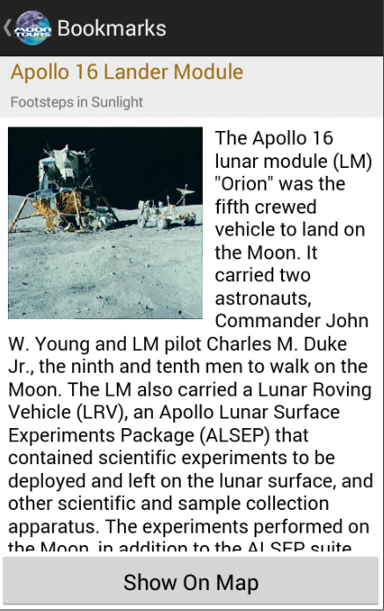
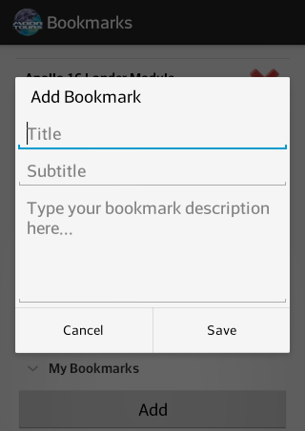
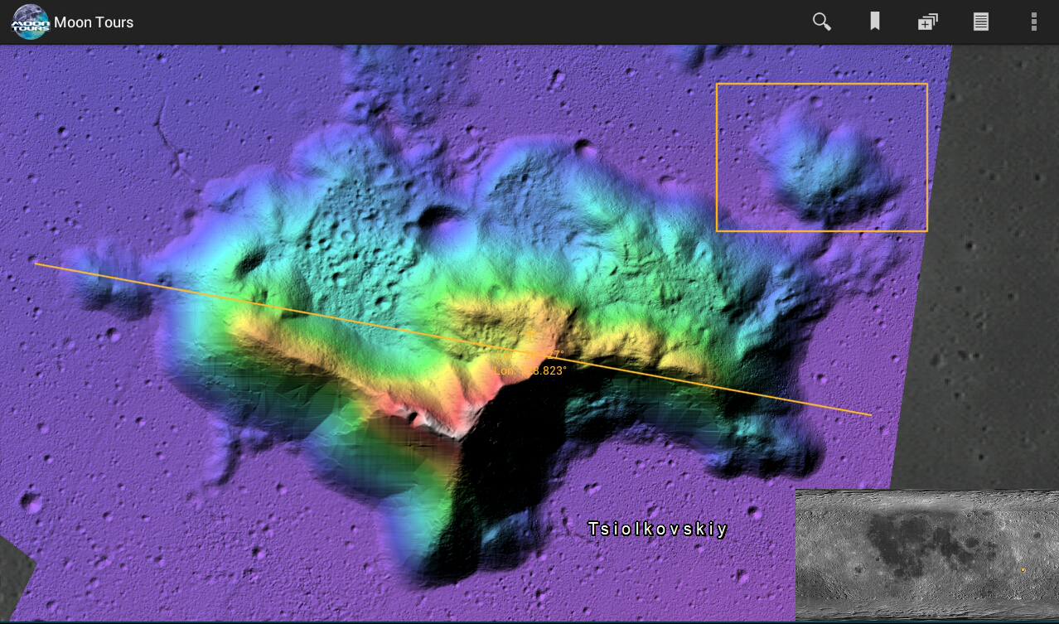
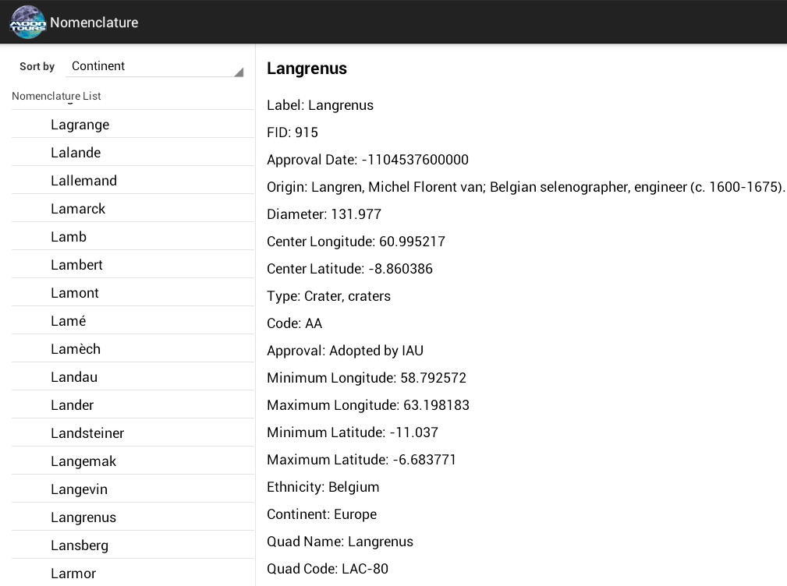
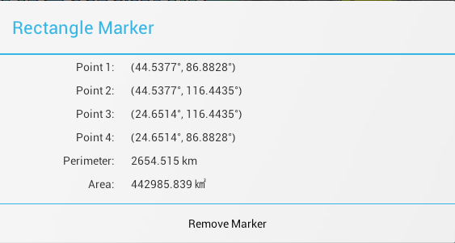
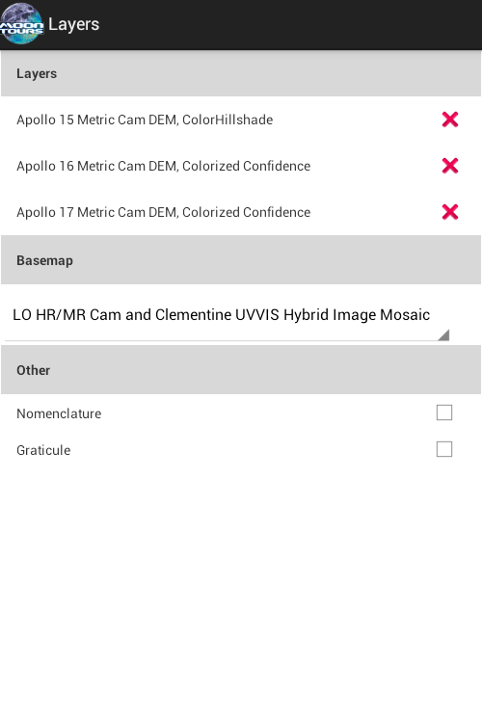
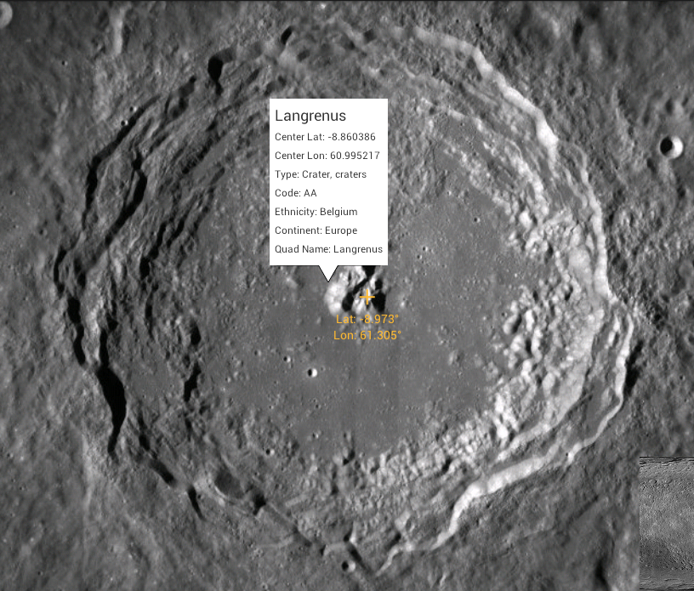
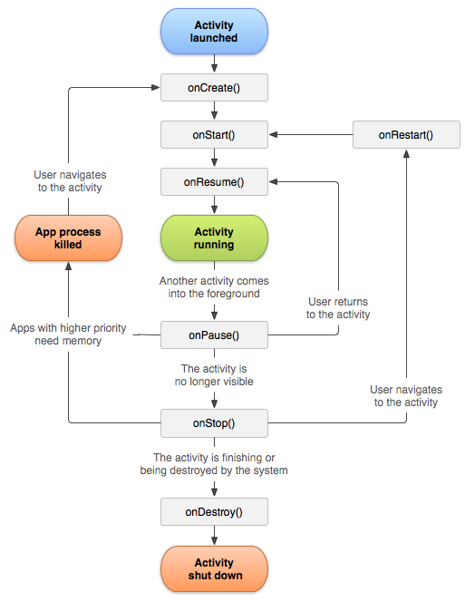
Lunar Exploration Web and Mobile Applications
Lunar Mapping and Modeling Portal Android Application
(LMMPAA)
Team Members: Eddie Arevalo, Alvaro Ortiz, Daniel Soto
Faculty Advisor: Chengyu Sun
Jet Propulsion Laboratory Liaisons: Emily S. Law, George Chang, Shan Malhotra, Kyle Dodge, Syed Sadaqathullah
Department of Computer Science
College of Engineering, Computer Science, and Technology
California State University, Los Angeles
Background
The LMMP website allows users to browse the wealth of information gathered by JPL during its lunar exploration missions.
Objectives
Layers
Marker Tool
Nomenclature
Bookmarks
Search
Devices:
Phone
Tablet
REST data, in the form of Json and XML data, are extracted from the JPL servers.
The REST data is downloaded into android devices to be displayed.
REST
(Representational State Transfer)
After extracting the xml layer data, images are downloaded to show various lunar map layers.
REST
Android SDK
Results
View information on famous lunar locations using the bookmark interface.
Gather information using the marker tools.
Use the nomenclature browser to find interesting lunar surface features.
Seven different marker tools including the ability to draw circles and polygons.
Add, remove, set opacity or reorder layers using the layers interface.
Switch between hundreds of layers and four different basemaps in order to see the lunar surface under the instruments of the LRO and Clementine.
Design
The combination of the different base architecture patterns allows for the ability to display a wide variety of information.
Results
Design
Architecture
App
Model
Control
View
Model View Controller in conjunction with the Android programming paradigm, including APIs such as ESRI and Jackson work together to form the application.
The LMMP Android App is currently in beta
testing on Google Play. An official release is coming soon.

