Slide 1
Satellite Anomaly Inject & Detection (SAID) Testbed
Powered by CSULA & Aerospace Corporation
Advisor: Zilong Ye
April 27th, 2022

Slide 2
01
Project and Team Introduction
02
OSK/COSMOS Overview
Ground and Flight System walk through
03
Denial of Service & Single Bit Error
Implementation Models
04
Challenges & Future Plans
CONTENTS
Goals and Issues in Development
05
Conclusion
Summary and Q&A

Slide 3
Welcome Agenda - Diana
Project Introduction - Diana Degiacomo
OpenSatKit - Tomas Velarde
COSMOS - Jae Lee
Denial of Service - Dearo Yam & Diana Degiacomo
Single Bit Error - Gabriel Kutasi, Michael Morris, & Gustavo Torres
Challenges - Gustavo Torres
Future Plans - Martha Caldera
Conclusion - Rafael Zaragoza

Slide 4
Organizational Chart - Diana
Project Leads
Diana Degiacomo
Dearo Yam
Documentation
Code Developers
Lead - Gabriel Kutasi
Lead - Diana Degiacomo
Lead - Dearo Yam
Lead - Gustavo Torres
Rafael Zaragoza
Martha Caldera
Tomas Velarde
Michael Morris
Jae Lee

Slide 5
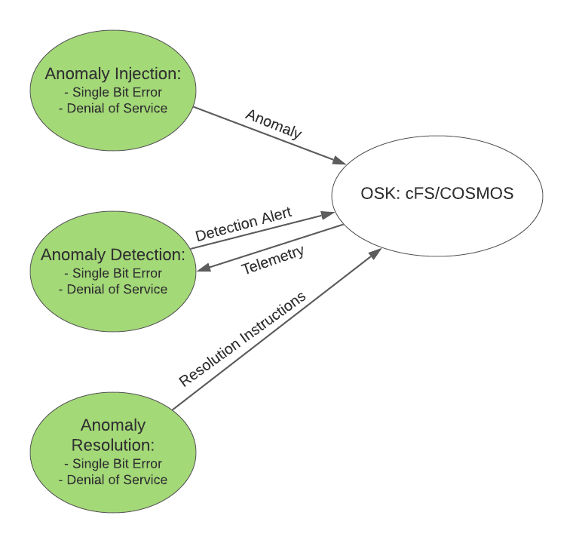
Project Introduction - Diana
Overall Project Goal: Protect satellites against malicious attacks
Industry Open Source Software: OSK - A core Flight System (cFS) Platform
Build apps to interface with this platform:
Inject Anomalies
Detect Anomalies
Resolve Anomalies
Anomalies:
Single Bit Error
Denial of Service
Notes:
general description of project. b4 jumping into technical details, what is said project, what does it do, show a picture, of a sat and ground system and how they communicate. protect Satellite against malicious attacks. protect sat system against malicious attack. bigger picture at the beginning

Slide 6
OSK/COSMOS Overview

Slide 7
OSK - Tomas Velarde
Open Satellite Kit (OSK) - A satellite simulation environment.
Our Team’s Goal with OSK- To use this simulation environment to simulate attacks against satellites and satellite malfunctions to produce effective countermeasures and remedies.
The 3 main components of Open Satellite Kit:

Slide 8
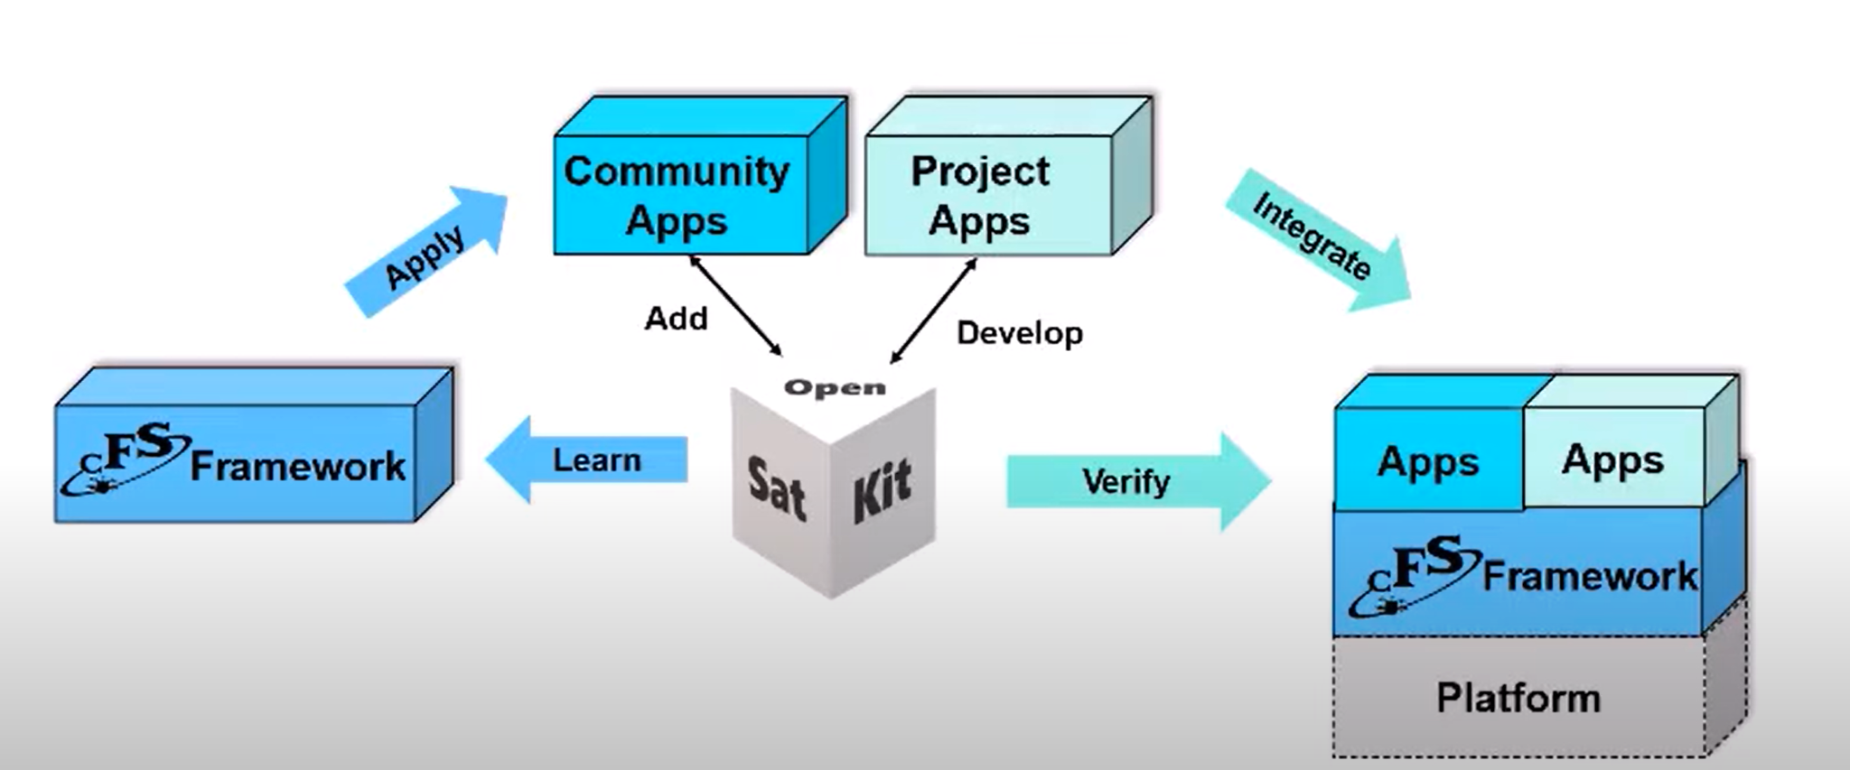
OSK - Tomas Velarde
Purpose of OSK

Slide 9
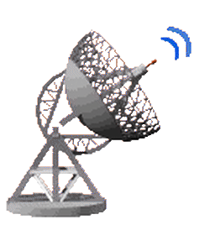
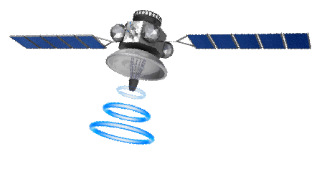
OSK - Tomas Velarde
Open Satellite Kit Composition: Three open source tools
Ground System
Satellite

Slide 10
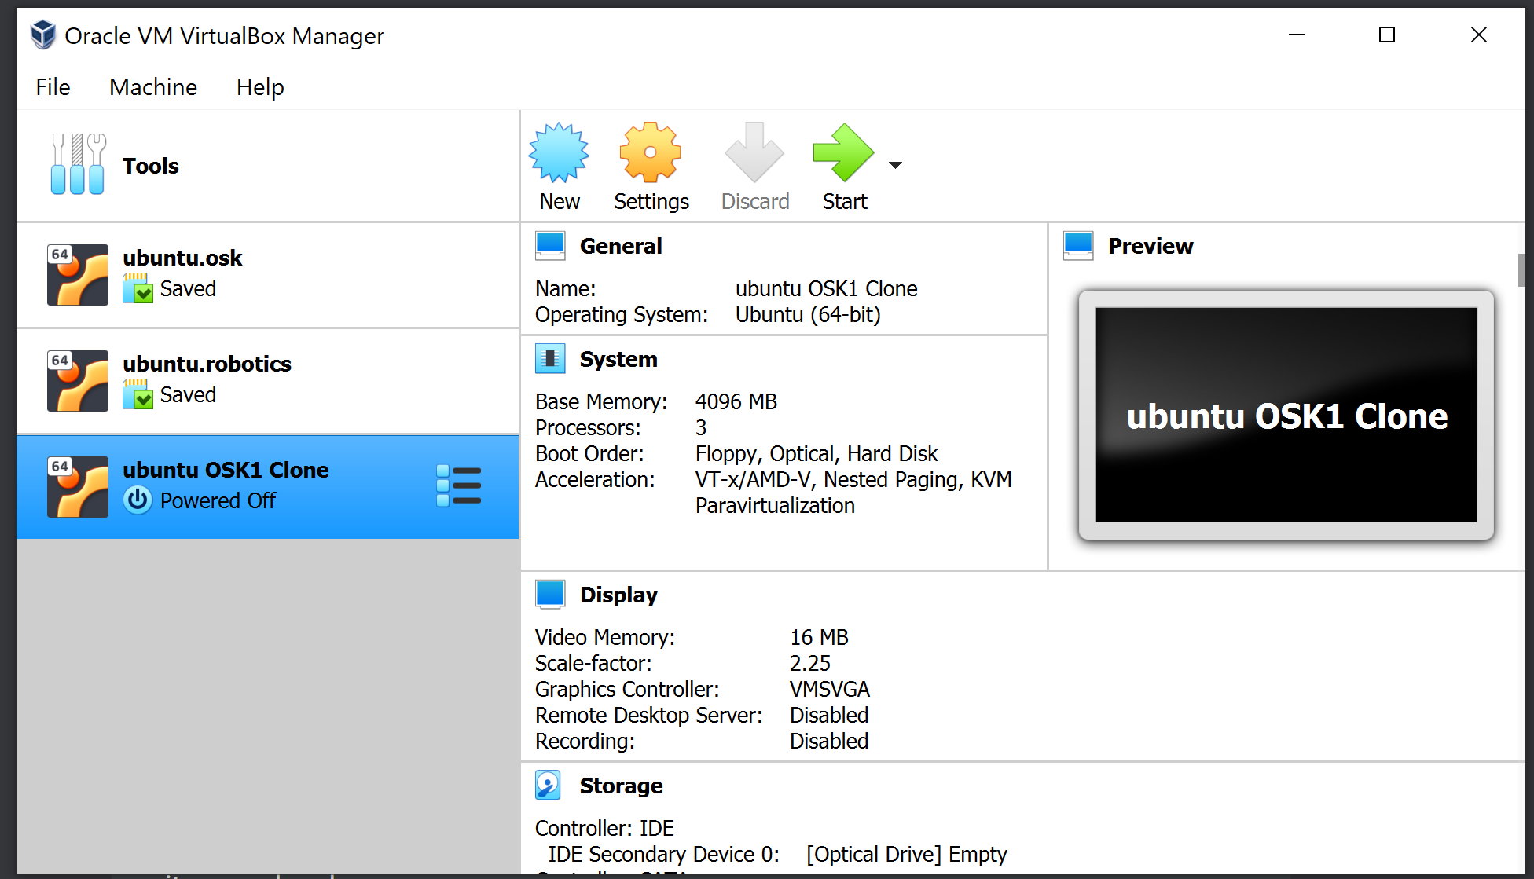
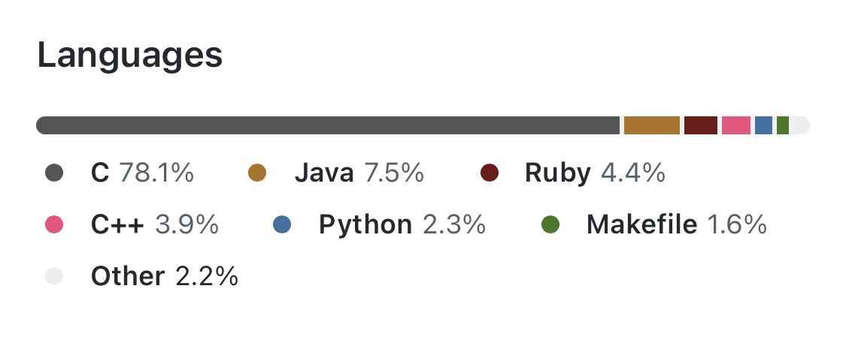
OSK - Tomas Velarde
Open Satellite Kit runs on Ubuntu Linux
Have installed Oracle VM VirtualBox, a virtual machine set up with Ubuntu Linux to run
Programming languages used in Open Satellite Kit:

Slide 11
Cosmos - Jae Lee
What is COSMOS?
A command and control platform
Open-source ground system
The primary OSK user interface
What is it used for?
To communicate with the satellite
Monitor the performance and health
Display the data
What is it used with?
Test equipment
Development boards
Satellites

Slide 12
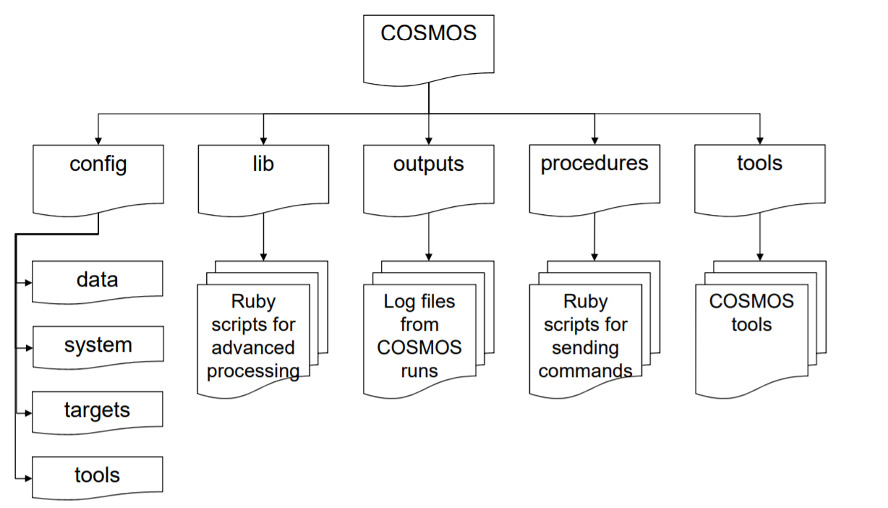
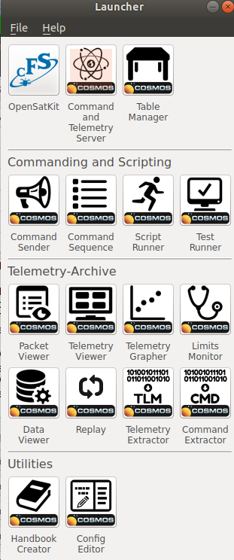
Navigating COSMOS - Jae Lee
Target
Destination for commands
Tools
The Launcher screen consists of tools

Slide 13
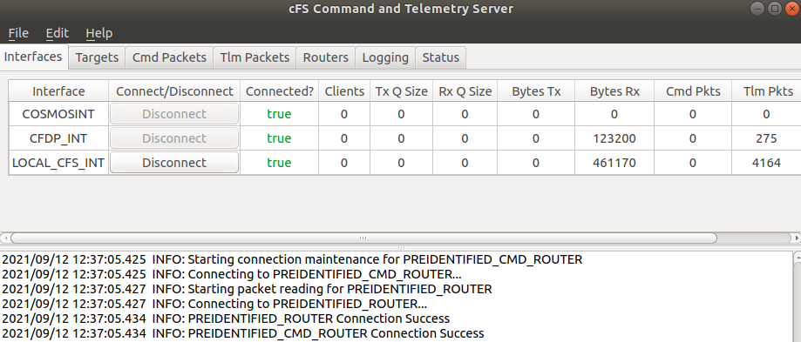
COSMOS Tool - Jae Lee
Command & Telemetry server tool
Overview of all the connections in the system

Slide 14
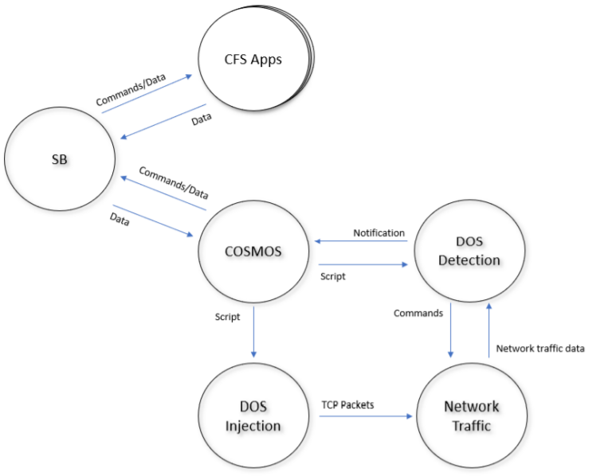
Using COSMOS - Jae Lee
Denial of Service (DOS) Injection

Slide 15
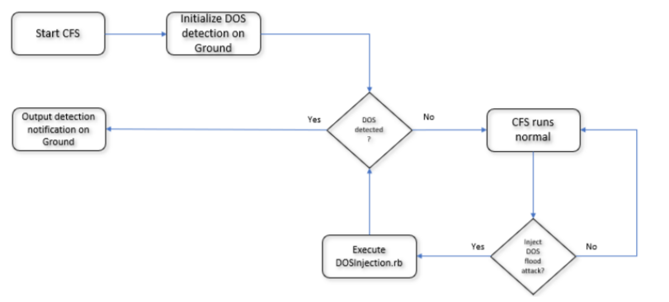
Using COSMOS (cont.) - Jae Lee
Denial of Service (DOS) Detection

Slide 16
Denial of Service

Slide 17
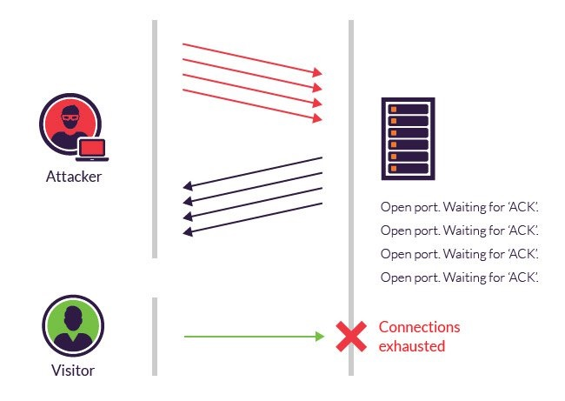
What is DDOS?
Attacker floods server
Server is unable to respond
Intended user unable to use server.

Slide 18
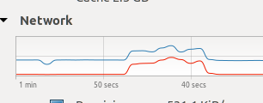
Injection Model DDOS - Dearo
Injection
injects a syn flood attack
happens for 8 seconds
Demonstration
Step1:
Final:

Slide 19
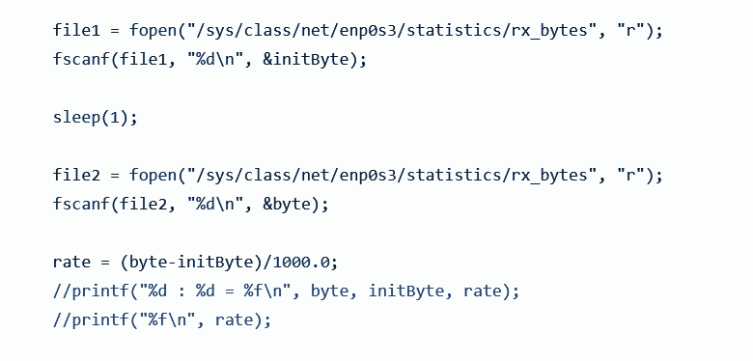
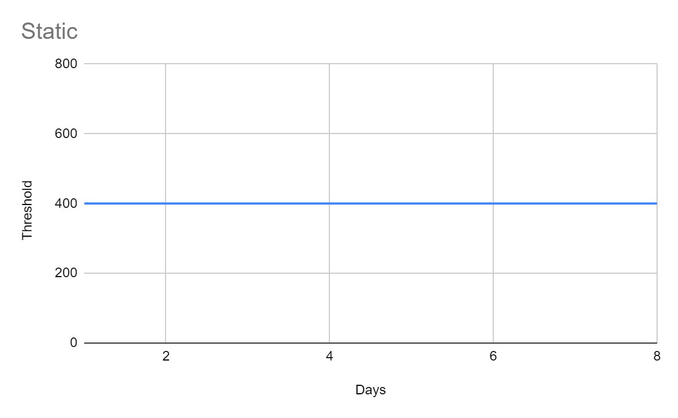
Old Model Of DDOS (cont.) - Dearo
Detection Of DOS

Slide 20
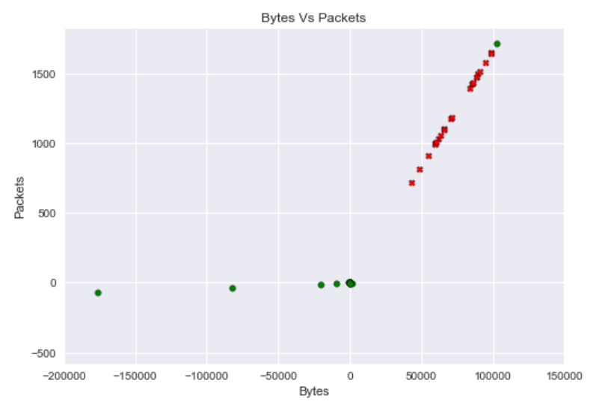
Current Detection Model - Dearo
Detection Of DOS
Machine Learning
How?
Our process
Lastly

Slide 21
KNN Model
Packets
Bytes

Slide 22
KNN Model
Packets
Bytes

Slide 23
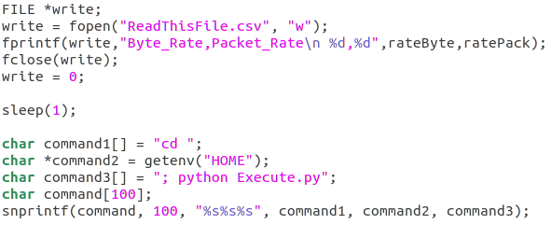
Current Detection Model - Dearo
Process
Read
Write
Output

Slide 24
Demo

Slide 25
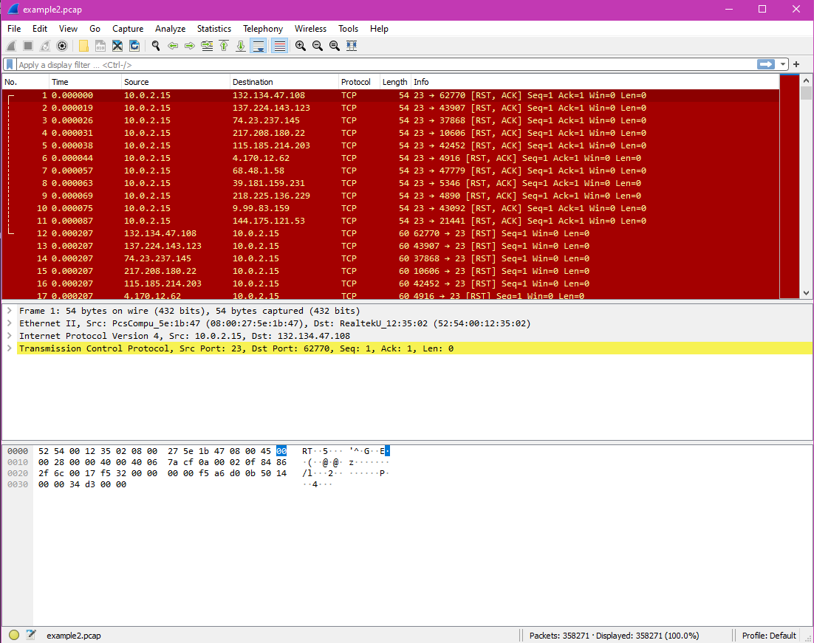
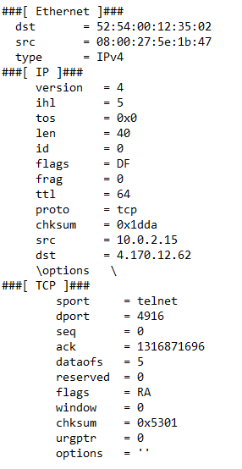
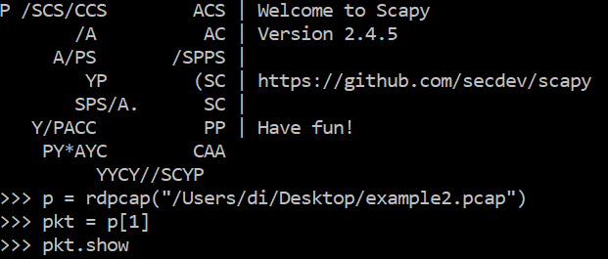
Wireshark/Scapy - Diana

Slide 26
Single Bit Error

Slide 27
What is Single Bit Error? - Gabe
Single Bit Error occurs when space weather is heavy and radiation hits the satellite. This causes a bit of RAM to be flipped.
Only one bit of given data is changed from 1 to 0 or 0 to 1
SBEI_Inject command is used for Injection which is located in the memory manager.

Slide 28
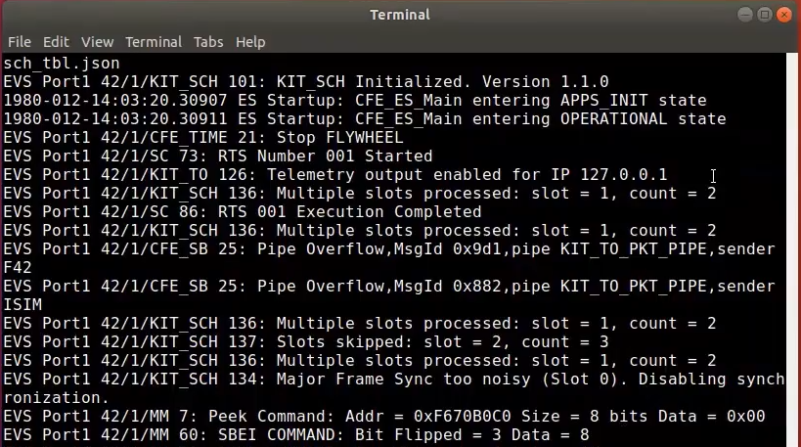
Single Bit Error Injection - Gabe
Single Bit Error Injection
Accessed through Command Sender
Injection command is located within the memory manager (MM)
Utilizing PEEK_MEM command will allow the user to view the memory that will be injected with the single bit error command
SBEI_INJECT will flip a bit in the memory, changing the data stored

Slide 29
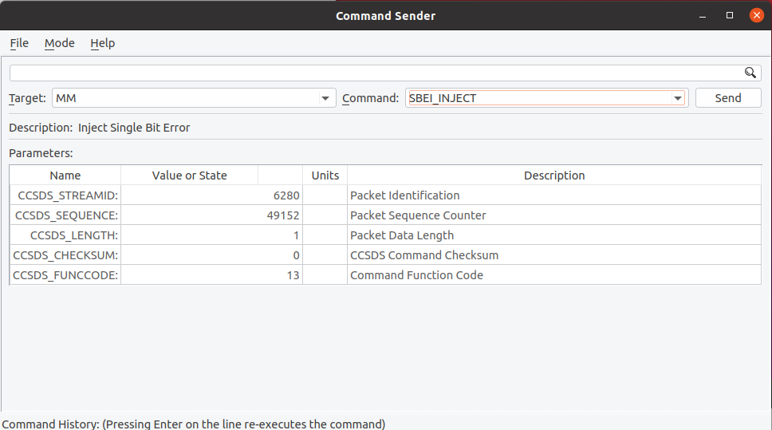
Single Bit Error Injection - Gabe
Single Bit Error Injection
The bits of the application’s data is changed when the command is called
The changed data isn’t stored to cosmos or cfs

Slide 31
Single Bit Error Detection Implementation Attempts - Gus
Attempted to constantly check when a bit was flipped using a loop
Attempted to have detection and resolution done in one command
Created another application that would have the commands to resolve and detect single bit error
Tried to implement a way to automatically detect when a bit was flipped

Slide 32
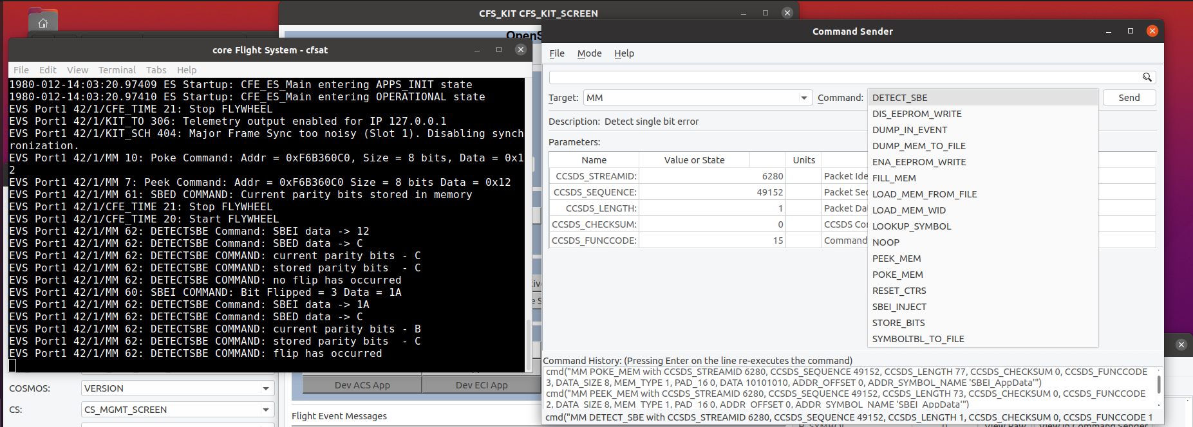
Current Single Bit Error Detection Model - Gus
Separated the detection software into 2 commands
Commands were created in the Memory Manager (MM) application
One command stores the parity bits from the ram of a dummy application to another dummy application
The second command then checks to see if the current parity bits are the same as the ones stored in the dummy application

Slide 33
Challenges

Slide 34
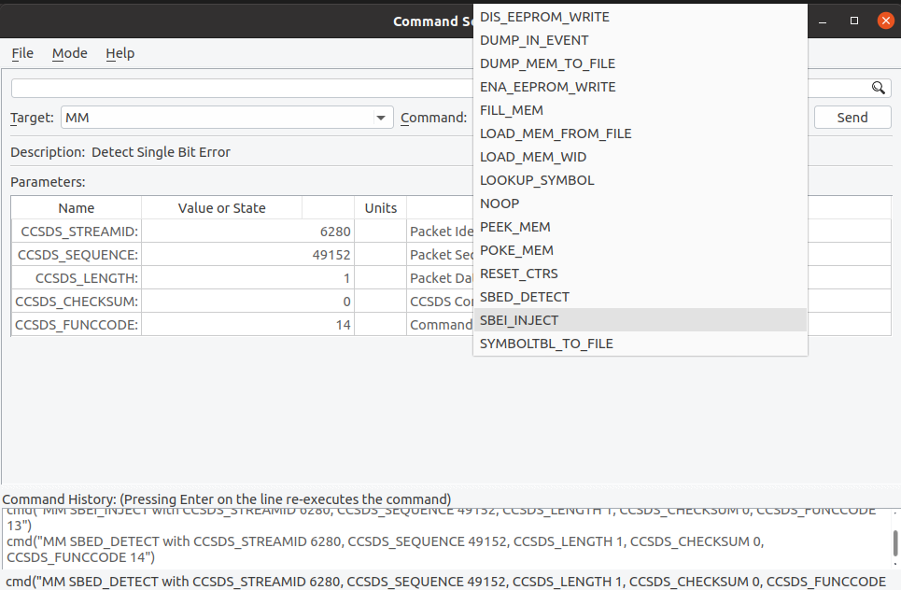
Challenges - Gustavo
Single Bit Error
Not able to read the data from an application twice in one run.
Cannot send a command to satellite while it’s already running a command from the same application
Having issues importing the CFE_utils
library to another application
Denial of Service
Lack of a proper dataset at the start
Having to learn a new topic (machine
learning) to some students

Slide 35
Future Plans

Slide 36
Future Plans - Martha
Denial Of Service (DOS) Detection
Packet Prediction
Automatic Start
Allow for more representative data into prediction model
Implement the resolution
Single Bit Error (SBE) Detection
Combine both commands to make it more efficient
Resolve the single bit error
Instead of manually running the command through the command sender automatically check to see when a bit is flipped.

Slide 37
Conclusion

Slide 38
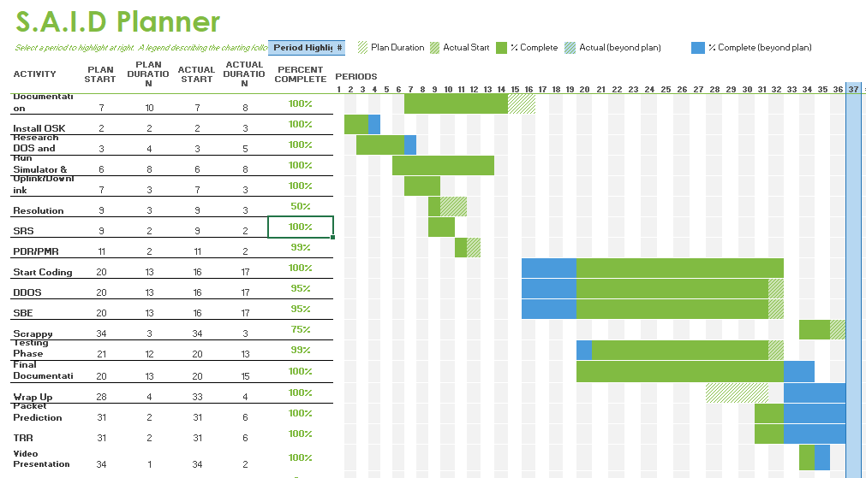
Progression Chart - Rafael

Slide 39
Summary - Rafael
//Accomplishment, future, outcomes,
//reiterate what our project goals were, how we accomplished them, things done differently
Outcomes
Possible Next Steps
Single bit error detection using hamming code
Single bit error detection command
Single bit flip errors and detailed documentation containing a plan on how to implement detection
DDOS error detection with machine learning algorithm
DDOS commands to read and write
DDOS detailed documentation on how to implement detection
Automate SBE detection
Increase representative data for anomalies to further improve algorithm for DDOS detection.
Collecting ISP data for analyzing and monitoring for clients.
Workaround for multiple commands
Implement the resolution

Slide 40
Remote Communication

Slide 41
THANK YOU
Questions?

