Slide 1
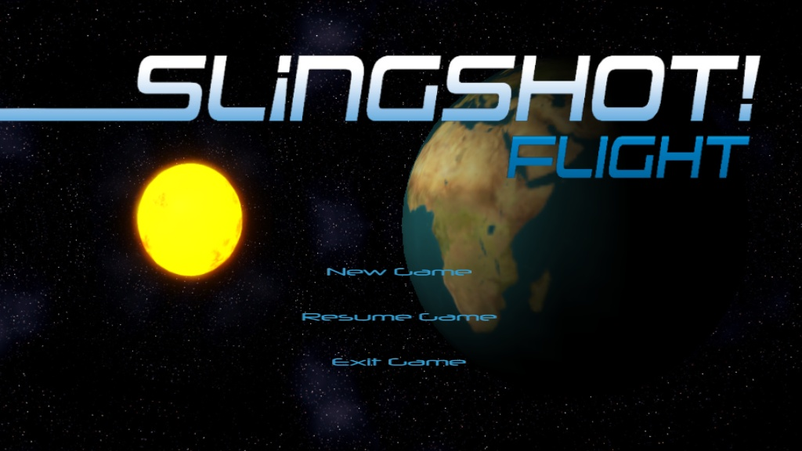

Slide 2
Slingshot flight background
Advisor: Dr. Elaine Eun-Young Kang
Part of the CalState SciVi project
Collaboration between computer science, physics, and art grads and undergrads
Space Simulation Game
Continuation of coding work by a previous student

Slide 3
purpose
As part of the SciVi project of Calstate LA, the purpose of the game is to educate the player about the Universe, specifically about the general motion of the planets in the solar system and the effects of impulse driven orbital changes that are most commonly associated with that of present spaceships and artificial satellites

Slide 4
Implementation
The game utilizes the Panda3D Engine to render the 3D objects in the scene graph
Allows for the use of glow and particle effects
Plenty of online documentation
Python is used to code Slingshot Flight
Easy to learn, easy to read

Slide 5
Scene graph
Render
Camera
HUD
Sky Box
Level Node
dummy
dummy
dummy
dummy
Body
(planet)
Orbit (ship)
Orbit (planet)
Body (ship)
Tree representation of the Panda3D Engine 3D scene graph

Slide 6
Top level interaction
User Interface
User input
Game Logic
Update position
Body Object
Body Object
Body Object
Get position
Get position
Get position
Orbit Object
Orbit Object
Orbit Object

Slide 7
Mid level interaction
Game Logic
Update Position
Body Object
Get position
Recalculate orbit
Get reference
Current Orbit Object
Try Orbit Object
Park Orbit Object
Glow
Solid
Glow
Solid
Glow
Solid

Slide 8
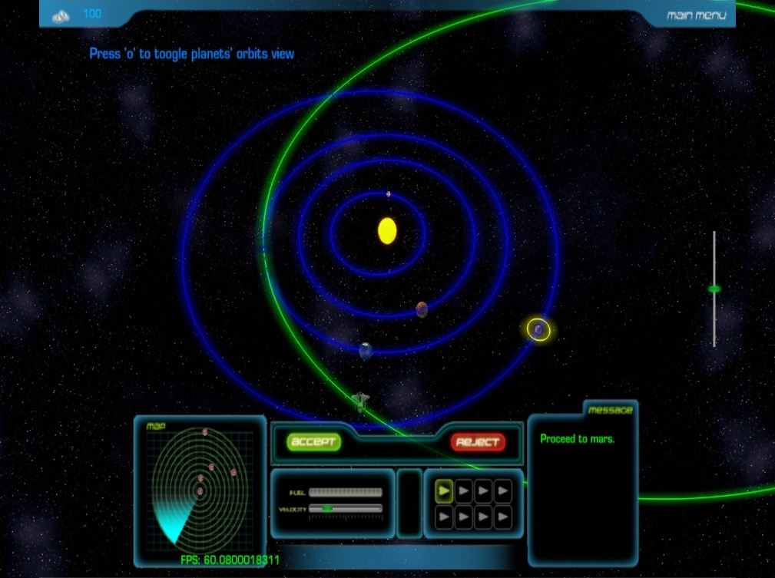
What Has Been Previously Done
Graphic Interface
Basic Game Programming
1-2 Levels
Simple 3D effects

Slide 9
What was Planned to be Added
Advanced game programming
Dynamic physics
AI?
2-3 more levels
More advanced than the last
Introduction of dynamic orbital maneuvers
Advanced 3D effects
Particle effects

Slide 10
What was actually Added
Revamped game logic
Orbits are now in full 3D
Orbital maneuvers can now be done in 3D with no constraint on the velocity vector direction
To complete certain missions, orbital maneuvers are necessarily multi-stage
Game Effects
Music, sound effects, visual effects (i.e. explosions)
1-2 more levels
Asteroid deflection
Slingshot Maneuver half implemented

Slide 11
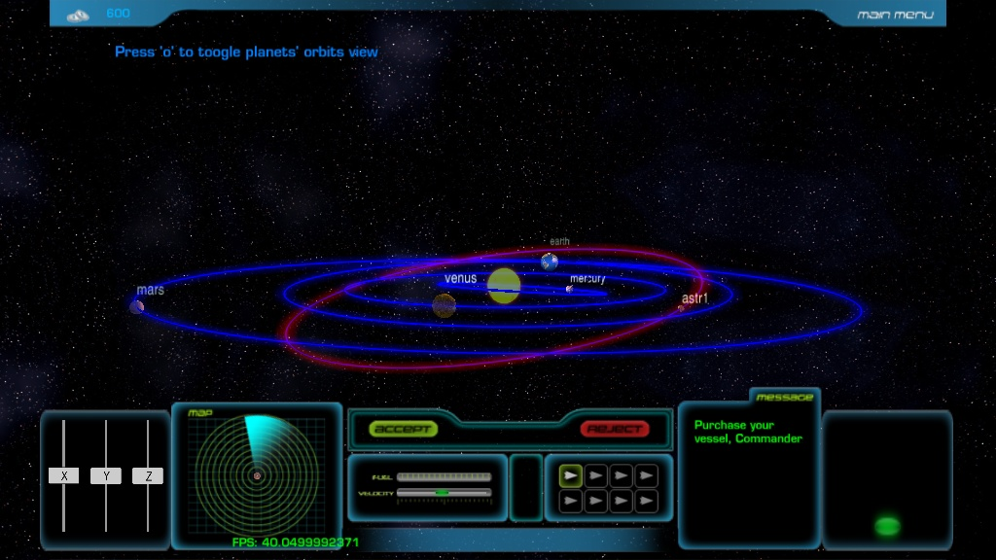
New GUI

Slide 12
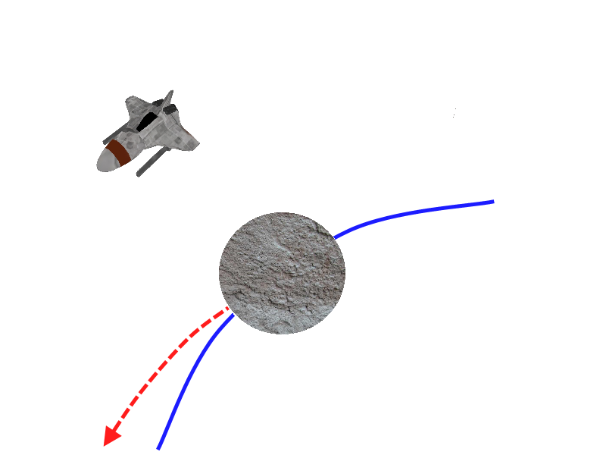
Gravitational Tractor
By hovering near a small body such as an asteroid, a space ship can slowly deviate the path of the asteroid by means of gravity deflection.

Slide 13
Implementation within the game
Rather than have the ship orbit the asteroid, it hovers over the asteroid in the direction normal to the asteroid’s orbit.
The asteroid’s path was deviated by means of a physical force update, however, the orbit did not change quickly enough or smoothly enough, so direct change of the orbit’s axis size was implemented
Victory conditions are based on the asteroid’s axis’ size

Slide 14
Problems with implementing the gravity tractor
The real gravity tractor is estimated to take around 15 years to significantly change the orbit of even a small orbital body (a long time even for the in-game time)
There are hardly any designs proposed to implement this method of asteroid mitigation (lack of real world data to help with game implementation)

Slide 15
Gravitational tractor

Slide 16
Slingshot orbit
When a small orbiting body is within the sphere of influence of a planet within this solar system, the orbiting body follows the planet as its orbital frame of reference
The diagram to the right is a simplified, but impossible example of a gravitational assist for educating purposes only

Slide 17
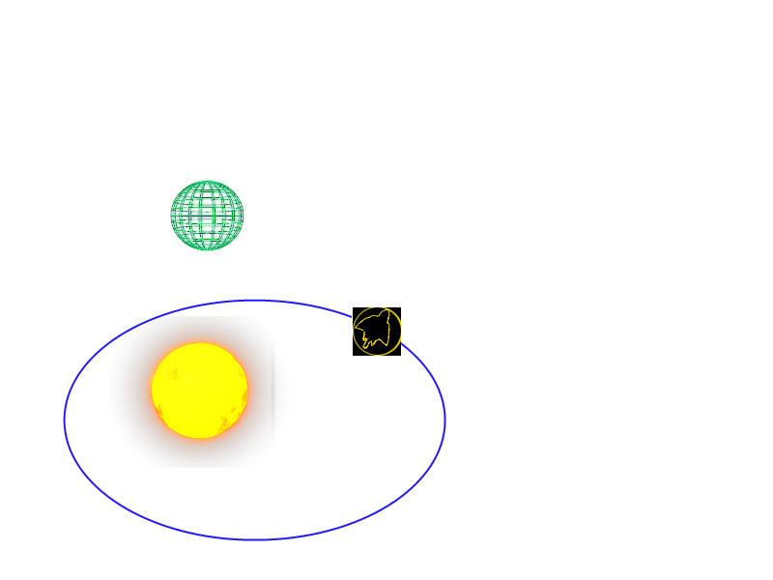
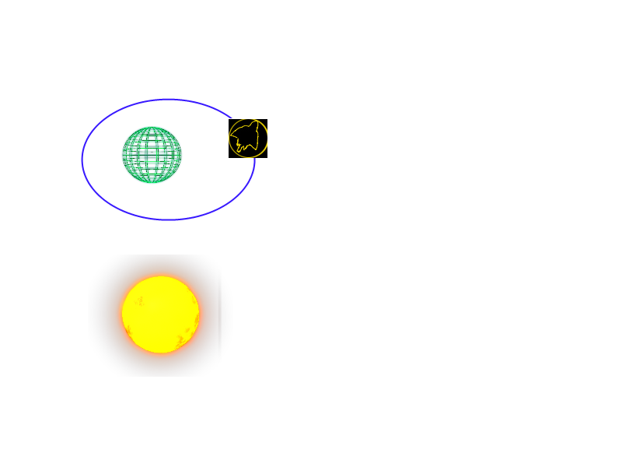
Slingshot Orbit
When the ship enters the sphere of influence of the referenced planet, it will orbit around the planet as if it were the Sun, while the referenced planet continues to orbit the Sun

Slide 18
Implementation within the game
From the heliocentric frame of reference, the ship is changed to the referenced planet’s frame of reference once the ship enters the planets sphere of influence
The ship’s velocity and position are adjusted to the referenced planet’s velocity and position
The ship will orbit the referenced planet as if it were orbiting the Sun
Sun
Planet
Ship

Slide 19
Problems with implementing the slingshot orbit
Switching between frames of references causes some trouble while ship is updating itself
Real world units modified for in-game use seem to break down when switching from one set of orbital state variables to another

Slide 20
Possible future work
Rework the asteroid level
Rather than using a gravity tractor, a one time nuclear explosion to deflect the asteroid is a more plausible solution
Travel to the outer solar system
Long term planning using an in-game aid to map out the timing of the impulse moment
Multiple slingshot maneuvers to be used

Slide 21
Demonstration

