Slide 1
Sidewalk Slope Monitoring System
Team Members:
Jan Bautista
Hua Chen
Abigail Garcia
Ana Guardado
Cristina Munteanu
Pabasara Navaratne
Alexis Pena
Beatriz Ruiz
Aoqian Wang
Liaisons:
Ted Allen
Alisa Blake
Advisor:
Jungsoo Lim
Notes:
Good morning everyone! | My name is Alexis pena and I’m the team lead for the Sidewalk Slope Monitoring System Project this year.
Together with my teammates (Name Them) We’ve worked with the city Los Angeles- Bureau of Engineering to pick up where last years team left off.
Our liaisons are Ted Allen and Alisa Blade, however, we’ve had the pleasure of working with many other people on their team
Our Senior Design Advisor is Professor Jungsoo Lim
SO were really excited to tell you more about our accomplishments over the last few months, but first a brief introduction on how the project came to be.

Slide 2
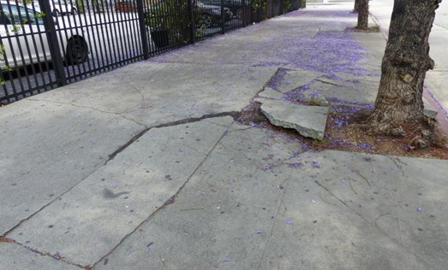
Introduction
Background
Rover
Slope Monitoring
Image Capture
Current Project
Web Application
Image Processing
Rover UI
Backend
Notes:
So as previously mentioned, this project first started in 2019 where the Senior Design team then was tasked with creating an affordable, multi tasking rover which can gather and analyze sidewalk data and report its finding back to a an LA city field agent. Removing the manual aspect of having someone go out to the field, measure, and calculate whether a sidewalk has met ADA guidelines, one single stretch of sidewalk at a time
If you take into consideration that sidewalks are prone to break and that Los Angeles has over 11,000 miles of sidewalks-- you can start to visualize why a project like this was considered in the first place. Measuring just one sidewalk is difficult and so keeping 11 thousand miles of sidewalk ADA compliant seems like an impossible task
And so with a working rover prototype provided by the last team, our team was able to pick up right where they left off and we’ve been working on manipulating the rover data and creating the software and infrastructure needed to package everything into a new and improved Rover provided by the Bureau of Engineering.
Our team was assigned 4 important tasks to tackle, the first one being to
Create a web application which would map the data collected by the Rover
Two was to Create a Rover User Interface which would allow a field agent to control said rover
Implement Image processing in order to get an enhanced image and extract useful information
And lastly to, create a backend database to collect, store and manipulating the data I’ll now passing this over to Hua, who will be going over the Web Application side of things.

Slide 3
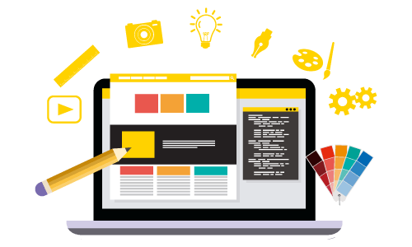
Web Application
Display data & images
Why we are working on this project
Why it's important.
Notes:
One of the task of our project is to create a website so we have a place to display all of our data and images. Later on as we developed our website we added additional page to explain why we are working on this project and why it's important, which we have discussed in the introduction. (20 sec)

Slide 4
Notes:
When we first started this project we created a simple framework of a single page to display our data. The page would display information vital to our project such as the images name, slope of the sidewalk and the coordinates to see where the sidewalk is located at.
The image lets us see the real damage of the sidewalk. For the image we want to be able to iterate through our database using the previous, next and auto button. As well as to pan, zoom in and out of the image. We also plan to implement a search bar to look though all our pictures by the images name or coordinates the image was taken from. However, as you might have notice, the framework does not look like a website page. (45 secs)

Slide 5
Framework
Notes:
Therefore we updated the framework to include a navigation bar, additional pages, and a footer to make it look more authentic. As you can see the additional page we have add include a home page, database page, an about page and a page to redirect to a website called navigate LA which displays the layout of LA city. The home and about page gives us additional information of our project, such as why we are doing the project and how it would help the city.
We are currently working on to make django server to host our website. This semester we have finished creating the UI of the website, and next semester we will be implementing the features of the website.
In the next slides, we have another way to display our data, which Ana will introduce.(50 secs)

Slide 6
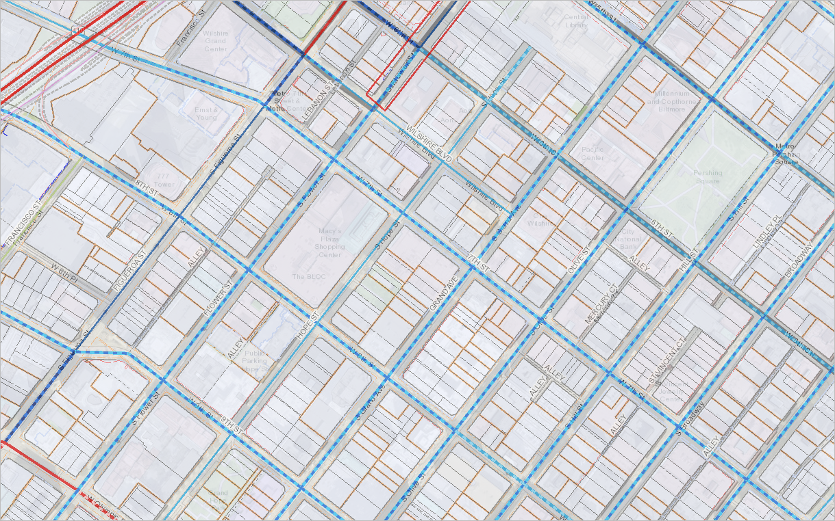
Notes:
With our web application, all of the image’s related data is shown in the console. Users can focus on one particular image or instance of the sidewalk data, switching back and forth between the images as needed.
Currently, BOE use a mapping application that they developed alongside the Department of Public Works and the Mapping and Land Records Division. This mapping application, called NavigateLA, visualizes data from reports produced by the the city, county, and other associated agencies. Data is broken down into layers. Users can select the layers they’d like to see or even load their own layers.
Ideally, sidewalk data would be added as a layer on NavigateLA so that BOE can visualize their data in one location. Using AutoCAD, we can automate the creation of the AutoCAD files that can then be hosted and visualized on NavigateLA.

Slide 7
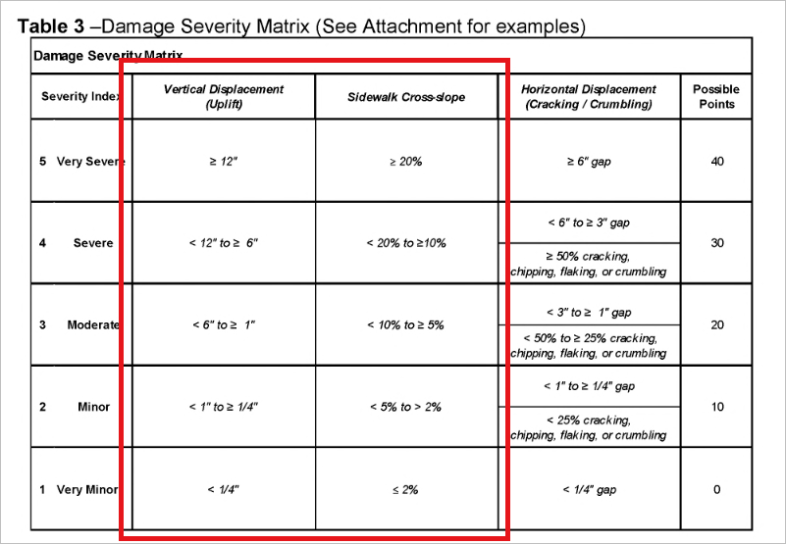
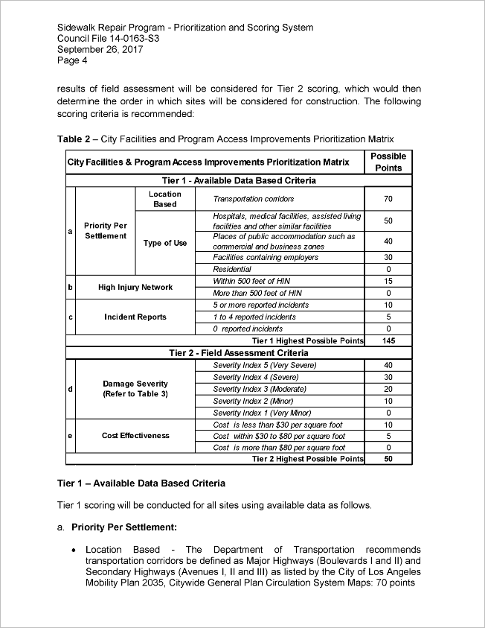
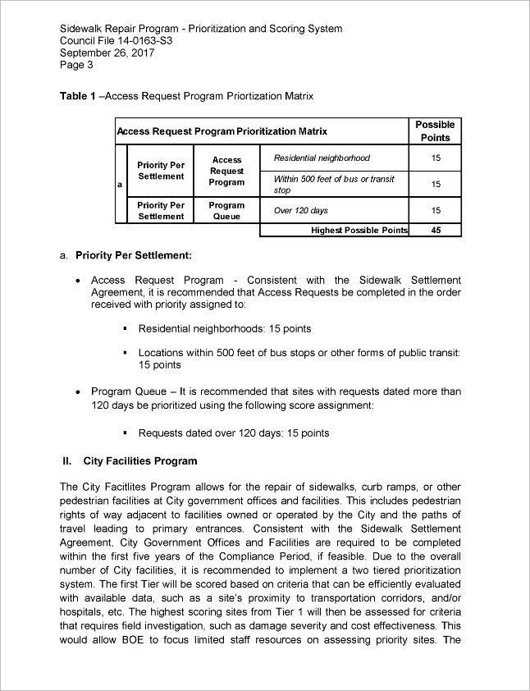
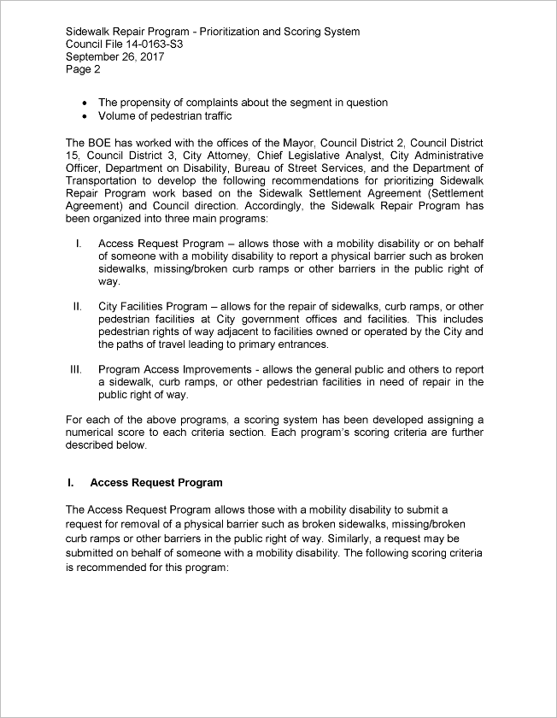
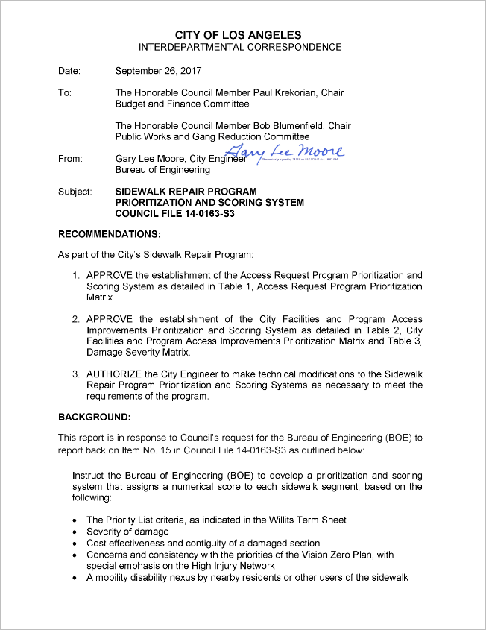
Notes:
To determine how the sidewalk data should be visualized, we needed to consider the city’s prioritization and scoring system. In their “Sidewalk Repair Program” document, they’ve developed a system that assigns a numerical score to sidewalk segments to determine which sidewalks require immediate attention.
They use a couple of matrices to decide on the numerical score, including the Damage Severity Matrix shown on the top right. For example, the sidewalk segment can receive a severity index score of 5 if the sidewalk slope is higher than 20%, pushing this sidewalk segment higher on the list for repairs.

Slide 8
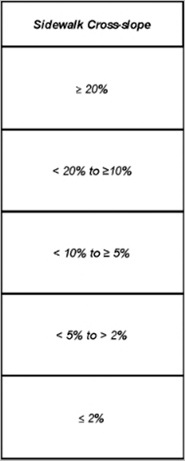
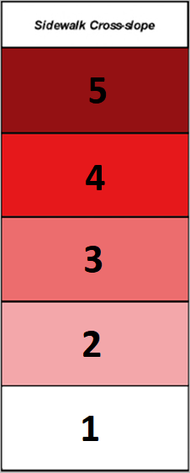
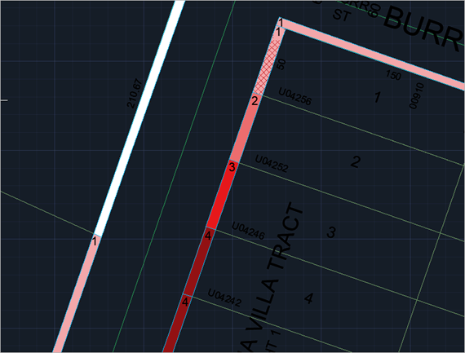
Notes:
The two criteria we will focus on are cross slope and running slope and their severity indices are identified by their color. In the DWG file on the right, we’ve shown an example of how we can visualize part of the slope-data.
As this task was a new item that had no previous years efforts, the main goal for this semester was to determine how we can visualize the sidewalk data on NavigateLA. This involved finding what application we should, determine how the 3D data like slope can be shown in a 2D manner, and building out sample AutoCAD files.
After completing these items, the next steps involve developing the scripts using AutoCAD’s command language and Python. Considering we do not have sidewalk data currently recorded, we will be collecting sample data and using this to build our scripts. The expectation for the next semester is to develop a few DWG files using our automated scripts.

Slide 9
Two Type of Image Processing
Analogue Image Processing
Analogue image processing can be used for the hard copies like printouts and photographs.
Digital Image Processing
Digital image processing techniques help in manipulation of the digital images through the use of computer.

Slide 10
Image Processing Steps
Image processing basically includes three steps:
Importing the image via image acquisition tools;
Analysing and manipulating the image;
Output in which result can be altered image or report that is based on image analysis.

Slide 11
Why OpenCV
Cross platform
Supports Windows, Linux, Mac OS, Android, BSD
Interfaces for:
Supports Java, Python, C++, MATLAB
More than 2500 optimized algorithms
It is free

Slide 12
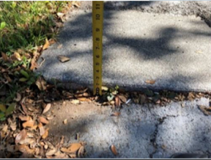
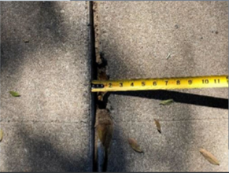
Goal
Vertical displacement
Horizontal displacement

Slide 13
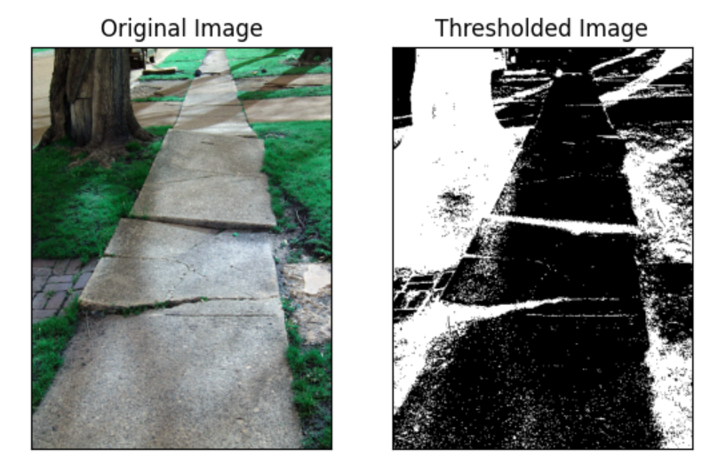
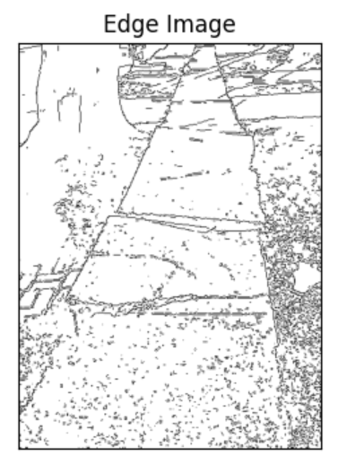
Canny Edge Detection - Image Thresholding

Slide 14
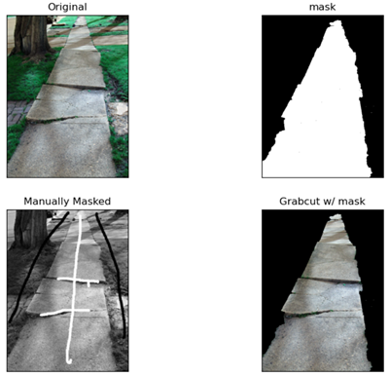
Image Segmentation - Grabcut Algorithm
Removes noise
Requires user input

Slide 15
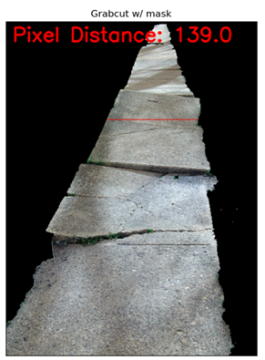
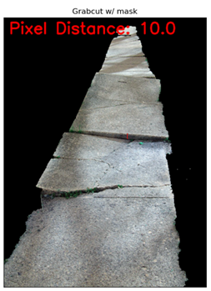
Counting Pixels

Slide 16
Future Planning
Convert pixel length to cm
Allow interactive drawing
Bring in machine learning

Slide 17
Rover UI
The Robot UI Now and Before
Data Display and Rover Mode Controls
Future UI Work for Winter & Spring
Notes:
Thank you Jan, good morning all. So our task was to re-design the Rover UI. We will be overviewing how the UI looks now ,how it looked before, the data display and rover mode controls and the future UI work for this winter and next spring

Slide 18
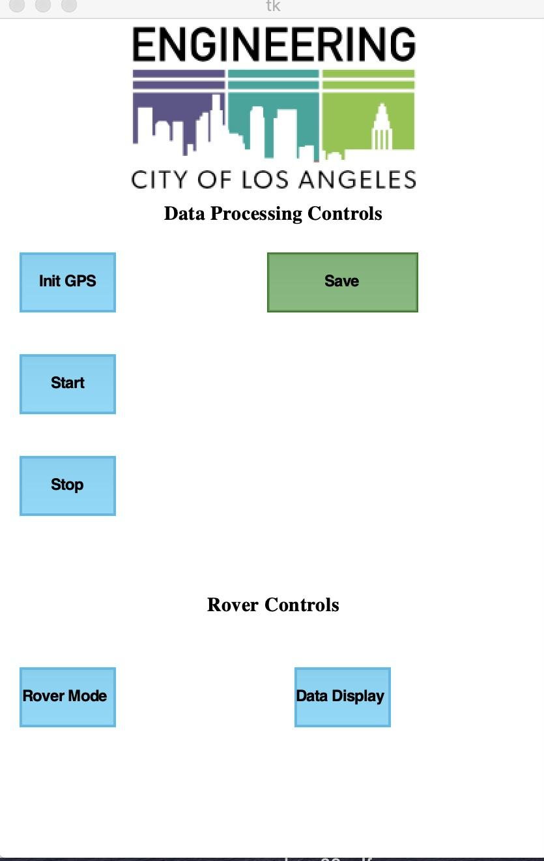
The Rover UI Now
Initializes GPS and camera
Saves all data collected
Starts data collection
Stops data collection
Displays Rover movement controls
Displays all data collected
Latest Rover UI Design 2020
Notes:
The rover UI has now been organized to display all functionality in a simple yet effective design as displayed in the picture. The main display now features new buttons that will make navigating the rover movement and all data collected easier for the field crew and later on we will implement the display of the current data such as LATITUDE, LONGITUDE, XSLOPE, AND YSLOPE.
All the buttons that have been rearranged and organized are the InitGPS button that initializes the Gps and simultaneously initiates the leo rover camera as well. The start button starts the data collection. The Stop button stops the data collection. The save button saves all data that has been collected. The data display button organizes and displays all data that has been collected and later on we will be creating a feature that will allow field workers to export all data collected so they can view and analyze the data since the data is saved in a csv file on the microsd located on the leo rover.. Finally the Rover mode button organizes and displays THE ROVER MOVEMENT FUNCTIONS INTO A SINGLE POP UP WINDOW THAT WILL ALLOW CLEAR ACCESS so that THE FIELD WORKERS can control the movement of the rover.

Slide 19
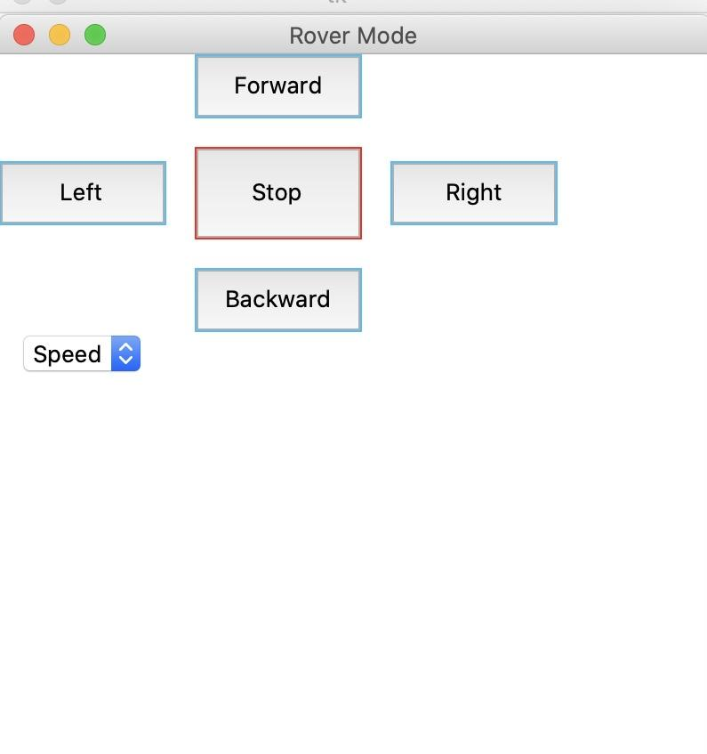
Data Display & Rover Mode Controls
Latest Rover UI Design 2020
Notes:
As previously introduced, we have now integrated two new buttons that have consolidated the rover movement and organized the view for all data that has been collected.
The photo on the left is the rover mode pop up window where we have combined all rover movement functionalities together.Rover Mode has 5 controls that will allow the field workers to move the rover in order to collect data such as to move forward, backward, left, right, stop and control the speed as well.
The photo on the right is the data display which displays all the data that the field workers have collected in one session in a separate window. This table displays the coordinate, time, date, gps location data, orientation, and as well as the pinid, and imageid data.
Now Cristina will go over the previous version of the rover UI and our future plans for the UI during this upcoming winter and spring semester.

Slide 20
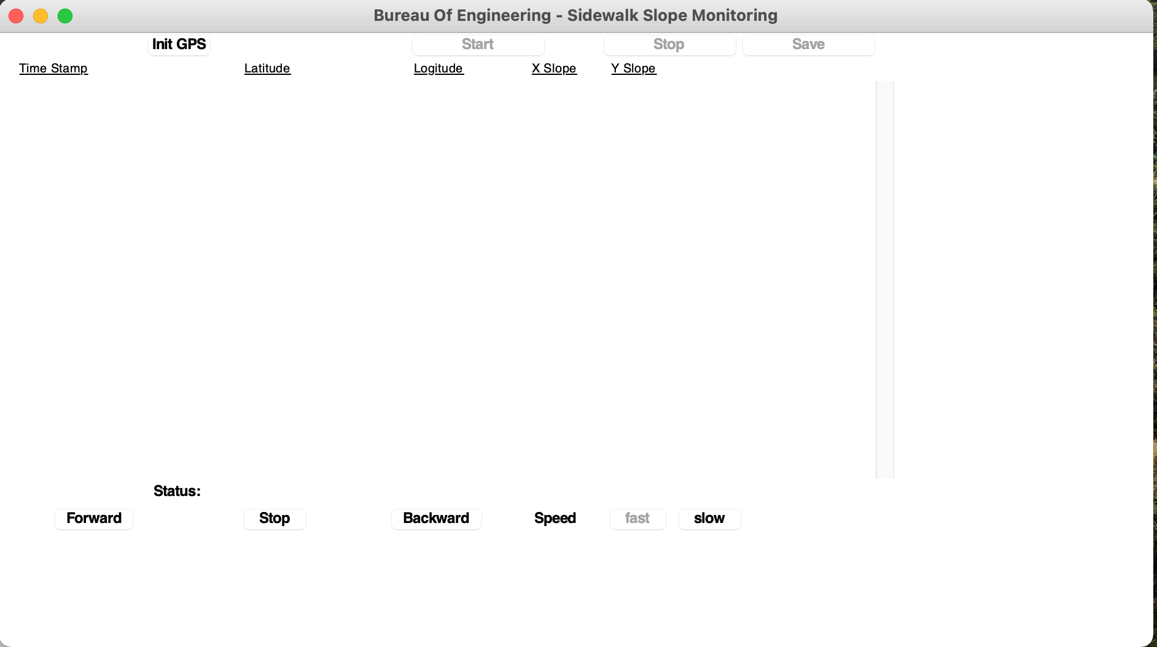
The Rover UI Before
Previous Rover UI design in 2019
Notes:
It was previously designed by last years students, and was used to control the rover that was built by them.
This year we have a new Rover called Leo Rover that our team has been working on assembling it, and should be completed by early Spring of next semester
On the new design as Beatriz previously presented , we have made the improvements as far as providing structure and organization to make data collection easier for the field team. We have developed two new buttons that have consolidated all rover movement and data to be controlled and displayed.

Slide 21
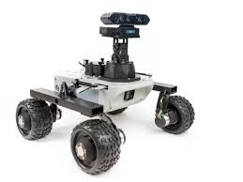
Future UI work in Spring
Notes:
So in the next slide we are going to talk about future Ui work in Spring
We will be testing the code on the actual LEO ROVER for accuracy once this is assembled
Rover Mode control buttons will be designed for easier recognition ( such as arrows and stop sign)
Data Display mode will have an export mode csv file, so that office users can access it easily.
Data display will be redesigned to save space in displaying the table.
Abigail - Back end Database

Slide 22
Back-end Database
DataBase Functionality
Relational Schema
Data: GoPro, Rover, NavigateLa/GeoHub
Azure Blob Storage
Future Implementation

Slide 23
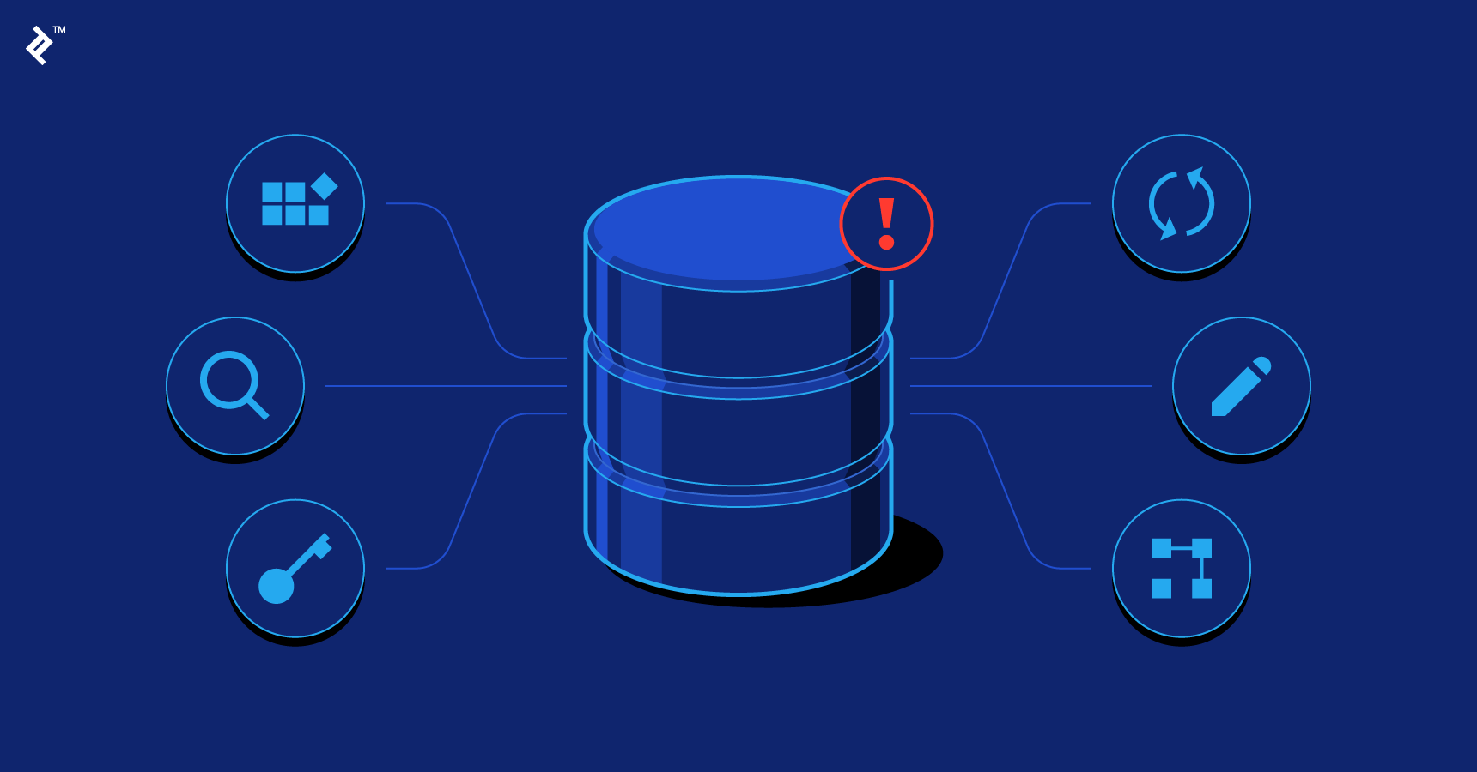
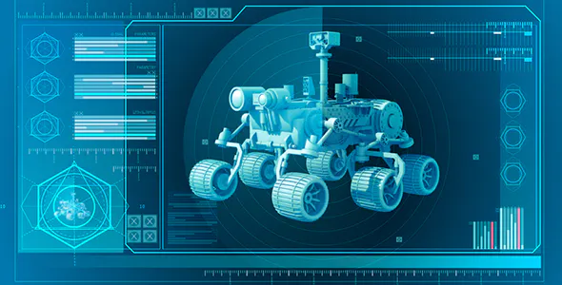
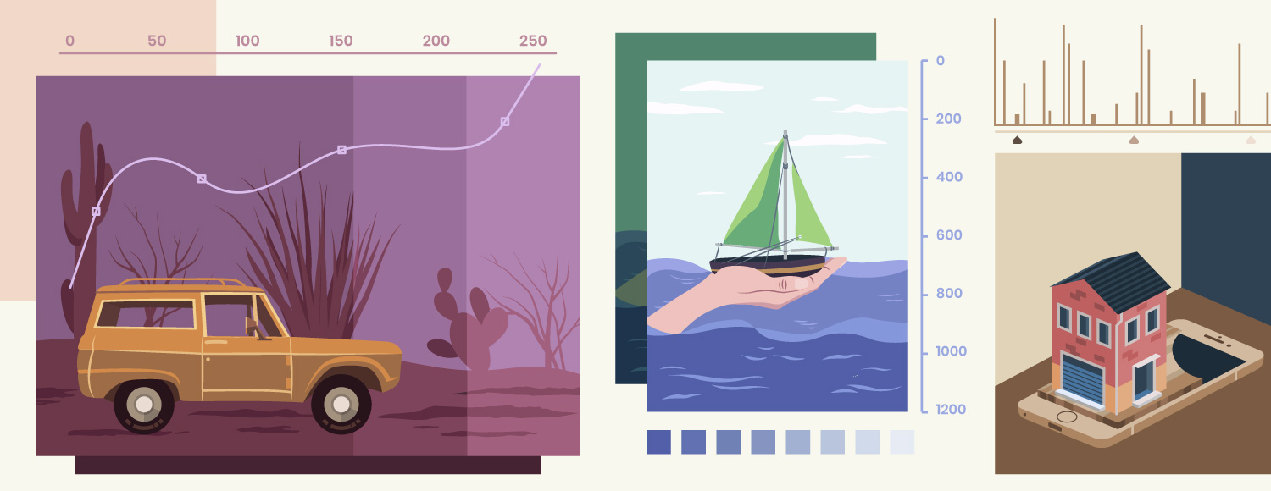
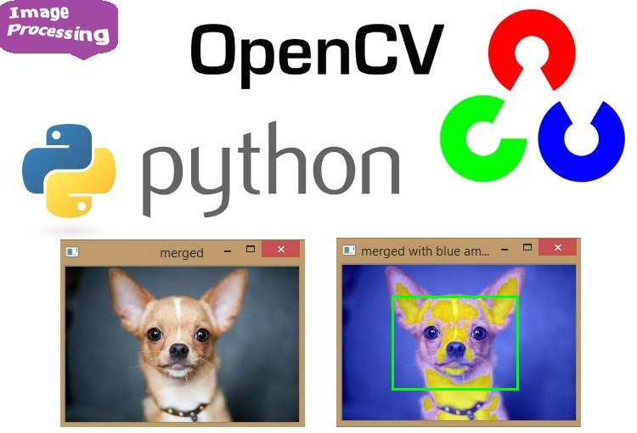
Database Functionality
Notes:
The database is essential as it will be utilized by all aspects of the project .
It links the existing data to new data collected by the rover and field agent .
It provides the storage for the web application to to display the data being used.
It also provides access and stores images from the Gopro and rover to be implemented to the image processing portion.

Slide 24
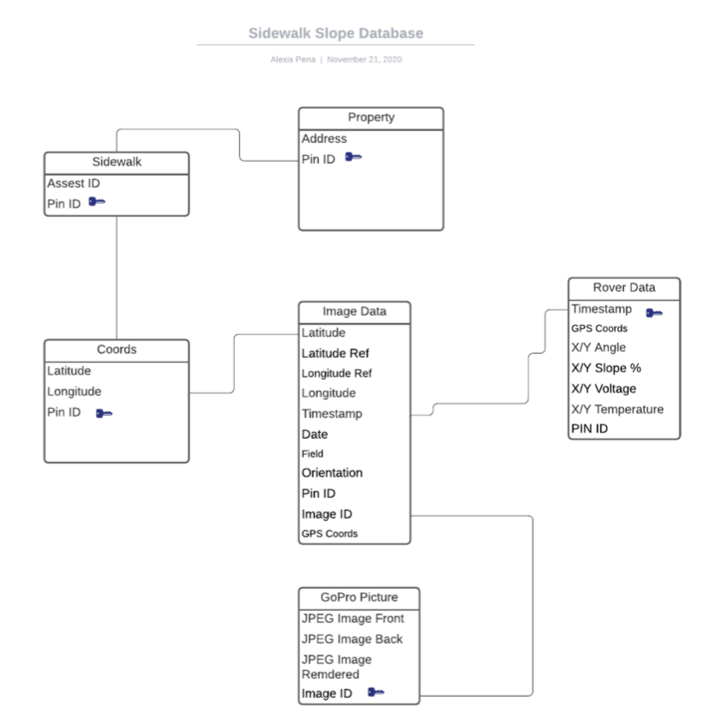
Relational Schema
Integrating all sources of data ( GoPro,Rover, NavLA)
Notes:
Our relational schema can be visualised by the different sources of data, the leftmost part being the existing data provided by BOE and the Navigate LA website mentioned earlier. This data includes PIN ID’s and asset ID’s which are essential in pinpointing specific properties and sidewalk locations.
Although we have not gotten the rover on the ground for testing, the idea is that Navigate LA data will serve as geographical reference points for the Image data and the rover data listed.
The rightmost data would be extracted from the rover itself such as timestamps and PIN IDs and will be linked to the GoPro Image data.

Slide 25
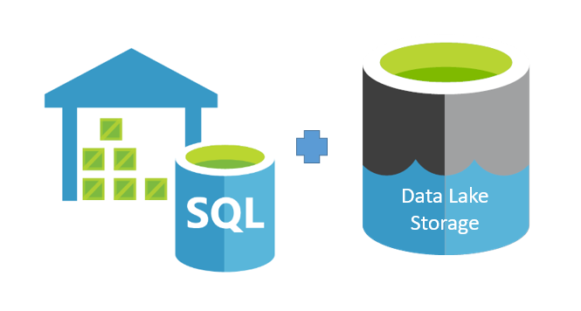
Azure Blob Storage
Affordable and cost effective method for scalable data storage and analytics
No-limits for data
Necessary for saving large quantities of Images
Front, rear, and rendered Images
Image IDs will serve as a link for the images stored
Notes:
With the azure database in place we realized that once the rover was fully operational, we would soon have to collect and store hundreds, if not thousands of images. Unlike our data beforehand this was a bit more complicated because each individual image was much larger than the data we had mapped into tables. This pushed us away from a regular azure DB and towards implementing azure blob storage which is (READ SLIDE POINTS)
This change had us rethink our approach of how we saved our data but in return allowed us to create a much more efficient method of storing images and sharing them across different platforms, such as our UI and web applications.
Now Alex will further discuss data collection

Slide 26
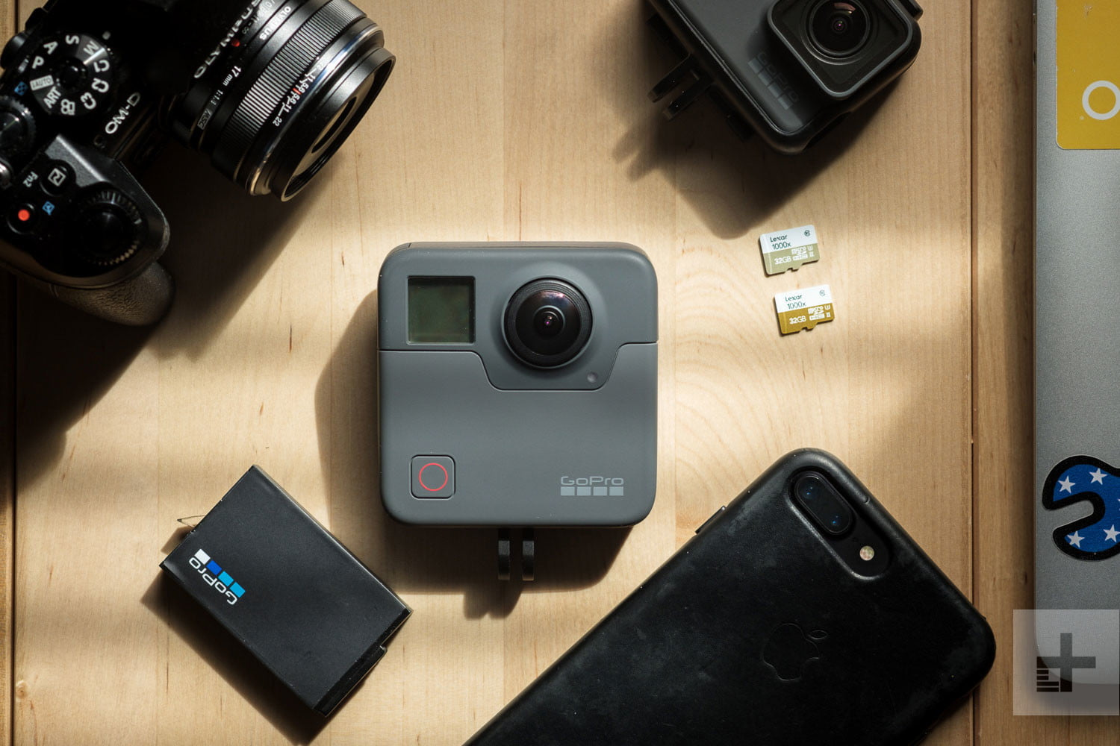
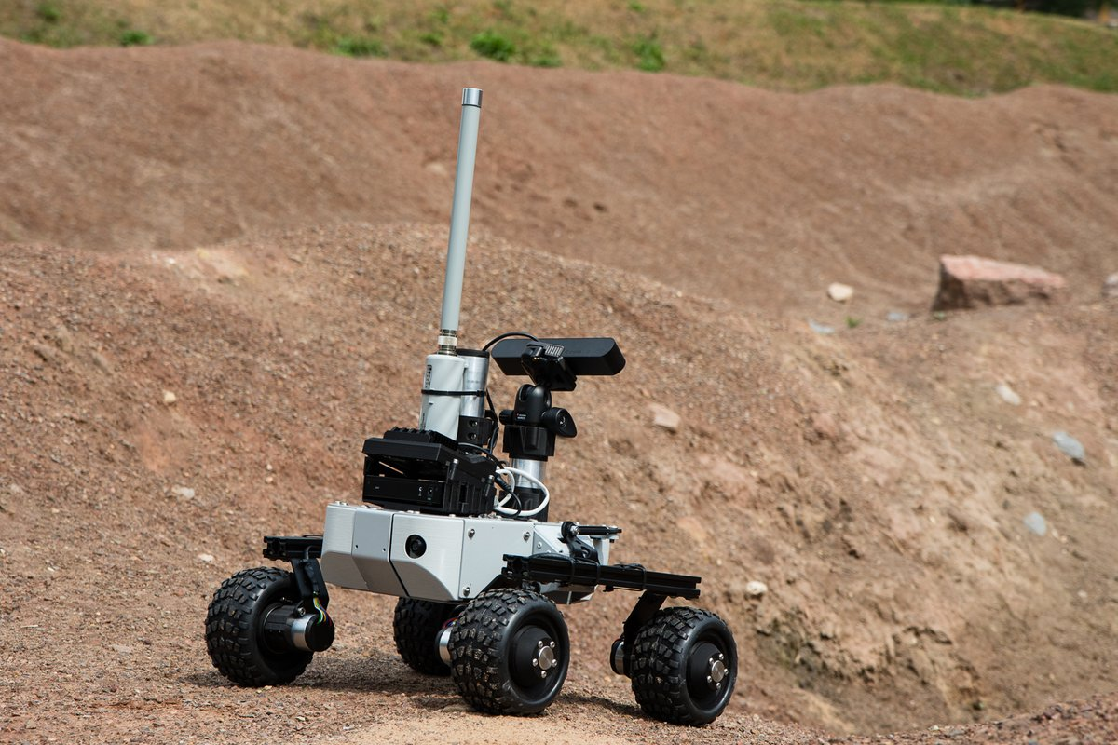
Data Collection
Rover
GoPro Fusion
Bureau of Engineering Mapped Data
Notes:
Thank you And so as Abigail mentioned, with the new Azure Database and Blog storage all mapped out and we started creating our dataset We worked with 3 separate sources
The Rover data collection was our main focus as it held key information that the city would be using to prioritize on what to fix first . This included
GPS Coordinates (Precise Lat and Longitude)
Timestamps
Leveler - Vertical and Horizontal displacement of the sidewalk
GoPro Fusion
Forward and Rear facing camera to create a 360 Degree image on the rovers surroundings
The gopro came with a few challenegs
Solutions to render images
Python code to exfiltrate the EXIF/METADATA from each image with provided us with yet another DB table to popoulate and that included things like ...
Existing data, already mapped by the Bureau of Engineering

Slide 27
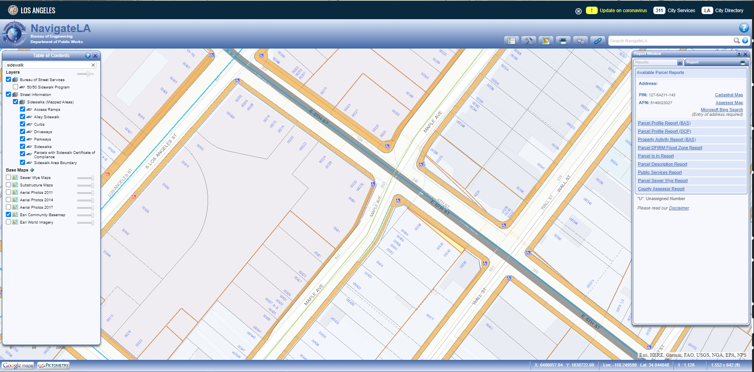
NavigateLA Data
Notes:
Don't worry if the text is a bit small to read
The main point I want you to see is that the bureau of engineering had already mapped and categorized every inch of sidewalk within los angeles on their Navigate LA websitsite
So our goal here was to expand our data collection by gaining access to the NavLA Databases and creating the
queries necessary to parse through the thousands of entries and pull whichever information we deemed important.
Things like important ID numbers for sidewalks and properties which are needed for deciding what sidewalks should be prioritized. This would makes things a bit more time efficient by eliminating the need to manually map the the data ourselves and more cost effective by reducing the space needed to create and store more data

Slide 28
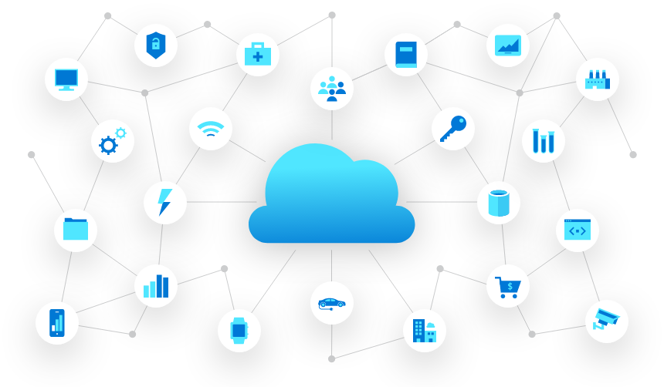
Future Implementation
Data Manipulation
Integrate with other existing data sources
Correlate data by location & timestamp
Severity levels
Implement Azure tools to refine and visualize data
Azure AI
Notes:
With an existing storage solution, how can we improve things moving forward.
With the help of our liaisons, We were able to sit down with Microsoft Azure employee who introduced us with different ways we can expand the data side of the things. Some of which overlapped with some our existing tasks
Future implementations consists of things such as
1. Data Manipulation
The way things are correlate, either by location and specific timestamps. Make things smoother as our data sets grow
2. Data Visualization
Azure offers Tools which help visualize our data, which offers a different perspective that could be implemented into our applications
3. Image processing
We can use Azure AI to introduce severity levels into our dataset and help reduce the manual labor and reach our goal faster and more productively
Moving forward well be looking at what Azure has to offer so we can introduce and implement things without having to create things from scratch.

Slide 29
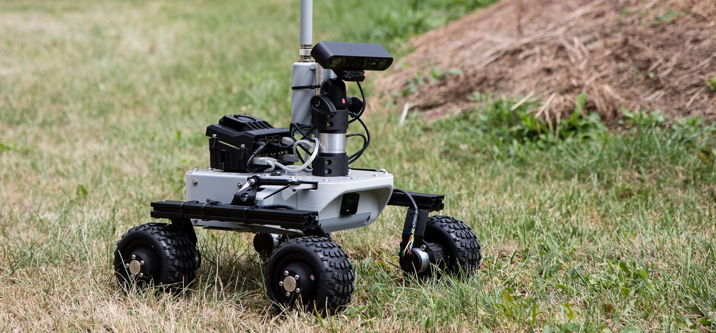
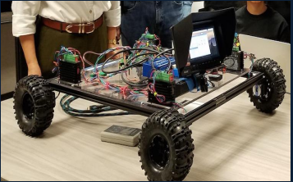
Robecca Leo Rover
Notes:
As previously mentioned, the Bureau of Engineering were extremely generous and helped us upgrade our
old rover (Robecca - left) with a much nicer platform, the the Leo (Right) Rover. Were in the process of building the new rover now and the plan would be to implement both the data collection aspect from last year with the newly implemented tasks from this year to have a working Sidewalk monitoring rover for the city of los angeles - bureau of engineering.

Slide 30
Q&A
Thank you
Notes:
This concludes the Side Monitoring project Presentation - If you have any question, we’d be happy to answer them now. Thank you

