Slide 1
Azure Cloud Database Migration & LACPD New Hire Enrollment Process Web Application
Team Members: Ryan Lee, Ismael Valenzuela, Joshua Perez, Norberto Rosales, Fabio Quintana, Simon Mai, Albert Chen, Shahram Mehri Kalantari, Wilfredo Paz, Michael Loria

Slide 2
LA County Public Defender & CSULA Senior Design Partnership
Michael
The Los Angeles County Public Defender has 32 office locations throughout the county. Integral to supporting the department’s mission is a team of more than 1,200 employees — including more than 700 attorneys, as well as paralegals, investigators, psychiatric social workers, and administrative/support staff. LA County Public Defender is the oldest and the world’s largest public defender.
VALUES:
Advocacy: We are zealous Defenders, working relentlessly to meet the needs of our clients.
Compassion: We listen to our clients, respect their life experience, and tell their story.
Dedication: We are passionate about indigent defense.
Collaboration: We work with County and community stakeholders to achieve our clients’ goals.
Sponsor of Fall 2021 CSULA Computer Science Senior Design
Advisor: Chengyu Sun
Liaisons: Mohammed Al Rawi, Bridgette Bates, Gratia Dsouza
Notes:
Emphasize the number of employees/ attorneys and cases they take

Slide 3
Project Overview
Michael
The team is tasked with working on employee management related software processes alongside the LACPD IT team
1st Project Requirement: migrate backend of two mobile applications (used by current employees)
PDGO
HelpDesk
2nd Project Requirement: redesign the employee enrollment web application developed by last year’s senior design team (used for new employees)
new employee enrollment process web app
Notes:
the team is working on two different projects(make it stand out) highlight we are doing two projects.

Slide 4
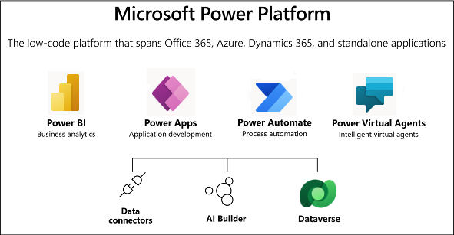
Microsoft Power Platform
Albert Chen
LACPD uses the MS environment (Sharepoint, Outlook, Teams) and an Infrastructure as a Service (IaaS) platform called the MS Power Platform for their current web and mobile employee management processes

Slide 5
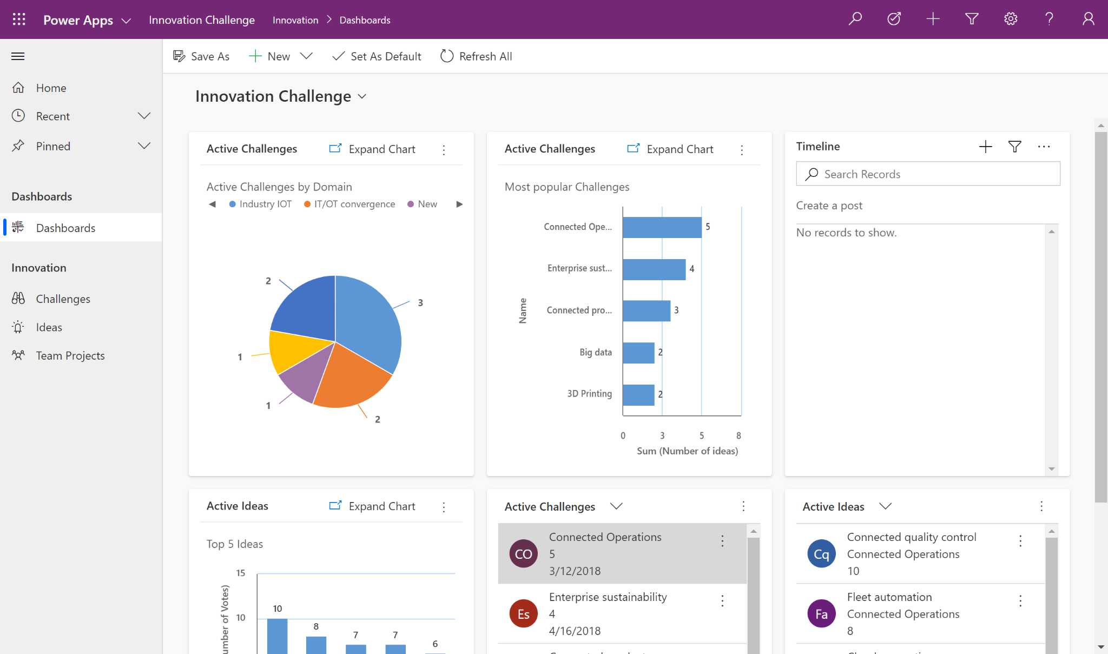
Power Apps
Albert Chen
Power Apps, included in Power Platform, is a combination of apps, services, and connectors, as well as a data platform, that provides a swift development environment to build custom apps for your business needs.
Using Power Apps, you can quickly build custom business apps that connect to your data without having to go through the trouble of writing code for your application.

Slide 6
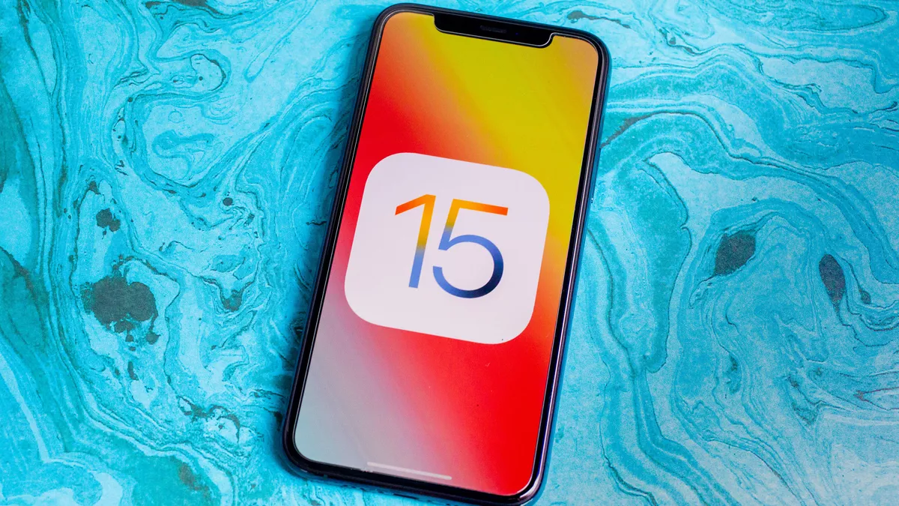
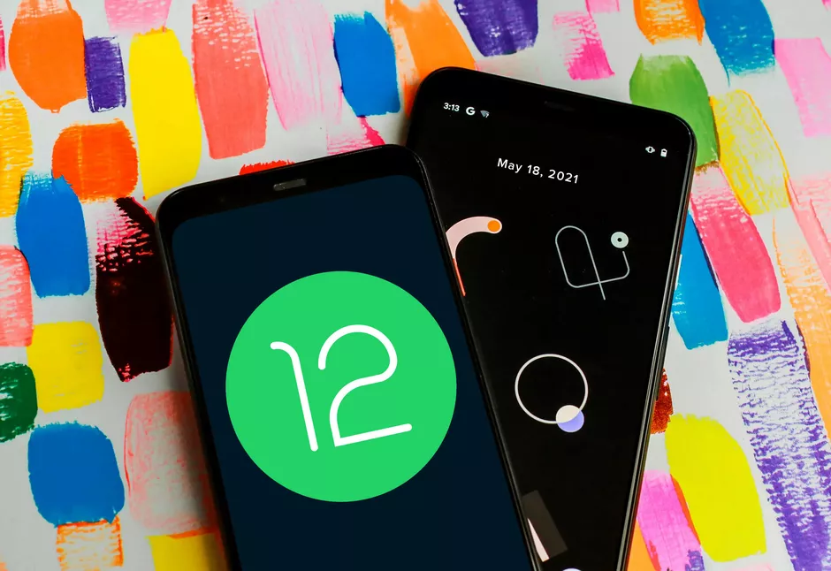
OS Usage Requirements for using Power Apps
Simon Mai
PowerApps supports a wide variety of device platforms and browsers, but for the best experience, it is recommended the following configurations:
iOS 14 or later is but recommended iOS 15 or later
Android 9 or later but is recommended Android 12 or later
Windows 8.1 or later but is recommended Windows 10 Fall Creators Update with at least 8GB of RAM

Slide 7
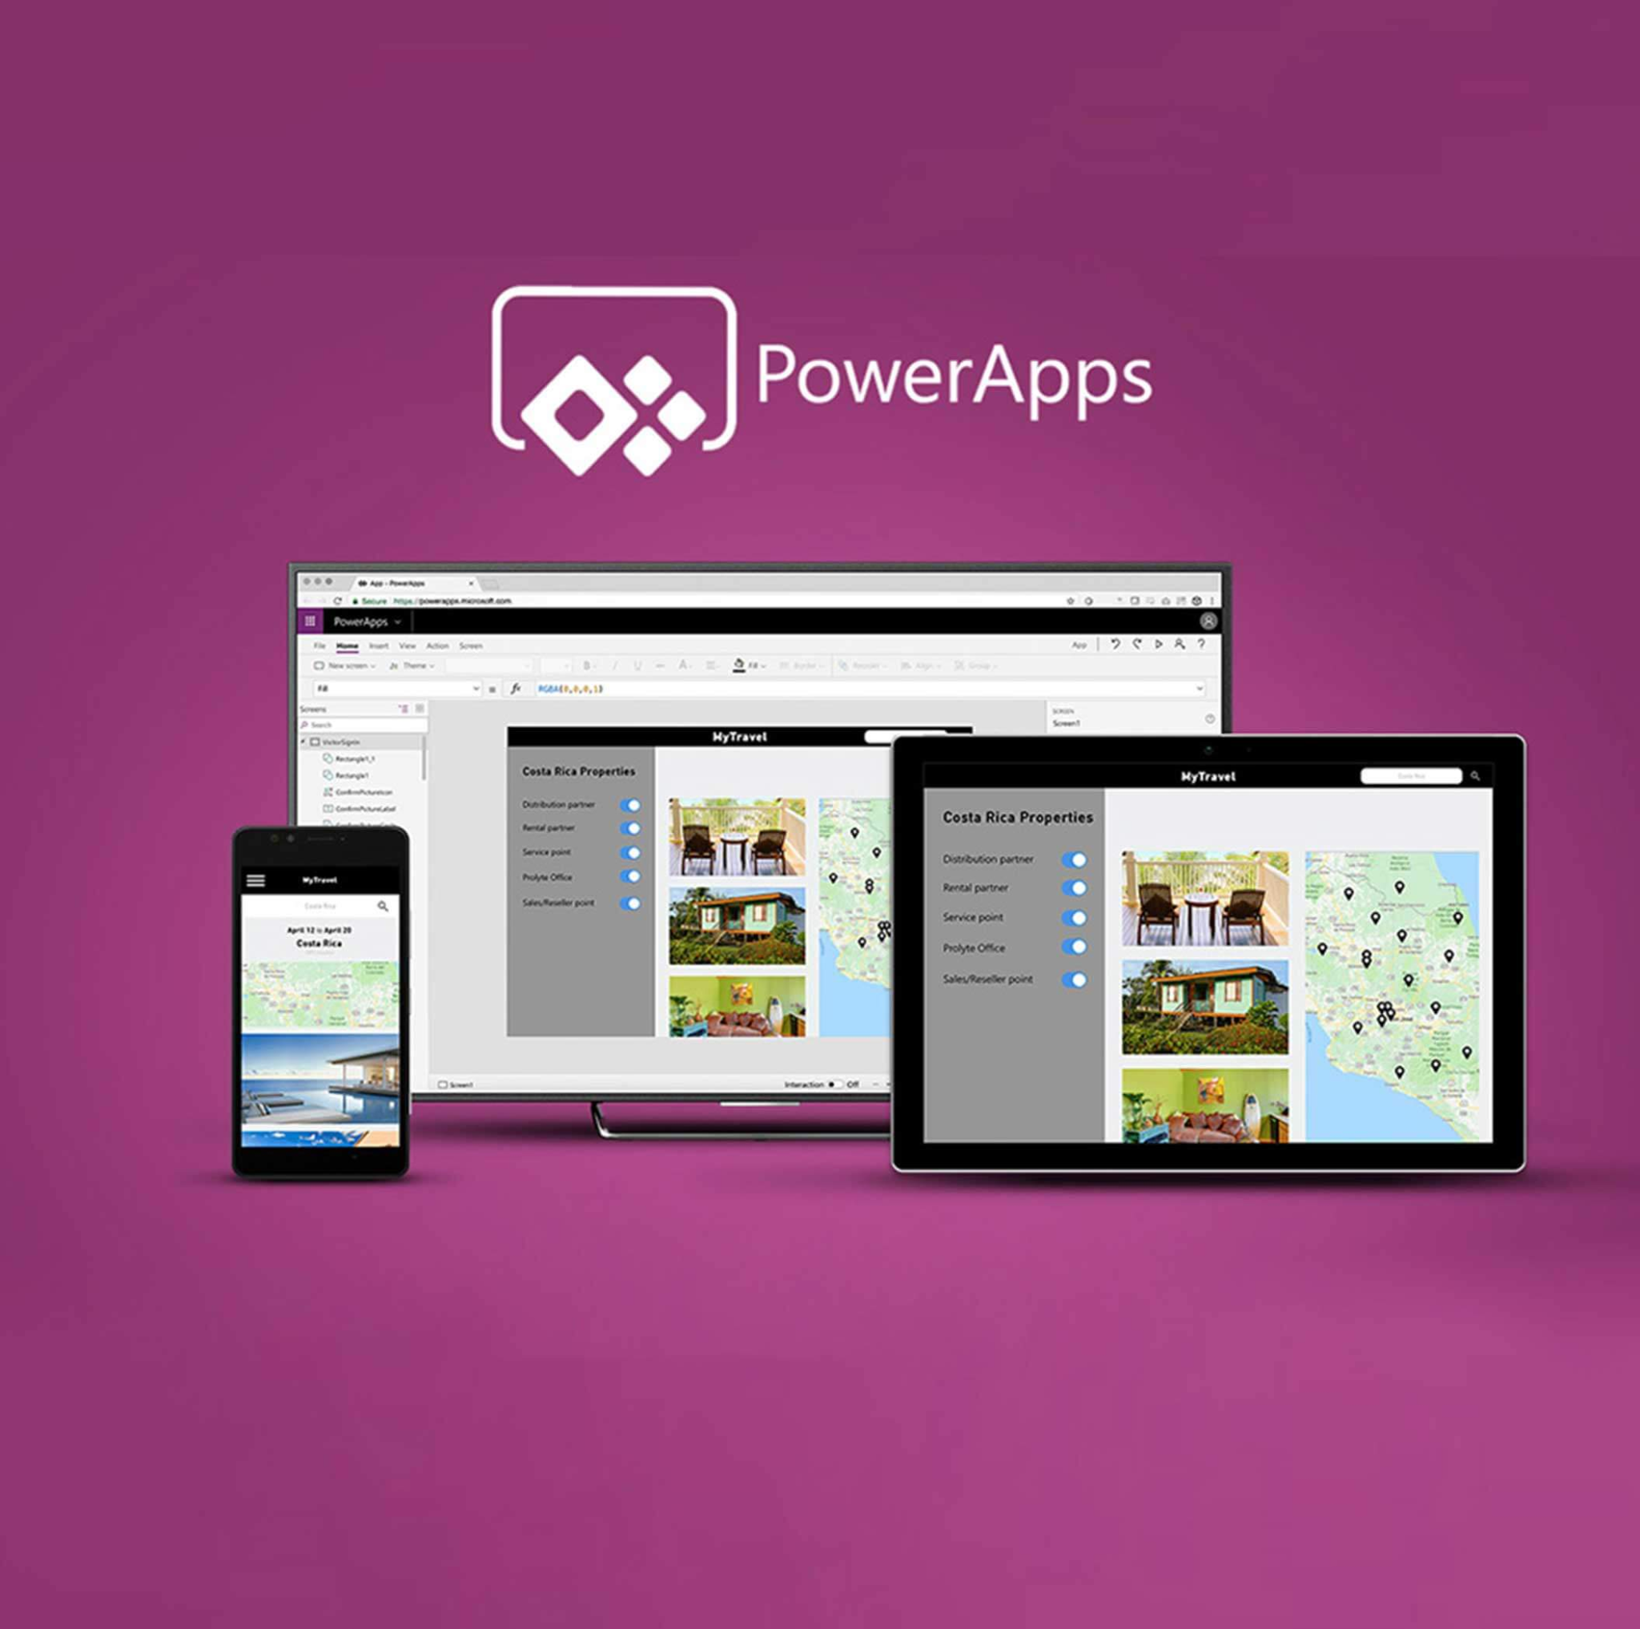
LACPD (Web & Mobile) Power Apps
Simon
PDGO
HelpDesk

Slide 8
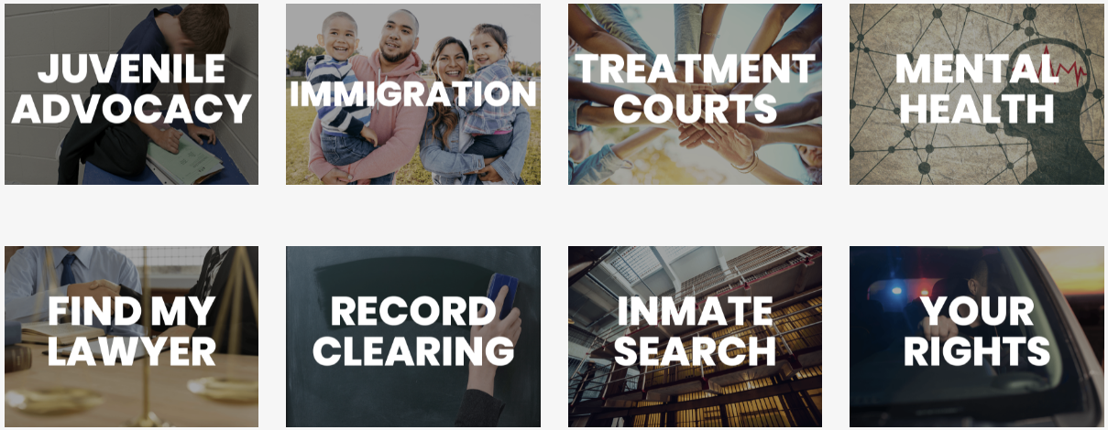
About PD-GO
Wilfredo
PD-GO is an LACPD Powerapp that is used by attorneys at LACPD to
get current case overview and relevant client information
update case information on the go
mobile convenience

Slide 9
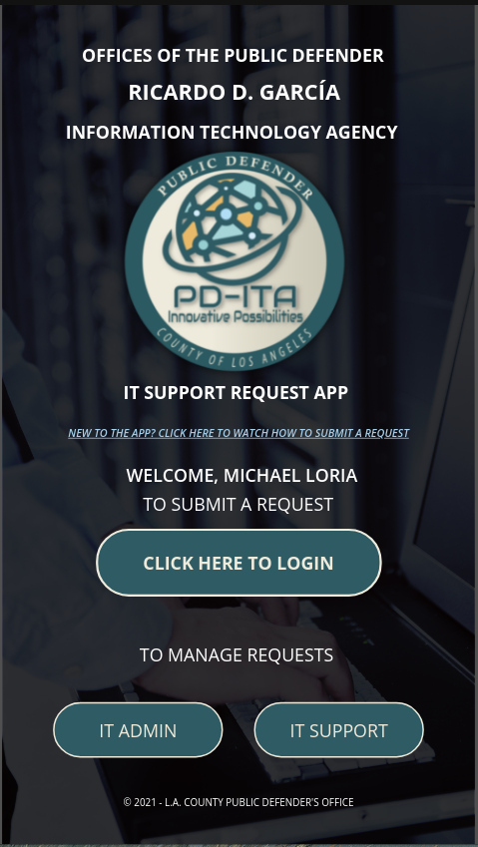
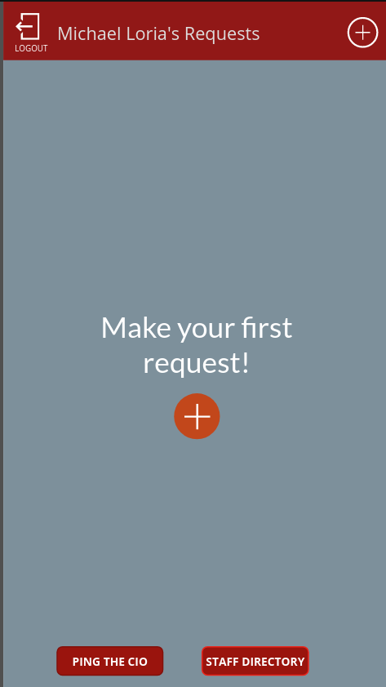
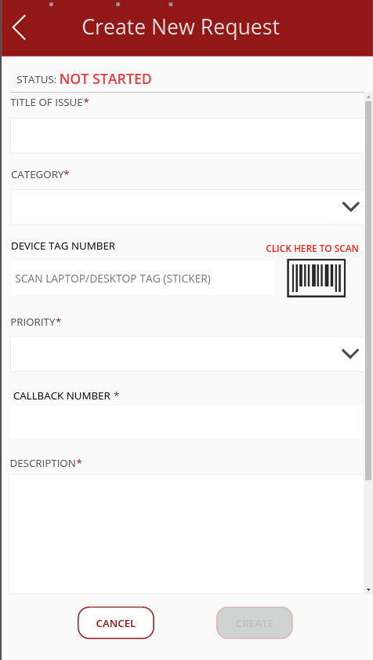
About Helpdesk
Wilfredo Paz
What does helpdesk do?
IT Support Request app
LACPD employees submit IT help requests
updates the progress on the issue

Slide 10
Project Requirements (Power Apps)
Wilfredo
Database migration for both PowerApps
Migrate Sharepoint lists over to Azure SQL database.
Using Azure Cloud Services will open a host of new tooling for developers
Microsoft recommends using Azure Cloud Services with PowerApps for rapid and reliable development
Increase data reliability and availability

Slide 11
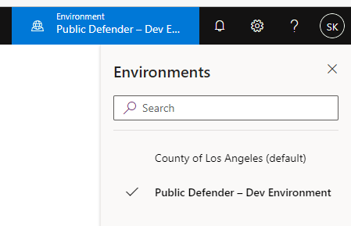
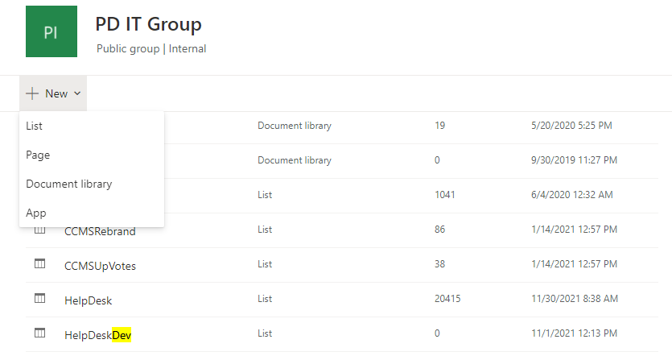
Get access to Power App LACPD Dev Environment:
Shahram Mehri Kalantari
Requirements:
. One student has access
to power app Dev.
. Sharepoint list link
to create Data.

Slide 12
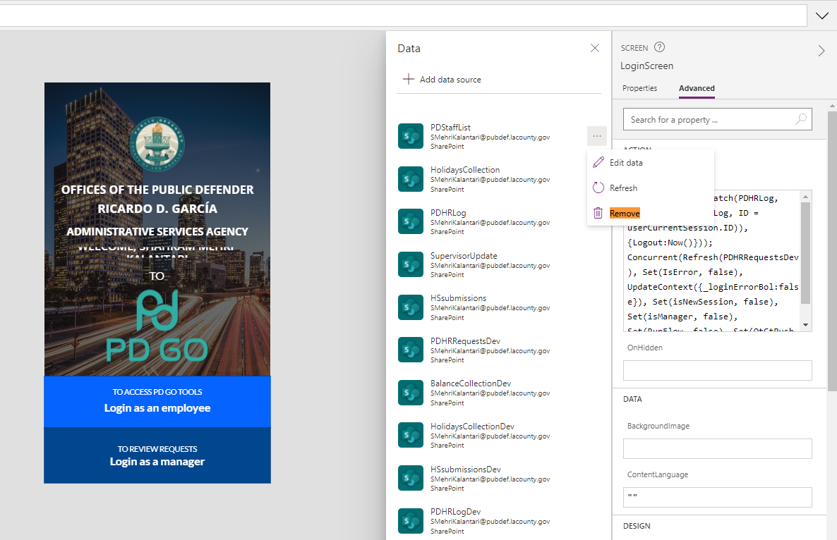
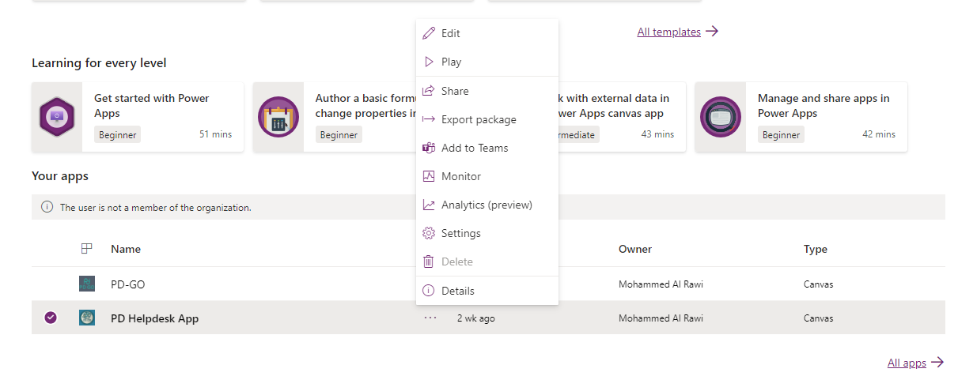
Get access to Power App LACPD Dev Environment:
Shahram Mehri Kalantari
. Connect to each power app in
Dev environment.
. Remove the original data lists for each app.

Slide 13
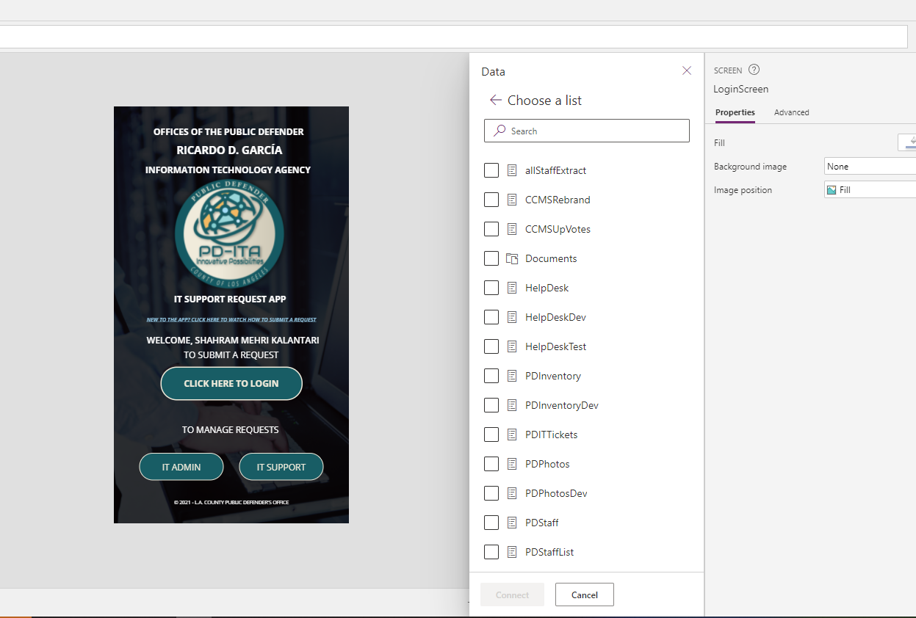
Get access to Power App LACPD Dev Environment:
Shahram Mehri Kalantari
. Add the new data list
. Fix the formula error

Slide 14
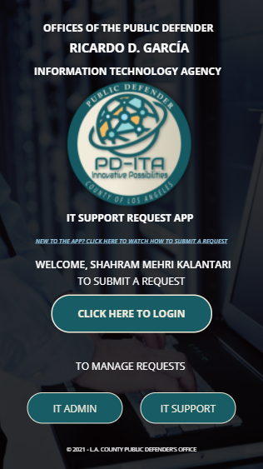
Current Progress (Power Apps)
Shahram Mehri Kalantari
Help Desk App: Done
Disconnected and connected Data
Fixed Formula Errors
PD-GO App:
New Data created
Added into the data source
Need to remove the Original data
Edit the formula error

Slide 15
Enrollment App
Onboarding Application with Adobe Sign

Slide 16
Employee Enrollment Web Application
Norberto Gomez Rosales
Is to allow users to request custom forms that will be created by the back-end.
Communicate between the app and Adobe API to store the given data.

Slide 17
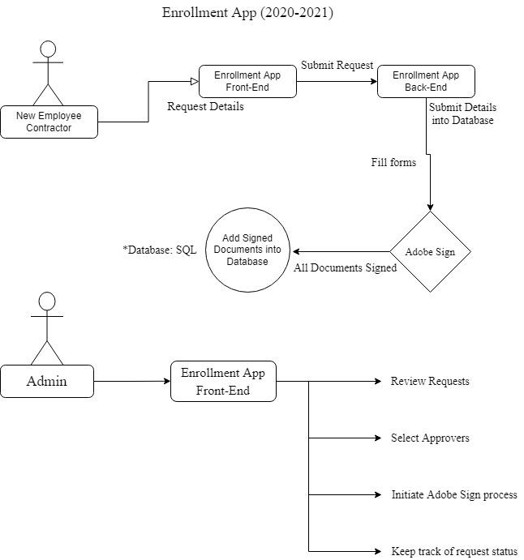
Last Year’s Enrollment App Diagram Process
Norberto Gomez Rosales
Angular was the main framework used to develop the process.
Notes:
one of the requirements is to implement Box drop Box

Slide 18
Last Year’s Enrollment App
Norberto Gomez Rosales
Requirements:
Developed using Angular w/ custom forms to obtain employee/contractor information.
Requests a ‘Status Page’ within the Angular app that gives you the option to continue as an employee, contractor, or input a form # of an existing form.
Inputs that are filled within the (Form Submission) are recorded and sent as an entry to the database.
All inputs are recorded and collected into one form to be submitted.
Form is sent to a ‘Requestor’ for review then, sends it to others for additional review.
Upon completion of the documents they are stored.

Slide 19
Revision to the Enrollment App is Needed
Security concerns - PD does not want public access to the app
Data leakage
Simplified forms - instead of 6 forms, now there are only 2
Notes:
What are the new requirements and why
Ismael
The LACP had concerns over last year enrollment application, particularly with security; ultimately however,it needed to be revised in order to meet their requirements

Slide 20
Technologies (Enrollment App)
Adobe Sign
Angular
Gmail
Spring Boot
Box
mySQL
Notes:
Ismael
Adobe Sign (formerly EchoSign and eSign) is a cloud-based e-signature service that allows the user to send, sign, track, and manage signature processes using a browser or mobile device.^{[4]} It is part of the Adobe Document Cloud suite of services.
Angular (commonly referred to as "Angular 2+" or "Angular CLI")^{[4][5]} is a TypeScript-based free and open-source web application framework led by the Angular Team at Google
The Spring Framework is an application framework and inversion of control container for the Java platform.
Dropbox is a file hosting service operated by the American company Dropbox, Inc
MySQL (/ˌmaɪˌɛsˌkjuːˈɛl/)^{[5]} is an open-source relational database management system (RDBMS).^{[5][6]} Its name is a combination of "My", the name of co-founder Michael Widenius's daughter,^{[7]} and "SQL", the abbreviation for Structured Query Language.

Slide 21
New Requirements - Enrollment App
New Enrollment App will focus more in Adobe-Sign
Forms will be prefilled/prepared by HR for confirmation of the new employee
Send out the Form to the new-employee/contractor
Sign it and emails the HR for approval
Once process is completed, upload to Box.com folder
Notes:
Ismael
Instead of six forms, only two forms are required
Everything will go through Adobe-Sign
Add additional approvers to the form
Needed signatures

Slide 22
Challenges and Setbacks
Communication With Sponsor
Learn New Technologies
Technical Problems
Conflicts in scheduling
Difficulty getting answers and explanations about the project
Angular
Adobe Sign
Spring Boot
Box
Changing passwords for our Public Defenders account
Trouble logging into our Public Defenders account
Getting Adobe Sign token
Creating multiple Adobe Sign accounts which are soon to expire
Notes:
Joshua
Communication with Sponsor
Learn new tech (spring angular)
Technical problems

Slide 23
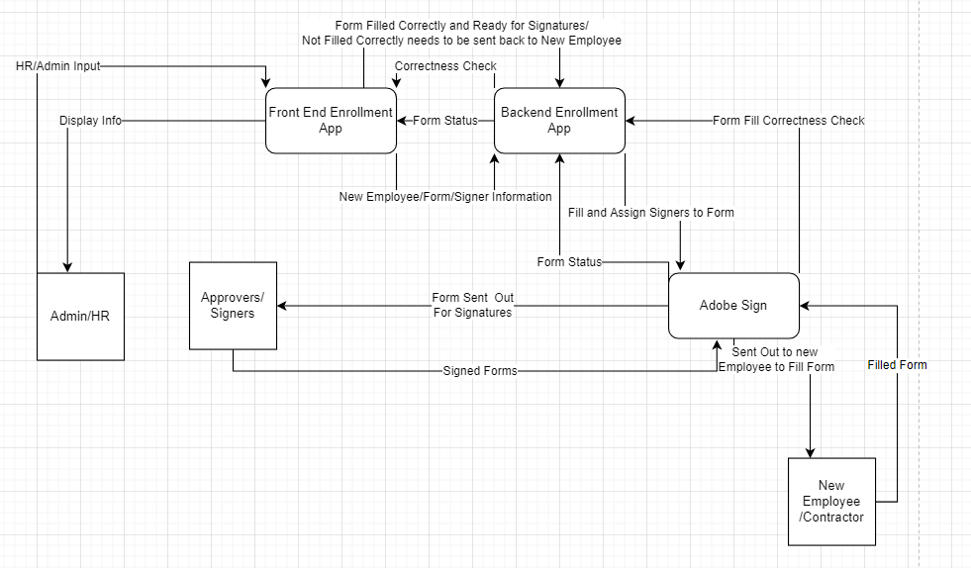
Prototype of New Enrollment App (DFD)
Ryan Lee
HR or Admin has ability to create new form with new employee and signer information.
Allows HR/Admin to Check for form filled correctness and status/stage of the form.
New employee or contractor will not have access to the Enrollment application for security reasons.
New employee will only receive an email from adobe sign to fill and sign form.
Admin/HR will have full control and status information of form through the process.

Slide 24
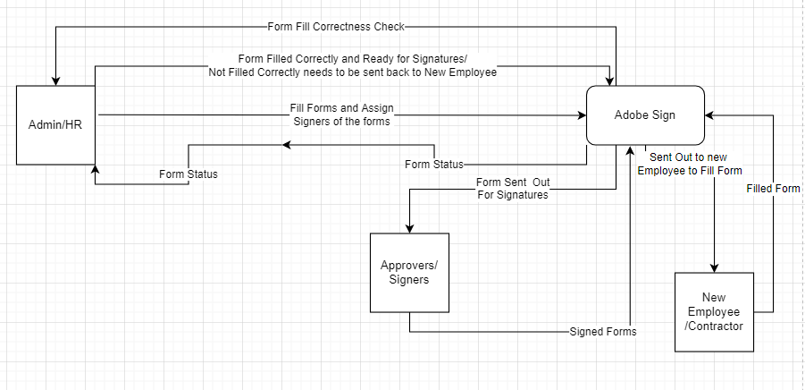
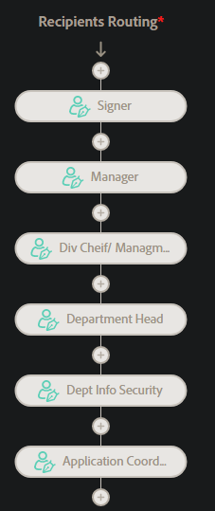
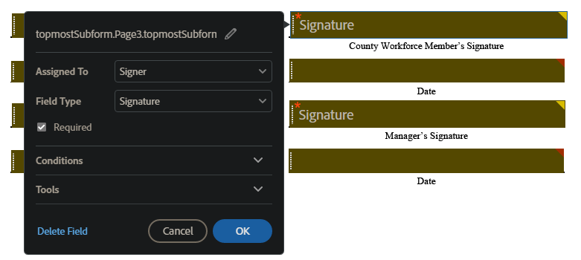
Current Progress (Enrollment App)
Ryan Lee
Able to create form templates
Assign certain form field to specific Members
Signature fields can only be filled by endorser
Capable of creating workflow to send form for filling and signing
Full process can be completed currently but Admin/HR will have to work within the Adobe sign web application
We were able to run the old enrollment, store and save the application in our database, although without access to adobe sign api we were not able to send out the emails with forms due to tokens being incorrect

Slide 25
What we accomplished
Power Apps
migrate backend of two powerapp
recreated one of the two sharepoint lists into SQL schemas
halfway through creating the new dev environment
gained proper access
Enrollment App
Navigate through Adobe Sign and API
Using PDF libraries to fill out PDF forms.
Create workflows to send the forms to employees and Company(HR,Manager…)
Notes:
Fabio
Summary and accomplishments completed

Slide 26
Moving Forward
Power Apps
Finish Migrating Sharepoint lists over to Azure SQL database
create a student production environment with the MS Power Platform
Enrollment App
Get Access to Oauth Tokens for the API Application in Adobe Sign
Implement new requirements into an app
Front-end updates
New layout
Not accessible to public
Back-end updates
Implementation of new processes (Form filled correctness ect.)
Notes:
fabio

Slide 27
Thanks for Listening!

