Slide 1
THE F.E.W.W.
(Faburkan, Enthral, Whisivil, Wulopa)
Patrick Hanna
Adan Constanzo
Erik Sorto
MingYang Liu
Advisor: Dr. Elaine Kang
Liaison: Prof. Sylke Rene Meyer
College of ECST (Engineering, Computer Science and Technologies)
IA (Institute for Interactive Arts, Research, and Technology)
Notes:
Hello and Thank you for listening to our presentation.
for our Senior Design project we are making a game in conjunction with the Institute for Interactive Arts, Research, and Technology
The game called the FEWW will be a role playing game centered around helping our main character Chuma free her people

Slide 2
Agenda
Why a Game
Story overview
Our team
Game Play
Game Mechanics
Challenges
Accomplishments / Future goals
Notes:
So today we are going to talk about why someone would choose to use the platform of a game
then we are going to give an overview of the story and talk about how our team is going to make this a reality
we’ll go into what the game play is going to look like and how we are going to go about implementing the mechanincs
next we are going to talk about some of the challenges we faced and end with what we have accomplished and where we plan to go

Slide 3
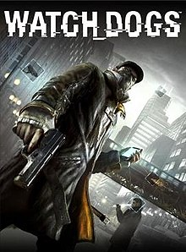
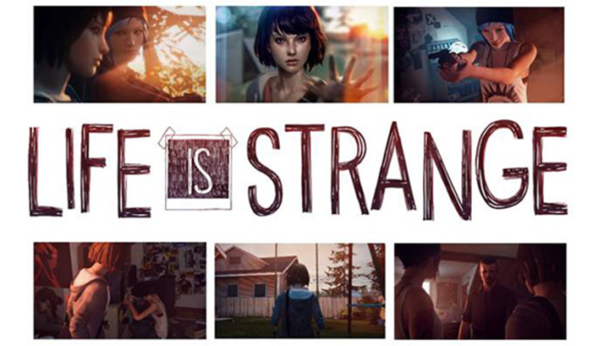
Why a video game?
Entertainment
Education
Explore social issues
Watch Dogs - Privacy, big data, government overwatch
Life is strange - Bullying
Notes:
Video games serve many purposes most commonly being entertainment with games like Mario or mortal kombat
Education is another reason that people create games. They try to create a fun and engaging way to help others discover new things
They can also be used to explore social issues. Examples

Slide 4
Purpose of Exploring Social Issues
Adds relatability to storyline
Introduce issues people might not fully understand
Sends a message via entertainment
Engage the public
Notes:
imbedding social issues in games can help make stories feel more relatable and make it easier for people to connect to them
They can also help engage the public and introduce them to issues that people might not have a full understanding of
The organization Games for Change does this by challenging programmers to create games to help educate about different topics about society

Slide 5
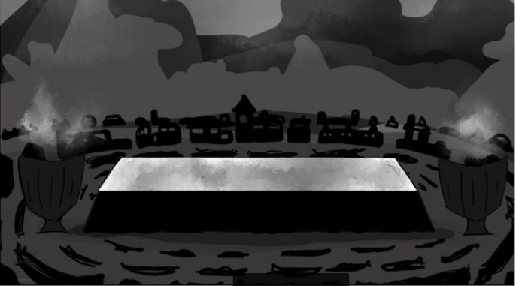
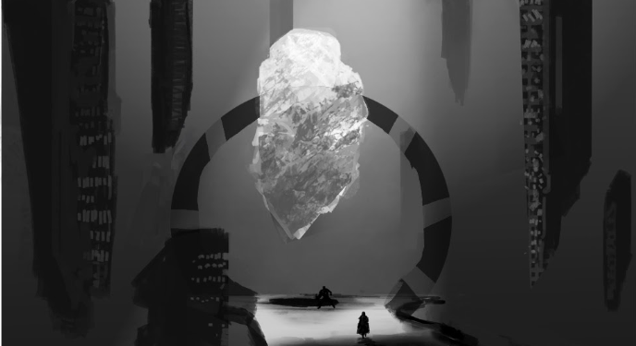
Starting out
Starting in land of Faburkan
Our Main Character, Chuma, must collect a dragon Heart Stone before the ceremony
Chuma must finish the ceremony to be able to fully participate with rebels
Notes:
Our story takes place in the world of the FEWW which stands for the four lands. Faburkan, Enthral, Whisivil, and Wulopa.
A special item called the star stone gives the people of each land abilities specific to them and as such the hold immense value to each land
The people of Enthral have taken over and are at the top and look down on everyone else.
We follow Chuma a Faburkan female who is preparing for the Warrior ceremony, a right of passage for her people
Chuma’s plan is to join the rebels once she proves herself

Slide 6
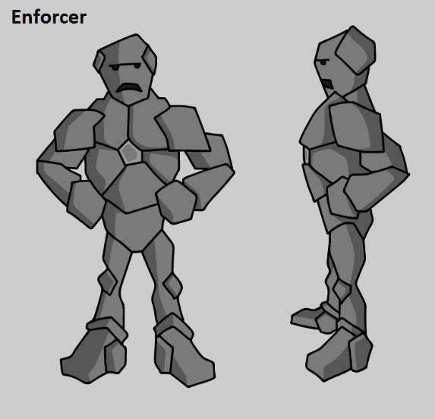
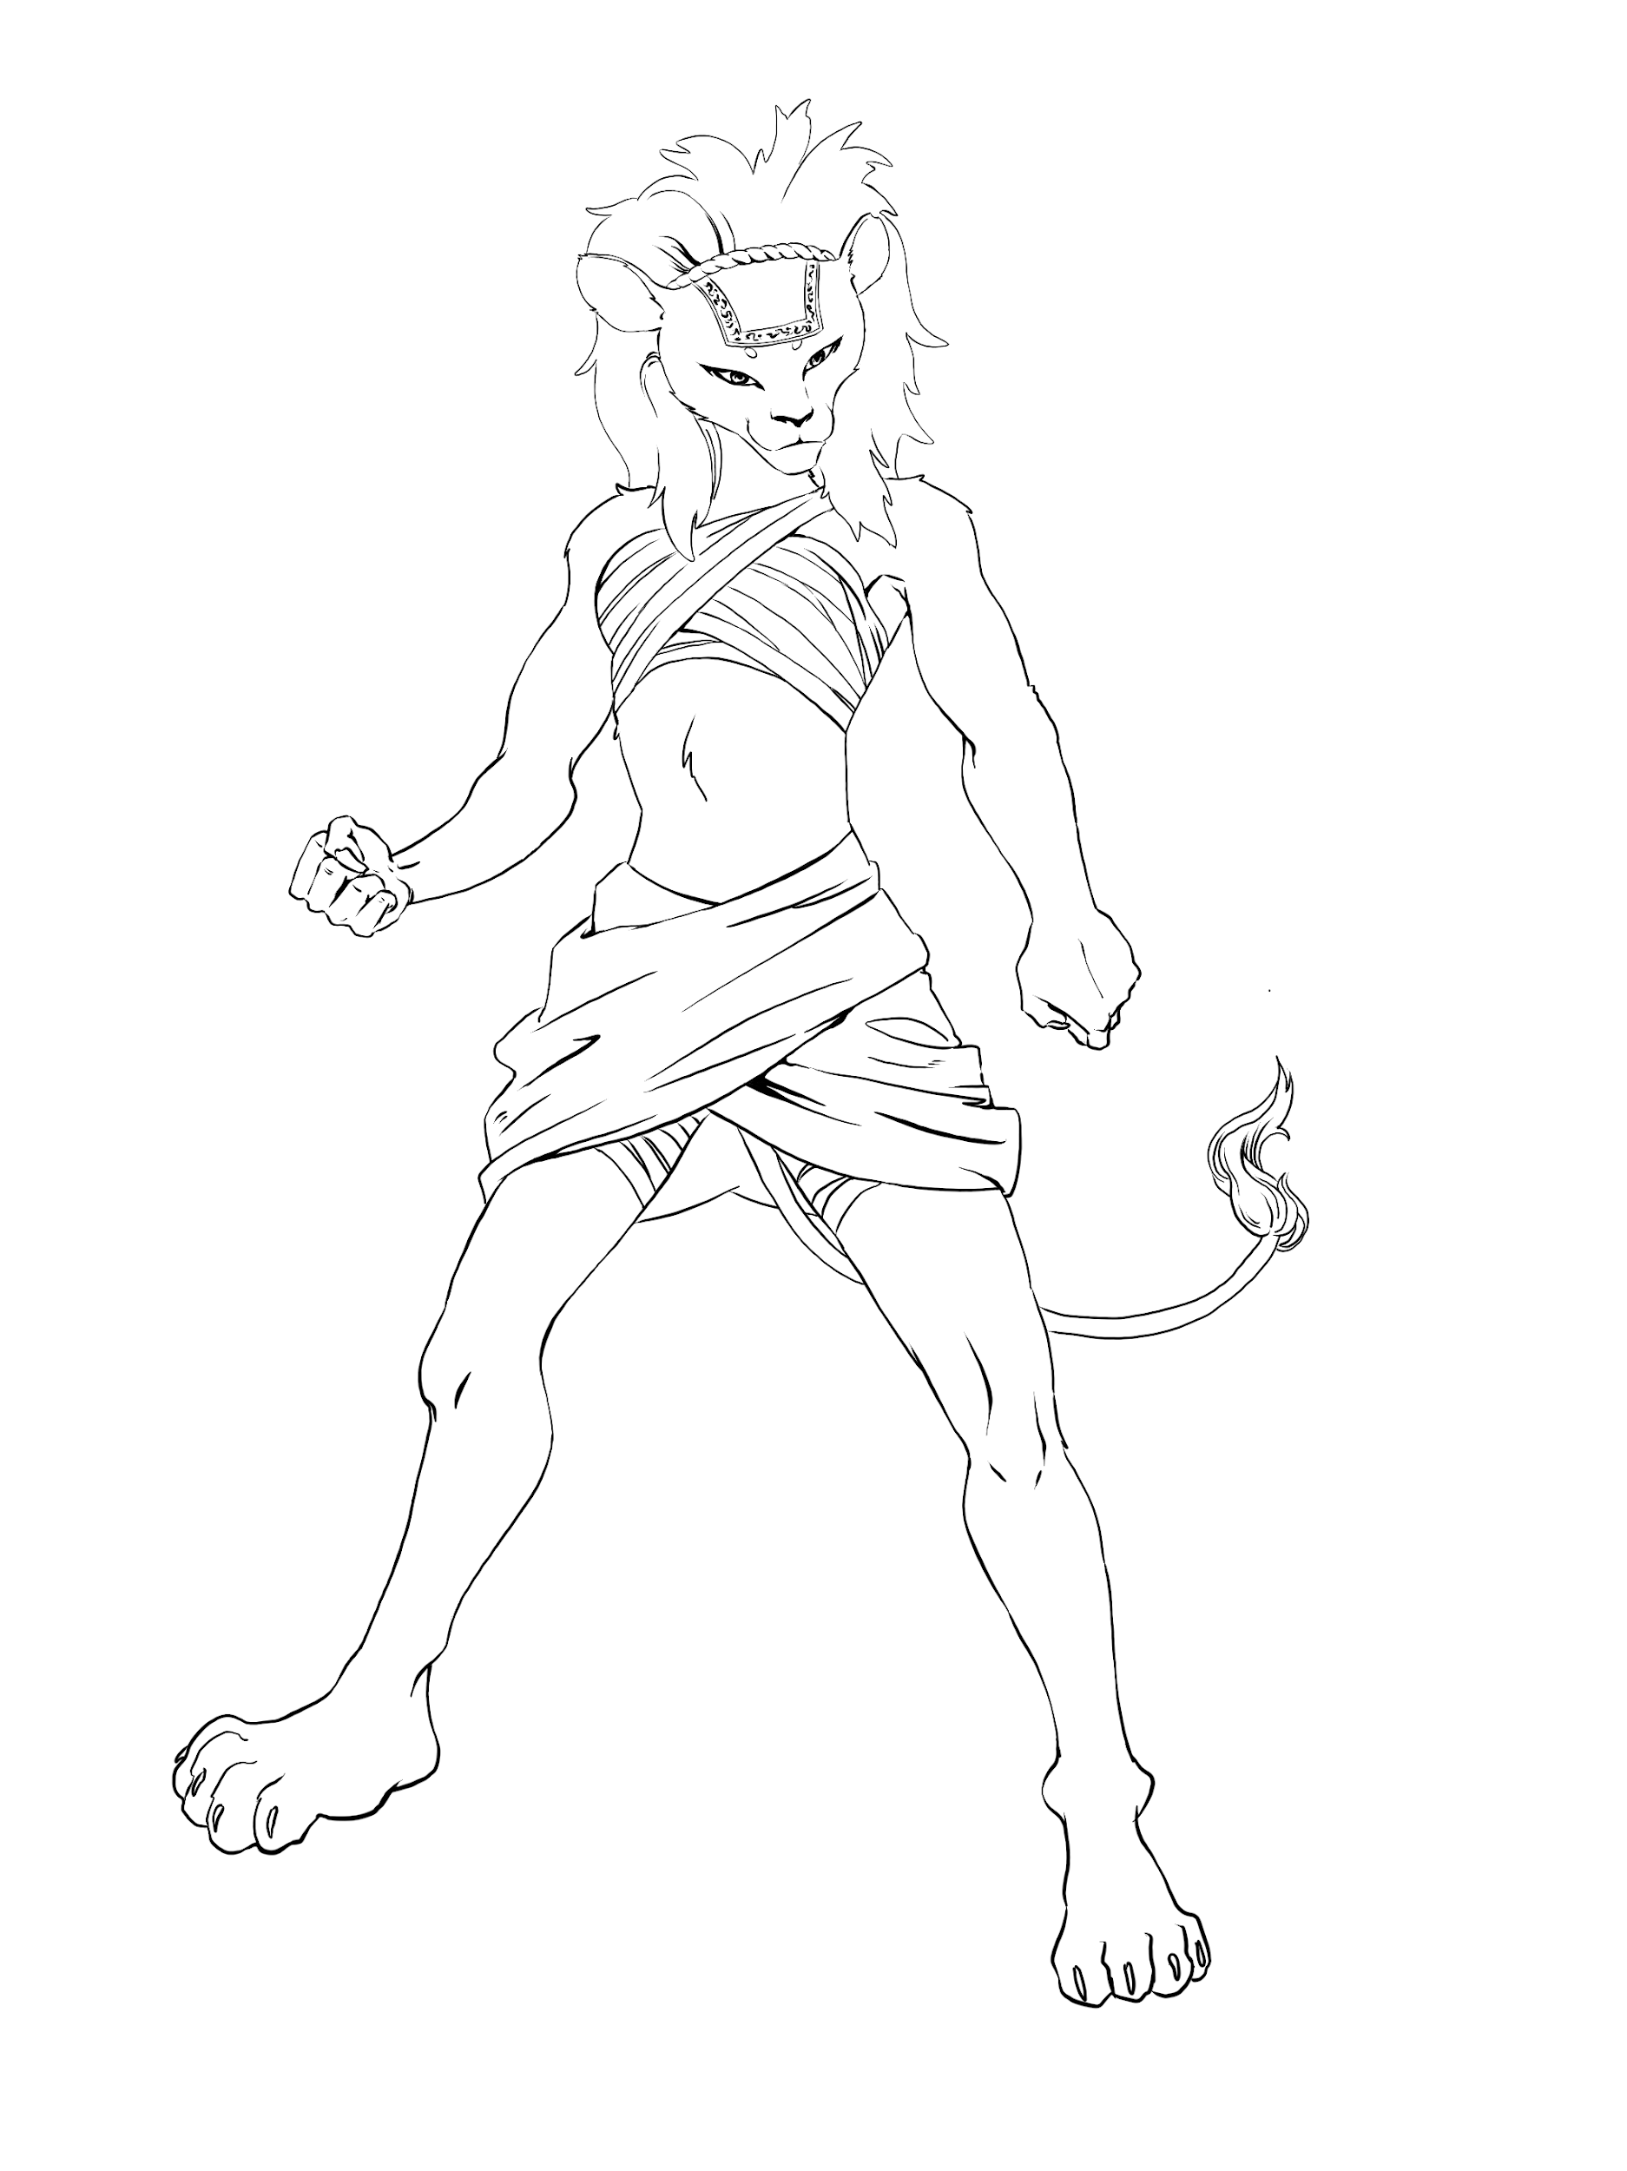
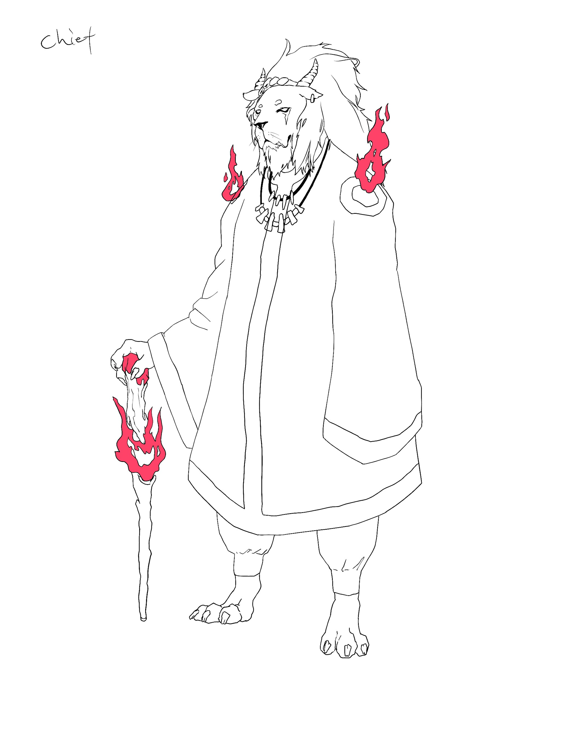
Enthral’s influence
Enforcers are from enthral
Control the allocation of resources to locals
Keep Chuma from getting the stone
Notes:
Enthral keeps their control over all the lands by using their enforcers to control the people and the allocation of resources.
They often abuse and mistreat the people of the lands they occupy and have created a narrative where they rank all the people
Chuma’s pride makes here feel obligated to stand against the injustice she witnesses which often means confronting the enforcers
As a result of actions like hers and the rebel forces the enthralians continually restrict access to the star stones
making Chuma’s preparations for the ceremony increasingly difficult
end with explaining social issues

Slide 7
Our Team
Faculty Advisor: Dr. Elaine Kang
Faculty Advisor: Prof. Sylke Rene Meyer
Game Design Lead:
Ananszah Goodie
Programmer:
Adan Constanzo
Erik Soto
Mingyang Liu
Patrick Hanna
Animation / Storyboard:
Lead
Marco Moncada
Character Design:
Leads
Bowen He
Amanda Hua
Environment:
Lead
Bryan Salvador
Writing:
Lead
Daniel Rivas
Notes:
Our Team is led by our Faculty Advisor Dr. Kang andLiaison Prof. Meyer.
The art team lead by Ananszah is broken up into smaller teams that focus on specific aspects.
We have the writing team, Environment team, Character Design, Storyboard and Animation.
And they are creating all the assets we will be using which include the environment, spritesheets, and the dialogue
We will then use these assets to build the game using Unity.
the goal being to be able to launch the game on both mobile and pc platforms
IA (Institute for Interactive Arts, Research, and Technology)

Slide 8
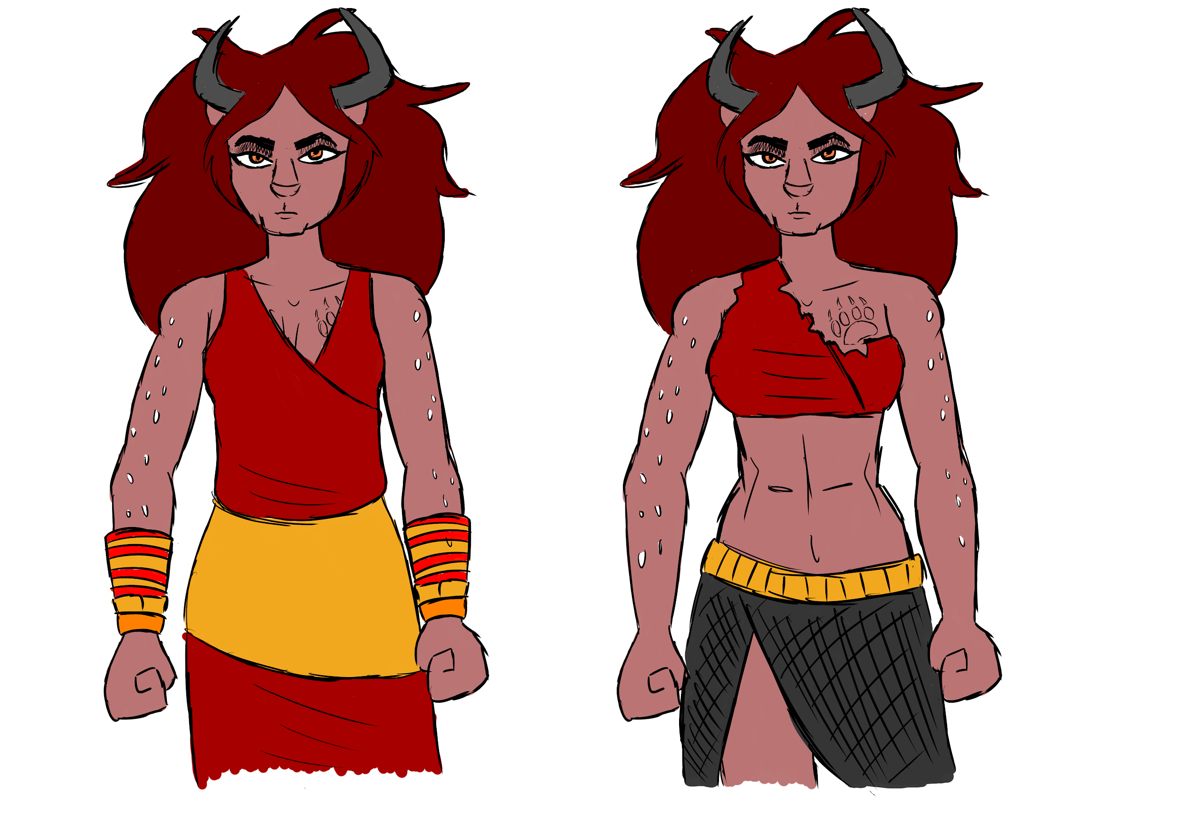
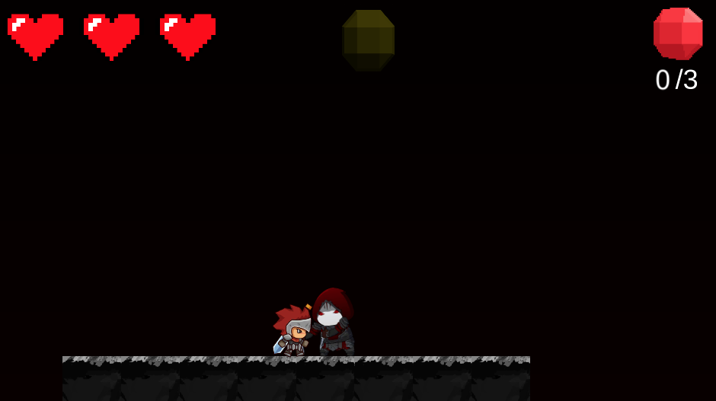
Game Play
Use strength or weaknesses throughout game
Fight dungeons and npcs
Experience discrimination within gameplay
Explore new cities
Notes:
Our gameplay for the FEWW consists of chuma, our main character from the furburkan class, to use her strengths or weaknesses to complete levels, fight in dungeons and experience discrimination and unfairness. Throughout the game, chuma will discover multiple cities where she then must gain their trust in order to collect enough star stones to default THE enforcer from Entrall

Slide 9
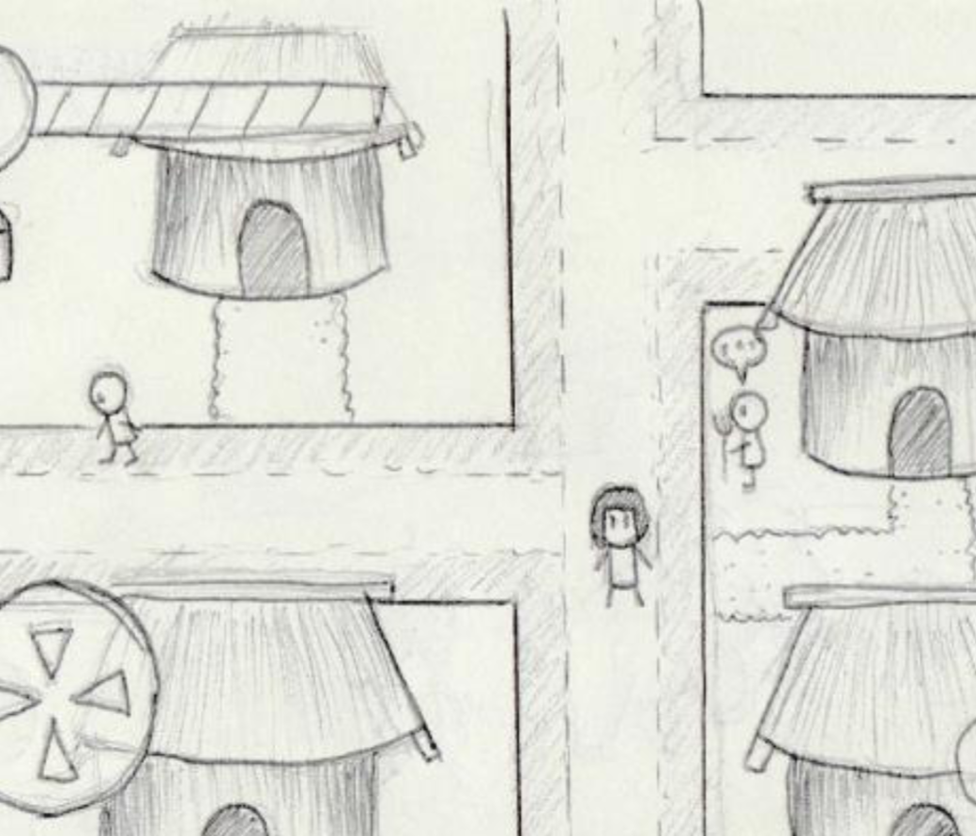
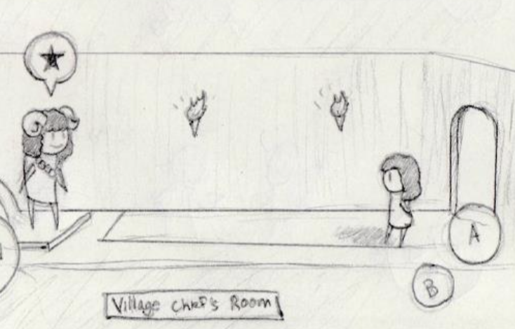
Game Layout
Role Playing Game
Side Scroller and Top Down View
Notes:
The game is going to be a Role Playing Game where chuma will interact with npc in cities and . We as a team decided to have a top down view during city exploration and side scroller for combat or quest.

Slide 10
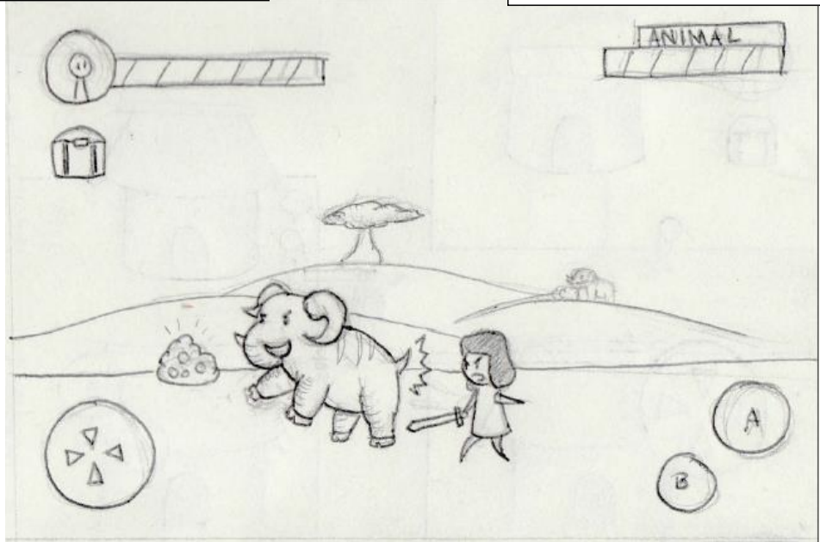
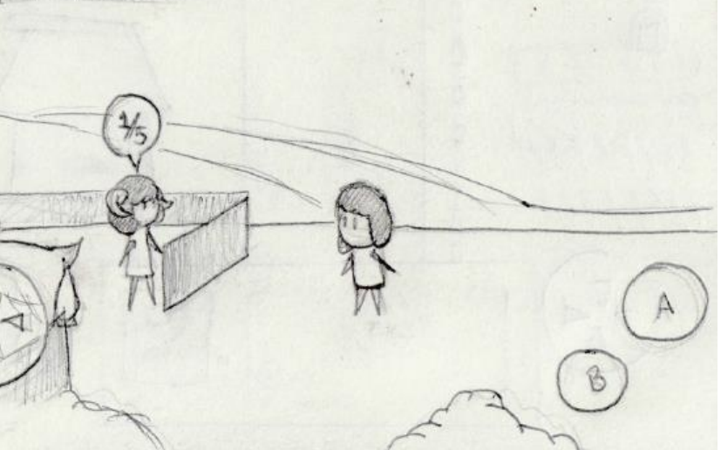
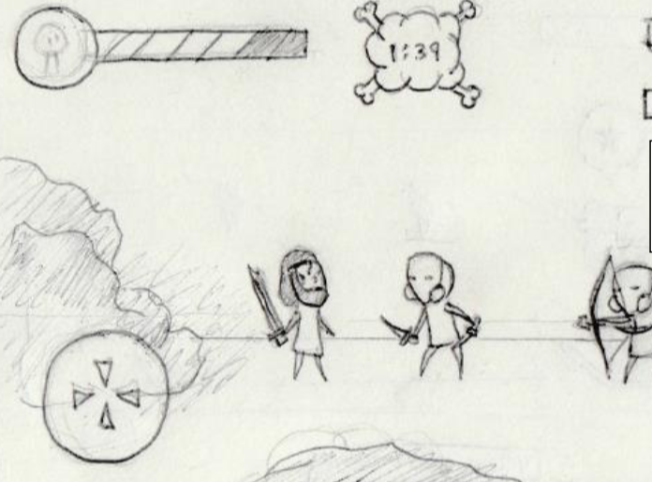
Mission Walkthrough
Player combat
Player quests
Notes:
Within the city there will be quest where chuma can increase her reputation within the city. As you can see above our story board team provided us with some quest! This quest, chuma is responsible to manage and tame some wild animals within the city. In addition, there unfriendly encorunter where npcs will attack chuma.

Slide 11
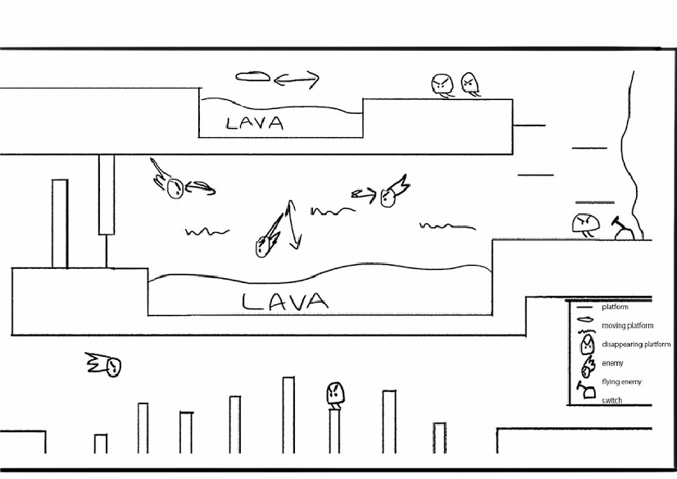
Level Layout
Notes:
Patrick will give general idea,
Mingyang goes into detail of environment concepts.
Showing many assets from team.

Slide 12
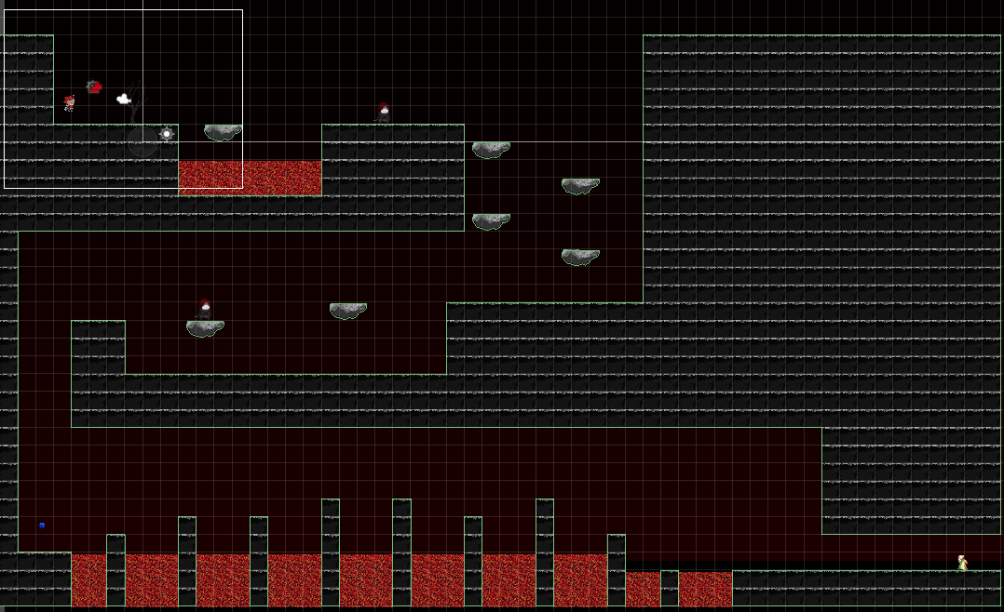
Level Layout
Notes:
Patrick will give general idea,
Showing many assets from team.

Slide 13
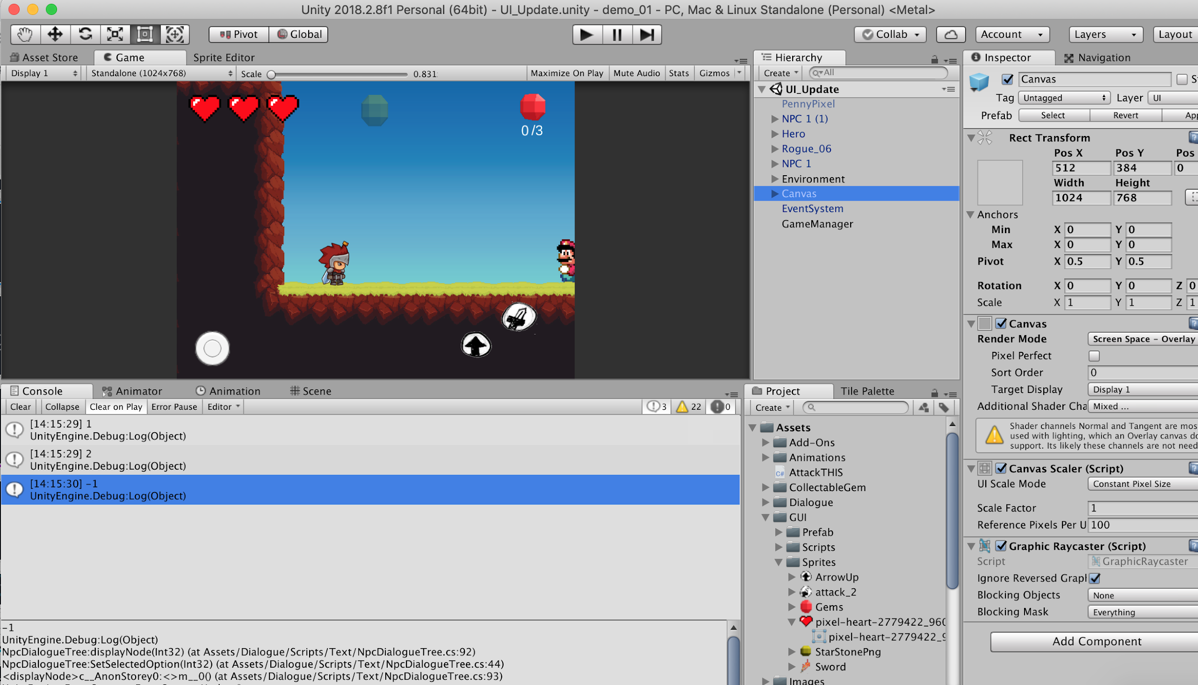
Game Engine
High code reusability
Collision
Physics
Input, Graphical Interface
MultiMedia
Unity’s GUI allows for visual adjustments
Multiple platforms
Notes:
For implementing our story and game play we decided to use Unity as our game engine. Unity provided base code for a typical game, such as collision, physics and so on. In addition, unity provides an editor for visual adjustment and manage during production. Finally unity allows us to export our game onto multiple platforms like PC or mobile.

Slide 14
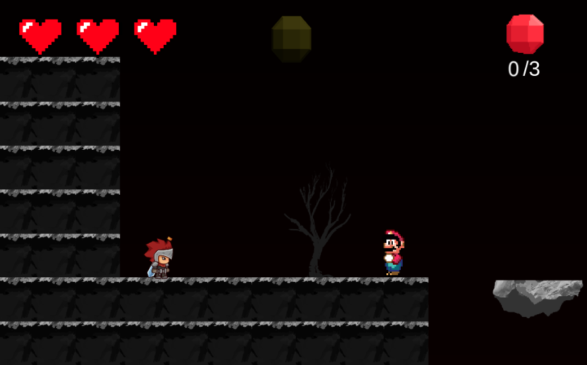
Implementation
RPG style game
Side-scroller
Mobile
PC
Notes:
In this semester, our focal point was implementing the necessary elements to meet our game requirements.
Since our game is two-dimensional, we were mainly focused in making the camera move, controlling the main character, implementing some of the enemy AI, and playing with physics engine to smooth out some of the character movements. Components found in RPGs and side scrollers.
As you can see, in its current iteration, our game doesn't look anything like the images from the art department and doesn't have a unifying theme yet. That is because the art department hasn't finalised the designs, but when they do, our hope is that we can easily replace our placeholders, which readily available online, with the actual game designs.

Slide 15
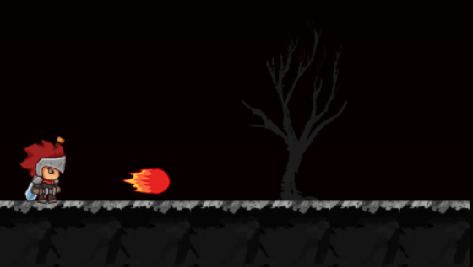
Mechanics
Furburkan
Heavy on brute combat
Uses weapons to attack and fireballs
Fireballs develop as player progresses.
Notes:
This semester we are focusing on implementing Fuburkan to have a template for the other classes such as Whisivil, Enthral, and

Slide 16
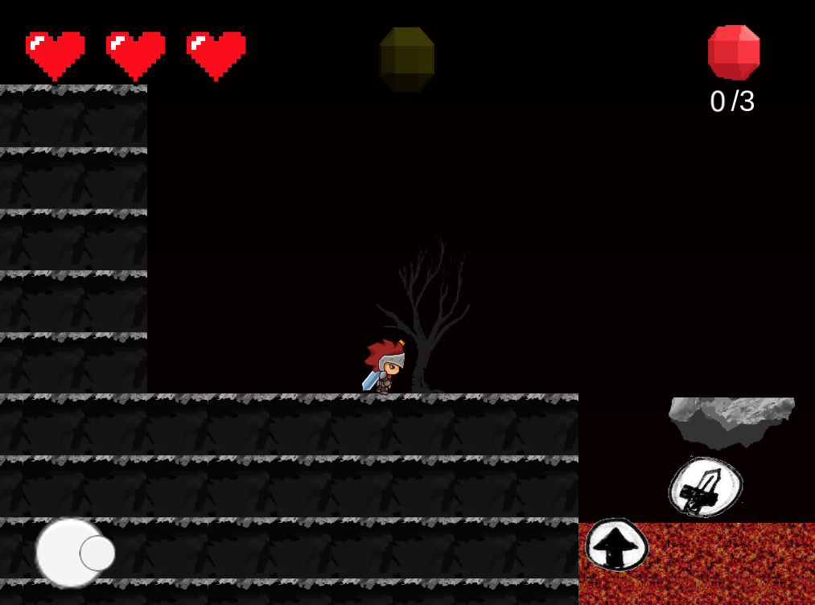
HUD
Joystick
Interchangeable action buttons

Slide 17
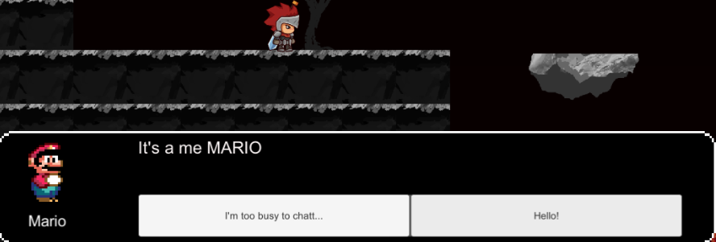
Dialogue System
Dialogue HUD
Decision Tree

Slide 18
Project Challenges
What game engine – Many choices to help in development
Working with another group – All art and assets developed by another team
Perspective of game – Changes in code to adjust whether
it is top-down or from the side
Notes:
Move this to the end.
Instead we need to talk more about the structures of the projects, art team, etc.
Audience must understand the collaborations is done within the project.

Slide 19
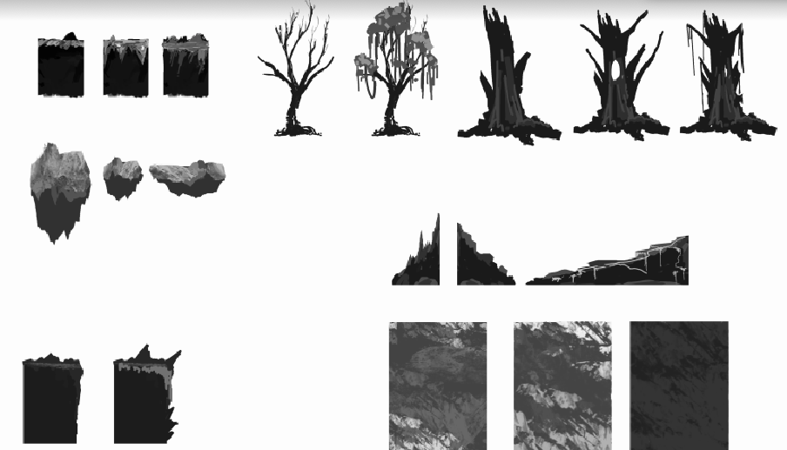
Fall Accomplishments
Familiarize ourselves with Unity
Learning different elements of the engine
Learning development workflow
Developing 2D prototypes
Develop game mechanics
Communicating with artist and concept teams
Notes:
Advertise what we did here,
Have room to expand. Show how assets are applied to the game.

Slide 20
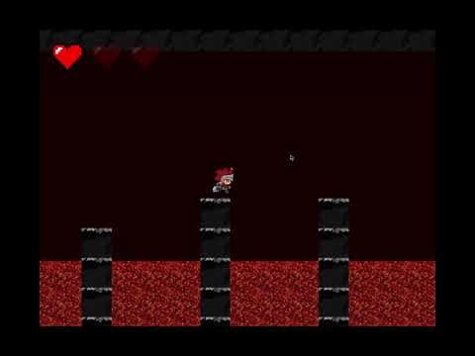
Demo

Slide 21
Future Goals
Refine mechanics
Battle
In Town
Import finalized, colored artwork
Camera follow character more naturally
Optimize algorithm for mobile
Sound effects
Notes:
Add a conclusions and summarize the greatness of the game :D

Slide 22
Thank You

