Slide 1
LA Hall of Administration Smart Board Directory Project
TEAM MEMBERS
Matthew Gerlits, Christopher Ly, Julius Macalutas, Jose Vega, Cedric Tong, Chelle Cruz
ADVISOR
Keenan Knaur
LIAISONS
Jeramy Gray, Amin Almuhajab, Rony Wirtz
Notes:
Working with limited info on IW
More Screenshots
Add Demo
Video backup

Slide 2
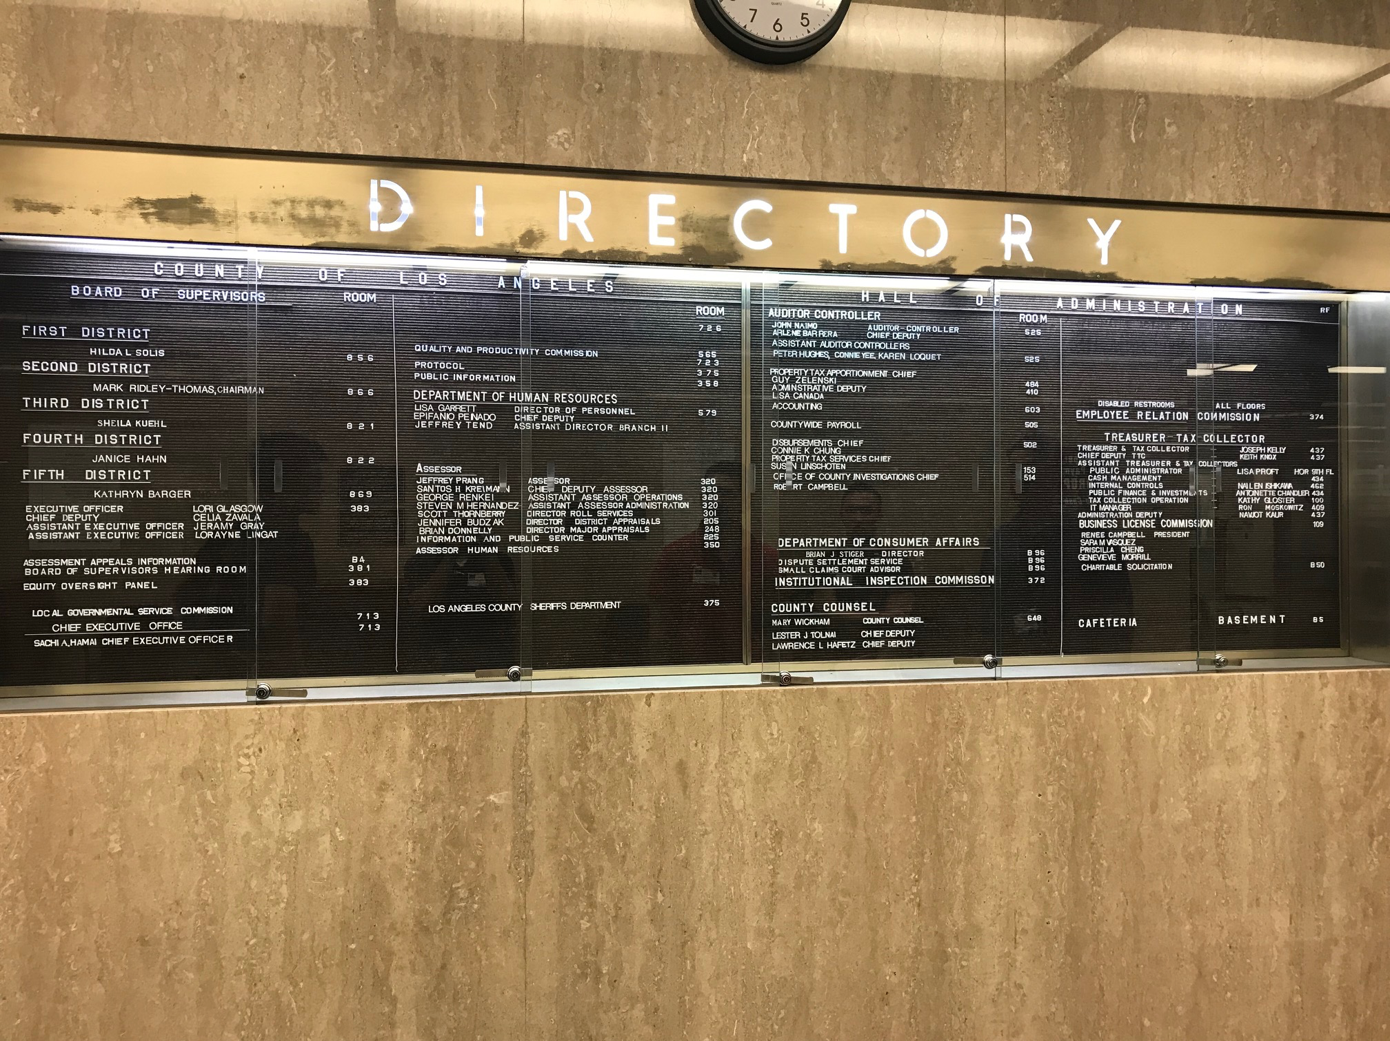

Slide 3
Project Overview
Administrative Portal
ASP.NET Core 2.0
Smart Board Directory
Interactive Map
Amazon Alexa
UI Layouts
Notes:
Explain why we had to make the portal
Eg. How is helps satisfy their requirements

Slide 4
Administrative Portal
Notes:
Discuss why we need a portal(they wanted to use excel sheet), why asp.net, screenshots, what requirement does it fufill

Slide 5
Administrative Portal
Web application separate from the Smartboard Directory
Database used to support Alexa Skill Kit (ASK)
Using ASP.NET Core 2.0 and Microsoft SQL Server
Design
Notes:
To begin, the administrative portal is a web application that is separate from separate from the smart board directory. The database created from the administrative portal is used to support the Alexa Skill Kit application.
Initially, the Hall of Administration (HoA) wanted to use a CSV file to store their departments’ and employees’ data. However, we decided to create an administrative portal using ASP.NET Core 2.0 and Microsoft SQL Server since it will it assists the client in managing their data.
We chose ASP.NET Core 2.0 because our client requested us to use C#, which ASP.NET Core 2.0 Framework uses. In addition, we chose Microsoft SQL Server because they are easily integrated in a web application.
The administrative portal is designed to allow each department to add or modify their own information as well as their own employees’ information.
For example, the IT account manages its own department information and its employees’ information. The HR account manages its own department information and its employees’ information. The HR account cannot view, modify, or delete the IT’s account information.

Slide 6
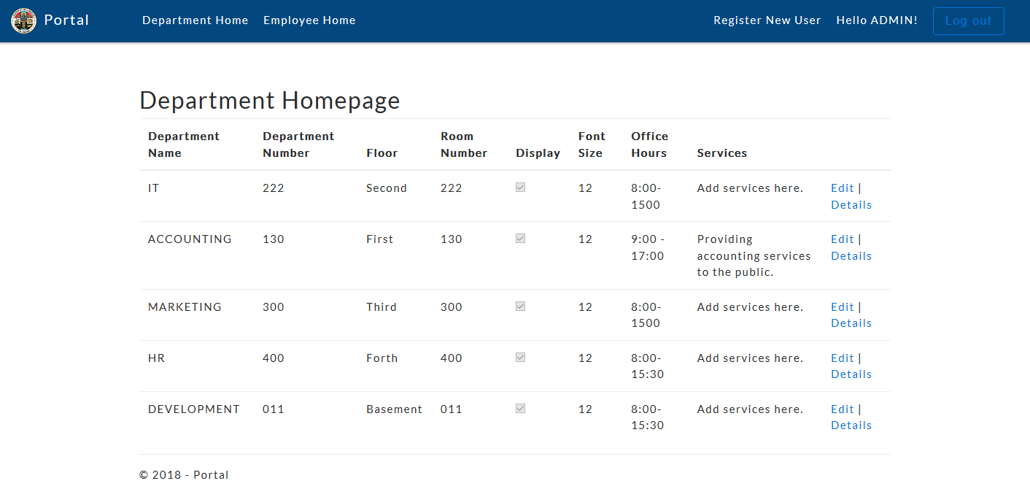

Slide 7
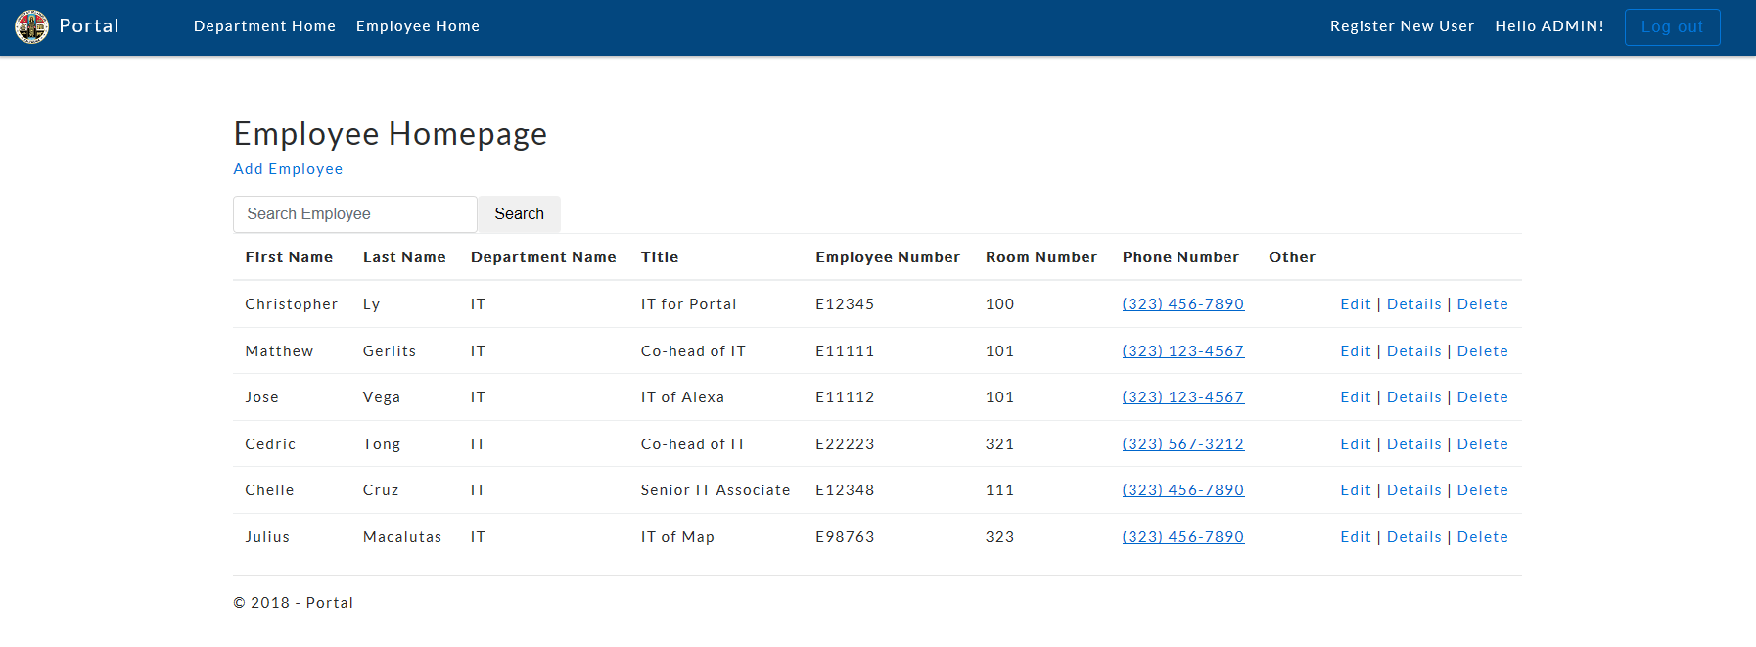

Slide 8
Challenges
Understanding the framework
Roles and policy based authorization
Deployment
Notes:
One of the challenges I faced while creating the administrative portal was understanding the framework.
To learn the ASP.NET Core 2.0 framework, I was advised to learn its older frameworks, ASP.NET under the .NET Framework and ASP.NET Core 1.0. This was almost essential since ASP.NET Core 2.0 is built on top of ASP.NET Core 1.0, which is built on top of the .NET Framework.
Another challenge I had encountered was creating role and policy-based authorization. It seems simple. A user has a role or a policy or both. And certain web pages can only be accessed by certain roles or policies. However there is no easy way to assign a role or policy to a specific user!
Lastly, deployment was a large issue. Running the web application under my local server in my IDE, Visual Studio would run just fine. No crashes, no 500 errors. However, after deploying the web application through IIS (Internet Information Services), the application would display a 500-internal server error. There was no good way in debugging this error since the only information the web application provided to me was error 500.

Slide 9
Creating the Map

Slide 10
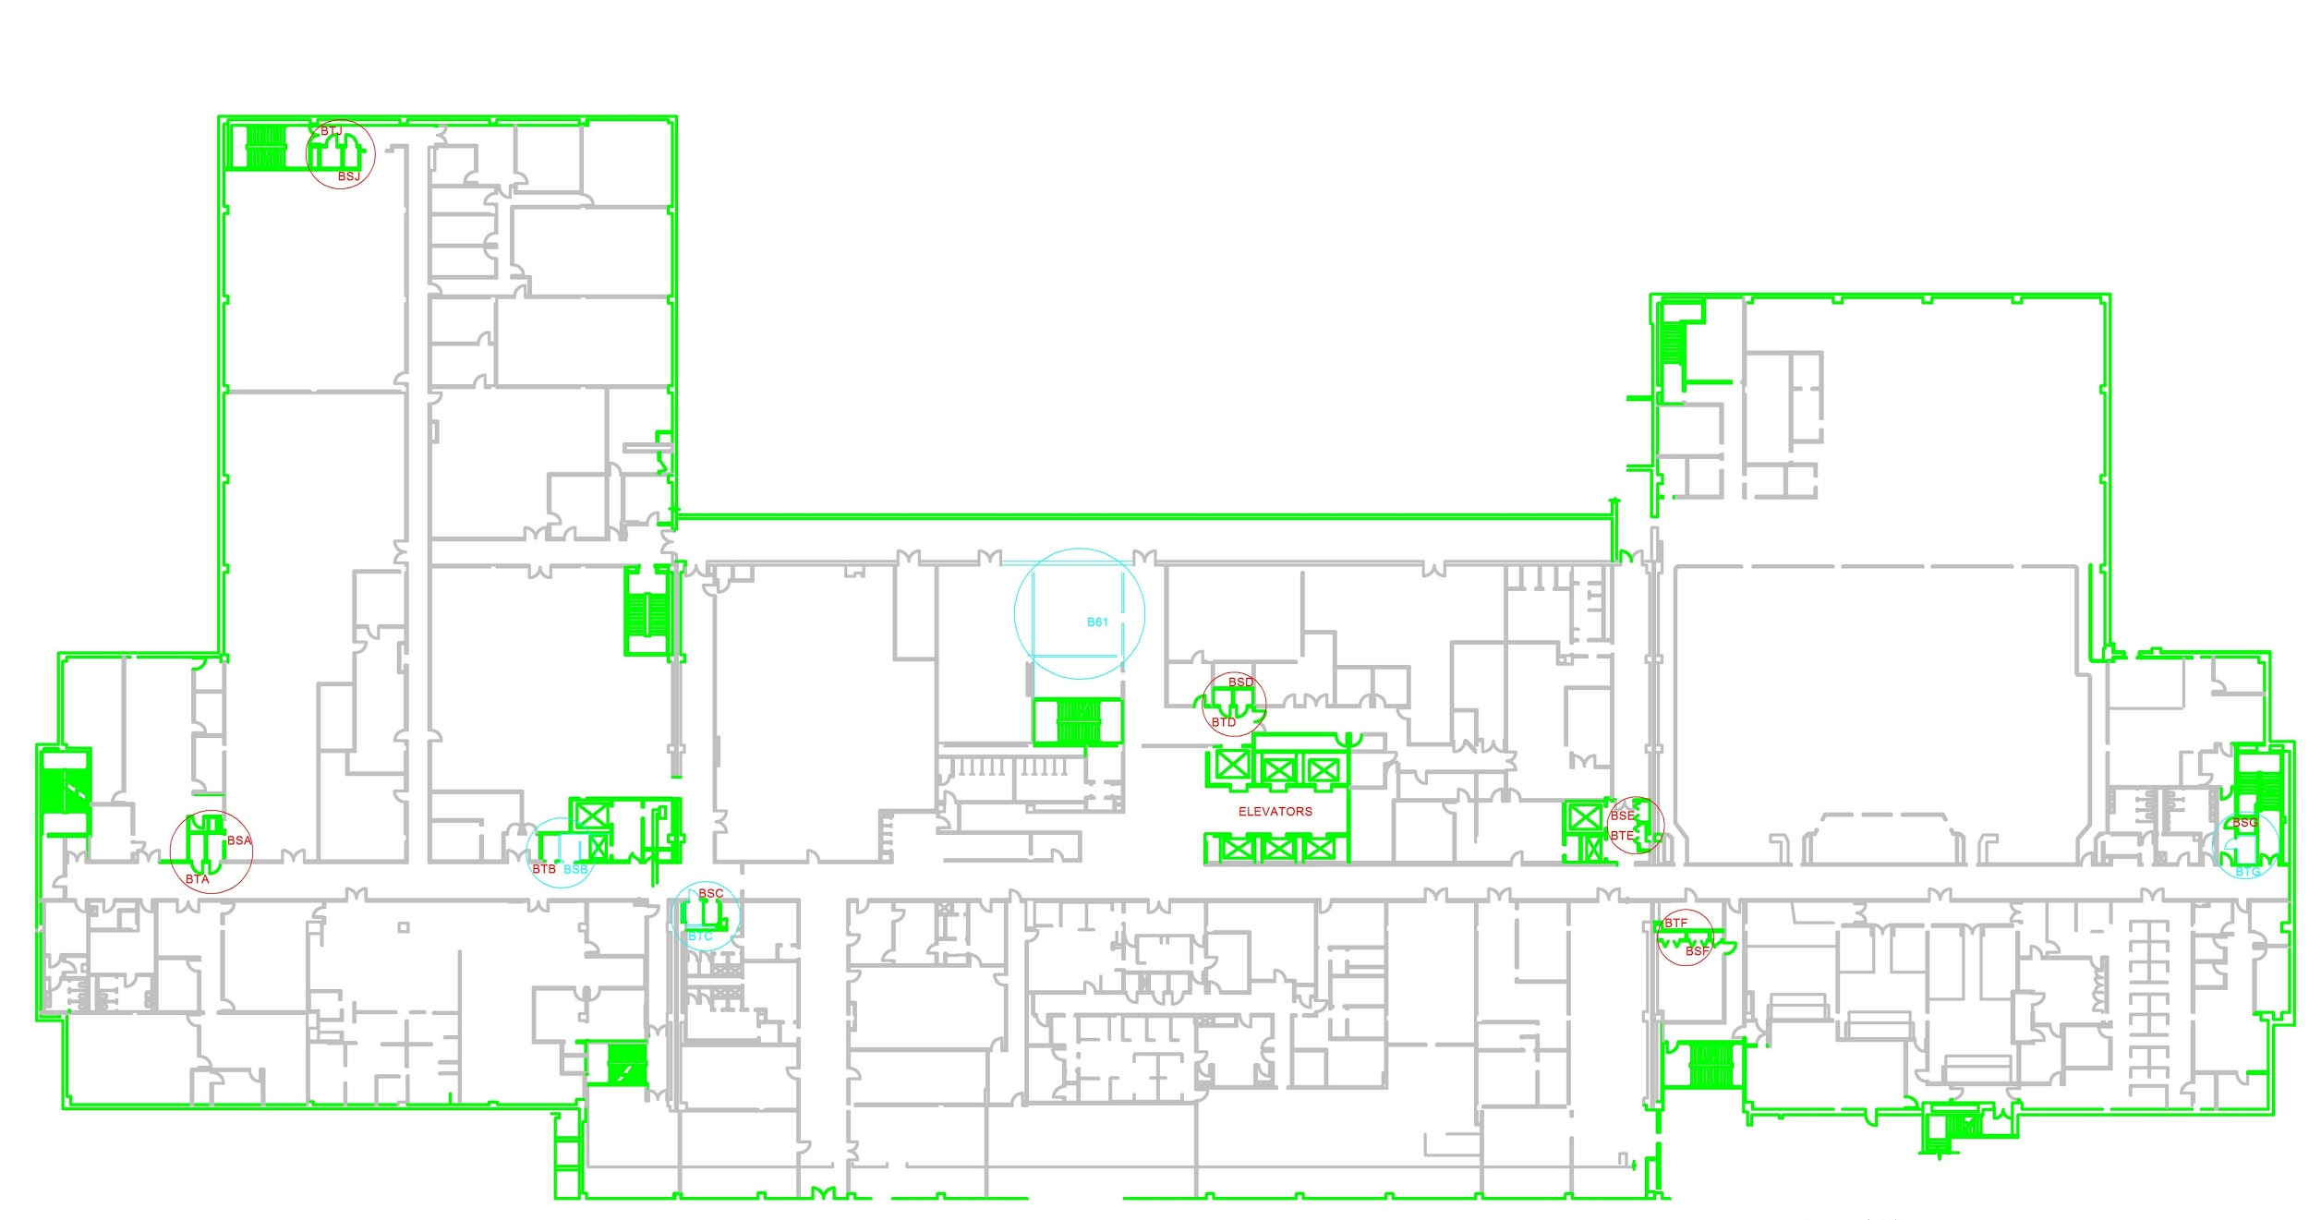

Slide 11
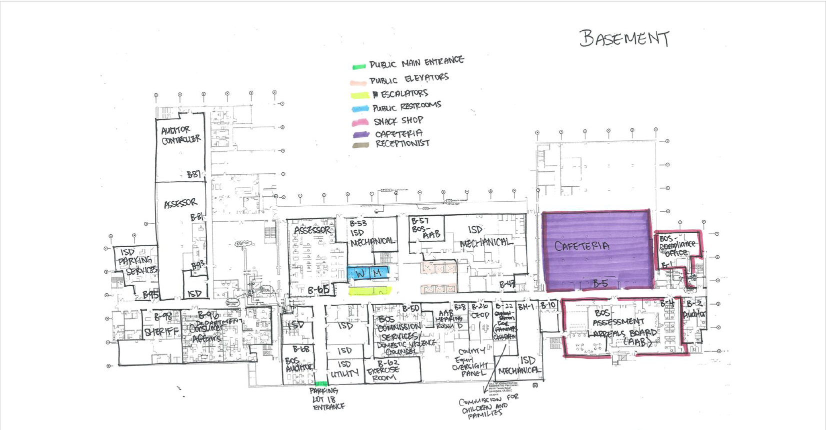
Notes:
Build from CAD File as reference
Show JPG and final as comparison
Colors are easier on eyes
Built by hand

Slide 12
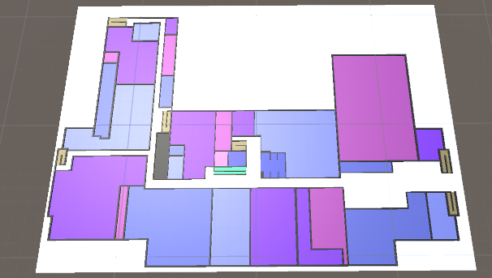

Slide 13
Pathfinding
Notes:
Add Julius part to this

Slide 14
Features
Visual and written directions to selected destinations
Displays basic information of each room when selected
Dynamic pathfinding

Slide 15
Technologies and Algorithms
Unity3d
Dijkstra’s Algorithm
WebGL
Notes:
More Connections

Slide 16
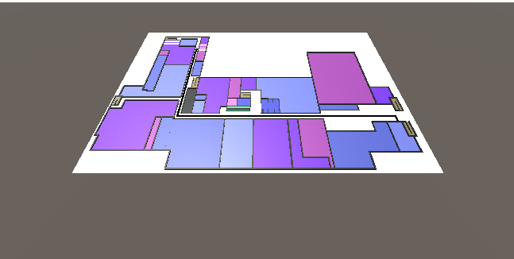

Slide 17
Alexa Skill
Notes:
I’m going to be introducing the Alexa Skill we have been developing.

Slide 18
What is Alexa?
Amazon’s intelligent virtual assistant
Capable of voice interaction, playing music, to do lists, etc.
Can do much more by installing “skills”
Notes:
What and why

Slide 19
Alexa Skills Kit
Enables a developer to build skills
Application that is usable on an Alexa powered device
Create interaction model that handles all the user inputs and helps determine the logic of the response
Intents that fulfills a user's spoken request
Notes:
An Alexa Skill is an action that Alexa can take in response to a voice command
APIs, tools, documentation, and code samples available
Create interaction model that handles all the user inputs and helps determine the logic of the response

Slide 20
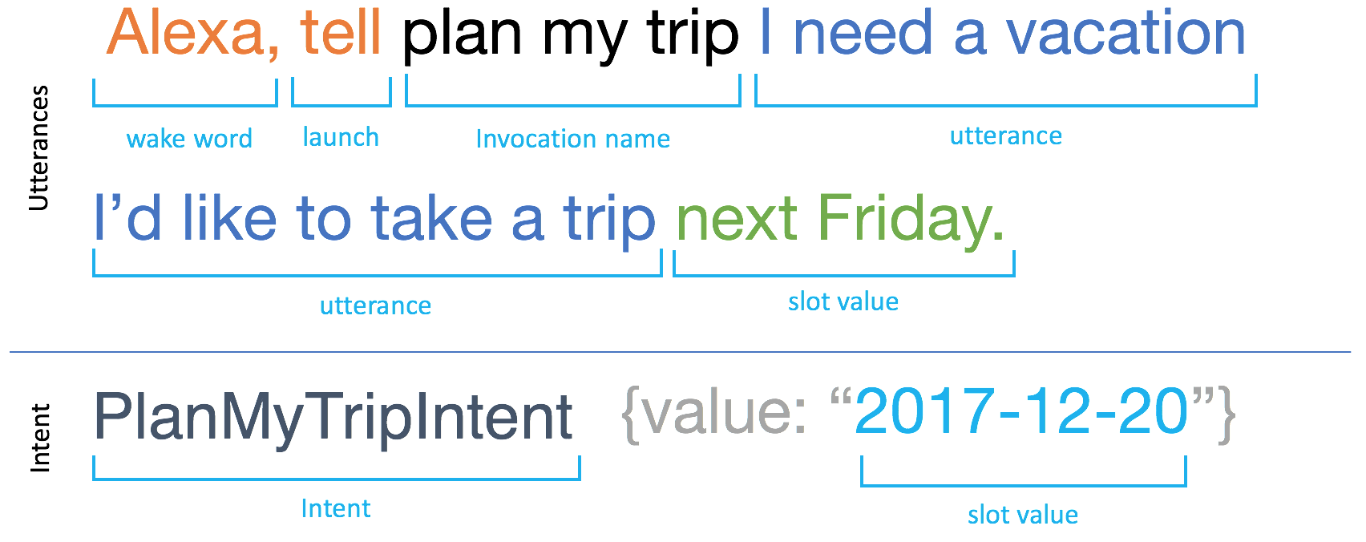
Alexa Skills Kit

Slide 21
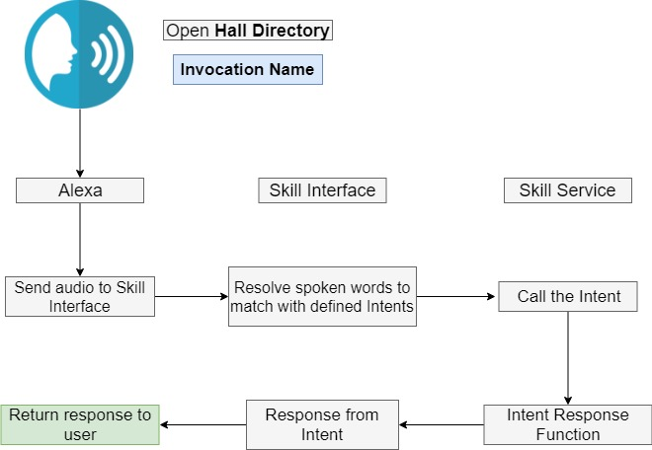

Slide 22
Alexa Voice Service
Allows developers to integrate Alexa into their own products
Used it to integrate Alexa into our web application
Alexa-powered device not needed

Slide 23
Amazon Web Services
Lambda
Run code without provisioning or managing servers
DynamoDB
Fast and flexible NoSQL cloud database service
CloudWatch
Monitoring service for various AWS products
Notes:
Talk more about lambda

Slide 24
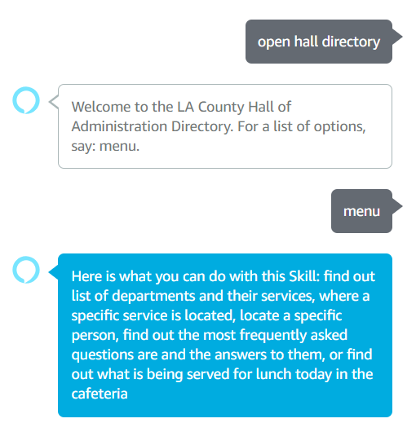
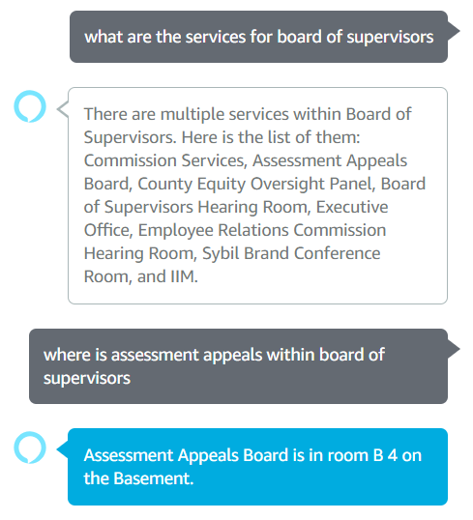
Notes:
Define Skill, Intent, interactive model
Split slides

Slide 25
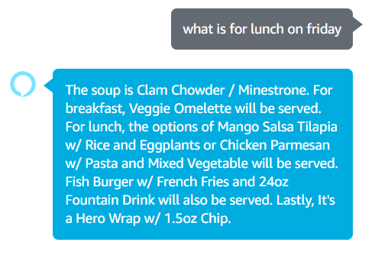
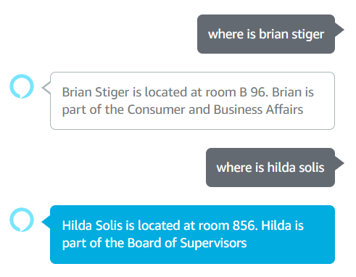
Notes:
Define Skill, Intent, interactive model
Split slides

Slide 26
Interactive Directory

Slide 27
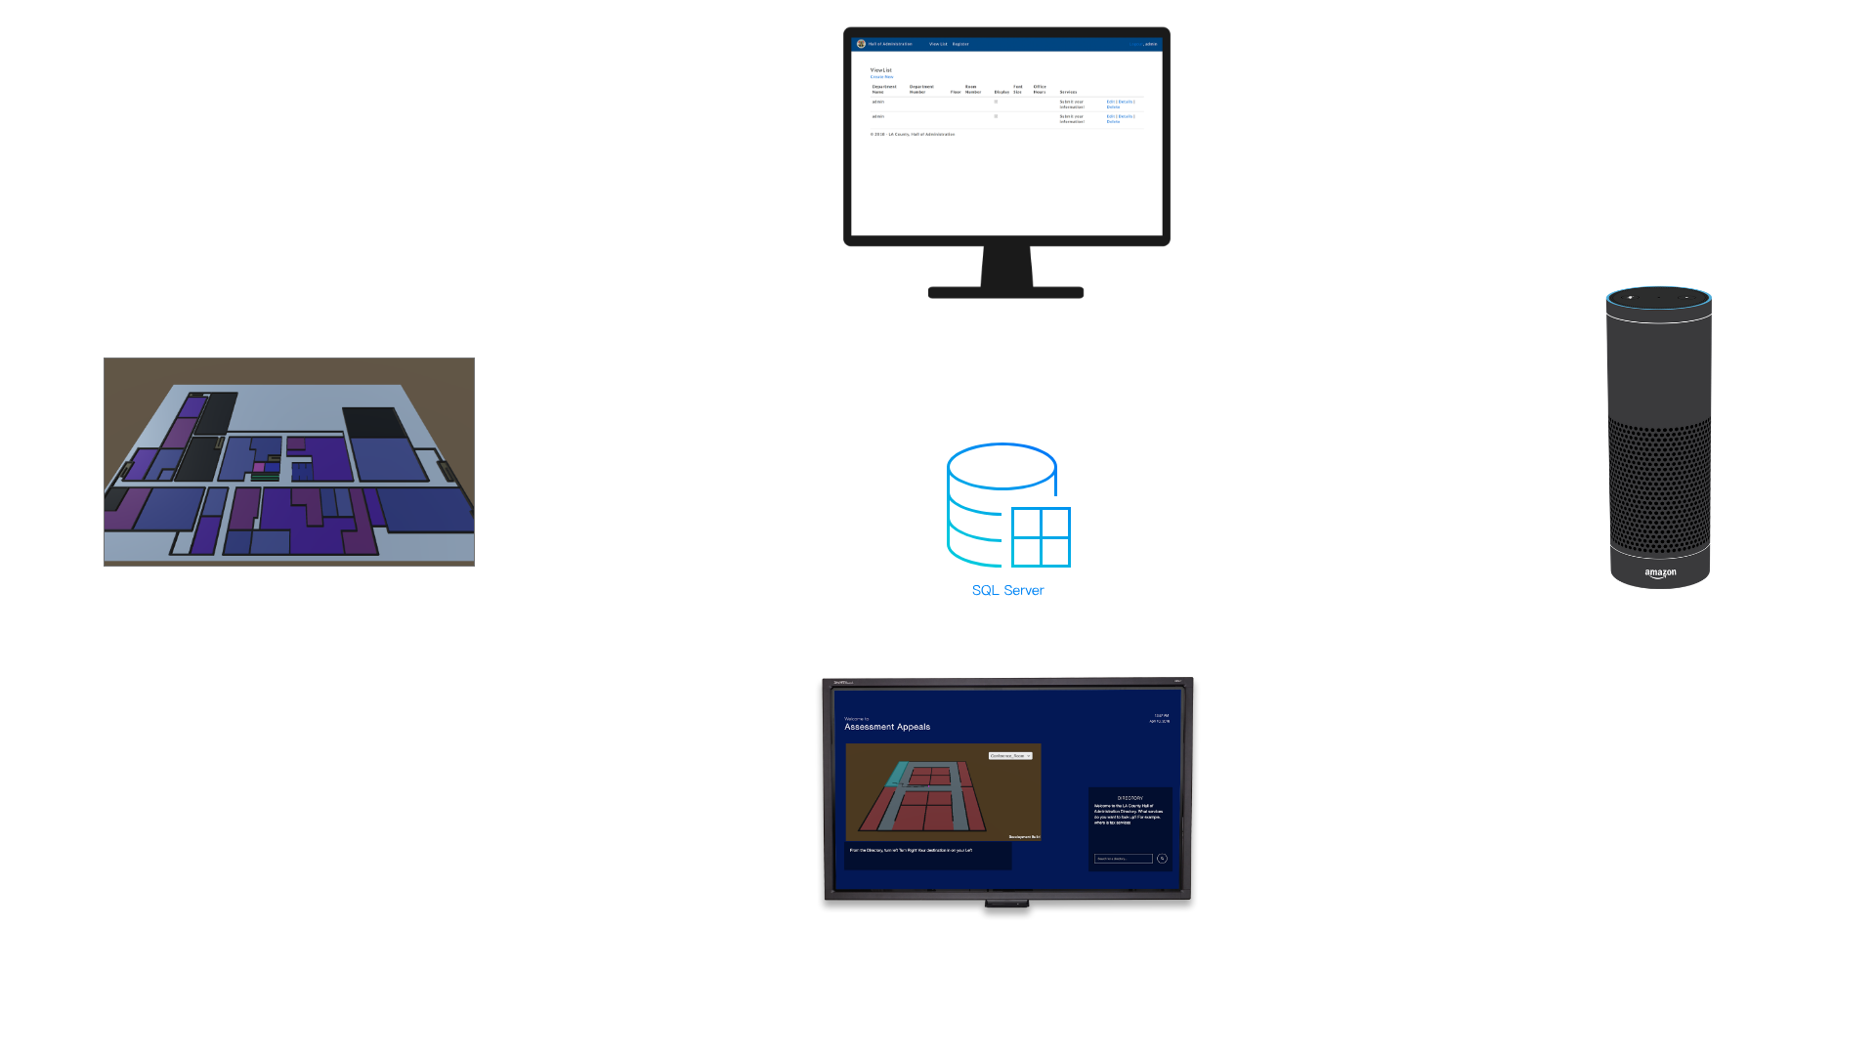

Slide 28
Notes:
Discuss elements of this slide
Map (main) Voice Search Module (right) Utilities (date and time)

Slide 29
Notes:
Discuss elements of this slide
Map (main) Voice Search Module (right) Utilities (date and time)

Slide 30
Technologies Used
CSS Grid
Vue.js
GSAP (Greensock)

Slide 31
Future Work
AWS AppSync for gathering real-time speech output more efficiently
More refined display/format of speech output
More refined map layout and integration

Slide 32
Questions?

