Slide 1
Notes:
neil
screen shot showcase

Slide 2
Team Members and Roles
Neil Hoggatt - Team Leader
Yash Ahuja - Technology Leader
Ryan Cram - Level Designer
Peter Trang - Artistic Director
Dr. Elaine Kang - Faculty Advisor
Gabor Kondas - Graduate Advisor
Sam Stokes - Industry Liaison
Notes:
neil

Slide 3
Agenda
What is Covert Protocol?
What are the major technical features and how were they implemented?
What challenges did we face? What did we deliver in the end?
Notes:
neil

Slide 4
Original Motivations
Create a game for the non-casual gaming market, who wants a tactical, squad-based game without requiring quick reflexes
To develop a new take on tactical games
To compete in the Microsoft Imagine Cup
Notes:
neil

Slide 5
What is Covert Protocol?
Genre:
Real-time
Squad-based
Tactical side-scroller
The player’s goal:
Aid their squad in overthrowing the government.
Complete every level, each with a multitude objectives and obstacles.
Notes:
peter
general obj??goal?conclusion? Overthrowing the government??
screen shot

Slide 6
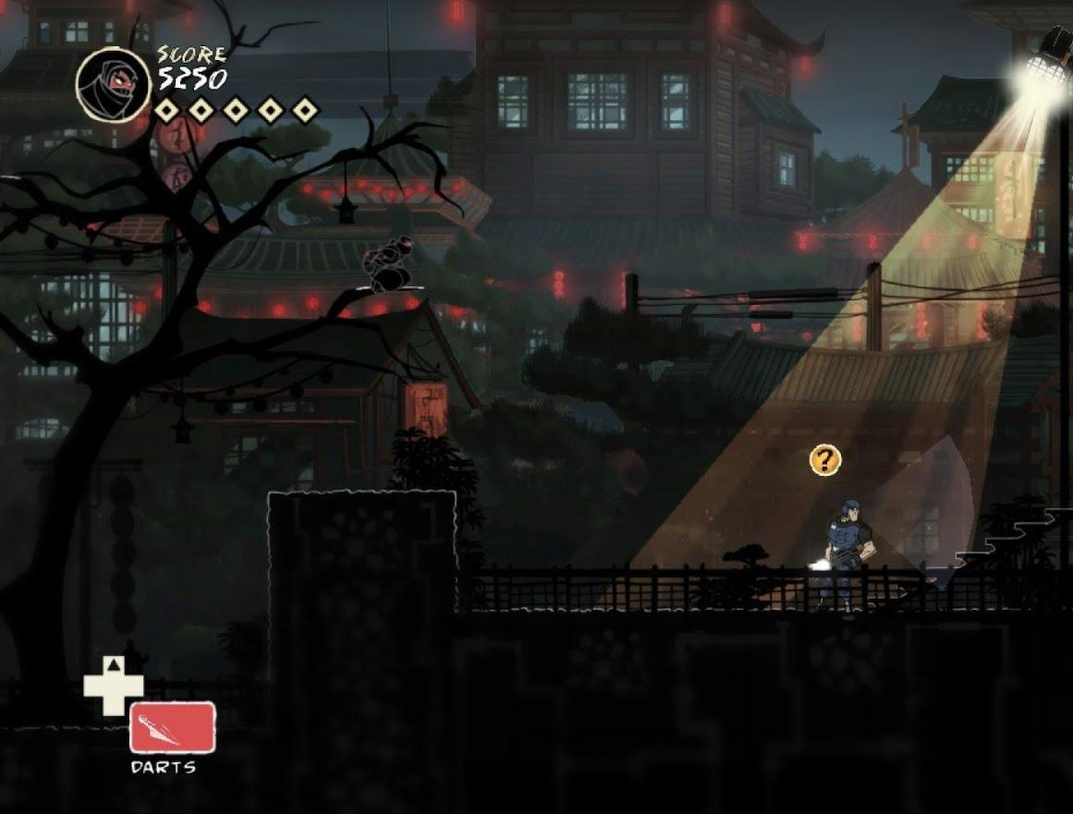
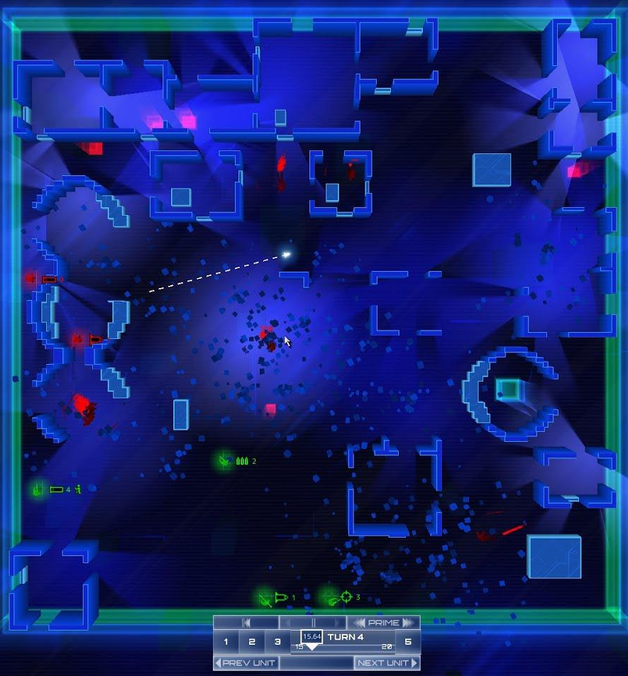
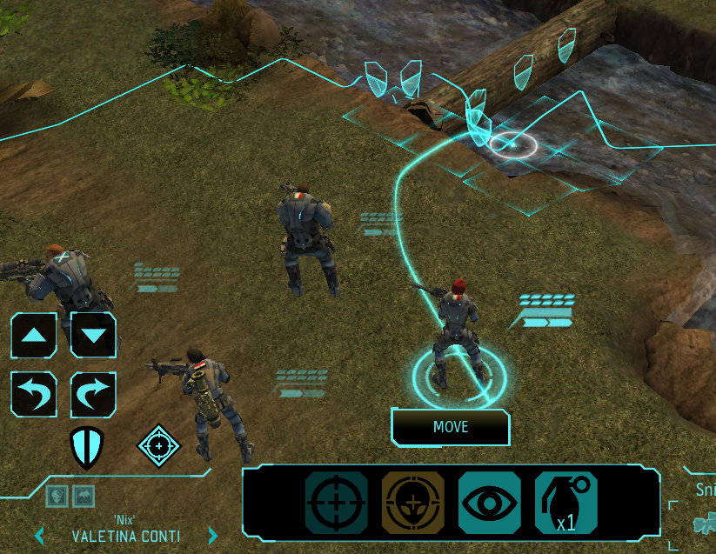
Inspirations from:
Mark of the Ninja
Frozen Synapse
XCOM
Notes:
fog - mark
tactical -frozen

Slide 7
The Setting
The city of Aegis is a dystopian society ruled by a corrupt government.
Order is maintained by the Tactical Assault and Peace Enforcement officers, also known as TAPE.
The player will control a group of revolutionaries, guiding them through their uprising.
Notes:
peter
change delivery and screenshot

Slide 8
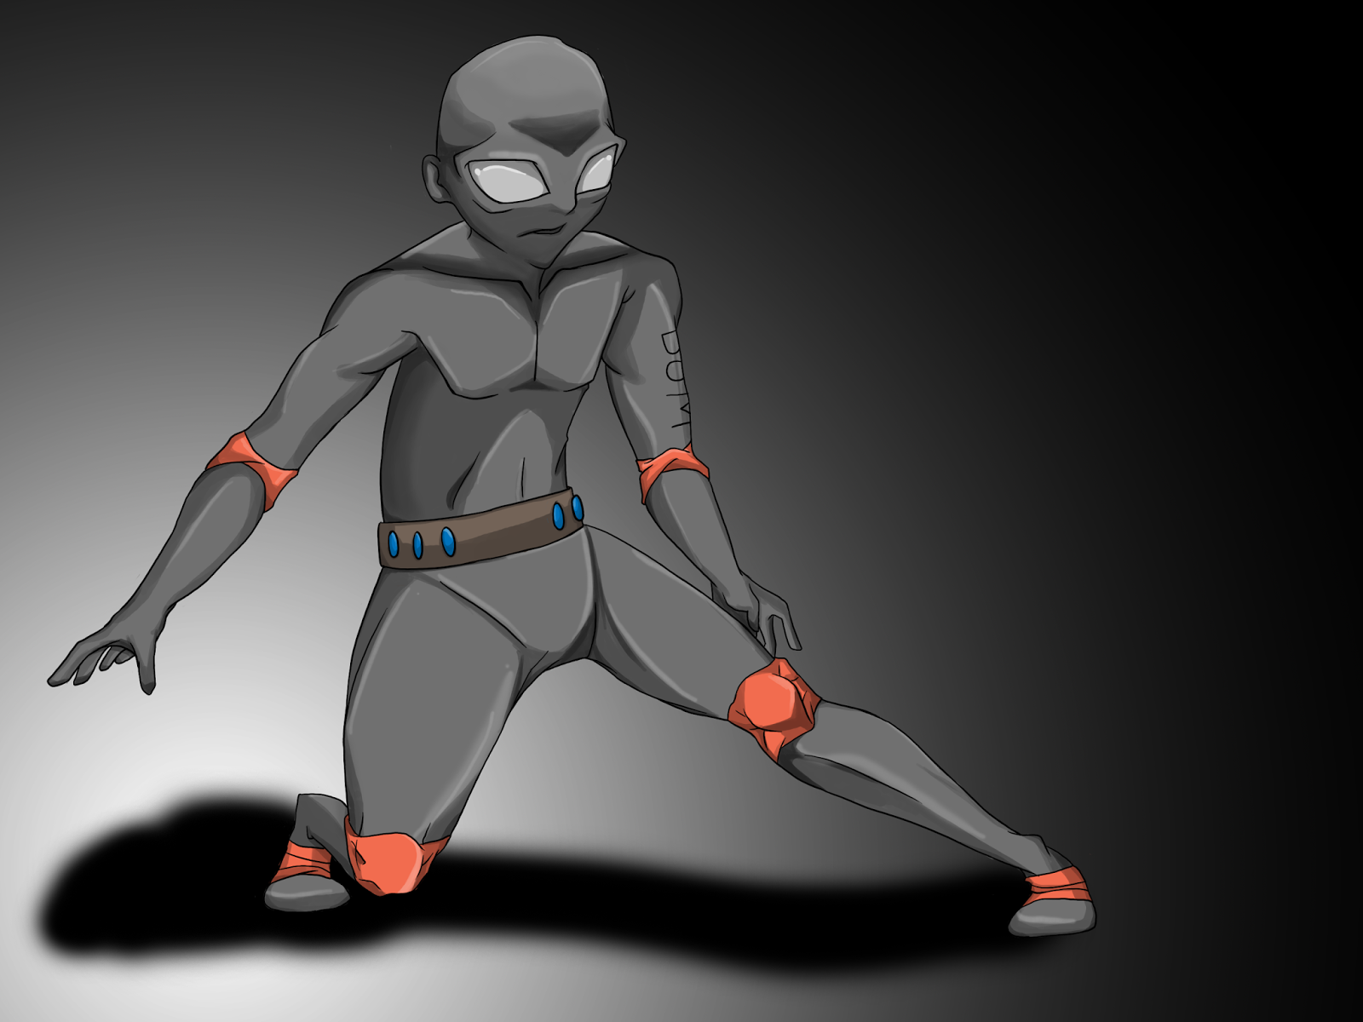
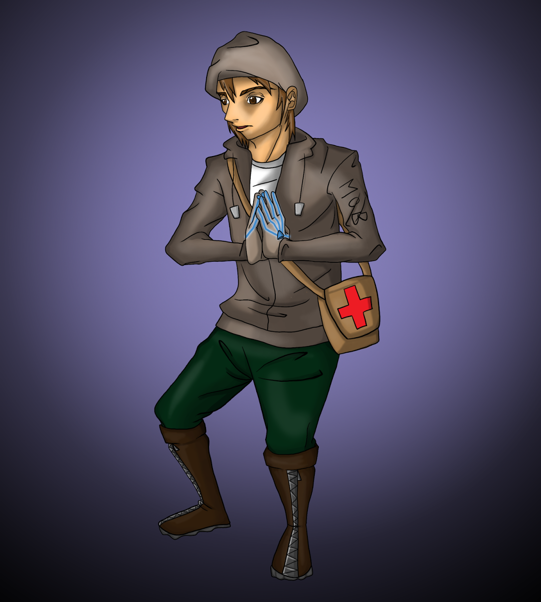
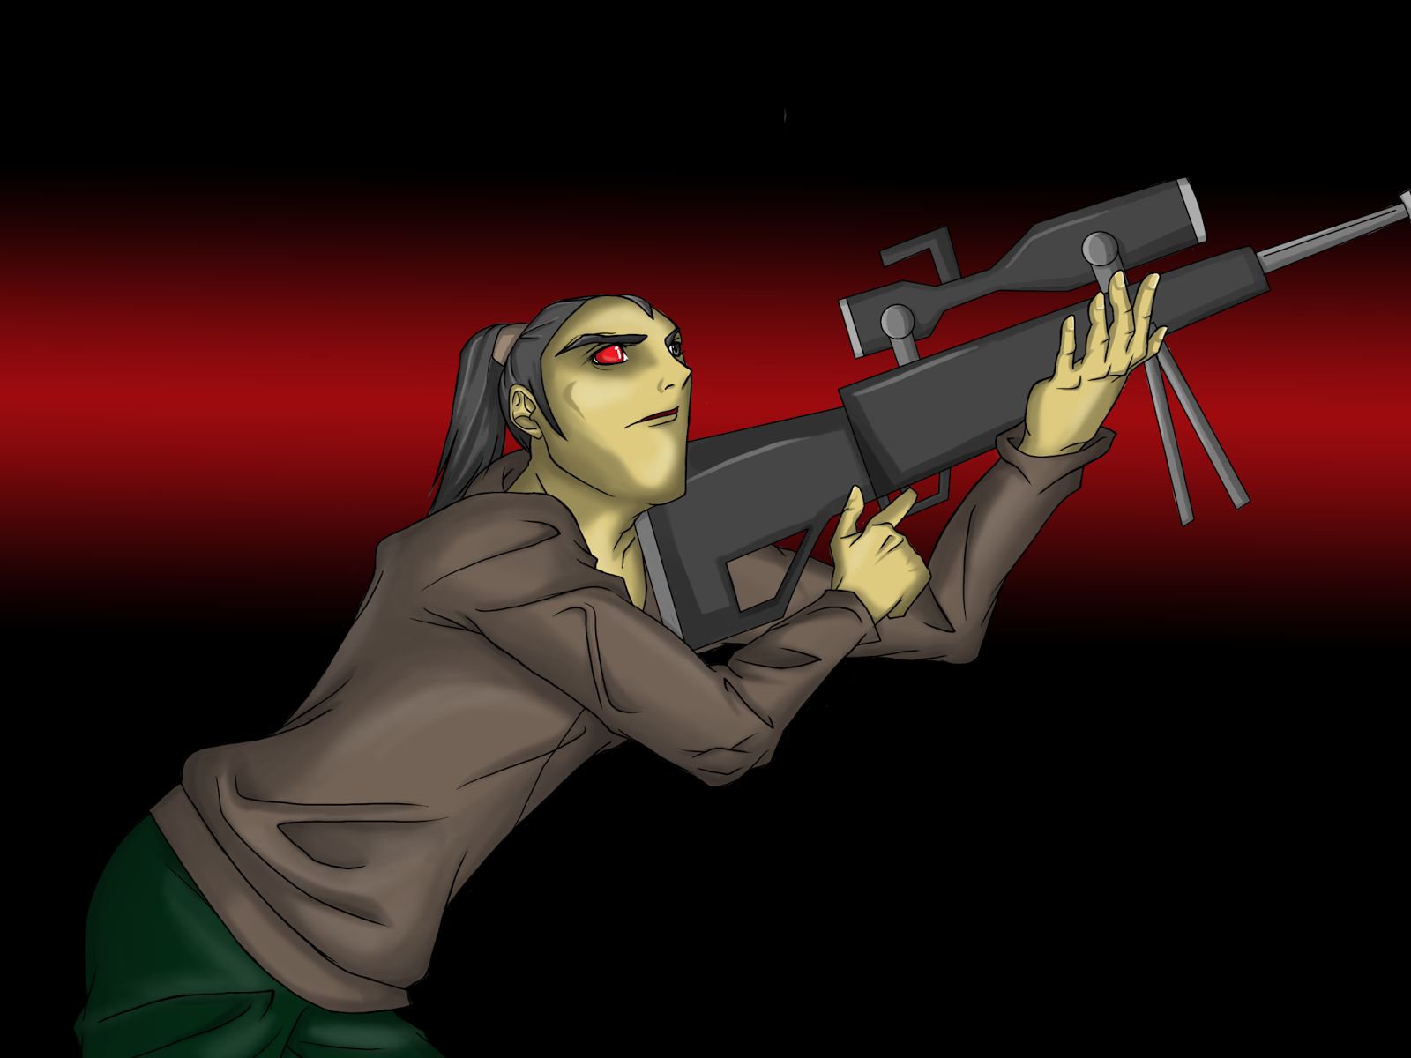
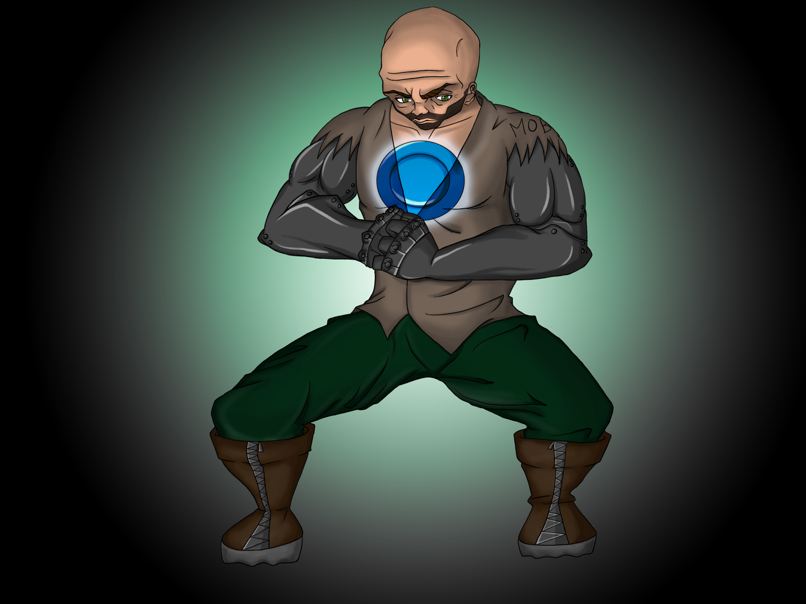
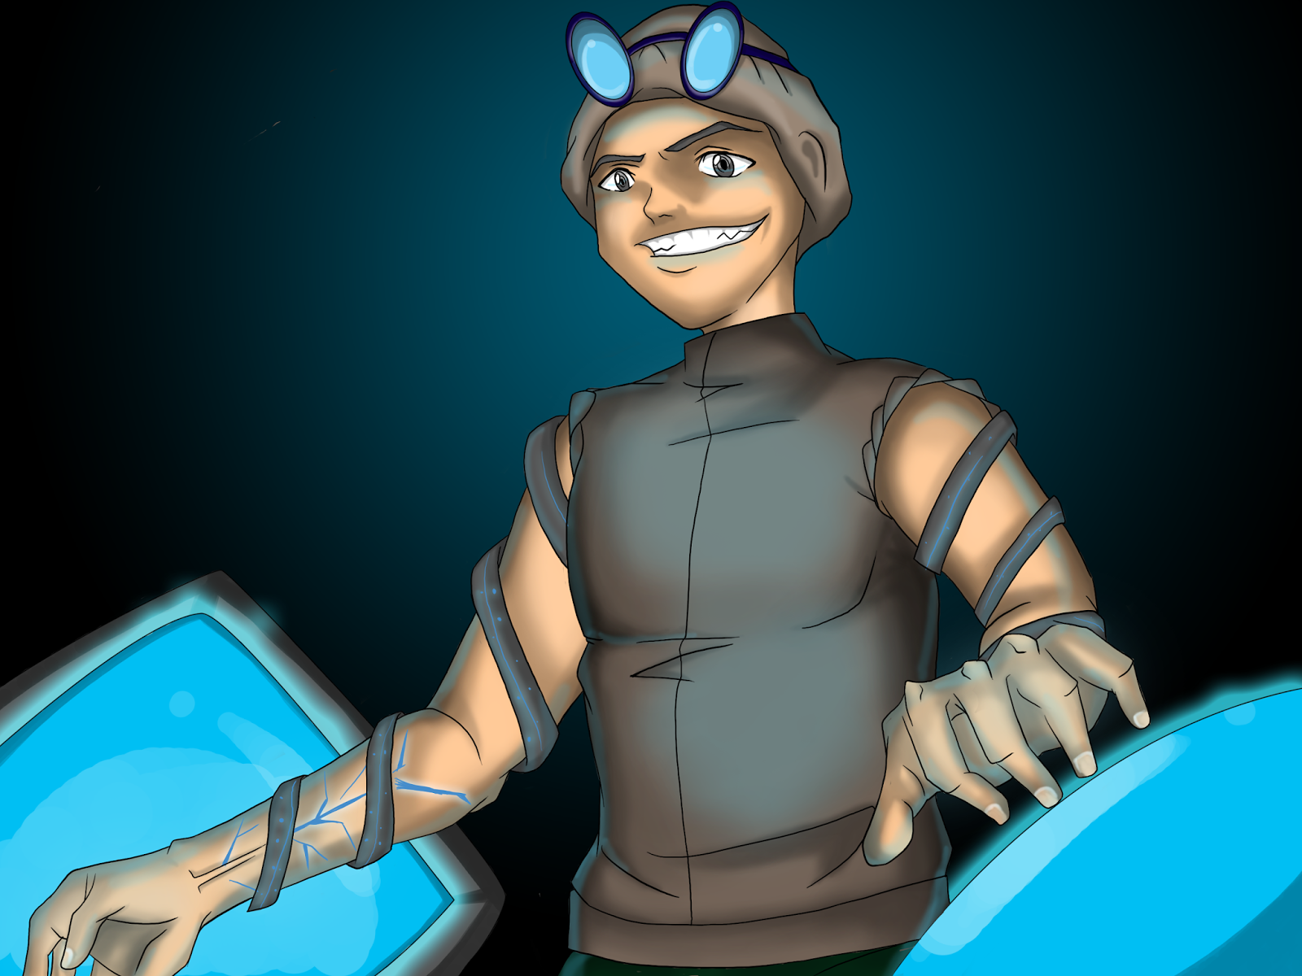
Squad Members
Scout
Medic
Sniper
Soldier
Hacker
Notes:
peter
names, use ppt animations to talk about them one by one

Slide 9
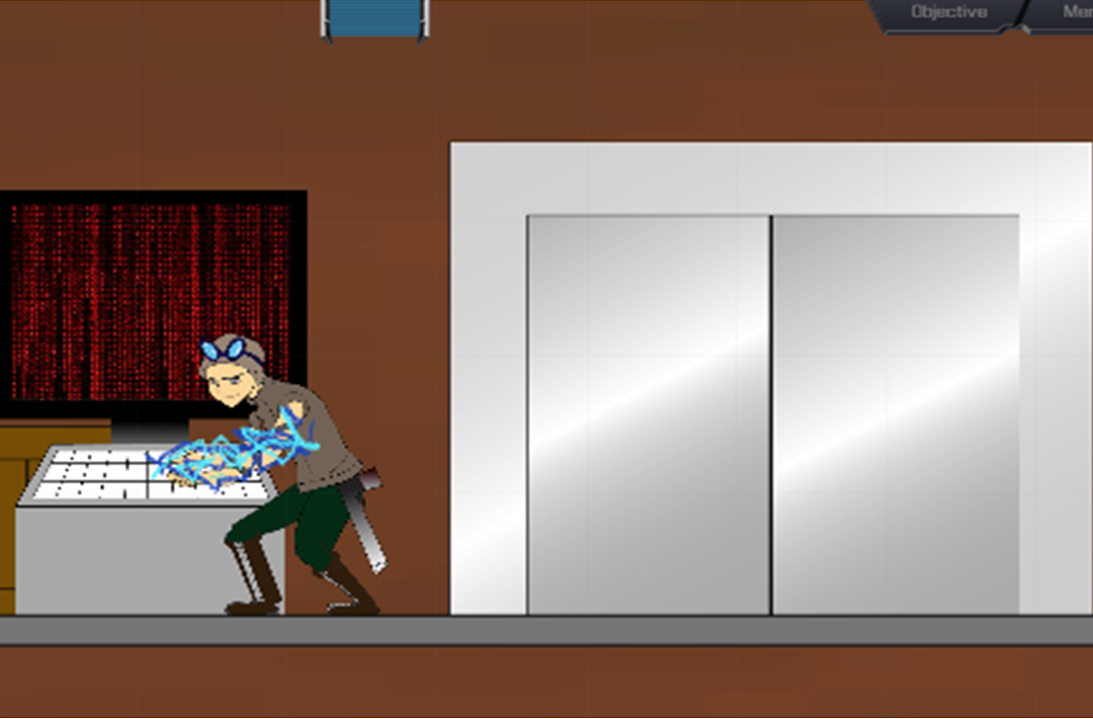
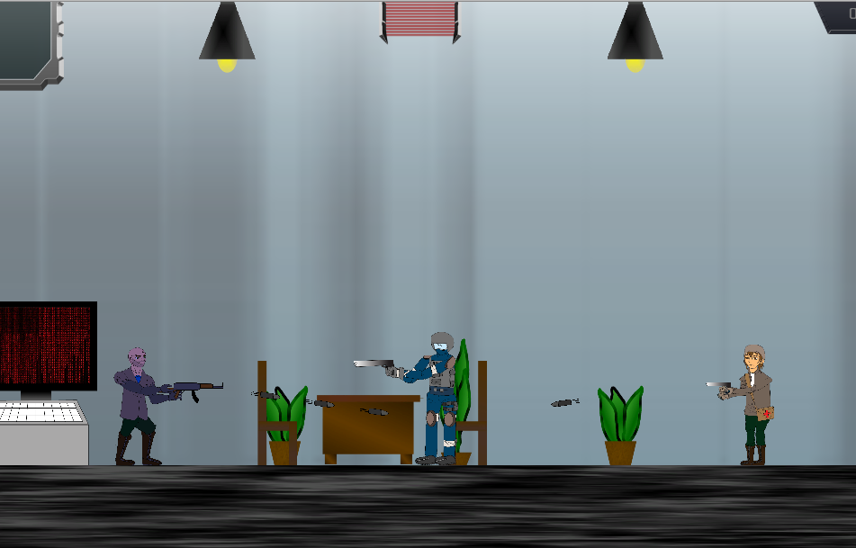
Major Features / Gameplay Elements
Throughout the game, the player will:
Hack traps and other objects in order to gain a tactical advantage against your enemies
Control squad members and manipulate the environment through point and click controls
Take advantage of the unique skill set of each team member
Complete different objectives in order to finish a level
Fighting Image
Notes:
ryan
screenshots

Slide 10
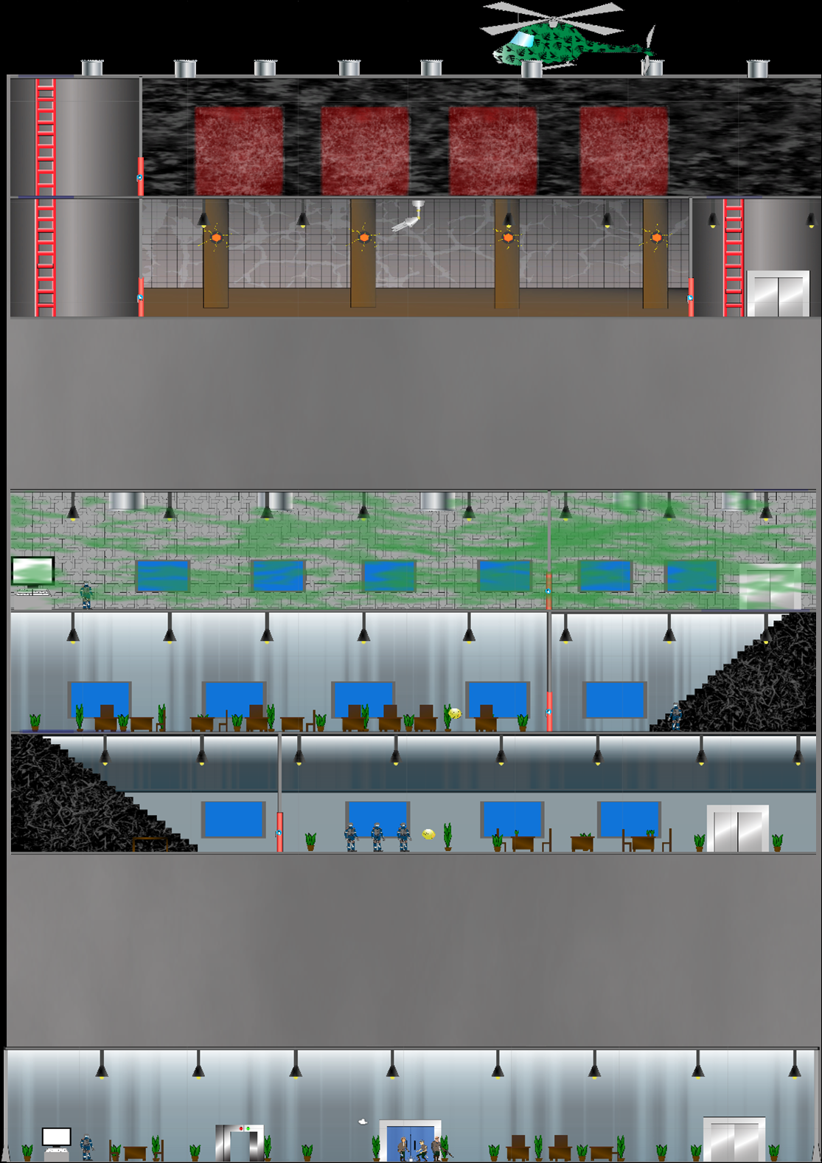
Level Design
Multiple Paths
Level flow changes depending on the path chosen
Various Objectives
Reach certain locations
Defeat specific enemies
Survive for a given amount of time
Variety of Enemies
Bosses, Robots, Soldiers and more
Notes:
ryan
level screen shot

Slide 11
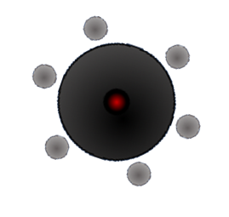
Enemies

Slide 12
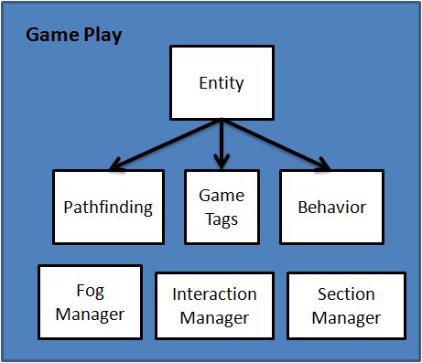
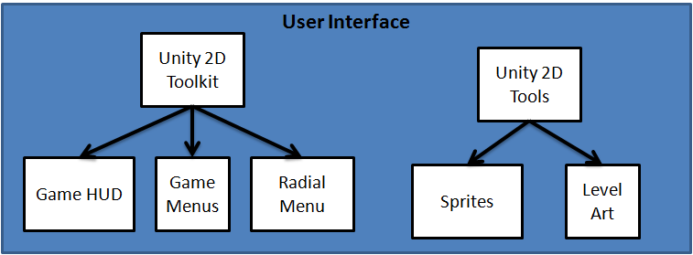
System Diagram
Notes:
yash
unity diagram/ architecture

Slide 13
How Unity Works
Unity is a component-based game engine
Objects in the game are referred to as Game Objects and each of them can have multiple components.
Components define the behavior for a Game Object, and are either built-in components or user-defined scripts.
Notes:
yash

Slide 14
Game Tags
Each object in our game has numerous tags that are under one component, called “GameTags”
These tags allow us to differentiate between the types of game objects we are handling
Ex: SquadMember, Enemy, Interactable
Notes:
yash
connect to unity
mention necessity of multiple tags while unity only allows for 1

Slide 15
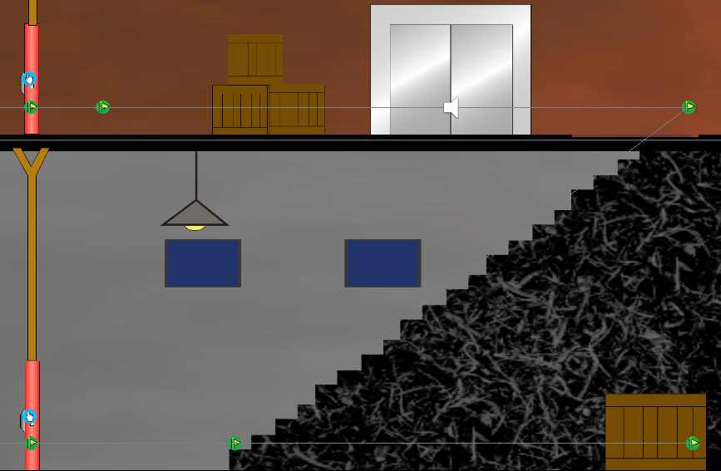
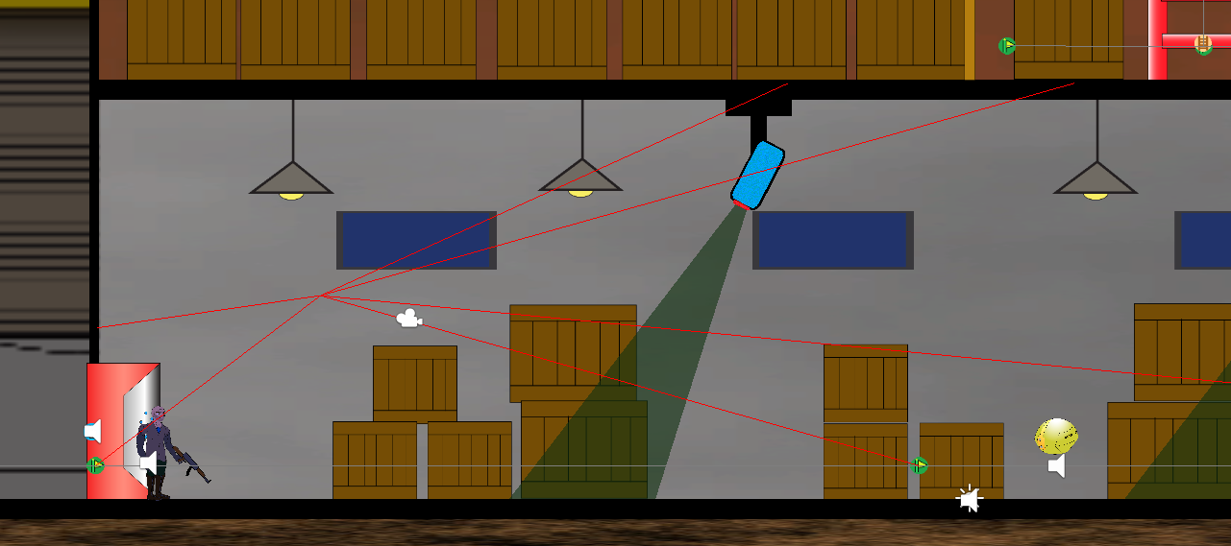
Pathfinding
Uses GameObjects with the component “WaypointController” to create an adjacency list of Waypoints accessed via a WaypointManager
Generates path with a modified version of Dijkstra’s algorithm
Notes:
yash
Explain what it’s for
screen shots of ray casting

Slide 16
Interaction System
Interactions are defined using C# function delegates contained in an “Interactable” type, which enumerates the different interactions
Two types of Interactions:
Direct and Indirect
Each Interactable object in our game uses a custom set of Interaction functions
The InteractionManager determines when to call the interactions
Notes:
neil
diagram of interactable obj and manger
more visual less wordy

Slide 17
Hacking
Hacking the environment is a large part of gameplay Hacking allows the player to:
Open doors
Trigger traps
Take control of robots
Notes:
neil

Slide 18
Hacking (Implementation)
Uses interaction system to swap GameTags and set the appropriate scripts on the hacked object
The object becomes “hacked” by swapping scripts and tags, thus changing its behavior
The player hacks by interacting with a terminal
Notes:
neil
condense

Slide 20
Technology and Languages Utilized
Unity with C#
Base Game Engine
Illustrator and Photoshop
Art Assets
Google Docs/Drive
Non-code File Management
Github
Code Management and Source Control
Notes:
ryan
after
demo the game(video)

Slide 21
Game Demonstration

Slide 22
What We Delivered
Implemented Core Game Mechanics
Completed Two Levels
Original Artwork and Music
Three Distinct Bosses with Unique Behavior

Slide 23
Overall Outcomes
Became Experts With Git
Learned C# and Unity
Worked interdisciplinarily (Art, Music)
Gained valuable experience working in a team environment
We gathered practical business experience from competing in the Imagine Cup
Notes:
For git, became experts using a specific git workflow and feature branches
neil

Slide 24
Technical Challenges
New to Unity and C# development
Our inexperience lead us to make some wrong assumptions
Sometimes took wrong approaches
Unity and Git do not always interact nicely
Unity’s 2D toolset was not 100% completed
Caused issues due to differences between the 2D and 3D physics
Notes:
ryan

Slide 25
Other Challenges
Art Assets Creation
Pixilation when scaling
Creating animations
Time Consumption
Sprite Placement
Notes:
peter

Slide 26
Special Thanks
Heather Kim (CSULA Art Alum) - Artist
Andrew Valdovinos - Musician
Gabor Kondas (Graduate Advisor) - User Interface Design

Slide 27
Thank you!
Any Questions?

