Slide 1
Dependency Injection

Slide 2
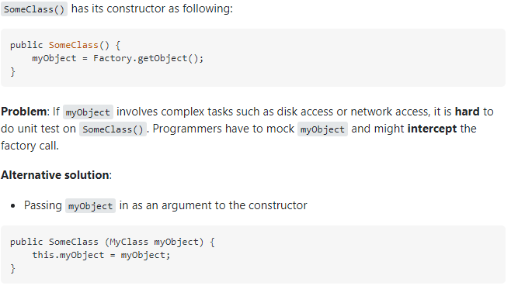
What is Dependency Injection
Giving an object its instance variables
Objects are designed in a manner where they receive instances of the objects from other pieces of code, instead of constructing them internally

Slide 3
Types of Dependency Injection
Constructor Injection
Setter Injection
Interface Injection

Slide 4
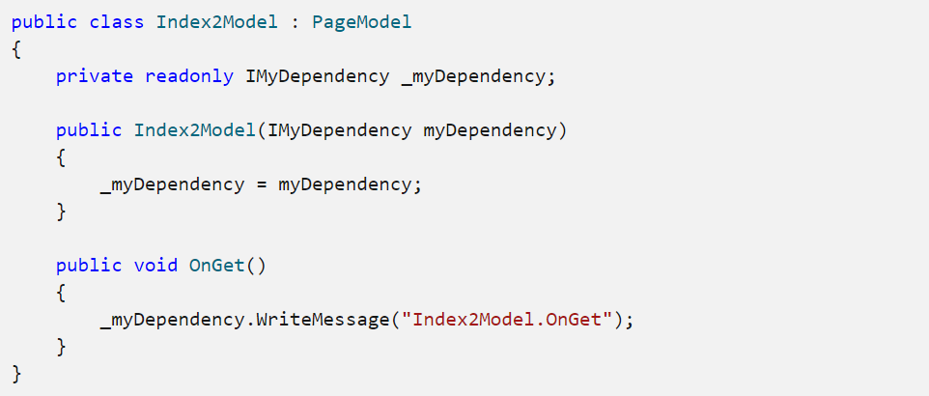
With Dependency Injection
Without Dependency Injection

Slide 5
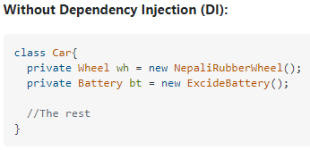
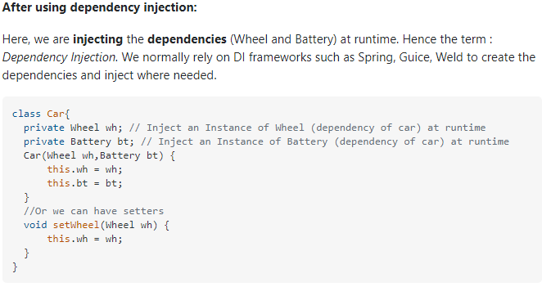
Benefits of Dependency Injection
Helps unit testing
Boiler plate code reduced
Extending application is easier
Enables loose coupling (separation of concerns)

Slide 6
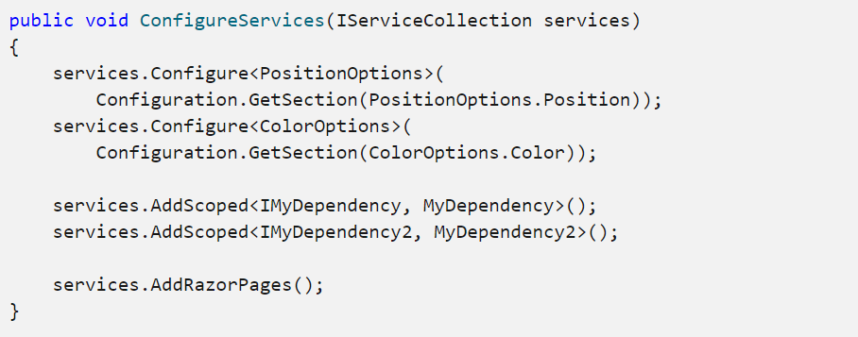
What to focus on

Slide 7
Authentication & Authorization
Authentication – Who are you? And prove it.
Authorization – Do you have access to this
Authentication Comes before you can Authorize

Slide 8
Types Of Authentication
Form – Cookies
Passport – Managed by Microsoft passport service
Windows Authentication – IIS handles authentication (Can only be used on Windows OS)
JWT – Represents a set of claims (custom)
Need an Identity Provider
Use a Nuget package to connect to IDP
OpenId Connect Handler
Cookie Handler
Google Challenge Handler
Authentication MiddleWare
Facebook Challenge Handler
JWT Handler

Slide 9
Claims or Roles Security
Roles – users are assigned a role or roles and then are given access based on those roles
Claims – User claims something, ASP.Net encrypts, saves as a token, then uses throughout the application
Claims are versatile, can be any key or value
(ClaimTypes.NameIdentifier, "JohnDoe")
OR
("favoriteColor", "blue")

Slide 10
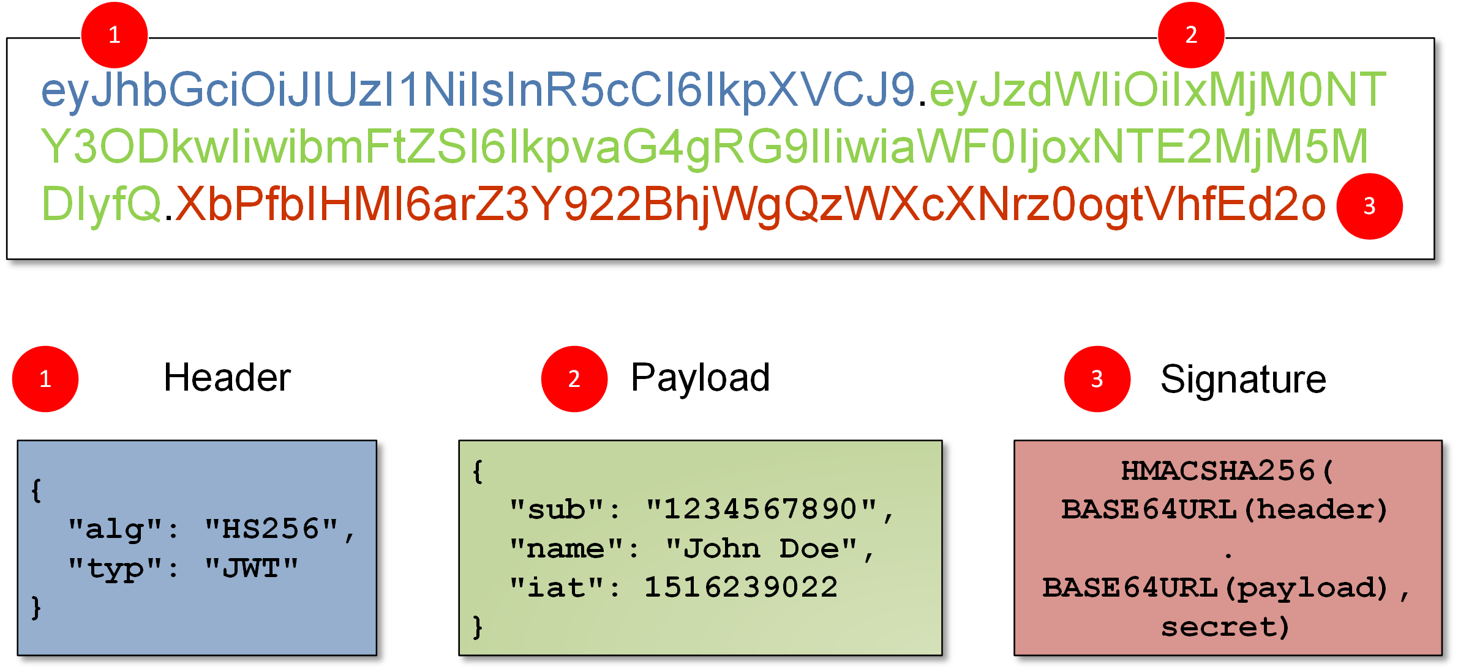
How Does JWT Work
HEADER.PAYLOAD.SIGNATURE
Security => if PAYLOAD is modified => Signature becomes invalid

Slide 11
Identity API
Is an API that supports login functionality
It can manage users, passwords, profile data, roles, claims, tokens, email confirmation, and more.
It supports external login providers like Google, Facebook, Twitter, and Microsoft Accounts.
This API generates a template that you can use or modify
Identity is typically configured using a SQL Server database to store user names, passwords, and profile data.
https://docs.microsoft.com/en-us/aspnet/core/security/authentication/identity?view=aspnetcore-5.0&tabs=visual-studio

Slide 13
Inversion of Control

Slide 14
Inversion of Control
Goal:
Achieve loose coupling between classes
Why do we want loose coupling?

Slide 15
Inversion of Control
Tight Coupling
High Interdependency
a change in one module can have a "ripple effect"
Module assembly will require more effort
A class may be harder to reuse or test

Slide 16
Inversion of Control
Tight Coupling
High Interdependency
a change in one module can have a "ripple effect"
Module assembly will require more effort
A class may be harder to reuse or test
Loose Coupling
Minimal dependency
Components have a "breakable relationship", changes in one have minimal effect on others
Less constrained by platform, language, etc.
Classes are easier to test

Slide 17
Inversion of Control
Control refers to any additional responsibilities a class has, other than its main responsibility

Slide 18
Inversion of Control
Control refers to any additional responsibilities a class has, other than its main responsibility

Slide 19
Inversion of Control
Control refers to any additional responsibilities a class has, other than its main responsibility

Slide 20
public class CustomerBusinessLogic { DataAccess _dataAccess; public CustomerBusinessLogic() { _dataAccess = new DataAccess(); } public string GetCustomerName(int id) { return _dataAccess.GetCustomerName(id); } } public class DataAccess { public DataAccess() { } public string GetCustomerName(int id) { return "Dummy Customer Name"; // get it from DB in real app } }
Code Example From TutorialsTeacher.com
Notes:
Problems with this code:
1. CustomerBusinessLogic and DataAccess are tightly coupled. Changes to methods in DataAccess will lead to changes in CustomerBusinessLogic.
2. Future changes to the database or web service used will require changes in CustomerBusinessLogic
3. CustomerBusinessLogic uses the new keyword to make a DataAccess object. So, ANYWHERE in ANY of our classes that create a dataaccess object would need to be changed if we have to change the name of the class
4. We create a concrete DataAccess object in the CustomerBusinessLogic class. It cannot be tested independently, and DataAccess cannot be replaced with a mock class.

Slide 21
public class DataAccessFactory { public static DataAccess GetDataAccessObj() { return new DataAccess(); } }
public class CustomerBusinessLogic { public CustomerBusinessLogic() { } public string GetCustomerName(int id) { DataAccess _dataAccess = DataAccessFactory.GetDataAccessObj(); return _dataAccess.GetCustomerName(id); } }
Code Example From TutorialsTeacher.com
Notes:
We have inverted the control of creating an object of a dependent class from CustomerBusinessLogic to DataAccessFactory

Slide 22
What Are Plugins?
Plugins allow an app to be extensible
Allows additional code to be injected into an app (Customizable)
Typically in the form of Interfaces and assemblies (.dll’s)
Extensible Library via Nuget Packages
Resources:
Creating .Net Core App with plugins
https://docs.microsoft.com/en-us/dotnet/core/tutorials/creating-app-with-plugin-support
Plugins (Reflection in C#)
https://www.youtube.com/watch?v=qDrPCMoqxdA

Slide 23
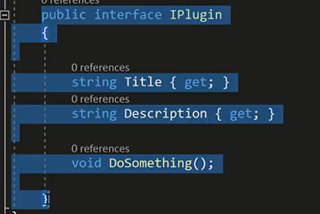
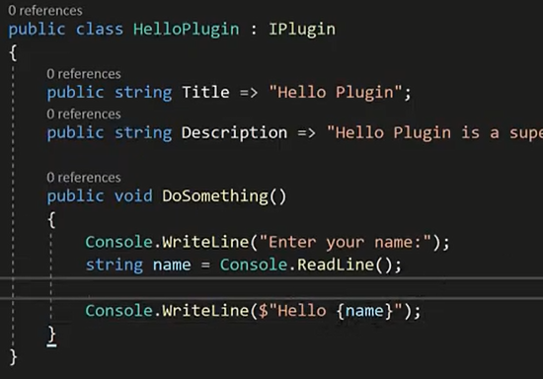
Typical Impementation
Create the plugin interfaces in the app
Thise code snippet Compiled as an “assembly” (.dll)
Another Developer Extends the dll.
And adds custom code
This code snippet is Compiled as an “assembly” (.dll)
Load The plugin (.dll) back into the app

Slide 24
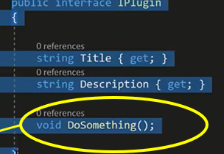
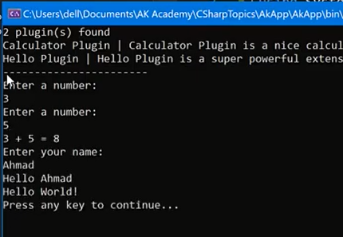
The App can now make use of added features / Code, without having to hard-code the entire app
Remember the the interface containing the “empty function”
DoSomething()
Now the .dll was able to implement the DoSomething() function (developed outside of the app), and get imported back into the app, without any modification to the original source code
Security Consideration – Harden the App against .dll hijacking

Slide 25
When writing & registering plug-ins
When writing plug-ins, each class in a project should be stateless and if it will be registered, must implement the IPlugin interface
https://docs.microsoft.com/en-us/powerapps/developer/data-platform/write-plug-in
For registering plug-ins, sign and build the assembly.
Use the Plug-in Registration tool to register the plug-in assemblies and upload it to the Dataverse database.
https://docs.microsoft.com/en-us/powerapps/developer/data-platform/register-plug-in

Slide 26
When to use plug-ins / Pros & Cons
Plug-ins can be configured to execute
Synchronously
The operation to wait until the code in the plug-in finishes its tasks.
Or asynchronously
Plug-ins are placed in a queue and are executed after the operation is completed which allows for minimal interruptions
Can be used to modify the behavior of the platform.
Pros
Plug-ins perform well and can be powerful when defining logic
Cons
Can be expensive to create and maintain
A poorly written plug-in can cause significant negative impact on the performance of the environment.
https://docs.microsoft.com/en-us/powerapps/developer/data-platform/plug-ins

Slide 27
Razor – Sprint Presentation

Slide 28
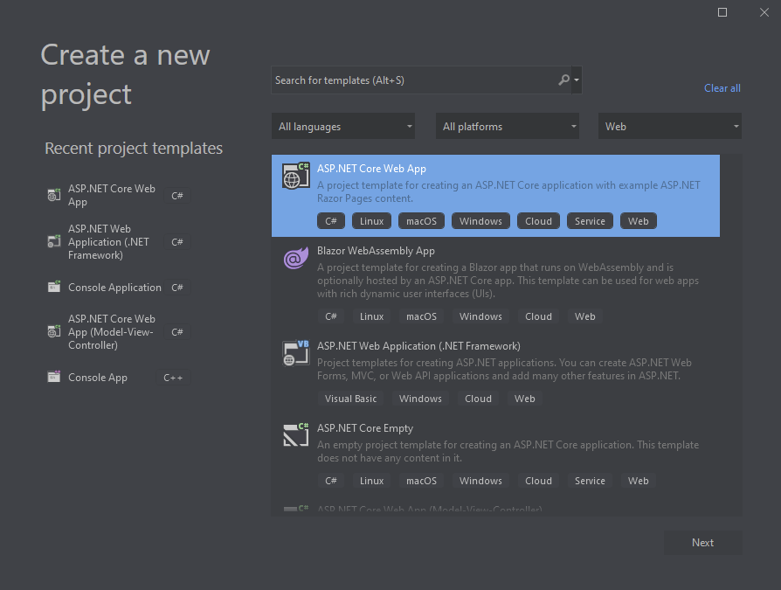
What is Razor?
Part of ASP.NET Core.
One of three ASP.NET Core UI solutions (others: MVC, and Blazor).
Used to embed .NET code into webpages.
Used for optimizing HTML syntax

Slide 29
What is Razor?
Razor is an ASP.NET programming syntax to create dynamic web pages with the C# or Visual Basic .NET programming languages.
Recommended for page-based or form-based apps (focus on UI).
Uses C# and HTML.
Pages generally have “.cshtml” as the extension.
For web development that is easier and more productive than using a controller and views approach.
More info: Introduction to Razor Pages in ASP.NET Core | Microsoft Docs

Slide 30
How to use Razor?
Syntax that uses C# within webpage uses “@” symbol to transition from HTML to C# and render content in HTML.
Can handle requests within the page instead of using a controller by using the “@page” directive.
More info regarding syntax here: Razor syntax reference for ASP.NET Core | Microsoft Docs

Slide 31
Example, using with a database.
Class models can be added with Razor.
This enables developers to work with databases through Entity Framework Core (EF Core).
Context objects (.NET objects) represent a session with a database, allowing querying and saving data.
The EF Core service is registered as part of dependency injection.
More info: Overview of Entity Framework Core - EF Core | Microsoft Docs

Slide 32
Razor Class Library (RCL)
Views, pages, controllers, models, components.
Can be packaged and reused.
Allows to share web app code with UI components.
Reusable Razor UI in class libraries with ASP.NET Core | Microsoft Docs

Slide 33
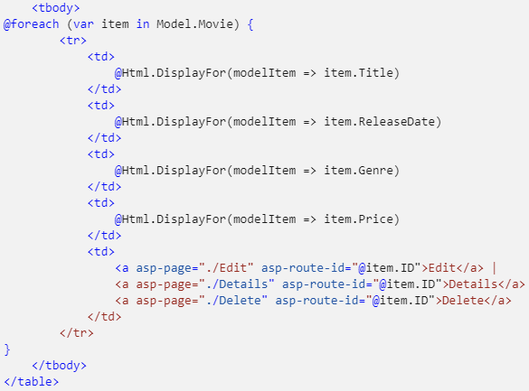
Sample Code

Slide 34
Why Razor?
Easy to learn
Syntax similar to HTML
Razor Engine supports TDD (Test Driven Development)
Better in almost every way than the default Engine (Web Form Engine)
Effective against XSS (Cross-Site Scripting)
Commands need not to be closed unlike Web Form Engine
Can just use the "@" sign to rather than "<% Content %>" and making the code more legible

