Slide 1
Lunar Exploration Web and Mobile Applications

Slide 2
Project Team
Liaisons: Emily S. Law, George Chang, Shan Malhotra, Kyle Dodge and Syed Sadaqathullah
Faculty Advisors: Chengyu Sun and Elaine Kang
Graduate Advisor: Richard Cross
Students: Eddie Arevalo, Kevin Huang, Howard Li, Alvaro Ortiz, Daniel Soto and Daniel Young

Slide 3
Agenda
Background
Goals
Lighting Tool (LMMPLT)
Android Application (LMMPAA)

Slide 4
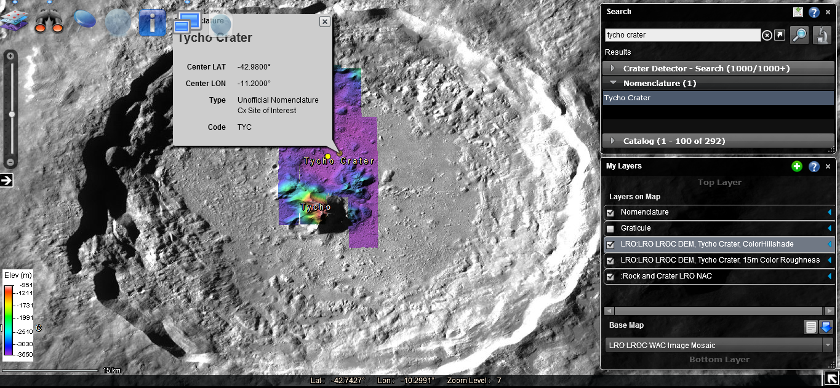
LMMP
Lunar Mapping and Modeling Portal
Lunar visualization data
Mission data
Browsing tool
Notes:
Missions: Apollo, Lunar Reconnaissance Orbiter, Lunar Prospector, Clementine, and Chandrayaan-1

Slide 5
Goals
Redesign LMMP’s Lighting Tool
Create an Android application version of the LMMP
Lighting Analysis Tool
Daniel Young
Kevin Huang
Howard Li
Android Application
Eddie Arevalo
Daniel Soto
Alvaro Ortiz

Slide 6
LMMP Lighting Tool
Notes:
What is the lighting tool?

Slide 7
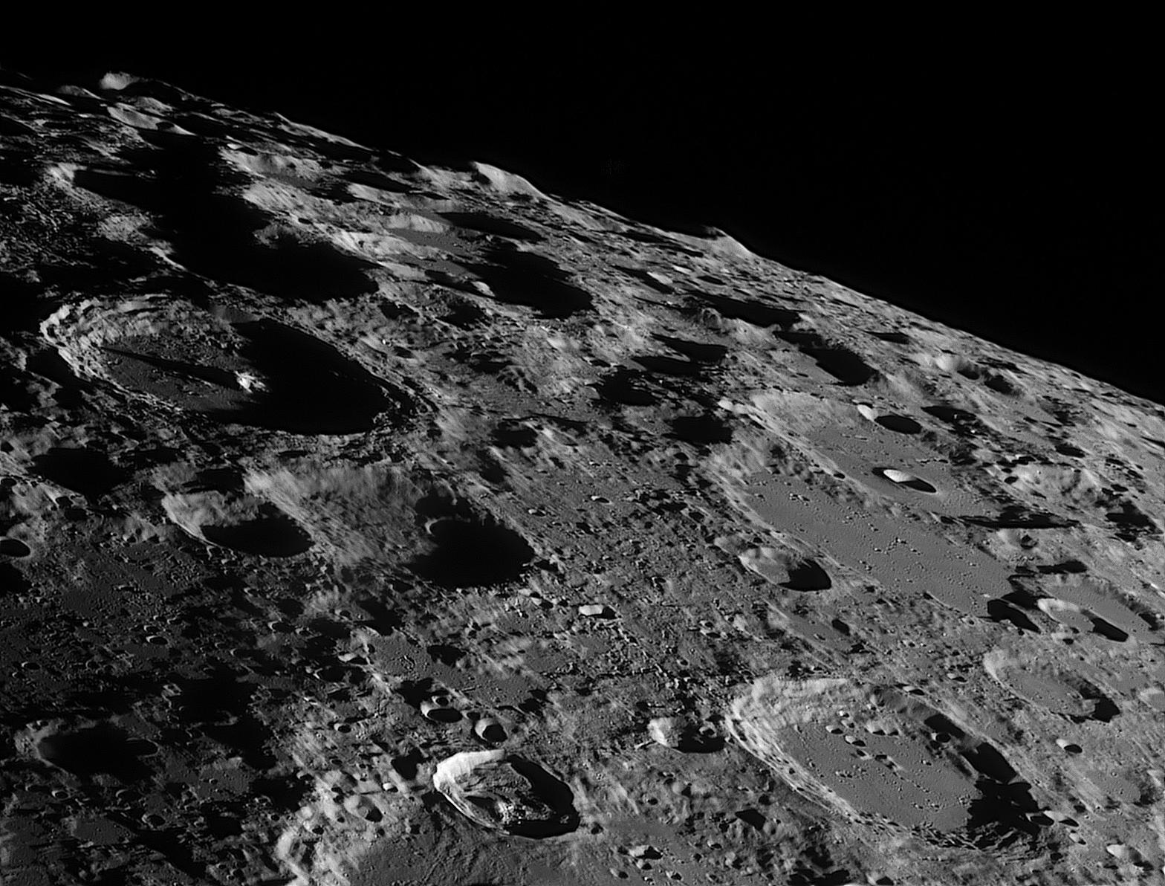
Image Courtesy of Aaron Foster
Notes:
The Lighting Tool allows anyone make light calculations on the moon.

Slide 8
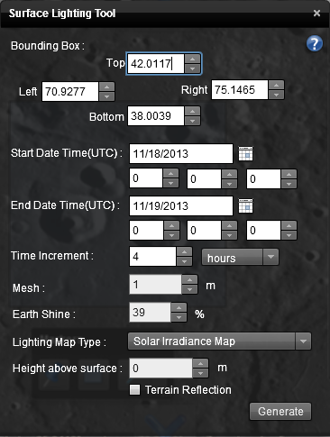
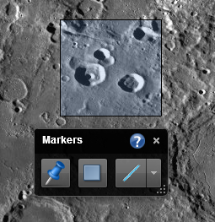
Notes:
The user makes a selection on the moon and sets an interval of time.

Slide 9
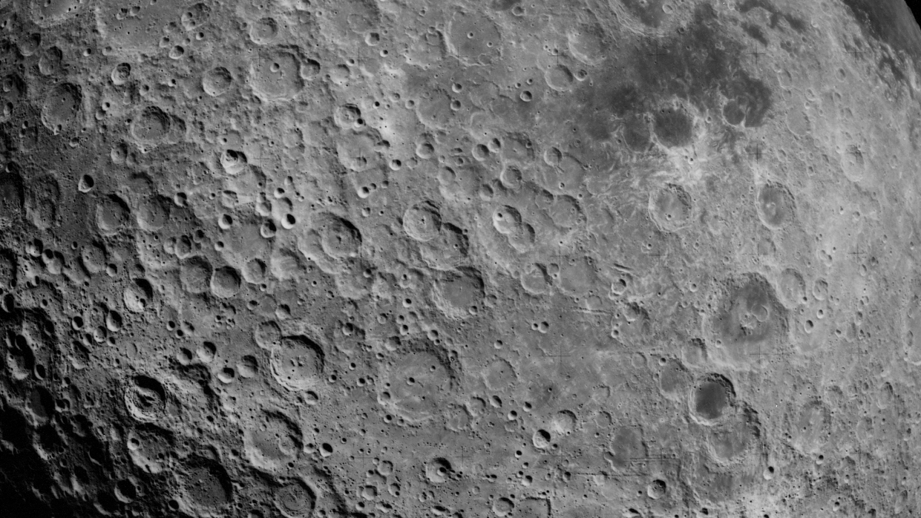
Digital Elevation Map
Notes:
The Lighting Tool takes a high resolution digital elevation model of the lunar surface

Slide 10
Digital Elevation Map
POV-Ray 3.6.1
Ray Tracing Engine
Notes:
The Lighting Tool takes a high resolution digital elevation model of the lunar surface

Slide 11
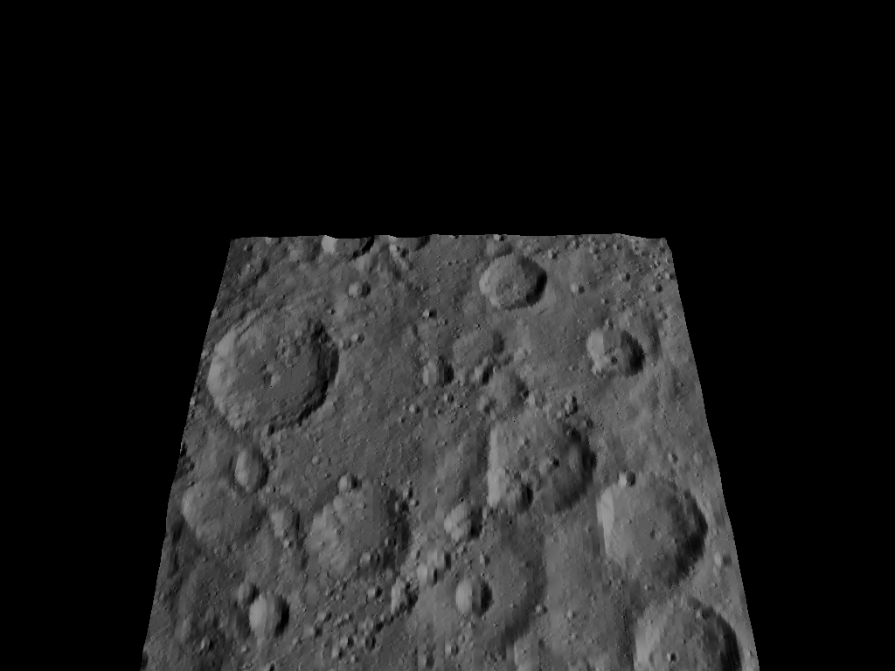
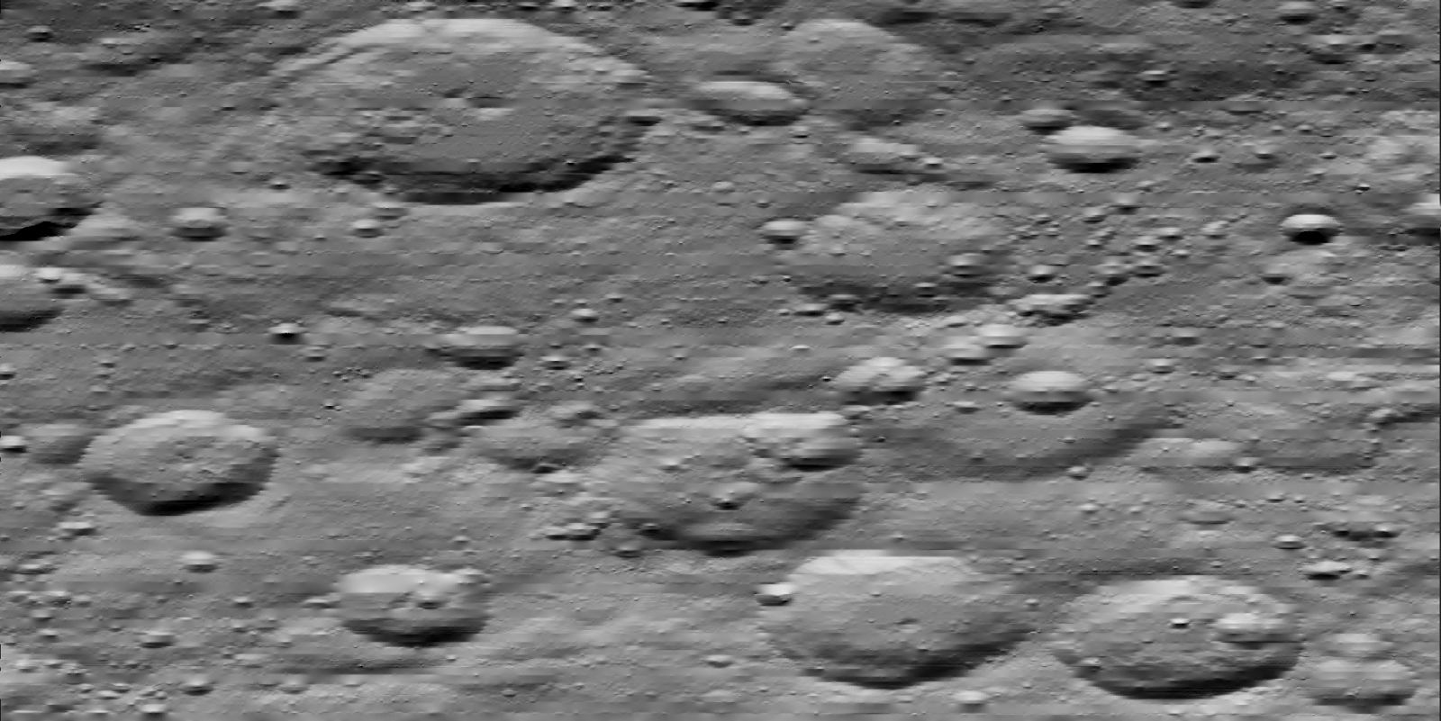
Digital Elevation Map
Regular Perspective Camera
POV-Ray 3.6.1
Ray Tracing Engine
Mesh Camera
Notes:
The Lighting Tool takes a high resolution digital elevation model of the lunar surface

Slide 12
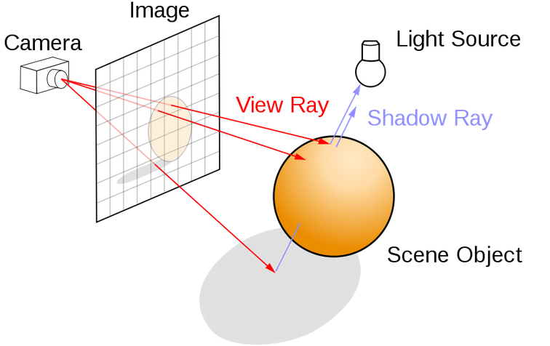
Notes:
The ray tracing engine creates the objects, specifically the sun as the primary light source, and creates an image of the scene

Slide 13
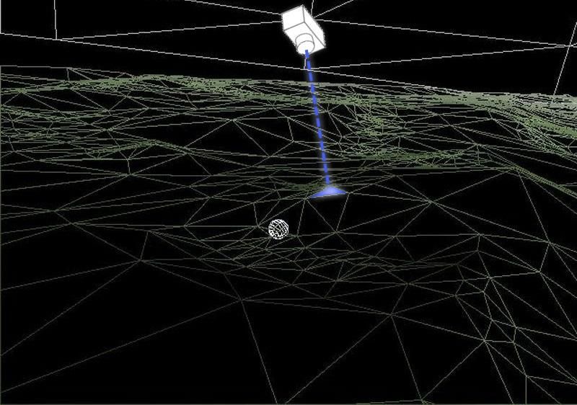
Notes:
A “Mesh Camera” was custom made by the creators of POV-Ray at the request of JPL for the use in the lighting tool. The mesh camera calculates the amount of light at every little triangle on the moon.

Slide 14
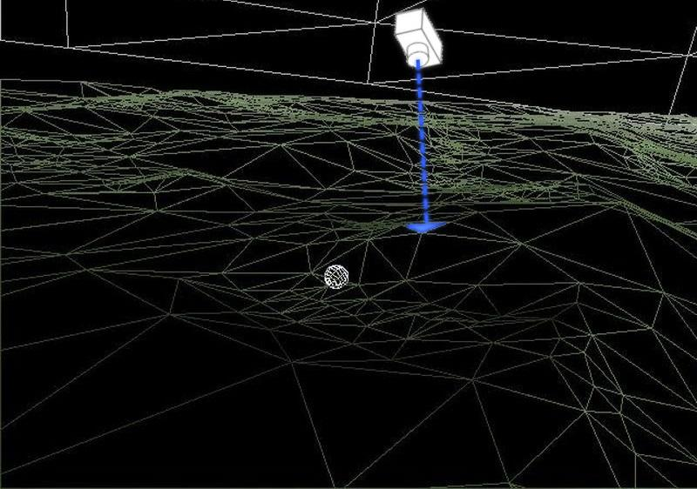
Notes:
This process is done for every triangle. Each triangle has a corresponding camera positioned perpendicular to that triangle.

Slide 15
Notes:
Eventually, the lighting tool will return a series of images showing the appearance at each time

Slide 16
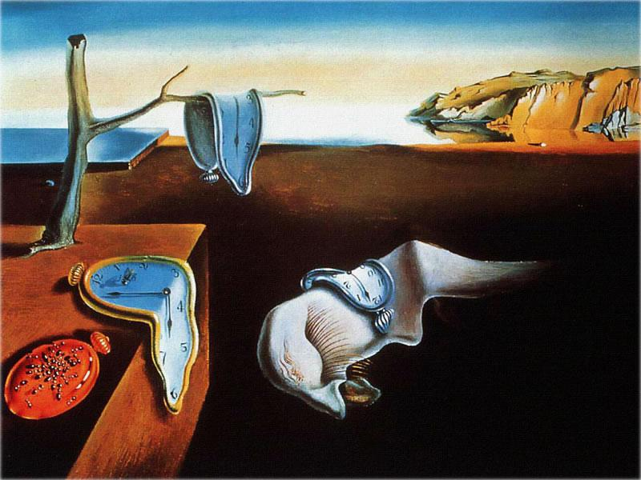
The Persistence of Memory by Salvador Dali (1931)
Notes:
Overall, this makes for a prohibitively time consuming process, often taking several hours for a single task.

Slide 17
Lighting Tool Objectives
Evaluate the existing Lighting Tool to identify potential areas of improvement
Make the Lighting Tool run faster and make recommendations for possible future improvements.
Test improvements for accuracy and quantify the amount of improvement made

Slide 18
Possible areas of improvement
Scene Generation
Reducing the amount of reading and writing to disk.
Reworking the architecture to remove “stovepipe” traits.
Renderer
Parallelize scene rendering to decrease turnaround time.

Slide 19
Renderer: POV-Ray
Issues with POV-Ray
Re-parses files each time it renders a frame.
Until 3.7, no support for multi-threading.
Parallelization done by process forking.
POV-Ray Version 3.6.1

Slide 20
Renderer: Optix Renderer
Nvidia® OptiX™ is a ray-tracing engine.
Created two variations for this project.
Distributed recursive raytracing
Pathtracing
Notes:
End Howard

Slide 21
Accomplishments
Notes:
Start Kevin

Slide 22
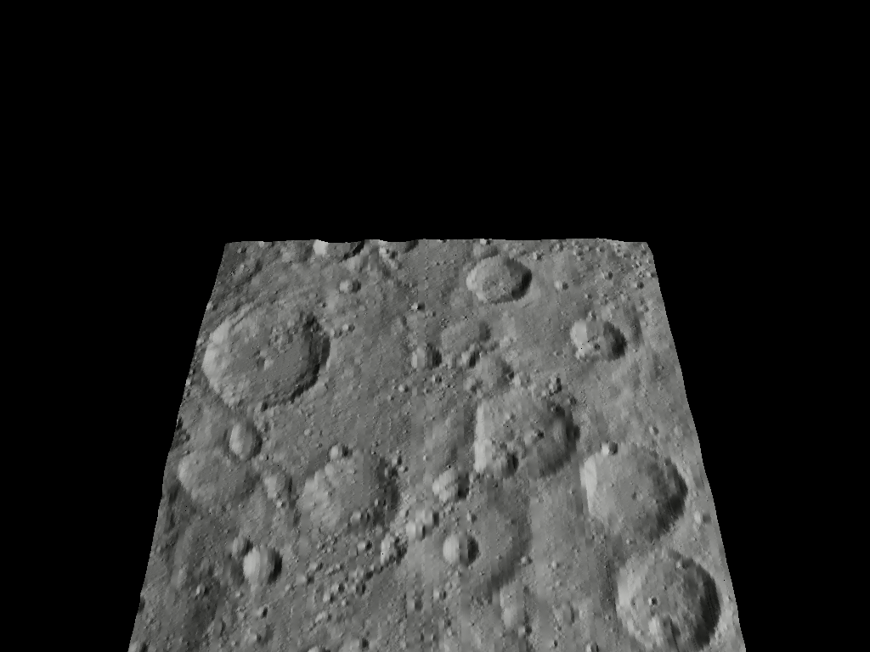
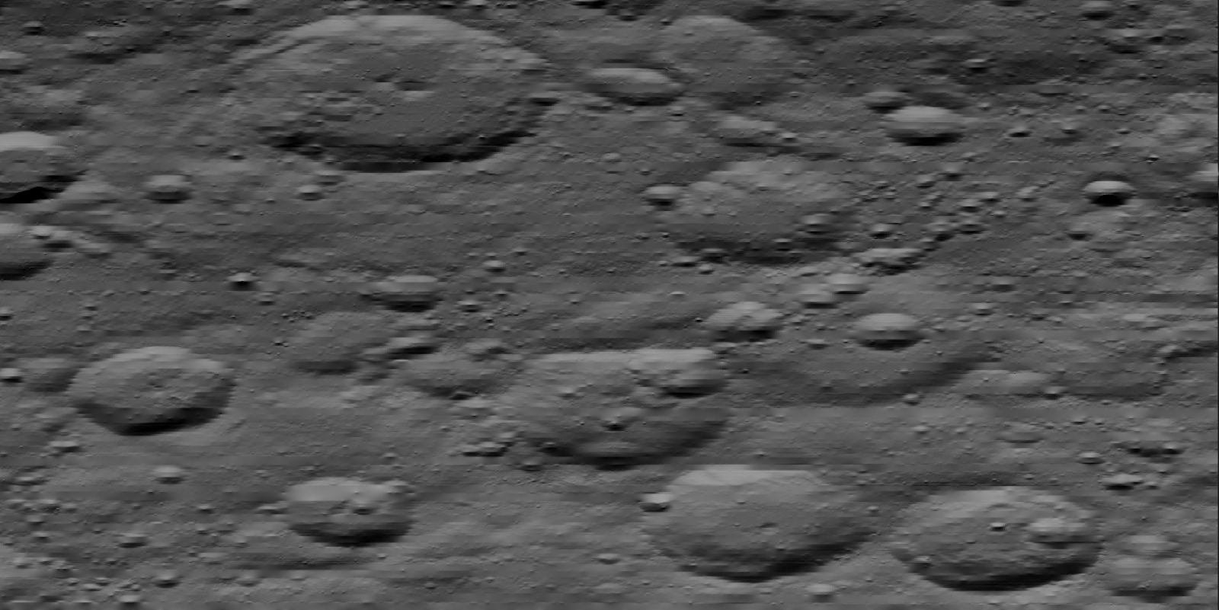
Digital Elevation Map
Regular Perspective Camera
Nvidia OptiX
Ray Tracing Engine
Mesh Camera
Notes:
The Lighting Tool takes a high resolution digital elevation model of the lunar surface

Slide 23
Visual Comparison
POV-Ray
Optix

Slide 24
Mesh Camera Comparison
POV-Ray
Optix

Slide 25
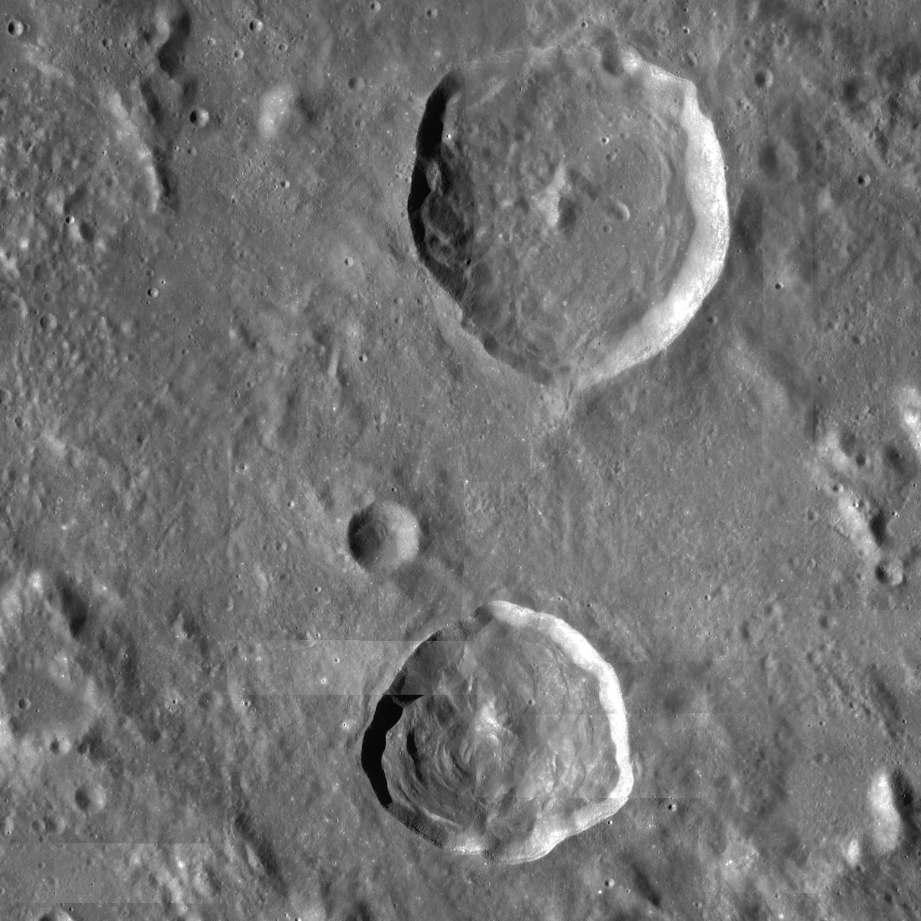
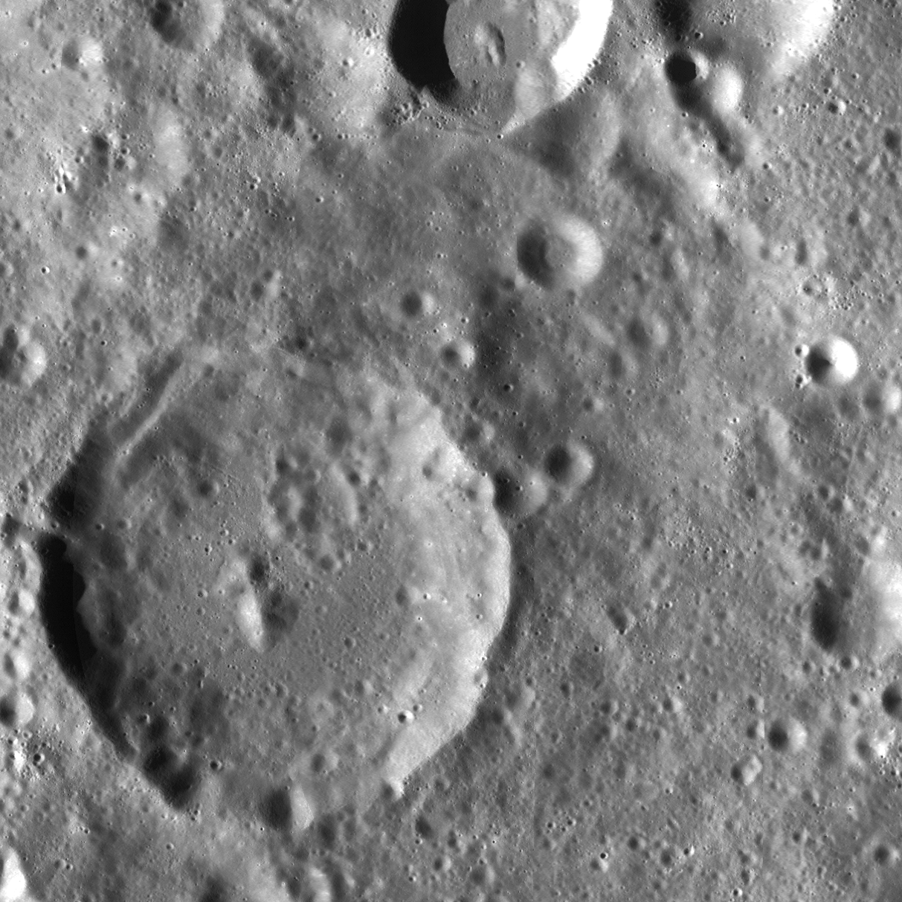
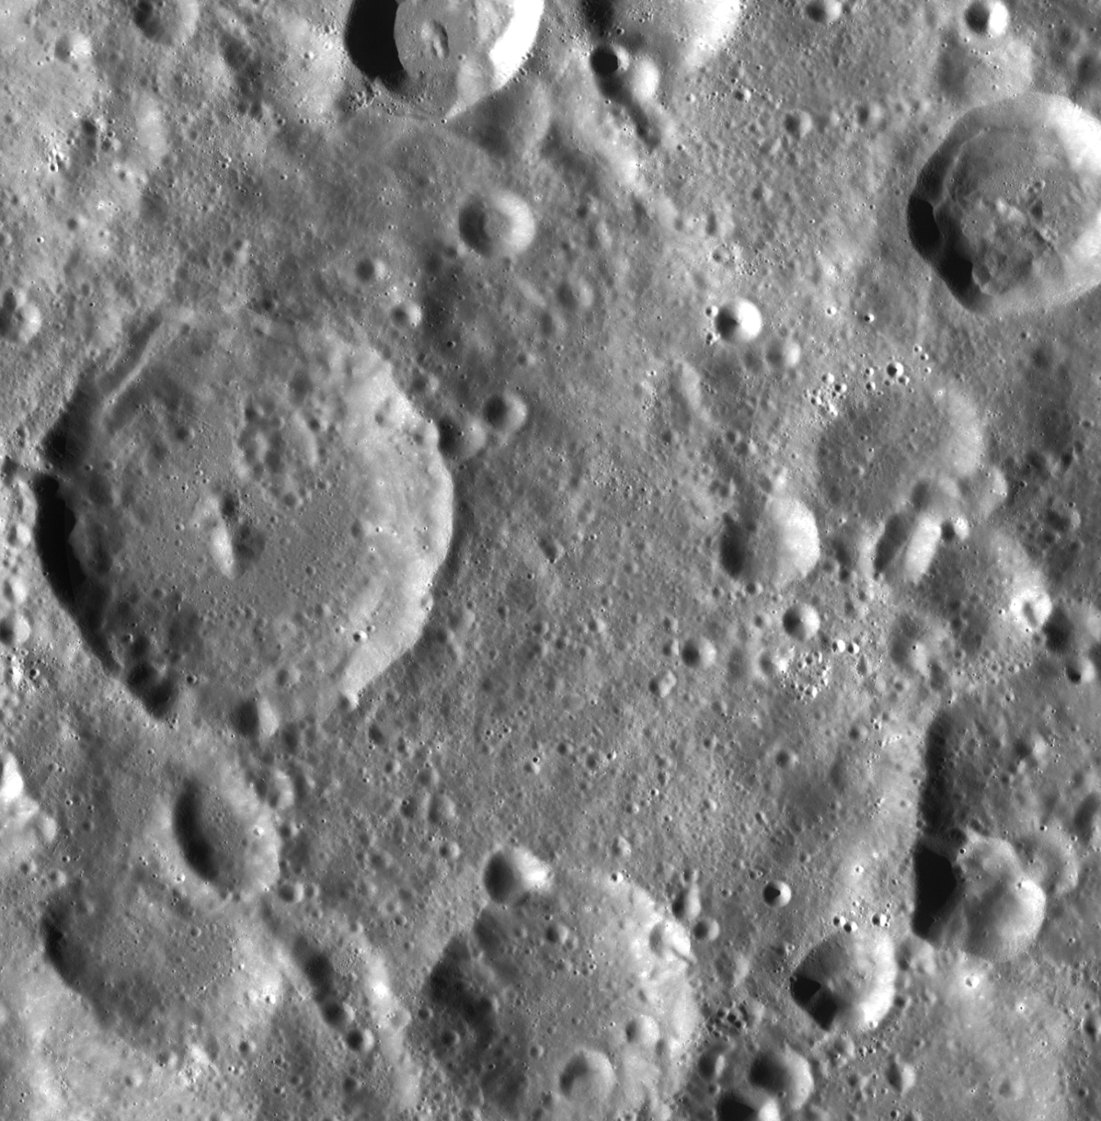
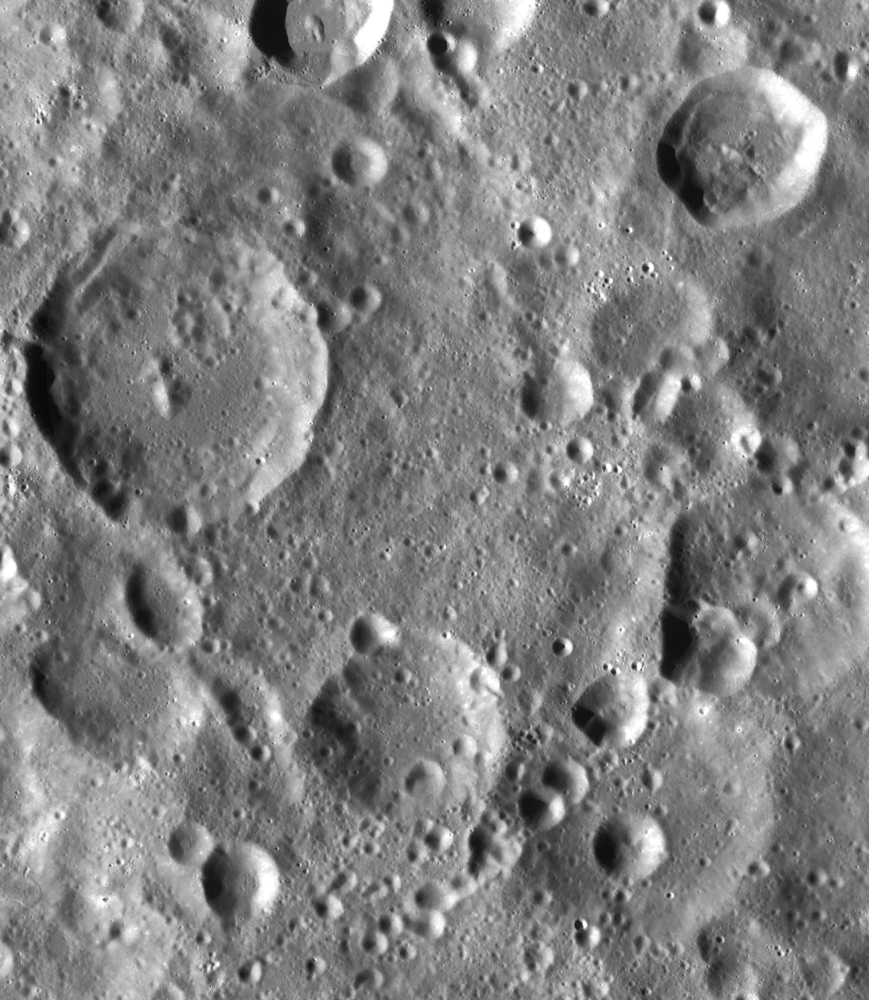
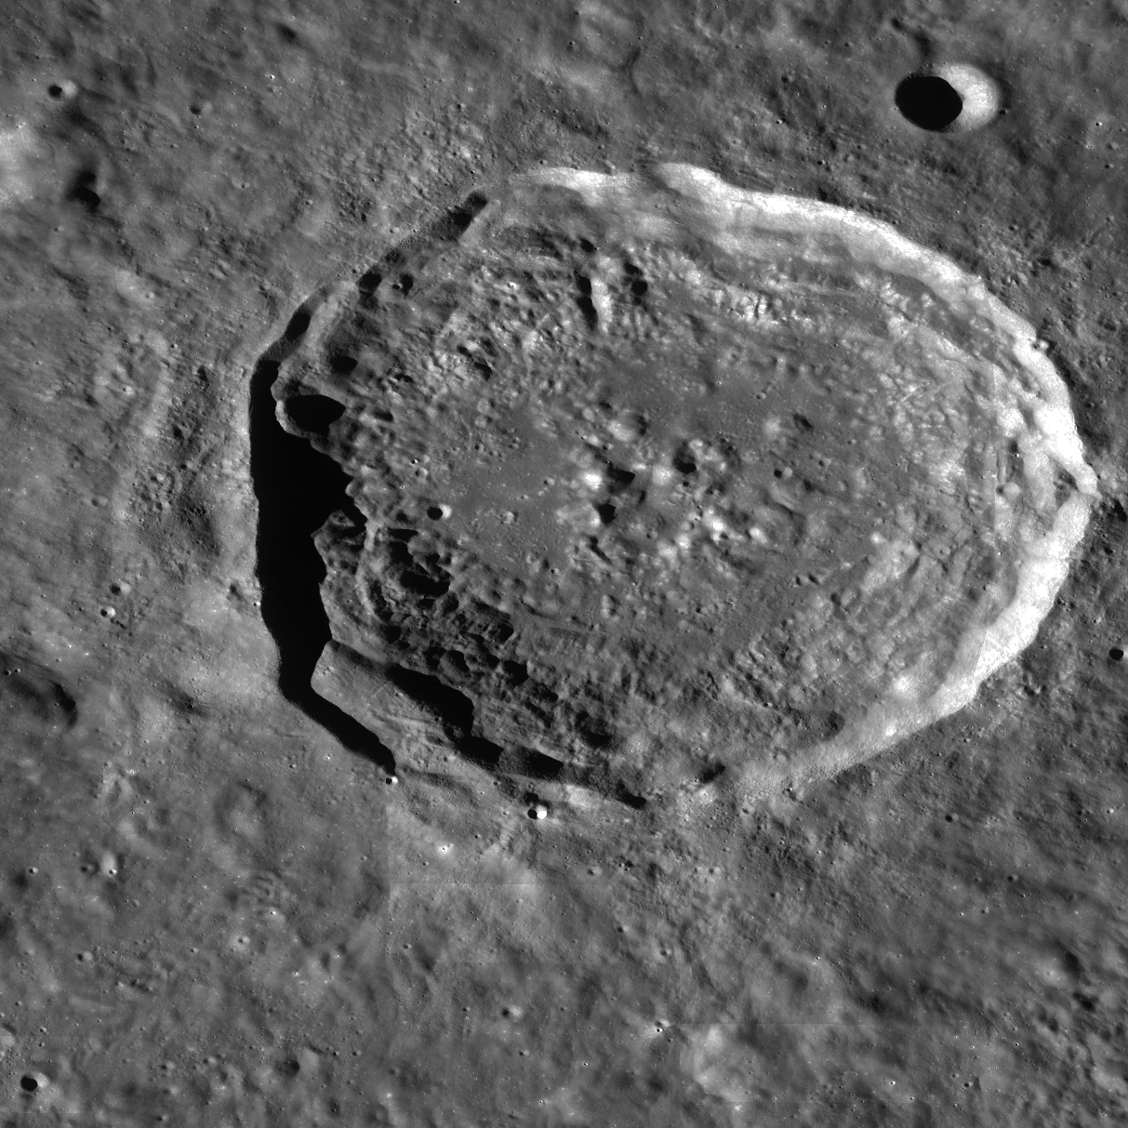
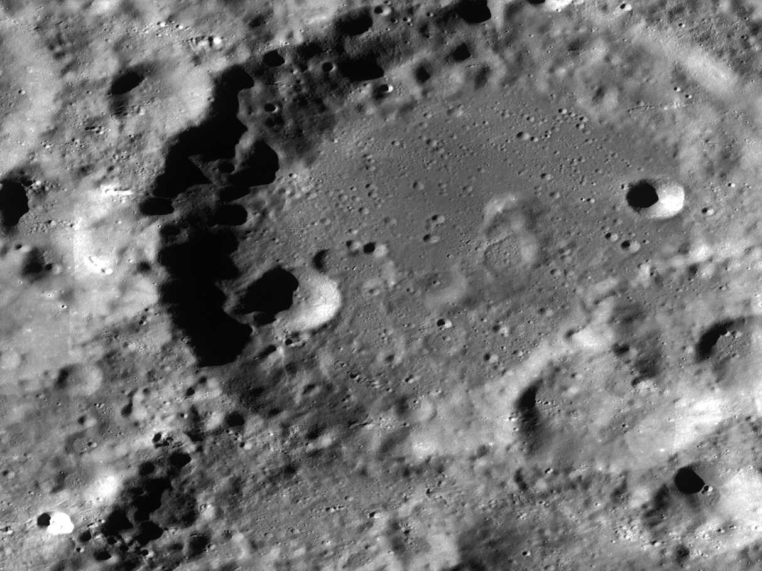
Comparison Setup - Test Cases
Test Case 14
Test Case 1
Test Case 4
Test Case 5
Test Case 6
Test Case 10
Test Case 11

Slide 26
Comparison Setup - Hardware Specifications
HP Z800 Workstation:
Dual - Intel Xeon X5650 2.66 12MB/1333 6C CPU-1(LOWPWR)
Dual NVIDIA Quadro FX4800 1.5GB PCIe Graphics card (192 CUDA parallel processing cores)
HP 24GB (6x4GB) DDR3-1333 ECC Reg RAM (Supported only with Dual Processor. ESTAR=DP)
HP 160GB SATA X25-M 1st SSD
HP 2TB SATA 7200 2nd HDD

Slide 27
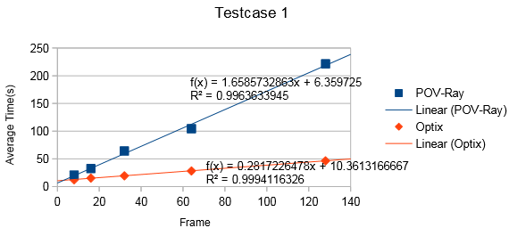
Speed Comparison: Solar Irradiance

Slide 28
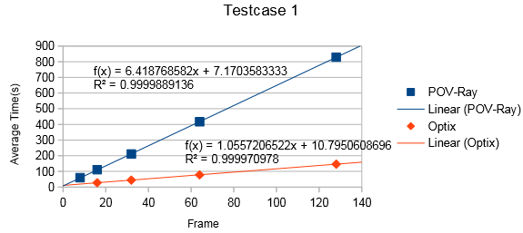
Speed Comparison: Total Irradiance
Notes:
End Kevin

Slide 29
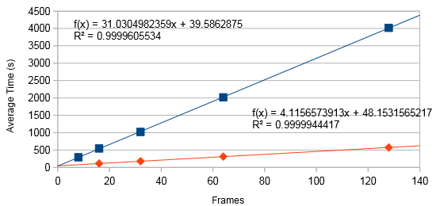
Best Improvement Time

Slide 30
Miscellaneous Implementations

Slide 31
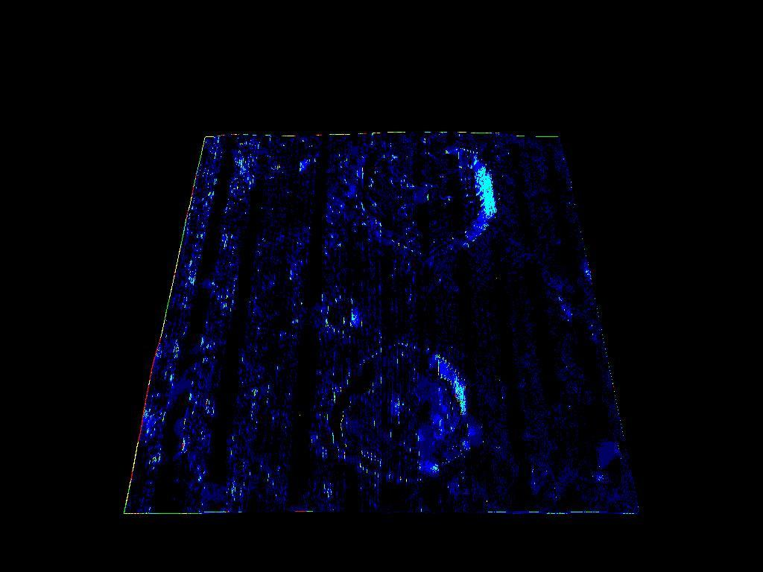
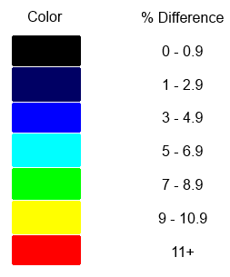
Image Comparison Tool

Slide 32
.png image output library

Slide 33
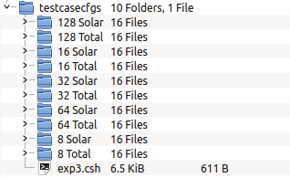
Testing Framework

Slide 34
Global Illumination
Global illumination (GI) is a feature in certain graphics algorithms that simulate indirect lighting.
Effects of indirect lighting
Shadows with soft edges.
Resolving objects in the shadow of another object.
Surfaces experiencing color bleed in the presence of other objects.

Slide 35
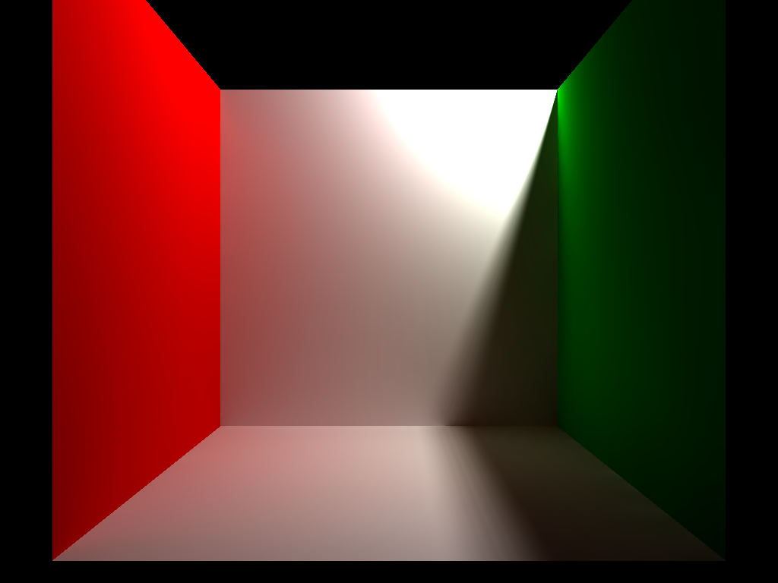
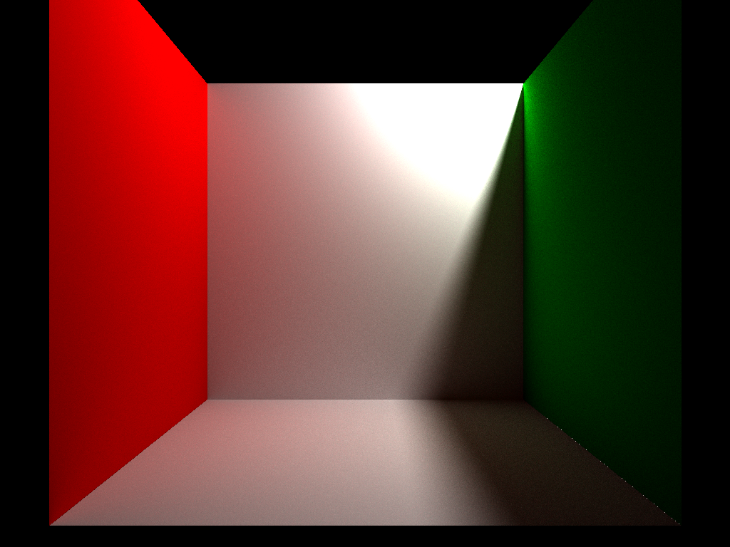
Global Illumination
POV-Ray’s Radiosity
OptiX Pathtracer

Slide 36
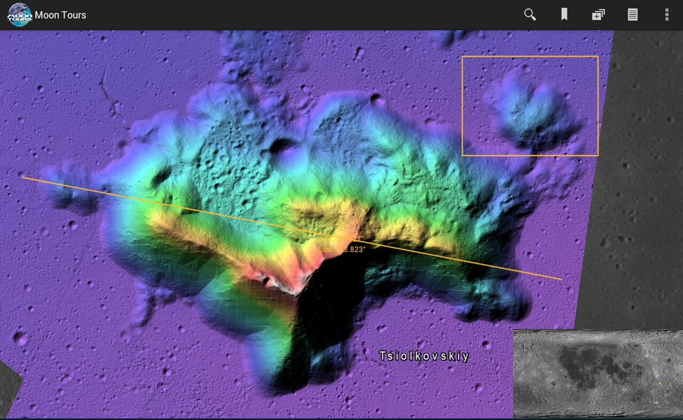
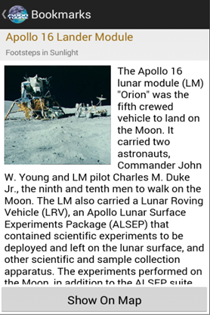
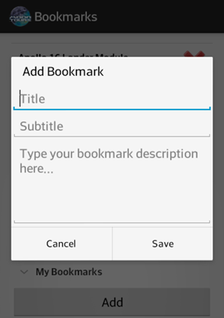
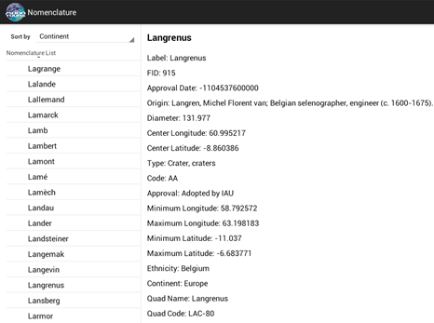
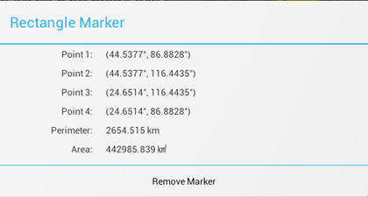
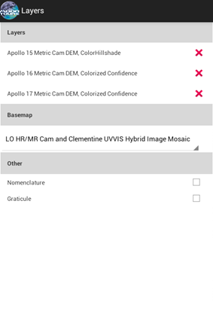
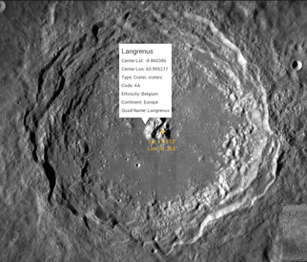
Android Application
Notes:
[Remove all the text and replace it with a screenshot that showcases as many features as possible. You’ll list the tools again later so you don’t need to put them here]

Slide 37
LMMPAA Prototype
ESRI ArcGIS Android SDK
Data from LMMP Web Service
Problems
Many bugs
Missing key features
Awkward UI
Code structure needed improvement

Slide 38
LMMPAA2 Architecture
Views
Adapters
User
Interface
Data Management
Models
Singleton Data Holders
XML/JSON
File and Network
Cache
I/O

Slide 39
LMMPAA2 Features and Tools
Layers
Nomenclature
Search function
Bookmarks
Mini-map
Marker tools
Settings
Help pages

Slide 40
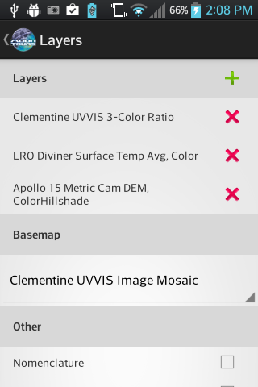
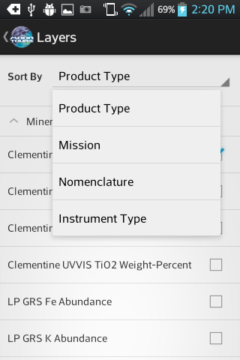
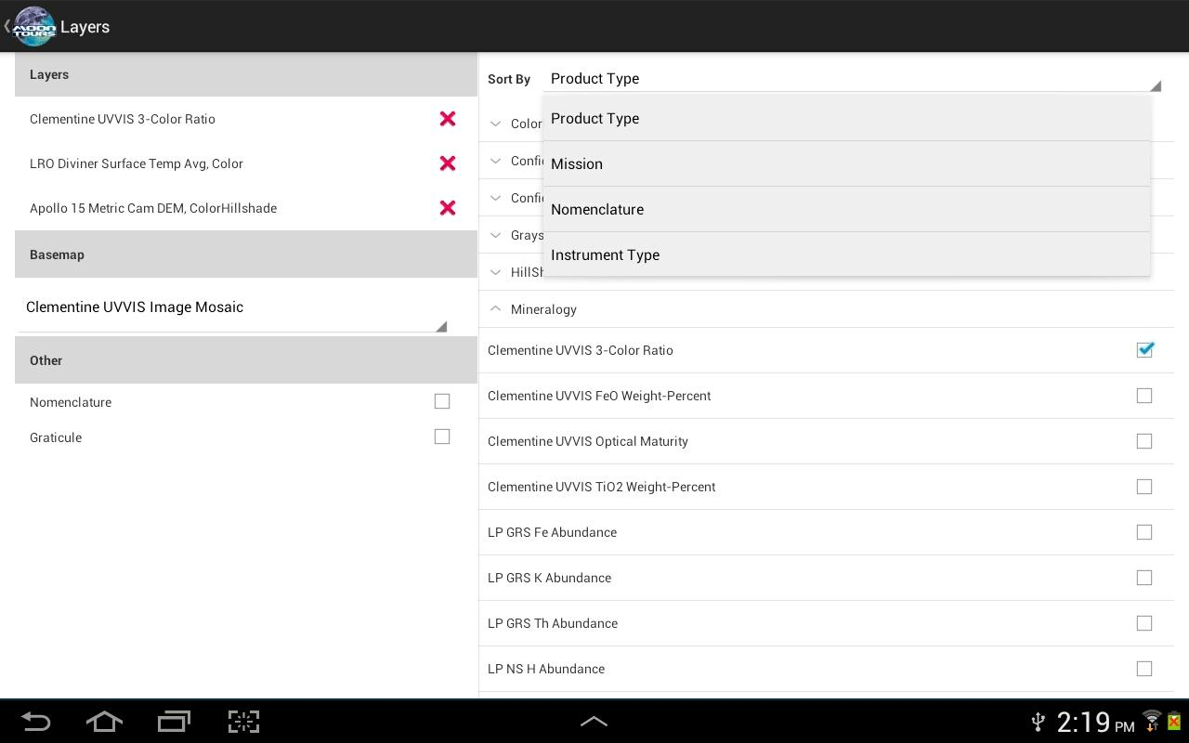
Layers
Allows selection and reordering of layers
Different layouts for different Screen Sizes

Slide 41
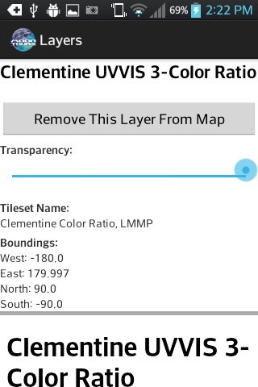
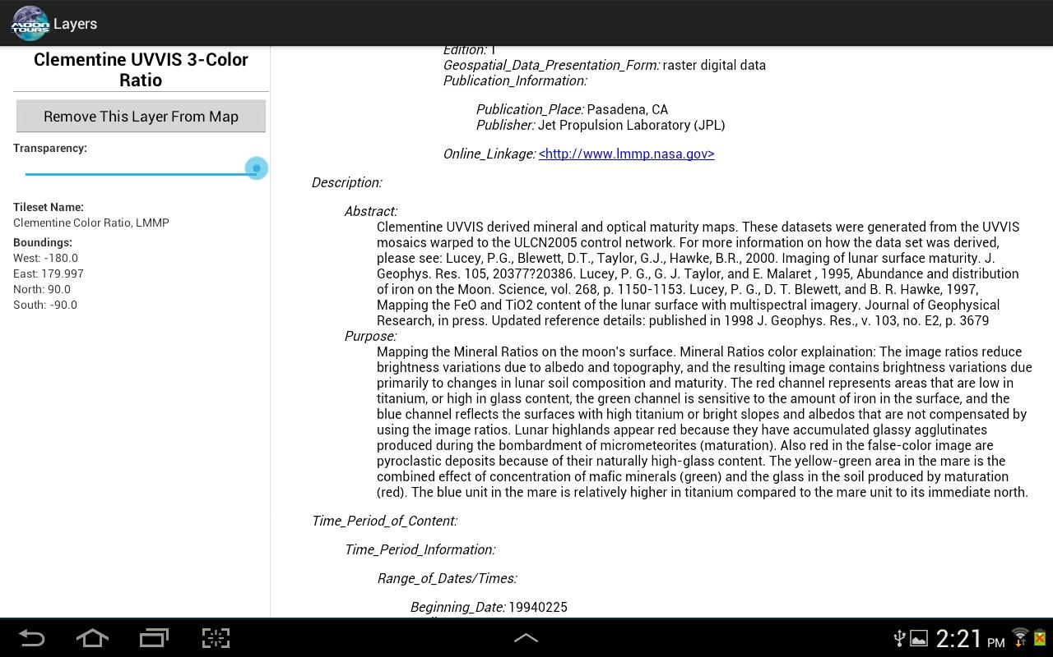
Layers
Allows viewing of layer details
Allows changing of transparency

Slide 42
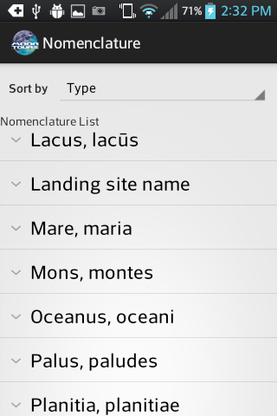
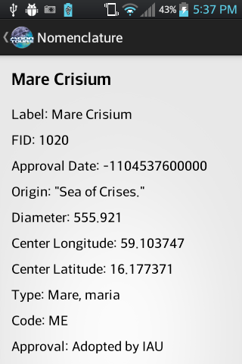
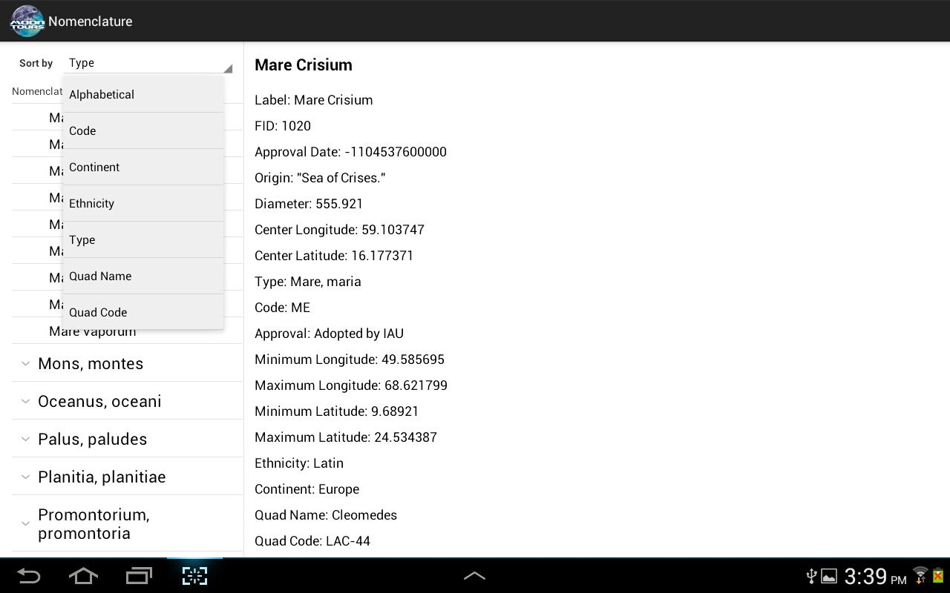
Nomenclature
Allows viewing of feature details
Sort by attributes

Slide 43
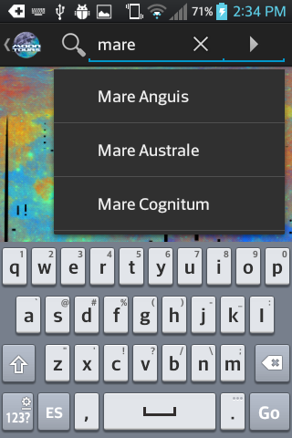
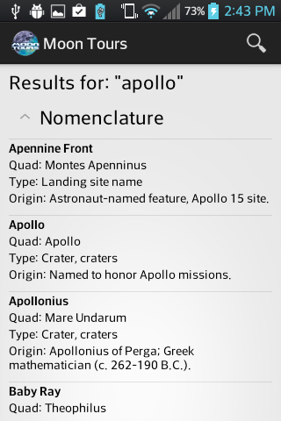
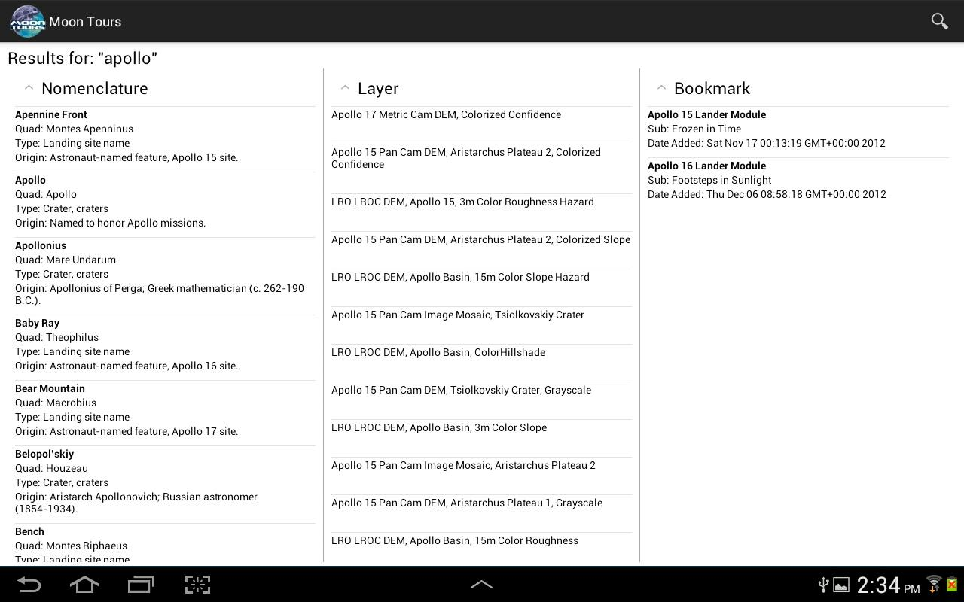
Search
Allows searching by terms
Results are ordered by data type

Slide 44
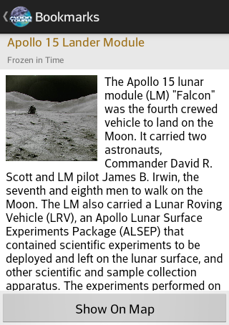
Bookmarks
Provides the user with information about lunar missions and sites
Initially designed to only display content of predefined sites and missions

Slide 45
Bookmarks
Satisfies views of different screen sizes
Different layouts are used depending on the device (tablet or phone)

Slide 46
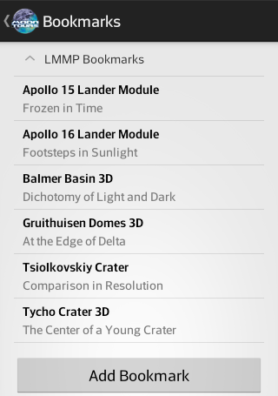
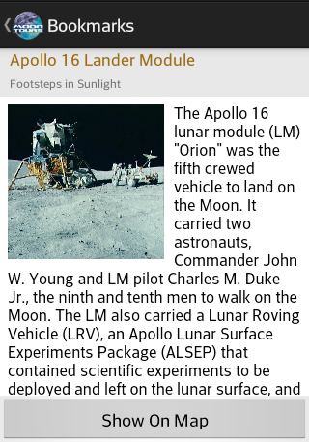
Bookmarks Phone Layout

Slide 47
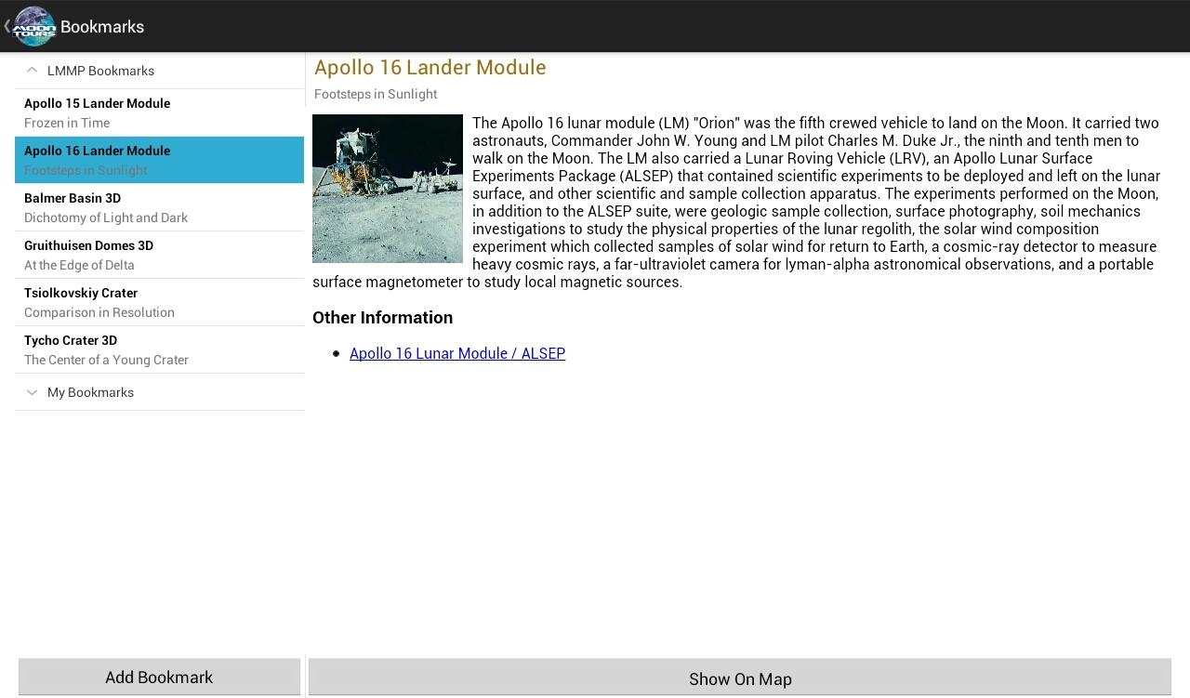
Bookmarks Tablet Layout

Slide 48
User Bookmarks
Additional feature allows the user to add their own bookmarks
Supply title, subtitle and description
Populates list displaying user bookmarks
Saves map location, extent, layers etc.

Slide 49
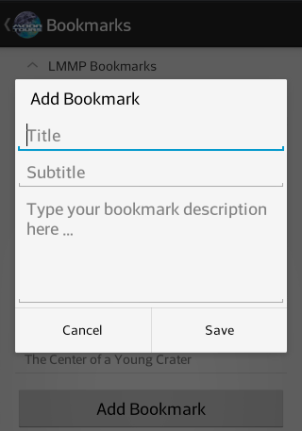
Custom Bookmarks

Slide 50
Showing Bookmark
Button in content container allows for a transition into the map
Data from selected bookmark is used to display content, such as layers onto the map

Slide 51
Showing Bookmark

Slide 52
Mini-map
Allows the user to know their exact location on the lunar surface
Move to a location on the map by tapping on the minimap

Slide 53
Mini-map
Minimap interface includes crosshair displaying the latitude & longitude
User can decide whether to toggle overall interface on/off

Slide 54
Mini-map On

Slide 55
Mini-map Off

Slide 56
Help WebView
Notes:
as you can see here, we have a picture of the index page of the help webView. The webView is designed in HTML and styled using css which goes to show all the broad amount of knowledge we must have to create this android application. We have XML being used to show to the user, we have java controlling the back end of things along with the Android api, there is the json data that is extracted using the jackson api, and we have html and css in the webviews.
the point of the help webview is to explain to the user the different tools and features available in our application. This manual can be looked at whenver the user does not understand how to use a tool, or wants to see if there features that the user is not making use of. All this information is shown in a way that even those that are inexperienced with developing applications can understand how to use the application. This also requires us to use a lot of pictures becuase frankly, pictures can explain a lot more in a shorter amount of time.

Slide 57
Help WebView
Use of Html and Css
Combining all the information for the application in one place
Supplying pictures to emphasize different points
Notes:
as mentioned in the previous slide, the webviews are displayed with html, all the information is in one place that is easy to understand, and ensuring consistency across different platforms. Our webpages must look good not only on your galaxy tablet, but on your nexus 7 and on your htc One.

Slide 58
Marker Tools
Notes:
The marker tools allow the user to get different information off the surface of the moon. We have the point tool which allows the user to place a point on the map and get the longitude and latitude of the location. We have a line tool which uses a drag feature in order to be drawn. The user places their finger in the starting point then drags their finger across the map to change the location of the end point. Once the user removes their finger, the end point is created. Several other tools function this way such as the rectangle and cirle tool. We have a Polyline and polygon tools as well that allow the user to draw out multiple vetrices for the polyline and polygon. We also have a freehand tool that allows the us

Slide 59
Marker Tools
Notes:
here i have a picture of a dialog that pops up when the user clicks on a rectangle. Here you can see the longitude and latitude of each of the points as well as the perimeter and the area of the rectangle created. The different marker tools we offer have their own pop up dialogs that offer data specific to the shape. The point tool only offers the longitude and latitude, the line offers distance and the location of the points, circle offers the circumfrence and area and etc. The user is also able to remove specific marker tools so that their screen does not become cluttered. We also hgive the option to remove all the markers just in case the user gets a bit too carried away.

Slide 60
Maker Tools Design
Required to come up with marker tools that offer many possibilities to users
The marker tools had to be balanced between simple to use and performing what the user expects

Slide 61
Settings

Slide 62
Settings
Changing the cache size from a static value to an easily editable one
Implementing the ability to switch units instead of sticking solely to one set of units.

Slide 63
LMMPAA2 Summary
Many useful features and tools for end users
Clean and well-structured code that forms a solid foundation for future development
Private beta has been on Google Play for a couple months now
Final release on Google Play in a couple of weeks

Slide 64
Thank You!

