Slide 1
Parameterized Model for Mobility Project Scoring and Estimation of Benefits

Slide 2
Team Members
Project Lead: Elizaveta Sokolova (sokolovatennis@yandex.ru)
Documentation Lead: Kevin Gamboa (kbgamboa92@gmail.com)
QA Lead: Kevin Lam (kevin.lam825@gmail.com)
Architecture / Design lead: Alvin Nguyen (anguyen8613@gmail.com)
Advisor:
Dr. Mohammad Pourhomayoun
Liaisons:
Hunter Owens - hunter.owens@lacity.org
Karina Macias - karina.macias@lacity.org
David Somers - david.somers@lacity.org

Slide 3
Agenda
1. Introduction & Overview
2. User Features
3. Score Process
4. Machine Learning
5. Demo
6. Conclusion

Slide 4
Introduction & Overview

Slide 5
Introduction
The Los Angeles Department of Transportation (LADOT) has partnered with the City’s Information Technology Agency Data Science Federation and California State University Los Angeles to develop a Parameterized Model for mobility project scoring and estimation of benefits.

Slide 6
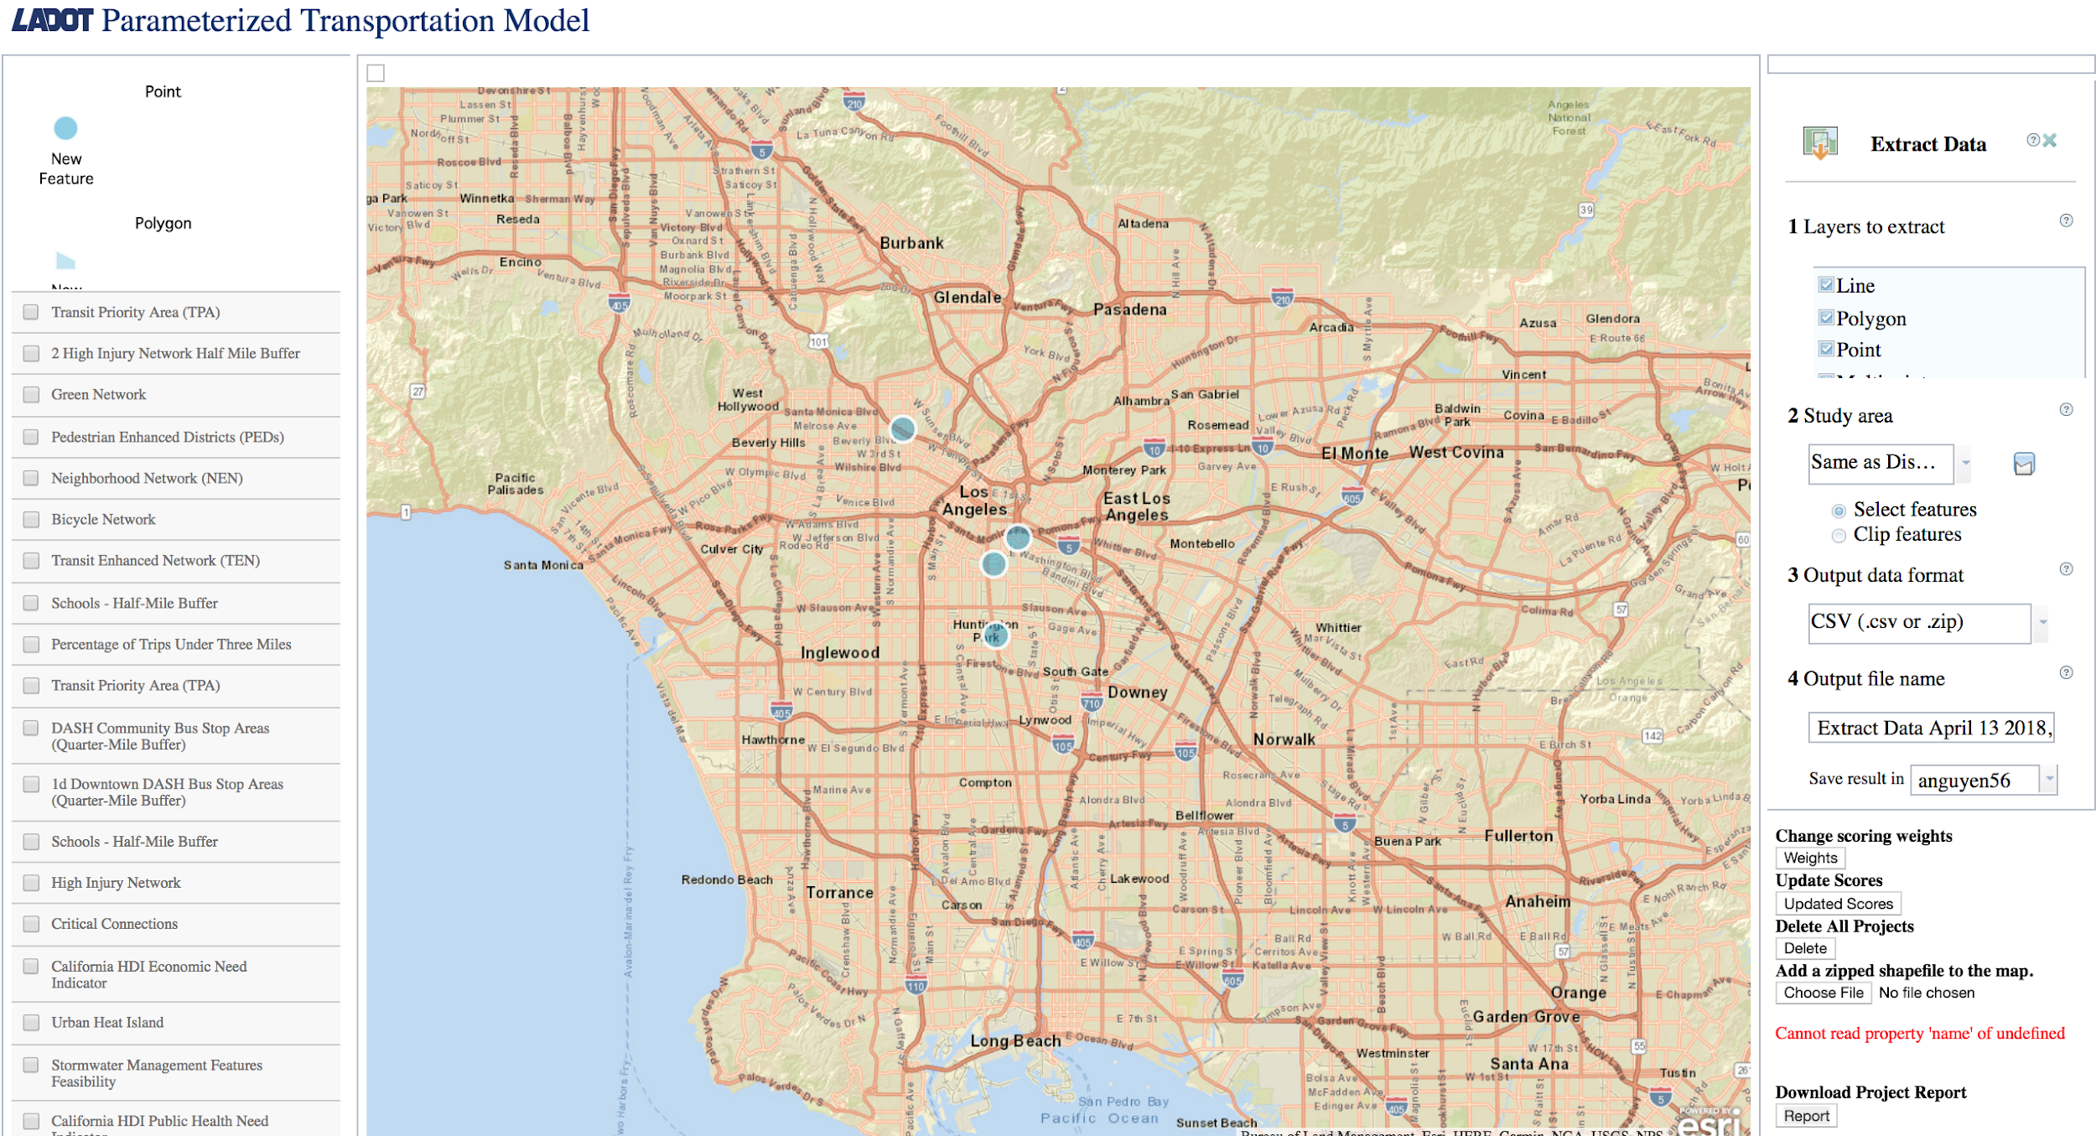
Deliverables
Automated mapping tool based on ArcGIS that gathers transportation capital project data and score projects based on LADOT priorities and City mobility goals.

Slide 7
Our Goal
Use automated overlay analysis to apply a weighted scoring model to the proposed projects
Calculate how consistent the investment is with the City’s mobility goals and policies
Enable LADOT staff to justify mobility investment according to their relative advancement of City mobility policy priorities
Evaluate the safety, access, sustainability, and livability of the project

Slide 8
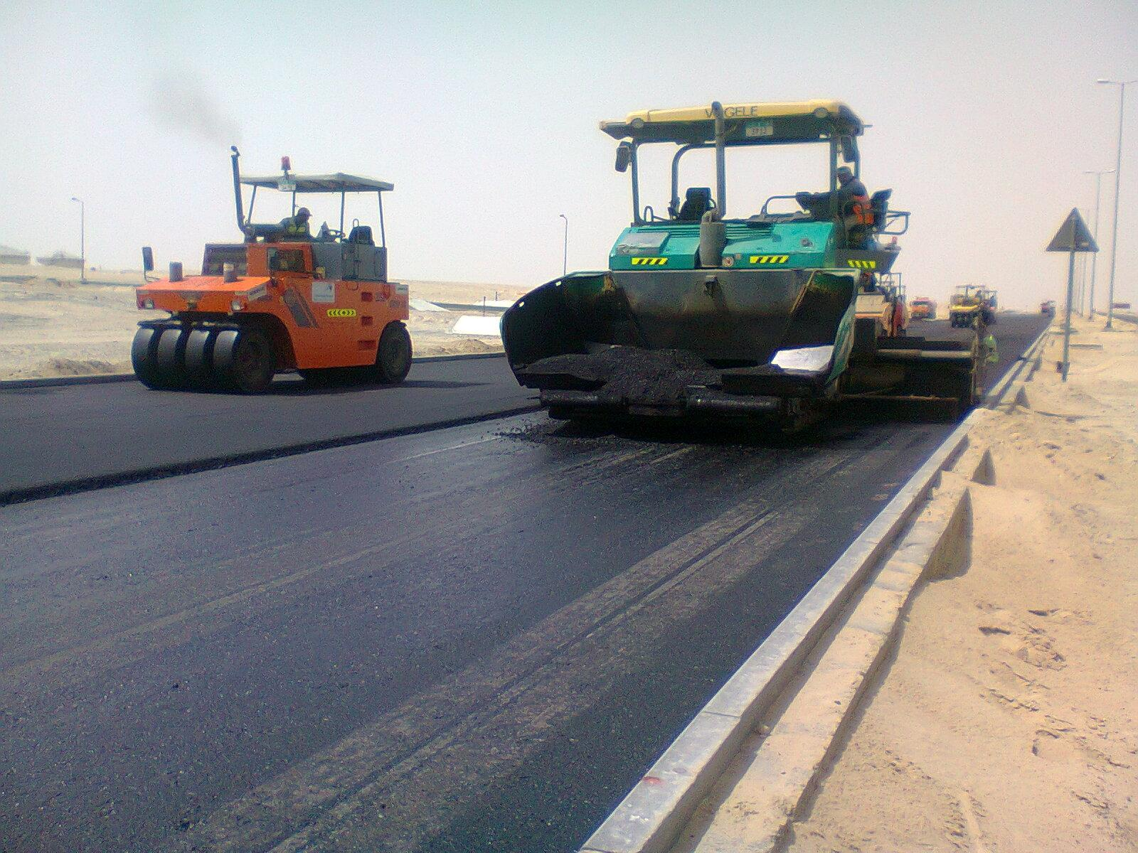
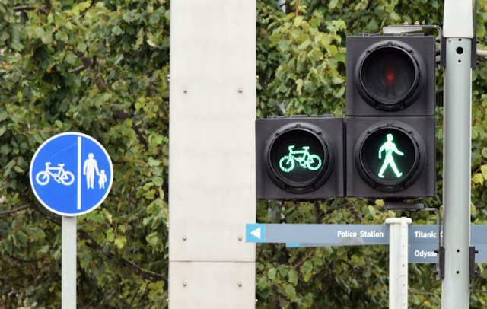
Why is this project important?
Fast and efficient way of prioritizing projects
Makes Los Angeles Area safer

Slide 9
User Features

Slide 10
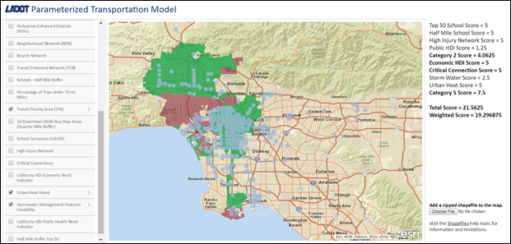
Layers
Notes:
Transit Priority Area - light blue color
Urban Heat Island - green color
Stormwater Management Features Feasibility - red color

Slide 11
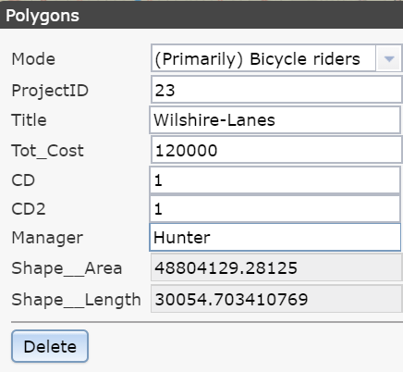
Project Feature
Notes:
type of mode each project serves

Slide 12
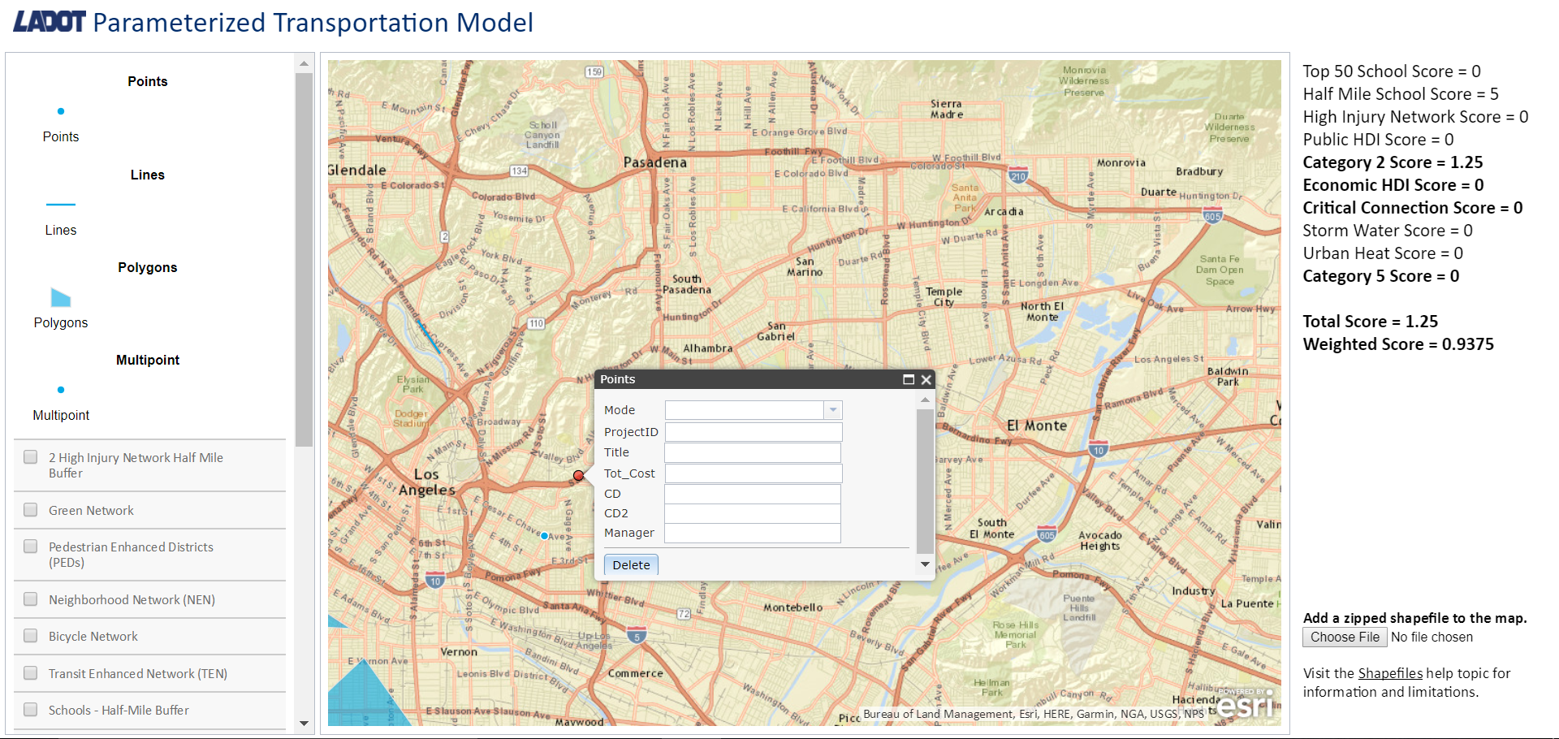
Point Feature
SELECTING THE POINTS FEATURE ENABLES THE USER TO CLICK ANYWHERE TO PROPOSE A PROJECT THAT CAN BE REPRESENTED AS A POINT ON A MAP.
Notes:
Examples: (STOP SIGNS, TRAFFIC LIGHTS).

Slide 13
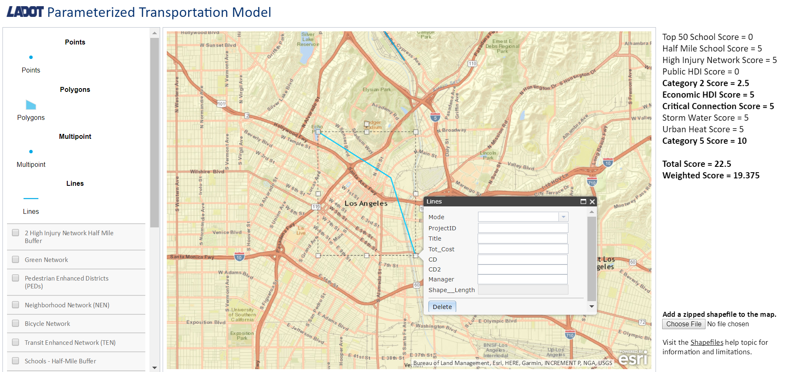
Line Feature
SELECTING THE LINES FEATURE ENABLES THE USER TO CLICK ANYWHERE ON THE MAP MULTIPLE TIMES TO PROPOSE A PROJECT THAT WOULD HAVE A PHYSICAL REPRESENTATION OF A LINE ON A MAP.
Notes:
Examples: Road Construction, Bicycle Lanes

Slide 14
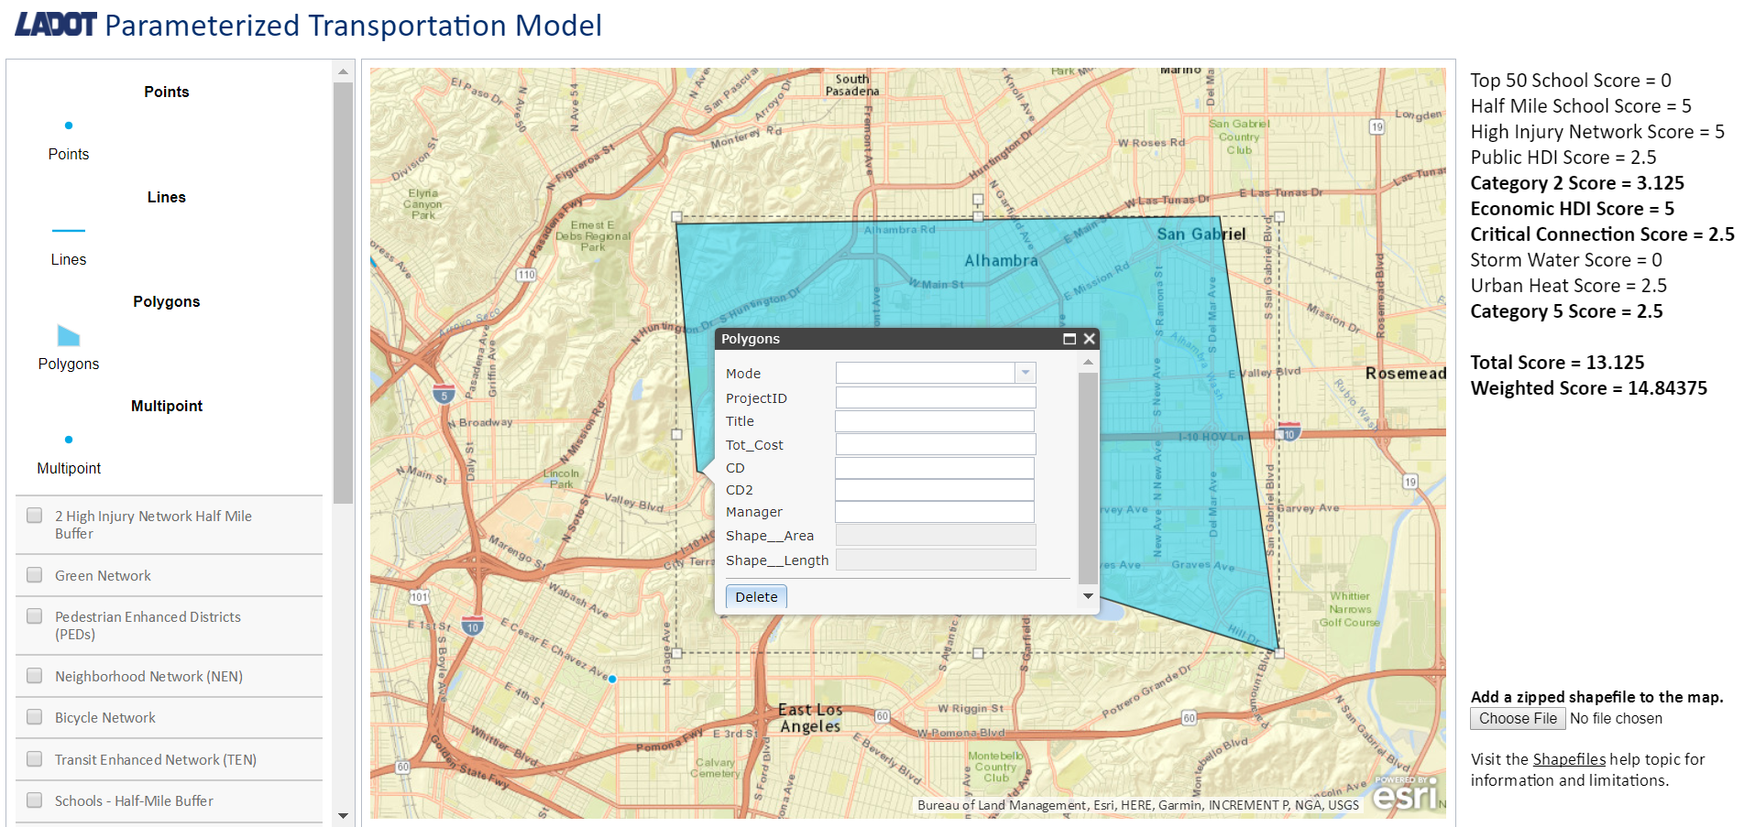
Polygons Feature
SELECTING THE POLYGONS FEATURE ENABLES THE USER TO CLICK ANYWHERE ON THE MAP MULTIPLE TIMES TO PROPOSE A PROJECT THAT HAS A PHYSICAL REPRESENTATION OF A POLYGON ON A MAP.
Notes:
Examples: (SCHOOLS, PARKS).

Slide 15
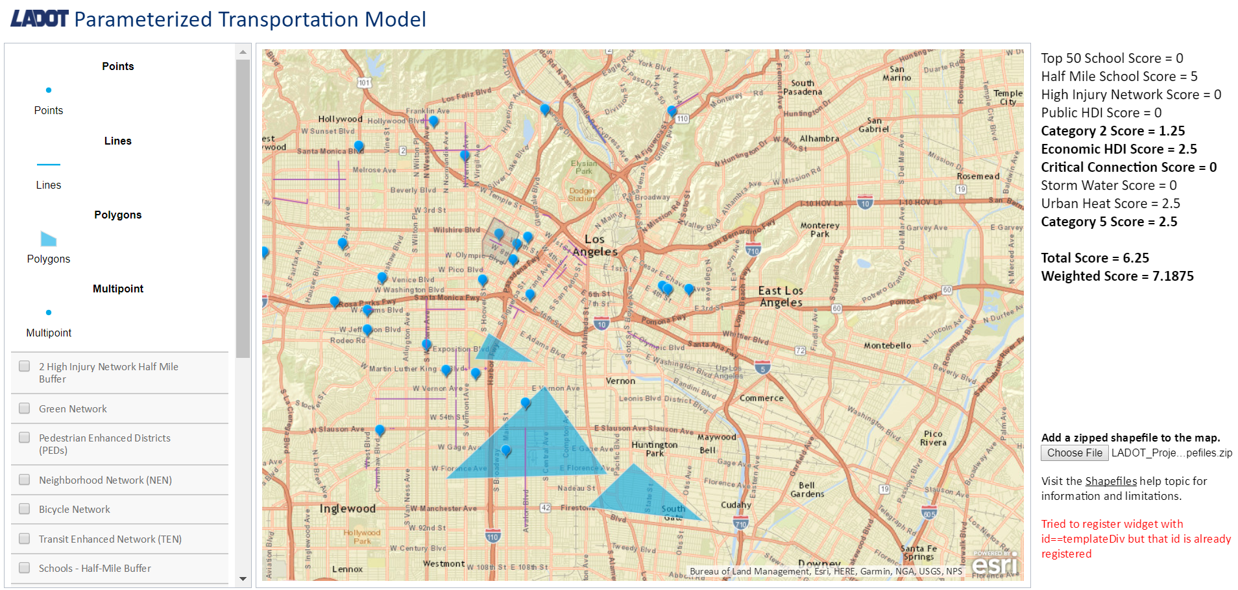
Adding Shapefiles Feature
THE “CHOOSE FILE” BUTTON ALLOWS THE USER TO UPLOAD A SHAPEFILE WITH PRE-EXISTING PROJECTS.

Slide 16
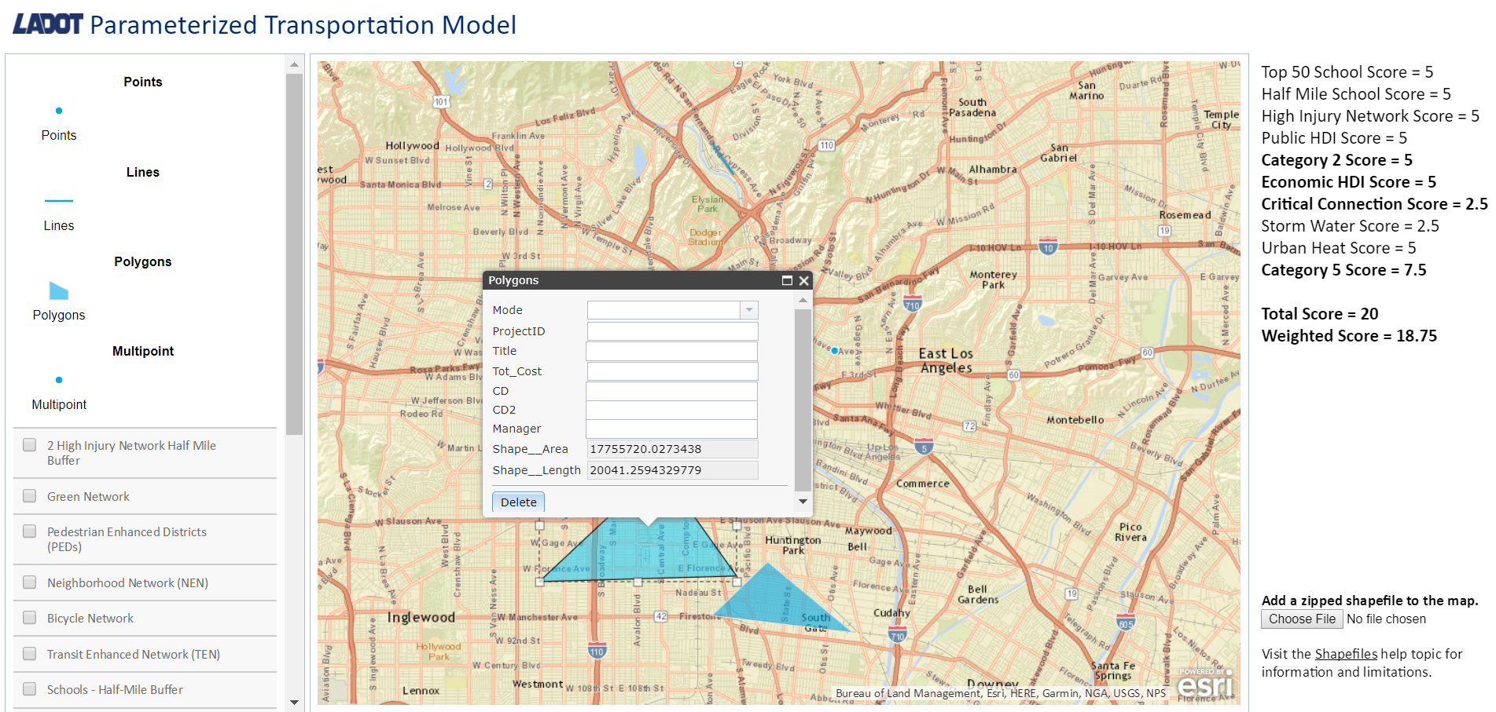
Scoring Feature
THE POSITIONING OF PROJECTS, IN TERMS OF ITS LAYERS, DETERMINES HOW THE SCORING WILL BE CALCULATED. THE CALCULATIONS ARE BASED UPON LADOT PRIORITIES AND CITY MOBILITY GOALS.

Slide 17
Score Process

Slide 18
Scoring Categories
Mobility Plan Alignment
Safe and Healthy
Equitable and Inclusive
Accessible and Affordable
Sustainable and Resilient

Slide 19
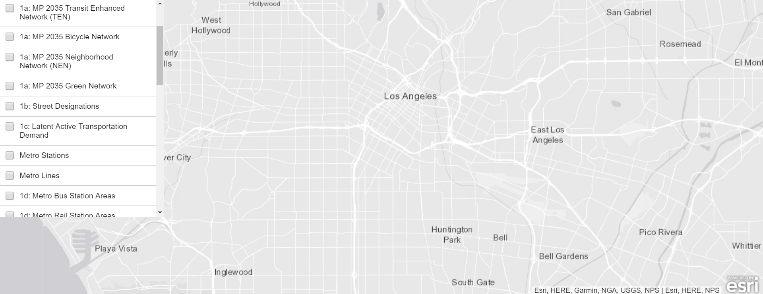
Current Scoring Method - Part 1

Slide 20
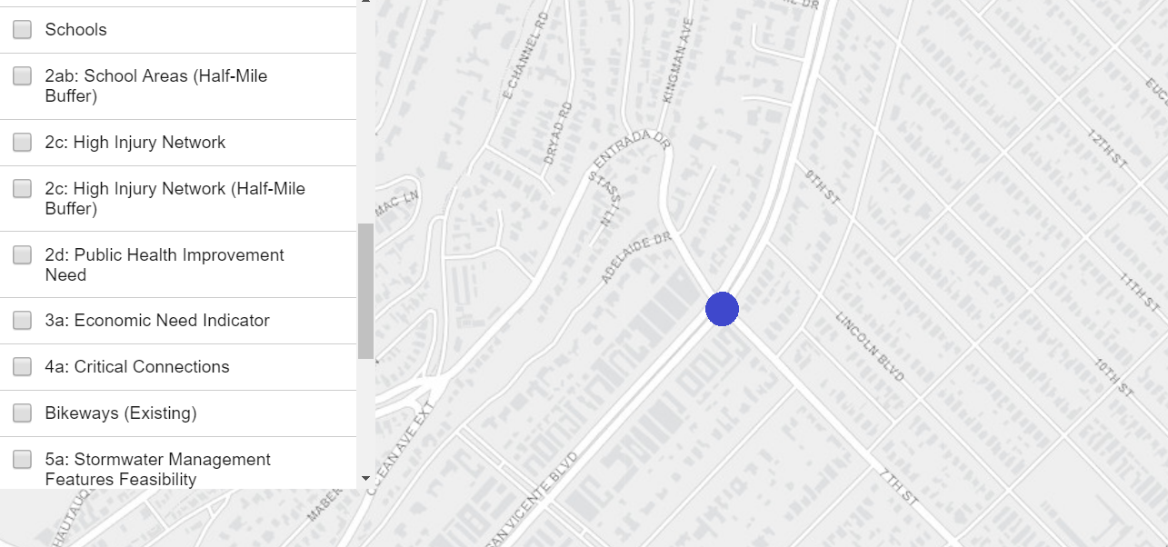
Current Scoring Method - Part 2

Slide 21
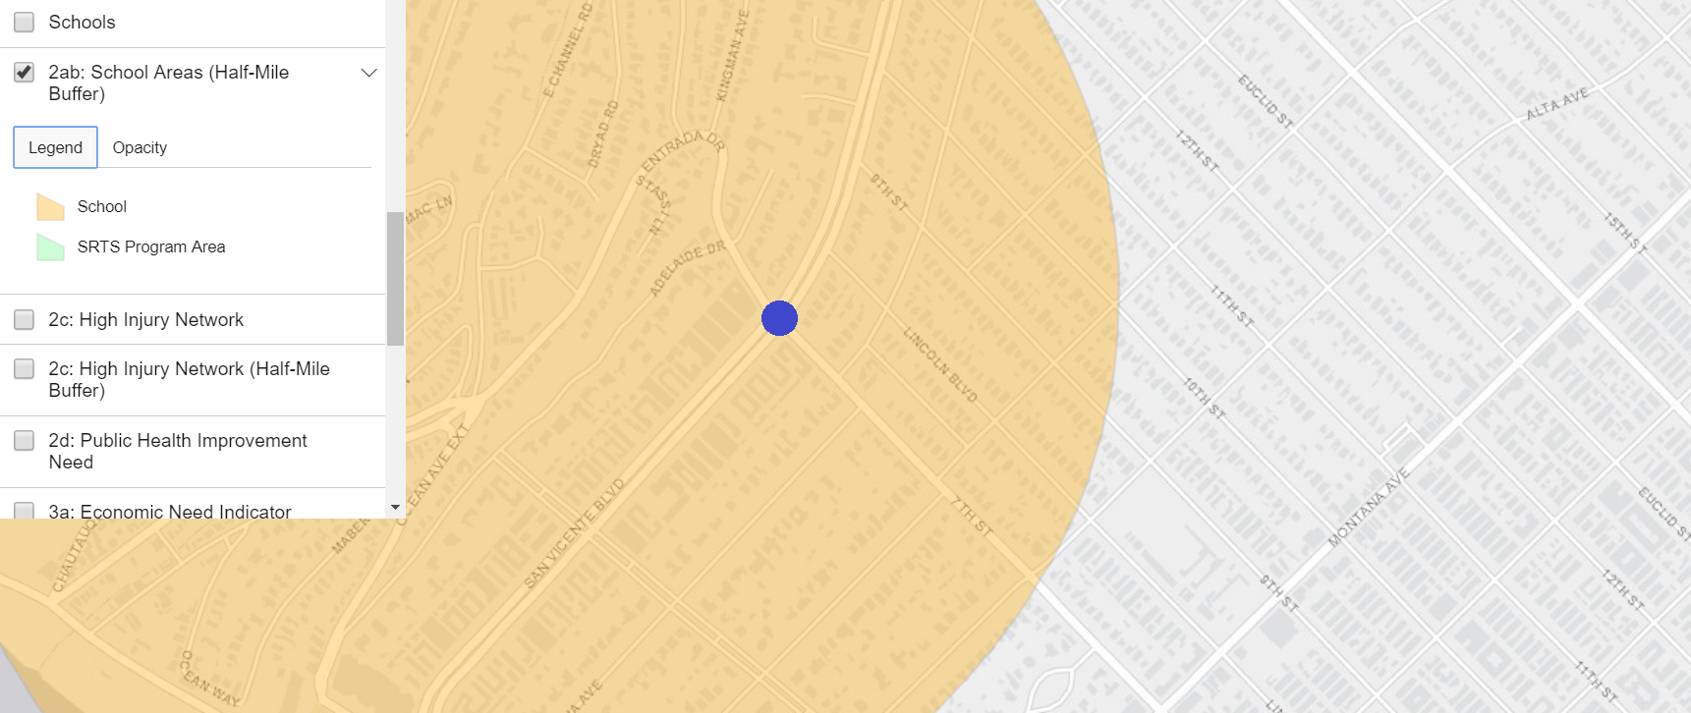
Current Scoring Method - Part 3

Slide 22
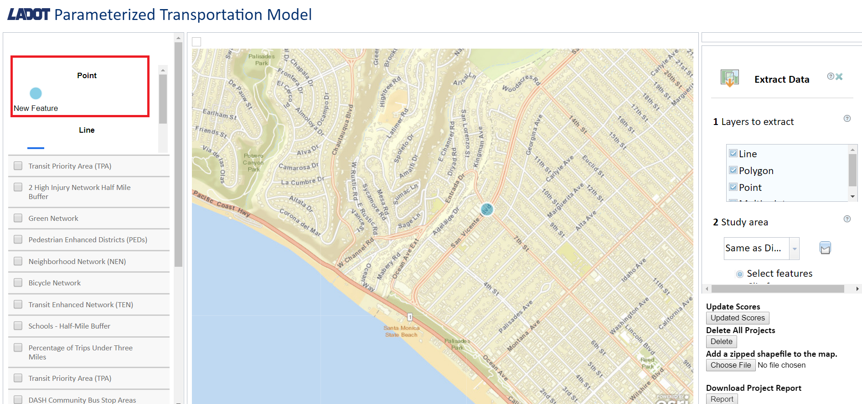
New Scoring Method

Slide 23
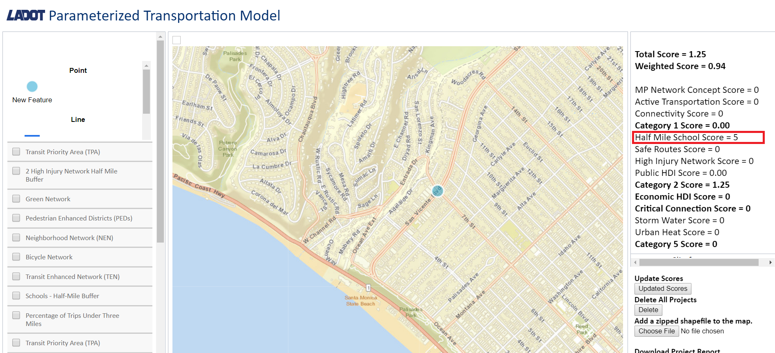
New Scoring Method - Part 2

Slide 24
Automated Weighting Based on Machine Learning

Slide 25
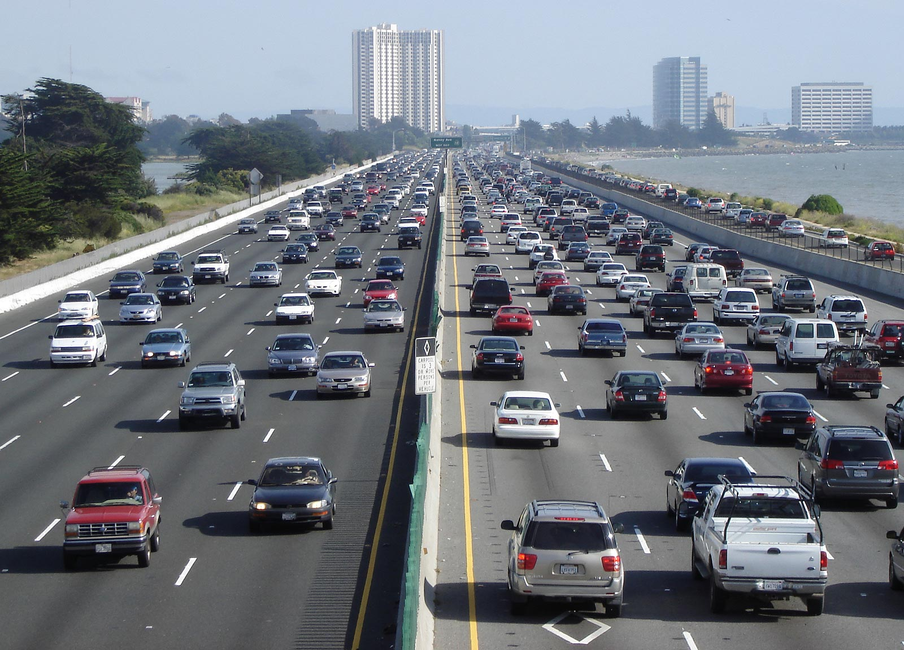
Improvements in Safety
Automatically design the best weights and scores rather than
using pre-defined parameters
Data driven approach that finds the best score based on historical data
Metric is the reduction in collisions for each project
Data from SWITRS (Statewide Integrated Traffic Records System)

Slide 26
Collision Table

Slide 27
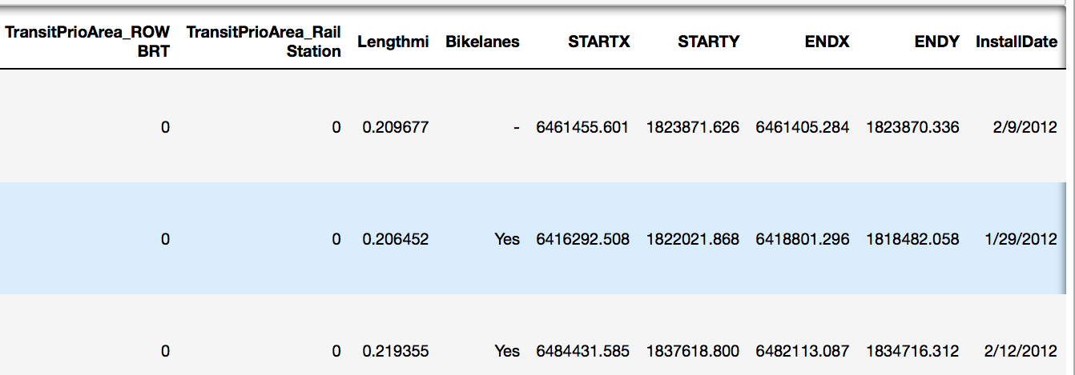
Projects Table

Slide 28
How we found the collision reduction

Slide 29
Project Demo

Slide 30
Application Benefits
Use machine learning to create a predictive model for benefits of proposed projects
Automate the scoring process using the interactive web map.

Slide 31
Publications and Conference Presentations
February, 2018
Karina Macias, David Somers, Hunter Owens, Jeanne Holm, Elizaveta Sokolova, Alvin Nguyen, Kevin Gamboa, Kevin Lam, Mohammad Pourhomayoun, “Parameterized Model for Mobility Project Scoring and Estimation of Benefits”, Esri Conference, 2018.

Slide 32
Thank you!
Do you have any questions?

