Slide 1
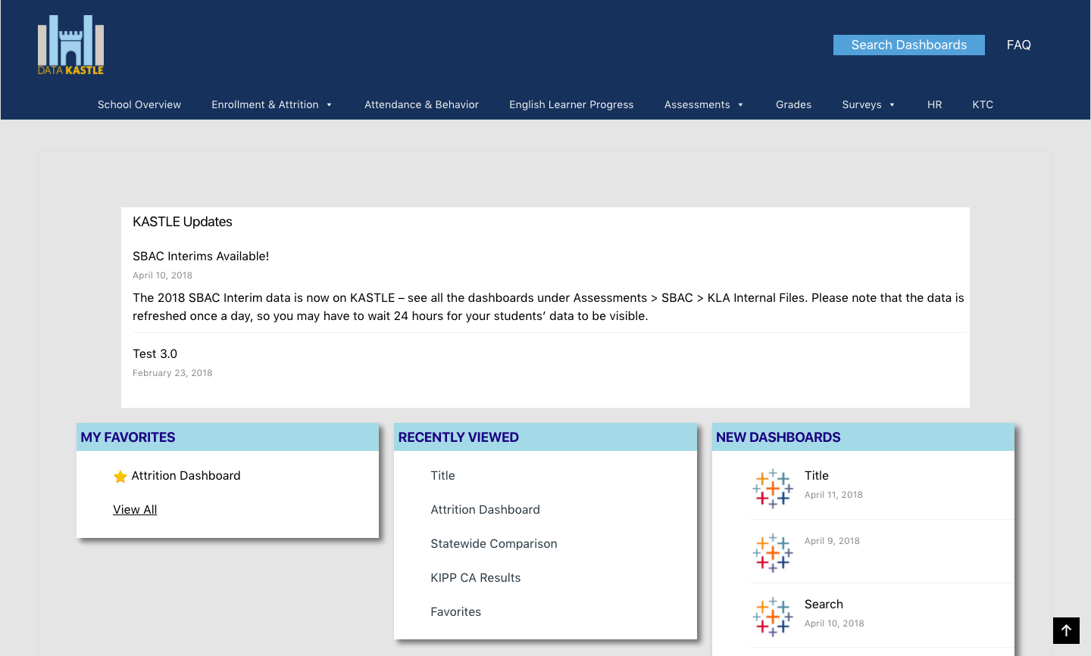
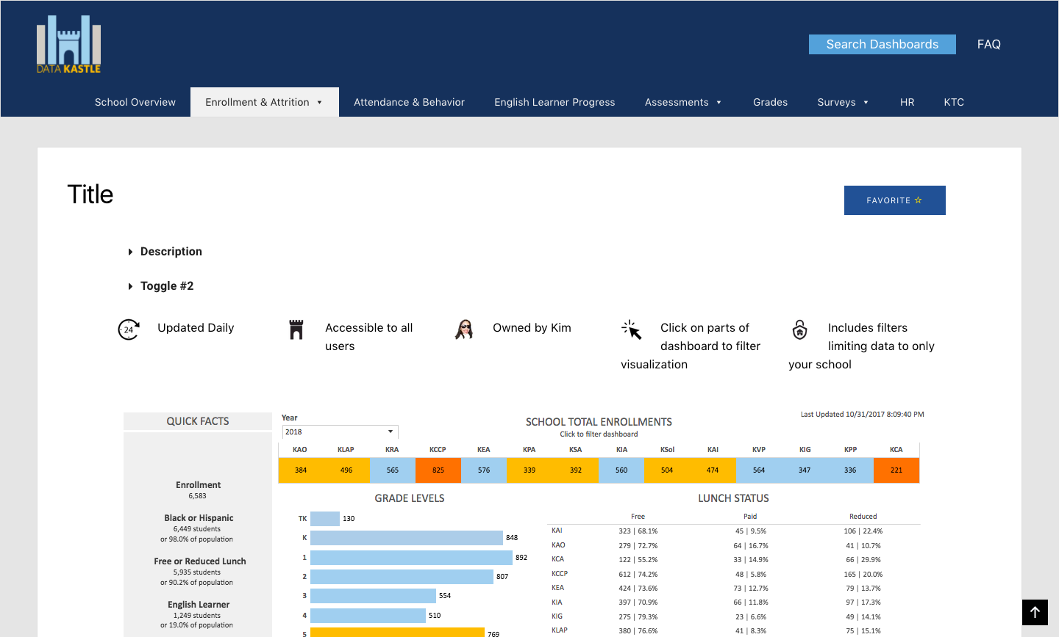
KIPPLA KASTLE 2.0 Team Members: Jose Gonzalez, Safa Al Mahbub, Juan Perez Faculty Advisor: Dr. Russ Abbott, Jungsoo (Sue) Lim Knowledge is Power Program Liaison: Kimberly and Nicole Department of Computer Science College of Engineering, Computer Science, and Technology California State University, Los Angeles
Background
Kippla’s website “KASTLE” is currently made with Google Sites, which had limited functionality. A major issue with our current setup is Google does not handle priority levels, as a result we have to maintain three separate website, and update them all at the consistently. Aside from this issue, our website needs to support Tableau Dashboards, have comments, and have a google sign in.
Objective
To create a nice, easy to use website for KIPPLA. We will be using the Content Management System (CMS) Wordpress to create the websites, which will be hosted on SiteGround.
Goal
How it Works Now
Toole Used
Notes:
‹#›

