Slide 1
Los Angeles County
Department of Parks and Recreation
Notes:
To change the image on this slide, select the picture and delete it. Then click the Pictures icon in the placeholder to insert your own image.

Slide 2
Project Team
California State University Los Angeles
Students
Patrick Flinner
Avik Ghazarian
Robert Karapetyan
Aaron Romero
Ken Shimauchi
Benjamin Valadez
Faculty Advisers
Dr. Russ Abbott
Dr. Jungsoo Lim
Los Angeles County Department of Parks and Recreation
Liaison
Sammy Urbina, Application Developer II

Slide 3
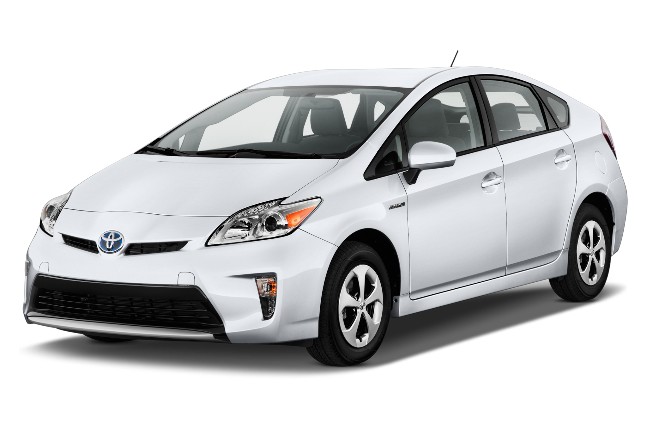
Department of Parks and Recreation
Oversee over 70,000 acres of parks and open spaces
Manage 182 sites
600 Vehicles
Difficult to track where vehicles go
Difficult to control unauthorized vehicle usage

Slide 4
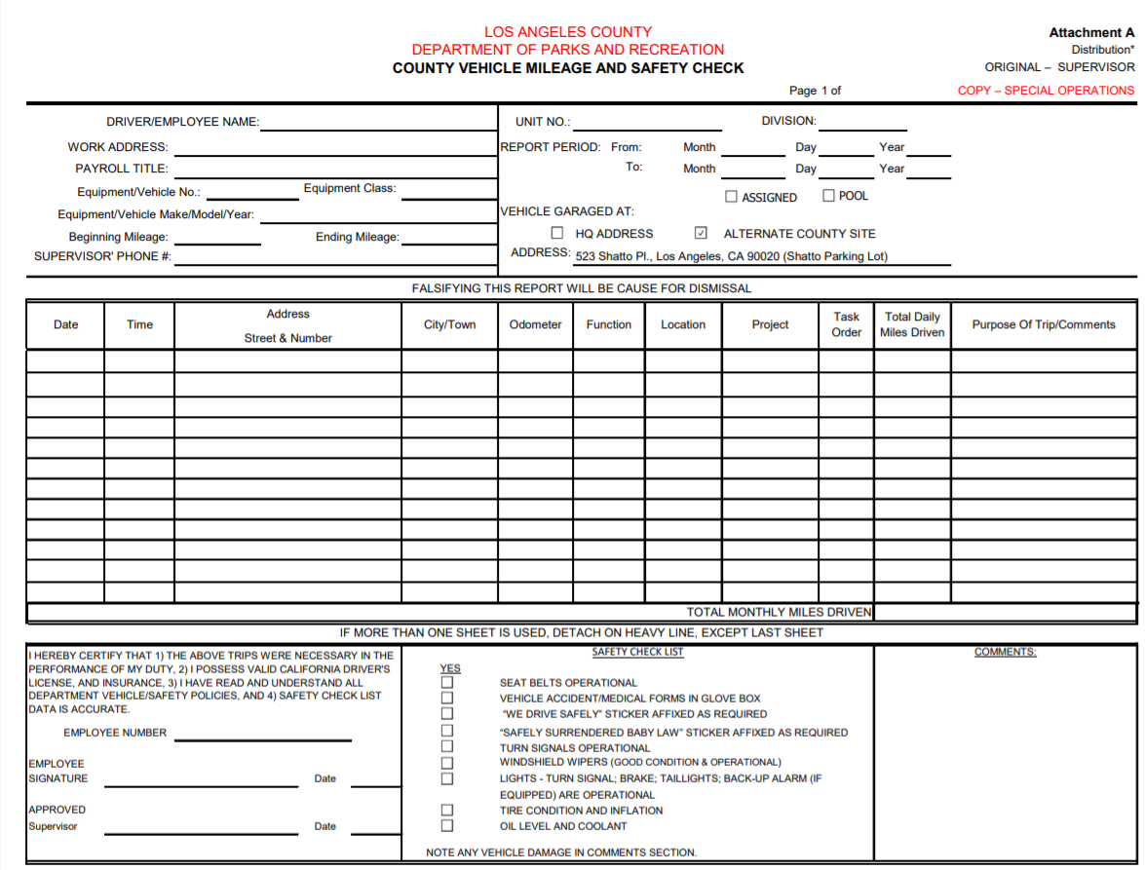

Slide 5
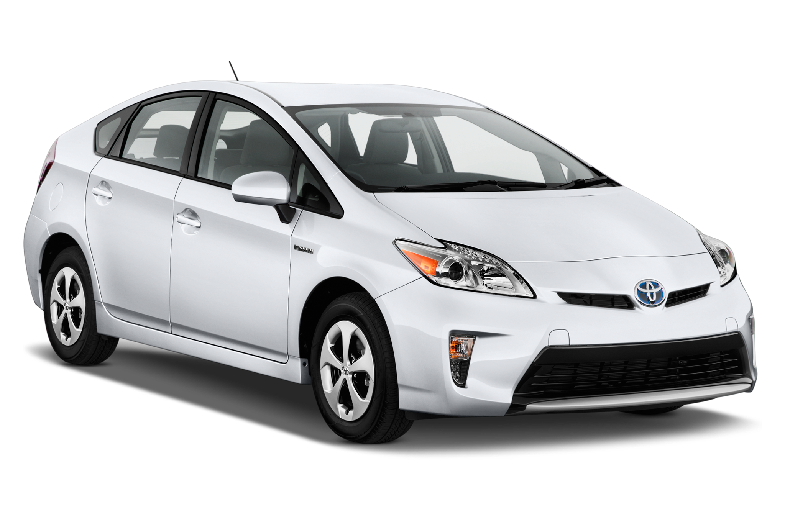
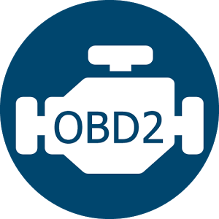
Architecture Overview
Bluetooth connection
Internet connection
Future Services
MSSQL Server

Slide 6
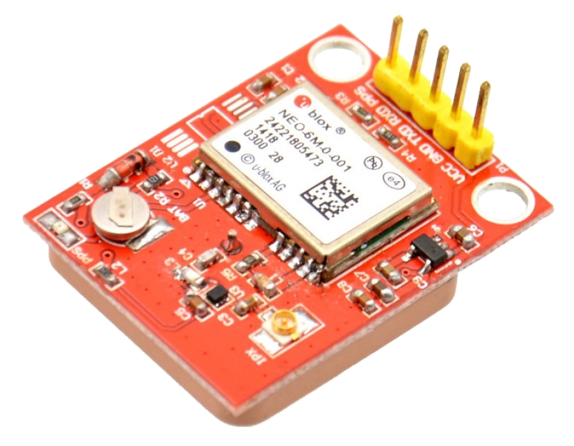
Edge Implementation - Components
RFID Reader
HID card Compatibility
USB Communication
GPS Module
OBD-II connection via Bluetooth
Python-OBD Library
Raspberry Pi Model 3
Battery(18650 Li-ion) powered for shutdown purposes

Slide 7
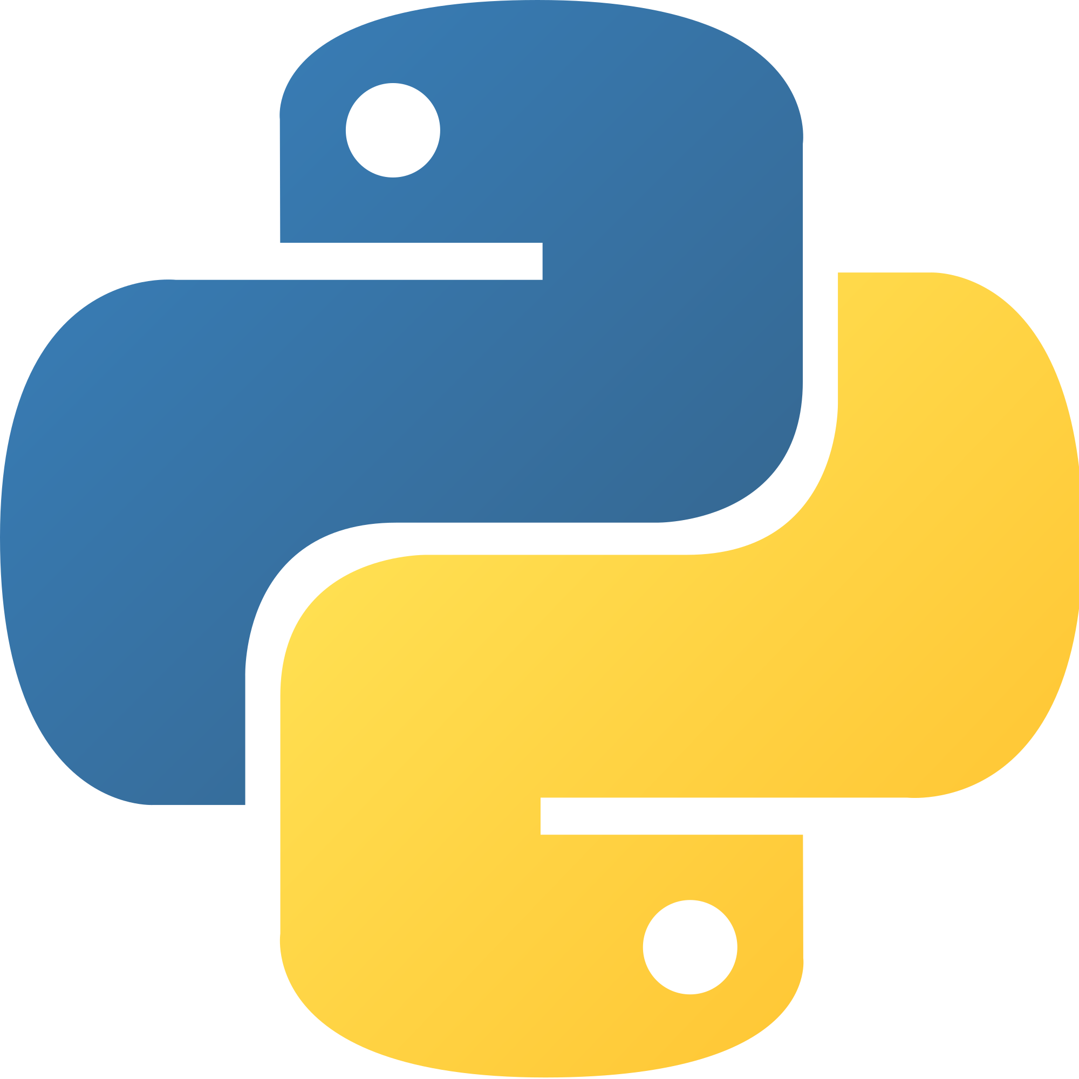
Edge Implementation - Raspberry Pi
Raspberry Pi runs 24/7
Determines when a car is moving
If a car moves, it begin gathering data
Don’t want to gather data while car is not in use
Raspberry Pi should be able to do everything with limited user interaction

Slide 8
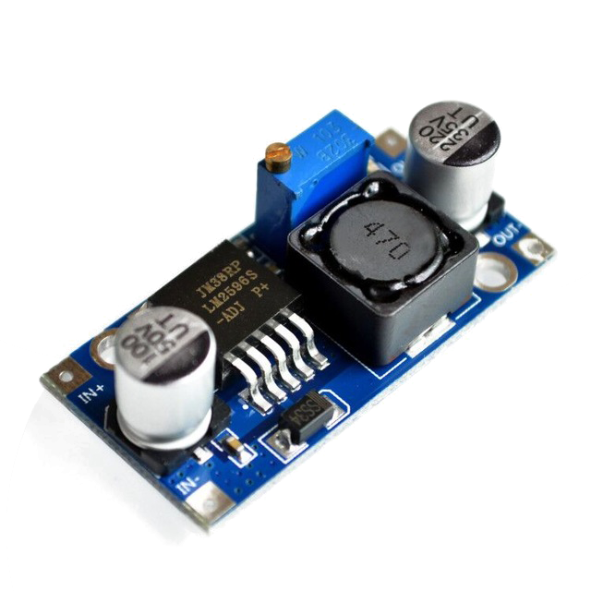
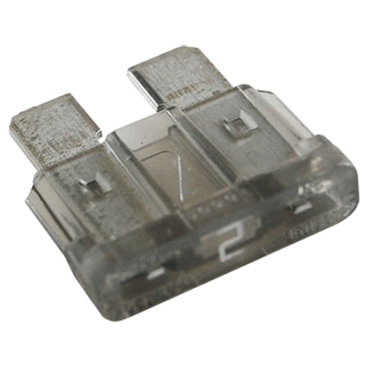
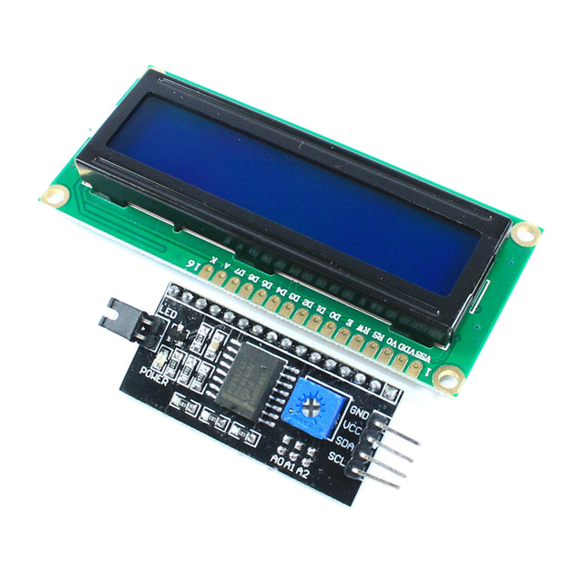
Edge Implementation - Device
Blender used for Device Case and Power Supply Case 3D model creation
3D Printed the physical model
Custom Power Supply to run off of 12V car battery
Step-down Voltage Converter turns 12V to 5V
2A fuses placed between the Device, PSU, and car battery for circuit protection
16x2 LCD Screen displays Device status to vehicle Driver
Uses an I2C Backpack module to reduce pinout to just 4 pins

Slide 9
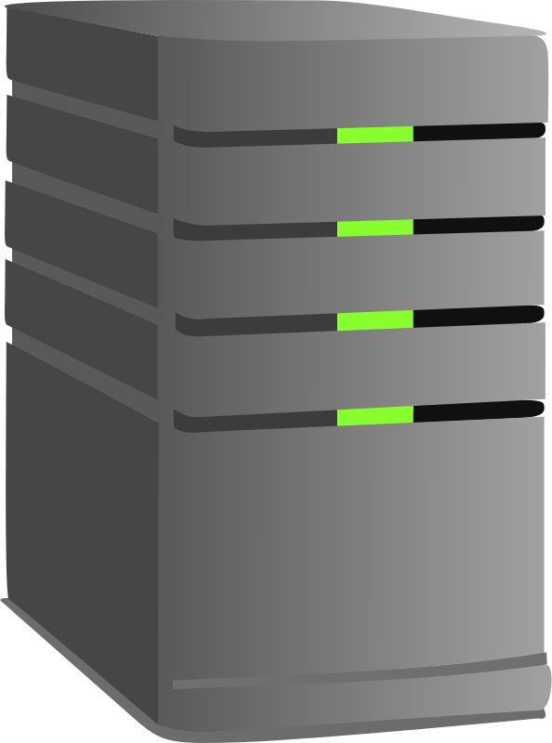
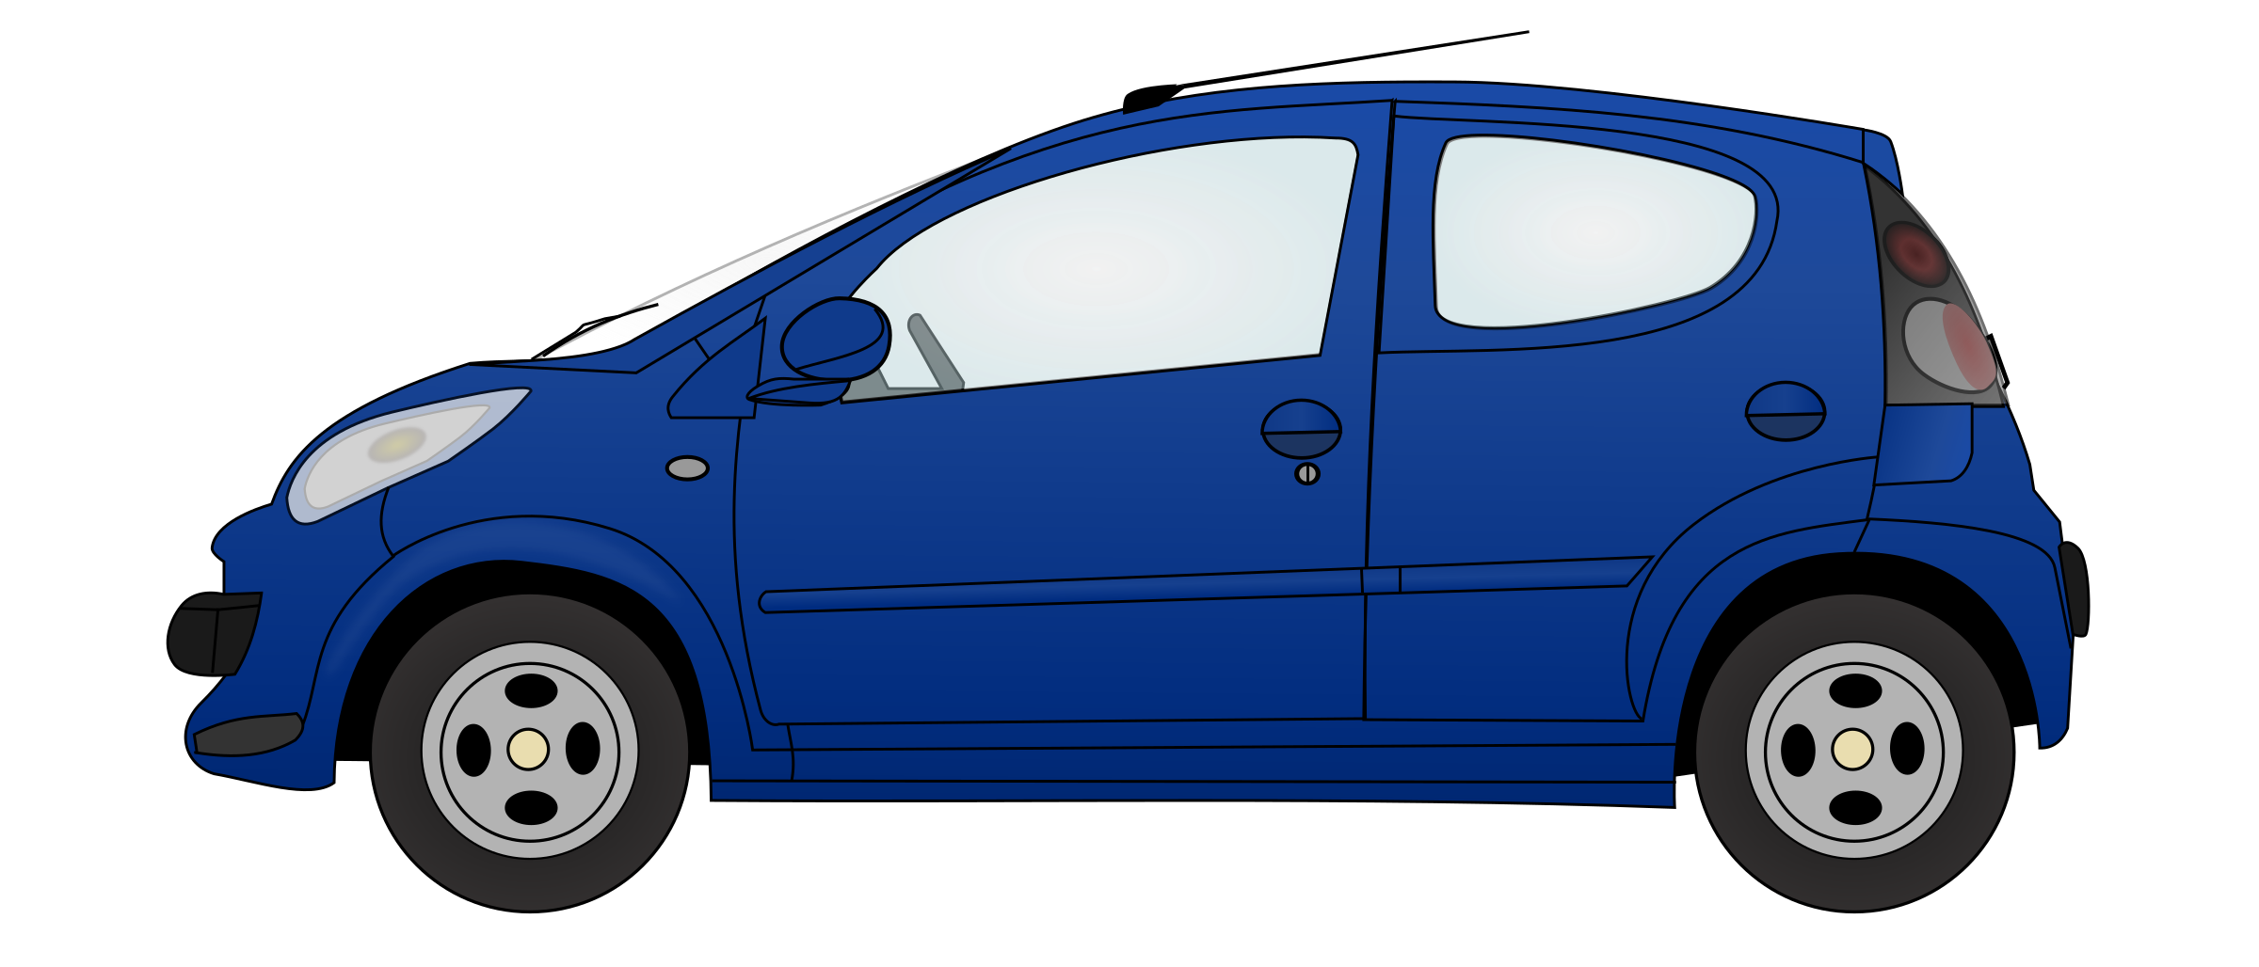
Uploading Data
Data is on the Raspberry Pi, but how do we send it to the server?

Slide 10
Apache NiFi to the rescue!
Visual Template Flow
Easy Data Transformation
Easy to get data from Point A to Point B
Notes:
Site to Site transmission
Ensures one time delivery: Data is not being reproduced along the way
Data Buffering for IoT devices
Visual Template flow which is uncommon in this space
Easy Transformation from one data format to another
Easy to get data from Point A to Point B

Slide 11
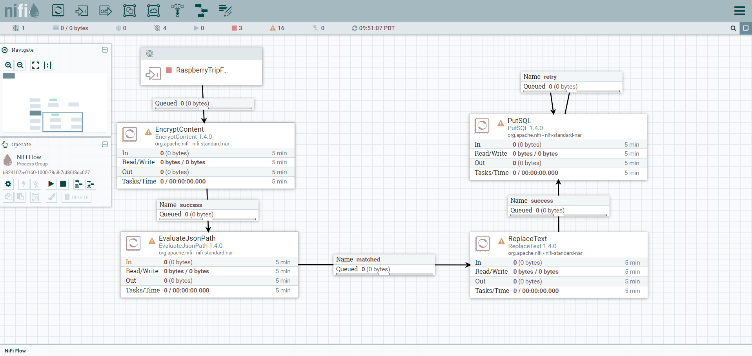
Network Implementation - Apache NiFi

Slide 12
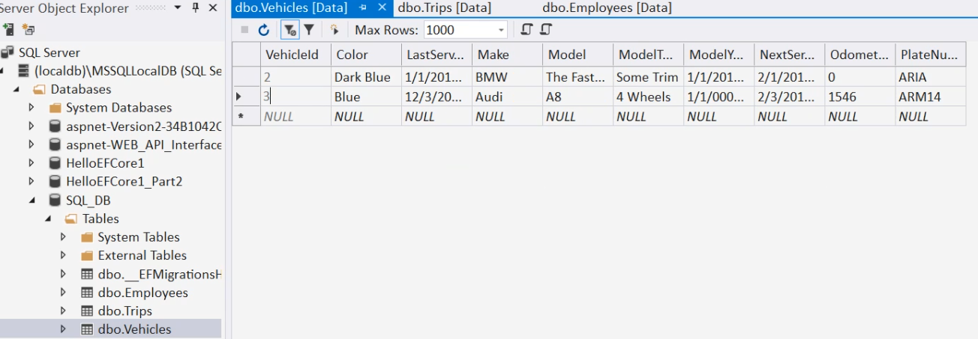
Web Application - MSSQL Database

Slide 13
Web Application - Back End
MSSQL Server
Transact SQL
Required admin set ups
.NET Core 2.0
Service used for the backend
Platform Independent Web API
Entity Framework Core 2.0
Translates C# to SQL Queries
Abstraction through Language Integrated Query
Notes:
Problem Statement: A. Persist Data B. Access Data C. Modify Data
Solution: We need a framework that gives us the tools to create a REST API and Persist Data
.NET Core Introduction: Free and Open Source Web Framework (it is modular)
Entity Framework Core Intro: Entity Framework is an object relational mapping module in .NET Core
Linq Intro

Slide 14
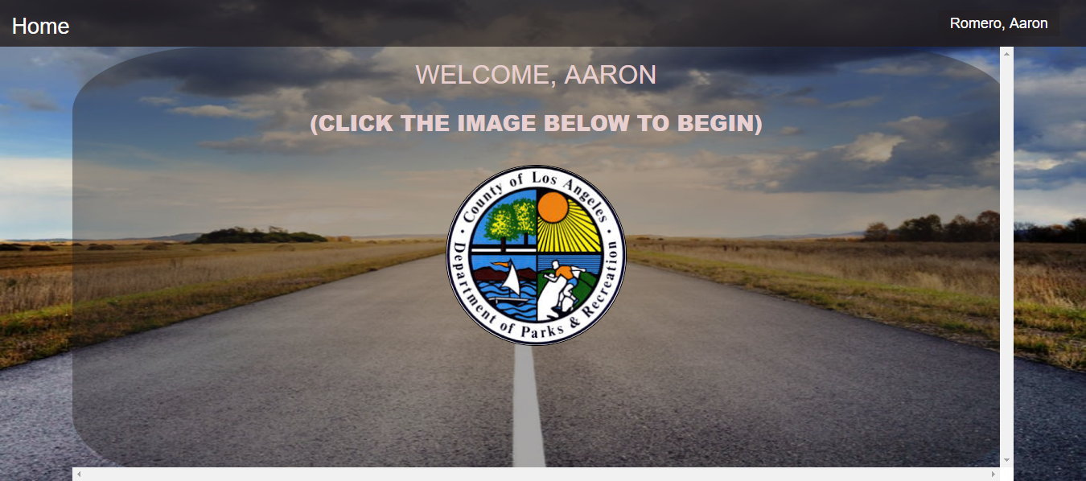
Web Application - Driver

Slide 15
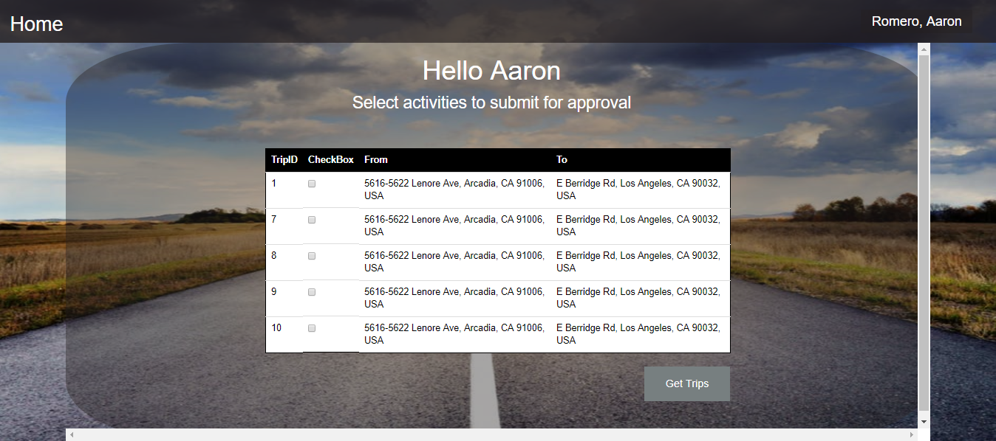
Web Application - Driver continued…

Slide 16
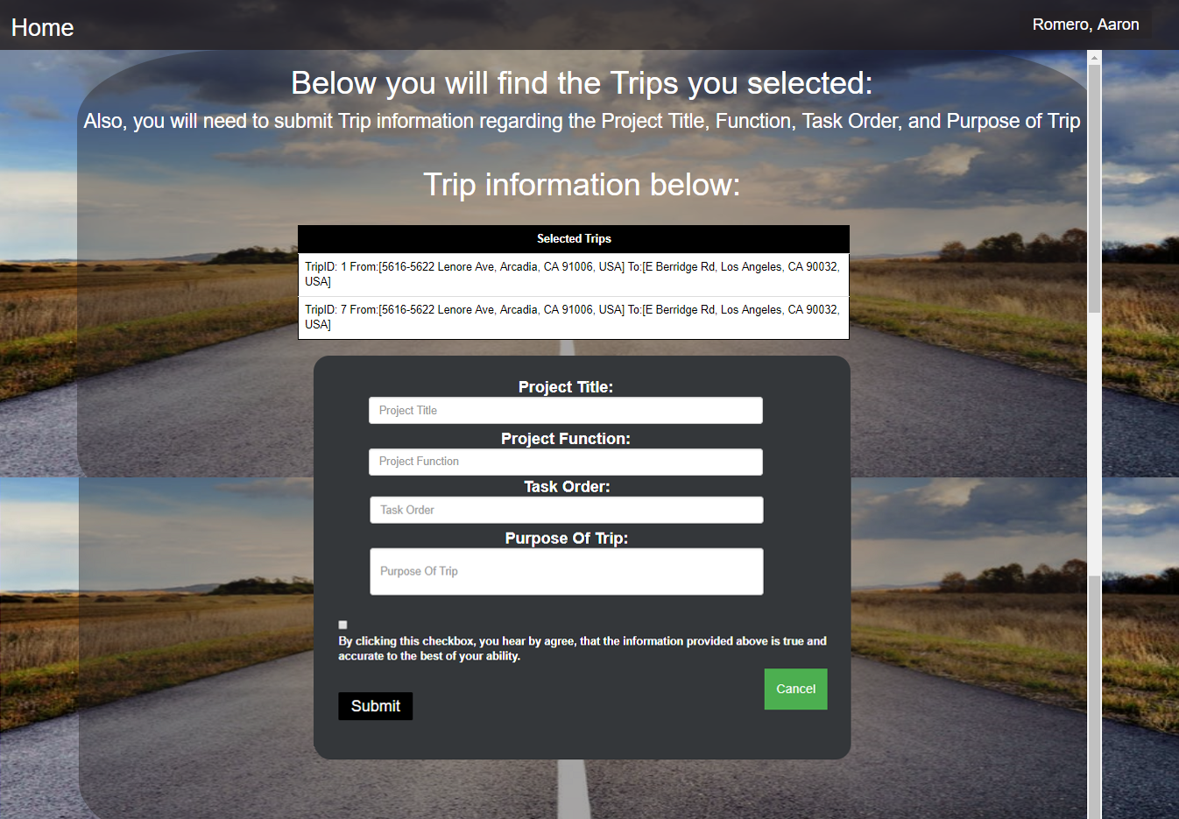
Web Application - Driver continued…
This page will show the Driver the trips they selected
Fill out form data for the trips they selected

Slide 17
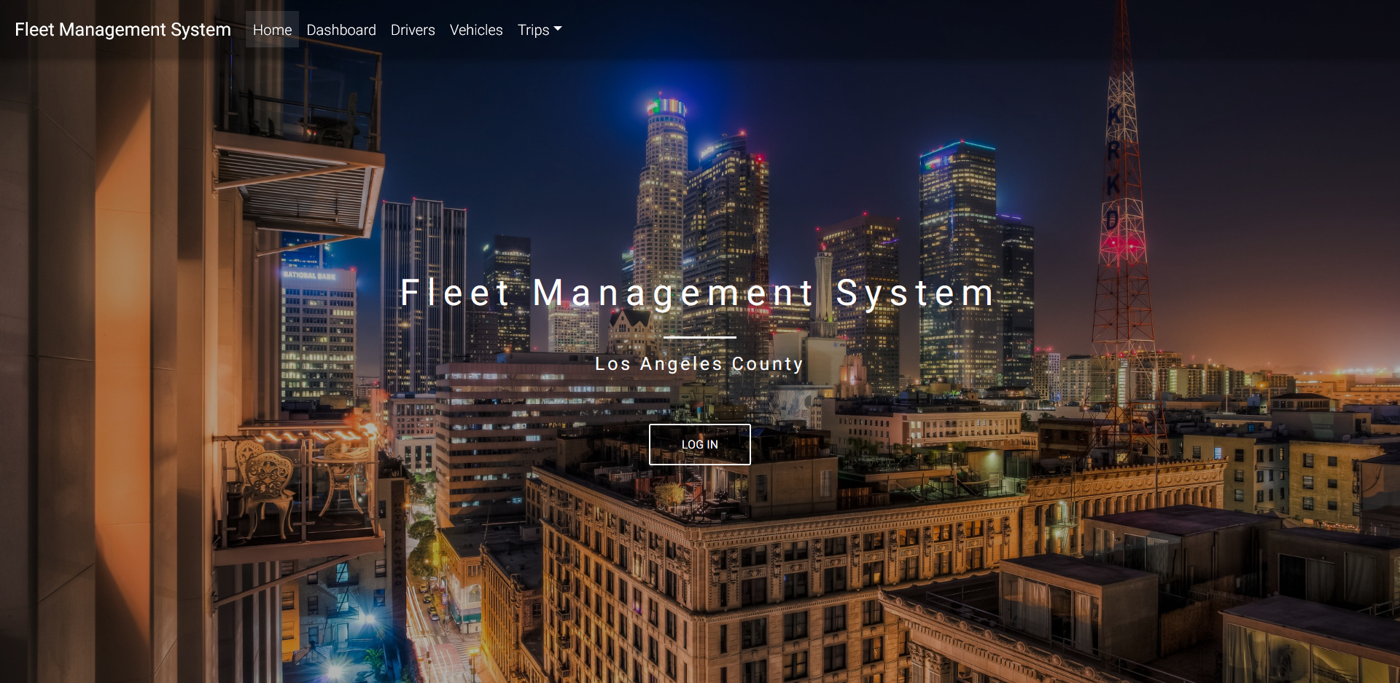
Avik Ghazarian

Slide 18
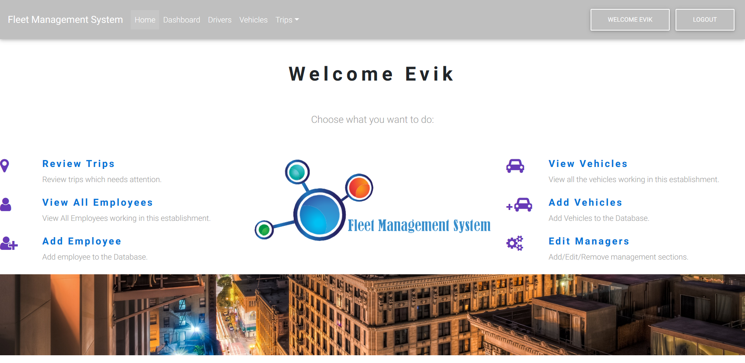
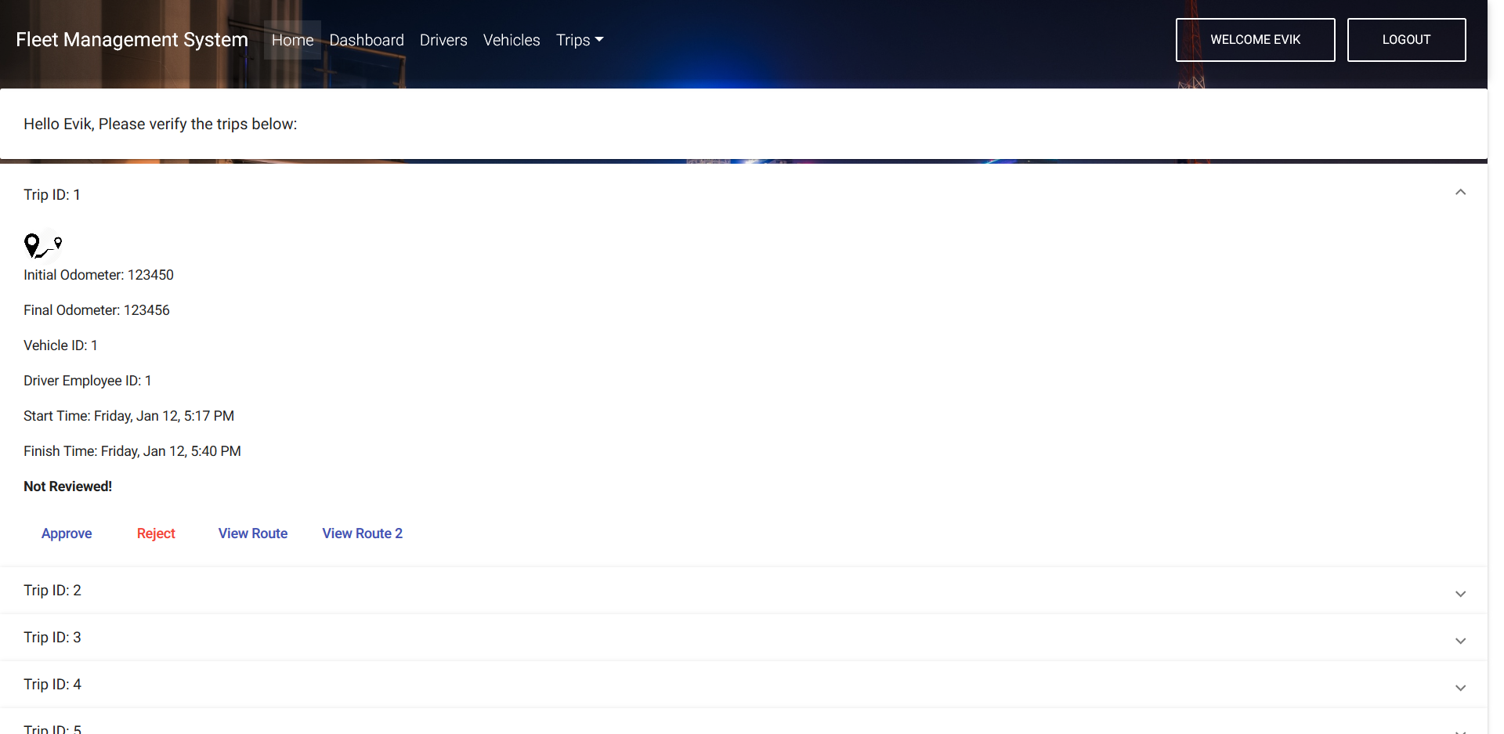
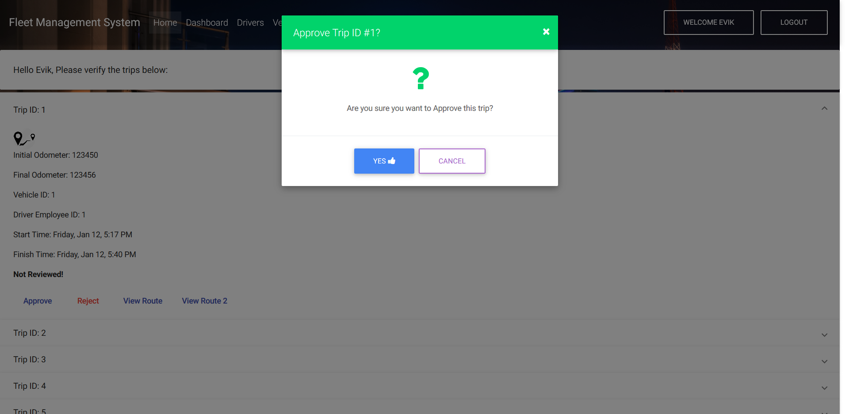
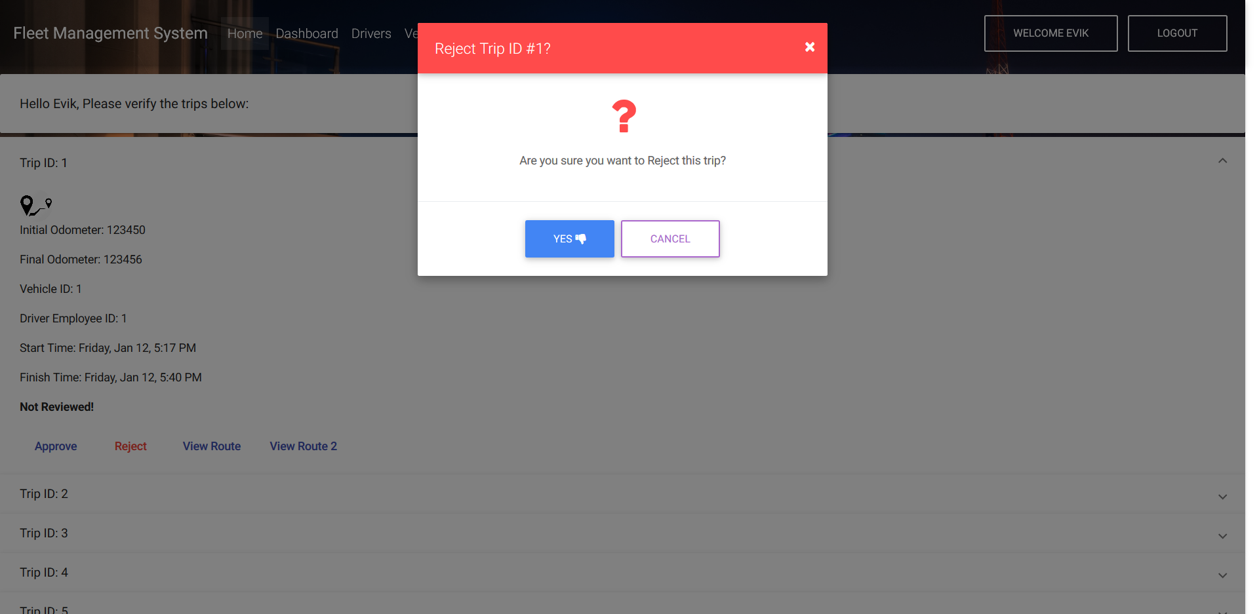
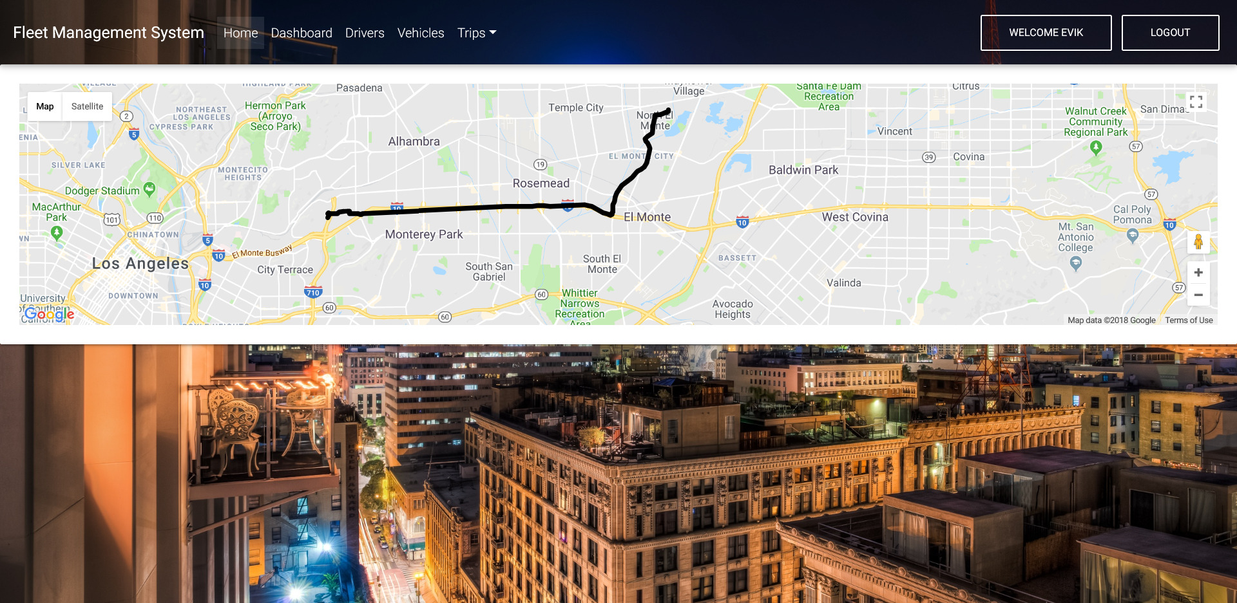
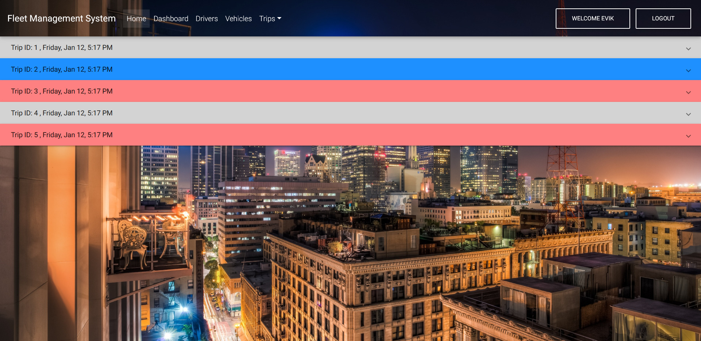
Avik Ghazarian

Slide 19
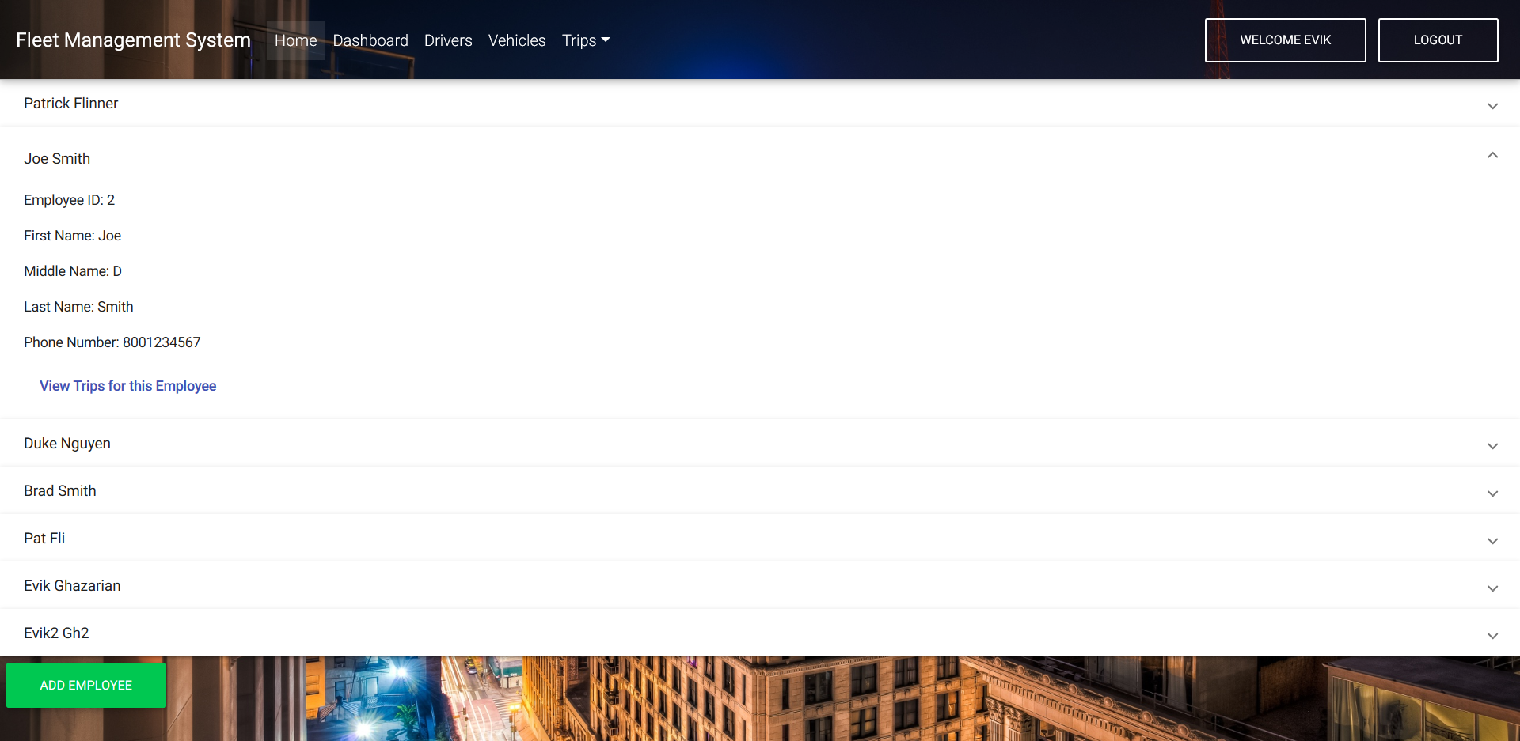
Avik Ghazarian

Slide 20
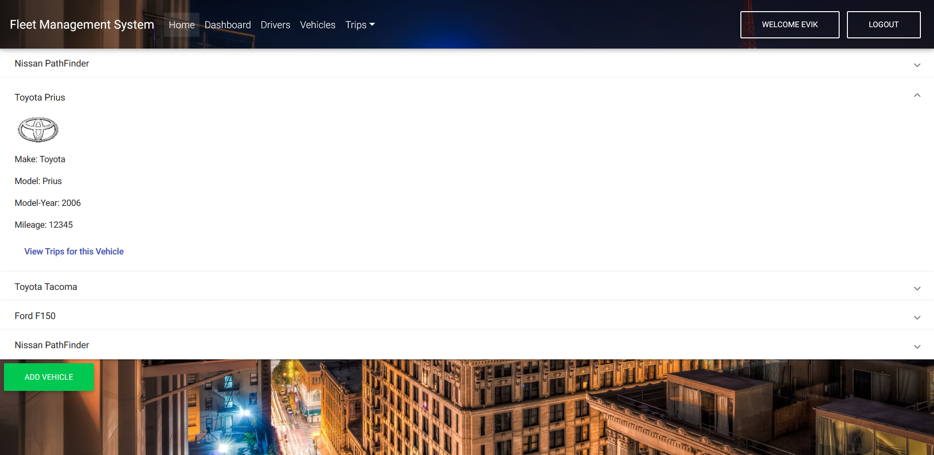
Avik Ghazarian

Slide 21
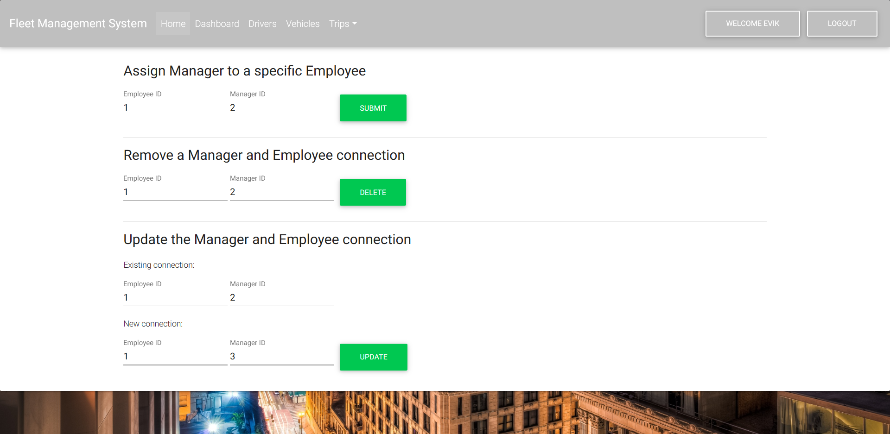
Avik Ghazarian

Slide 22
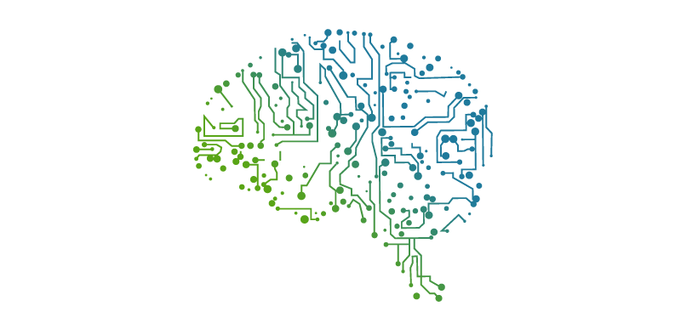
Future Plans
Report generation system for web application
Maximo Integration: Machine Learning to determine when a car will break down
Prevent Vehicle from starting without proper identification
Notes:
The Maximo Integration Framework (MIF) is an integral part of the Tivoli Process Automation Engine (TPAE) that allows the synchronization and integration of data and of applications between TPAE and external systems in real time or batch mode by using a variety of communication protocols.

Slide 23
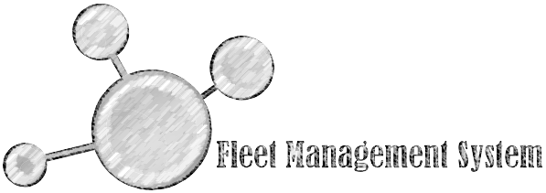
Questions?
Comments?
Thoughts?

