Slide 1
Immersive Storytelling with Engaging Physical Actions
Advisor : Dr. David Krum
Institute for Interactive Arts, Research, and Technology (INART)
Notes:
Good morning everyone, the senior design project for our group is Immersive Storytelling with Engaging Physical Actions

Slide 2
Meet the Team 👋
Anthony
Viramontes
Document Lead
Joseph
Chong
Level Designer / Programmer
Jimmy
Hernandez
Sound Engineer /
Programmer
Edwin
Hernandez
Lead Artist /
Programmer
Jaquan
Jones
Sound Engineer /
Level Designer
Alberto
Landeros
Sound Engineer /
Level Designer
Tony
Lee
Sound Engineer /
Level Designer
Jennelle Maximo
Sound Engineer /
Level Designer
Eduardo Meza
Test Programmer
Dean
Nguyen
Concept Designer
Notes:
Our group consists of 10 students,
Myself … and …

Slide 3
Immersive Storytelling with Engaging Physical Actions
Project Sponsor/Liaison:
Institute for Interactive Arts, Research and Technology (InART)
Faculty advisor: Dr. David Krum
Notes:
Our project sponsor is the Institute for Interactive Arts, Research and Technology, or InART
Our faculty advisor is Dr. David Krum.

Slide 4
Agenda
Project Overview & Backgrounds
Project Technologies
Project Challenges
Functional Requirements
Non-Functional Requirements
Current Progress & Future Goals
Notes:
We have a lot of ground to cover during this presentation,
We’re going to start by giving you a project overview and share the ideas that we’ve come up with so far,
Then we’ll talk about some of the technologies that we will be using to make our project a reality,
We have some challenges to go over,
Project requirements,
And lastly, we will share our current project status and our goals moving forward.

Slide 5
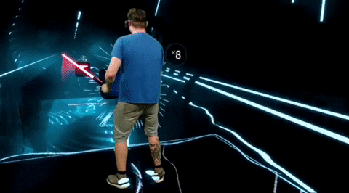
About our Project
Jimmy
Immersive Experience in VR
Story telling about Immigrants
3 different stories
Experience first generation immigrants
Gestures
Notes:
Create a immersive experience about the life of immigrants: ones such as Mexican, Vietnamese, etc. Gestures used. Talk about the 3 different stories

Slide 6
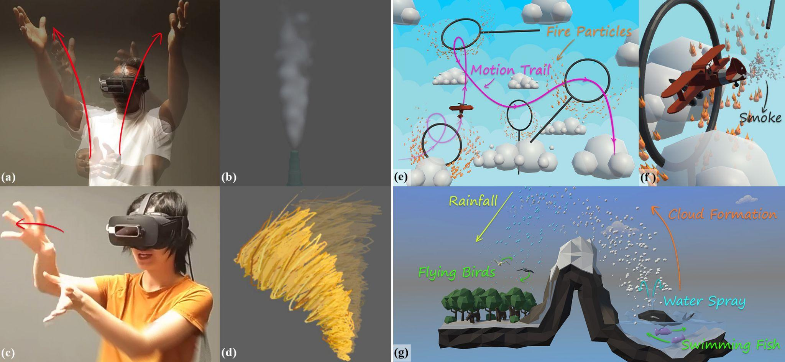
About our Project
Jimmy
Gestures Must be used
Notes:
Brief explanation how gestures play a role

Slide 7
Experience #1 : Street Food Vendor
Jennelle
Inspiration from team members’ backgrounds
Set around the 1970’s, the end of the Vietnam War
Street food vendor must earn enough cash to leave Vietnam and reunite with family abroad.
Photo by Frankie Shutterbug on Unsplash
Notes:
THIS CAN BE QUICK, SIMPLE EXPLANTION IS FINE,

Slide 8
Experience #1 : Street Food Vendor
Jennelle
Gameplay is to perform several cooking tasks such as preparing Pho bowls for oncoming customers.
Similar to that of Cooking Mama
Allows many cooking gestures
Emotional Takeaway
See how food connects people
Understand the background & results of emigration
Poverty
Family Reunification
Photo by Lightscape on Unsplash

Slide 9
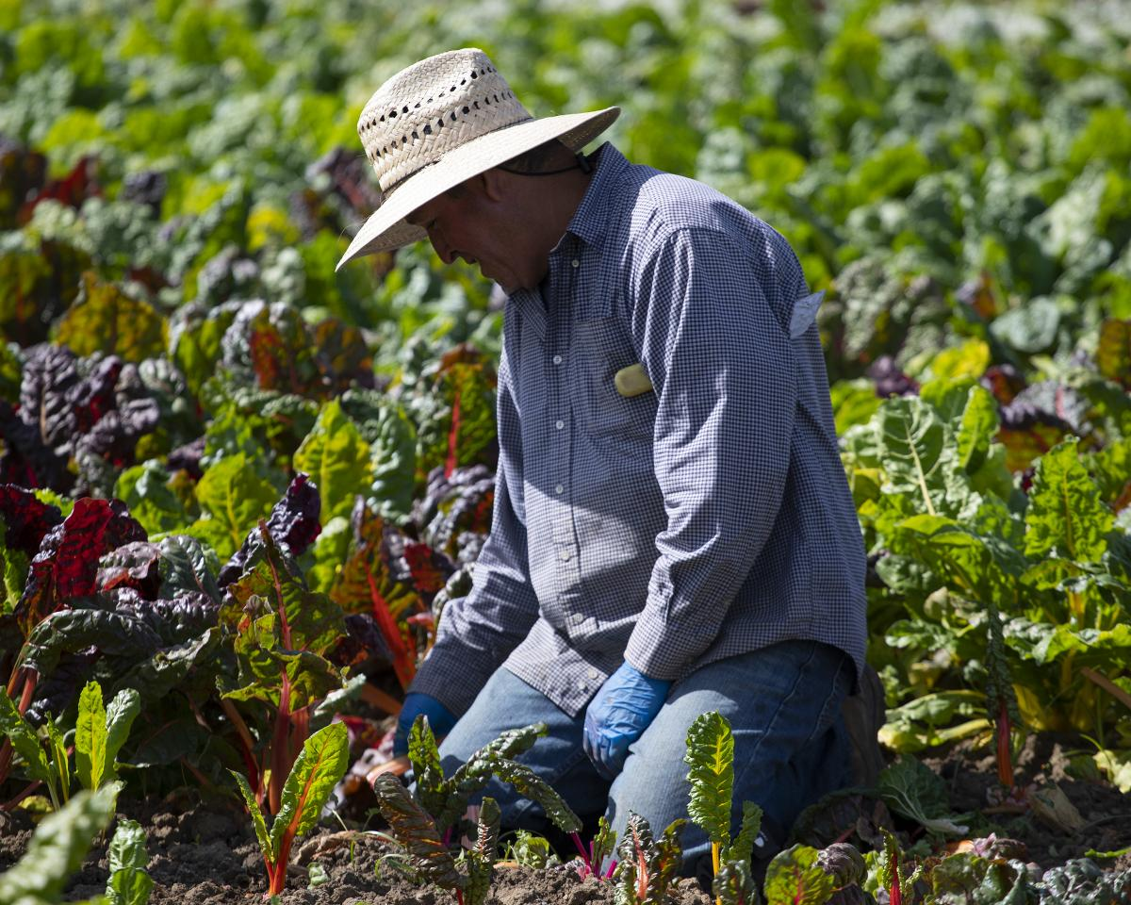
Experience #2 : Farm/Jail Story
Anthony
Mexican Immigrant working in farm
Horrible Boss
Notes:
Explain basic story of this level, PREFER SOMEONE WHO IS DOING THIS LEVEL

Slide 10
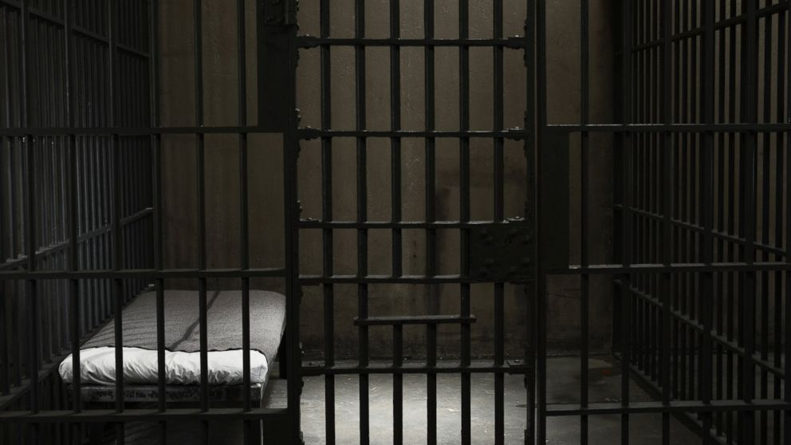
Experience #2 : Farm/Jail Story
Anthony
Taken to Jail
Use Gestures to communicate
Different Endings based on communications

Slide 11
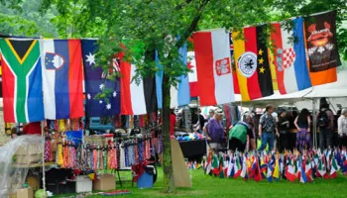
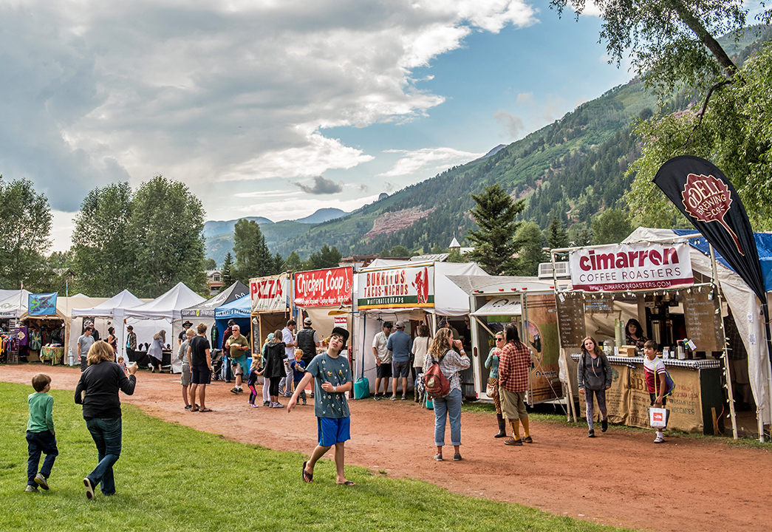
Experience #3 : Festival Story
Dean
Joyful celebration of the global multicultural community
Booths and activity areas
Notes:
(Copied from SDD, needs rewrite for speaking)
Raising awareness of refugee groups through a joyful celebration of the global multicultural community, featuring music, food, art, and fun.
Outdoors, assortment of booths and activity areas.The time is night or sunset with many lights to promote a lively atmosphere.

Slide 12
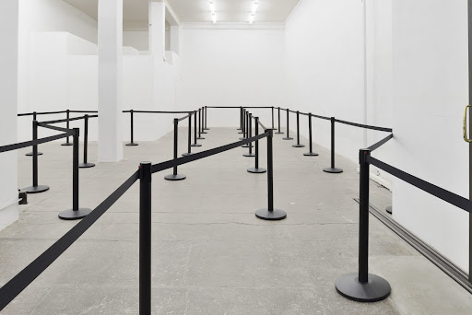
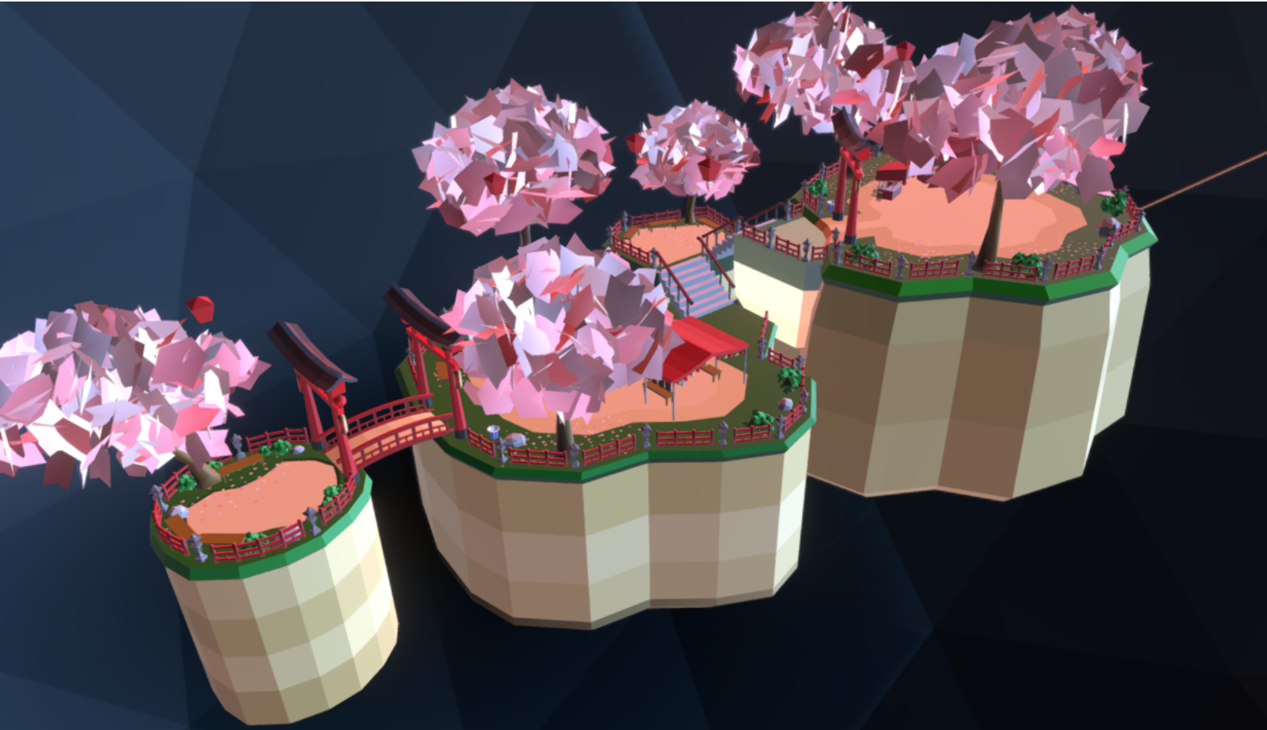
Festival - Storytelling and Player Experience
Dean
Give player an interactive educational experience
Player can visit and interact booths
Certain booths are minigames
Objective: Reach the “end” of the event
Progress through two mini checkpoints
Illusion of choice, semi-scripted path
Single walkway
Player is asked to participate
NPC’s can help the player
Suggestions
Notes:
(Copied from SDD, needs rewrite for speaking)
The player is free to roam the environment and explore the festival offerings; however, all interactions are limited to the scope of the following storyline narrative interactions.

Slide 13
Festival - Checkpoints
Dean
Arrival
Minigame A: Flyer
Minigame B: Maze
End
Notes:
(Needs work)
The level starts with the player in the middle of an interaction with a ticket booth attendant near the entrance of the festival grounds. The attendant welcomes the player to the event and recommends that the player visit the three most popular attractions at the festival. (The three attractions will be the interactive elements of this festival level.)
The player is then free to enter the festival, the level is structured so that the three minigames must be played at least once before the end of the night can occur.
At the end...

Slide 14
Festival - Themed Minigames
Dean
Minigames are themed to an aspect related to different refugee groups
NPC’s can share news or stories regarding their particular struggles
Minigame A: Flyer
Theme: Syrian crisis (childrens’ kites)
Minigame B: Maze
Theme: Latin American migrant caravans (train yard)
Notes:
(Needs work)
The three mini games that are available to the player have been themed to an aspect that relates to different refugee groups.
As the player navigates through the festival, they have the opportunity to meet with NPC’s that can share their stories, news, or experiences regarding their struggles.
Minigame A: Flyer
Theme: Syrian crisis (childrens’ kites)
Minigame B: Maze
Theme: Latin American migrant caravans (train yard)
Minigame C: Target arena
Theme: ???

Slide 15
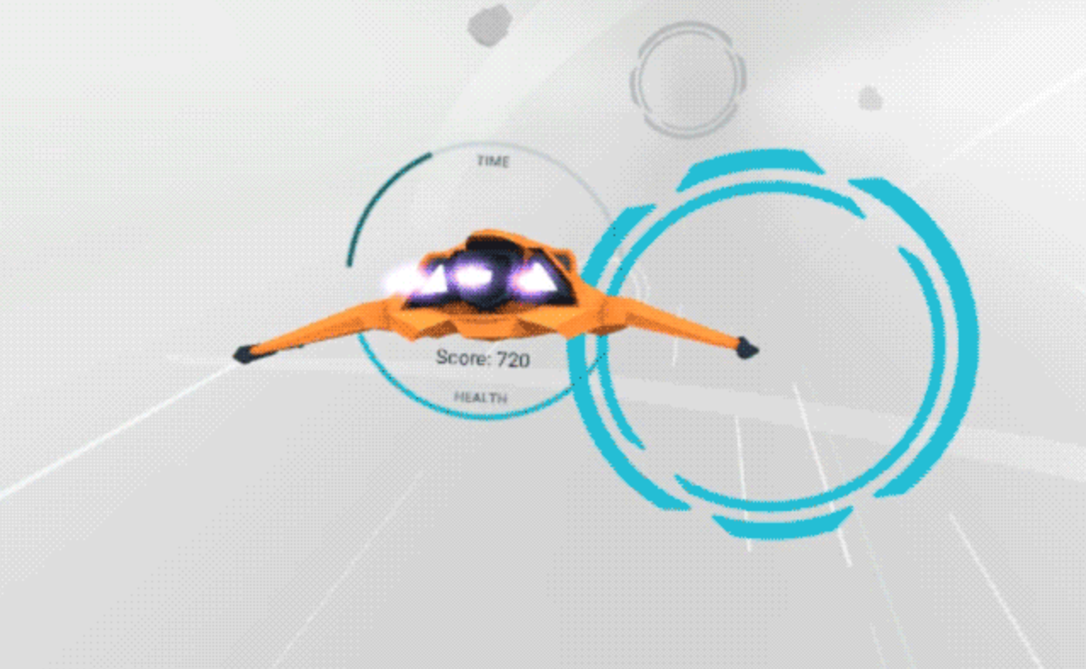
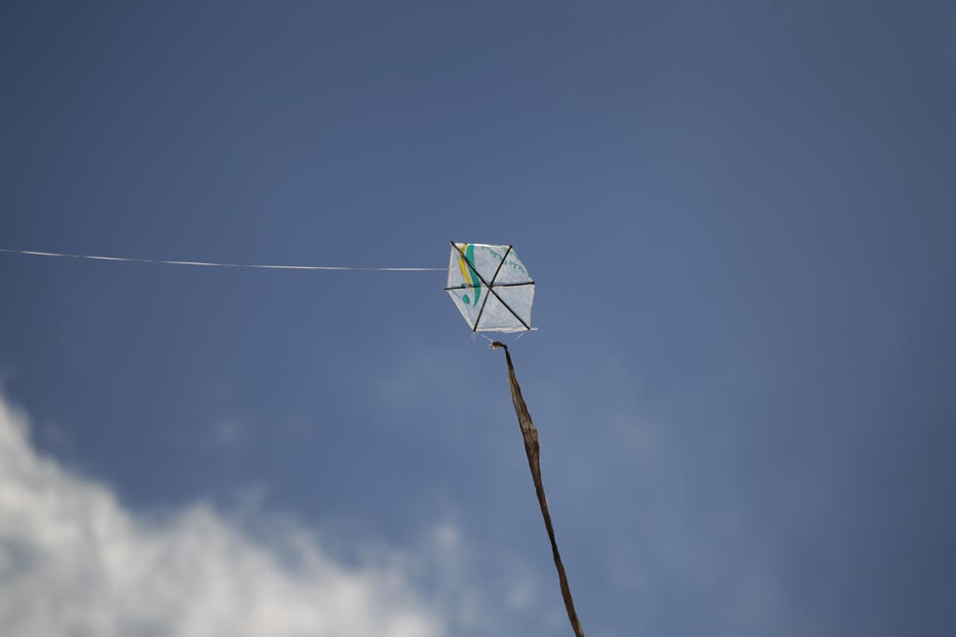
Festival - Minigame A
Dean
Flyer (Themed to kites)
Shoot kites (with burst of air) to keep them elevated
Points awarded on various actions
Notes:
(Copied from SDD, needs rewrite for speaking)
Minigame A, Flyer (Syrian kites): The player guides a flying object while shooting (wind) to elevate kites that are slowly descending in elevation. The player gains points depending on how high and how many kites are flying after a certain amount of time.

Slide 16
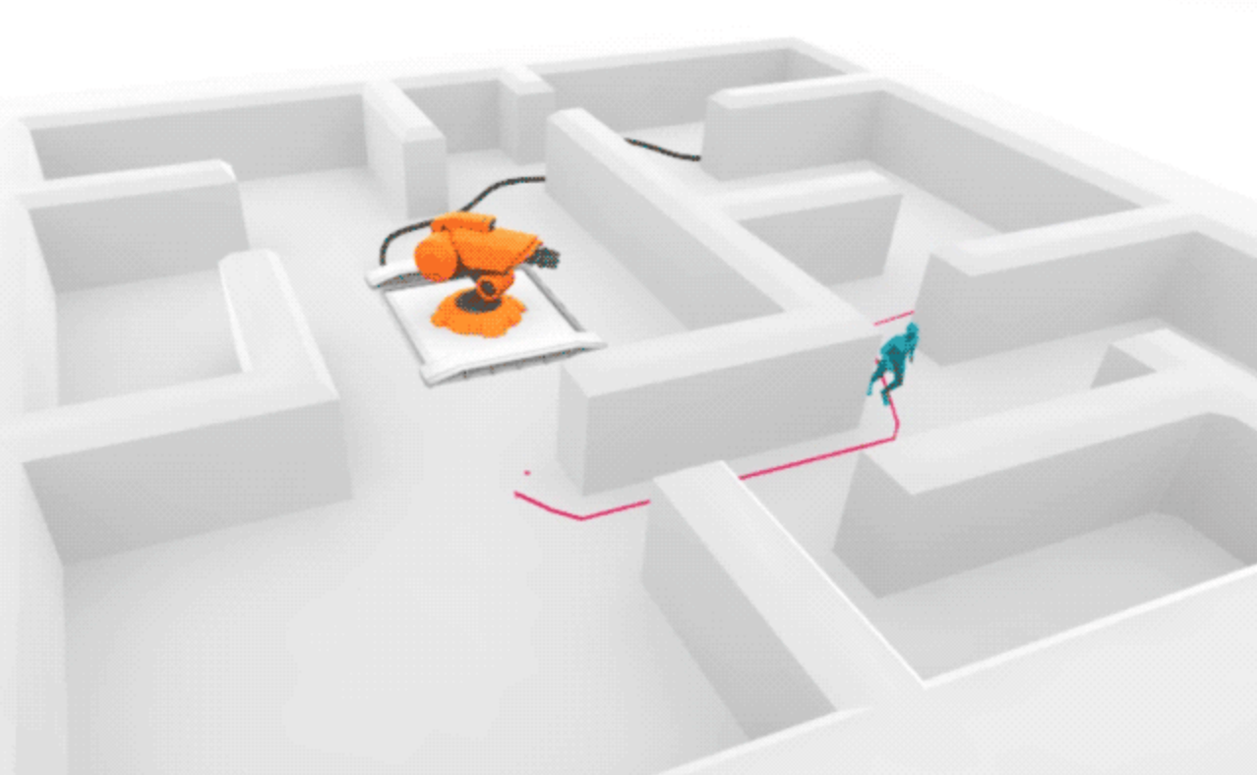
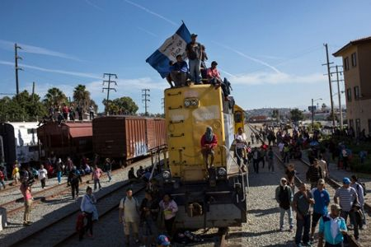
Festival - Minigame B
Dean
Maze (Themed to train yard)
Top-down view
Guide player around obstacles and moving hazards
Notes:
(Copied from SDD, needs rewrite for speaking)
Minigame B, Maze (Train yard): The maze is a top-down-view game that uses a combination of head tracking and button input to guide a character to safety out of a train yard without being caught by a stationary enemy.

Slide 17
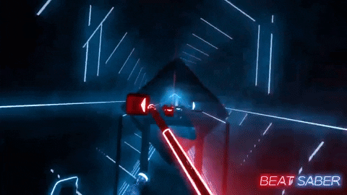
Technologies: Software
Tony
Unity based
Examples:
Beat Saber
Superhot
Phasmophobia
Blender
Notes:
Describe why the game is Unity based, give examples of games that are Unity based. Blender to use for in case we need to make our own assets

Slide 18
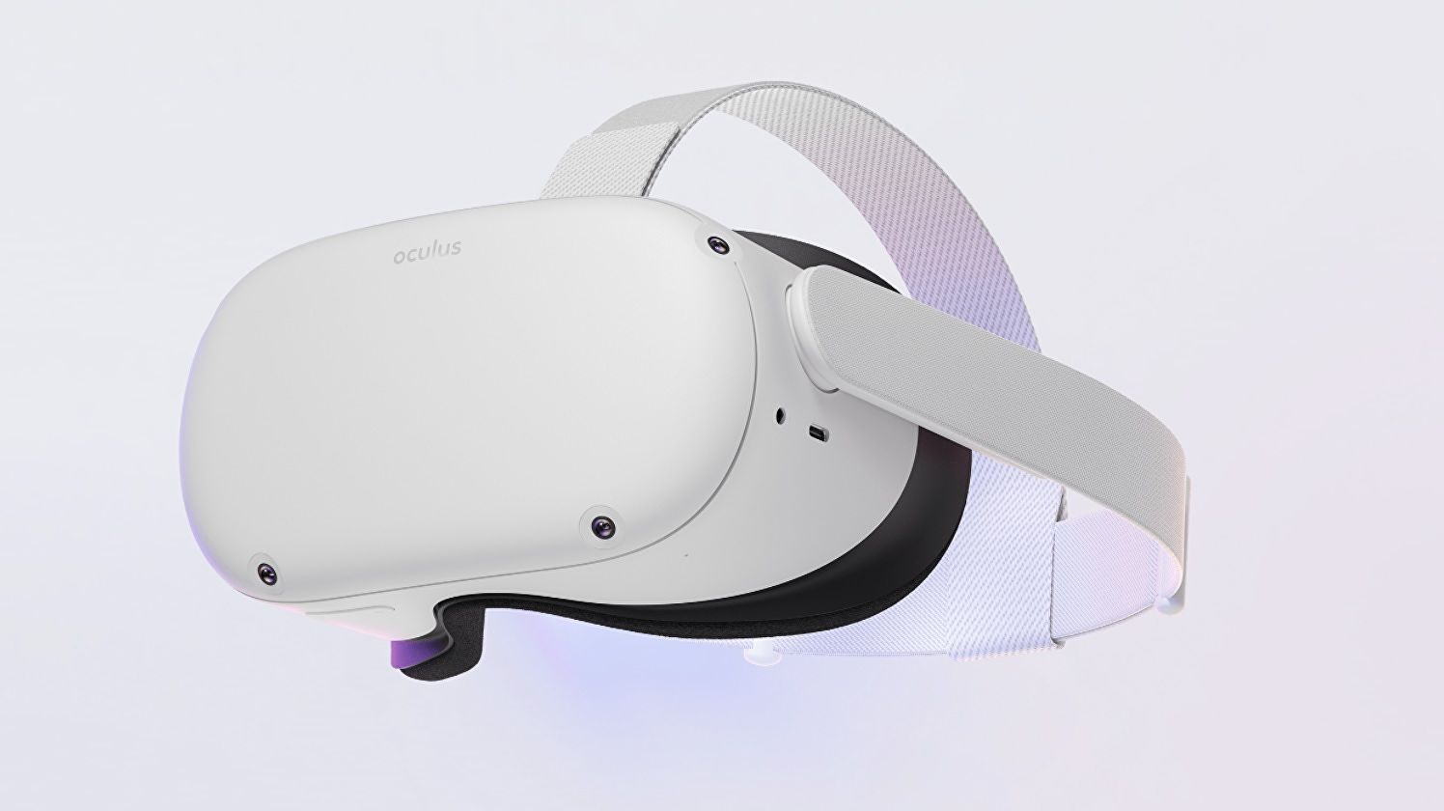
Technologies: Hardware
Tony
Notes:
Oculus Quest 2, seems the most optimal

Slide 19
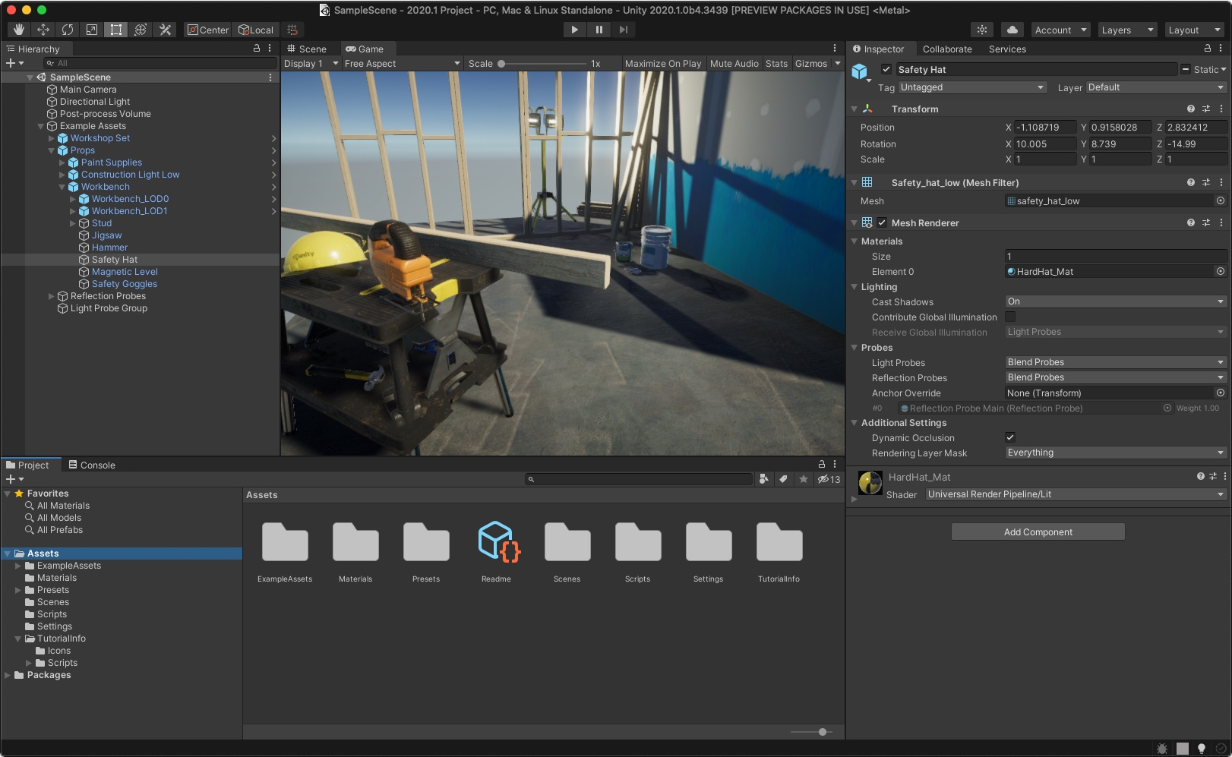
The Problems and Challenges
Alberto
Learning the controls of Unity
Needed assets not available
Notes:
Stepping on new grounds of Unity. Unity assets may not be available from Unity Asset Store. Explain how to solve these, time and Blender to create new assets

Slide 20
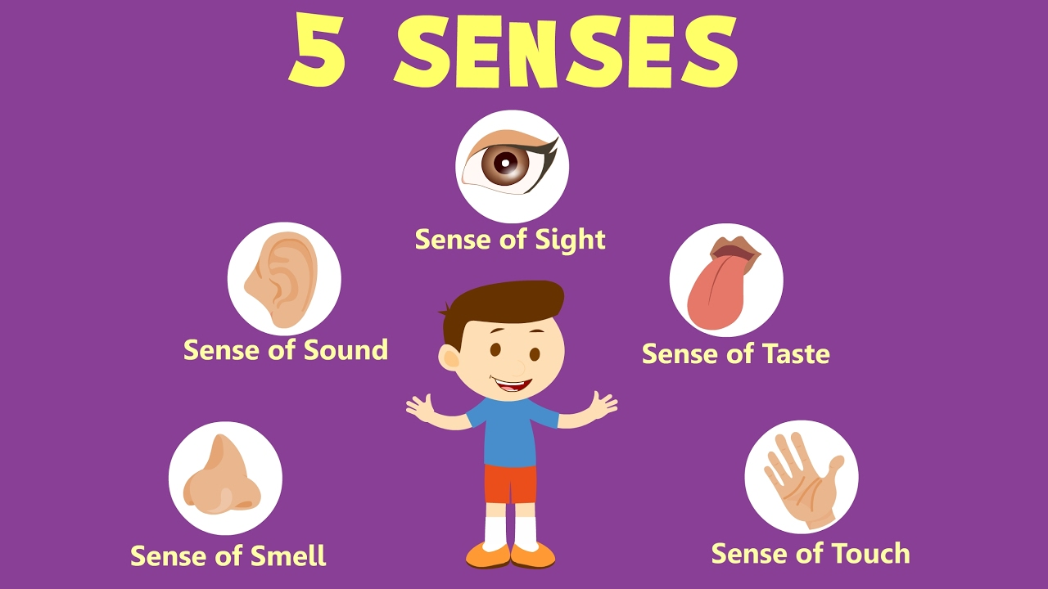
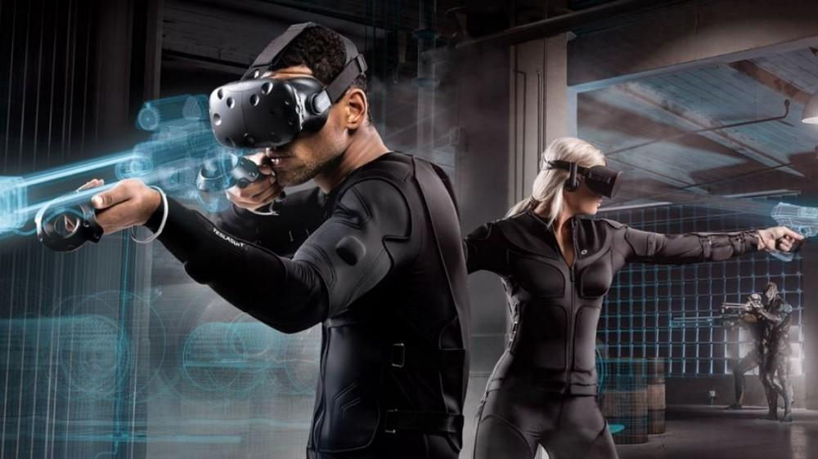
The Problems and Challenges
Alberto
Immersion
Notes:
Talk about the 5 senses and how they play a role with immersion. Decent Actors, graphics need to be as clean as possible, movement needs to be smooth, grabbing objects need to be smooth

Slide 21
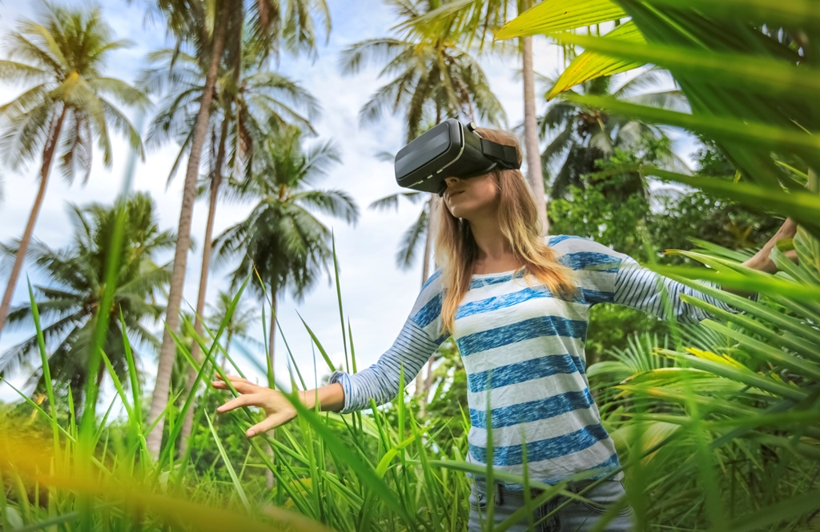
Functional Requirements
Edwin
Environment
Interactable Objects
4 Different Scenes
Proper Scale
Sound
Adjust Volume
Distinct Sounds for Events
BGM
Sound Effects
Lighting
Adjust Brightness

Slide 22
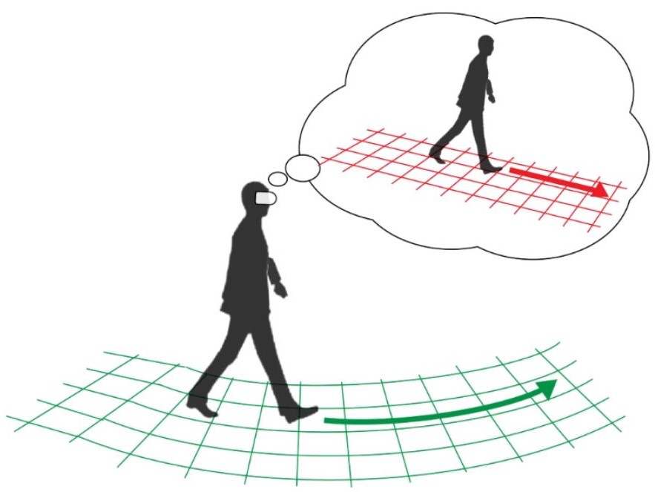
Functional Requirements
Edwin
Performance
Be Free of Bugs
Run smoothly
Design
Locomotion
Options Menu
Gestures

Slide 23
Non-Functional Requirements
Joseph
Performance
Single Player
Realistic as possible
User Friendly
Safety
Optimal Space for User
Security
None since Security is based on the existing Software we have no control of
Notes:
Explain each non functional Requirements as much as possible

Slide 24
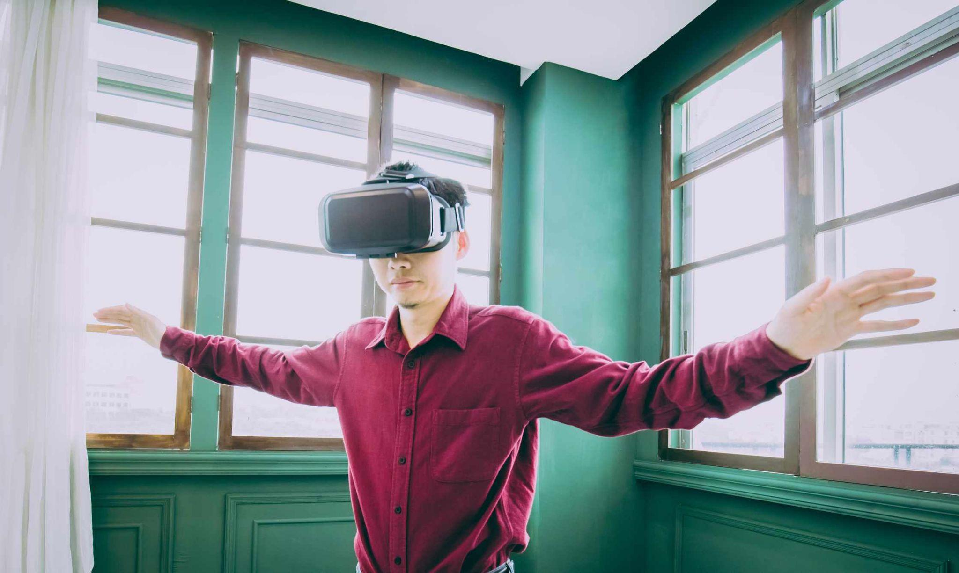
Non-Functional Requirements
Edwin
Software Quality Attributes
Available to all VR Headsets
Target Focus is Oculus Quest

Slide 25
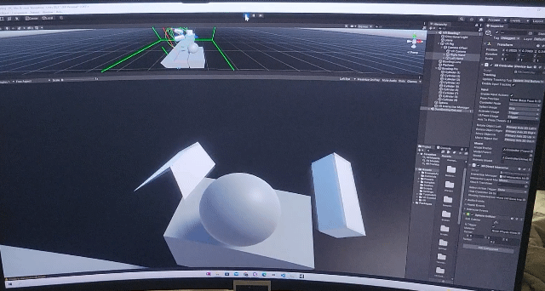
Progress so far
Jaquan
Notes:
Explain basic Progress of demo

Slide 26
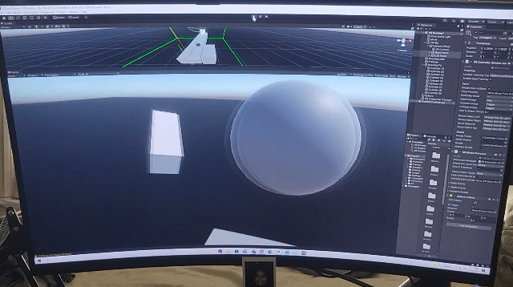
Progress so Far
Jaquan
Basic Movement Implemented
Basic Camera Controls Implemented
Notes:
So following the designing and planning, the programming progress we’ve accomplished so far has primarily been testing basic user movement and camera controls
For camera control we’ve so far implemented 3 VR camera rigs.
The first camera rig is connected to the Oculus headset. To test that VR camera rig worked correctly in tracking head movement while wearing the headset, we tested that when the user rotated their head, the camera view in the game simultaneously rotated proportionally in the same direction.
Similarly, we implemented camera rigs for each handheld controller connected to VR. To test the tracking and basic movements of each controller in the user’s left and right hand, we used material geometrics shapes to represent each hand, confirming that each shape moved proportionally with the movement of each handheld controller.
Lastly, to test general object interaction in the settings, we also simulated a virtual bowling lane. We Created geometrical box shapes representing bowling pins and a sphere representing the bowling ball and we then set up basic physics and collisions settings for the objects. After picking up the bowling ball and following up with the throwing motion and lettings go of the ball, the ball successfully moved toward and collided with the pins. Through this simulation, we were able to test out the basic grabbing motion that will be present in future interactions within the game’s levels.
Now im going to pass it to Eduardo.

Slide 27
Future Goals
Eduardo
Understanding Unity
Understanding Blender
Gestures to use
Notes:
Last, we would like to share our future goals as we continue to refine our goals and develop our project.
As Alberto mentioned earlier, at the start of the semester most of our group members had no previous experience with the Unity game development platform.
At this point in time we’ve since had the opportunity to get acquainted with, and practice using Unity.
What we have come to realize is that to fulfill the requirements we’ve set to make our immersive storytelling experience with engaging physical actions depends largely on importing visual and audio assets to create our worlds and scenarios.
What that means is we need to work with more than cubes, spheres, and non-textured polygons.
So our group is planning to acquire assets, ideally open source.
Our project vision is highly specialized, what I mean by that is that our gameplay scenarios are not typical, and going back to the challenges mentioned earlier, we have found that we will have to spend some time exercising our creativity skills by creating the visual assets ourselves using 3D modeling software, such as Blender.
And it also means that we will spend some time developing ways to track the physical gestures that implement the gameplay actions.

Slide 28
Thank you!
Any Questions?
Notes:
Thank you all for hearing our presentation.
We’ve covered a lot, and if anything in particular stood out to anyone, or you’d like clarification on anything, we’re all here and available to answer any questions at this time.

