Slide 1
Augmented Reality for Hydrology Version 2
Notes:
Our project is Augmented Reality for hydrology version 2, an android application that is designed to help teach users about hydrology, the study of earth's water, in their local area.

Slide 2
JPL Liaisons
Team Members
Mher Oganesyan - Team Lead
Leonardo Obay
Anthony Soto
Refugio Arroyo-Martinez
Gilberto Placidon
Dr. Elaine Kang - Advisor
George Chang
Natalie Gallegos
Emily Law
Shan Malhotra
Michael Rueckert

Slide 3
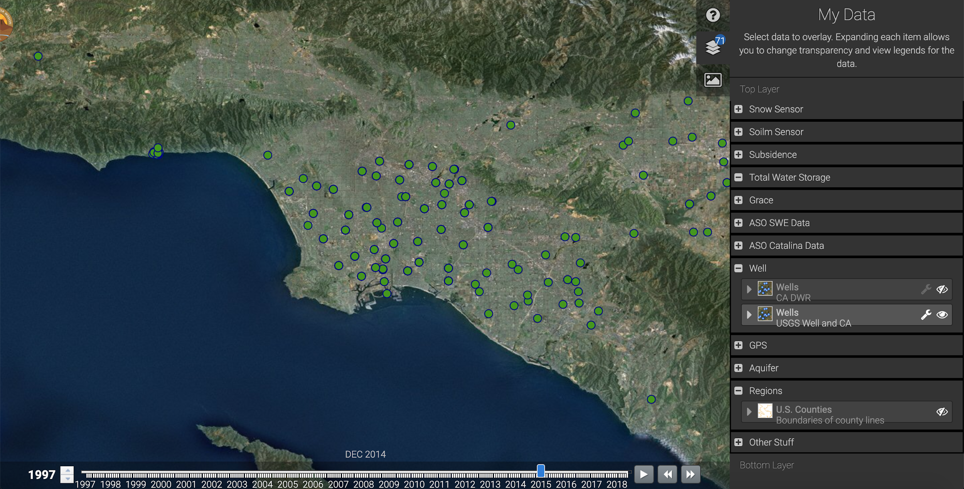
WaterTrek
WaterTrek is a Science Data System focused on hydrological datasets covering the western United States
Data is collected via sensors or calculated by mathematical models
Collected Data can be used to study hydrologic phenomena or to generate analytic reports
NASA WaterTrek web application (Location of wells being displayed)

Slide 4
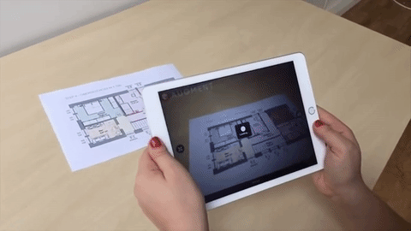
Augmented Reality and its components
Use of computer generated graphics to alter the users perception of the real world
Device
Computer Generated Graphics
Track Movement of Device
Source: https://www.chocolatemilkdonuts.com/
Presenter: Mher Oganesyan
Notes:
Movement of the deivce needs to be precisouly tracked

Slide 5
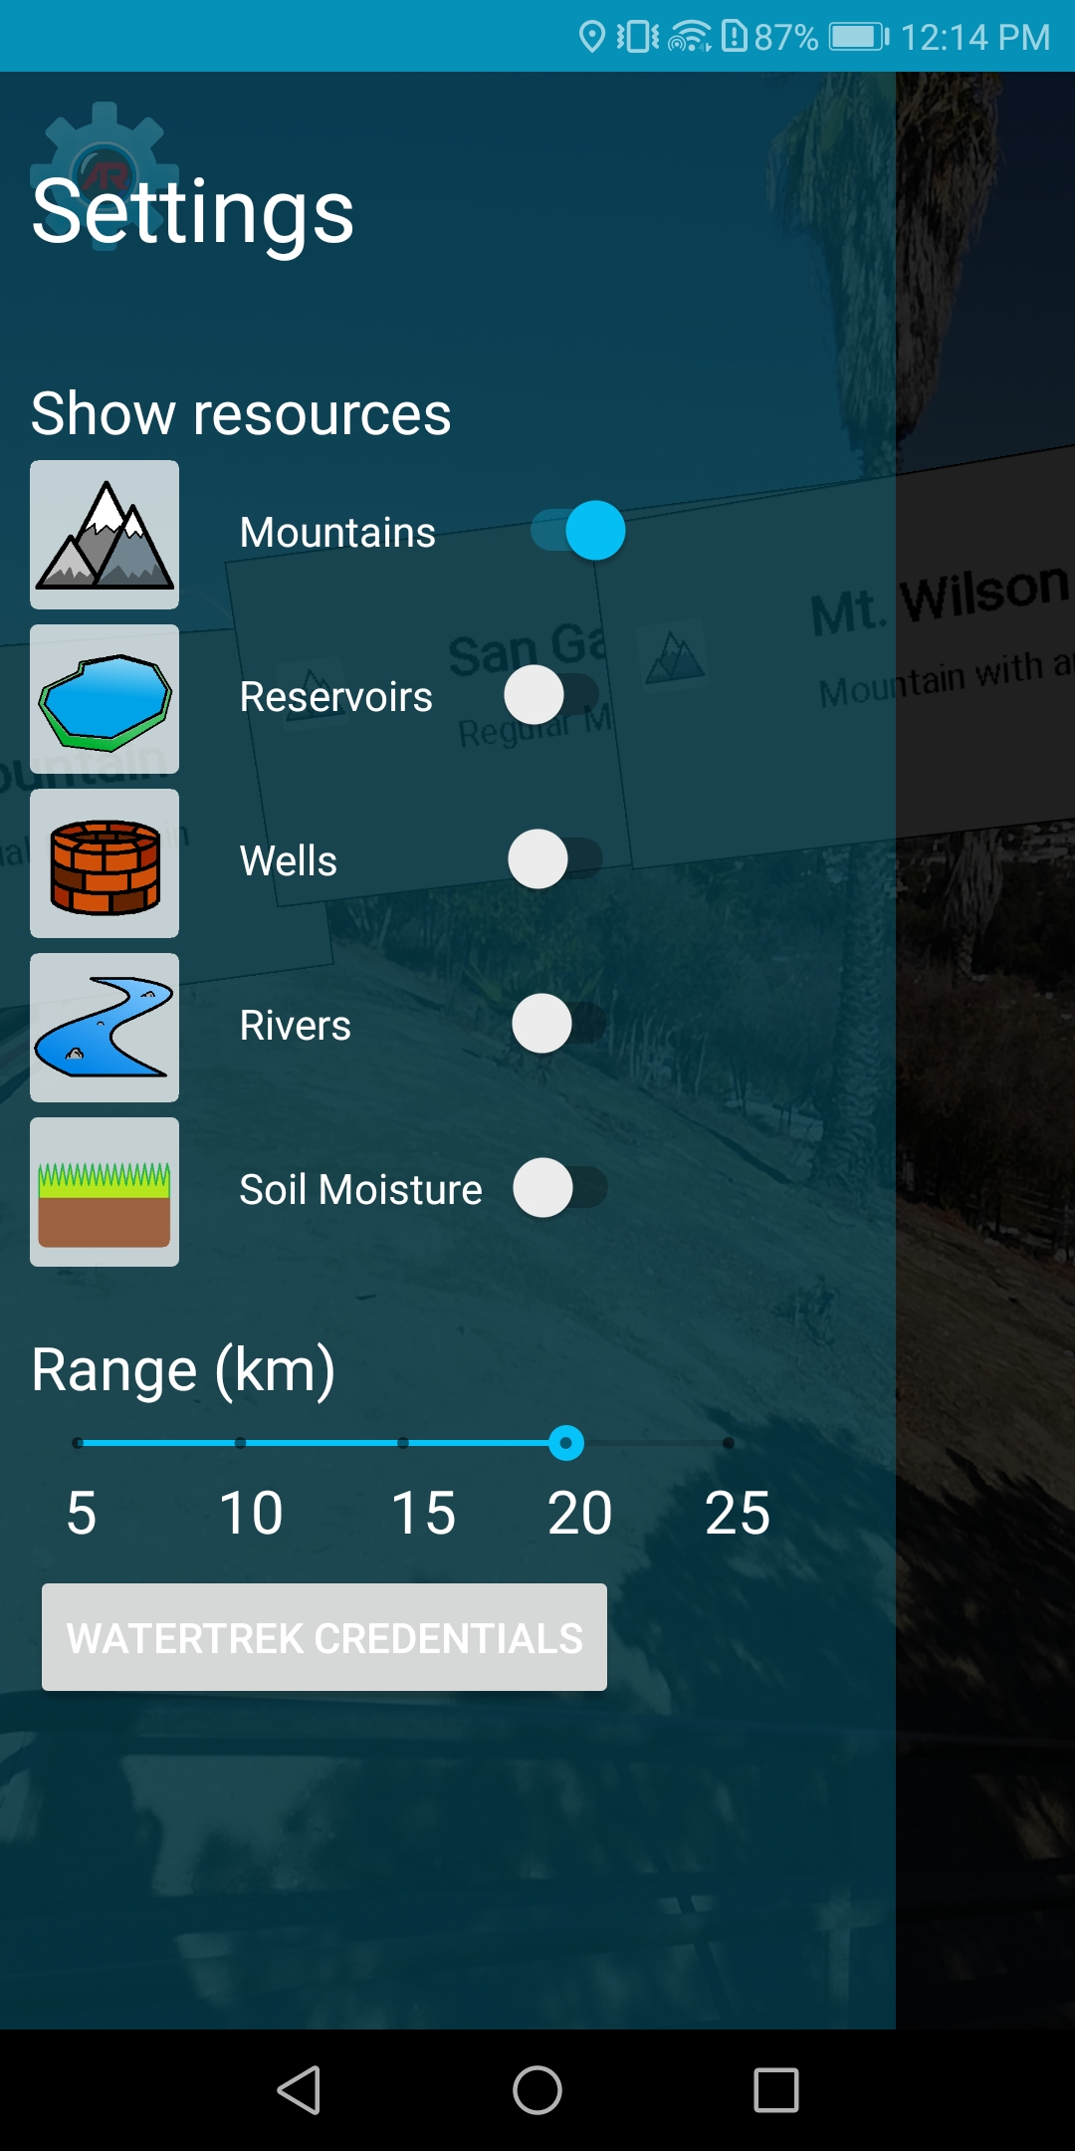
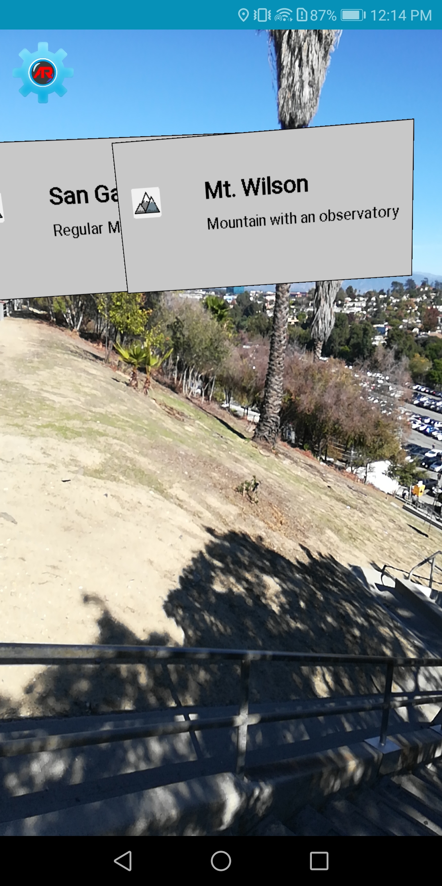
Version 1 of Application
Provided us with a framework for augmented reality and an application that:
Supports Android 5.0+
Uses gyroscope and GPS to figure out where the user is and where the device is pointing
Uses OpenGL to render objects to live camera feed
Handles network calls to the JPL servers
Handles internal database queries/storage
Data type selection/Settings
AR live camera feed
Presenter: Mher Oganesyan

Slide 6
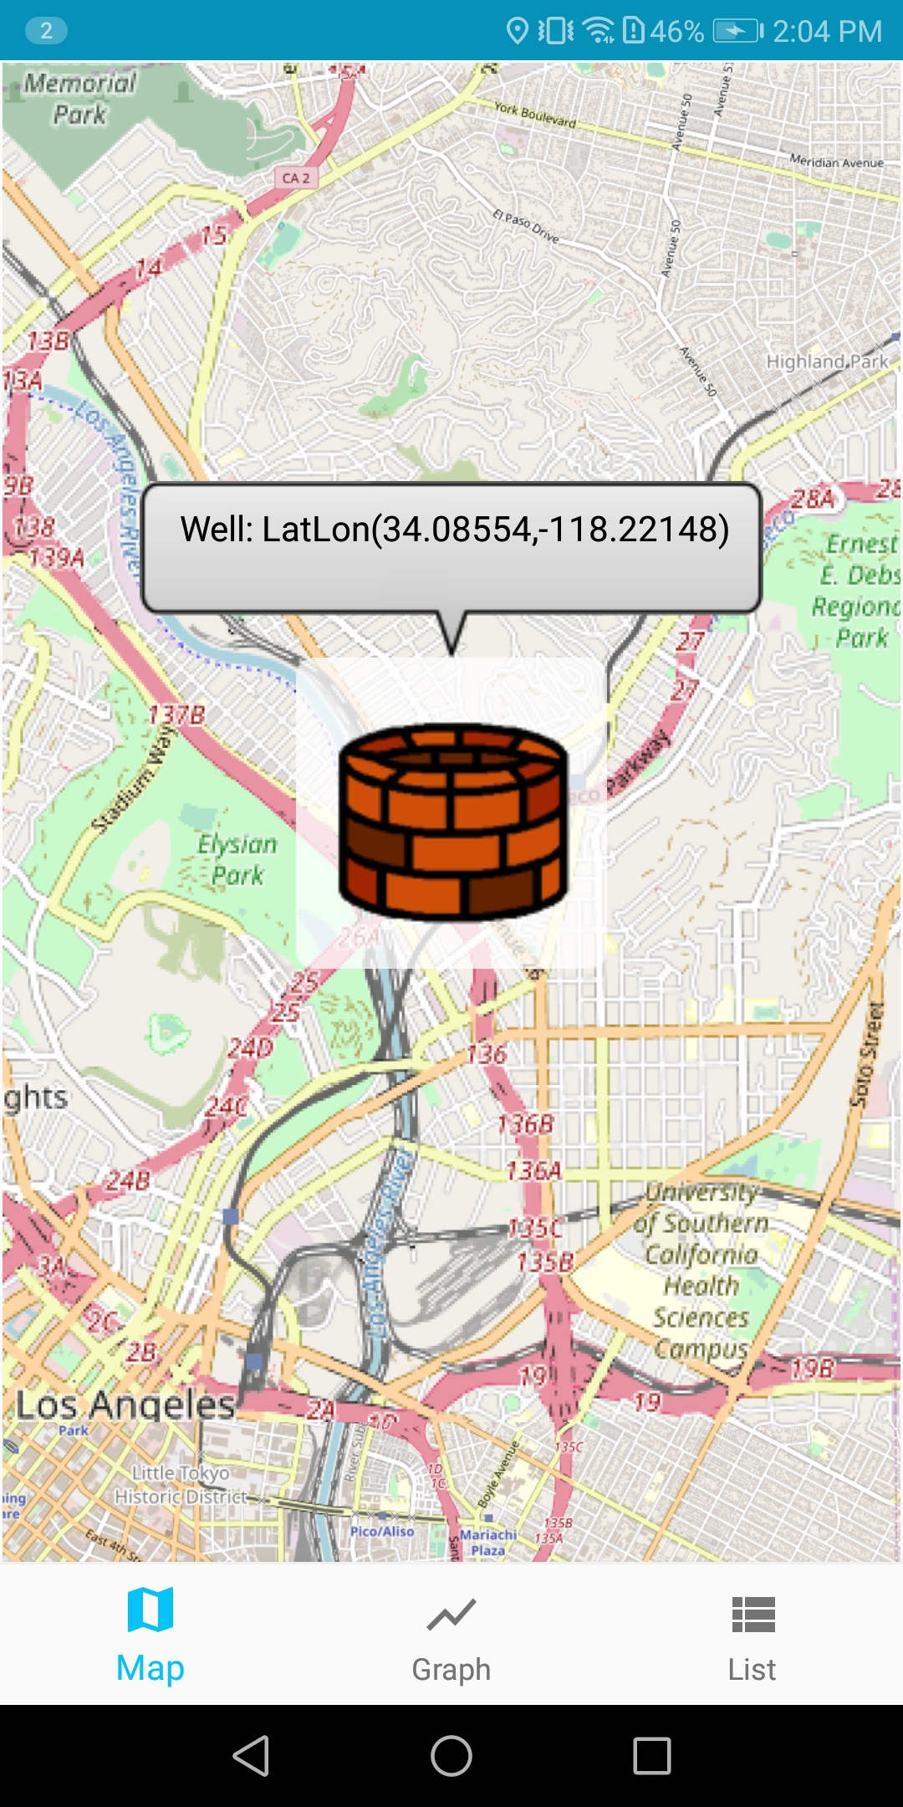
What is our objective?
Using the hydrological dataset provided by Jet Propulsion Laboratory and the AR framework from version one, Augmented Reality for Hydrology V2 improves the representation of the hydrology data by implementing a more robust and visual user interface.
New User Interface for selected points of interest (Map View)
Presenter: Mher Oganesyan
Notes:
Using the hydrology dataset provided to us by JPL and the framework from last years team, version 2 of the application is aimed at improving the representation of the data by implementing a more robust and visual UI.

Slide 7
Why make this product?
Availability on mobile devices allows for access on the go
Interactive way of learning about hydrology in users local area
AR technology extends what the user can see
Providing data to the user using graphs helps with understanding the data
Presenter: Mher Oganesyan
Notes:
Our objective was to take what last years team provided and expand and improve on their application while implementing their framework. We are doing this to…..
The AR technology will extend what the user can see, for example, one might not be able to see a well since it is underground or be able to visualize soil moisture since it is not something that is clearly visible. And the AR aspect of the app will help by putting into perspective what is usually not visible

Slide 8
Improvements
Refine the interactive user interface that visualizes datasets
Improve the user interface/user experience
Provide line-of-sight information
Enhance implementation of data processing for REST calls
Present data in a graph format for clearer data analysis
Allow user the ability to filter data by specifying a range in time
Superimpose terrain mesh onto actual terrain through the camera
Use implementation of maps to help guide user to a point of interest
Presenter: Mher Oganesyan

Slide 9
System Components || System Flow
WaterTrek Database
Data Processing
Augmented Reality
Framework
User Interface
Presenter: Mher Oganesyan
Notes:
USE example to explain

Slide 10
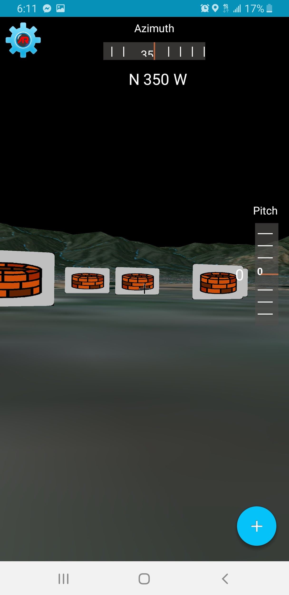
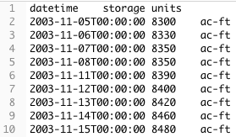
Datasets
Hydrology Data:
Reservoir
Well
Soil Moisture
Snotel
River
Terrain data:
Elevation
Textures
REST call for listing Reservoir sites
REST call for a specific site_no
Mesh with markers
Presenter: Anthony Soto
Notes:
So, what data are we utilizing in our application?
We are primarily working with hydrological datasets.
These include Reservoir though River datasets which are provided by JPL restful services.
At the top right is an example of a rest call to retrieve a list of reservoir sites.
We get a text file that represents a table with various fields.
The fields are.
site_no which represents a unique number.
description to that site.
longitude and latitude for location.
max and min datetime which corresponds to the max and min units of reservoir.
What are these units?
Well the second call below is displaying a REST call for a specific site_no.
Which includes a datetime along with storage units in ac-ft. Which represents the volume of water in a reservoir.
This schema structure is displayed throughout the other datasets each with their specific site number, location, and units.
The well dataset includes dbgs which is the amount of water in a well.
The soil moisture is the amount of water for specific area of land.
Similarly the snotel units display the snow water equivalent which is the depth of water in an area of snow.
The River data units measure flow rates at various points throughout the length of a river.
In addition to jpls datasets we include mountain data which can store the height of the mountain or other hydrological datasets.

Slide 11
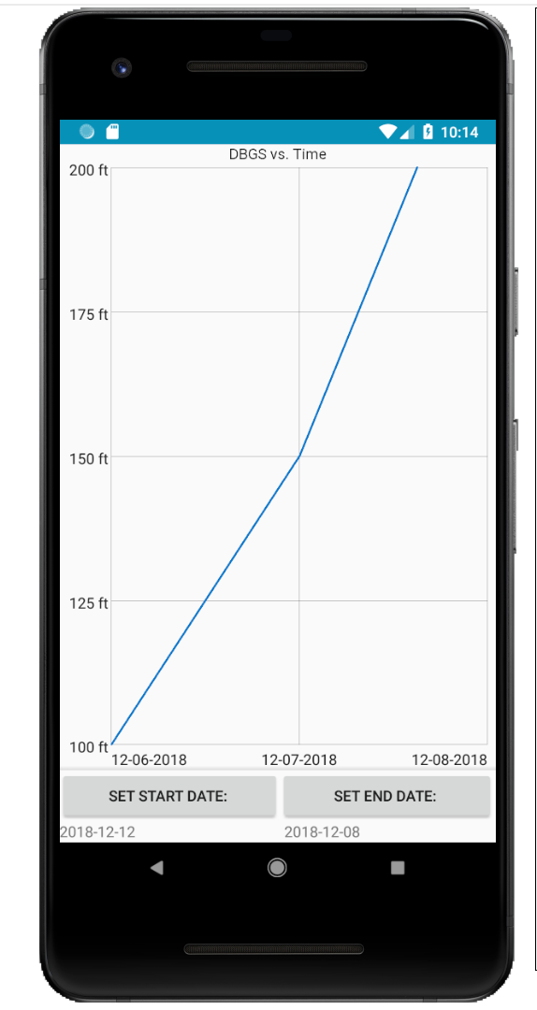
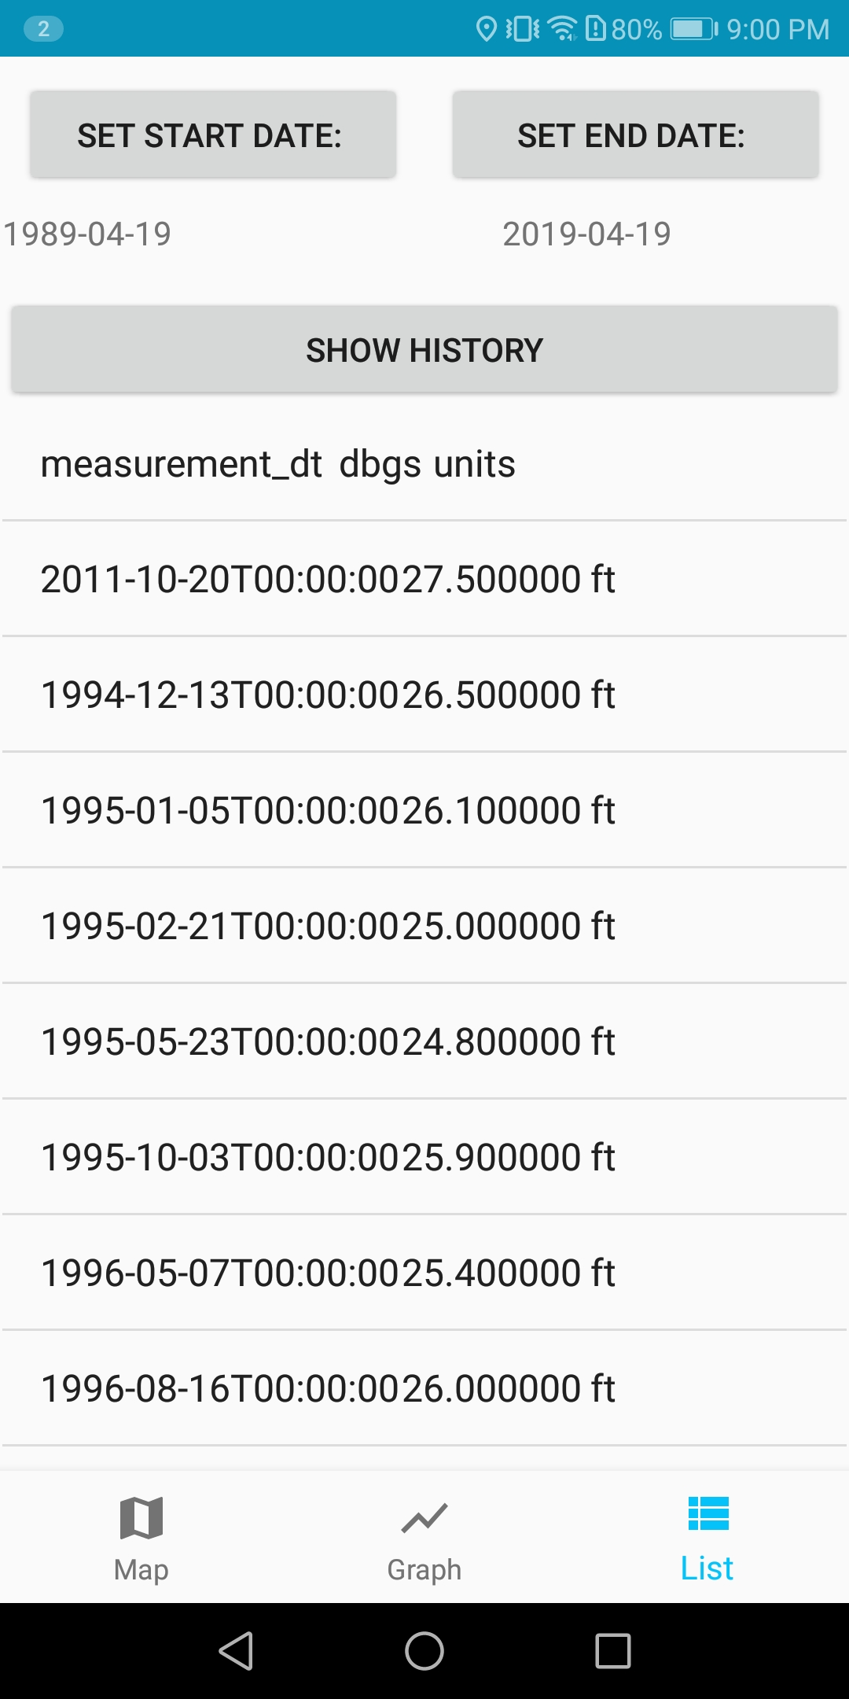
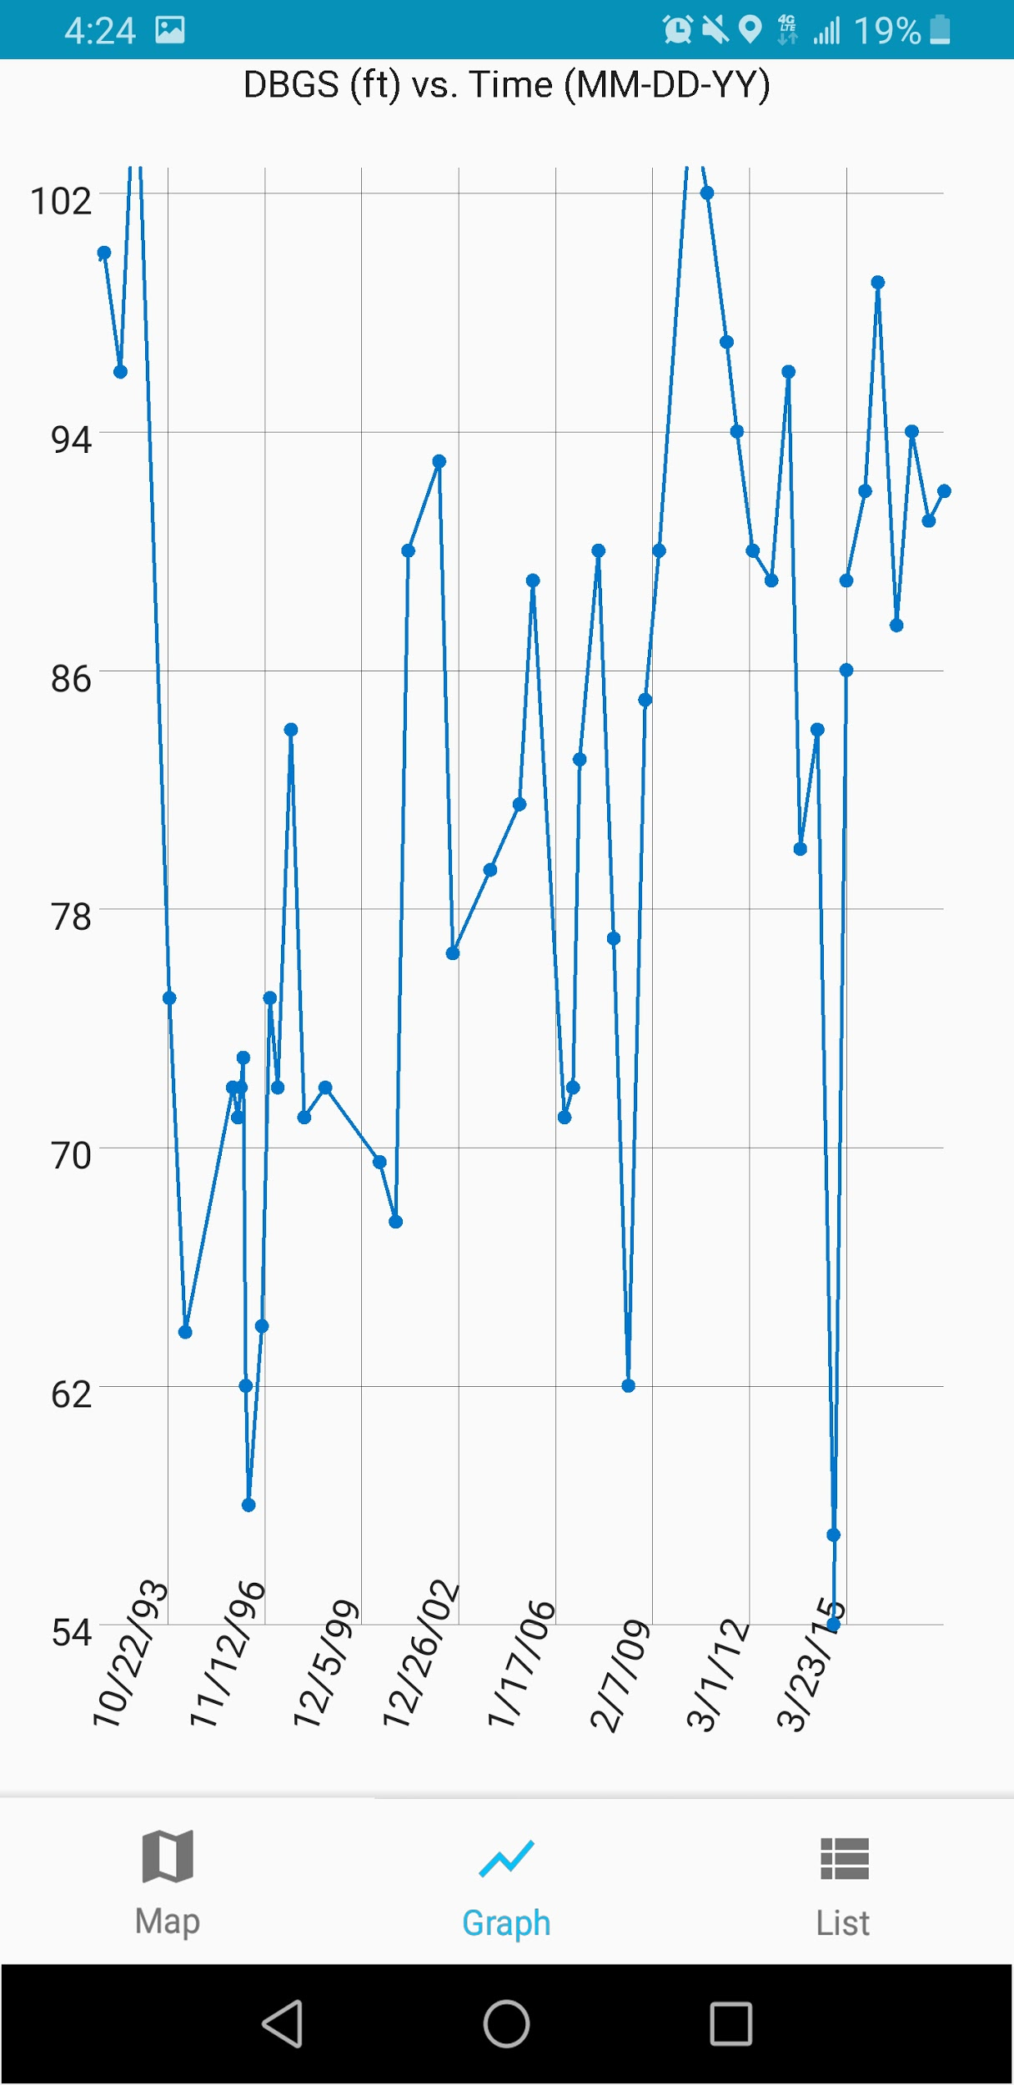
Representing Numerical Data
RecyclerView used to display a list of data. Numerical data such as:
min
max
mean
GraphView used to display data in a line graph. Useful when representing:
variables over a continuous time
standard deviations
RecyclerView
GraphView
Presenter: Anthony Soto

Slide 12
Line of Sight
What is line of sight ?
We will use line of sight in order to retrieve various height elevations
Returns elevation of first obstruction of land
Presenter: Leonardo Obay

Slide 13
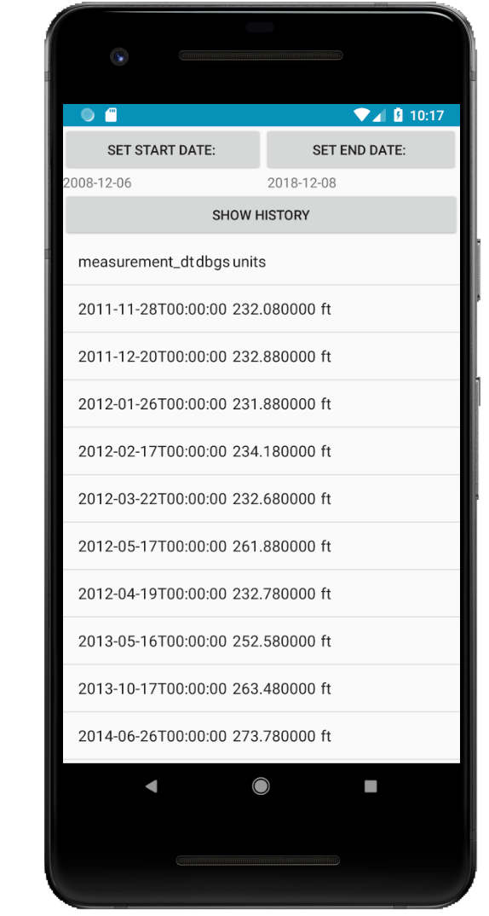
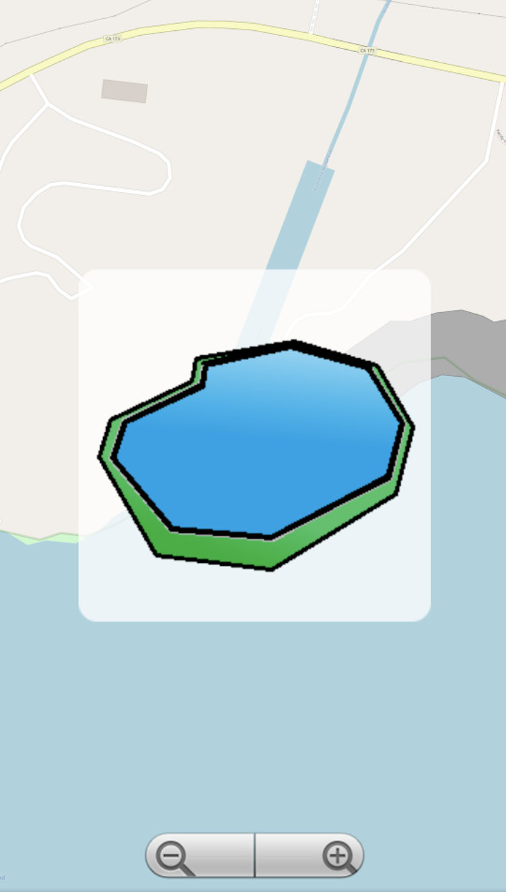
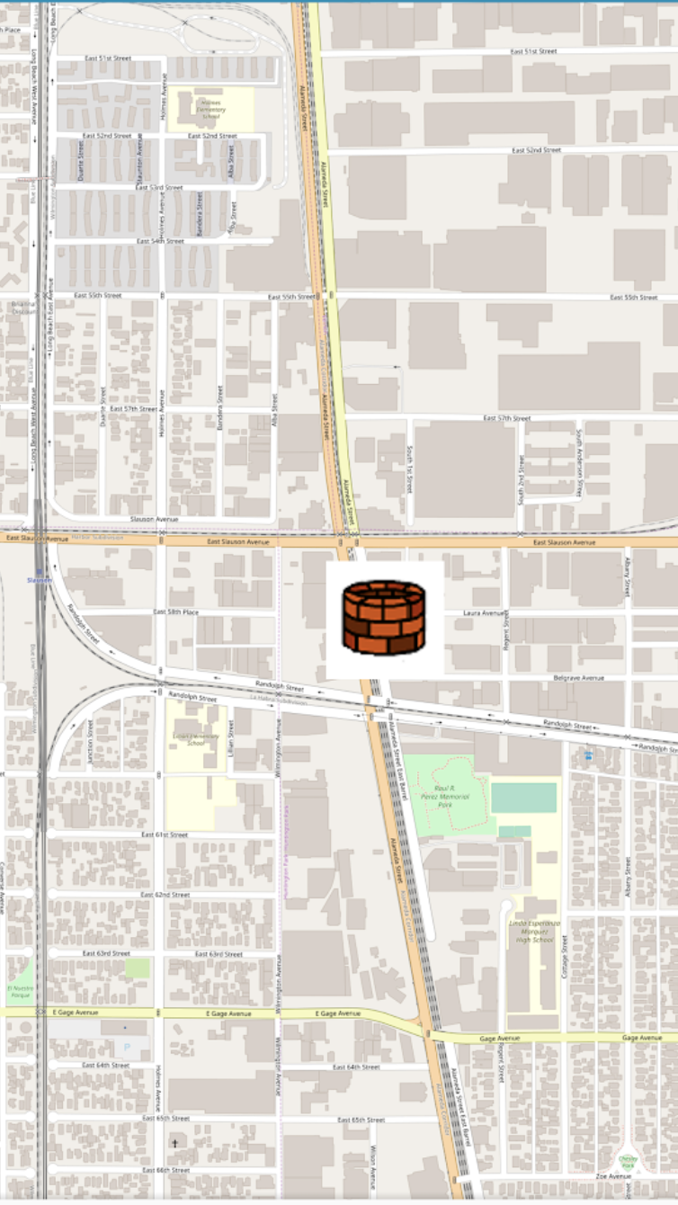
Map View
Lets users view nearby (POI)
This feature was implemented so the user can have access to (POI) without accessing the camera or AR aspect of the app
Map View (POI)
Presenter: Leonardo Obay

Slide 14
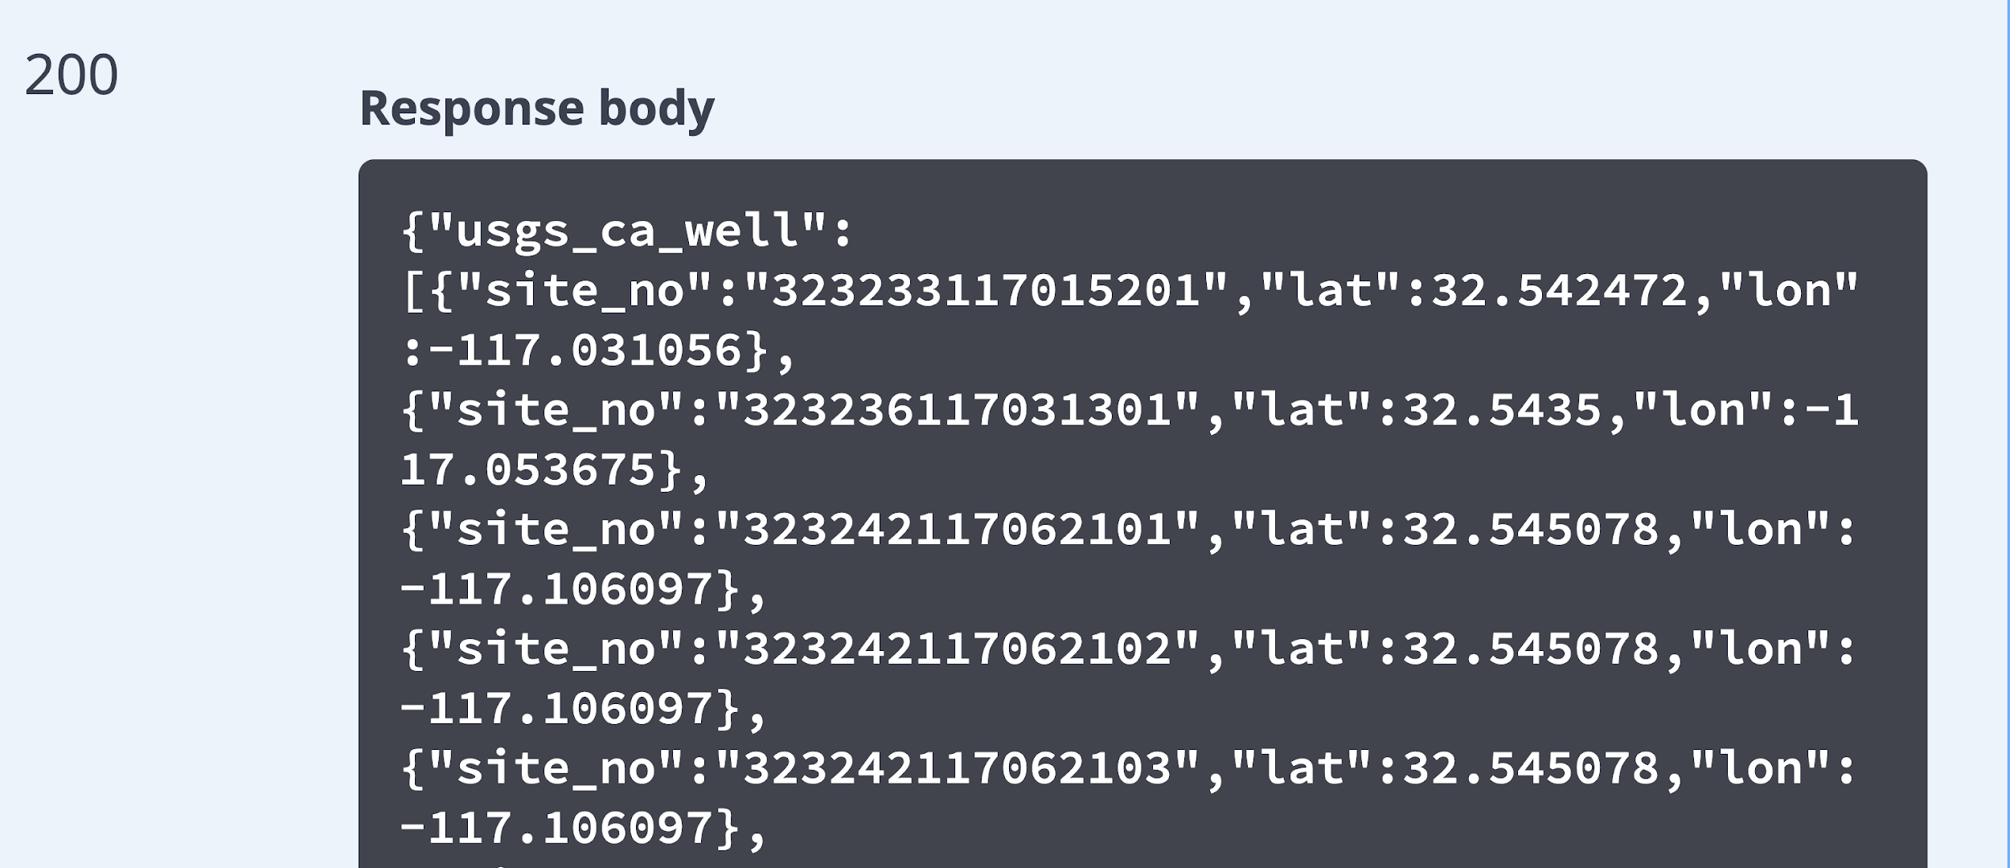
Rest Calls
(JSON Well DATA)
Network calls that provide data of various (POI)
Due to the data size being so massive Network calls were ideal
Presenter: Leonardo Obay

Slide 15
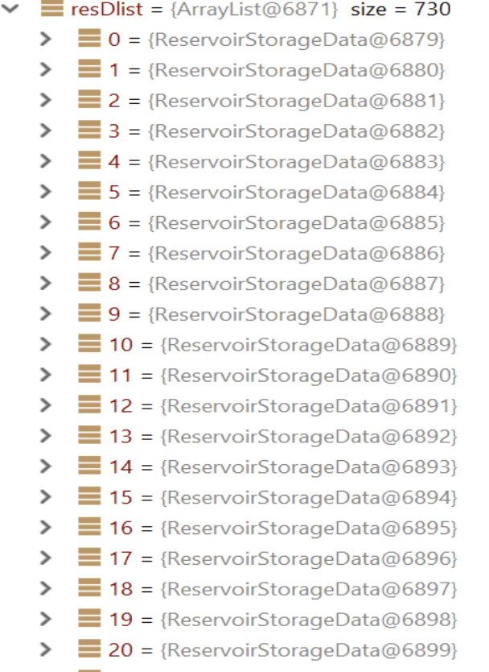
REST Call - Performance Improvements
Stores Data locally temporarily
Serialization/ Deserialization using GSON
Multiple HTTP URL REQ
Reduced Runtime Overall
(Reservoir Storage Data)
Notes:
Notes: tbs of POI data dates as far back as early 1950s double check fact
Android low computtation power to parse and sort all data values
Reduced run time to n to O(1) by using key values
Used Serialization and deserialization to saved data Locally as arraylist …
Different photos reduced runtime from 30 seconds to 3
Talk about multiple json calls also instead of just one and appending it to the list challenges solutions ...

Slide 16
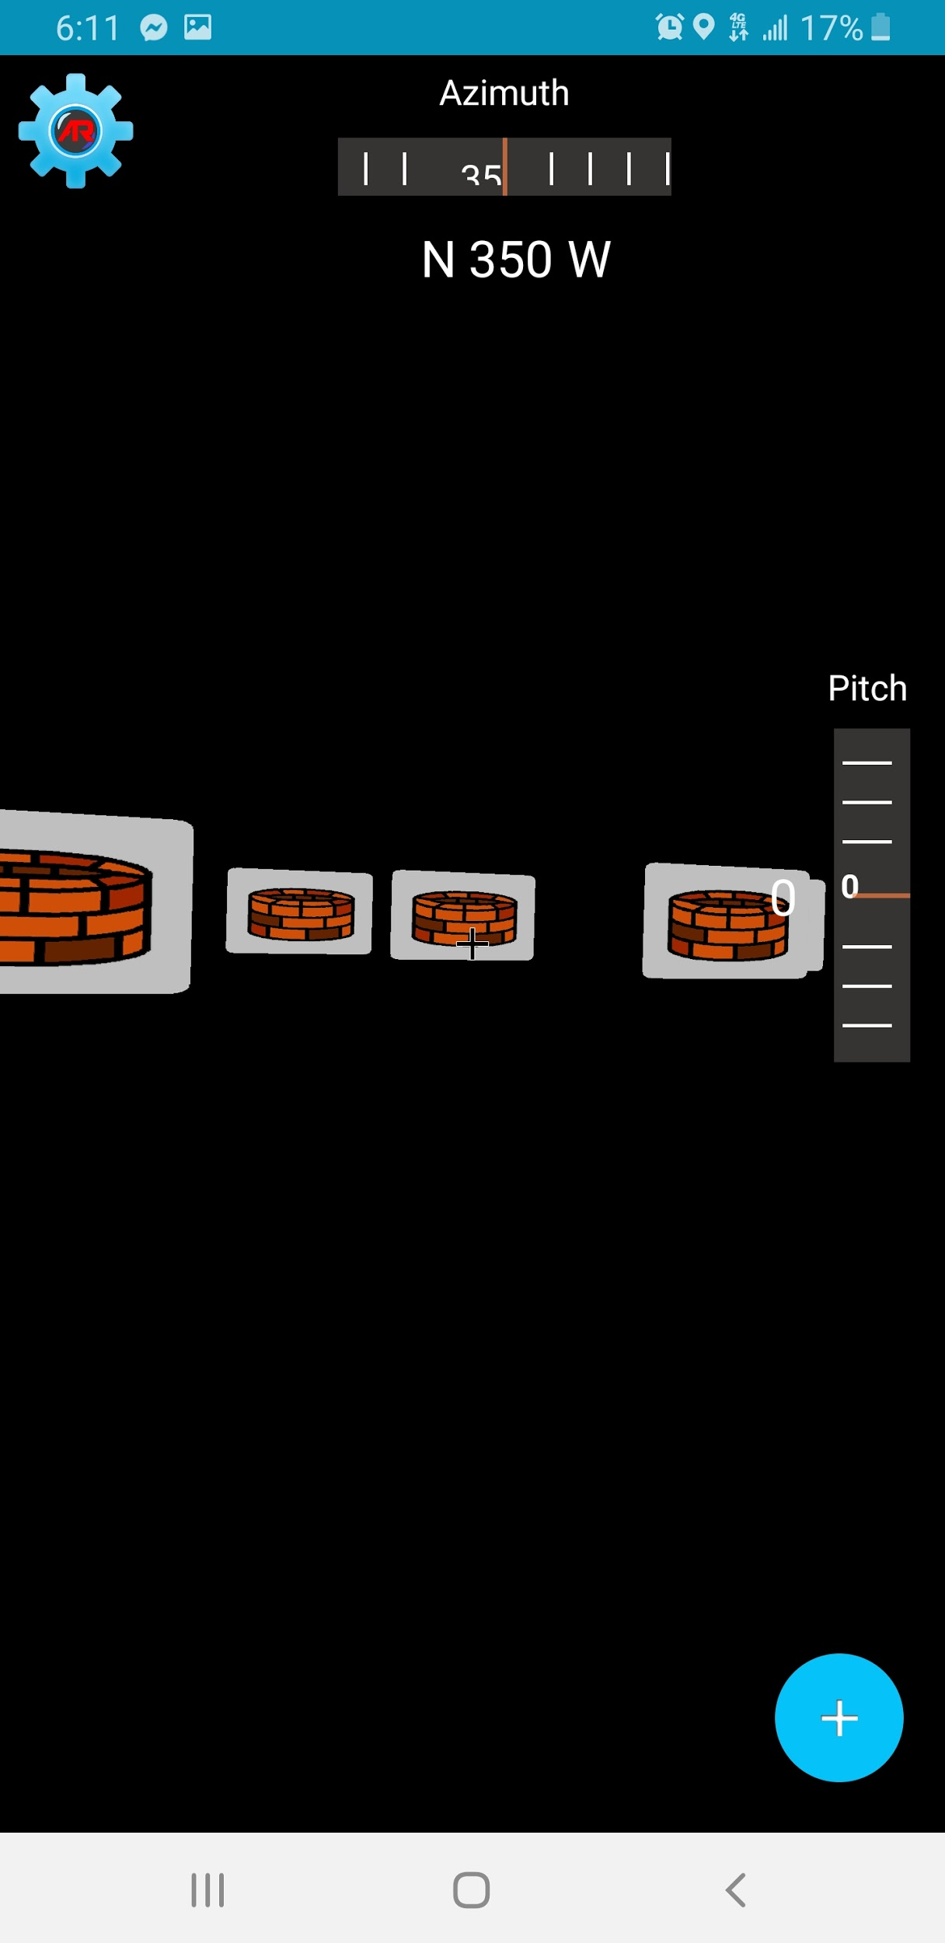
3D Mesh Display
App is in an AR environment so visualization of terrain must be in 3D
Helps give depth perspective to POI’s (Billboards)
Main Activity w/
Wells toggled On
Main Activity w/
Wells and Mesh Toggled On
Presenter: Refugio Arroyo-Martinez

Slide 17
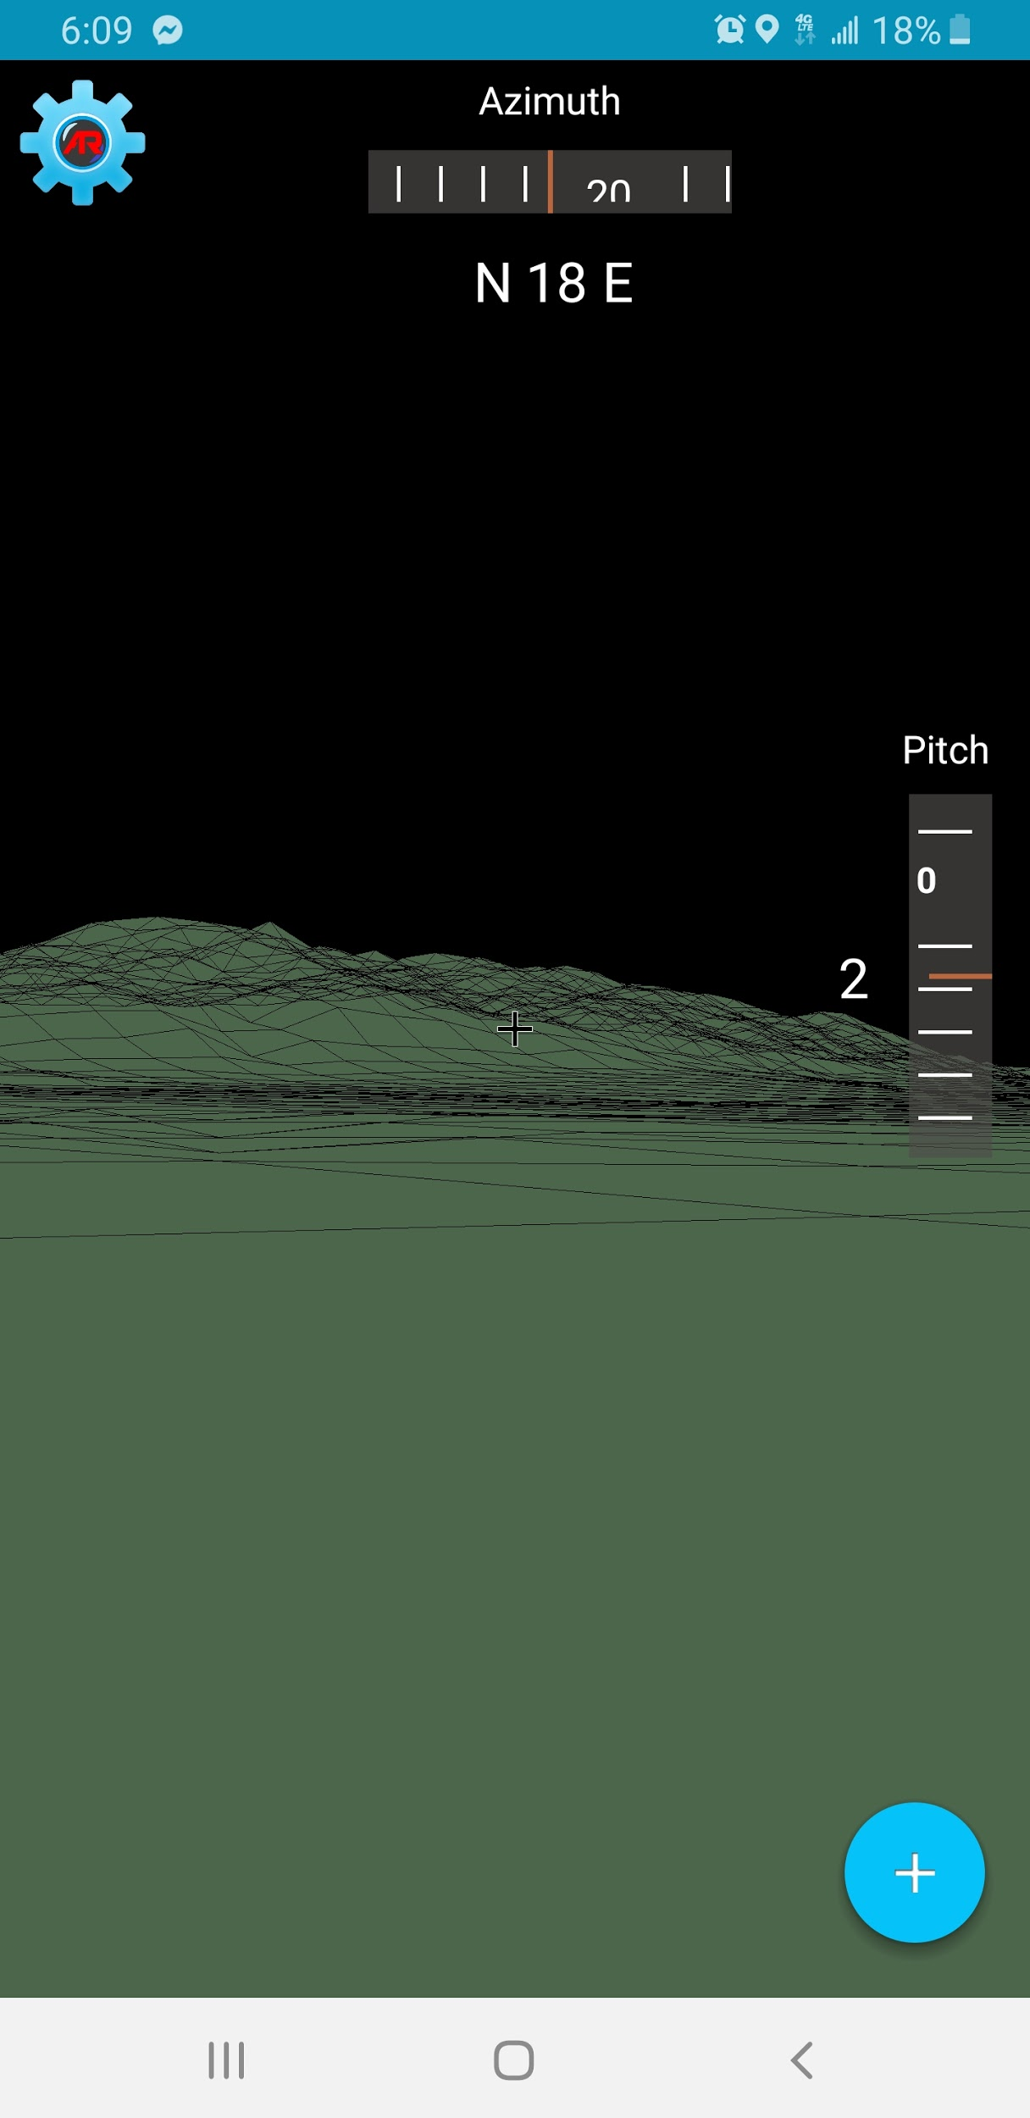
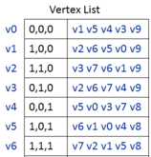
Mesh Process
DEM from JPL Server
Vertex Shader
Main Activity w/ Mesh Toggled On

Slide 18
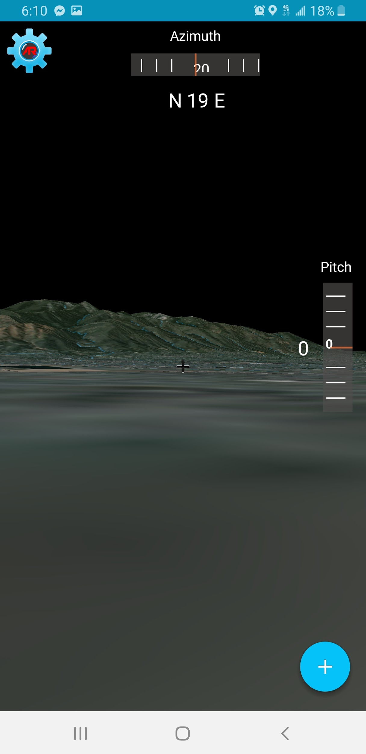
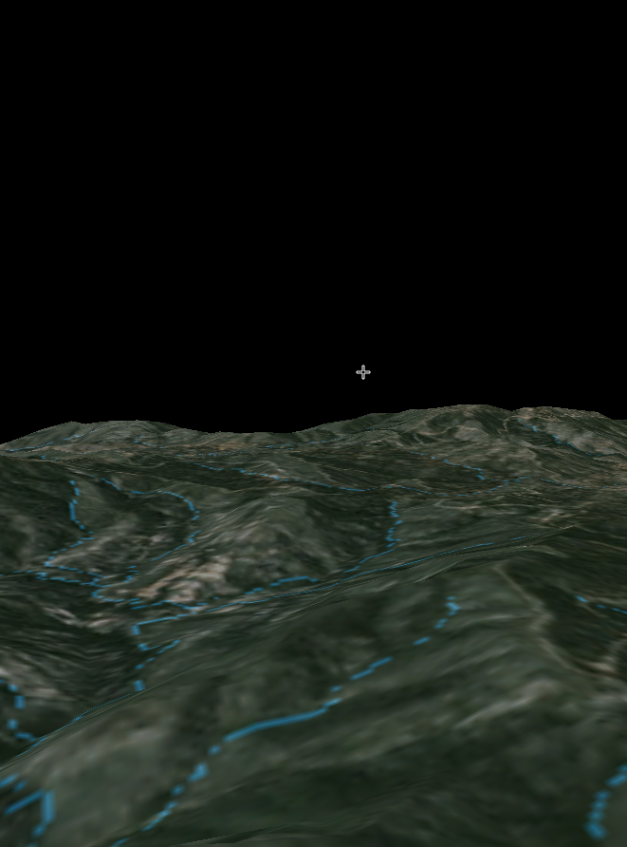
Usage of Textures
Textures gives mesh a nicer look
Texture layers for added details
Allows for higher down sampling, resulting in less computation
Mesh without texture
Mesh with Texture
River Texture Layer
Presenter: Refugio Arroyo-Martinez

Slide 19
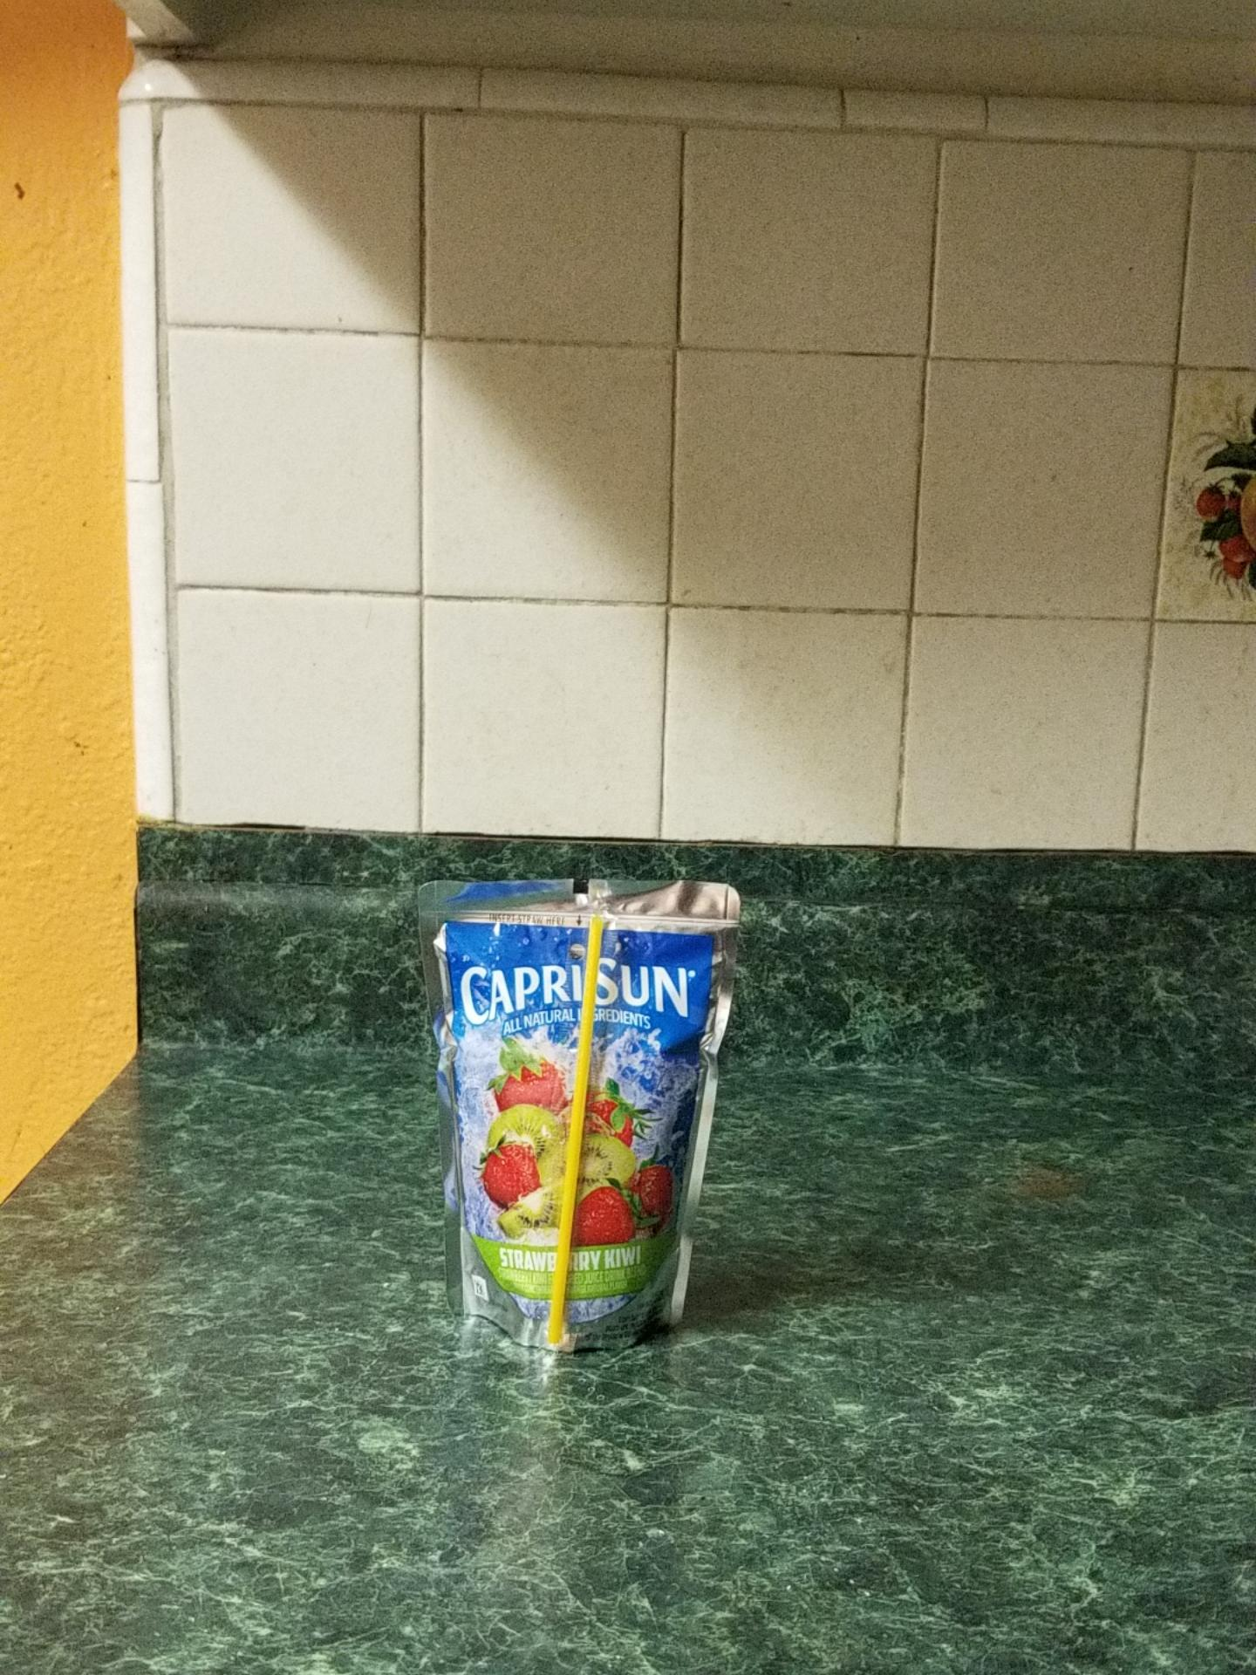
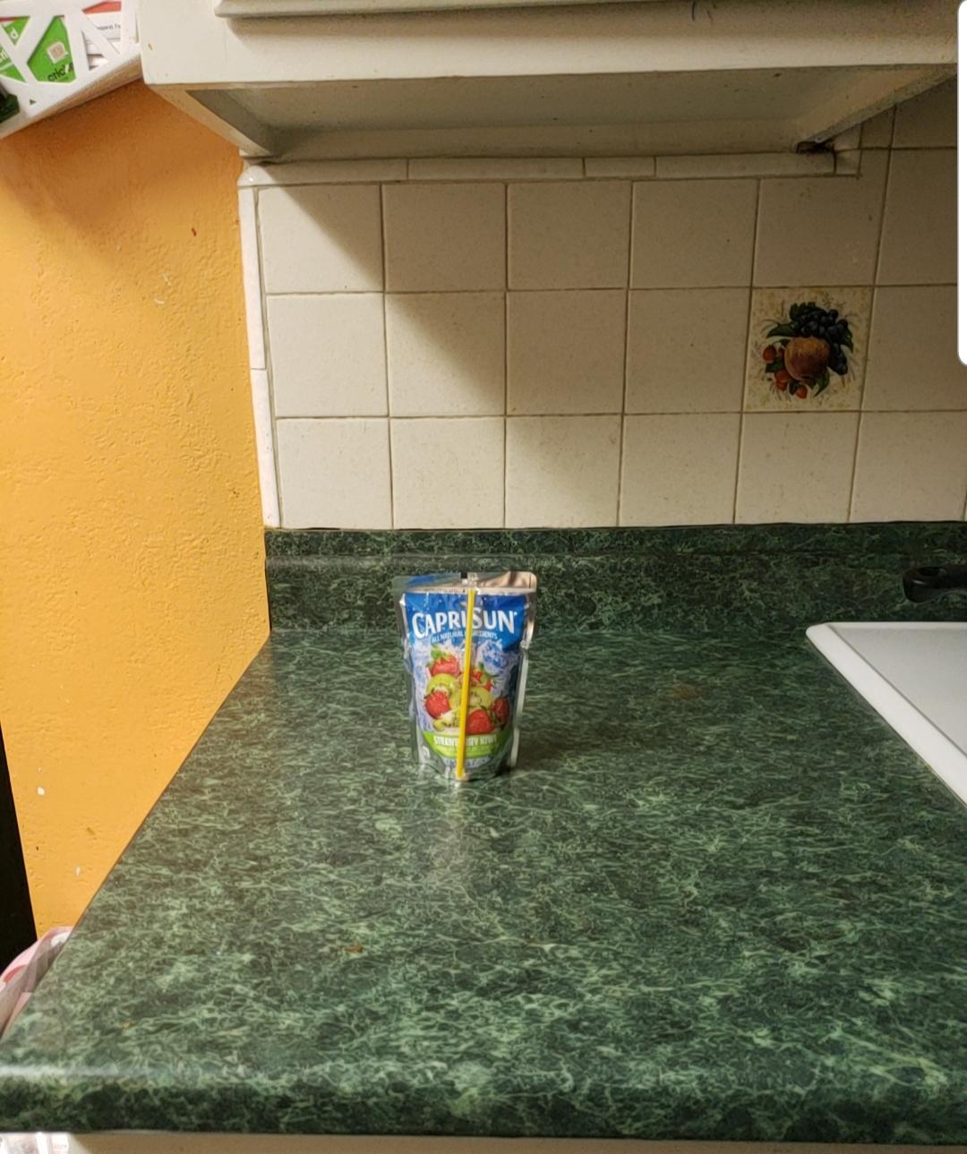
Mesh Scaling
Devices have different camera hardware
Field of View must be calculated for the different camera lenses of devices
Ensures a consistent experiences for users regardless of device used
Samsung S9
Samsung S8

Slide 20
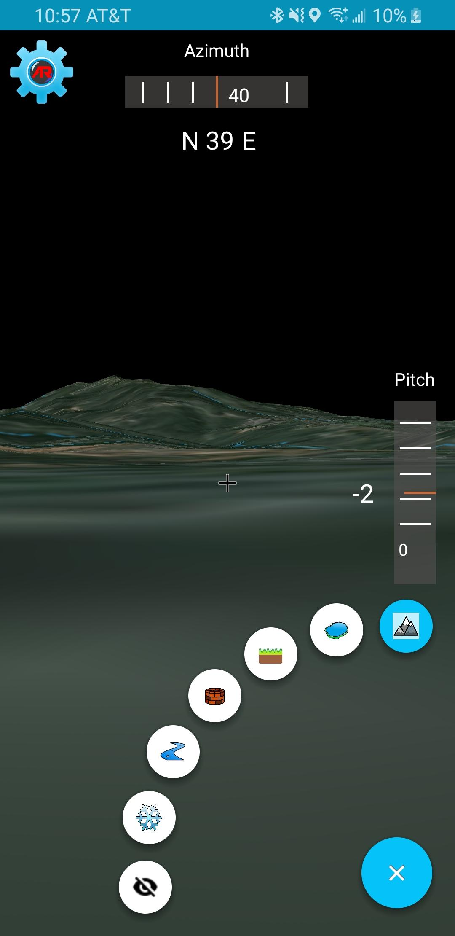
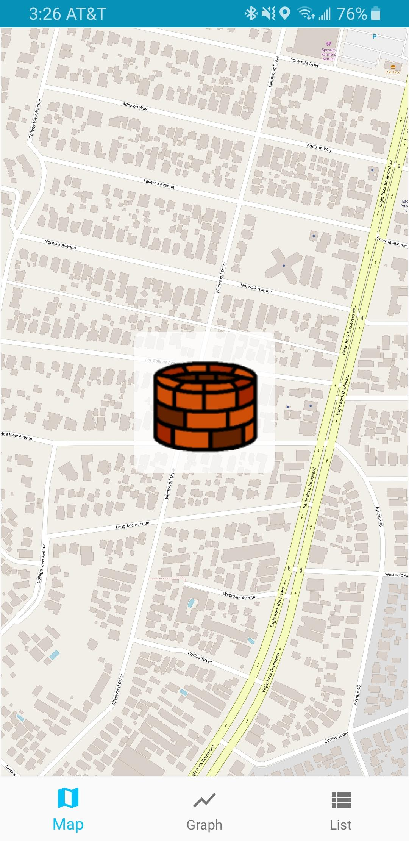
User Interface - Adjustments
Simpler Interface
Reducing the amount of steps it takes to perform an action.
Functionality
Azimuth and Pitch to compliment the mesh in giving the user a sense of direction.
Presenter: Gilberto Placidon

Slide 21
User Interface - Main Menu
Arc Menu
Stylized menu that allows the use to select each type of POI
Azimuth & Pitch View
Azimuth view displays angle of direction
Pitch displays rotation of phone about the x-axis
Azimuth
Pitch
Arc Menu
Presenter: Gilberto Placidon

Slide 22
User Interface - Point of Interest
Three separate views for POI:
Map View
Graph View
List View
Presenter: Gilberto Placidon

Slide 23
Demo Video
Presenter: Gilberto Placidon

Slide 24
Conclusion
Results
Android application that visualizes hydrology data using Augmented Reality components built from version one’s framework
Main Challenges
Data processing/Device performance
3D terrain mesh scaling accuracy
Discrepancies from sensors of different devices
Future Work
Offline mode
More accurate mesh registration using Computer Vision techniques
Cross platform
AWS utilization for large scale usages by the general public
Presenter: Mher Oganesyan

Slide 25
Thank You!
Questions?

