Slide 1
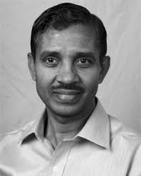
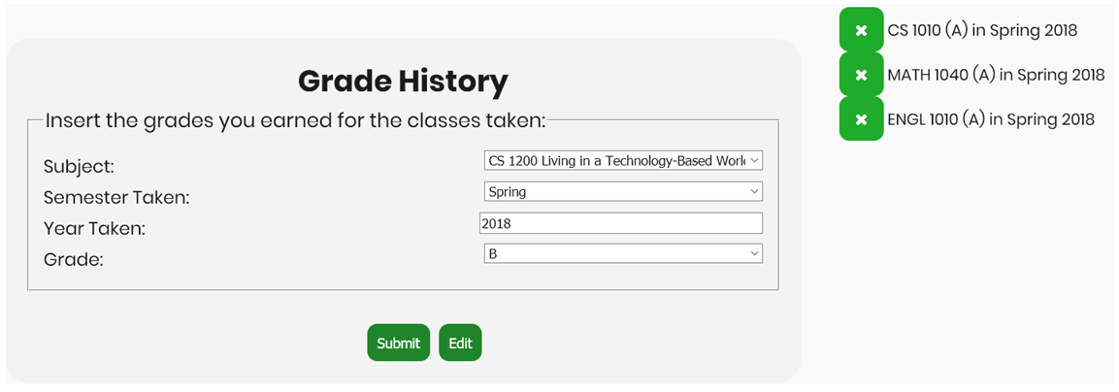
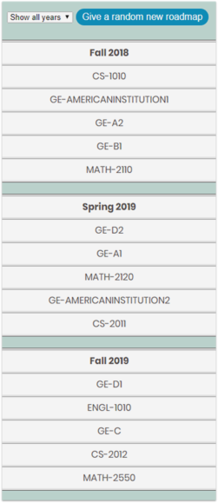
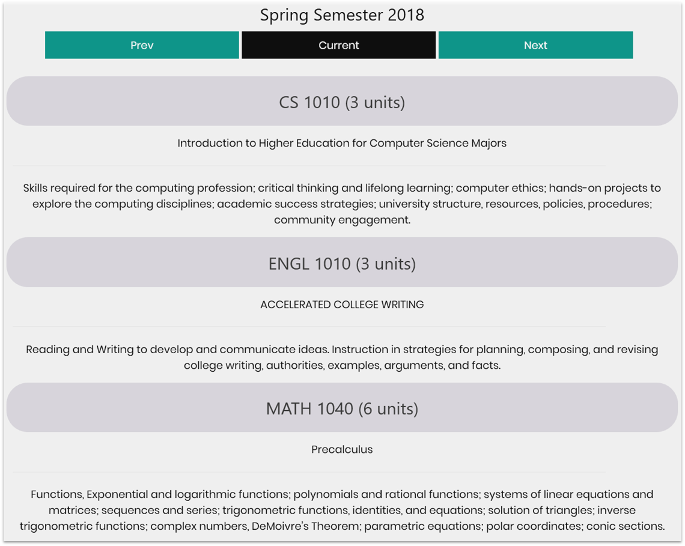
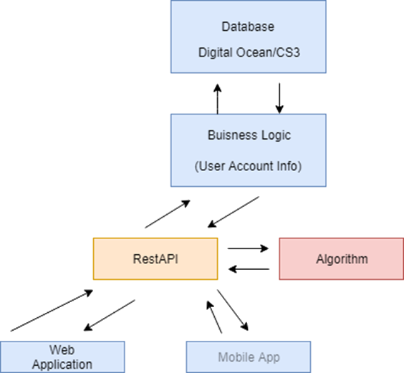
CS Scheduler Team Members: Leonard Velazquez, Ka Cheng, Le Feng, Yifei Yang,
Kevin Ha, George Kassar Faculty Advisor: Mark Sargent Liaison: Raj Pamula, Elaine Kang, Zilong Yi, Yuqing Zhu, Chengyu Sun Department of Computer Science College of Engineering, Computer Science, and Technology California State University, Los Angeles
Sponsor Logo
Background
The Cal State LA Computer Science department requested an application that will provide students with efficient roadmaps to smoothly guide them towards graduation. The application would also assist the department in deciding the number of courses to offer each semester.
Objectives
Provide a user-friendly interface for students and admin to navigate
Generate the most efficient path for students to graduate
Allow administrators to modify classes and make adjustments to student’s roadmap
Students insert the classes they have already taken
Roadmap is generated based on classes already taken
This page shows classes students entered from grades page
Conclusion
The CS Scheduler is a web application that implements our own artificial intelligence to create an efficient roadmap that users can follow. With this project, we obtained experiences and challenges we normally would not get from attending regular classes. We believe that this application will be an asset to the ECST department and will lessen their workload from the increasing students to the department.
Notes:
‹#›
Have students check that the logo is the appropriate one to use.

