Slide 1
Climate Change Management System
Mission Statement: Our mission is to provide the valuable resource/information to be aware of Wildfire in California.

Slide 2
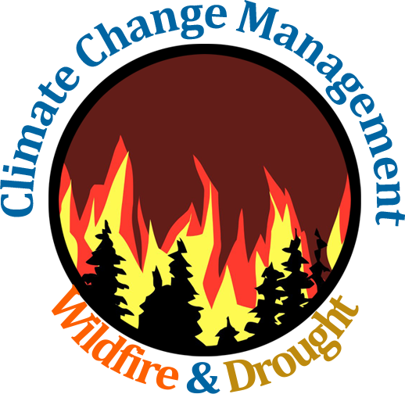
Artificial Intelligence and Data Science for Climate Change Management
with Focus on Drought and Wildfire in California
Creators: Mazel Fernandez, Rayan Hyder, Victor Raj, Jennifer Serrano-Perez, Funing Yang
Project Lead: Mazel Fernandez
Academic Advisor: Mohammad Pourhomayoun
Sponsors: NASA and LA City
Grad Support: Ryan Dunning

Slide 3
Agenda/Table of content
Definitions
Causes of wildfires
Recent wildfires
Significance
Goals of our project
Impacts
Achievements so far
Demo
Future goals

Slide 4
Project/Faculty Advisor: Dr. Mohammad Pourhomayoun

Slide 5
Sponsors: NASA & LA City

Slide 6
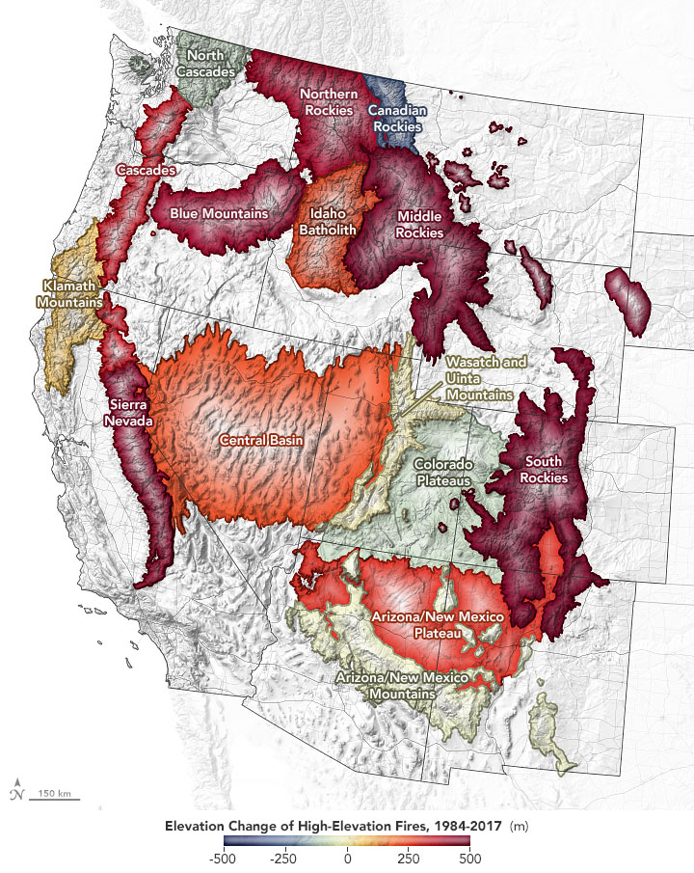
Definitions
Climate Change: a change in global or regional climate patterns, in particular a change attributed largely to the increased levels of atmospheric carbon dioxide
Wildfire: a large, destructive fire that spreads quickly over woodland or brush
Factors to consider in spread of wildfires: wind, temperature, cloudiness, moisture, and air pressure
Speaker: Mazel

Slide 7
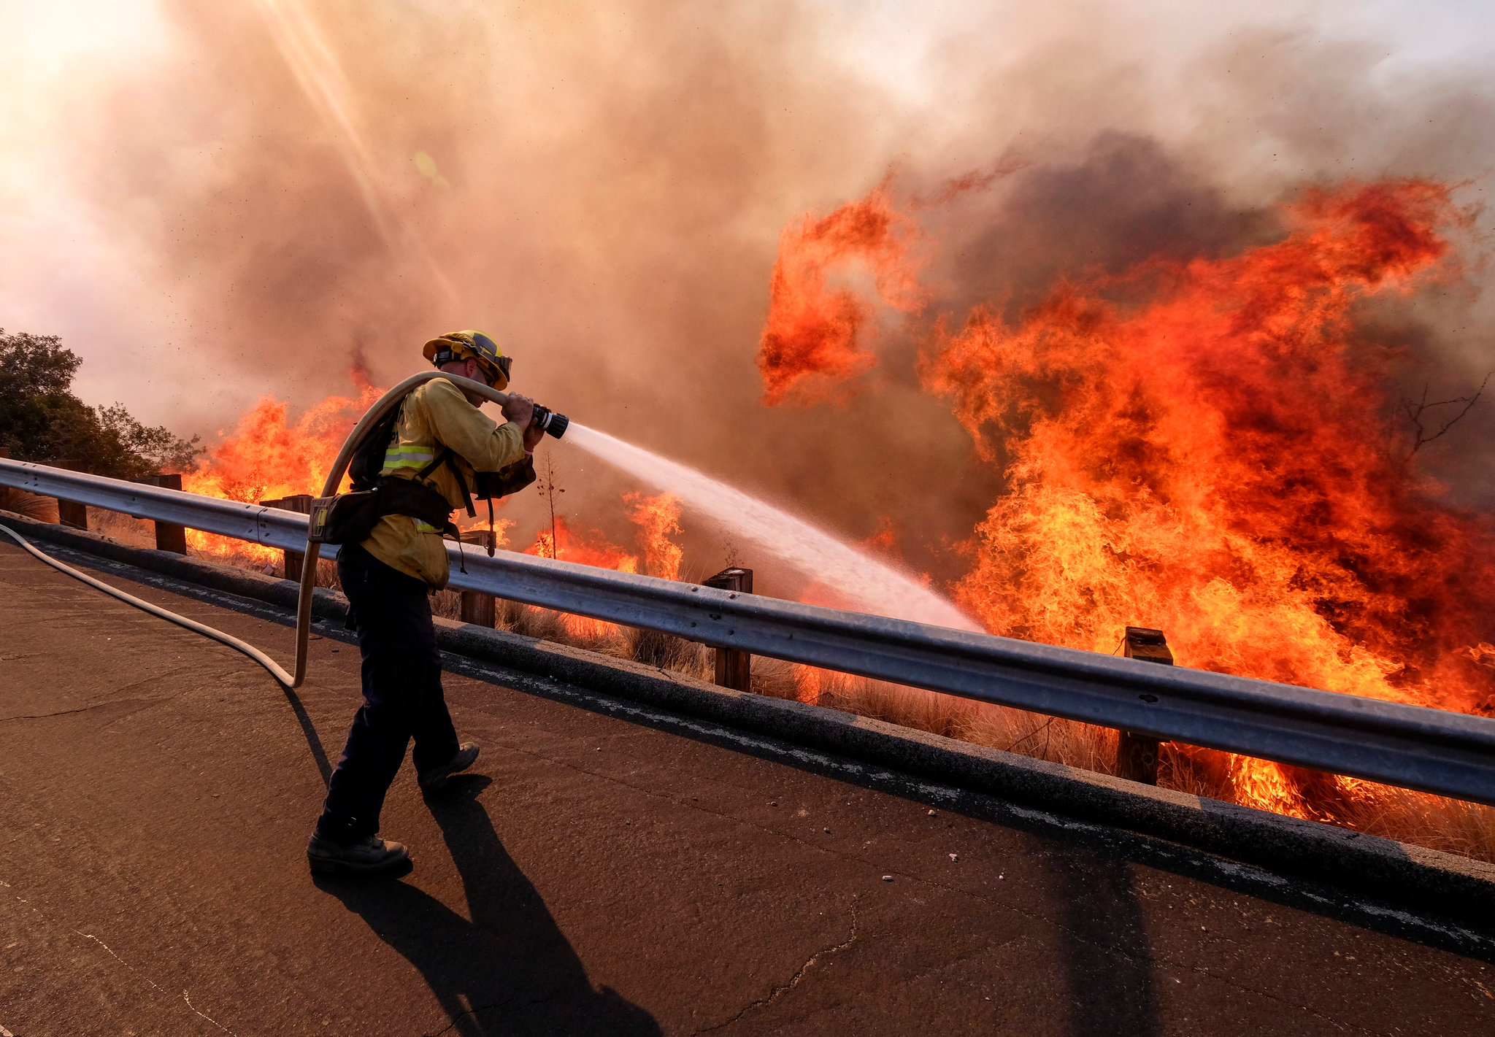
Why are wildfires hard to extinguish?
Wildfire size makes it harder to control
The climate in which fires start is incredibly dry (humidity is an enemy of forest fires)
It is impossible to place firefighting crews in the middle of the blaze (think of it like a storm)

Slide 8
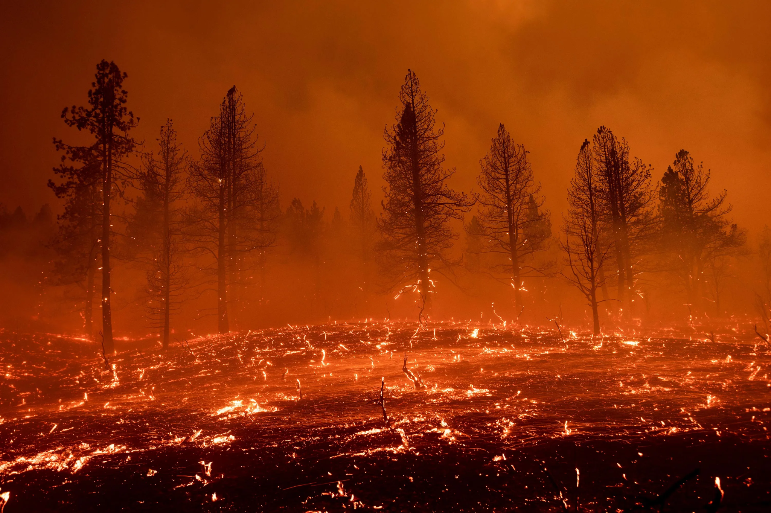
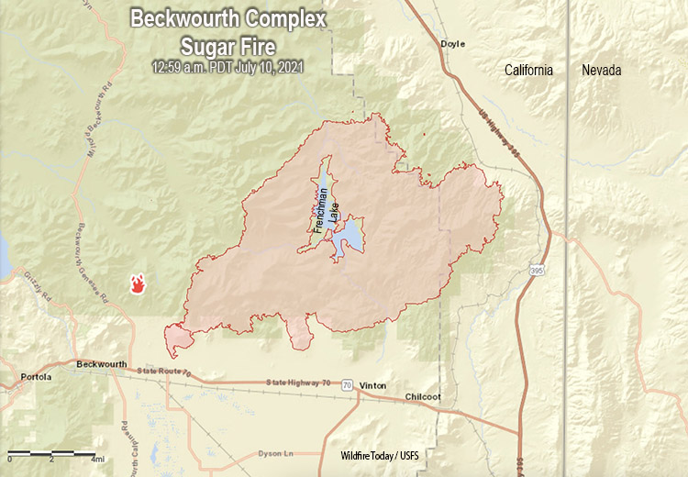
Beckwourth Complex Wildfires
July 3, 2021 - September 22, 2021
Burned: 105,670 acres
Speaker: Mazel
Notes:
Mention length of wildfires, and containment

Slide 9
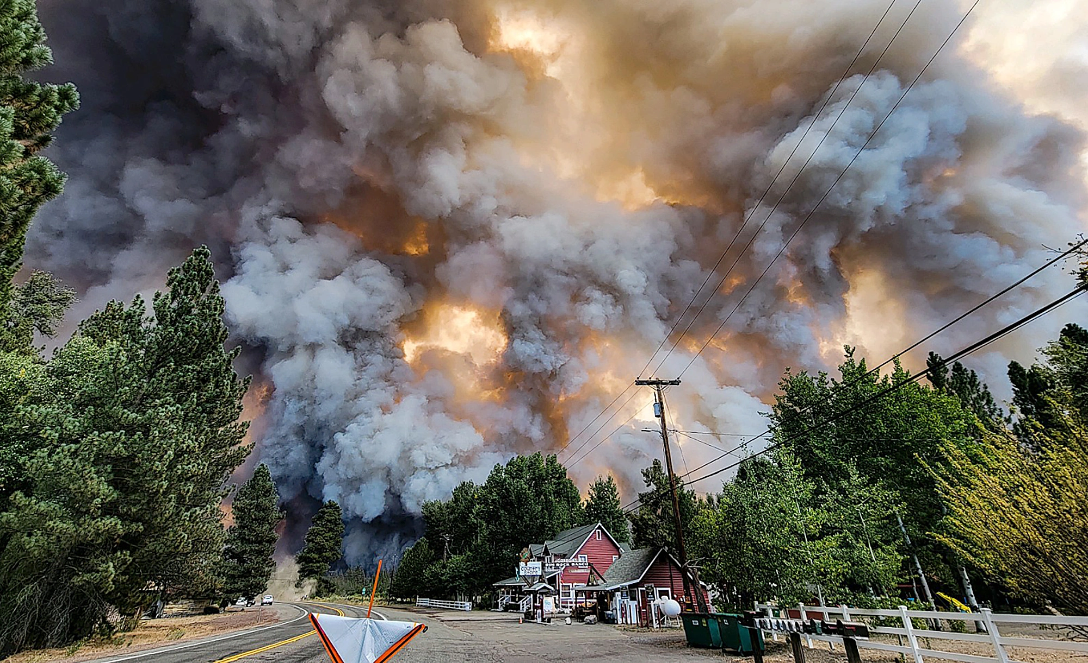
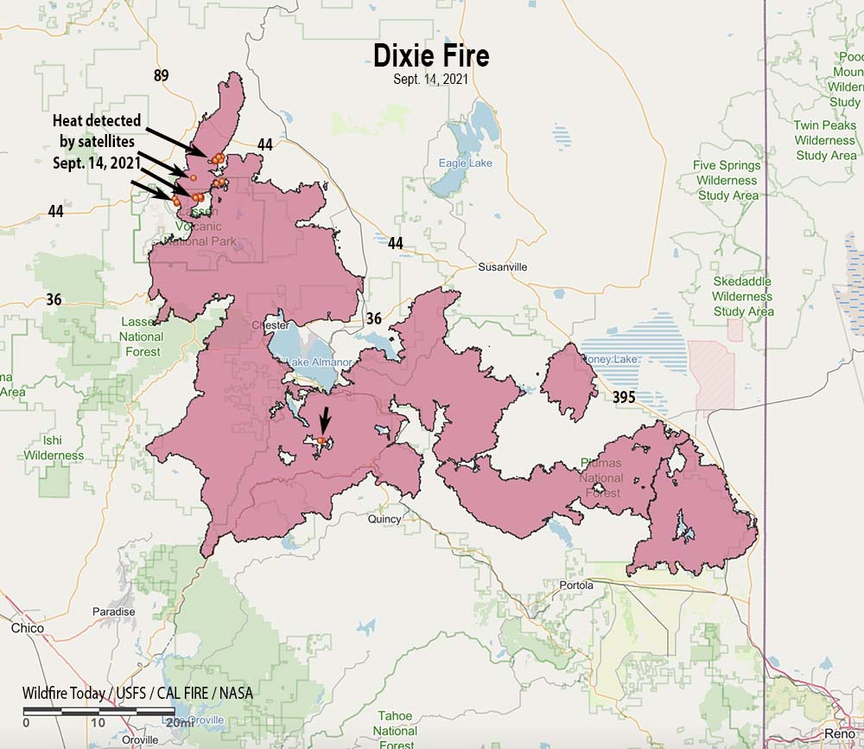
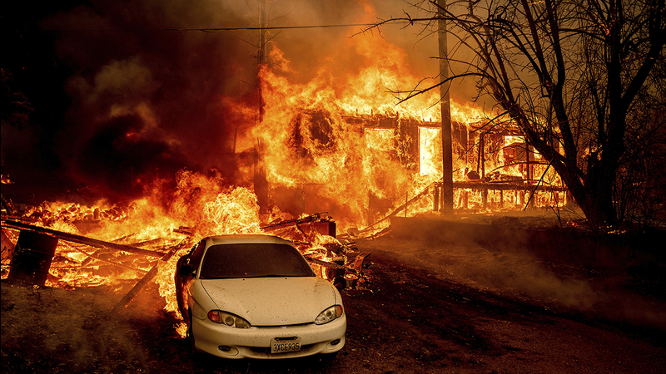
Dixie Wildfire
July 13, 2021 - October 25, 2021
(LARGEST in California’s history)
Burned: 963,309 acres
Speaker: Mazel
Notes:
Talk about it as the largest wildfire in california

Slide 10
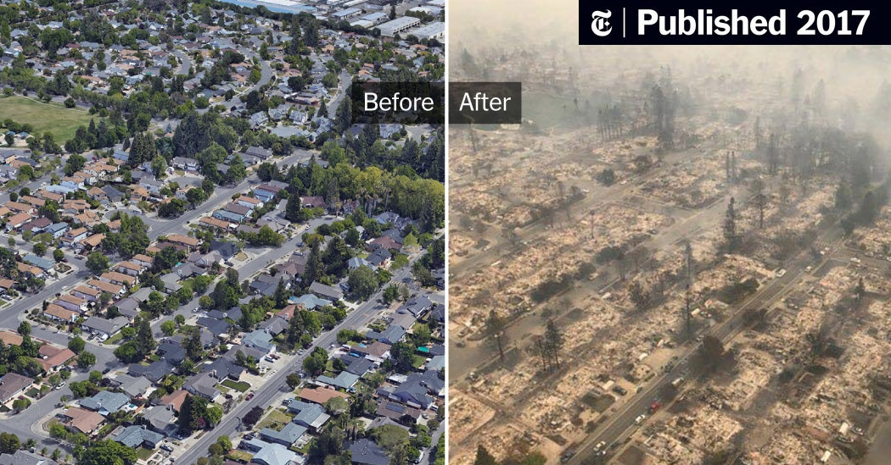
Aftermath of Wildfires
Fires destroyed an area of the Coffey Park neighborhood in Santa Rosa, Calif (2017)
Speaker: Mazel
Notes:
Famous landmarks in ruins

Slide 11
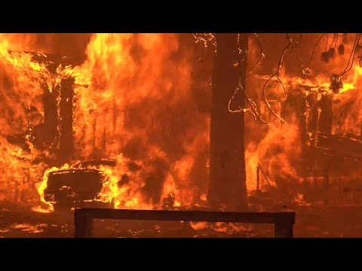

Slide 12
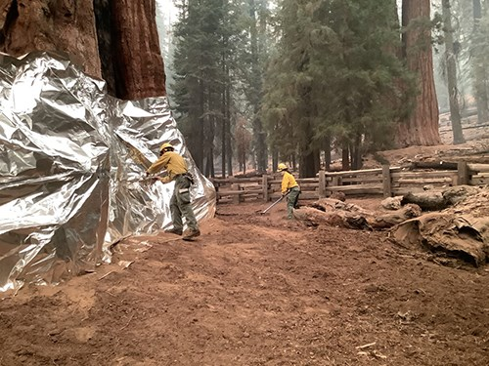
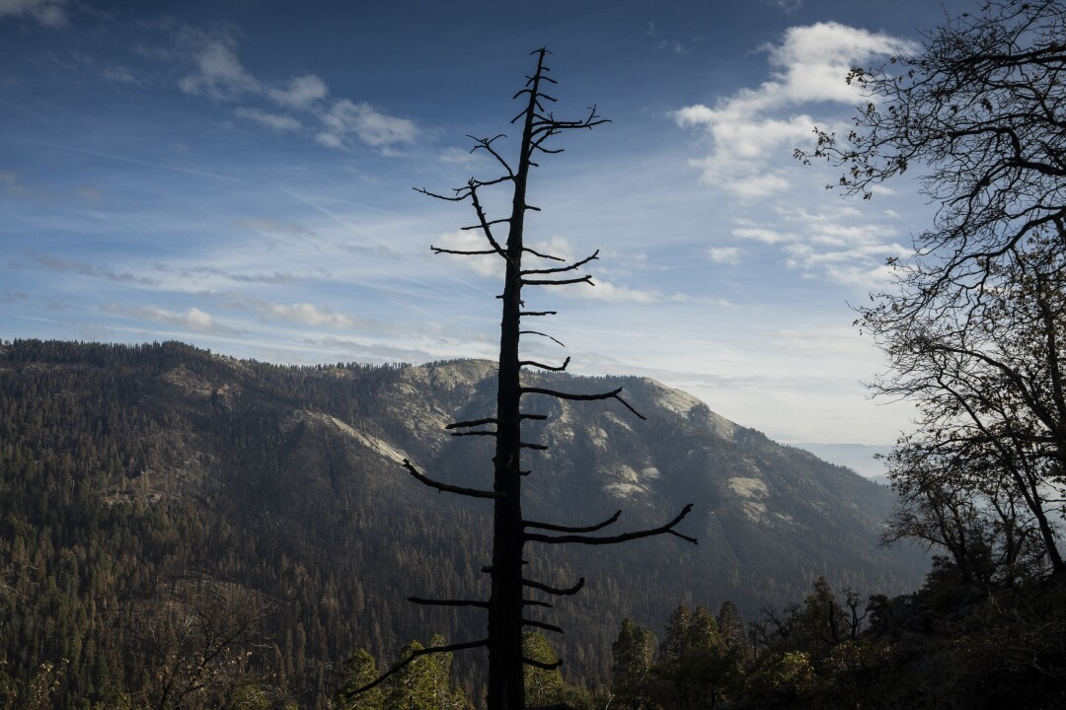
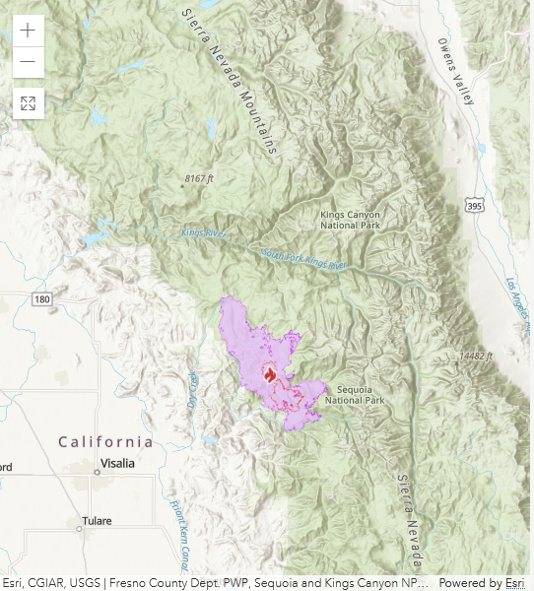
Significance
KNP Complex Fire - Sequoia and Kings Canyon National Parks
Paradise and Colony fires merged, forming the KNP Complex Fire
2,380 giant sequoias burned or are expected to die in a couple years
Speaker: Jennifer Serrano

Slide 13
Significance
High Costs: California spends an estimated $2.5 billion a year on CAL Fire firefighting
Money is being spent on putting out fires, not prevention
Only putting out fires is not enough because climate change has made it difficult to put out
Loss of Wages: Farmworkers in Northern California in 2020 were estimated to have lost an average of $5,500 in wages due to fires.
Speaker: Jennifer Serrano

Slide 14
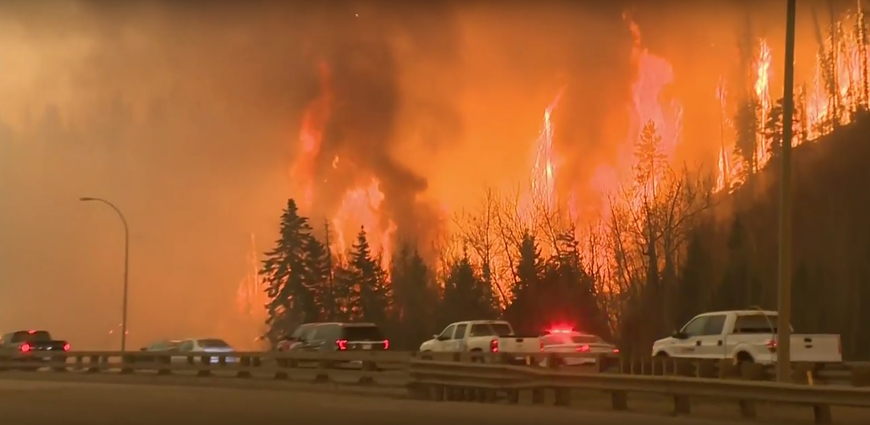
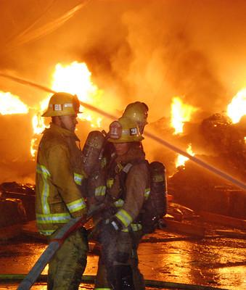
Significance
Fire seasons are starting earlier and ending later each year
Problems with evacuation in California
An investigation found that only 22% of high-risk communities have evacuation plans
Evacuating from wildfire zones is difficult
Difficult for people in wheelchairs, health conditions to evacuate
Speaker: Jennifer Serrano

Slide 15
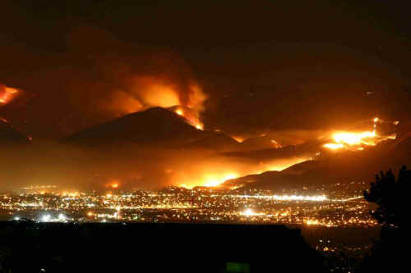
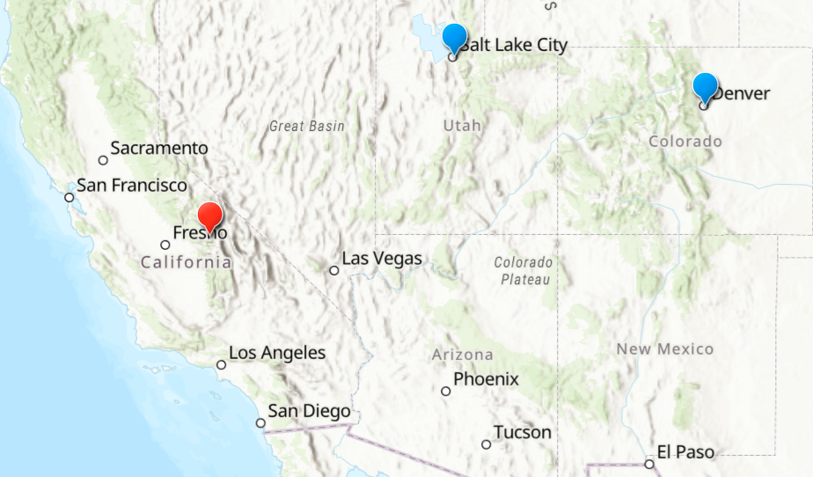
Significance
Smoke can travel very far
Smoke from California fires and other parts
of the west reached Colorado and Utah
Air quality in Denver and Salt Lake City were
among the worst in the world
Health Issues
Smoke from wildfire is unhealthy and can impact
children, older adults, citizens with respiratory diseases, etc.
Children breath more air, including air pollution
Wildfires can trigger mental health conditions
Speaker: Jennifer Serrano

Slide 16
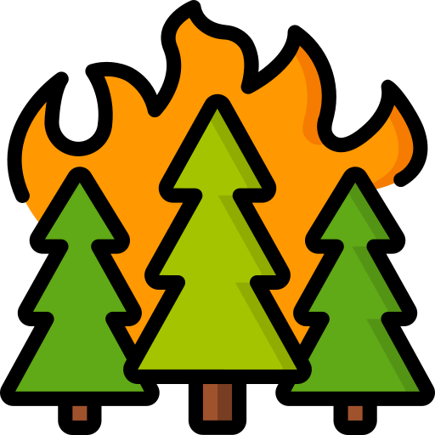
Wildfires in California
According to the California Department of Forestry and Fire Protection...
3,083,507 Acres Burned
8,367
Incidents
3
Fatalities
3,629
Structures Damaged
2021 Fire Season so far.
Speaker: Jennifer Serrano

Slide 17
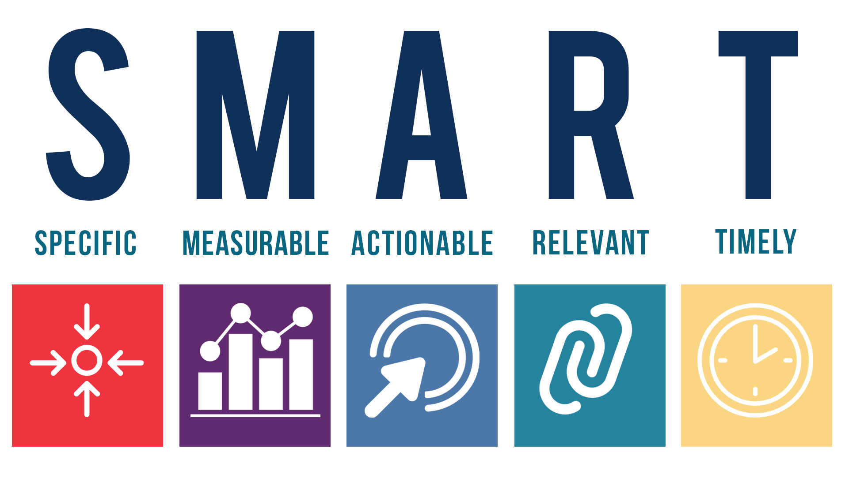
Goals of Our Project
Goals:
The KISS principle ("Keep it simple stupid!")
The Software has a mandatory delivery date that must be met.
Emphasis on speed versus memory use
The product should work, look, or "feel" like an existing product
The data gathered from ArcGIS’s Living Atlas should be accurate
The data gathered from the various APIs should be accurate
The GUI should be user-friendly
The application should be able to effectively extract knowledge of climate change and wildfire data for users
To create a dashboard with data analytics models includes AI and data science models in the back end to correlate the cause and effect of wildfires
Speaker: Rayan Hyder

Slide 18
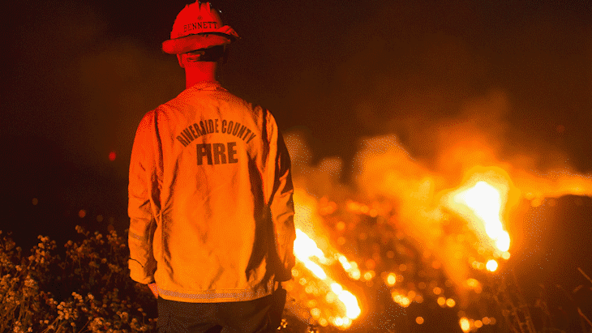
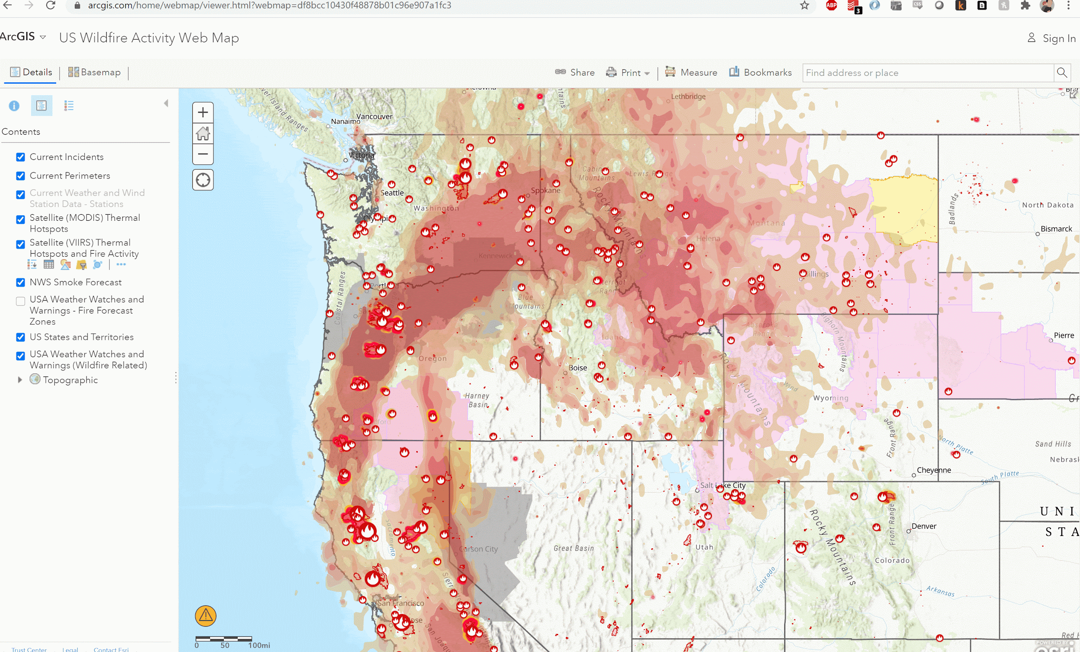
Purpose of our project
The main purpose of our product is to educate and empower people to prepare themselves for man made climate disasters like wildfires and droughts.
Illustrate prescient models or administrations that will give the fundamental data around fire climate, fire danger/fuels, an intelligence/resource status data that fire directors got to expect critical fierce blaze movement and decide where to position firefighters, motors, air ship and other rapidly spreading fire concealment resources to reply to it.
Speaker: Rayan Hyder

Slide 19
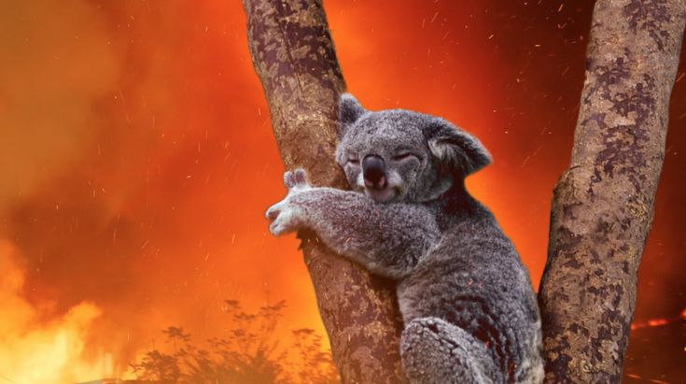
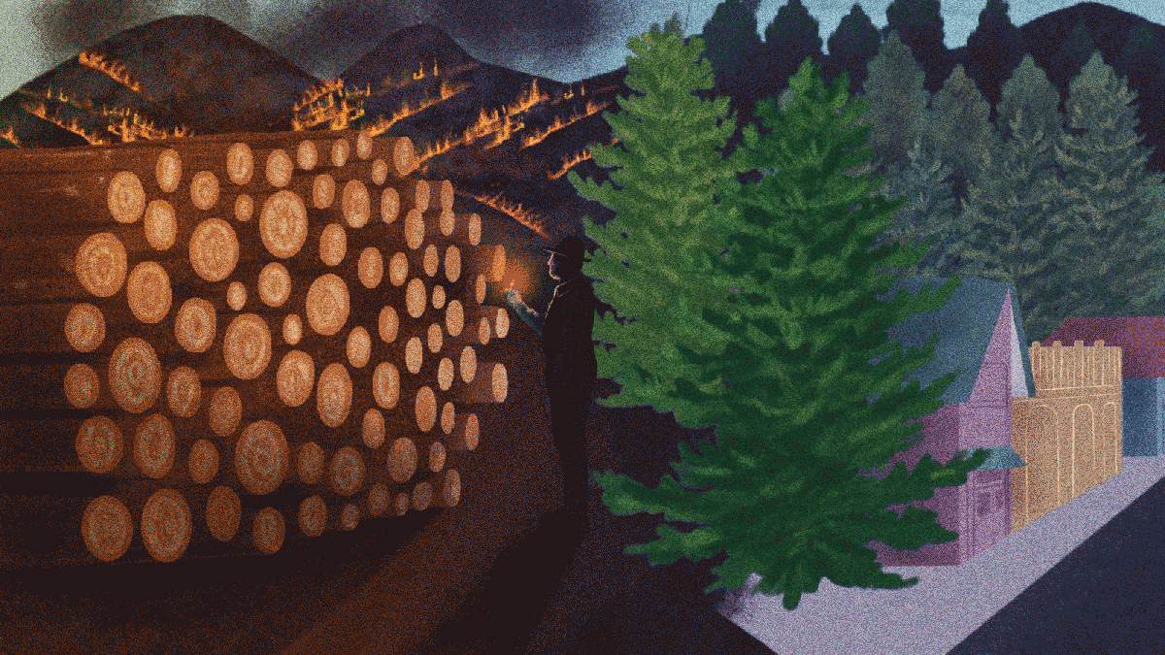
Impact on Ecosystem
Some scientists acclaimed that intrusive weeds and grassses might surpass local plants and bushes, making soil disintegration more likely which may lead to indeed more visit fierce blazes within the future, concurring to CBS.
The effect on creatures will depend on the species. Littler creatures, such as rabbits and a few birds, might have inconvenience surviving within the confront of the misfortune of local vegetation on which they depend, according to CBS piece said.
Depending on the environment, different process, such as extended lodging advancements and the utilities they require, fire exclusion/firefighting, and timber gathering, within the past a few decades have made it easier for fires to urge out of control, concurring to the USFS.
Speaker: Rayan Hyder

Slide 20
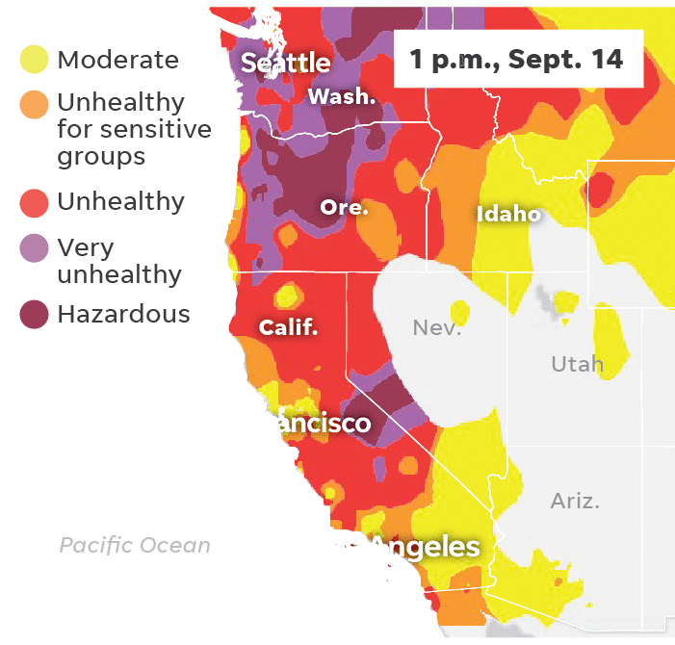
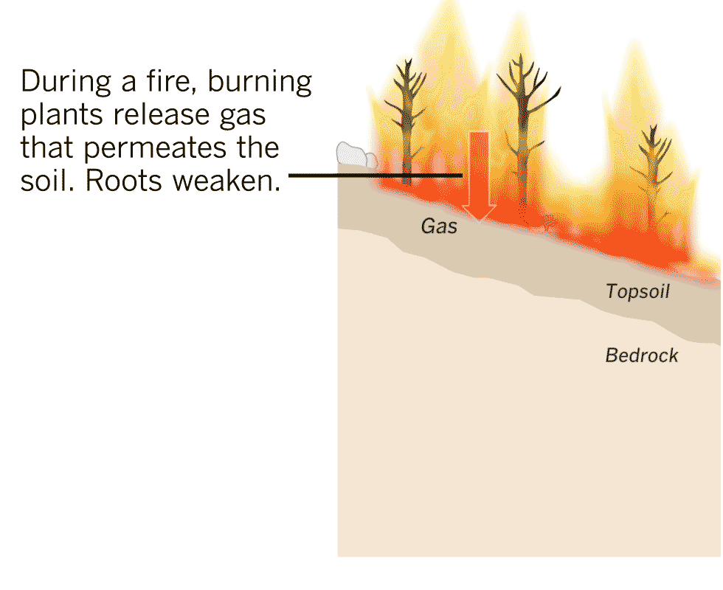
Impact on health
The poisonous smoke has as of now caused air quality to fall to unsafe levels in California, Oregon and Washington in addition to poisonous air, there is also debris and ash that covers some neighbourhoods toxic to humans and animals alike.
Another enormous concern for inhabitants is the danger of avalanches. Fierce blazes can char soil and enliven the probability of disintegration, which when matched with an attack of flooding precipitation makes however another catastrophe inhabitants must confront. When fire burns up vegetation, it annihilates what keeps soil steady. At that point when it downpours intensely, the water washes all of that soil absent with ease
Speaker: Rayan Hyder

Slide 21
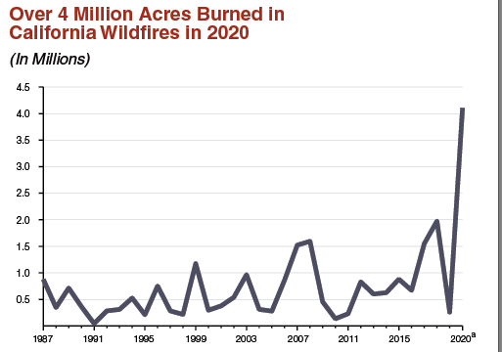
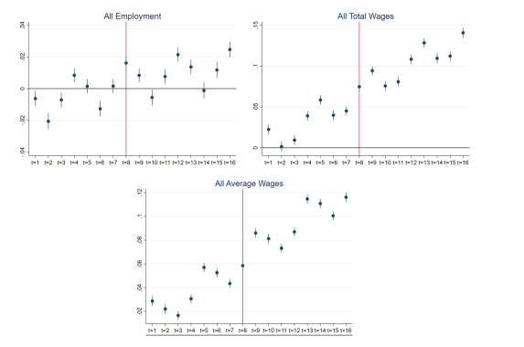
Impact on Economy
In 2020, for example, a team of researchers studied the nationwide impact of California’s 2018 wildfire season, and estimated that its economic damage totaled $148.5 billion.
As rapidly spreading fires gotten to be a more noteworthy chance around the world, it's imperative to consider the ways that fires and fire season influence the economy. An financial think about has assessed that each extra day of smoke presentation from a rapidly spreading fire diminishes profit in a community by around 0.04% over two a long time
Speaker: Rayan Hyder

Slide 22
Technologies Used
Speaker: Funing Yang

Slide 23
Achievements So Far
A website prototype:
Tweets from wildfire-related media
Wildfire map
Information page with various ArcGIS maps - rain, heat, etc.
Up-to-date News
Subscribe to mailing list
Speaker: Funing Yang

Slide 24
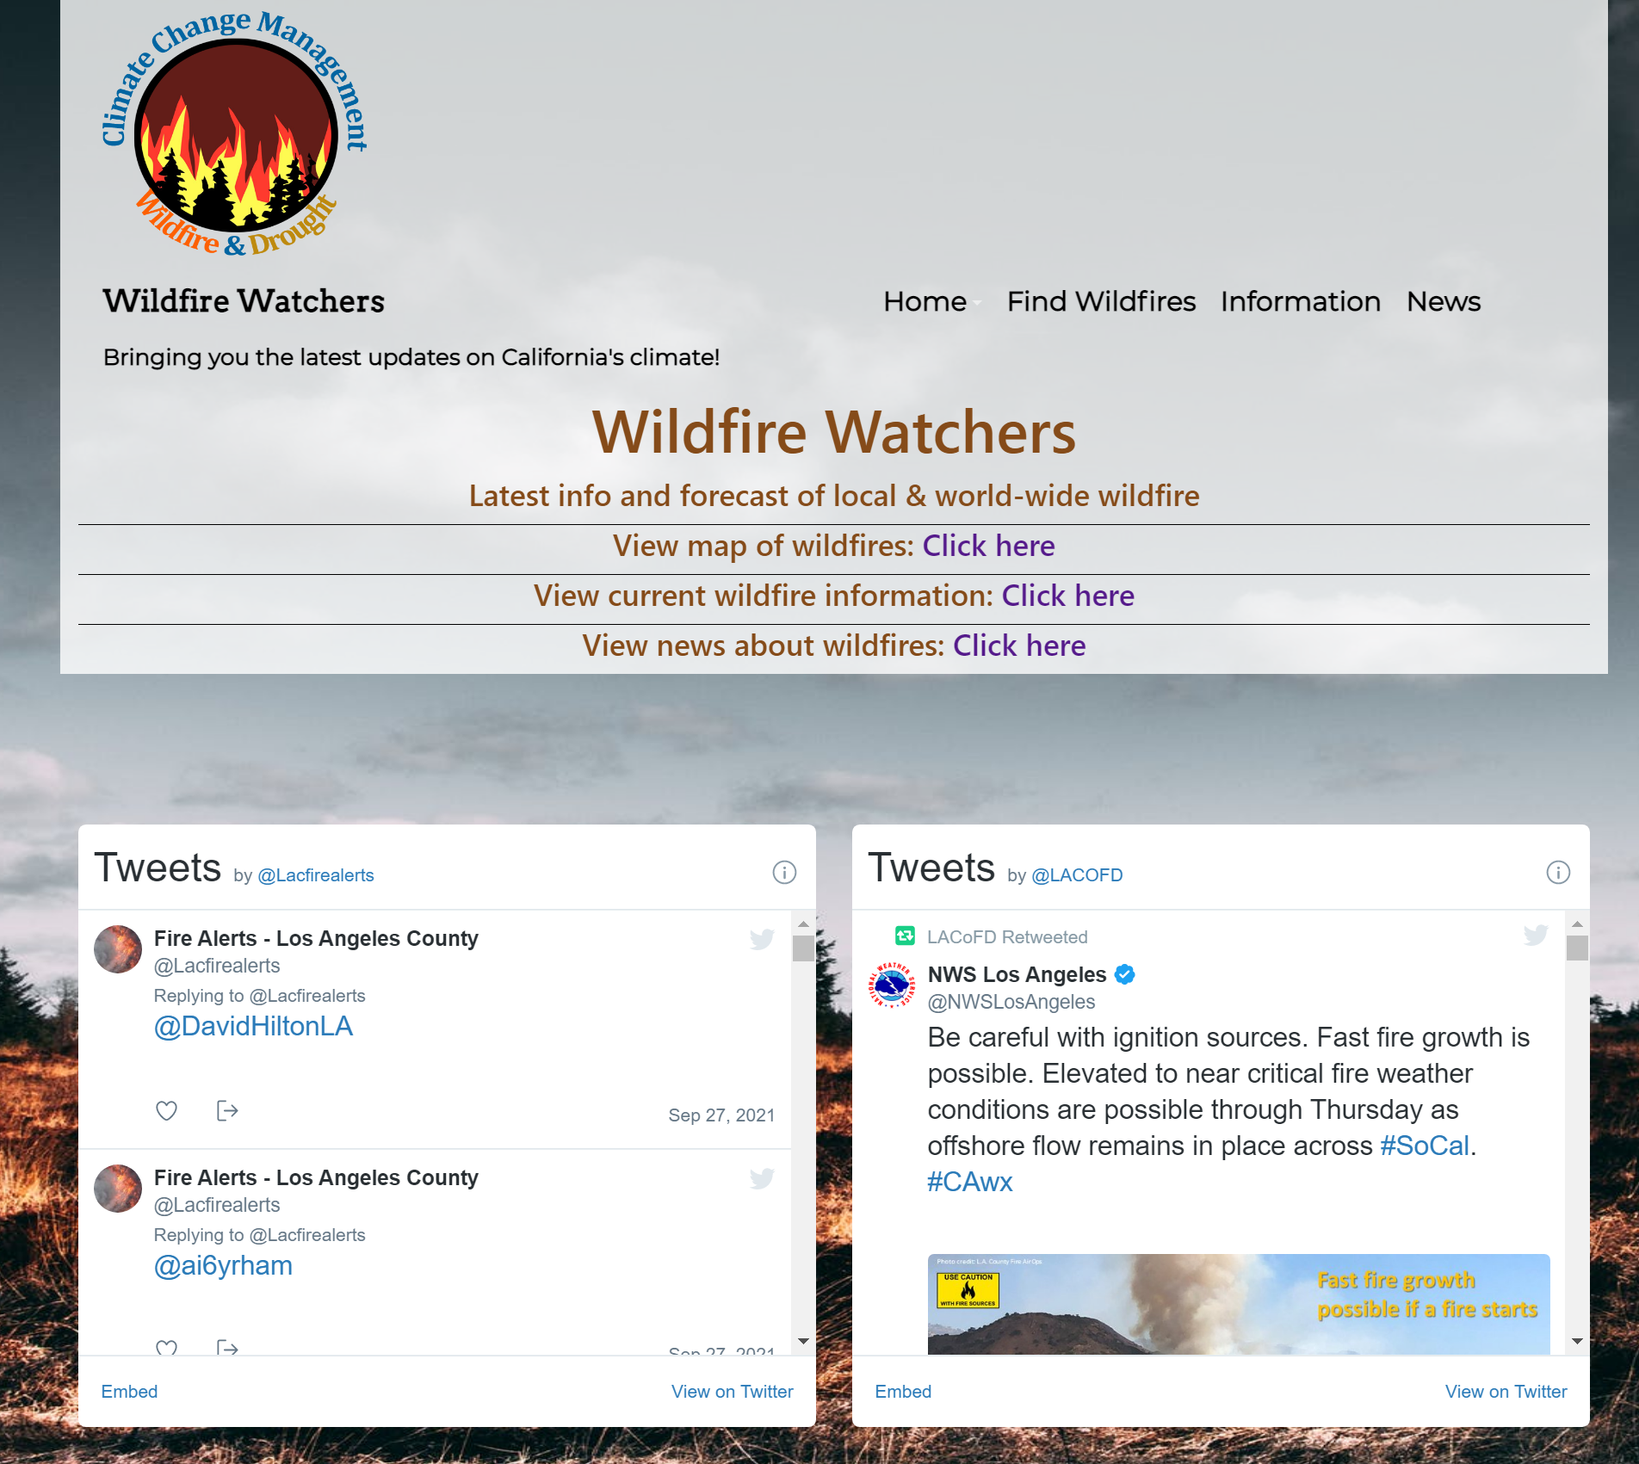
Home Page
Speaker: Funing Yang

Slide 25
Mission Page
Speaker: Funing Yang

Slide 26
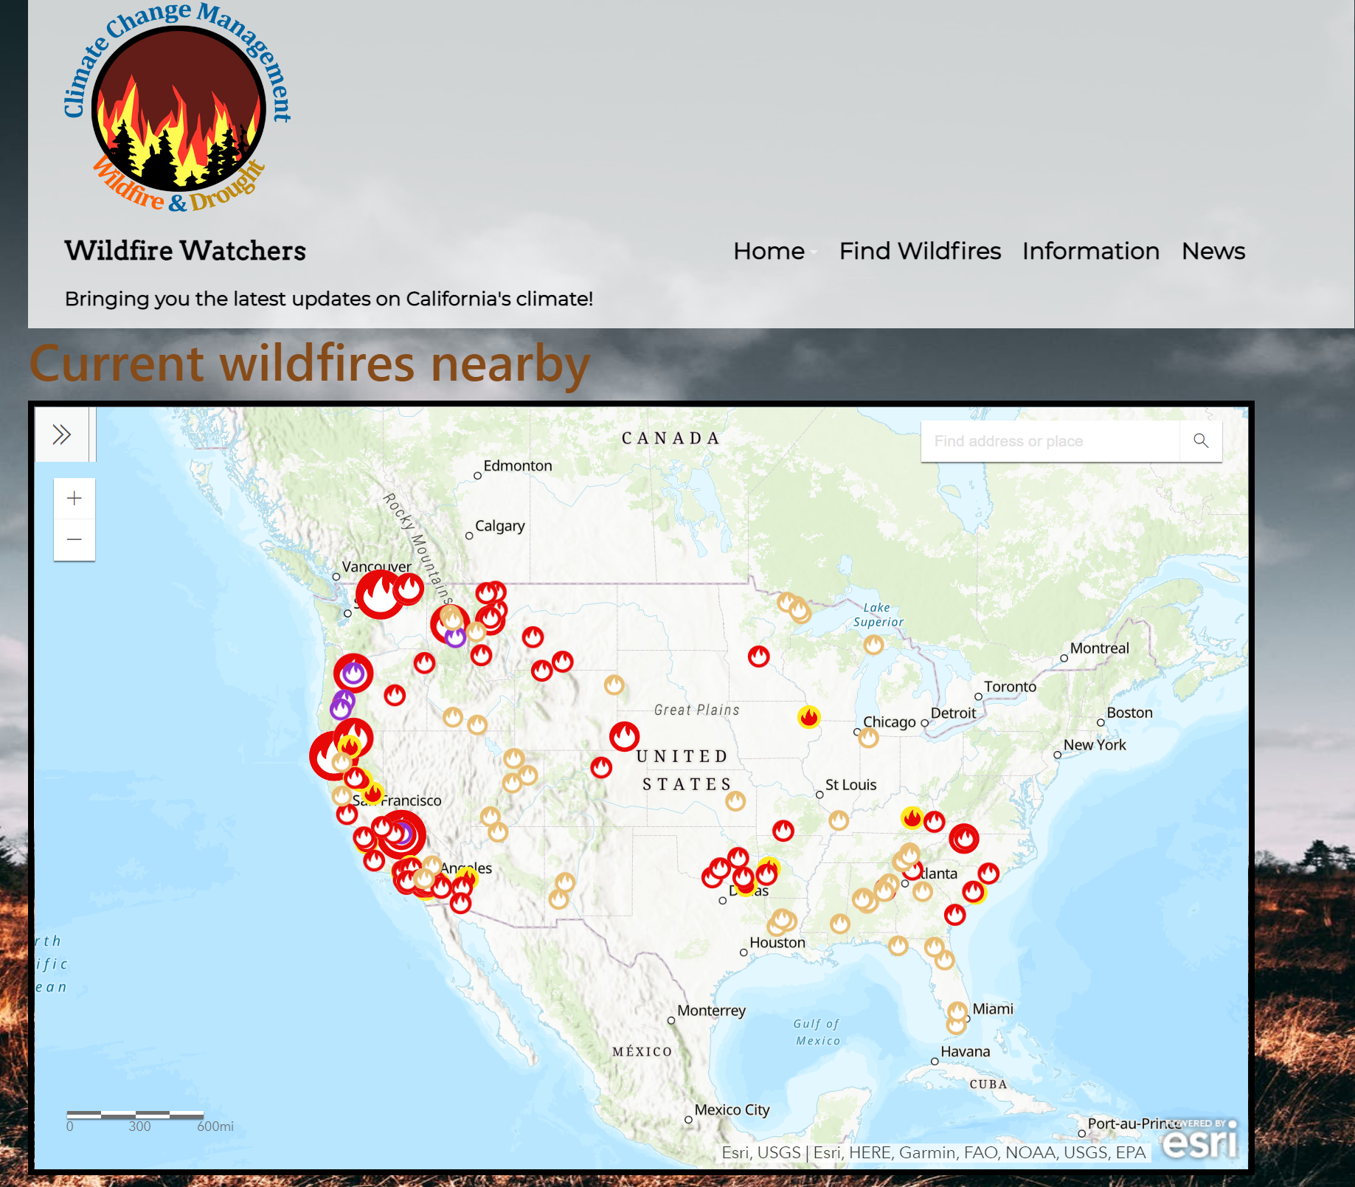
Find WIldfires Page
Speaker: Funing Yang

Slide 27
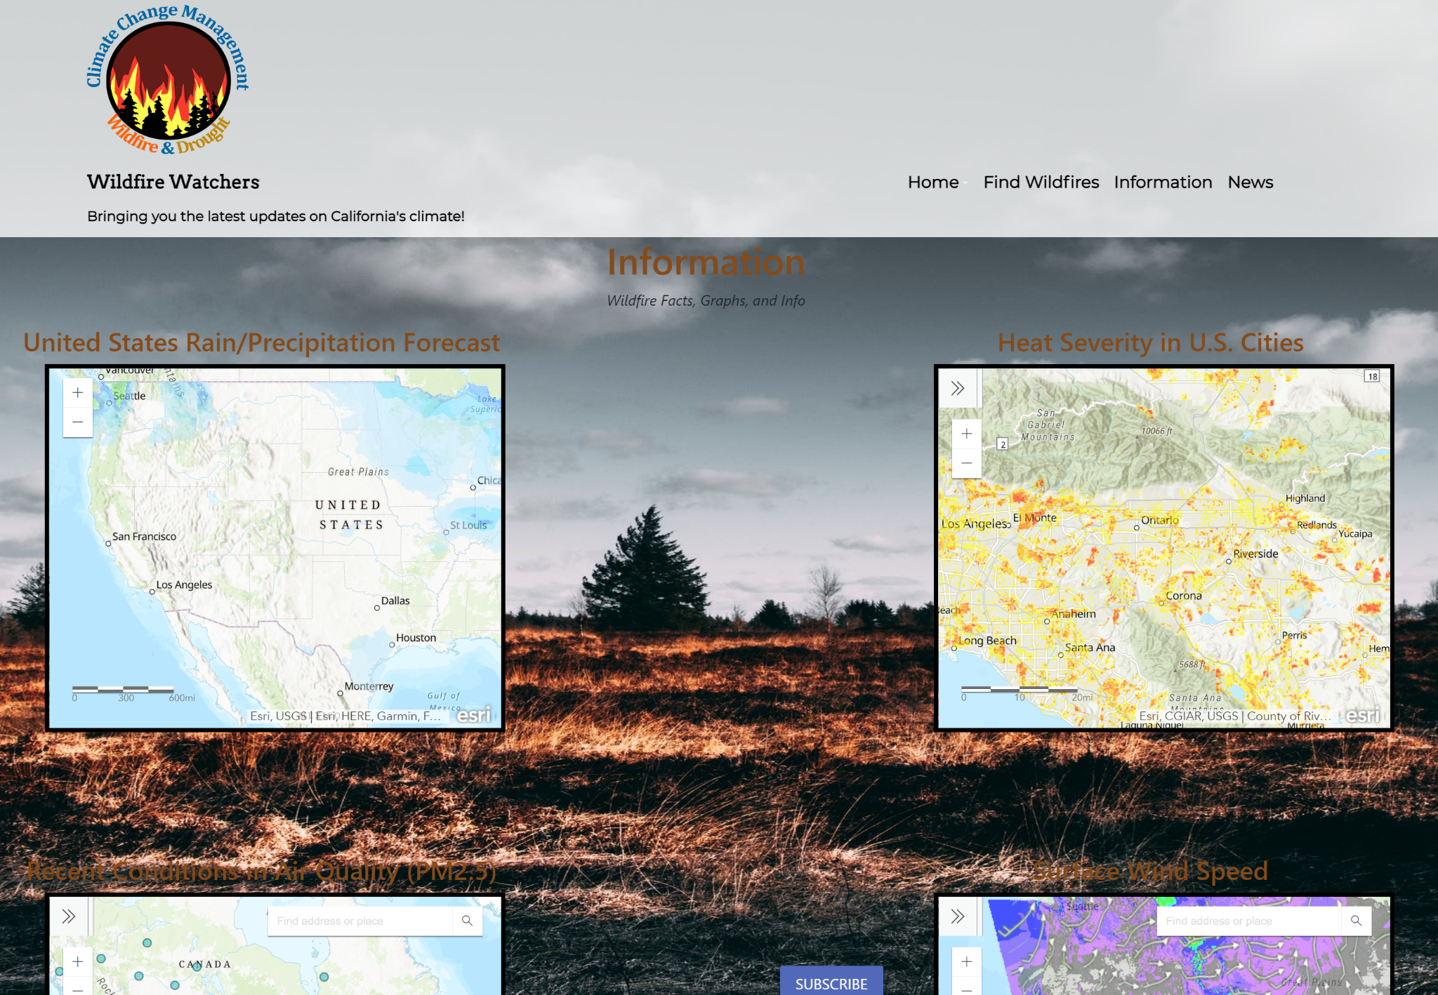
Information Page
Speaker: Funing Yang

Slide 28
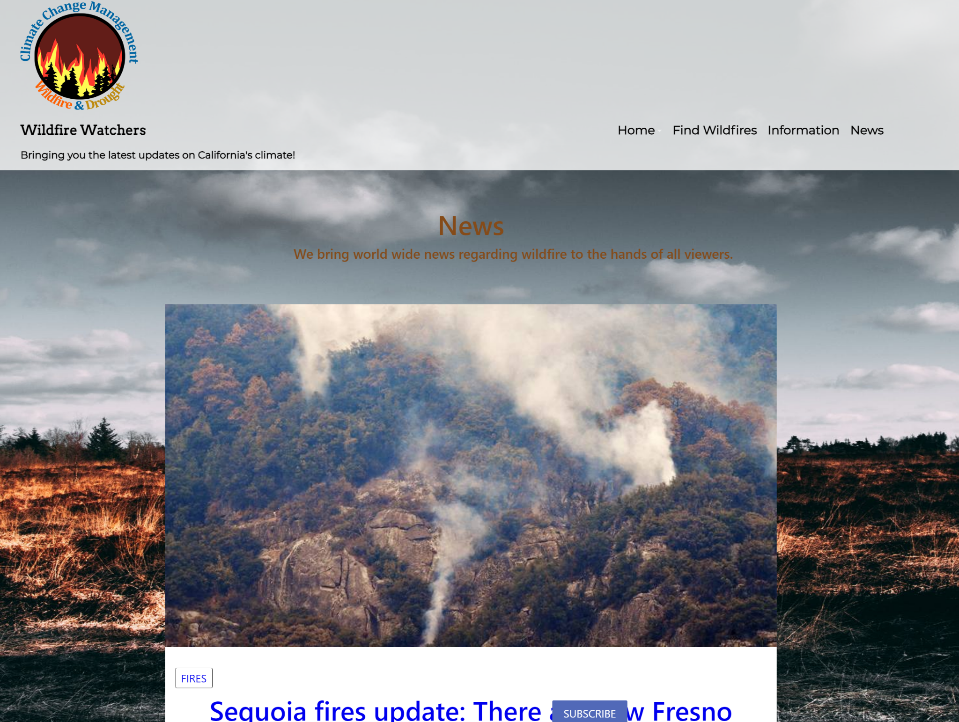
News Page
Speaker: Funing Yang

Slide 29
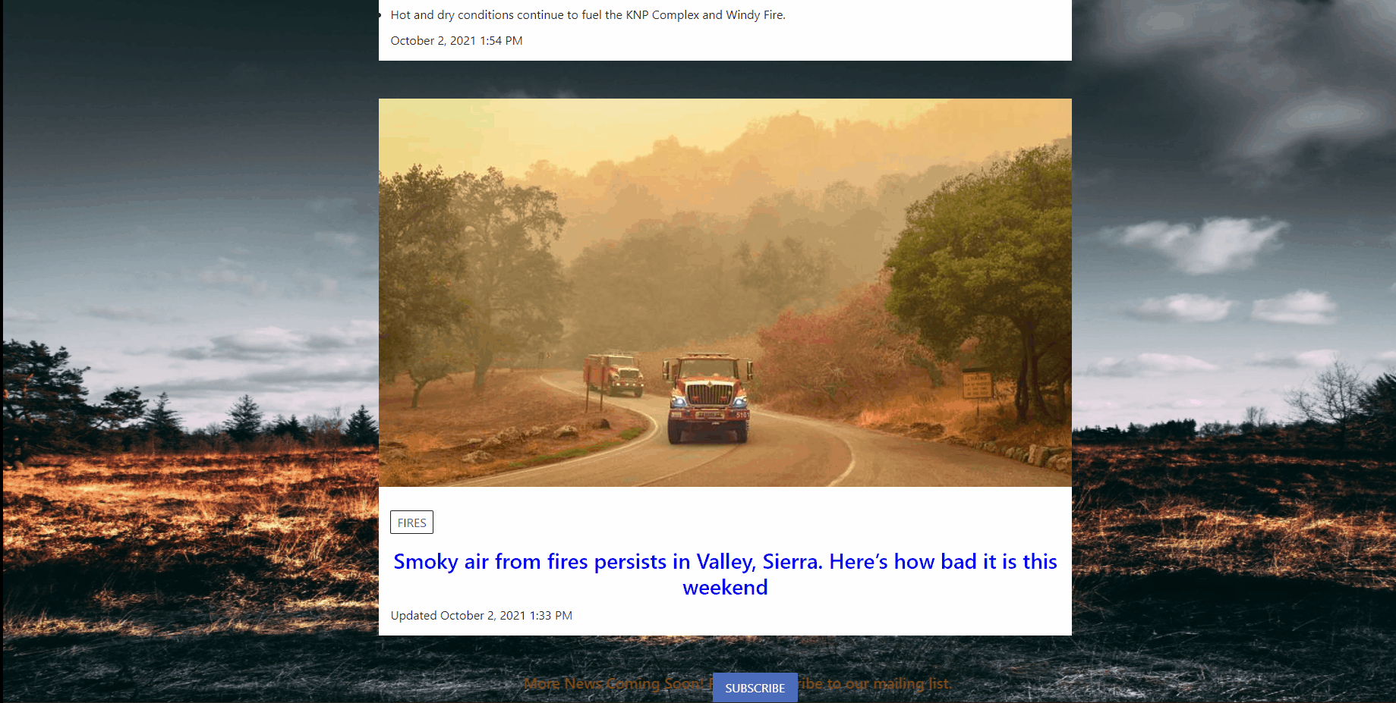
Subscribe to our mailing list​
Speaker: Funing Yang

Slide 30
DEMO
Speaker: Funing Yang

Slide 31
Future Goals (Web Application)
Add more detailed maps
More functionality
Add more data
Prediction data of air quality
More live data of air quality
Speaker: Victor Raj

Slide 32
Future Goals (Project - Long Term)
Add More GUI Elements:
Buttons for the different map information types (Ozone, PM 2.5, PM 10)
Real time data(both apps)
App Data
Predictable air pollution (AI)
In Depth information guide of specific points
Possible IOS implementation
Speaker: Victor Raj

Slide 33
Links/Works Cited
https://codesandbox.io/s/wildfire-map-koeg7
https://idahofirewise.org/fire-ecology-and-management/wildfire-ignition-behavior-and-effects/
https://earthobservatory.nasa.gov/images/148789/climate-change-pushes-fires-to-higher-ground
https://www.c2es.org/content/wildfires-and-climate-change/
Wildfire Watchers website

Slide 34
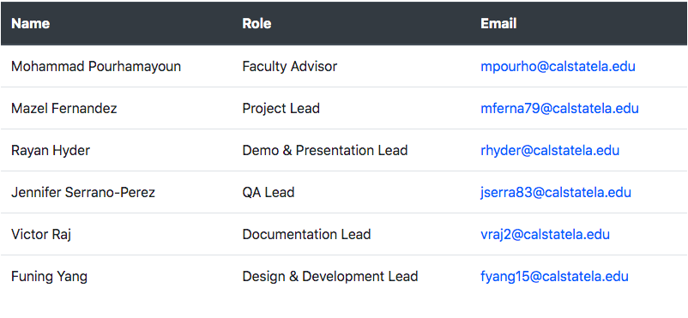
Contact Info
Discord: https://discord.gg/NF5hTmhVAw

Slide 35
THANK YOU!

