Slide 1
A Location-based Intelligent Forwarding Strategy for NDNWiFi
Faculty Advisor: Dr. Zilong Ye
Members:
Antonio Garcia
Saba Mahbub
Michael Oceguera
Kevin Tong
Hieu Tran

Slide 2
Overview
Introduction and Project Description
Background Technology
Algorithms
Location Detection
Current Project Development
Antonio Garcia

Slide 3
Introduction: Scenario
Many large outdoor areas don’t have Wi-Fi connectivity but you may need to get information from someone.
Our project aims to connect to the free wifi channels in the air so that in these situations, communication is still possible
Antonio Garcia

Slide 4
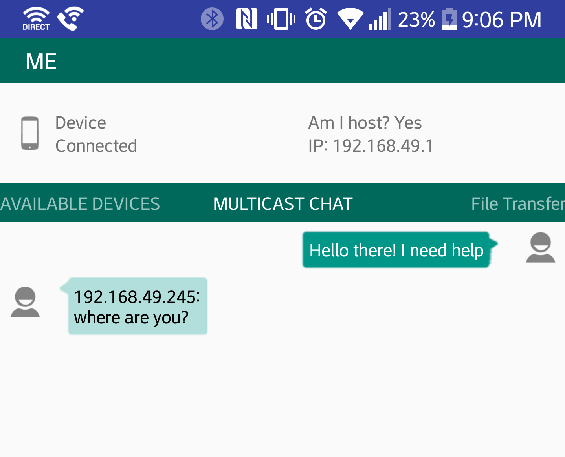
Project Requirement
Create a means of communication in communication challenged environments.

Slide 5
Project Description
Using the NDN and Wi-Fi Direct the previous project wanted to create forwarding strategies that reduced Bandwidth and File Transmission Latency.
Bandwidth = network resource consumption
File Transmission Latency = File Download time.
Antonio Garcia

Slide 6
Getting an Interest
NDN(Named Data Networking) is getting information based on the name of a file rather than traditional internet usage where information is transferred through addresses.
What not Where
Antonio Garcia

Slide 7
Project Timeline
Remove router centralized location
Implement peer-to-peer communication
Determine location detection as specific as possible
Implement forwarding strategy based on location
Antonio Garcia

Slide 8
Background Technology: Wi-Fi Direct
Wi-Fi Direct is a Wi-Fi standard enabling devices to connect to each other
Allows two devices to establish a direct connection without requiring a wireless router
Single radio hop communication, not multihop
Useful for everything from browsing the internet to file transfers and also to communicate with one or more devices at usual Wi-Fi speeds

Slide 9
Background Technology: Wi-Fi Direct
Conventional Wi-Fi networks are usually based on WAPs which provides various services
Typical home networks have various devices connected where the AP acts as a central hub
Wi-Fi Direct devices allow devices to communicate with each other without ever requiring a dedicated WAP
Kevin Tong

Slide 10
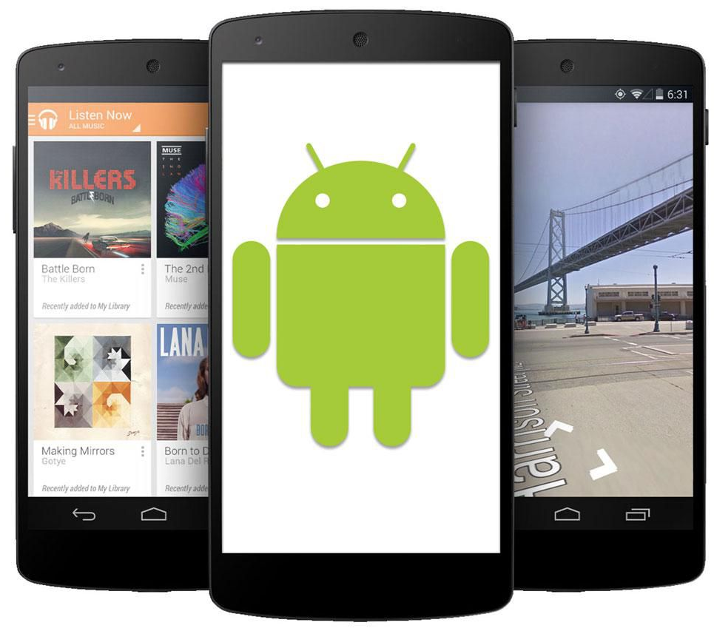
Background Technology: Wi-Fi Direct
Embeds a software access point into any device that must support Wi-Fi Direct
When a device enters the range of the Direct host, it can connect to it
Soft APs can be as simple or complex as the task requires
Standard includes WPA2 security.
Wi-Fi Direct certified devices can connect one-to-one or one-to-many
Kevin Tong

Slide 11
Wi-Fi Direct: How it works
One person acts as leader/central connection
Requests people around them to join leader’s group
Connect to group
Can send messages and files
Downfall: If group leader is disconnected or loses their service, entire group is lost and disbanded
MUST have a group leader
Kevin Tong

Slide 12
Previous Three Forwarding Strategies
First-Fit, Flooding, and Hit-Aware-Multicast
(1) When a person wants to request information, they sent an interest to the closest NDN router.
If the NDN has the data, return to the customer immediately.
Else interest will be cached in its Interest Table
(2) Request/Send file through algorithm
(3) If no nearby user has the data needed, the interest is still kept in its cache. This accounts for the situations if there are limited internet connectivity/ unreliable wireless communication.
Saba Mahbub

Slide 13
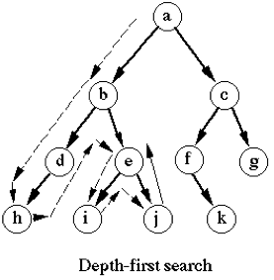
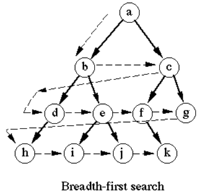
First-Fit vs Flooding
A selective strategy using Depth First Search
It iteratively searches down the tree until the router finds the data.
Flooding utilizes a Breadth-First Search forwarding strategy.
The request is sent to any available user in the range altogether.
Saba Mahbub

Slide 14
Hit-Aware Multicast
Hit-Aware-Multicast is the halfway point between First-Fit and Flooding.
In this approach, each router has a counter of hits and missed Interests.
In this case we send a request to the user based on their hit-rate determined by historical evidence(if they’ve been search before, etc.) and will more likely lead to
(1) someone who owns a rich set of cache or
(2) has the shortest route between the NDN router, and the internet.
Saba Mahbub

Slide 15
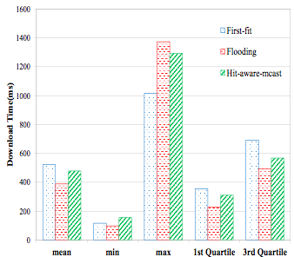
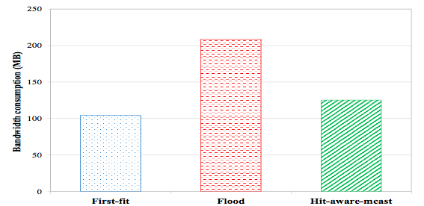
Comparisons
Flooding takes the most bandwidth but has least download time
Hit-Aware Multicast is the average of the three and is the best so far
Saba Mahbub

Slide 16
Current Project Developments
Overall Goal: Develop a location-based intelligent forwarding strategy in NDN-WiFi
Aim for optimal performance
Bandwidth consumption
Information retrieval latency
Two main objectives for this current project
Location Discovery
Forward Based on Moving Direction
Michael Oceguera

Slide 17
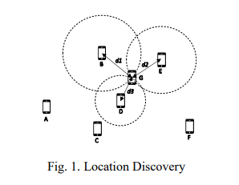
Step 1: Location Discovery
New user G, in Fig. 1, initiates “hello” messages to at least three neighbors with assigned coordinates.
User G then receives information from neighbors B, D, E with their coordinates and transmission latency.
Alternatively, the user G’s location can now be discovered by other devices
Michael Oceguera

Slide 18
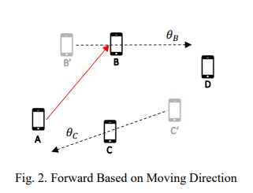
Step 2: Forward Based on Moving Direction
Each user tracks of their current and previous location.
Determines the user’s moving direction.
Intelligent routing can be made.
Ex: User A needs to send data to user D. Rather than send data to all users, A can send to user B who is moving towards D.
Michael Oceguera

Slide 19
Current Project Developments
Location is found through GPS coordinates
Can calculate bird-eye distance through Haversine formula
Can calculate angle/direction of movement through bearing formulas
The use of the Multi-cast socket to send a user’s location to everyone in the group
Michael Oceguera

Slide 20
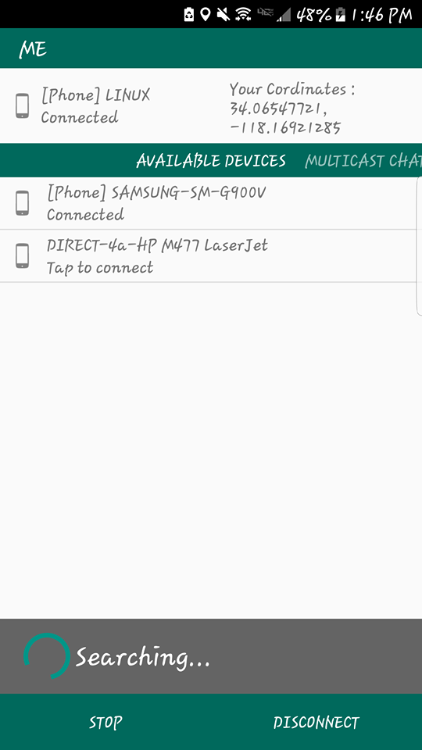
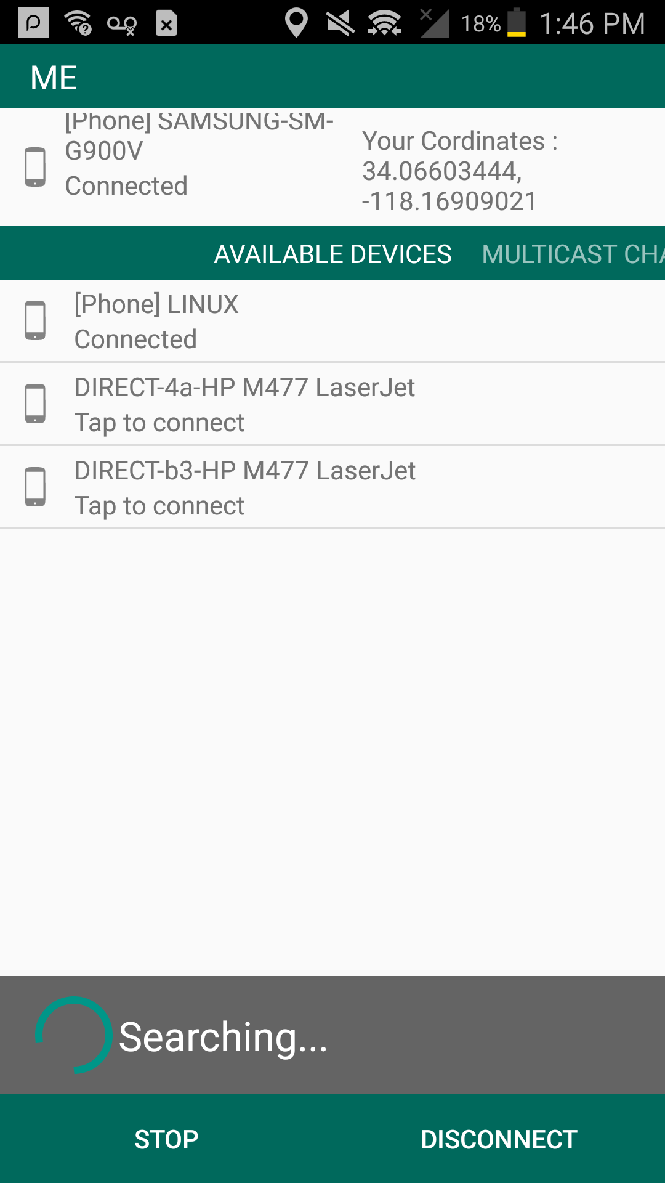
In App: Location Discovery

Slide 21
Current Project Developments
Wifi-Direct Single Socket
Private chat
No more than 2 people in the chat
Must create multi socket first
Wifi-Direct Multicast Socket
- Allow more than 2 people in the group
Need to be created first before user can use private chat
The main function of the app
Allows user to create group
one to many
Hieu Tran

Slide 22
Current Project Developments
Send text messages
File Transfer
Create multi chat room
Periodically exchange location information through the chat
Whenever someone wants to contact anyone, has option to see who is closest
When chosen, create single socket between the two devices
Hieu Tran

Slide 23
Future Goals
Set up experiment
Compare new algorithm with existing ones
Allow group leader to change
Make the app more enjoyable
Hieu Tran

Slide 24
Questions?

