Slide 1
Box.com/eDefender Integration & Document Tag Parser
Team Members: Daniel Guevara-Dominguez | Jesica Lopez De Leon | Luke Williams | Sergio Tapia | Shaocheng Shi | Chuang Huang | Marco De La Torre | Joshua Cabrera | Raul Gallegos | Dang Le
Faculty Advisor: Dr. Lim
Santa Barbara Public Defender Office: Deepak Budwani | Angella Stokke | Bryan Burzon | Sarah Rothschild | Aidan Bassett
Department of Computer Science
College of Engineering, Computer Science, and Technology
California State University, Los Angeles
Notes:
Daniel
Our group’s project initially started as Box.com/eDefender integration and we later pivoted to develop a separate application titled Document Tag Parser. We will be discussing each of them in separate sections, starting with the Box integration.

Slide 2
Box.com/eDefender Integration
Notes:
Joshua

Slide 3
Project Goals for Box.com/eDefender integration
Provide a method for transcribing both video and audio files
Adapt the existing Box skill application to function within our sponsor’s environment
Collaborate with our sponsor’s developers to add an alert system to the app
Test the application to ensure it functions as expected with all external dependencies
Notes:
Joshua
1. SBPD wanted a way for their attorneys to conveniently review video and audio files. It is likely that those reviewing a file would need to refer to it multiple times. The ability to quickly jump to the most important parts of the file would save a lot of time and help build a stronger case for their clients.
2. In 2020, another senior design team created a Box Skill application which performed the same task. Part of our goal was to add on to that project and adapt it for SBPD’s purposes.
3. They use a case management system called eDefender. All relevant details to each case can be accessed through this platform. Another important goal was to make eDefender a “one stop shop” for all relevant case material. This would mean sending an alert from Box to eDefender when new case discovery is uploaded.
4. Our final goal was to deploy the application within SBPD’s environment and ensure it is functioning properly with all dependencies.

Slide 4
What is a Box Skill Application?
Small, lightweight application
How does it function?
In what environment is it designed to function?
What output does it produce?
Notes:
Joshua
Box.com is a cloud storage provider which also provides additional features for users who wish to tailor their experience for their specific business needs.
A box skill app is a small, lightweight application that runs in the background and performs custom processing for files uploaded to the cloud
The box API is available in multiple programming languages, and provides a convenient framework for interacting with Box. It is designed to be used in code that is deployed as a serverless instance, such as a google cloud function or AWS lambda function.
It is typically triggered by a file upload. A user can specify a folder or set of folders which are tied to the application. The processing it performs does not modify the file and is perfect for processing metadata on the file.
In our case, that metadata is used to build a user interface in box which allows a user to easily navigate a video or audio file that is tied to a specific case.

Slide 5
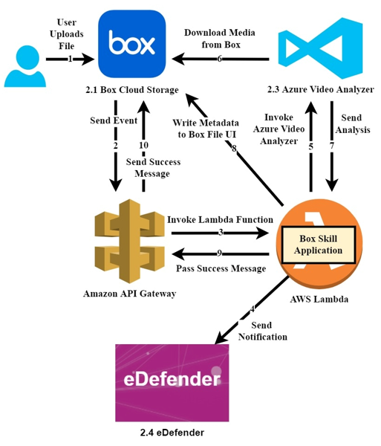
Integration Architecture
The user uploads a media/audio file
The Box Skills service invokes the lambda func
Lambda connects to Azure Video Analyzer which retrieves the file directly from Box.
Azure Video Analyzer returns its analysis to the Lambda function
Lambda sends the metadata to box, as well as a success message once the process is completed
.
Notes:
Chuangh
To account for the additional eDefender alert system requirement, the design was revised as shown in the picture here. In the next slide, we will go over the results of the processing. For now let’s take about how these separate pieces fit together.
A user uploads a media file to a case folder within Box
The Box Skills service sends an event request to the AWS API gateway with the access token, and triggers the lambda function
From within lambda, the Box skill app runs and provides the access token from box skills service to Azure Video Analyzer so it can retrieve the file directly from box. The Box skill app does not handle the file directly.
Azure Video Analyzer returns its analysis to the Lambda function, and the skill app then generates metadata based on that analysis using skill cards.
Lambda then returns a response containing that metadata to box.com, which includes a success message indicating that the process was completed
The Box skill app also sends an alert to eDefender letting the user know that a file had been processed.

Slide 6
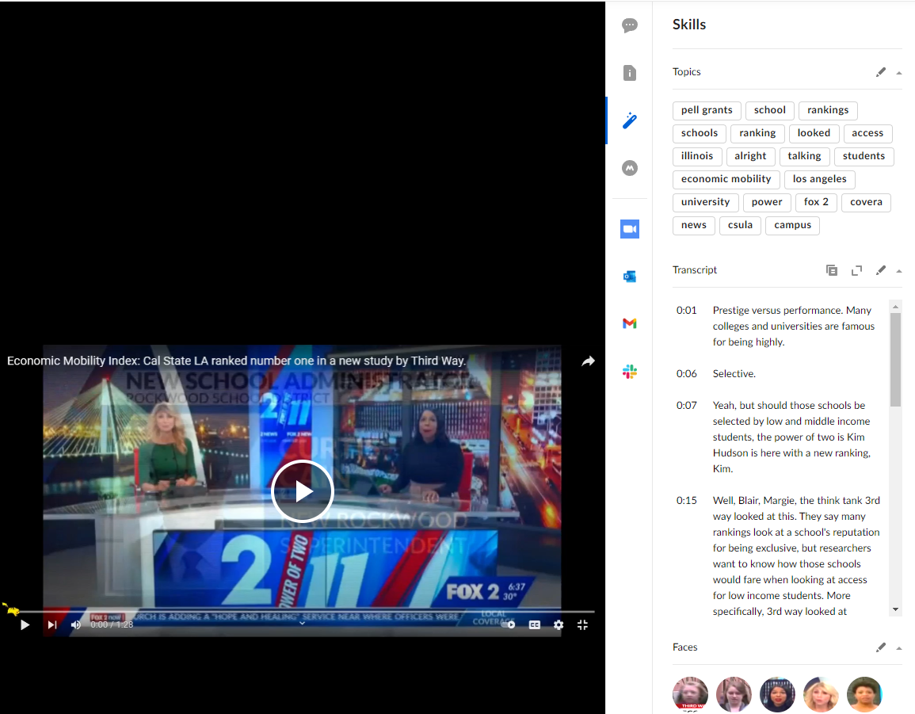
Box Transcription Results
Notes:
Luke
Here is a screenshot of one of the test videos we uploaded. After dragging and dropping in the file in Box, and a brief waiting period, the UI shown on the right will appear whenever a user clicks on the file.
This UI was created from the metadata served to Box from the skill application. The primary purpose of the Box Skill app is to enable Azure Video Analyzer’s machine learning technology to provide facial recognition as well as transcription.
This is a video about how Cal State LA sets up its students for a prosperous career. Under topics, you will see keywords such as economic mobility, csula, and so forth. You can imagine how this might be useful as an attorney. Under transcript, you will see a timeline and a few sentences related to what was spoken at that particular point in the video.
Finally, the faces heading gives a quick overview of the people who appear in the video. For the purpose of legal evidence, this can be used to quickly identify if and when a client is present in the video.

Slide 7
eDefender Integration and Project Results
Testing was completed using our own AWS and Azure accounts
Santa Barbara PD’s existing Box instance was used for uploading
Collaboration with SBPD regarding the eDefender alert system
Result of the Box.com/eDefender Project and future plans
Notes:
Luke
To achieve the result we just presented, we used SBPD’s existing Box instance as well as our own AWS and Azure Video Analyzer accounts.
Given our results, we were confident they could be replicated with any Azure and AWS account.
We then moved onto designing the eDefender Alert System. We initially met with our sponsor’s lead developer Josh Gill.
We were not familiar with eDefender, but we understood the Box API. After some discussion, the initial design was to have the Box skill app make an API call directly to eDefender. This proved challenging, since eDefender was better suited to make http requests, rather than receive them.
After reviewing the Box API and discussing our options with Josh, we decided that a good back up plan would be to query Box for recent files that had their ‘transcript’ property set. This would indicate a file had been processed and was ready for review.
In the meantime, we wanted to move forward and assist SBPD with deploying the application using their own AWS and Azure accounts. However, a contract had not yet been finalized with the vendors and the public defender’s office.
Given that time was running out, we discussed our options with our sponsor and we decided to pivot to a separate stand alone application, which would also improve the efficiency of case review. We will discuss that application next.

Slide 8
Document Tag Parser App
Notes:
Daniel

Slide 9
Project Goals for Document Tag Parser
Build a software application that can automate the process of renaming files.
Utilize machine learning and multi-threading to assist in processing of documents
Provide a results report to the user once the process is complete.
Save time spent on manual labor.
Notes:
Jesica
Thank you Daniel. Hi, I will go over why we created the Document Tag Parser app.
So SBPD receives files in various formats including pdf, jpg, and png
These files are typically already bate stamped by a 6 digit number as can be seen on the file icon
The size of the files can range from 1 page to hundreds of pages and each page receives a bate stamp
SBPD spend approximately 1,000 hours yearly manually renaming these files based on the bate stamp range on each file
Bates-stamps are used to help identify documents that have been produced and to refer to them in legal proceedings
We identified a standard process that was used to rename these files and believed we could create an app to automate this process
This will be further explained in the next slide by Raul

Slide 10
Document Tag Parser Requirements
Process pdf files (text based/image based) of any size.
Files (should) include sequentially ordered bate stamps
Rename files with a standardized naming convention
Process files within a selected folder or individual file(s).
Notes:
Raul
Hello. In order to accomplish the goals set out for us we had to establish some requirements that our program would ultimately complete.
The process is relatively simple: Take a file of any size, if there’s more than one document in the file it needs to be sequentially ordered, and we need to read and write from directories.
The program had to be prototyped and developed while not knowing how the data that we would be processing looked
Our vision included automating the process, and creating a completion log with any errors found.
For our approach and libraries used I would like to introduce Marco

Slide 11
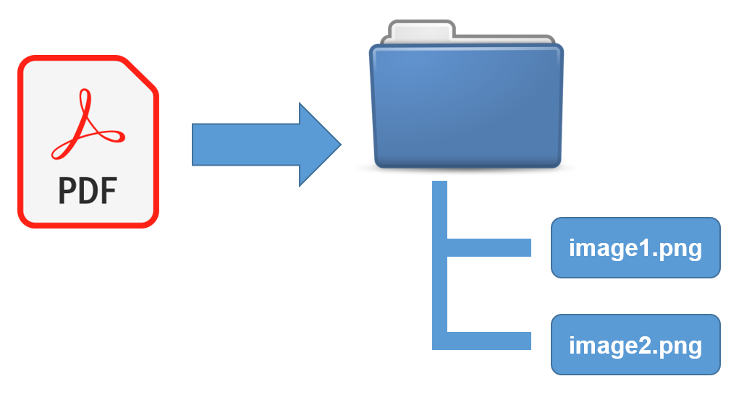
Technologies Used
Python
Pytesseract OCR Library
Pdf2image library
Tkinter GUI toolkit
Notes:
Marco
Hello, I'll be going over the technologies used for our Document Tag Parser App, such as the chosen programming language, and the libraries we used.
Python is an easy to use object-oriented, high level programming language with built-in GUI support and extensive library and module support.
Python-tesseract is an optical character recognition tool (or OCR tool) for Python. Python-tesseract is a wrapper for Google’s Tesseract-OCR Engine and is used to read characters in an image (eg. jpeg, png, gif, bmp, tiff, etc.)
Pdf2image is a module that wraps pdftoppm and pdftocairo to convert PDFs to a PIL(Python Imaging Library) Image objects which is then converted to images for Python-tesseract to read from.
Tkinter is a graphical user interface (GUI) module for Python that makes creating desktop apps easy with Python. With Tkinter, we are able to refine our desktop app window size, buttons, text and images amongst other things.

Slide 12
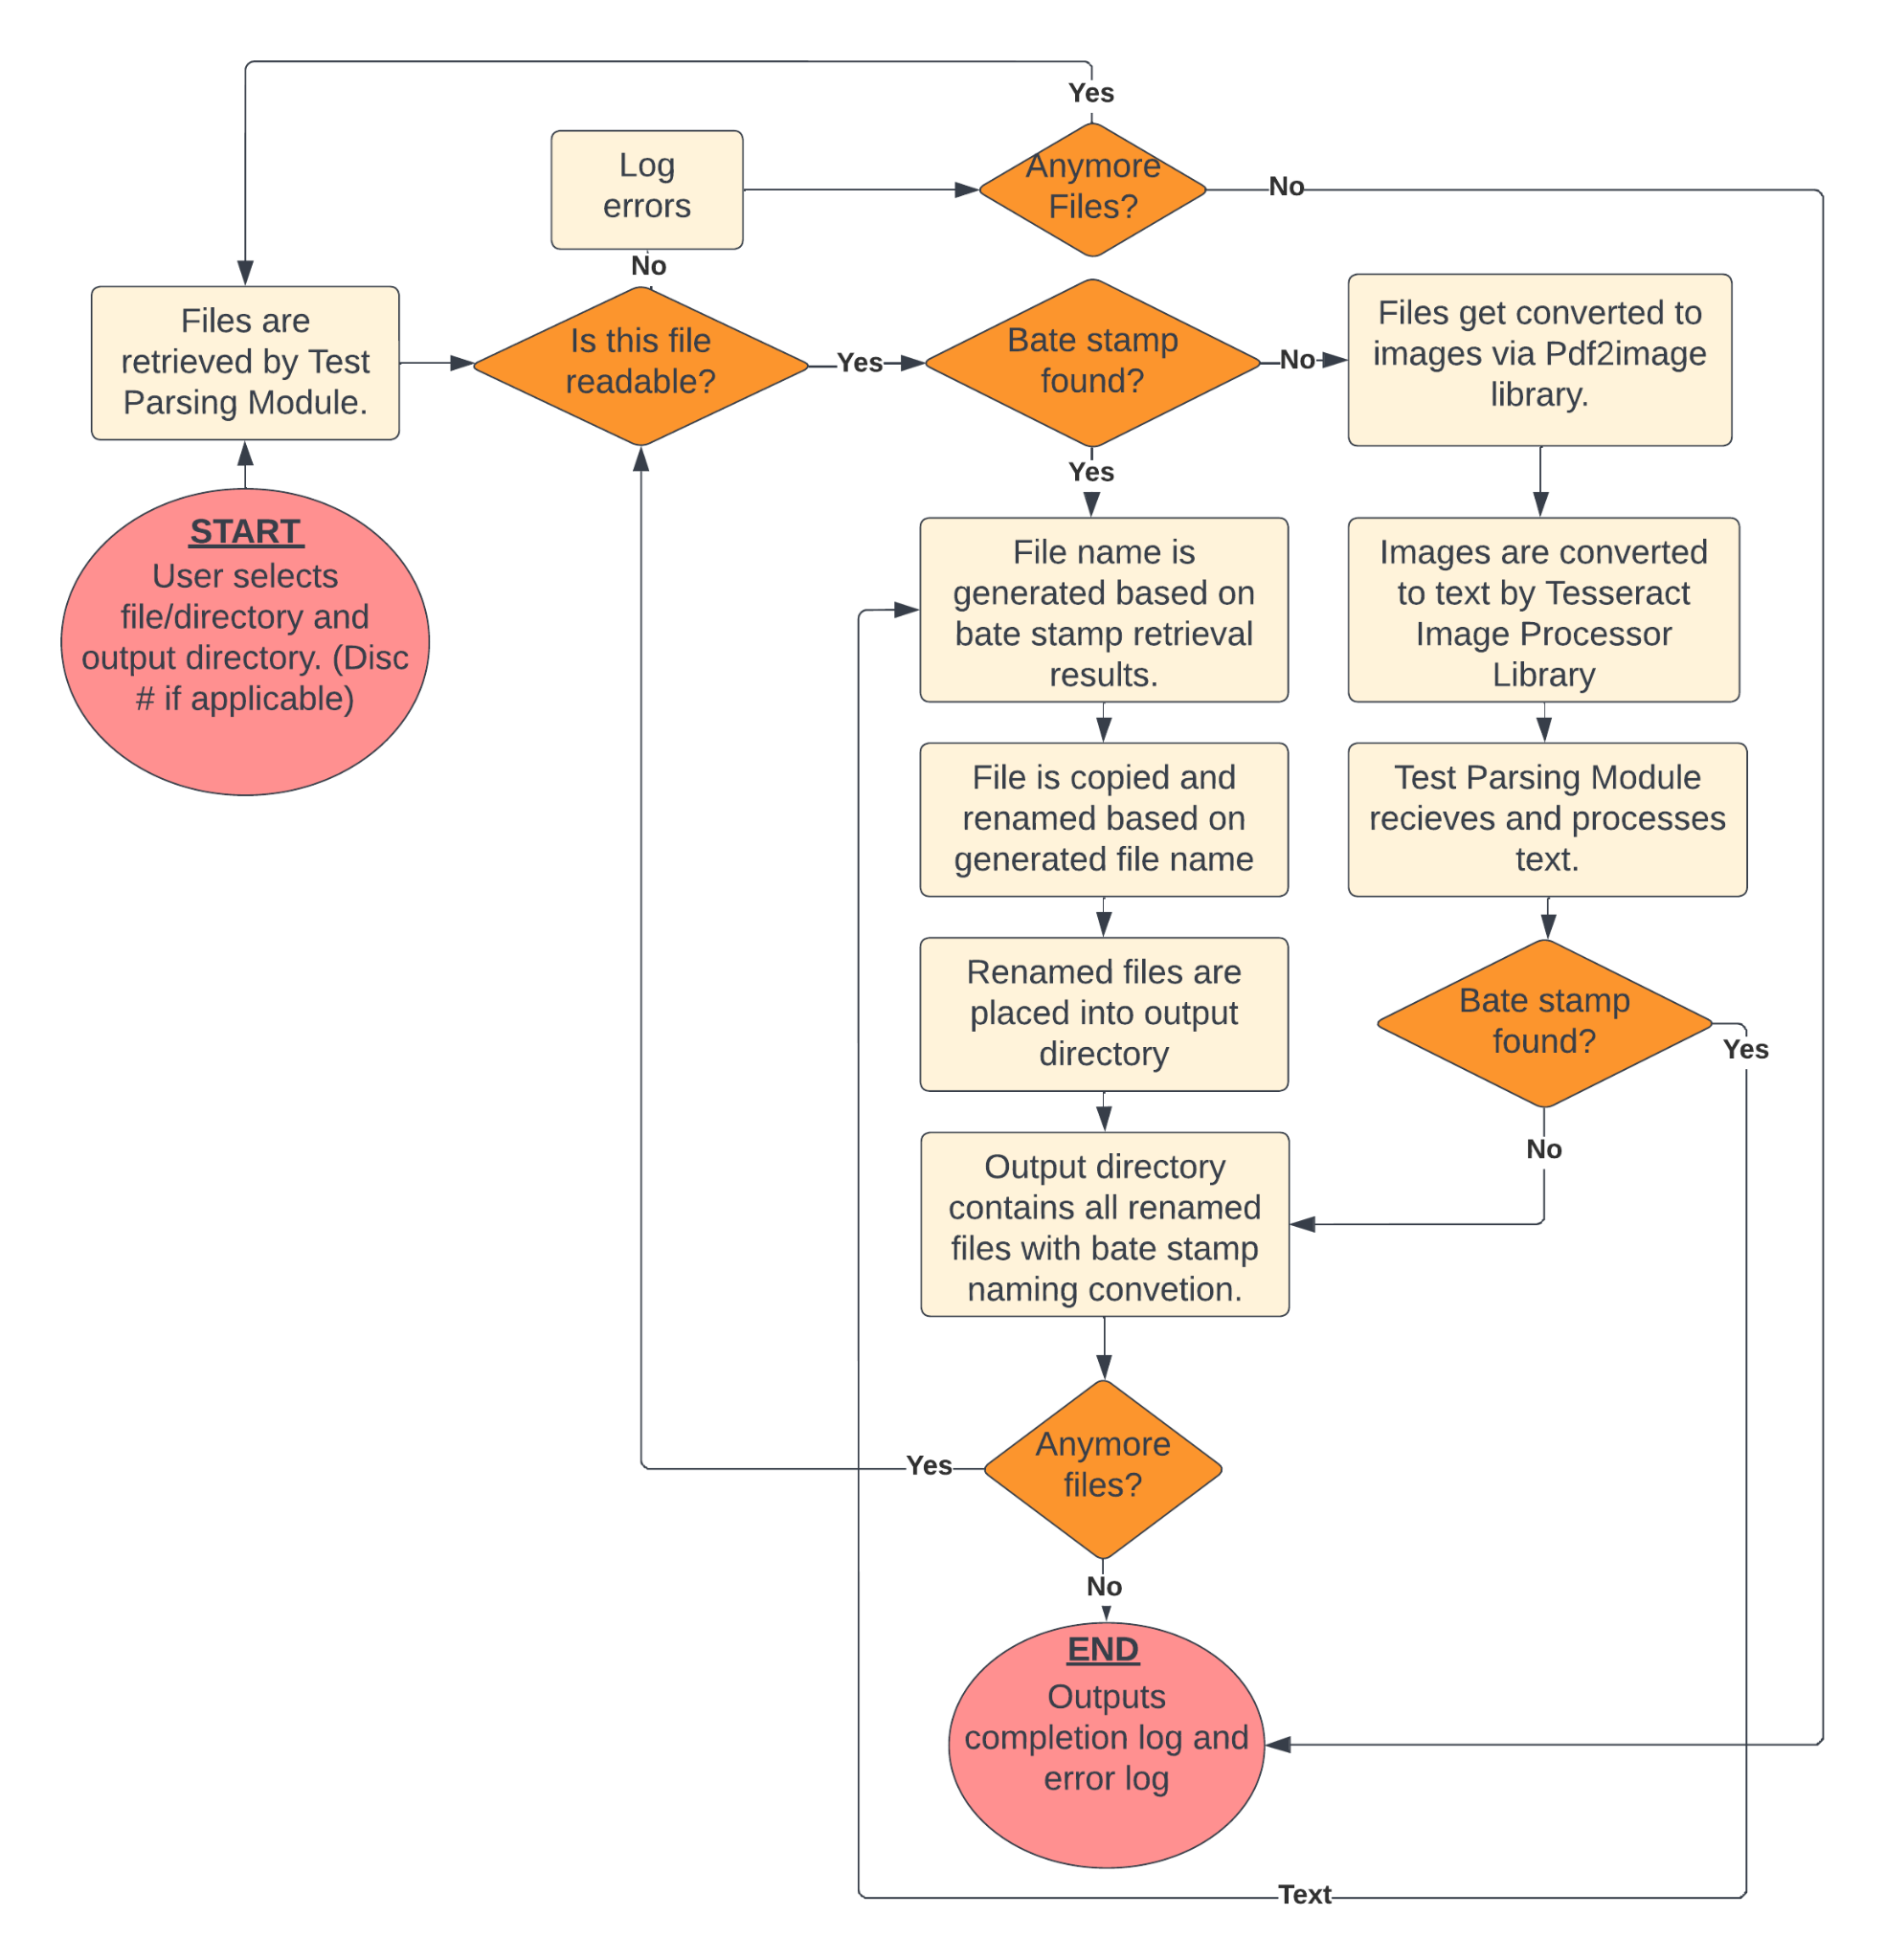
Document Tag
Parser FlowChart
Notes:
Dang

Slide 13
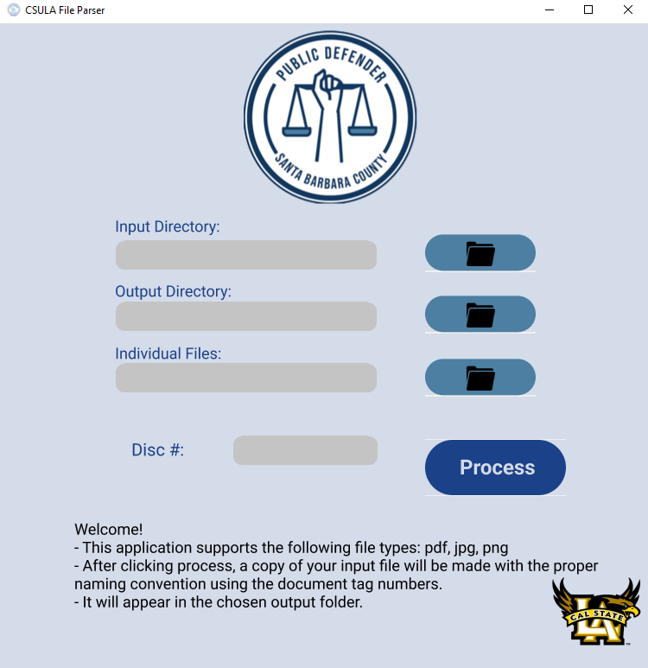
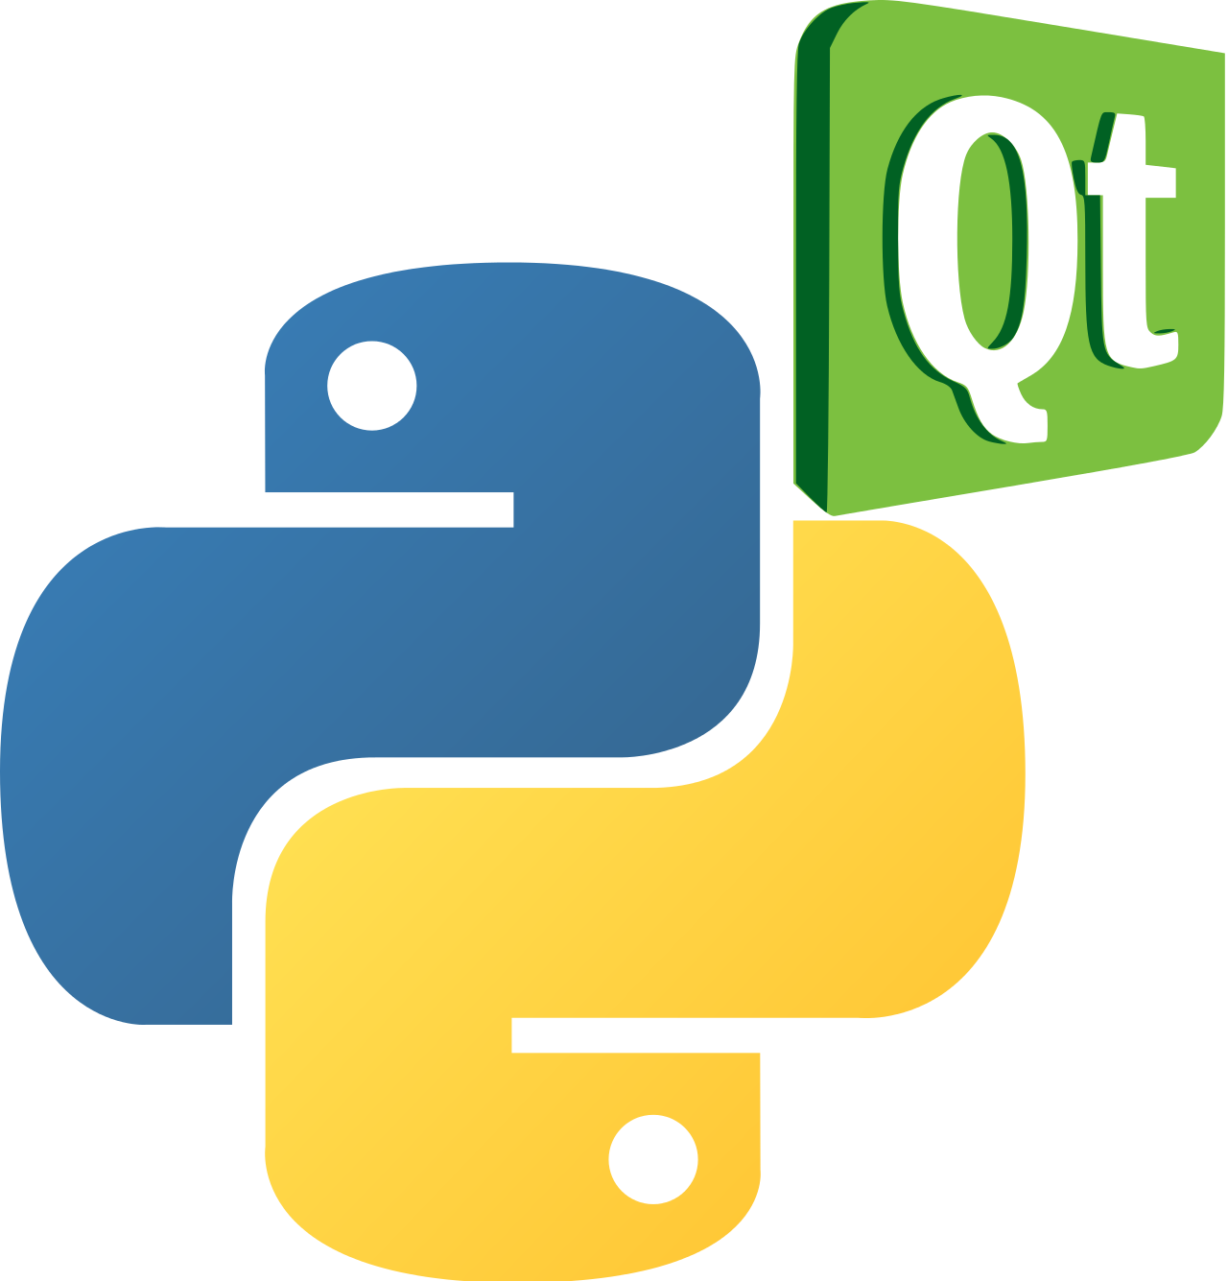
Front End
Used PyQT5(drag and drop application) and Tkinter for design
Input fields/buttons(images used for buttons)
Input directory/selected files
Output directory
Loading bar
Single thread to keep GUI responding.
Notes:
Shaocheng Thanks you Dang. Good Morning, everybody, My name is Shaocheng Shi. I am the UI lead of our team. I will be introducing the UI part of our program. Since it’s a file parser tool, we want to make sure our tool is easy to understand and use. Therefore, we basically used two GUI tools that are very common on the market. One is pyqt5, which gives us the drag and drop application, and the other is Tkinter, which is Python's in-fact standard GUI. As you can see, the head image of our UI is Santa Barbara Public Defender logo because it’s a program sponsored by them. Our CSULA logo is on the bottom right.The file types our program supports are pdf, jpg and png. If you are using other types file, our program would generate an error log that tells you the file type is wrong. Under the santa barbara logo, there are four fields and 4 buttons that do functions. The first one is input directory, where you want to find the files. The second one is output directory, where you want to put the files. The third one is individual files, which files you want to select. And the last one is the process button. Once you click it, our program starts doing its job. The disc# is also applicable if you want to use. When our program is processing the files, a loading bar will appear under the bottom as an indicator. It tells you when the process is finished. Now when we are processing the files, our gui for some reason would stop responding. To fix that, we use a separate single thread for the gui part so that it is responsive always. That’s pretty much about it. Thank you, ball to Sergio.
Thanks you Dang. Good Morning, everybody, My name is Shaocheng Shi. I am the UI lead of our team. I will be introducing the UI part of our program. Since it’s a tool for file parsing, we want to make sure our tool is easy to understand and use. Therefore, we basically used two GUI tools that are very common on the market. One is pyqt5, which gives us the drag and drop application, and the other is Tkinter, which is Python's in-fact standard GUI. As you can see, the head image of our UI is Santa Barbara Public Defender logo because it’s a program sponsored by them. BTW, Our CSULA logo is on the bottom right. Under the santa barbara logo, there are four fields and 4 buttons that implement the functions. The first one is input directory, where you want to find the files. The second one is output directory, where you want to put the files. The third one is individual files, which files you want to select. And the last one is the process button. Once you click it, our program starts doing its job. The disc# is also applicable if you want to use. The file types our program supports are pdf, jpg and png. If you are processing other types file, our program would generate an error log that tells you the file type you are giving is wrong. When our program is processing the files, a loading bar will appear under the bottom as an indicator. It tells you when the process is finished. Now when we are processing the files, our gui for some reason would stop responding. To fix that, we use a separate single thread for the gui part so that it is responsive always. That’s pretty much about it. Thank you, ball to Sergio.

Slide 14
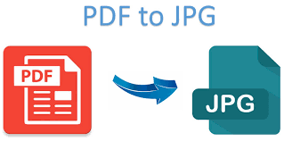
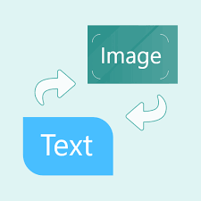
Backend
Stored procedures that provide the functions needed for the application.
A main algorithm which detects the bate stamp numbers within a file.
Multithreading to allow for the processing of multiple files to be quick and efficient.
Four processes to evenly divide workload.
Notes:
Sergio
(Script Rough Draft) - (Say Thanks to Shaocheng) Good Morning everybody, my name is Sergio Tapia and I will be covering the backend of our program.
The way our program was designed is intended to speed up the process of doing tedious work done by the people at the office of Santa Barbara. We were given a task to help speed up the way in which the employees rename their files within their system. Normally, they would each have to open pdf files which contain bate stamp numbers which are found within the pdf files and are needed in order to rename the file correctly. However, given the fact that the Office of Santa Barbara receives a large amount of files everyday this task can take up a good chunk of their time. Our program fortunately was able to solve this issue. We came up with an algorithm that converts the PDF’s into images then into text files and then converts them back to a pdf. We were able to do this by implementing four processes to evenly divide the workload. The reason behind this is so we can accurately find the bate stamp numbers needed so that when we convert back to a pdf we will include the bate stamp number that was found in the newly renamed file. We did take much precautions as to not just overriding the original pdf and so when the application is run, the output directory in which the user selects is the location of where the files will be. In other words we kept the original files and made copies but renamed them properly in accordance to how the office of Santa Barbara wanted. With lots of testing done we finally had a very consistent working program however we noticed a few issues in terms of speed and so the team decided to implement Multithreading, which allowed for the processing of multiple files to be quick and efficient.

Slide 15
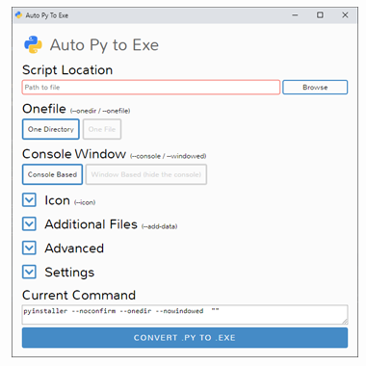
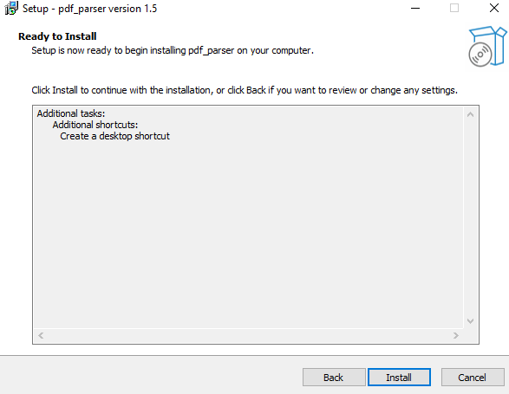
Deployment
Release testing tools
What is pyinstaller?
What is auto py to exe?
Final release and InnoSetup
Notes:
Luke
For deployment, we initially we used a library called pyinstaller. This allows a developer to compile a python application into a windows exe using a command-line shell.
We had created a working desktop GUI application that could be downloaded and then started by clicking a shortcut.
However, we wanted to improve on this for our beta release. In the windows taskbar and the file explorer, we wanted to use our own custom icons
To solve this issue, we used auto-py-to-exe, which handled attached icons to the exe and application window.
However, users still had to manually create an application shortcut and place our application in their program files directory. For our final release, we used another application called InnoSetup, which allowed us to create a typical step by step installer that most windows users would be familiar with.

Slide 16
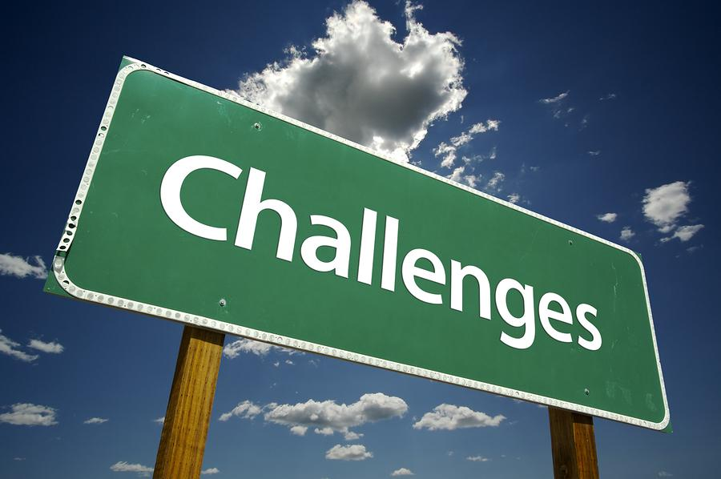
Technical Challenges
Learning new technologies.
Incorporating different libraries.
Debugging and identifying best solutions.
Developing and launching application.
Notes:
Daniel

Slide 17
Document Tag Parser Accomplishments
Full software application was launched for Santa Barbara Public Defender’s office.
Able to process folders/file(s) in under one minute.
Around 99.99% accurate.
Accuracy rate is higher preventing human error.
Created an error log that easily allows the team to review files.
Saves Santa Barbara Public Defender’s office roughly 20+ hours per week.
Notes:
Daniel

Slide 18
Live Demo

Slide 19
Q & A

Slide 20
Big thanks to the staff at the Santa Barbara Public Defender’s Office:
Deepak Budwani, Angella Stokke, Sarah Rothschild, Bryan Burzon, Aiden Bassett, and Josh Gill

