Slide 1
EXAM FILE manager
Advisor:
Keenan Knaur
QTC Liaison:
Francisco Guzman

Slide 2
Team leaders: NORMAN Avery & JOSH mermelstein
Members:
Dean Baquir
Jeffrey Lum
Sameen Khan
Noe Lopez
Wilson Tobar
Daniel Ibanez
Jose Mierzejewski
Abdullah Alwabel

Slide 3
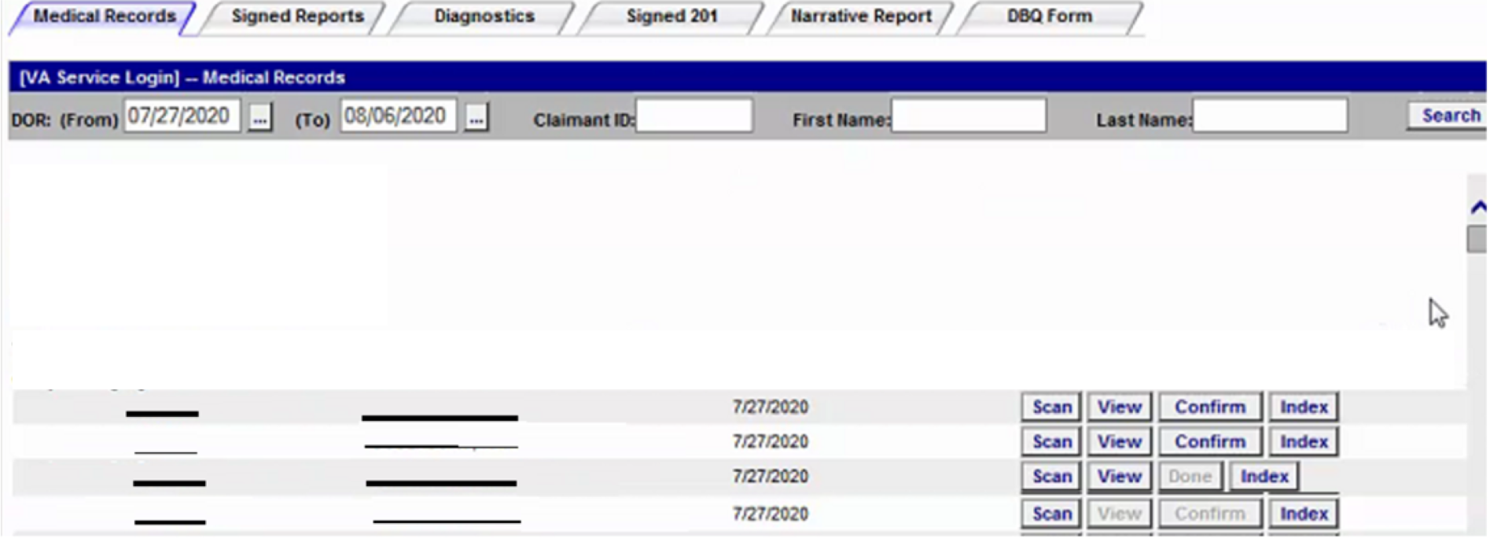
The Project: Exam File Manager
Document Repository of Medical Exams
Used by different types of businesses and organizations (Government agencies, Medical professionals, etc.)
These exams are often used to qualify people for additional services, such as government-funded benefits.
The web application’s different features vary according to each line of business. Examples of some of these features are:
Scan new medical exam documents
View medical exam documents
Index, Confirm, Modify, Repair document files.
Notes:
A background on our Project
QTC provides Medical Exams for many different types of businesses and organizations, including gonvernment agencies and medical professionals. These exams are often used to qualify people for additional services, such as gevernment-funded benefits.
The project that we are involved in is called "Exam File Manager". this Project is a Web Application. In essensce, it's a file repository that provides end users with access to these medical documents.
The Web application provides this document access mutliple lines of business, for Example, one line of business is "The U.S. Department of Veterans Affairs", another line of business is "The U.S. Department of Labor", and so on
The web application is designed to provide different features, according to each line of business. Examples of some of these features are:
- The ability to upload new medical exam documents
- The ability to view medical exam documents
- The Delete, Modify, and Repair document files.
Currently, QTC would like to redesign this web application, so that it is more scaleable. The current design cannot not be easily modified for new changes.
The proposed solution was to redesign the web application for scaleability, by making use of extensible plugins, which will be covered in detail later in this presentation.
--------
Exam file manager is basically like a storage for different lines of business that can be used for scanning and uploading files such as medical reports.
EFM have a couple of different lines of business and all of them have access to the same file repository. Also, each LOB have their own features. Some lines of business have common features. For example, LOB 1 and 6 might have more than 1 common features. However, LOB 2 might have unique features depending on their LOB.

Slide 4
qtc
WHO THEY ARE
largest provider of disability and occupational health examination services
WHAT THEY DO
QTC offers a complete one-stop shop for medical, disability and occupational health services.
HOW THEY DO IT
QTC’s proprietary technology automates the examination workflow and provides clients with real-time access to case information, tracking, and reporting.

Slide 5
services
Administer independent medical examinations and associated services.
Vision services
Immunization/ Vaccinations
Medical Evaluations
Dental Examinations
Military disability examination

Slide 6
WHAT THEY COVER
Document supply and distribution
Data entry and system interfaces
Scanning and indexing health records

Slide 7
clients
U.S. Department of Veterans Affairs
U.S. Department of Labor
U.S. Railroad Retirement Board
U.S. Department of Health and Human Services, Federal Occupation Health
Department of Justice

Slide 8
What is Exam File Manager? (EFM)
EFM is a file managing application used browsing and modifying documents
Medical Records
Diagnostics
EFM authenticates users and places them in a line of business
EFM has varying functionality depending on a user’s line of business
VA – Medical Records, Diagnostics
Non-VA – Signed Reports

Slide 9
Medical Records
Functionality will also vary across the different types of documents
All documents will have ‘View’, ‘Import’, and ‘Scan’
Some documents will have ‘Index’
Additionally, documents can also be searched and filtered
Date
Claimant ID
First/Last Name
Diagnostics
Signed Reports
VA
Non-VA
Invoice
Misc.

Slide 10
ISSUES AND CHALLENGES
Programming in HTML and CSS
Top it off with Model-View-Controller for a clear view
Elementary level of web programming
This project involves familiarizing ourselves with advanced web programming concepts
An Academic Epiphany

Slide 11
ISSUES AND CHALLENGES
Learn Dependency Injection - A design pattern that enables us to inject services , objects, and other dependencies
Prevalent use of Hardcoded objects
Avoid manual modification of each instance
Dependency Injection

Slide 12
ISSUES AND CHALLENGES
Minimal exposure to frameworks
Comply with the trend
Variety of services
A web development framework that enables us to build modern apps with .NET services
.NET Implementation

Slide 13
ISSUES AND CHALLENGES
Met with QTC every week to update ourselves with study the current logic and technologies
Foreshadowing an issue
Renovating current website
Dynamic vs Manual Expansion
Conditionals and Extensibility
A challenge or an issue may seem overwhelming and a hindrance to education at the beginning but facing it is a major part of the learning process itself

Slide 14
Initial Challenges
Overwhelming amount of new technologies
New Language
New Framework
"Why wasn't I taught this???"
Notes:
Jose

Slide 15
Initial Challenges
We were taught to be adaptable, not "know-it-alls"
Be ready to learn!
Notes:
Jose

Slide 16
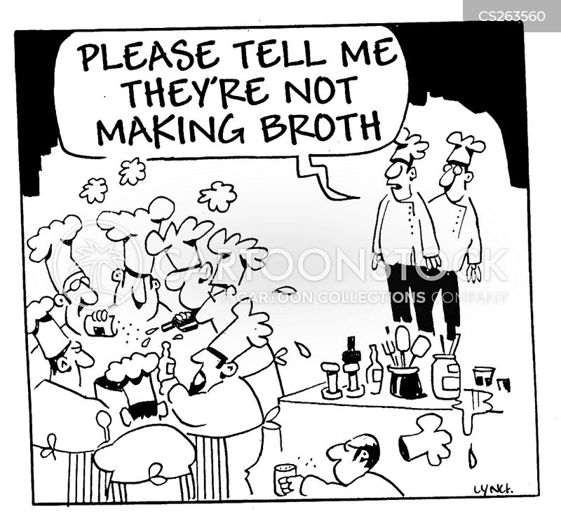
Initial Challenges
Communication Issues
Find the right tools!
- Discord
- Github
Notes:
Jose

Slide 17
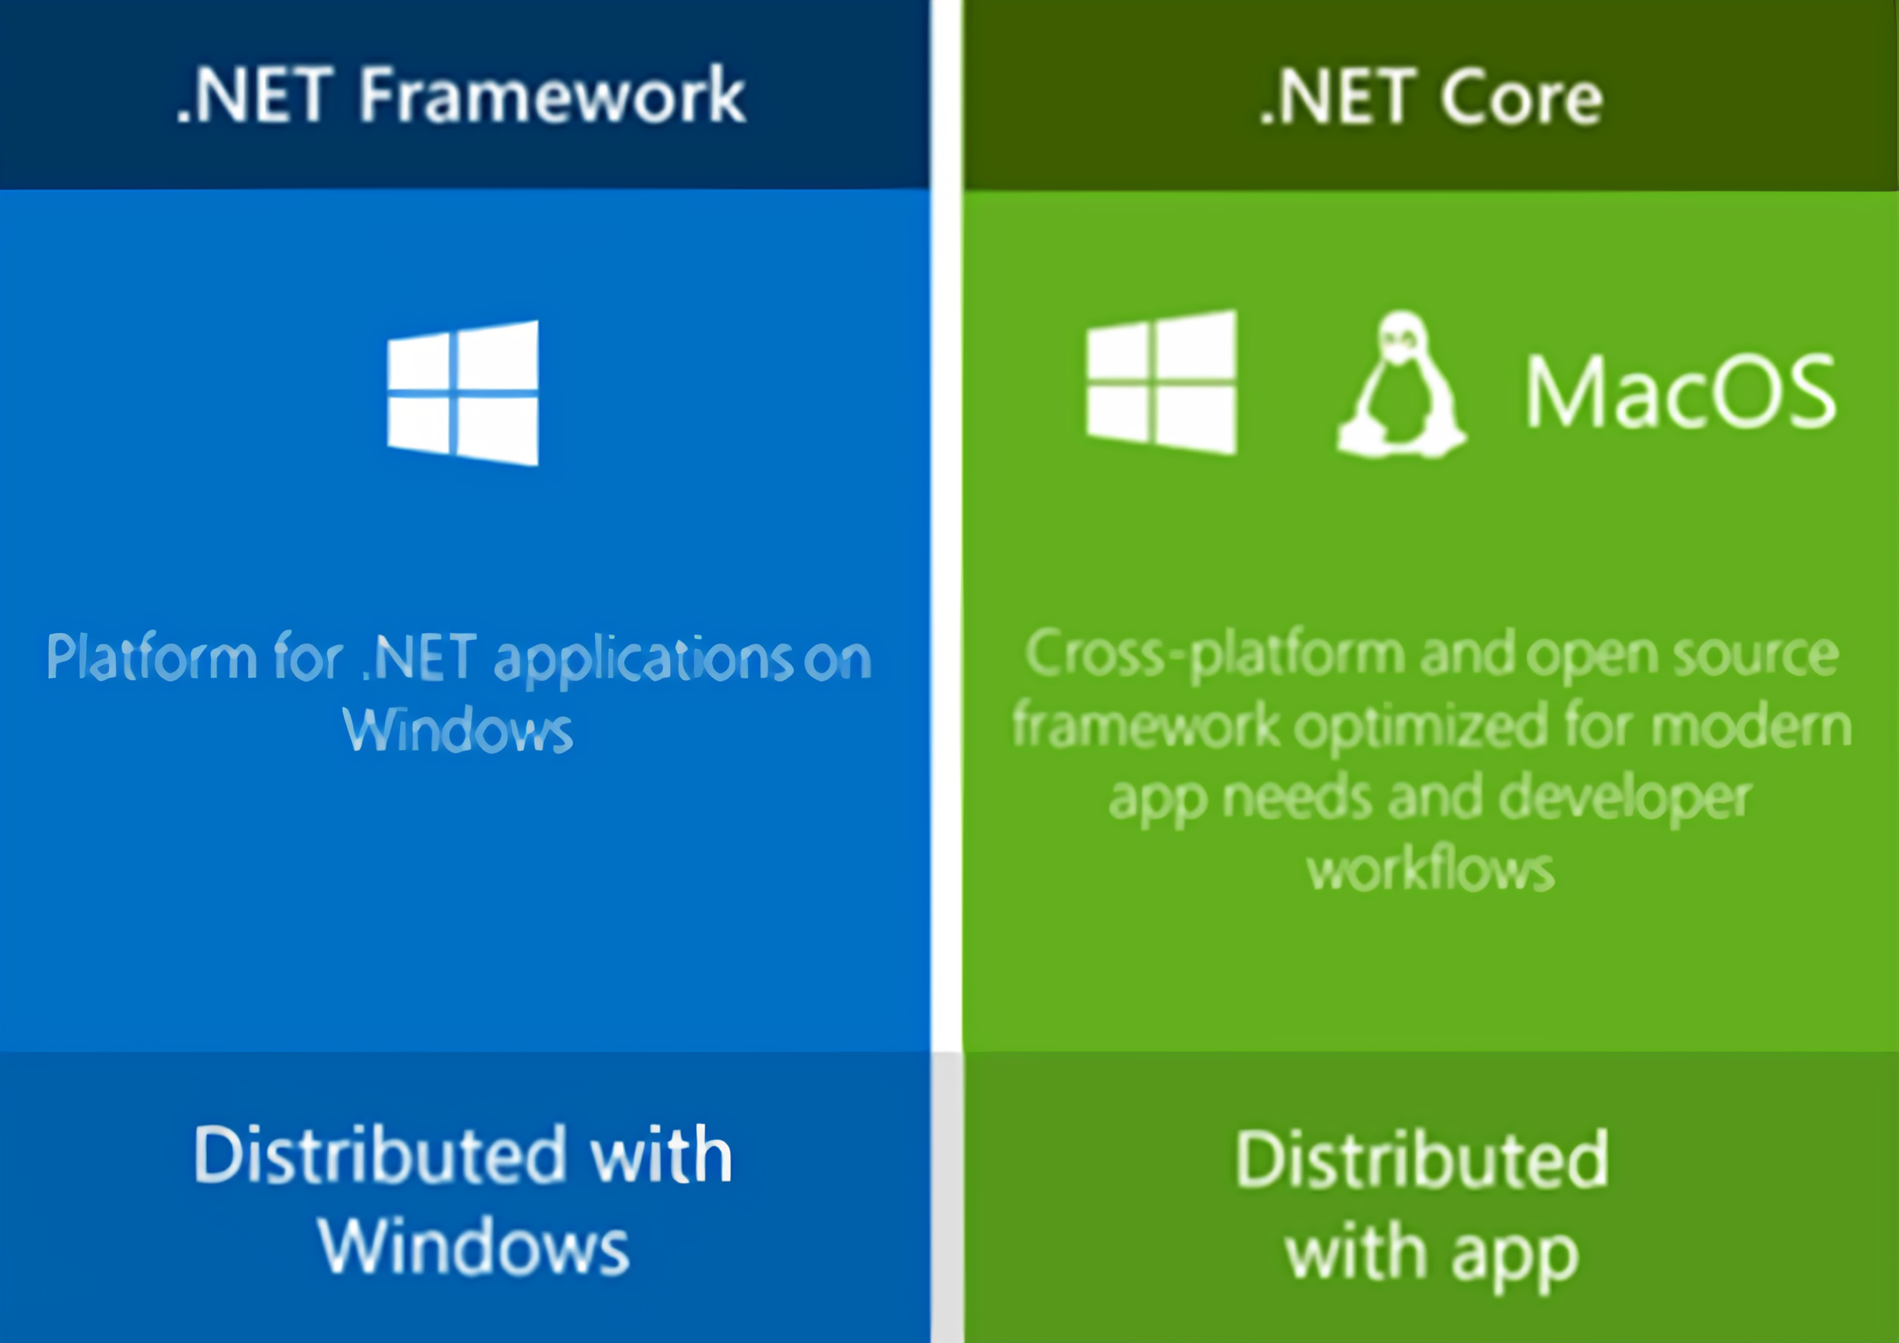
ADAPTING TO New TECHNOLOGIES
.NET
.NET Core
.NET Framework
.NET Standard
ASP.NET Core MVC (Model View Controller)

Slide 18
ADAPTING TO New TECHNOLOGIES
GitHub
Inexperience and collaboration
Docker
The team researched and looked into Docker which can assist with our development but ultimately decided to not use it due to overengineering.

Slide 19
Technologies and Design patterns

Slide 20
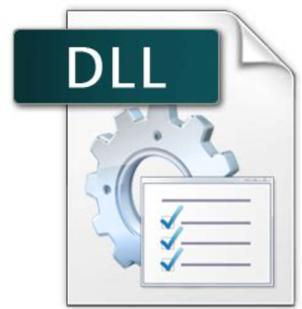
Technologies and Design patterns
Fundamental in .Net-based Applications
Assemblies take the form of executable (.exe) or dynamic link library (.dll) files
In .NET Framework, assemblies can contain one or more modules
Allows projects to be scalable - several developers can work on separate source code files / modules, and compile into a single assembly
Assembly Framework (.Net)

Slide 21
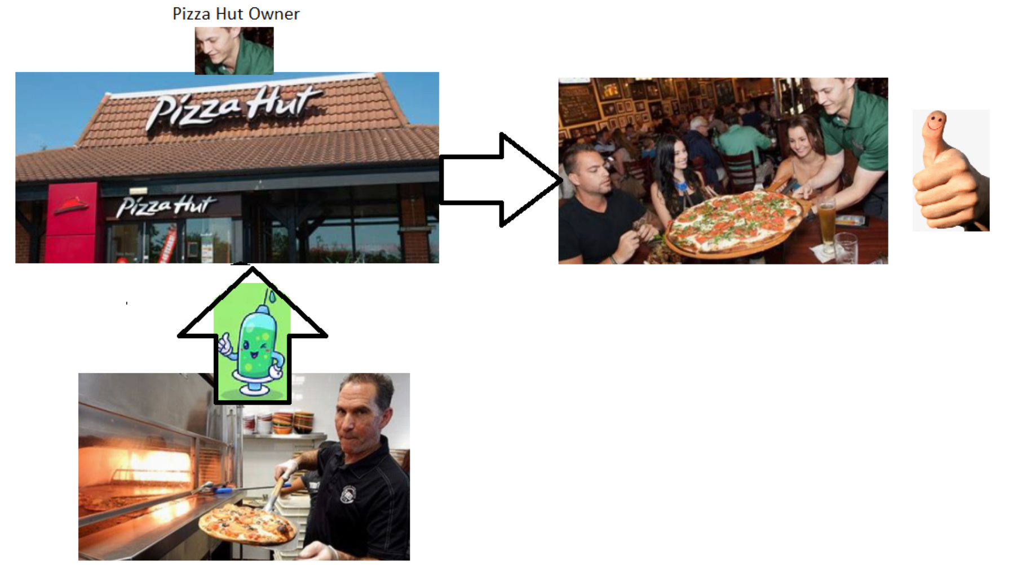
Technologies and Design patterns
Dependency Injection (DI) - One way to achieve “Inversion of Control” Analogy
Dependency Injection

Slide 22
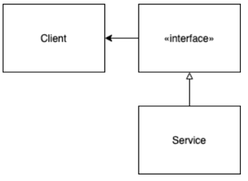
Technologies and Design patterns
Dependency Injection (DI) is one way to achieve Inversion of Control
Client needs to execute logic / code (doesn’t need to know the code)
A service (dependency) containing the code is injected into the client via an Interface
Interface: The bridge between the Client and the Service.
Instead of a client building or finding a service, the service is passed to the client. (The client does not need to know how to construct the service)
Dependency Injection

Slide 23
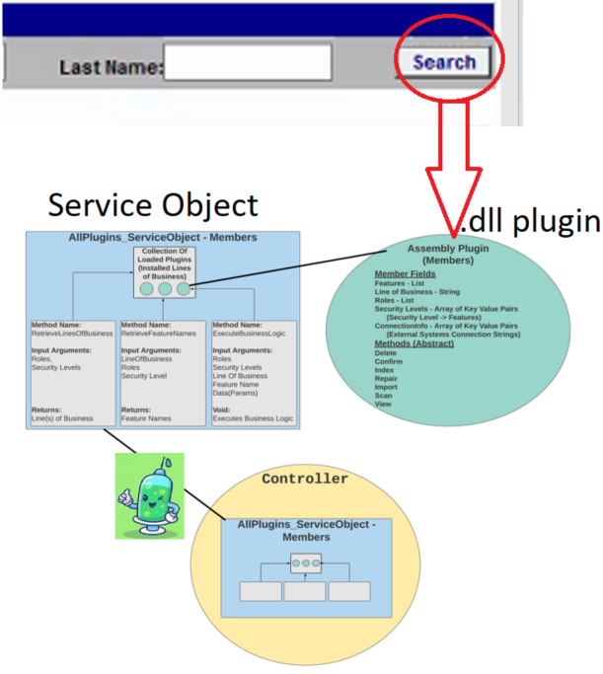
Technologies and Design patterns
Assembly interface extends common functionality (ex. Search Button). Assembly is implemented by a “Plugin” class
Plugin class objects are constructed and injected as service objects at runtime, used to extend the business logic for common features.
A “Search” button click event causes the controller to reference the service object, which executes the code within the .dll
Using Dependency Injection and Assembly Framework Together

Slide 24
What Have We Discovered?
Built Multiple Proof of Concept and tested out many different libraries/techniques
Authentication
Dependency Injection
Razor
.Net
Why?
To get an idea of what we needed, and how to get where we wanted to be.

Slide 25
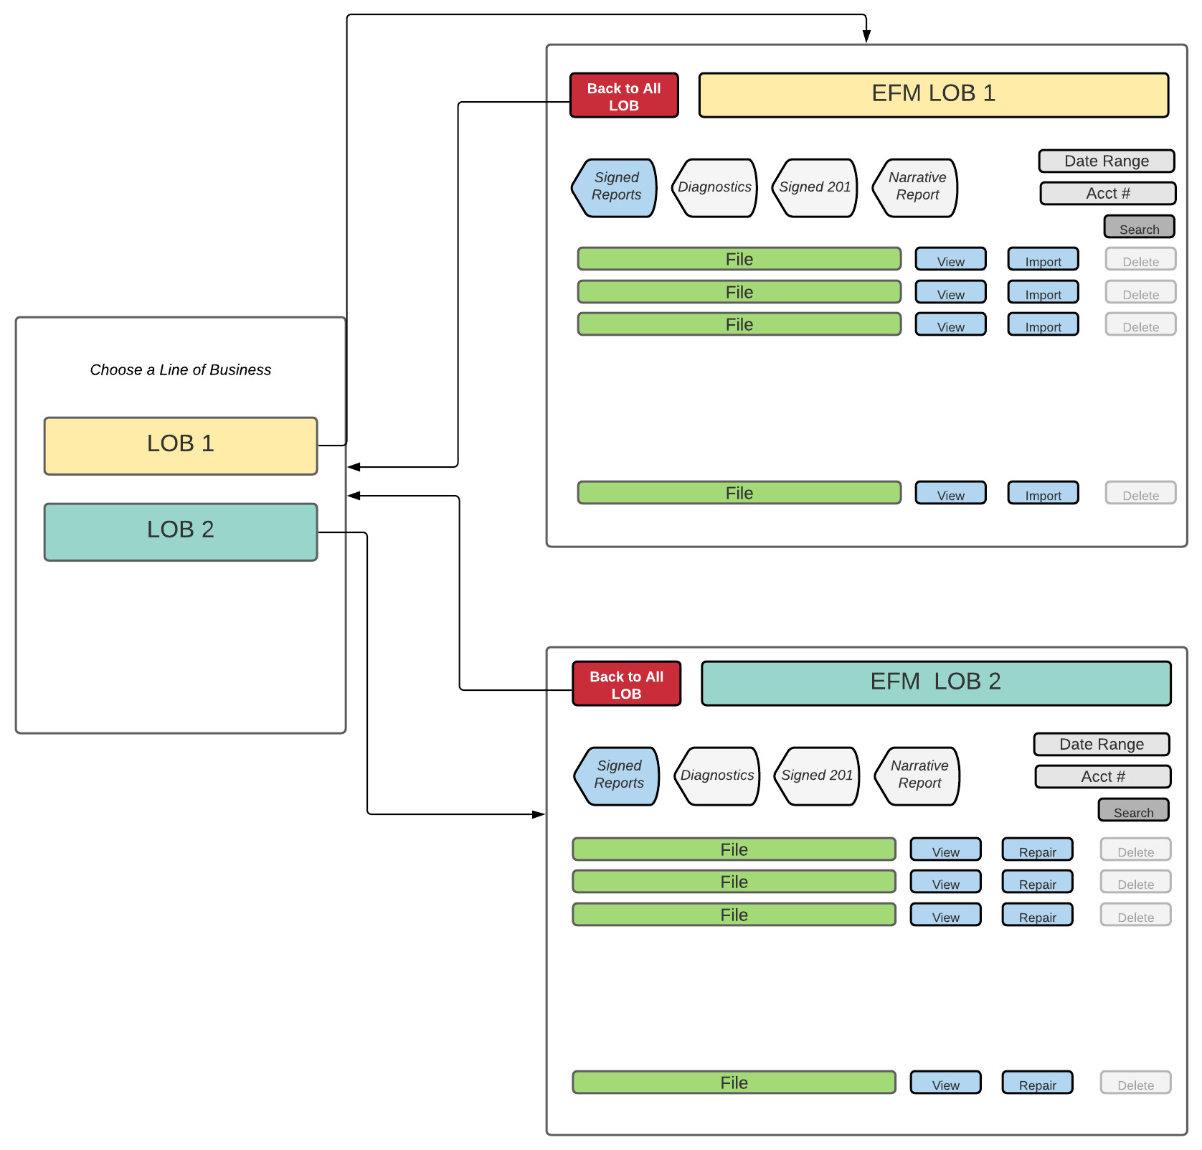
What did we do with all of this?
Started to write everything down and moved away from coding.
Began with some UI Flow:

Slide 26
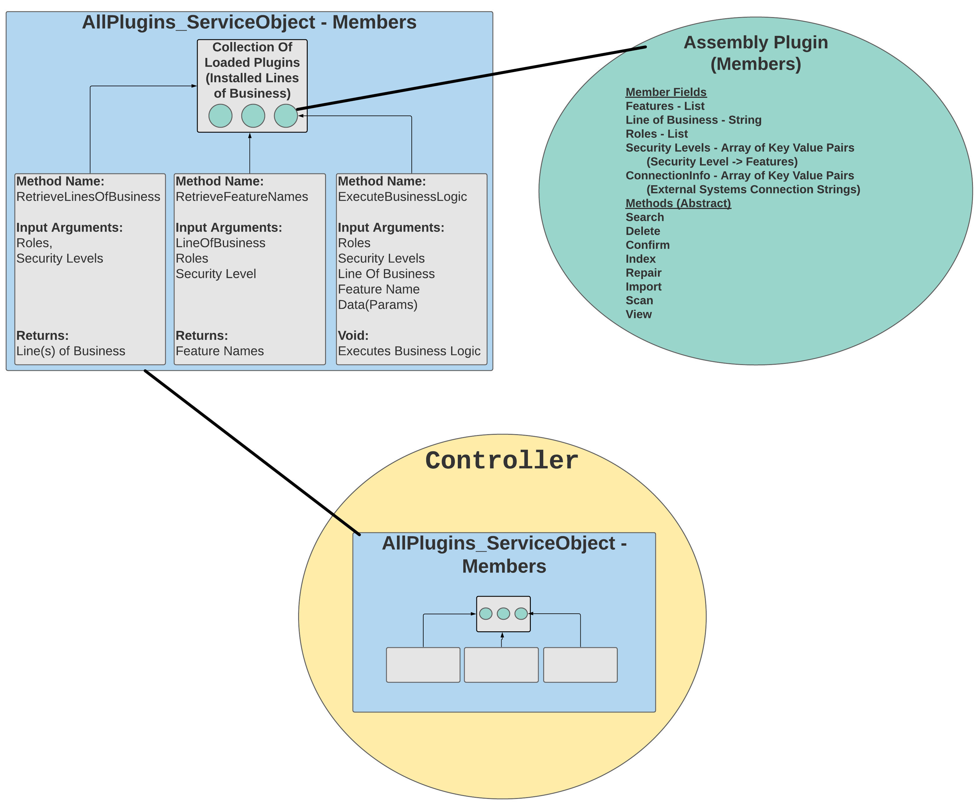
What did we do with all of this?
Needs to use QTC authentication
An Application built with dependency
Injection (.dll)
File systems
Controller, and how should it work
with the unknown?

Slide 27
Where does the team stand now?
Each one of us has written, tested, and utilized C# and .net respectively with something needed for this project.
Created a design document for better mapping out how everything needs to talk to one another.
Why is this so important? This is active, with 1,000’s of users. It needs to work properly.

Slide 28
FEATURES WE ARE IMPLEMENTING
Features are implemented as plugins.
Not all lines of business share the same features.
Not all users have access to enabled features.

Slide 29
FEATURES WE ARE IMPLEMENTING
Index
Delete
Import
Confirm

Slide 30
FEATURES WE ARE IMPLEMENTING
Repair
Search
View
Scan

Slide 31
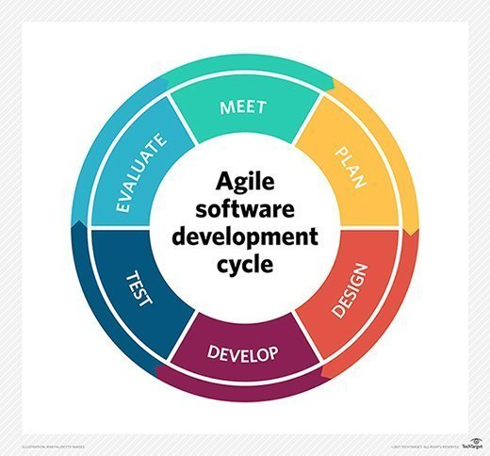
Agile overview
Process for developing software
Teams deliver value to customers faster
Working software over comprehensive documentation
Responding to change

Slide 32
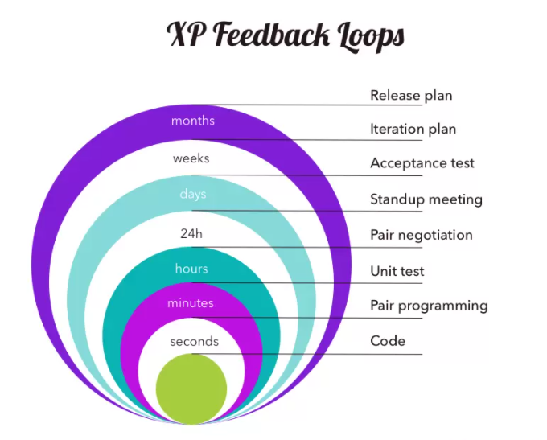
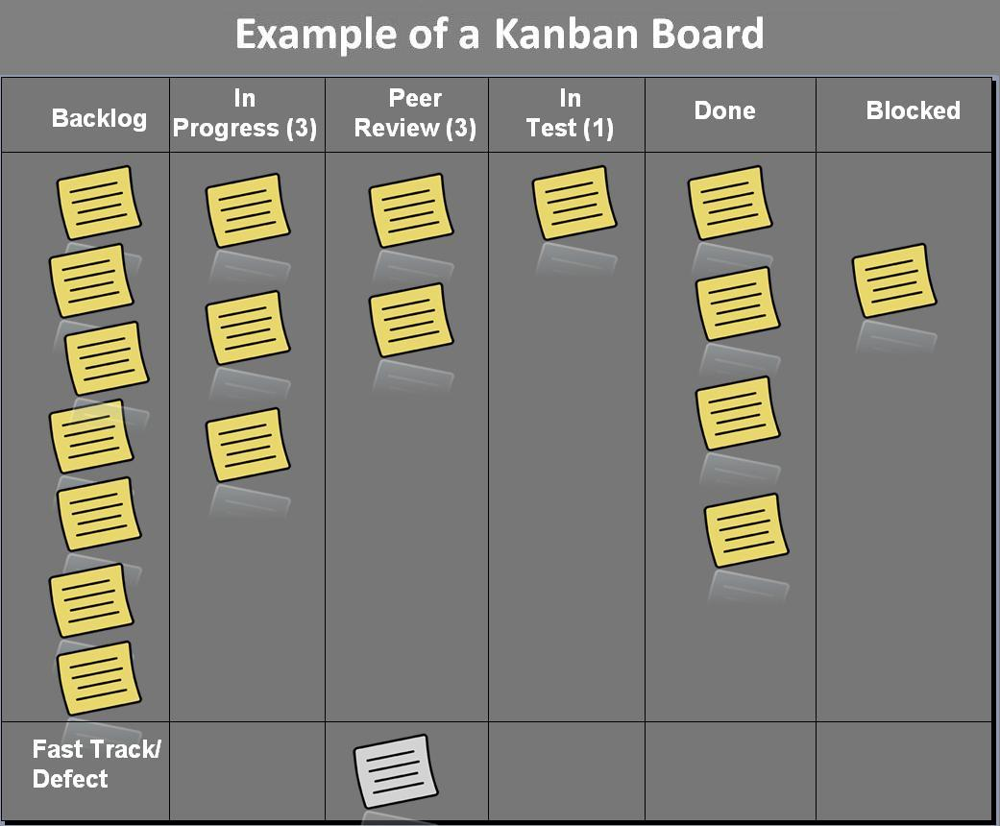
Agile frameworks
Common Frameworks
Extreme Programming (XP)
Kanban
Scrum
Extreme Programming (XP)
Test-driven development
Pair programming
Emphasis on good practices
Just enough design and architecture
Kanban
Work visually presented on a board
Blockers and dependencies identified
Maximize flow and delivery

Slide 33
What we used -scrum
Roles
Product Owner
Scrum Master
Development Team
Agile Ceremonies
Backlog grooming
Sprint planning
Standup
Sprint Review
Sprint Retrospective

Slide 34
Going forward
Documentation
Software Design Document (SDD)
Software Requirements Document (SRD)
Building
Scrum
Building
Testing

Slide 35
Thank you

