Slide 1
Library Card
Registration System
Maurice Mejia, Alvin Tsui, Christopher Lee
Brent Hamada, Jose Aparicio
Advisor: John Hurley
Liaisons: Michael Oey, Allan Padilla

Slide 2
Agenda
Introduction & Overview
Project Requirements
Modules & Services
Accomplishments & Future Goals

Slide 3
Introduction
About County of Los Angeles Public Library
Transition to the future
What they need from us
How we’re going to help
Notes:
The LA County Library has decided to move online with their library card registration page. This will include 87 libraries throughout the LA County. This project is to ease that transition and create a web portal customers can sign up for a library card on a desktop or mobile device. We will be looking into OCR for scanning driver licenses, spam reduction, and email verification. We hope is that we make the library card registration system fast and easy to use for the average customer.

Slide 4
Workflow Tools
Github - All the code is saved here
Google Drive - All the documentation is shared here
Slack - Group team collaboration tools and services
Zoom - Conference call application with the liaisons

Slide 5
Project Challenges
Building the application so it’s accessible to everyone
Voice Assist
Optical Character Recognition (OCR)
Data validation
Customer Street Address
Security

Slide 6
Program Technologies
Django (Python Based Web Programming Framework)
HTML, CSS, Javascript
Google APIs
Maps
Cloud Speech
reCAPTCHA
MySQL
Tesseract

Slide 7
LCRS Data Flow Diagram: Level 0
User
Library Card Registration System
(LCRS)
GUI
Email Confirmation
OCR
Address Lookup
Voice Assist
Output
Library DB

Slide 8
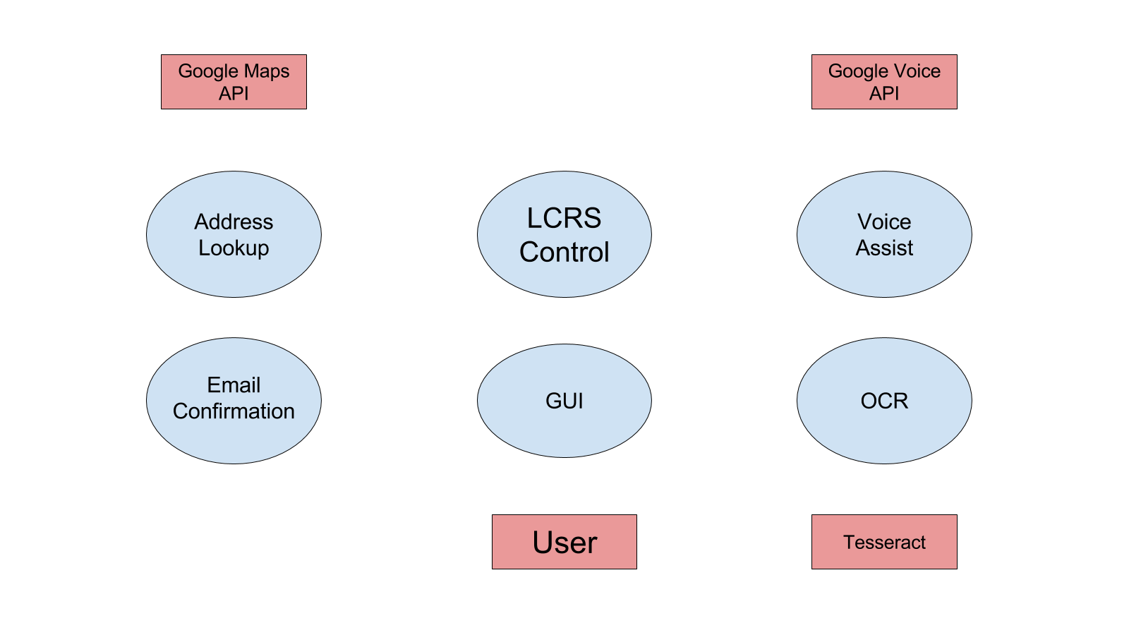

Slide 9
Graphical User Interface (GUI)
Client-Side Functionality
Checking whether user is a minor
Google Address Autocomplete Form
reCAPTCHA
Web User Interface
Responsive Design
Challenges
Implementing desktop features for all devices
Must follow Web Content Accessibility Guidelines
Multiple language support

Slide 10
State of GUI
Current Progress
Completed client-side functionalities
Completed basic overlay
Goals
Improve visuals
Multiple languages

Slide 11
Email Confirmation
Purpose
How it works
Challenges
Integrating email service into Django
New webpage for email confirmation
Progress

Slide 12
Optical Character Recognition (OCR)
Functionality to autocomplete fields
Scans image of text
Fills corresponding application field
Technologies
Tesseract - OCR engine made by HP
Challenges
Image Quality
Watermarks
Running everything on web environment
Bandwidth optimization for image uploads
Notes:
The purpose of Optical Character Recognition (OCR) is to make form filling more efficient for the user.
OCR takes an image as input from either the user’s phone or computer.
If they are using their phone, OCR will access their phone’s camera.
If they are using their computer, OCR will accept an image upload in various file types.
Tesseract is a google sponsored OCR engine made by HP.
Tesseract is an open source library with training data supporting many languages.
Tesseract can be installed on Windows, Mac, and Linux however most testing and documentation is for Windows and Ubuntu.
After an image is uploaded, OCR will send the image to Tesseract
Tesseract then processes the image and extract all text from the image.
OCR receives the text information and determines which field each segment of the text belongs to and fills in the form.

Slide 13
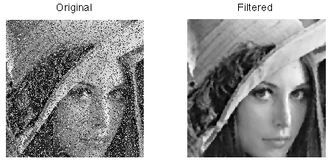
State of OCR
Current Progress
Accepts and processes images
Returns text
Goals
Integrate with GUI
Higher accuracy
Image compression

Slide 14
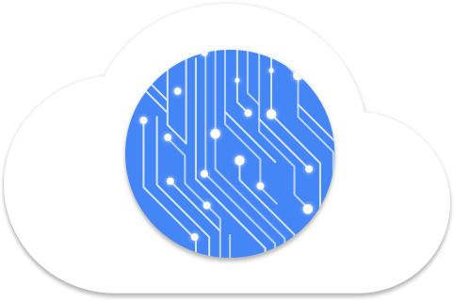
Voice Assist
Intended Users
Implementation
Technologies
Challenges
Browser compatibility
Incorporating technologies
Network quality
Notes:
Purpose
Make it a fun experience boring form
Chat bot experience
Who is it for?
Aside from experience, we want it to be easy for visually impaired
How will it be built?
Rest API
backend services
socket
google cloud speech
Conversation
Current state
web browser api
autofill user voice
works in chrome
Technologies
Google Cloud Speech API
Python DJANGO backend rest api
Challenges
Browser compatibility
Implementing server side technologies
Client side technologies
Network quality on mobile devices
MAURICE

Slide 15
State of Voice Assist
Current Progress
Web Speech Integration
Auto-Fill
Basic Integration
Goals
Conversational
Validation
Speech-to-text Libraries/Services
Client/Server API

Slide 16
Accomplishments
Basic Application
Additional Scripts for GUI
Google Address Autocomplete
Checking for minors
reCAPTCHA
Speech-to-Text

Slide 17
Future Goals
Email Confirmation
Conversational Voice Assist
OCR
Maintainability

Slide 18
Thank You

