Slide 1
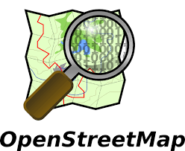
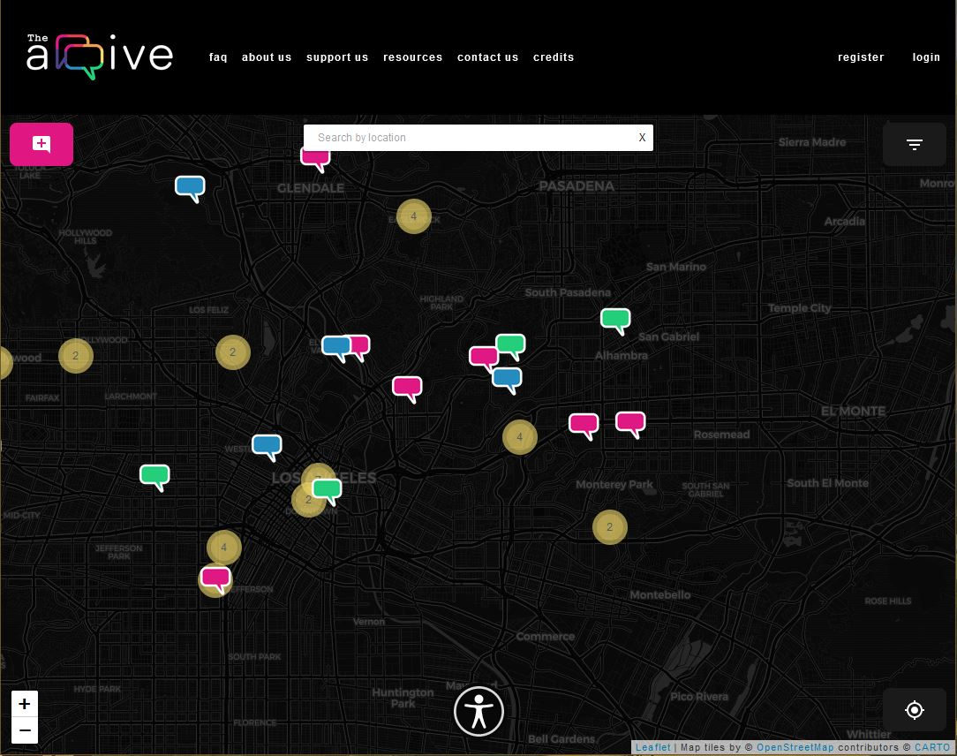
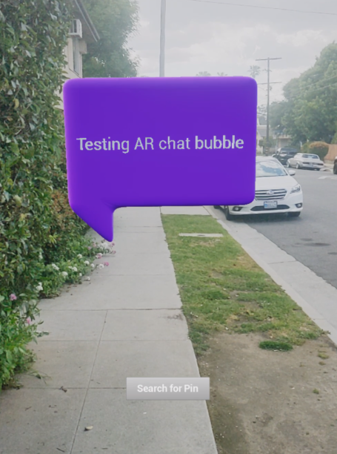
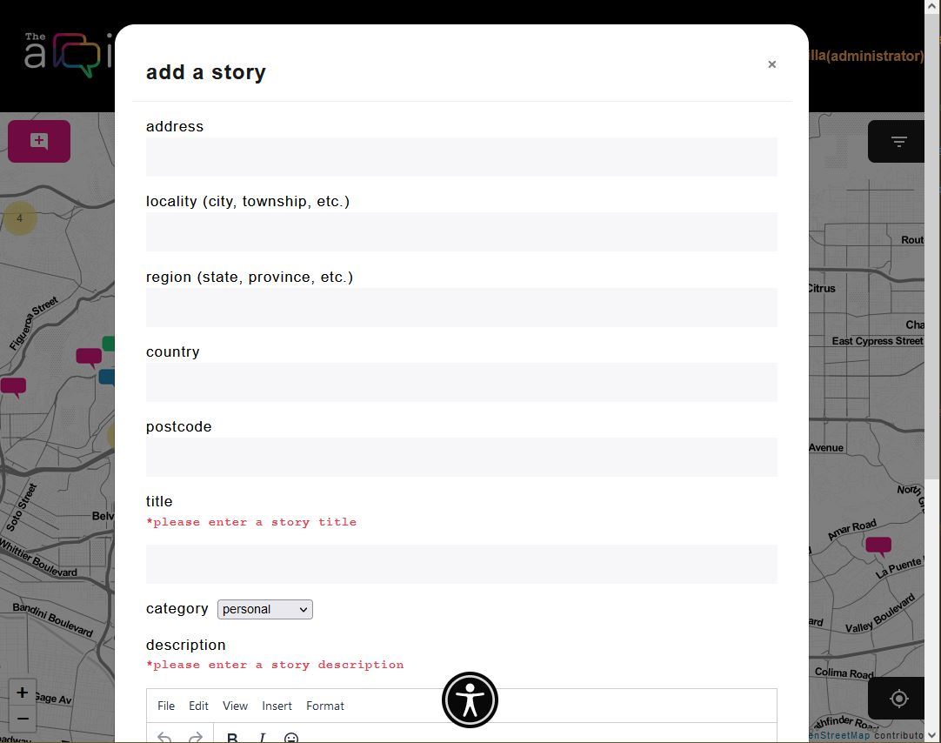
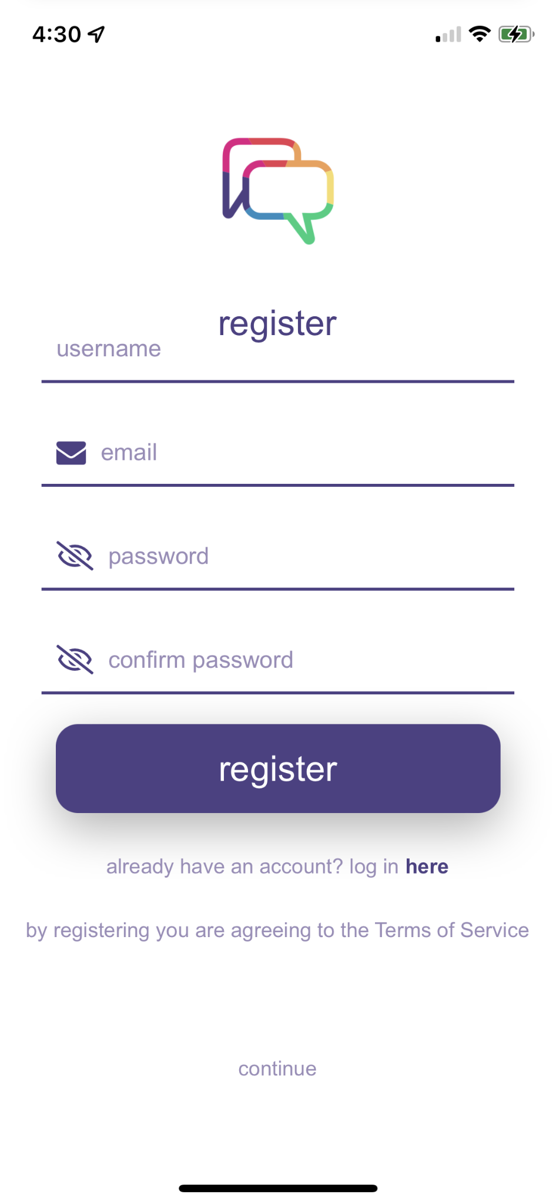
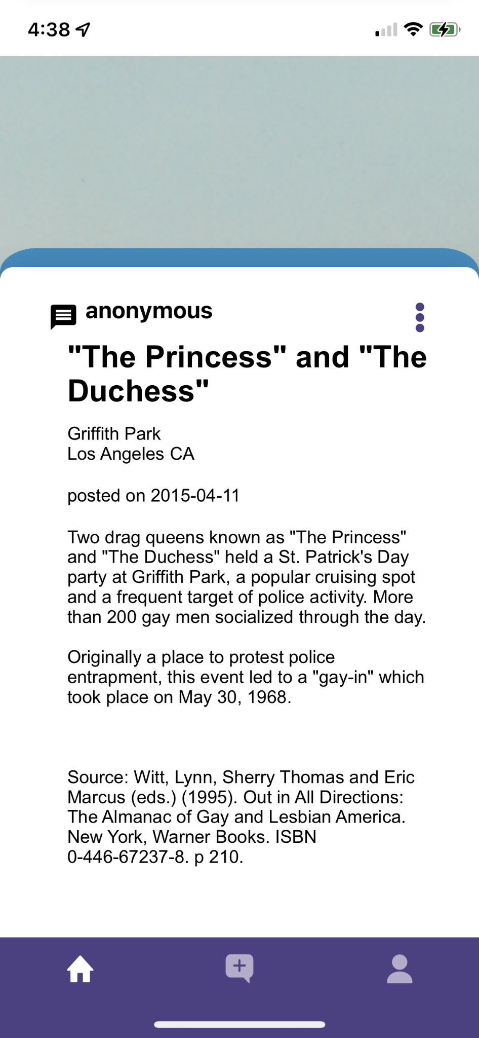
Team Members: Matthew Frias, Jesus Gonzalez, Kevin Kazaryan, Daniel Lee, Stewart McKenzie, Erica Payne,
Erica Santos, Leslie Segovia, Bryan Sosa, Elio Vences Faculty Advisor: John Hurley The arqive Liaisons: Dr. Cynthia Wang & Zachary Vernon Department of Computer Science College of Engineering, Computer Science, and Technology California State University, Los Angeles
The arqive is a digital online storytelling map for LGBTQ+ stories that seeks to provide the full range of queer stories and then geolocates them and digitally preserves them. Users have a safe platform where they can share personal, historical, and community stories, as well as have access to information about safe spaces.
The arqive is both a web and mobile application.
Our objective this year was to expand upon the progress made in the last two years, including:
Implement content moderation
Add further security measures for users who choose anonymity
Enhance gamification features to improve user engagement
Link posts to other social media sites
Add AR/VR features
background
project goals
technologies
results
frontend
numerous UI/UX enhancements
posting images on mobile
time restriction on posts
backend
weekly automatic backups
extensive refactoring for efficiency
content mod/security
inappropriate content classifier improvements
server login security / penetration testing
login/register
must be logged in to post
must agree to TOS to register an account
ar/vr
view a pin at its geolocation
Notes:
‹#›
Have students check that the logo is the appropriate one to use.
2020: https://csns.cysun.org/department/cs/project/resource/view?projectId=7248602&resourceId=7735064
Red: e63f52
Orange: f0a055
Yellow: f5dc6d
Green: 00ce7d
Blue: 248dc1
Purple: 4d4185
Pink: e01783
Grey: 98999b
Black: 0b0b0e
https://www.fontshmonts.com/text-fonts/eina/

