Slide 1
current developers
Matthew Frias, Jesus Gonzalez, Kevin Kazaryan, Daniel Lee, Stewart McKenzie, Erica Payne, Erica Santos, Leslie Segovia, Bryan Sosa, Elio Vences
advisor
John Hurley
sponsors
Cynthia Wang, Zachary Vernon

Slide 2
agenda
introduction
project goals
final outcomes
frontend
user experience
database
content moderation
security
augmented reality
challenges
conclusion
demonstration
Notes:
Introduction/Background - Erica S
Project Requirements/Methods & Technologies - Erica P
Frontend & UI - Daniel
UX - Matthew
Databases - Jesus
Content Moderation - Kevin K
Security - Elio
AR - Stewart
Challenges - Leslie
Future Work/Conclusion - Leslie
Demonstration - Bryan

Slide 3
introduction

Slide 4
what is The arqive?
The arqive is a storytelling platform for LGBTQ+ individuals to tell their stories, share resources or information about popular areas of interest, or post anything they find meaningful, while navigating their gender and sexual identities.
queer community, connection, and solidarity
Notes:
[read]…Now you may be wondering what inspired The arqive…

Slide 5
background of The arqive
“[George Chauncy’s book Gay New York] details queer stories and happenings in New York City in the early 1900s… I thought to myself, wouldn’t it be cool if you could walk around a neighborhood in New York City, and see that the Chipotle on the street corner used to be a popular gay bathhouse in the 1920s?”
-Cynthia Wang, “Interactive Storytelling for the Screen” (2021)
Notes:
…So let me share a quote from Cynthia Wang, in “Interactive Storytelling for the Screen.” [read quote] Cynthia had experienced a lack of up-to-date resources about LGBTQ+ hotspots. Now, as physical landscapes change, the community loses its history tied to these spaces. Queer communities in particular have had to fight for their stories to be recognized and told, let alone documented.

Slide 6
history of The arqive
2014 - The arqive (GlobaltraQs at the time) was founded by Cynthia Wang, Associate Professor of Communication Studies
2019 - Cynthia was joined by Zachary Vernon, Assistant Professor of Art (Graphic Design/Visual Communication)
2019-2020 - Senior Design team creates a new website
2020-2021 - Senior Design team develops the mobile application
Notes:
So in 2014…

Slide 7
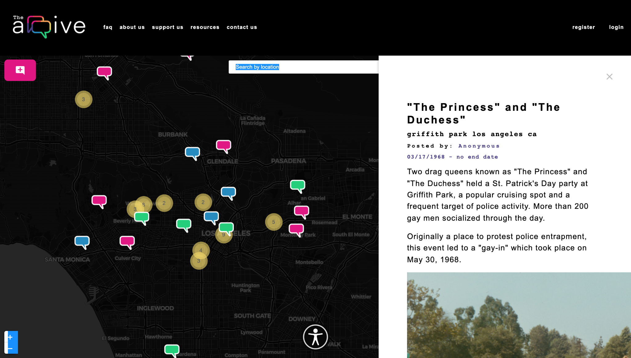
overview of The arqive
Users
Login
Add/Edit/Delete story
Bookmark/Unbookmark user
Flag posts
Manage profile
Anonymity
Admin
Login
Add/Edit/Delete story
Bookmark/Unbookmark user
Anonymity
Review/Remove flagged posts
Review/Remove flagged comments
Remove users
Notes:
Start with explaining anon users privileges

Slide 8
project goals
Notes:
Project goals, holistic approach (meeting/development styles), technologies used

Slide 9
project goals
this year's project for The arqive focused on expanding the website and mobile applications. expansions included:
beginning implementation of content moderation
adding further security measures for users who choose anonymity
linked posts to other social media sites
starting the implementation of AR features and gamification

Slide 10
handling changes and implementations
weekly meetings
meetings with advisor
team meetings
full team
sub-team
meetings with our sponsors
progress tracking sheet
updated weekly
status: to do, in progress, ready to deploy, deployed

Slide 11
project technologies
Django REST Framework
Web APIs
OpenStreetMap
React
React Native/Expo
ReactJS
Hosting: Digital Ocean
Ubuntu 18.04 (Server OS)
PostgreSQL
SciKit-learn

Slide 12
final outcomes

Slide 13
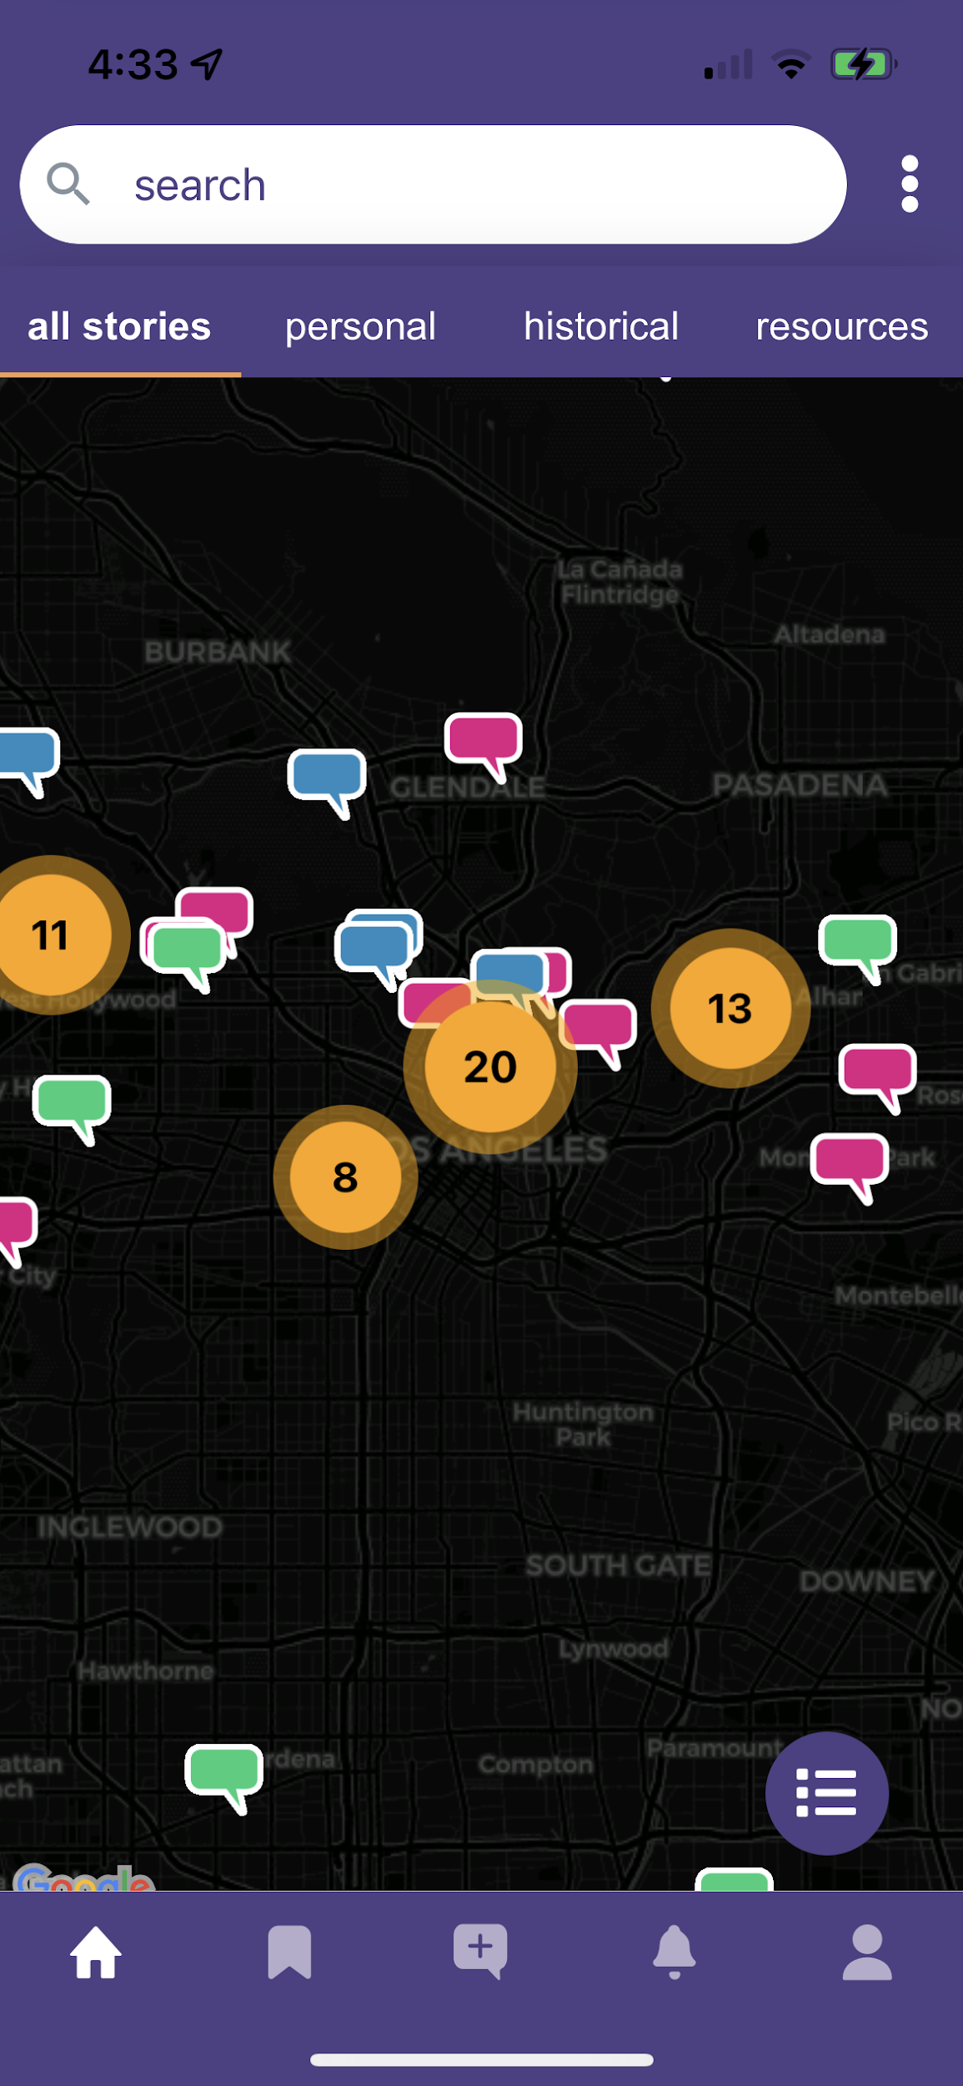
frontend
improved login/register experience
post timing limitations to avoid spam
menu alignment with systems
pins loading on startup
loading speed reduced
new pages added
terms of service
credits
Notes:
Improved Login with more information in regards for what people are signing up for.
Post timing limitation (not let users post too much in 1 setting)
Between different devices, menus were misaligned
Map and pin has its own extensive loading; needed to speed up the pins

Slide 14
user experience (UX)
users
keeping user logged in
fixed website blanking out bug
email validation
meta tags for social media
admins/developers
API key fixes
admin privileges
Notes:
this could be a separate slide for Matthew: kind of the in between quality of life changes that help the user (Frontend) as well as us developers (backend)

Slide 15
database
Postgresql database stored in DigitalOcean
create a secondary location for database backups
an extra source of backups is vital for the project in the event that:
connection to DigitalOcean is interrupted or lost due to some outage.
an error during arqive production that severs connection to DigitalOcean (as seen this year)

Slide 16
database (continued)
a cronjob that has access to both DigitalOcean and Github was created as a solution.
the cronjob currently runs every week a few days separate from DigitalOcean’s in case the original database ever gets compromised.

Slide 17
content moderation
ML model trained and tested using over 200,000 lines of data
model has 95% accuracy
negative comments shall be flagged and possibly removed
removed comments shall notify user
model shall be retrained with user posts

Slide 18
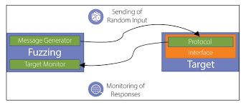
security
server login security
accomplished by using Fail2Ban intrusion software
renew website certificates using Certbot
every three months, certificates will be renewed
penetration testing
SQL Injection Attacks
Cross Site Scripting Attacks
Fuzz Attacks

Slide 19
augmented reality (AR)
3D pins displayed through a mobile device’s camera
all content is in sync with all arqive app versions
pins are geographically accurate (within a few feet)

Slide 20
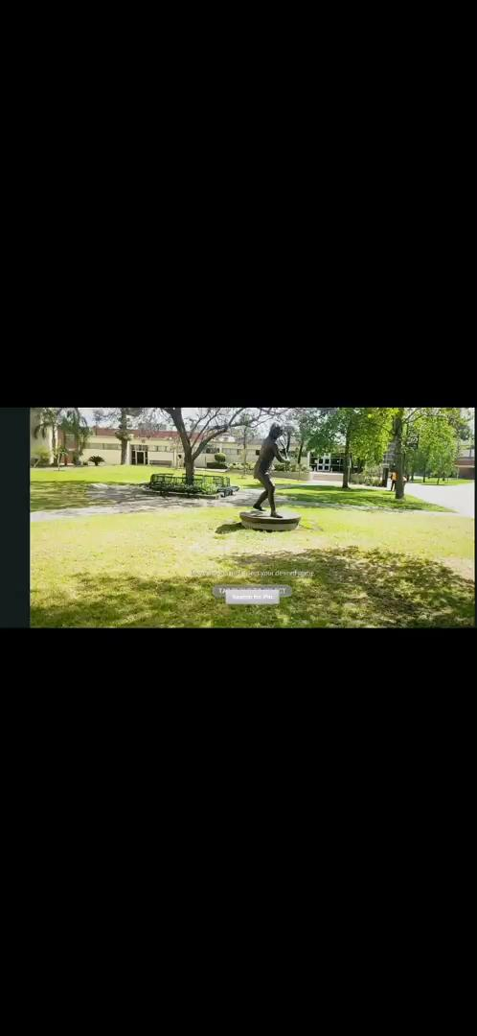

Slide 21
challenges
Notes:
And now we’ll talk a bit about some of the overall challenges we faced.

Slide 22
main challenges
refactoring backend files
configuring ML model to work with backend
server config files
stack version issues
some solutions revealed underlying issues
Notes:
One of our main challenges involved taking previous backend code and strengthening any parts that may delay the progress of new features or fixes. As a team, we were able to make the necessary changes and now have a solid foundation for future work.
Along the way, we found that improving the backend also contributed to having issues with configuring the machine learning model to insert into the backend.
We also encountered permission issues with the server config files. This was significant as the files are in charge of the website’s display and how the website communicates with the server. In other words, it’s what gets the website up and running.
As for stack version issues, a lot of the technologies we use for the website such as postgres, python and the Ubuntu server all run on older versions that has its limitation. However, updating them did not resolve the issues ad many of the technologies being used require newer versions.
Overall, applying solutions to challenges across the website and mobile apps at times revealed other underlying issues, most of which we were able to resolve.

Slide 23
conclusion
Notes:
And finally we’ll have a look into our future work

Slide 24
future work
more documentation
backend changes
stack update or refactoring (as needed)
potential for improvements
NSFW tag/flagging untagged NSFW content, flagging users
Google Maps API
AR experience
gamification
Notes:
For future work, our team has created a detailed documentation on our changes to the backend and where the start of new features left off.
We would like to note that it would be in the best interest of the app to go through with a stack update and do any refactoring to the backend as needed.
On the other hand, the apps contain the start of a feature such as tagging NSFW content and flagging users that violate the app’s guidelines.
The Google maps API would offer an autocomplete option for users when posting as it would grab the GPS location from a user’s phone. This API would serve to be versatile for the user’s and developer’s experience.
And finally the AR experience which will allow for a unique storytelling that can contribute to the gamification aspect of the app.

Slide 25
demonstration
Notes:
Demo should be ~1 minute

