Slide 1
PRISM
Program Review Information System Management
David, Leanne ■ McLees, Andrew ■ Sarenas, Justin ■ Solis, Ben Jair
Liaisons: Dr. Karin Brown and Veronica Ramirez from the Office of Graduate Studies
Advisor: Dr. Chengyu Sun
Notes:
http://ecst-csproj2.calstatela.edu:4188/
https://159.65.105.147/

Slide 2
What is program review?
A process that:
Examines a program’s standing
Validates a program’s strength
Identifies areas for improvement in a program
Maintains accreditation
Handled by Program Review Subcommittee (PRS)
Notes:
Definition: A formal evaluation of a curriculum’s performance that is an intensive and quality oriented process

Slide 3
External Reviewer
College Dean/Designee
Department Chairs
Program Review Subcommittee
External Review Report
Self-study Document
Questions for Department
Summary Report
Response to Questions
Follow-up Questions
Commendations & Recommendations
Response to Follow-up Questions
Memorandum of Understanding
Notes:
Ben
Nonlinear
12-16 prs members
Versions
9 core documents+
Complexity of the process
Specific requirements - how to collaborate, reqs are better addressed in custom web app

Slide 4
Problem Overview
Email used for
Collaboration on documents
Scheduling meetings
Distributing templates and previous review documents
No easy way to track review progress
No central archive of past documents
Notes:
and the motivation for the project (slide #4)
What is wrong with emails:
Keeping track of emails
Did they read the email
Bunch of revisions, how do u know if people received the current up-to-date revisions how do you know ___?
Scheduling meetings over email:
Don’t have reminders
Have a centralize place to keep everything basically in one place
Templates:
A lot of overhead, sometimes go through their email and dig up the old templates, references and email them out
Have to send out the templates, some people don’t have the templates and could be asking after a long while
In our system, templates already there ready for download
In admin POV,
8 reviews going on, how to keep track of which documents are uploaded, etc, etc.
CENTRAL archive:
No one place, scattered everywhere,
Paper archive = always chance of losing them (RIP)
Backup reviews, easy look up of past completed reviews

Slide 5
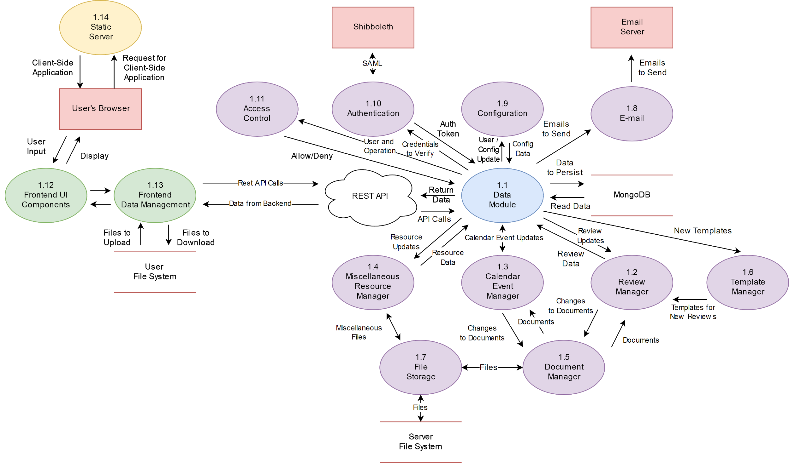
Review progress tracking
Document versioning and storage
Automatic document templating
Email notifications
External review reports
Notes:
Andrew
you want to show the complexity behind the scene without spending too much time on it, so choose your words carefully and don't rush through it
Define Document (set of files)
Comments

Slide 6
Notes:
https://www.youtube.com/watch?v=IfJ3yd_P8GQ
Backup link
Speech:
- You’ve learned about the review process in theory and how we planned on alleviating the problems faced in the old method, now let’s see how it’s actually implemented in our system
- User enters their credentials to log into the system
- Greeted with their dashboard, list of active reviews they’re involved in
- Click on a review to be taken to the review component:
Visualization graph of the review process mentioned before
Each node contains a document that must be finalized in order to move on to the next document;
Explain a document
Contains a main file (usually most recently uploaded file) along with old versions or revisions, each also containing the old file
Discussions among other PRS members happen in the Comments tab where they can leave their feedback to a particular revision of the Document
When a document is ready to be finalized, the admin will go ahead and do so which in turn locks the document to prevent any more changes
Notice how that particular node in the graph turned from blue to green, signifying its completion and opened up the next set of documents that were grayed out until its pre-reqs were completed
Flow =>
Finalized questions, department chair downloads the finalized document

Slide 7
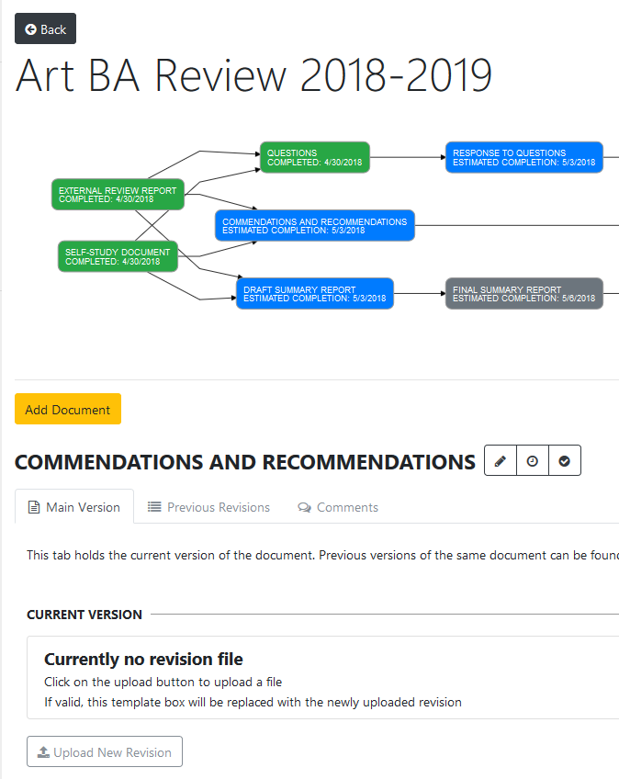
Representing
Reviews
Notes:
Why we chose this
Asynchronicity of review required an acyclic directed graph to represent its structure (this has the advantage of easy date estimation)
All documents can be reached in 3 clicks if already logged in
Explain
Review schema nodes performance issues less requests

Slide 8
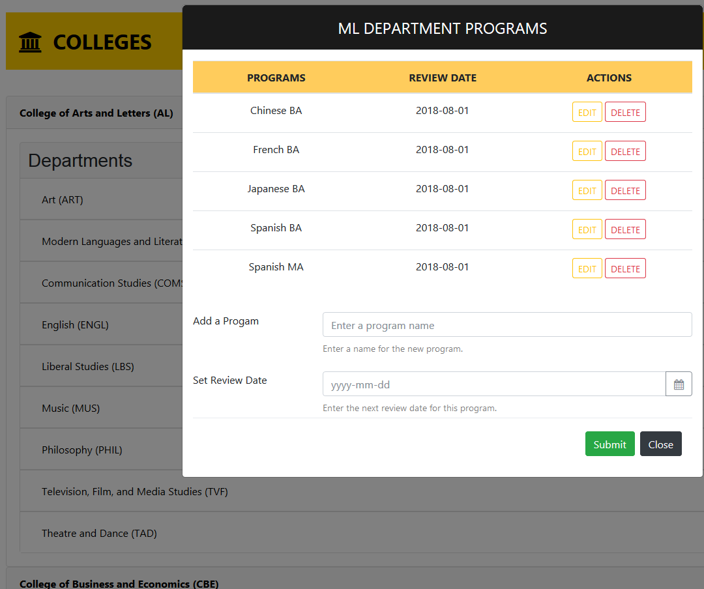
University
Hierarchy
Notes:
We had to structure the hierarchy that isnt overwhelming and as similar to what the users own. Users would be able to select the college they want then the department and the program they want.

Slide 9
External
Reviewer
Notes:
We tried our best for to make it simple and fast. We send them an email for link to our website, they upload and submit. We generated secure token 2^256 bit token. They dont get access to our system because we dont want them seeing or interfering with our system. The only downside is if they upload the wrong file they wont be able to edit. They need to get a new account from the adminstrator and upload the external review

Slide 10
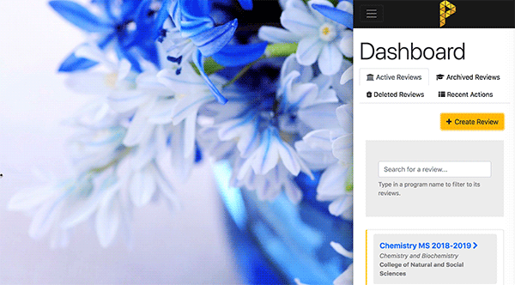
UI Library
&
Responsiveness
PrimeNG
ng-bootstrap
Notes:
Add responsive
Primeng unstable so we switched to bootsstrap
Huge learning curve,
Wasnt as simple
Previous experience with bootstrap
prime ng had a more complex structure for calendar than bootstrap

Slide 11
Future Improvements
Real-time in-browser document editor utilizing WebSockets
Review graph customization
Revision change summary
Email attachments
Notes:
This slide can be run slowly or quickly depending on remaining time

Slide 12
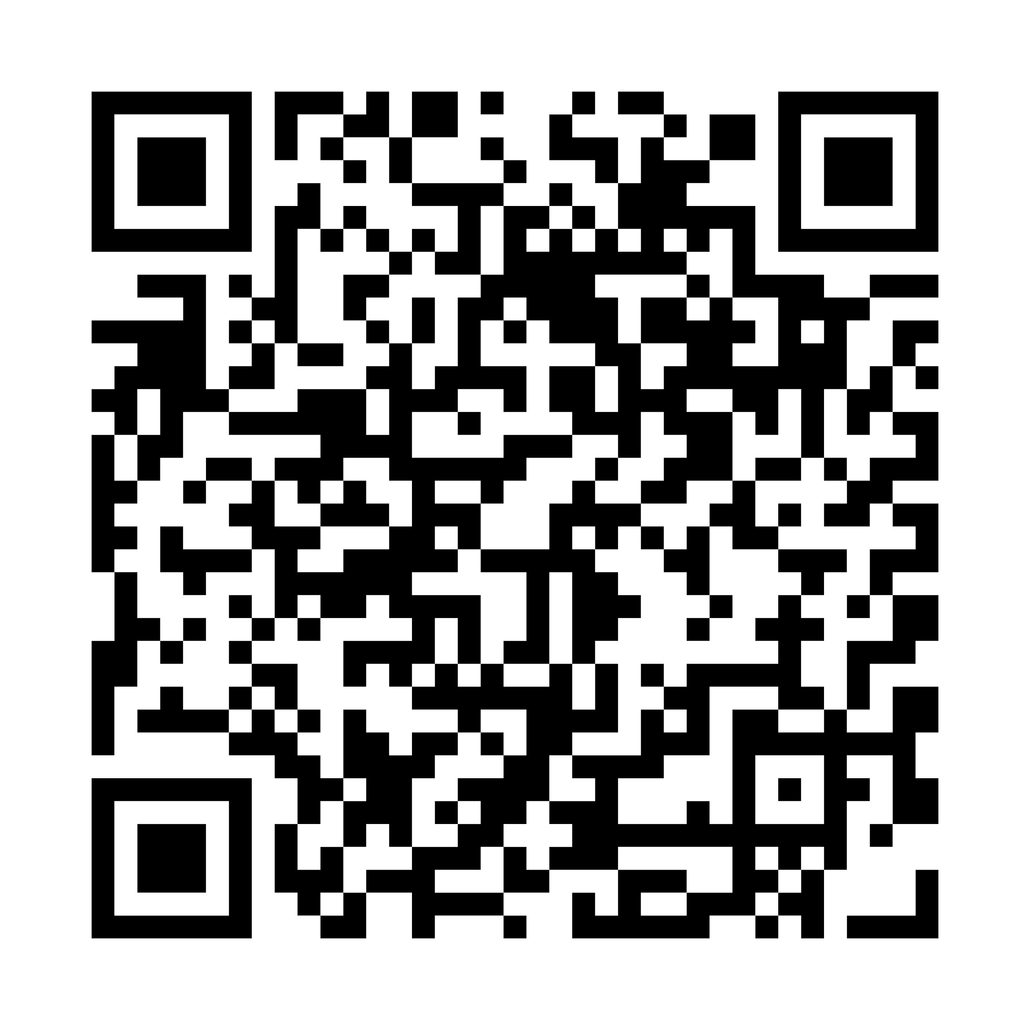
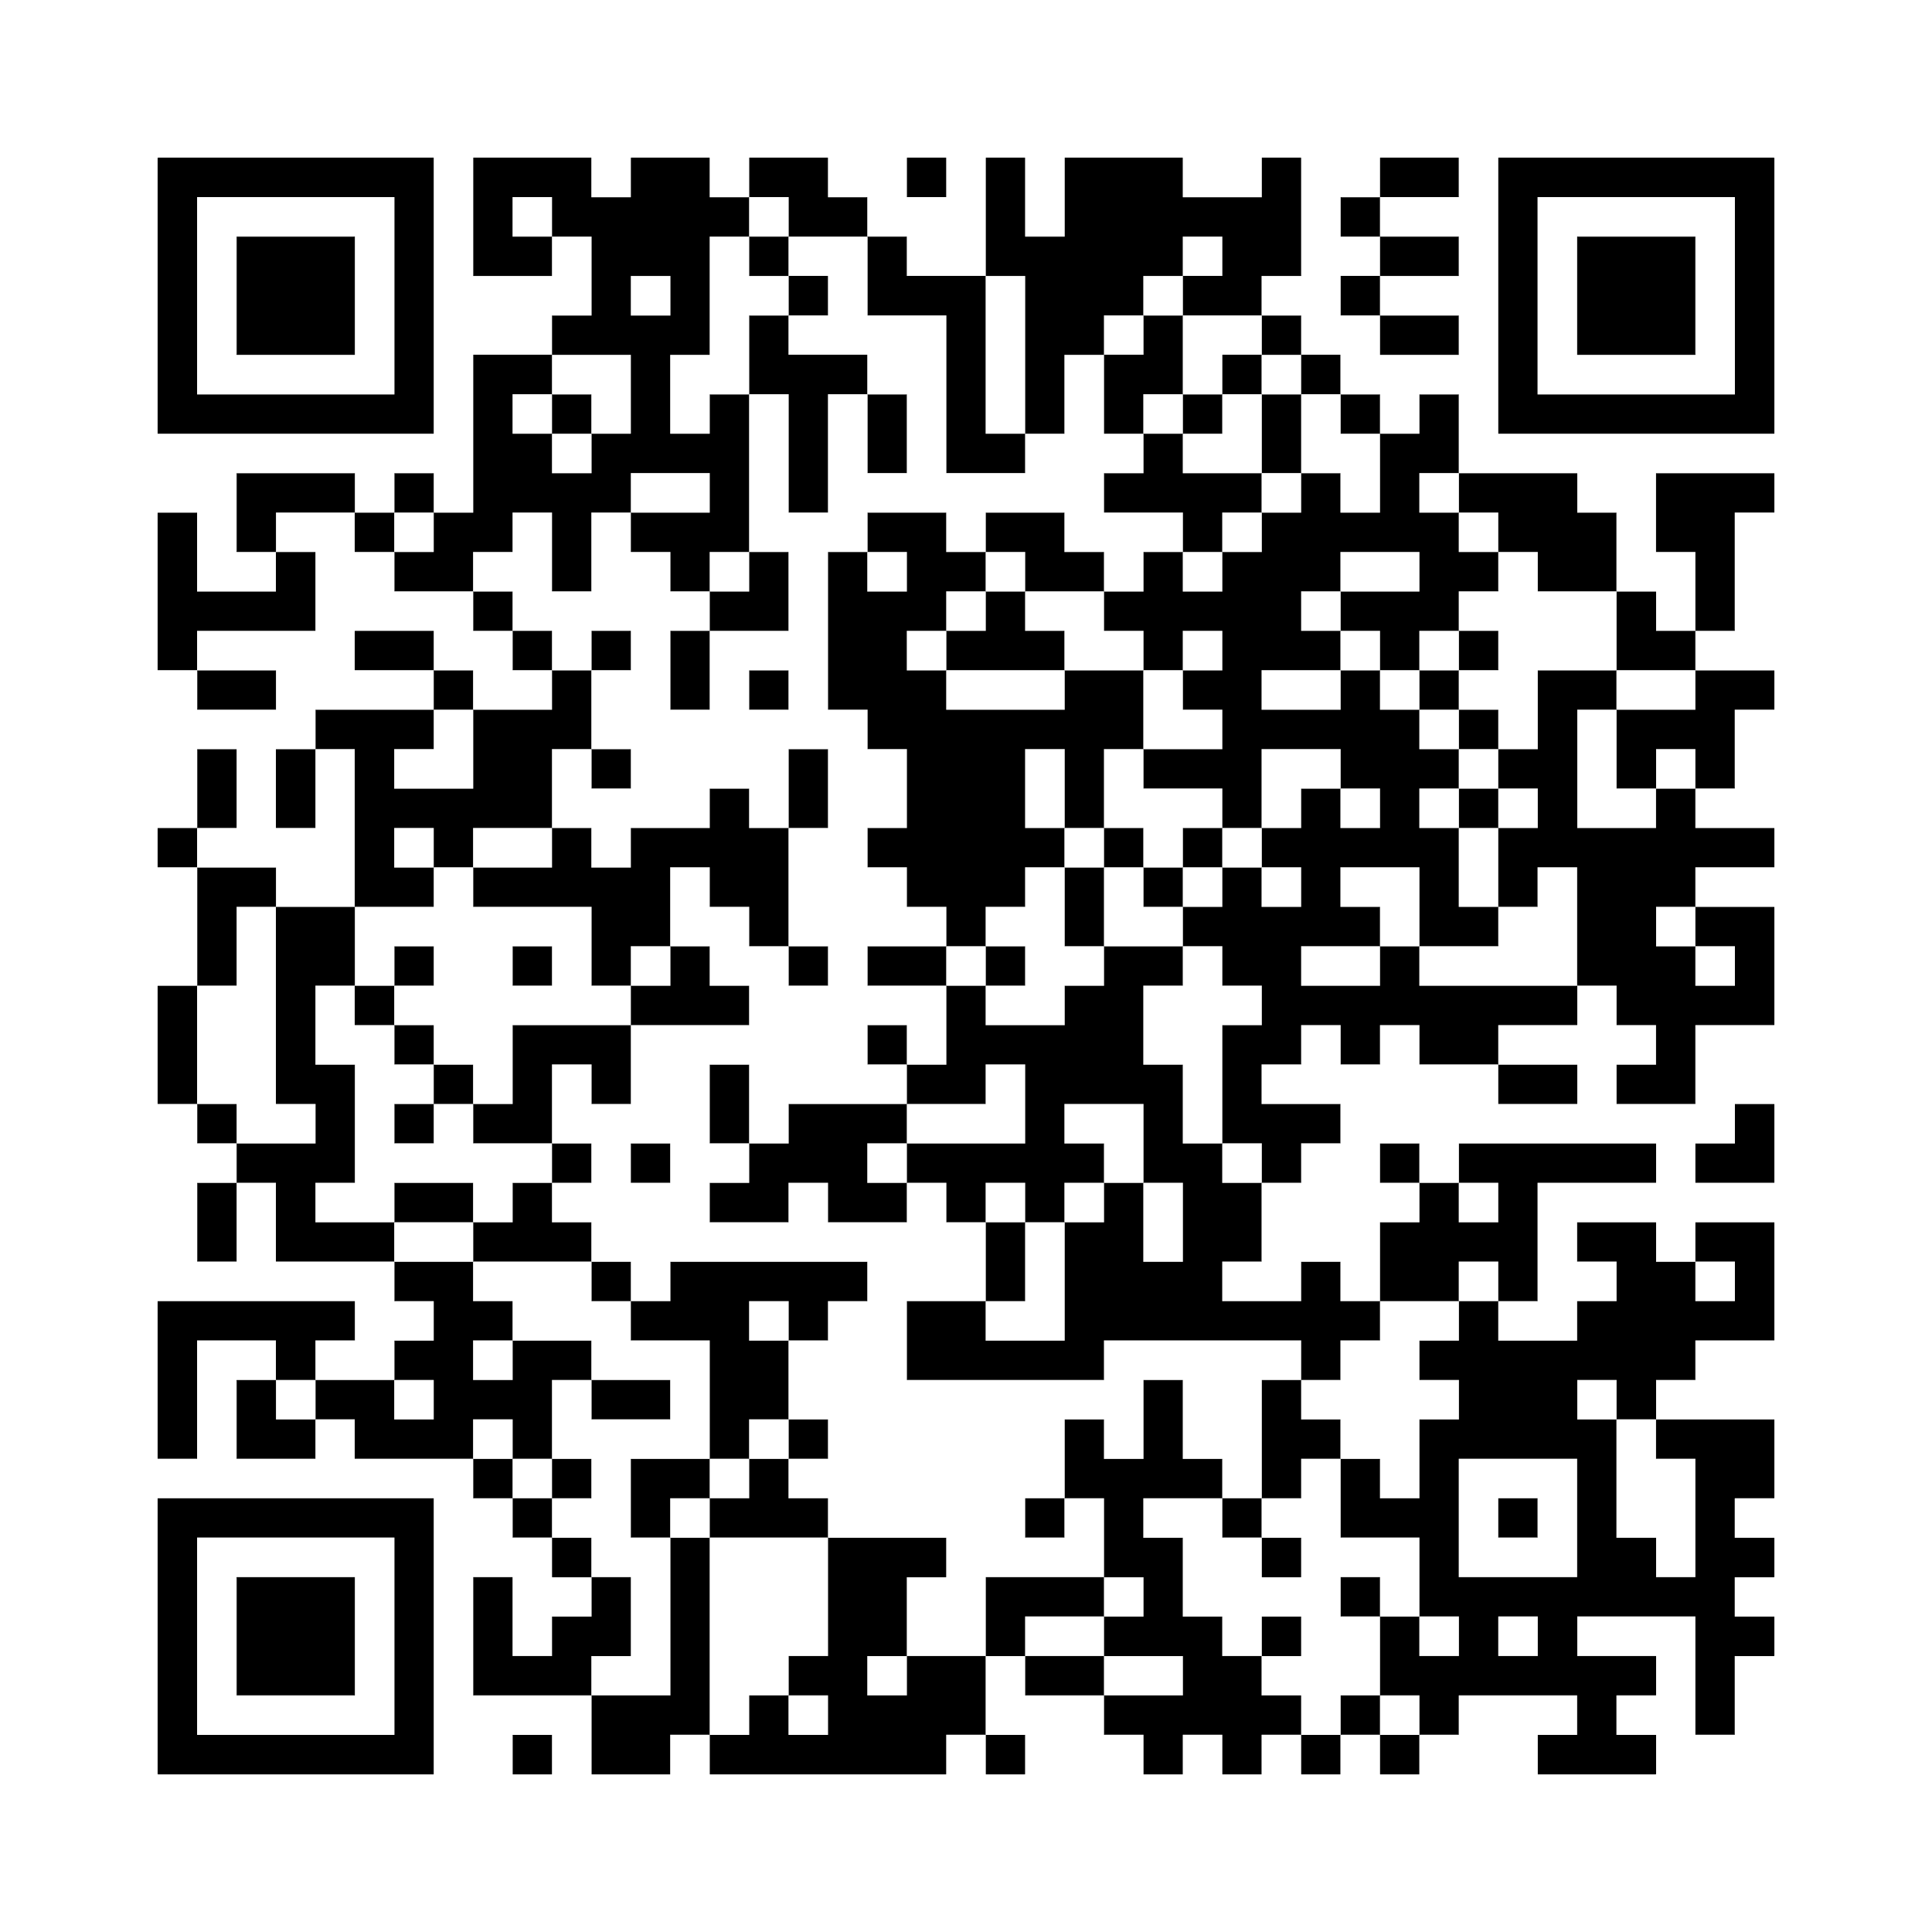
THANK YOU
prism-api
prism-frontend
David, Leanne ■ McLees, Andrew ■ Sarenas, Justin ■ Solis, Ben Jair

Slide 14
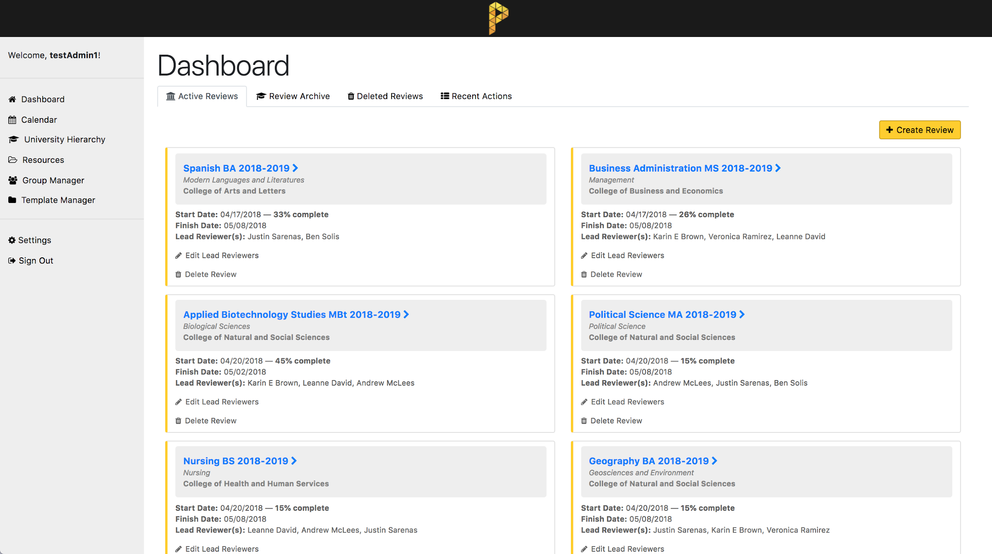
Notes:
Leanne

Slide 15
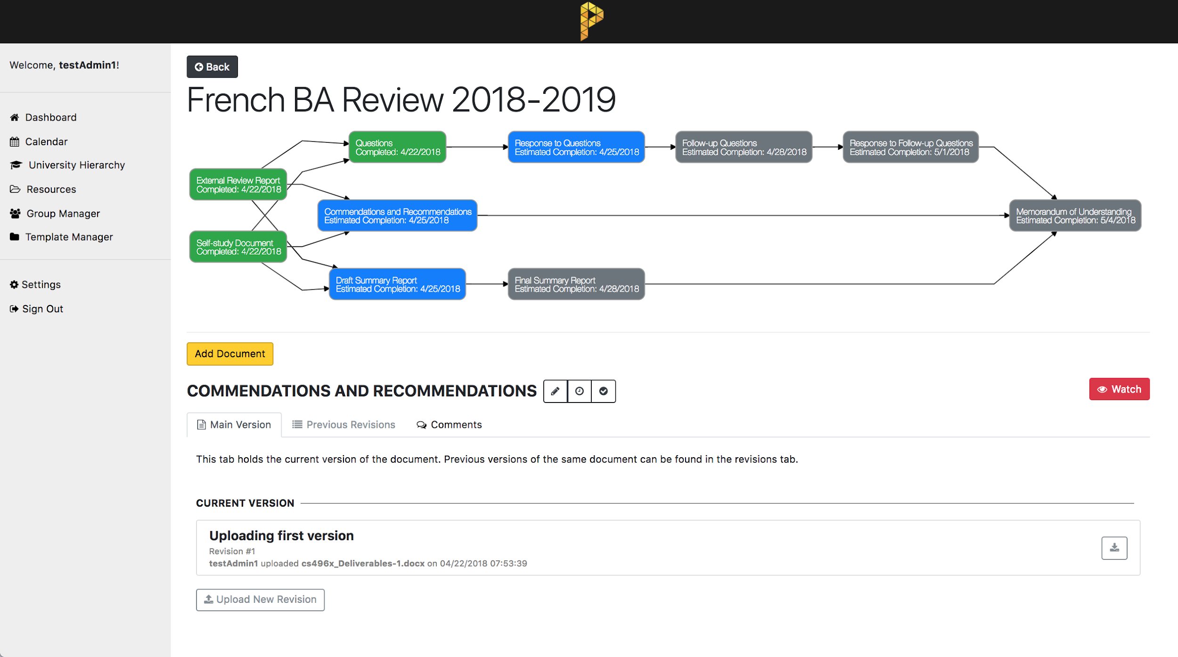

Slide 16
Web API
80 endpoints
Not quite RESTful API
Validation
Logging
Access control
Authentication
Email
Testing
Notes:
Not RESTful as it doesn't meet the hypermedia constraint
Thorough validation, PRISM is a critical part of the workflow. The frontend can be refreshed, but the backend needs to always be solid
Thorough logging, debugging and maintenance both have already been helped by this. Logs also transparent to users as will be shown in the frontend section
Constant-time no-database authentication with an in-memory cache of JWT tokens. BCrypt password hashes stored
Access control with ACLs where needed and simple group-based elsewhere
Some unit testing of more complex models, HTTP testing done with Postman, describe postman/ program
Jasmine for code heavy models user and review automatic testing, automated test runner for javascript
Cron npm package / time based job scheduler
Protractor e2e testing, not alot of success but still in implementation
Jwt for authentication, stateless protocol decrypt token so we dont make another database request to get the token

Slide 17
Program
Review
Contributors
External Reviewer
College Dean/Designee
Department Chairs
Program Review Subcommittee
Notes:
Ben
Combine with slide 2

Slide 18
Program Review Subcommittee (PRS)
Comprised of CSULA faculty
Serves to process program reviews
Notes:
Ben
Combine with slide 2

Slide 19
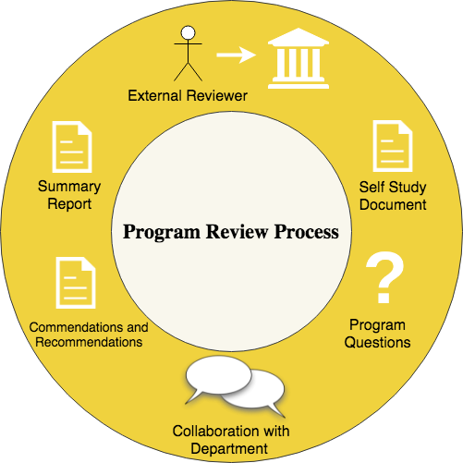
Notes:
Ben

Slide 20
User Experience
Frontend
Nice workflow
Responsive
Simple Dashboard
Easy Navigation

