Slide 1
BOE Sidewalk Assesment System
Liasons: Ted Allen, Alisa Blake, Irvin Nguyen, Christopher Tsangaris, Jonathon DeLeon, Miguel Grajeda, Raul Virgen
Advisor: Jungsoo (Soo) Lim
Team: Aquil Alam, Alejandro Chanocua, Omar Eclicerio, Ernesto Garcia, Francisco Gastelum, Henry Gonzales, Gui He, Perla Ramirez, Rishi Shah, Daniel Zeng
Notes:
Hello and Welcome Everyone, My name is Alejandro Chanocua I am the Team lead for the BEO Sidewalk Assesment System project.
Our project advisor is Soo.
And the Liasons are Ted Allen, Alisa Blake, Irvin Nguyen, Christoher Tsangaris, Jonathon DeLeon, Miguel Grajega, and Raul Virgen

Slide 2
Teams
UI
ROVER UI
DATABASE
FIELD TESTING
NAV LA
Perla
Alejandro
Gui
Omar
Henry
Francisco
Ernesto
Rishi
Daniel
Aquil
Notes:
We are also joined with our teams for our project.
In the UI team we have Perla and Francisco.
In the RoverUI team we have Ernesto and myself.
In the Database team we have Gui and Rishi.
The Field Testing Team we have Omar and Daniel.
And in the Navigate LA team we have Henry and Aquil.

Slide 3
Agenda
Motivation and introduction
Overview of project flow.
Project sub teams
Technical breakdown
Notes:
To go over our agenda for today we will cover:
- The Motivation and introduction of the project
- A brief overview of how the project flows.
- And each project sub team with their technical breakdown of how they accomplished their task.

Slide 4
Motivation
Contains over 11,000 miles of sidewalks.
City of LA data is used for categorizing sidewalk conditions for Federal ADA standards.
Rover and data collection speeds up the process of analyzing sidewalks.
Notes:
The motivation behind the inception of this project is The City of LA and Bureau of Engineering contains 11,000 miles of sidewalks.
The data that was gathered will be used to categorize sidewalk conditions that follow Federal ADA standards.
With the rover, sidewalks can be analyzed in an easier, efficient, and less labor intensive manner.

Slide 5
Rover in Action
Rover is driven by a user with the Rover UI.
The rover collects data of a sidewalk segment:
GPS
Crossing & Running Slope
Time signature
Section ID
This data is processed/stored by the DB team's algorithms to be used as an index for severity of sidewalk segments in Los Angeles.
Notes:
Here is a brief overview of the project flow:
- The rover is driven by a user by using the Rover UI and data collection starts here.
- The rover collects GPS data, Crossing and Running Slope measurements, a time signature, and the section ID.
- The data is then process and stored by the Database team's algorithms to be used as an index for severity of sidewalk segments in the City of LA.
I'll now hand it over to our WebUI team that will expand on the Web User Interface.

Slide 6
Web UI
Overview
Interactive user-friendly UI
Collect Rover slope data and GoPro camera images
Display Rover and GoPro data

Slide 7
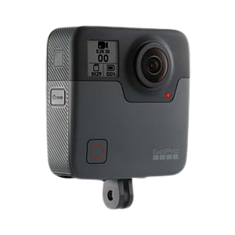
Technologies Used
React
Node.js
GoPro Fusion
Google Maps API
Azure Blob Storage
Languages Used:
Javascript
HTML

Slide 8
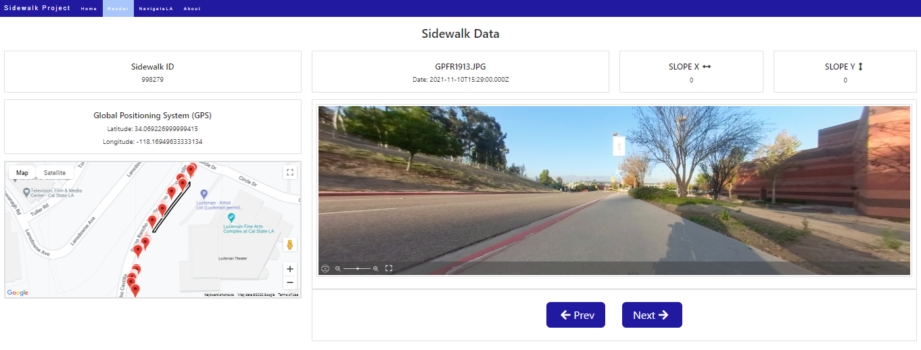
Web App
GPS Rover Data
Section ID
Image name and date
Slope data
Google Map displays GPS points from Rover data
Users can switch back and forth between images

Slide 9
Rover UI
Overview
Intuitive user friendly UI
Controls speed and direction
Initial point of data collection

Slide 10
Technologies Used
Languages:
HTML
Javascript
Bootstrap
roslibjs
Robot operating system

Slide 11
Navbar
Logo
Battery
Meter
Data Count
Fullscreen
ID field
Set ID
Start
Control Buttons
Notes:
Hi it's Alejandro again
The rover UI's main component is the NavBar at the top of the screen.
In the NavBar we display the BEO's logo
There is a battery meter that displays the rover battery.
A data counter that represents then number of data segments collected.
A Fullscreen button that will transform the view to fullscreen of the device being used.
An ID field that accepts the ID of the section.
And the following buttons:
- Set ID which sets the ID from the section ID field.
- A start button to begin collecting data.
- A stop button that ends the data collection.
- A reboot button that reboots the rover system.
- And a turn off button that shuts down the rover.

Slide 12
Navigation Controls
Directional Buttons
Stop Button
Notes:
In the Rover UI we also have a set of Navigation Controls.
A directional set of buttons provide a semi-autonomous control of the rover where the user only needs to provide lateral guidance to the rover.
And a stop button that stops the rover from moving.

Slide 13
Rover UI Demo
Notes:
Here is a brief demo of the Rover UI.
The user begins by entering the section id, setting it, and starting the data collection. Once they completed the data collection they can stop.
As the user performs an action with the buttons they are notified of their action via a small non intrusive notification.
At the same time they are also able to control the rover direction with the directional and stop buttons.
I'll now hand it over to our DB and Backend team.

Slide 14
DB/Backend
Overview
Python code for database input
Organize raw data in a SQL view
Relate collected slope to percentage

Slide 15
DB/Backend
Sample of collected rover data
SQL View contains aggregate data
Better way to organize all slope data

Slide 16
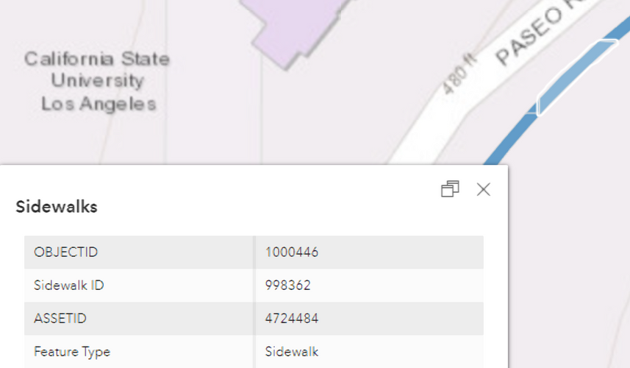
DB/Backend
Sample GoPro image metadata
No clusters of GPS points
GPS testing is accurate to field test locations

Slide 17
Backend API
Overview
Web API's role
Tech stack
Features

Slide 18
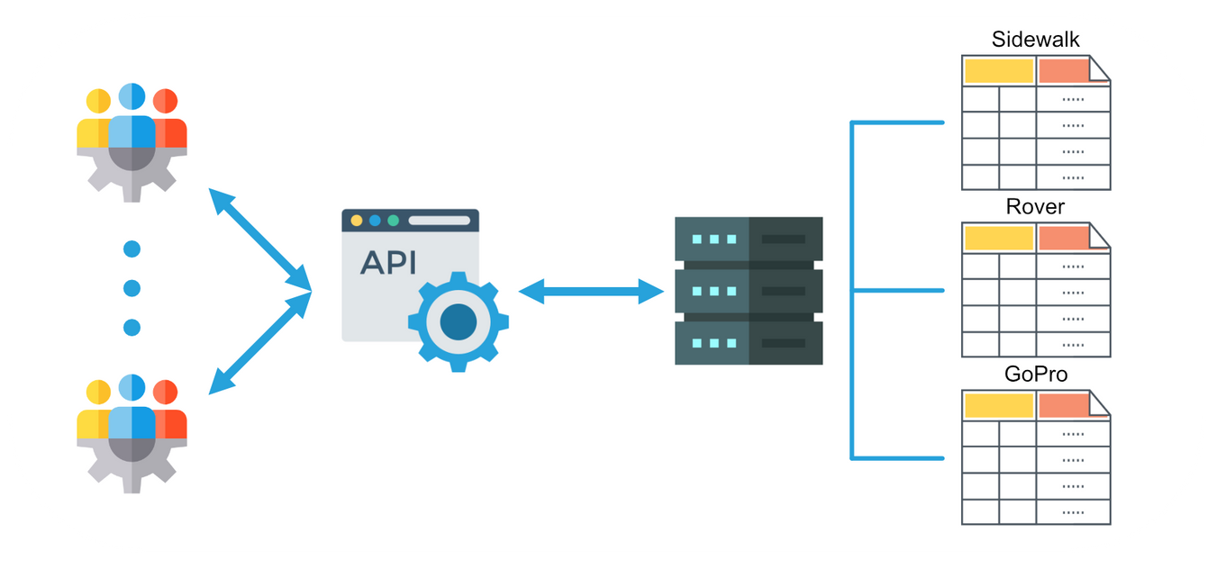
Web API - Role
Provide data accessibility across different teams.
Reduce overhead by centralizing data handling at a single source.
Promotes separation of concerns.

Slide 19
Web API - Tech Stack
NodeJS: Cross-platform back end JavaScript runtime environment.
ExpressJS: De facto standard web server framework for NodeJs. Used to build API
Ms-sql: Microsoft SQL Server client for NodeJS.

Slide 20
Web API - Features
Primary endpoint for accessing data from database.
Accepts JSON in body requests or JSON encoded in URL.
Offers flexibility in data requests.

Slide 21
Web API - Features
Supports:
LIMIT/TOP & OFFSET
Column functions (COUNT, DISTINCT, etc)
WHERE clause(s) (=, >, NOT IN, etc)
Attribute selection
GROUP BY & ORDER BY functions
Multiple table selections
Simple joins

Slide 22
Web API - Features
Given a coordinate, finds the sidewalk closest to the coordinate and return its data.
Converts a given list of coordinates from one spatial reference to another.
When a rover or GoPro CSV file is uploaded, the file is processed and inserted into the appropriate database table.

Slide 23
Field Testing
Overview
Collected field data
Editing collected data
Used Excel to:
display thresholds
calculated the data

Slide 24
Field Testing

Slide 25
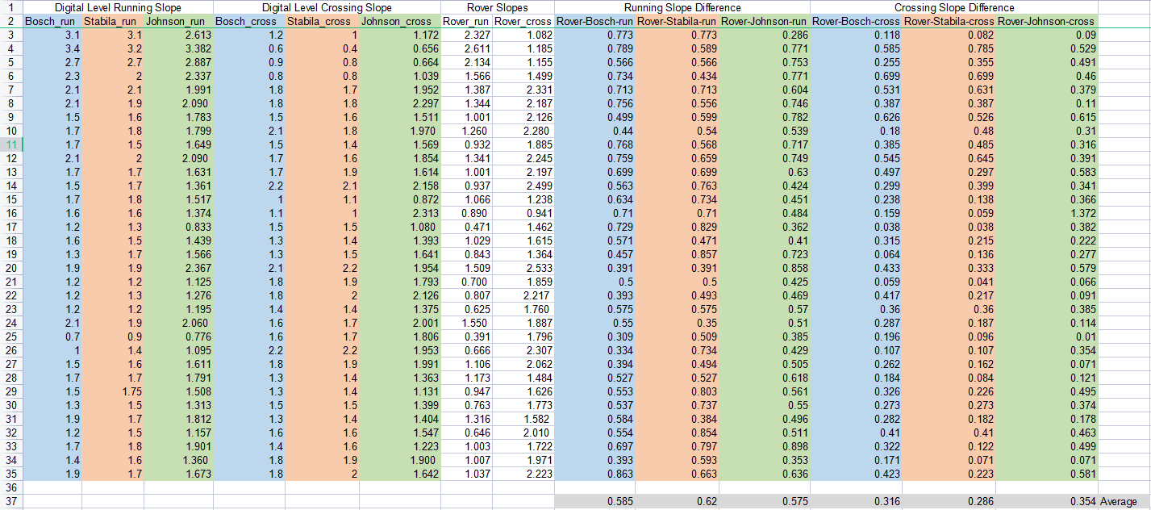
Digital Level Comparisons

Slide 26
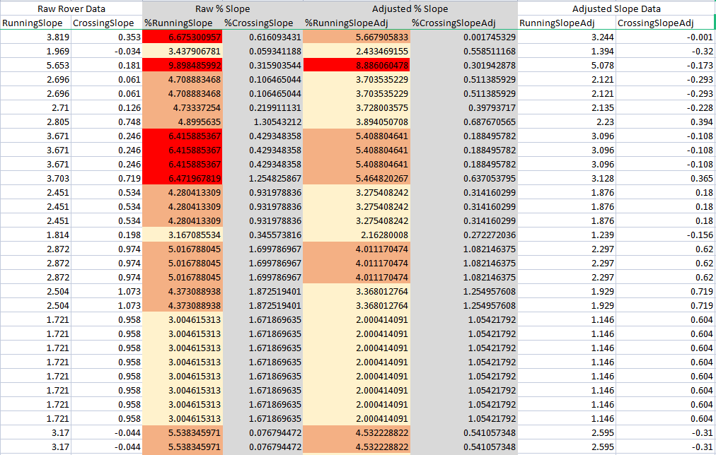

Slide 27
Navigate LA
Overview
Collected data will serve as geographical reference points for the GoPro data and the rover data listed.
Mapping files will be hosted on NavigateLA as a layer of sidewalk data for the Bureau of Engineering to view.

Slide 28
Navigate LA Interface

Slide 29
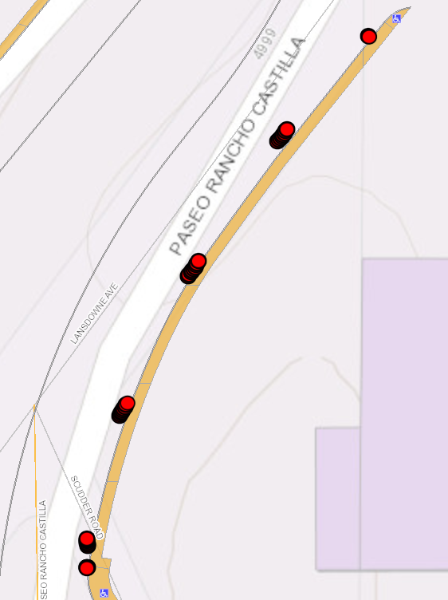
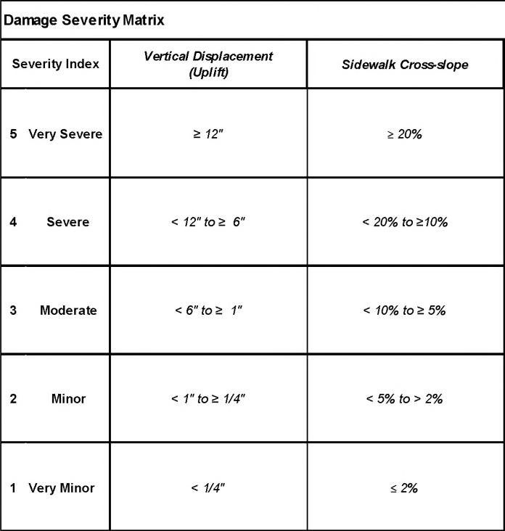
Navigate LA Data
Categorizing:
Cross slope used for Severity Index

Slide 30
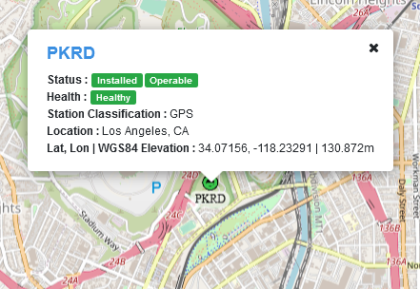
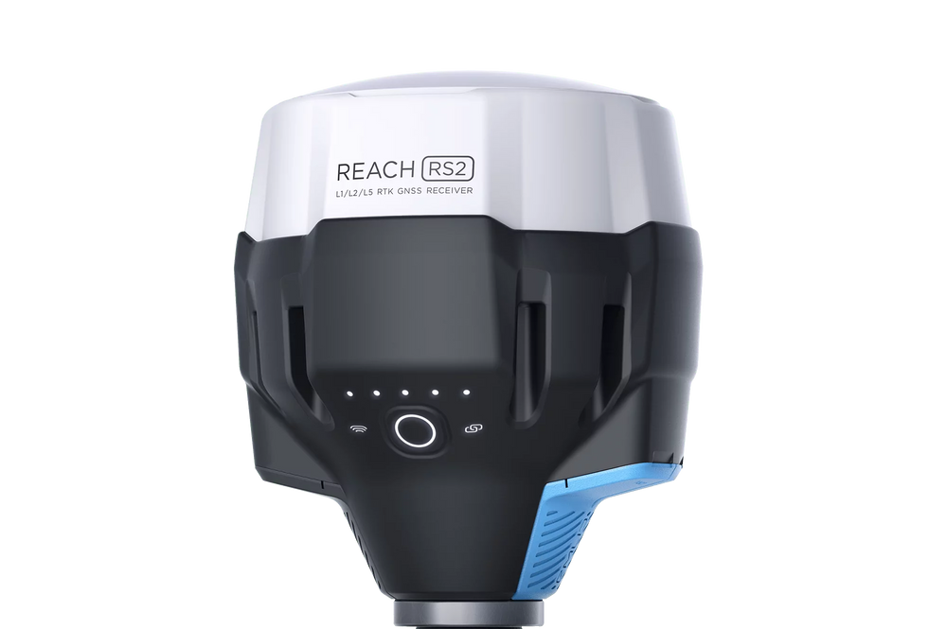
RTK Viability
Base Station
Reach RS2
RTK Positioning
&
GNSS Reciever

Slide 31
Rover GPS vs RTK
Rover GPS Data
Reach RS2 Data
Sidewalk Segment

Slide 32
Future Recommendations
Web UI
Set default data to current network location
Implementation of automatic photo conversion rather than manual
Rover UI
Create a mobile application
Database
Implement authentication for insert, update, and delete actions
Add support for batch csv file uploads
Add support for locating nearest Section ID
Field Testing
Check if it's possible to get a survey from civil engineers
NavLA
Color code records based on Severity Index
Host layer on NavLA so there is no need to drag & drop records
Notes:
As a team we a have set recommendation that we believe would improve the project .
For the WebUI making the default value the current location and automatic photo conversion of the images.
For the Rover UI a user friendly mobile application to control the rover.
The Database could implement authentication for insert, update, and delete actions.
Add support for batch CSV uploads and support for locating the nearest Section ID.
Increasing the accuracy of measurements is also an improvement that can be worked on, such as getting a survey from civil engineers.
And for Navigate LA future work on this project can color code records based on Severity Index and a host layer on Navigate LA so there is no need to drag and drop records.

Slide 33
Q & A
Notes:
At this moment if there any questions about the project we can now answer.

Slide 34
Thank you
Sponsors: City of LA and B.O.E for the opportunity to work on this project.
Notes:
We also want to thank our Advisor Soo, the City of LA, and Bureau of Engineering that have given us this opportunity and have been a great pleasure to work with. We have a learned a lot from this project and the team.
We hope that this project is expanded beyond where we leave it.
Thank you everyone for taking your time to watch our presentation.

