Slide 1
Pelvic Image Analysis and Geometry Reconstruction
using Artificial Intelligence
Client: Dr. Mathias Brieu (Mechanical Engineering)
Advisor: Dr. Negin Forouzesh (Computer Science)

Slide 2
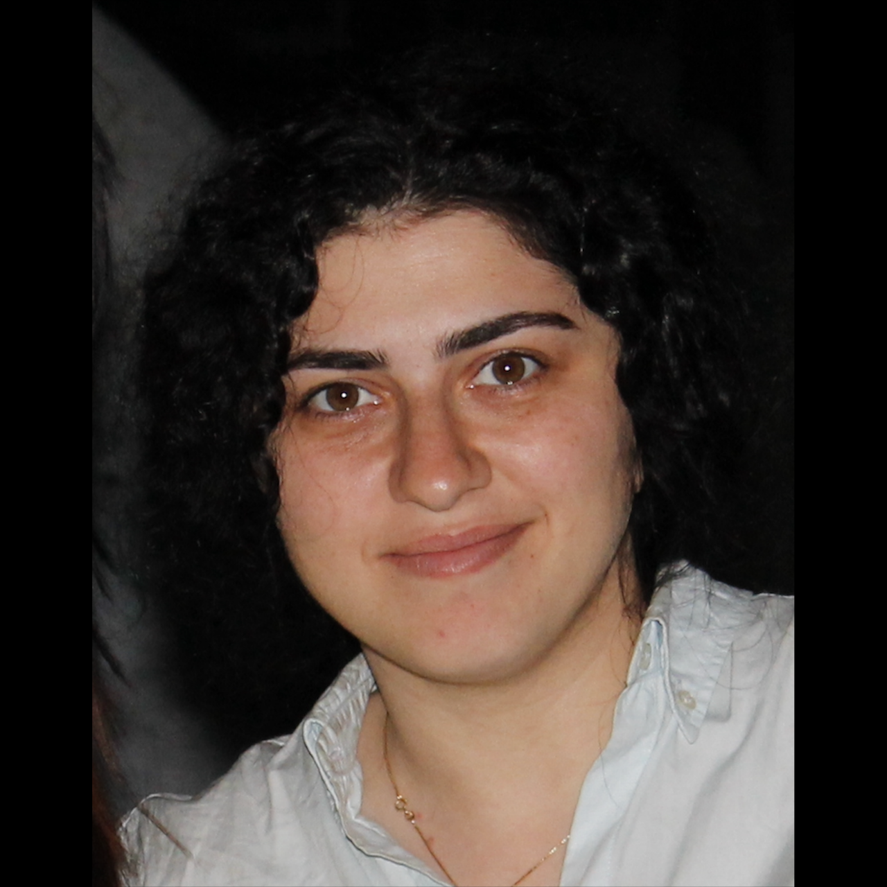
Meet the Team
Ralph Belleca Project Lead, Front-end
rbellec@calstatela.edu
Robin Mok Front-end
rmok2@calstatela.edu
Alejandra Olvera Front-end
aolver14@calstatela.edu
Sabino Ramirez Front-end
srami207@calstatela.edu
Mary Semerdjian Front-end Lead
msemerd2@calstatela.edu

Slide 3
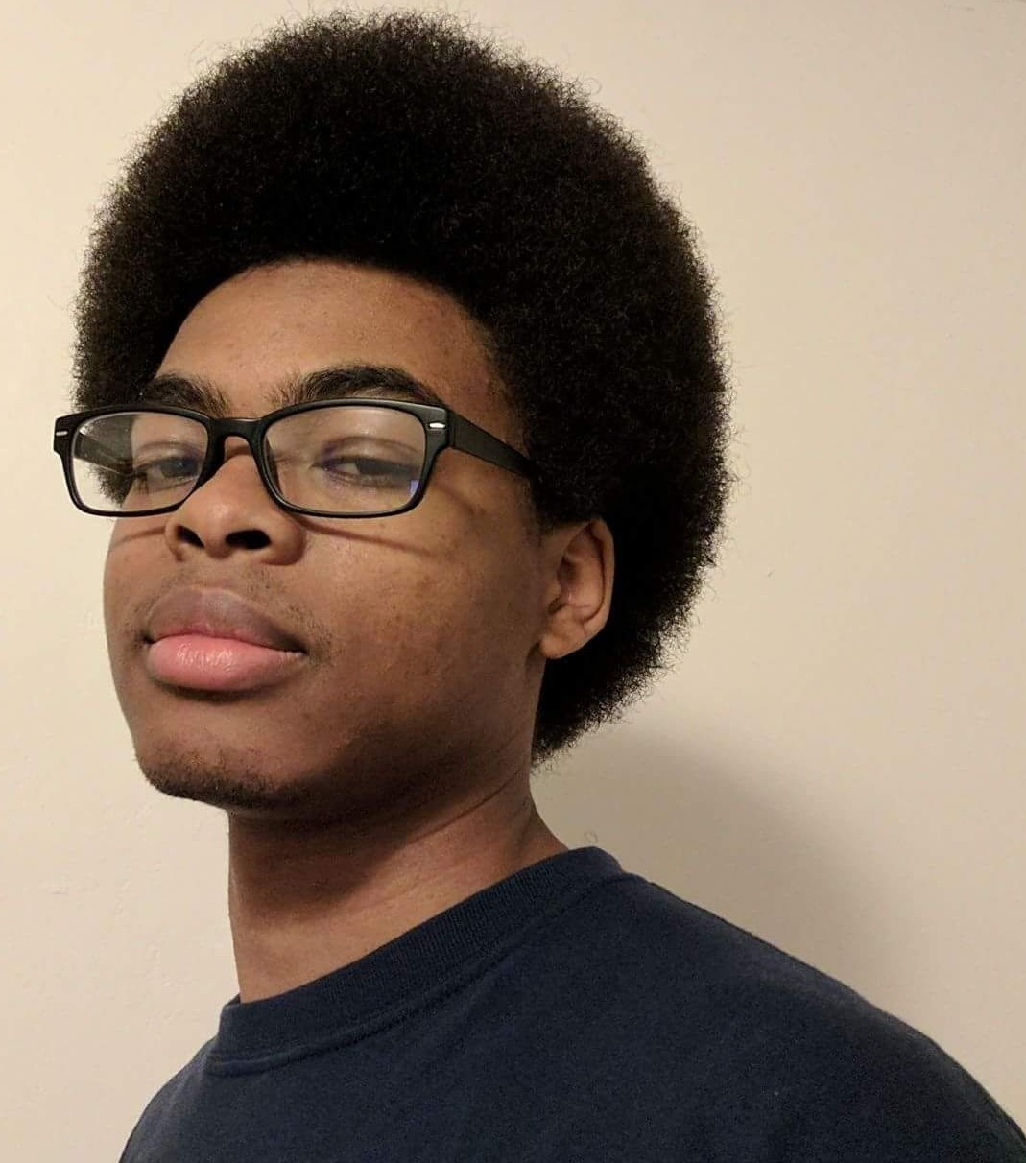
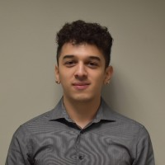
Meet the Team
Nicol Barrios Back-end Lead
abarri53@calstatela.edu
Ted Kim Back-end
tkim56@calstatela.edu
Silvano Medina Back-end
Documentation Lead
smedin63@calstatela.edu
Demetrius Parker Back-end
dparke11@calstatela.edu
Jason Tejada Back-end,
Customer Liaison
jtejad12@calstatela.edu

Slide 4
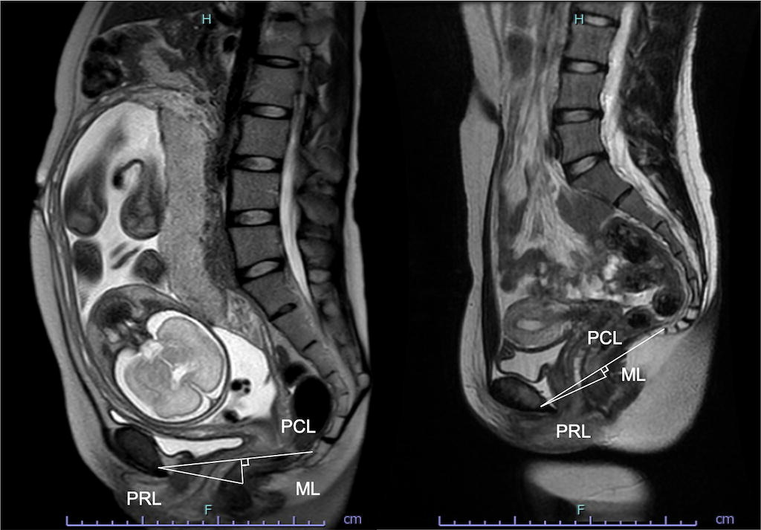
Context
Example of Medical Imaging
MRI image taken during pregnancy

Slide 5
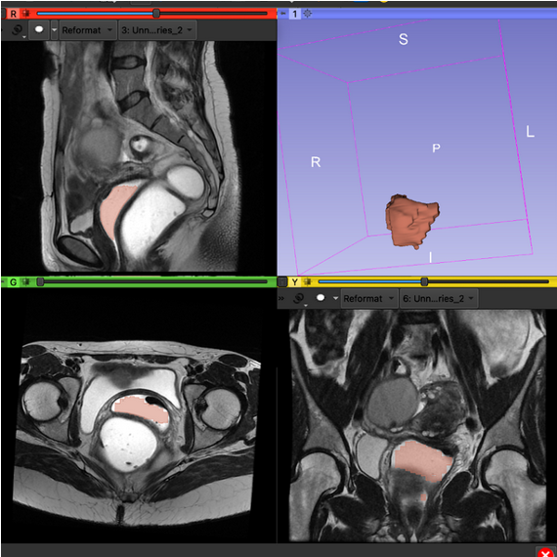
Context
Project’s Focus: MRI Scan
Example of Medical Imaging
MRI image taken during pregnancy
Performing image segmentation on an MRI image
with vagina as target organ

Slide 6
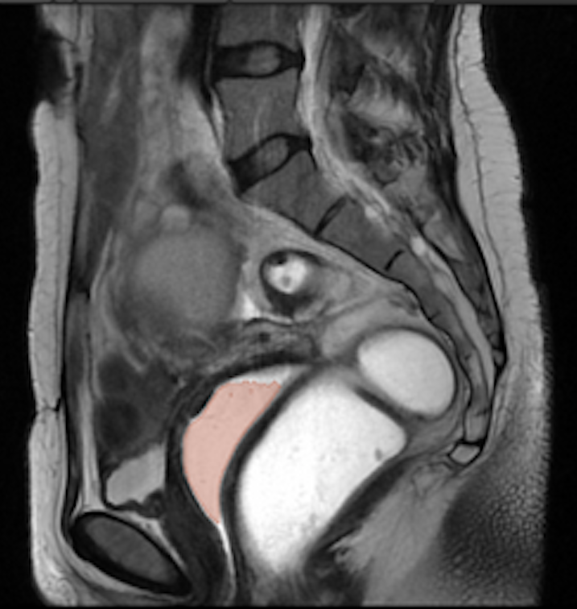
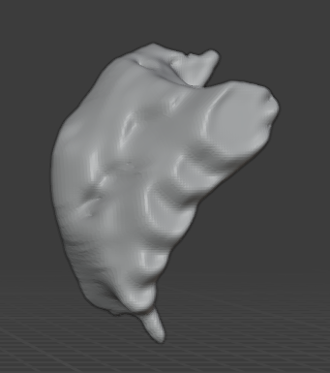
Problem
Traditional methodology is
tedious and requires various repetitive manual procedures.
Manual
Thresholding
Other Manual
Refinement
MRI Input
3D Object
of Pelvic Organ
(Vagina)

Slide 7
Goal
Streamline the process of converting MRI images of pelvic organs into 3-D models using Artificial Intelligence
AIAA
Semi-automatic thresholding using custom AI model
MRI Input
3D Object
of Pelvic Organ
(Vagina)

Slide 8
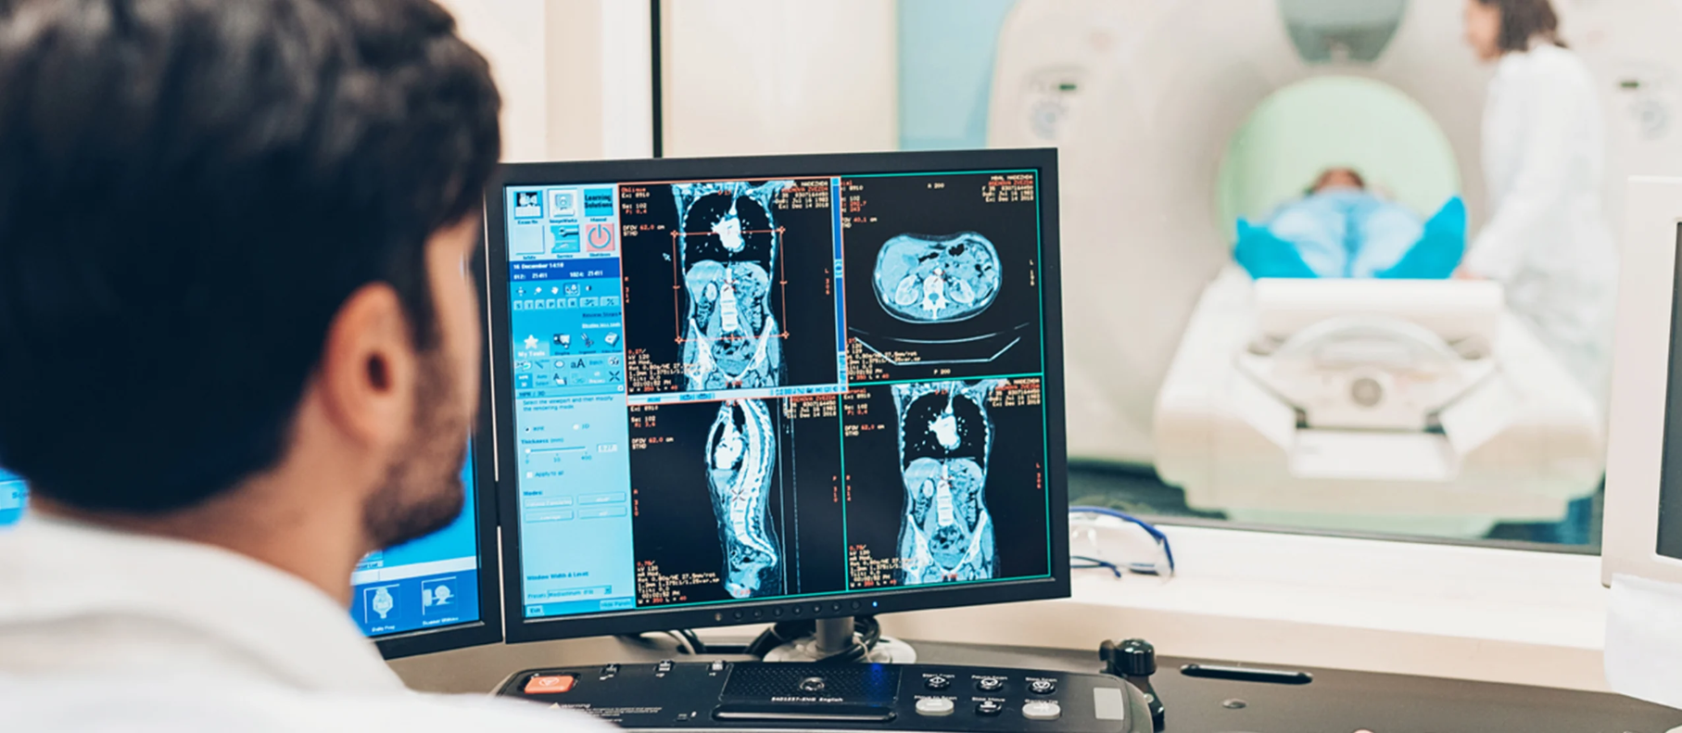
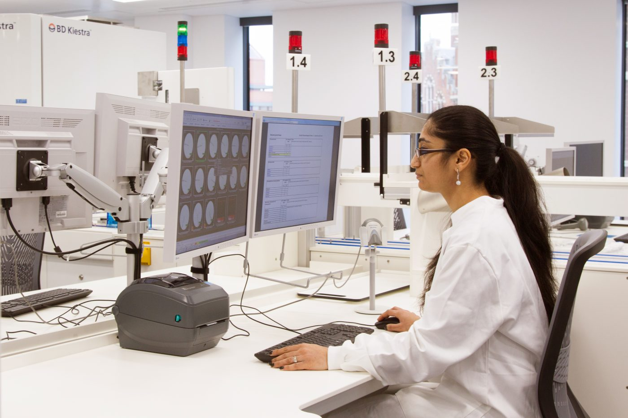
Significance
Allow medical professionals to do image analysis in a faster and more effective way by simplifying the creation of 3-D models.

Slide 9
Approach for Spring Semester
System
Configuration
Masking
Training
Integration
to 3D Slicer
System Requirements and Installation
Highlighting and labeling region of interest
Learns to create model using dataset
Model used to help create organ of interest in
3D Slicer

Slide 10
Approach for Spring Semester
Use AI-Assisted Annotation to create pelvic organs using data in MRI scans given to the program
Use Clara Train to Create Custom 3D AI - Generated Model of pelvic organs

Slide 11
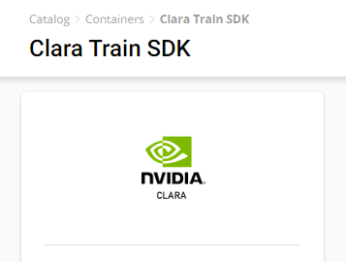
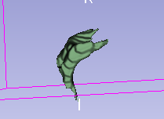
Start of Spring
Determined to use Deepgrow
Goals:
-Use Clara Train
-Find & mask Data Points
-Training & Creating Usable model
-Use Trained model with Deepgrow
Example of 3D model

Slide 12
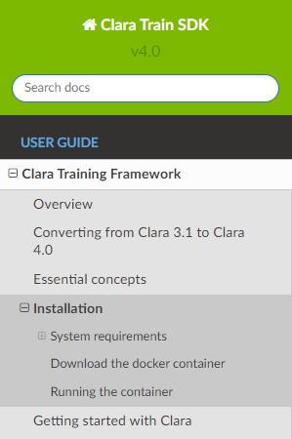
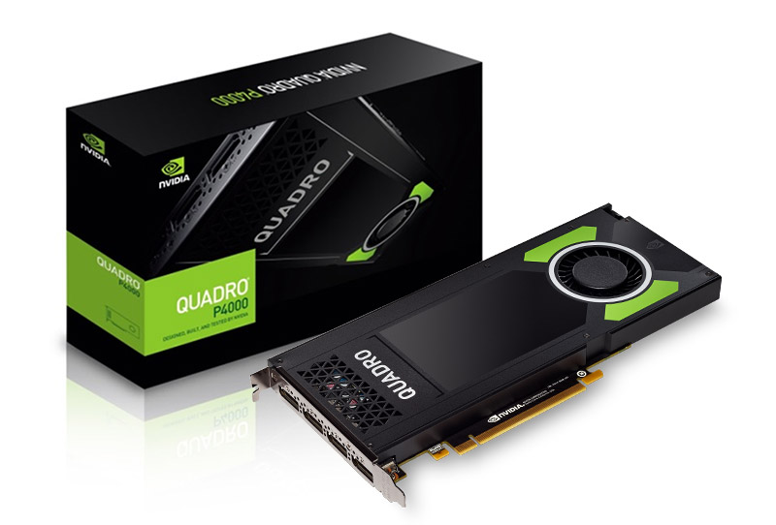
Installation of Core Programs
-Installation
-Github
-NVIDIA’s website
-Requirements
-Linux
-NVIDIA GPU
-Data Points
Clara Train SDK Documentations
Image source: https://en.wikipedia.org/wiki/Linux https://www.leadtek.com/p_images/zoom/10775_1M.jpg

Slide 13
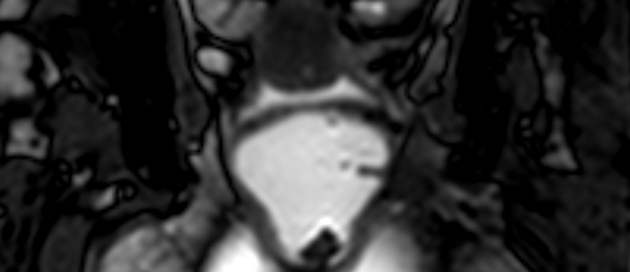
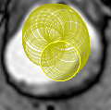
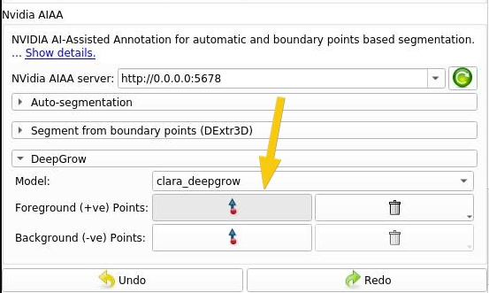
Data Points
-MRI Scans
-Usable inputs
-Test Models
-Masking and labeling of Data Points
-Training
Examples of Scan
Masking/Labeling

Slide 14
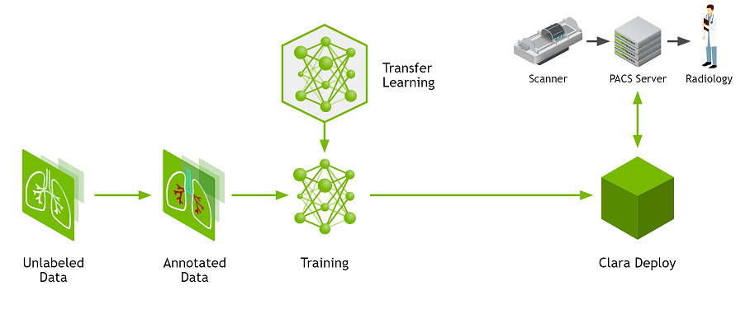
Clara Train (Version 4.0)
An application framework that allows users to quickly get started for annotating, training, and adapting AI models while providing pre-trained models.

Slide 15
Clara Train (Version 4.0)
An application framework that allows users to quickly get started for annotating, training, and adapting AI models while providing pre-trained models.

Slide 16
Clara Train (Version 4.0)
An application framework that allows users to quickly get started for annotating, training, and adapting AI models while providing pre-trained models.

Slide 17
Clara Train (Version 4.0)
An application framework that allows users to quickly get started for annotating, training, and adapting AI models while providing pre-trained models.

Slide 18
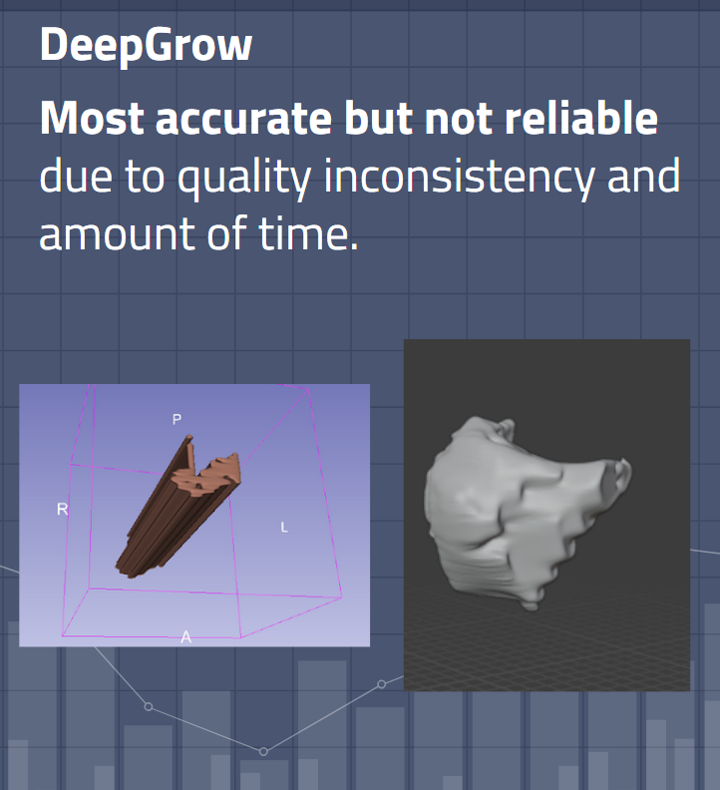
Masking and Binary Labels
Previously last semester…
Our results from last semester were all based on a brain tumor model that the AIAA plugin provided for us. This semester we chose to use our own pelvic model that we had to create.
Demetrius P.

Slide 19
Masking and Binary Labels
In order to get the best model generated by Nvidia AIAA plug-in we need to create our own model.
To do this we need to use the Nvidia Clara Train Framework to create a model of the organs we specify and train the A.I. on that model.
To specify the organ we create a binary labelmap using the masking process.
Demetrius P.

Slide 20
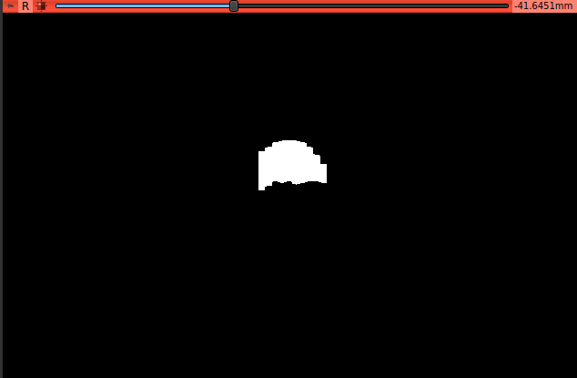
Masking and Binary Labels
Binary labelmaps are created in 3D Slicer using a process called masking.
Masking is the process of blanking out a segment or area in a volumetric image to show only a selected organ. It can be used for creating a binary labelmap for registration, bias correction, etc.
Demetrius P.
Binary labelmaps for bladder(top) and vagina(bottom)

Slide 21
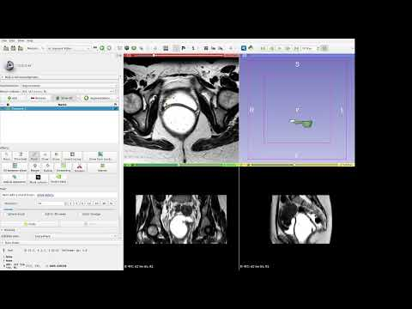
How-To Mask
Demetrius P.

Slide 22
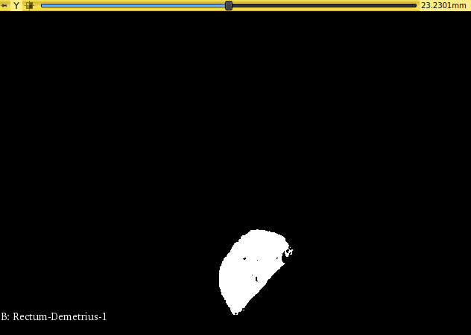
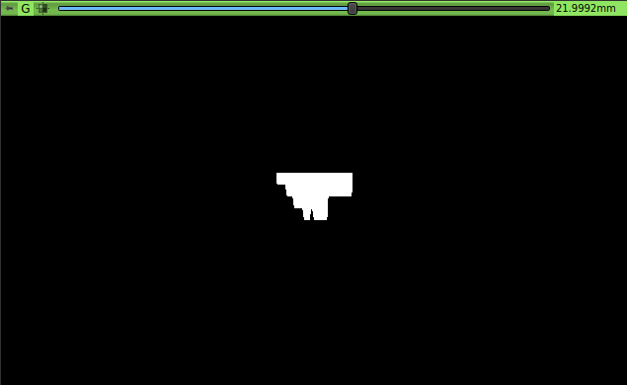
Masking and
Binary Labels
Once the labelmap have been created it is ready to be used by the Clara Train Framework.
Demetrius P.
Binary labelmap for rectum(top) and
bladder (bottom)

Slide 23
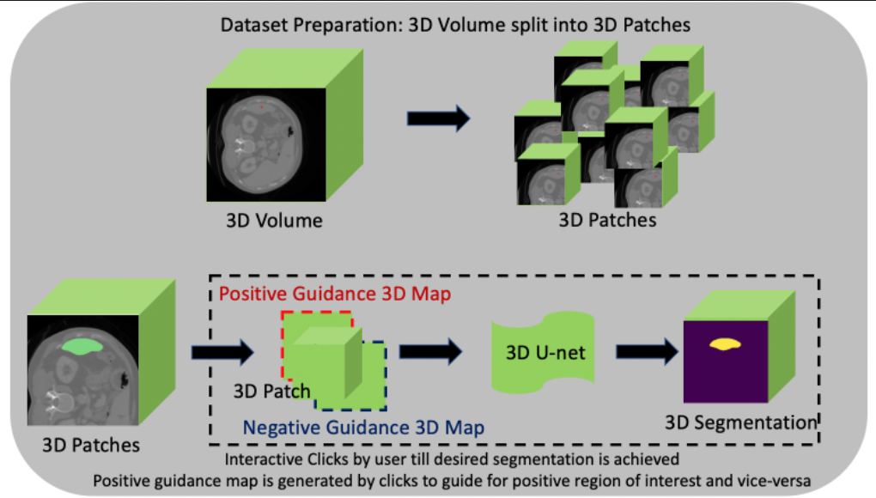
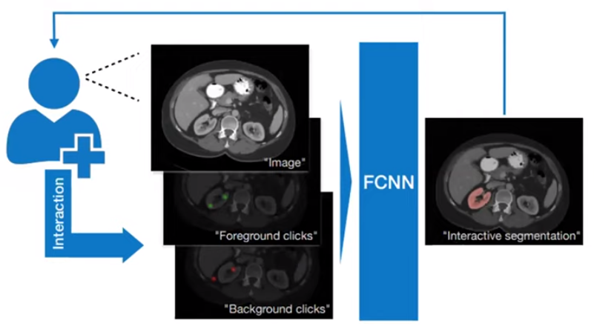
Nvidia DeepGrow
A pretrained model from Nvidia that applies segmentation based on foreground and background clicks by the user.
Built around the 3D U-Net convolutional neural network architecture.
Output consists of a single channel containing a 3D semantic segmentation represented by a binary label system.
Top: From Nvidia’s site showing data preparation. Bottom: annotation workflow from user’s perspective.
Sabino

Slide 24
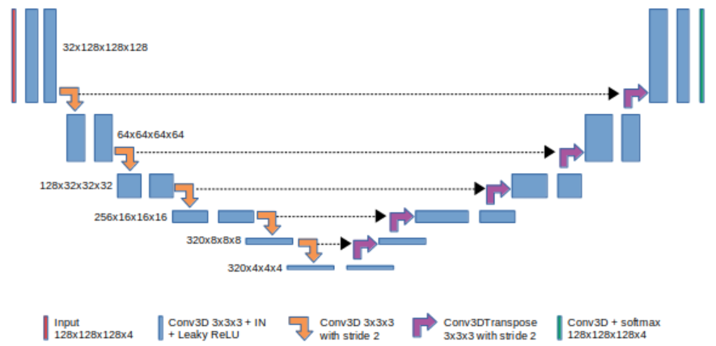
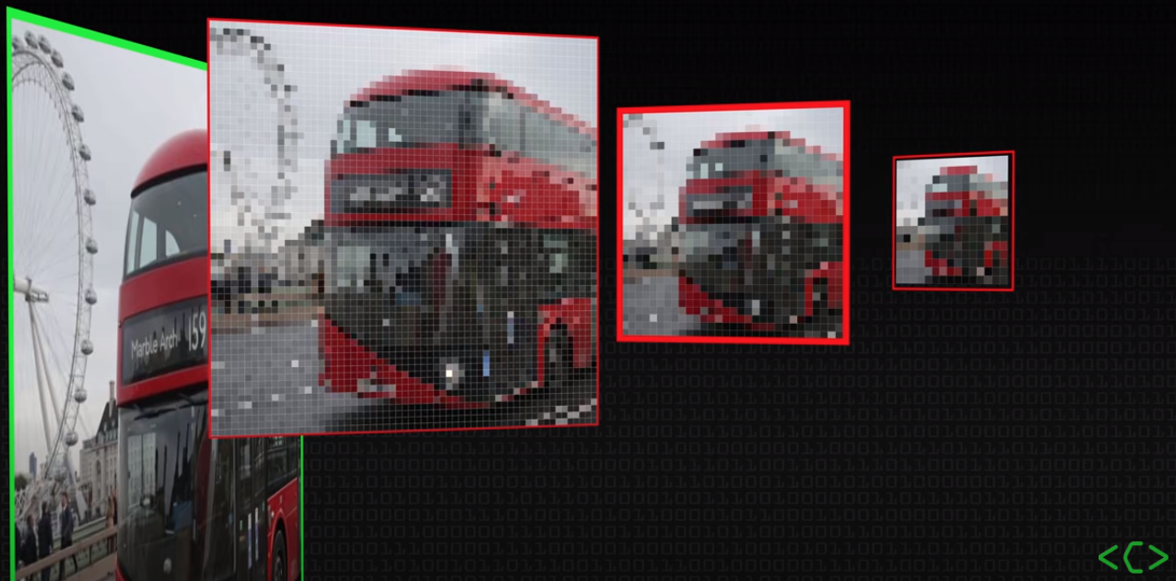
3D U-Net
An encoder-decoder network that can return accurate and detailed segmentations.
The Encoder uses convolution and max pooling layers to downsample the image.
The Decoder combines info from the bottom of the “U” with high res. Feature maps output by the encoder levels via skip connections.
Does not require a large dataset.
Top: Graphical representation of untet architecture. Bottom: example of down sampling
Sabino

Slide 25
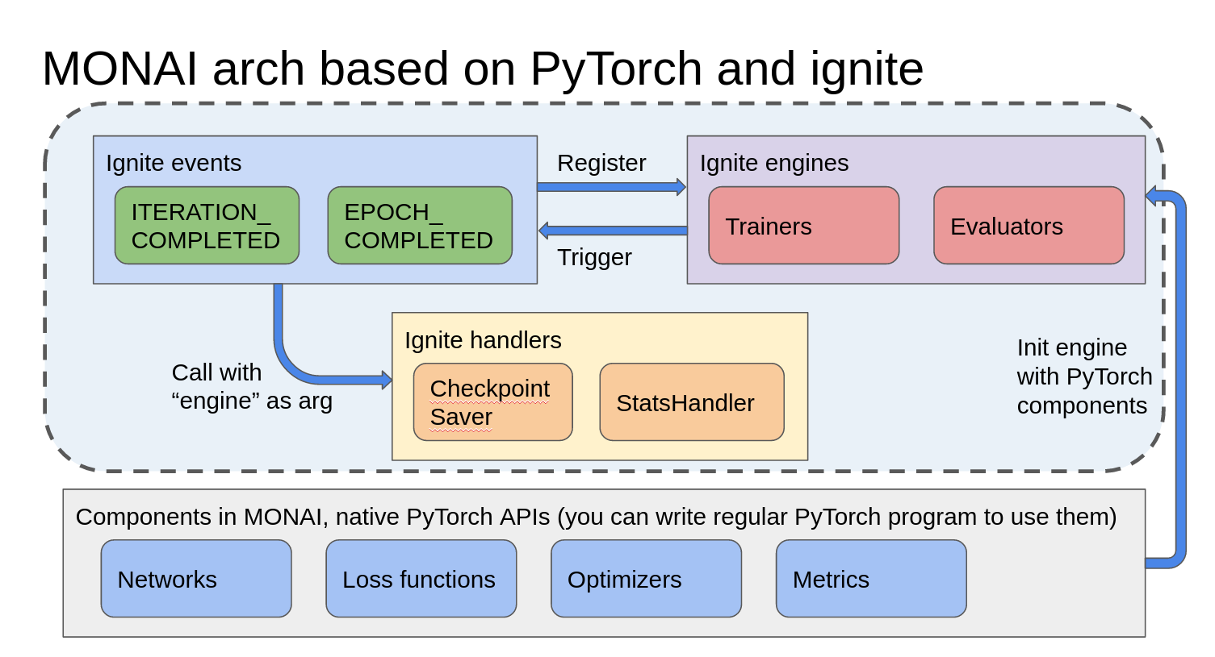
Monai Framework
PyTorch-based open source framework for deep learning in medical imaging.
The main components we see are Loss Functions, Optimizer, Metrics, Transforms, and Handlers.
For instance, the default loss function for Clara Train 3D DeepGrow is DiceLoss which will provide useful metrics.
Engine is a trainer, validator, or evaluator and initiate a loop. Within the loop, events get triggered and the attached handlers get called.
Monai workflow example from Nvidia’s website
Nicol, Sabino

Slide 26
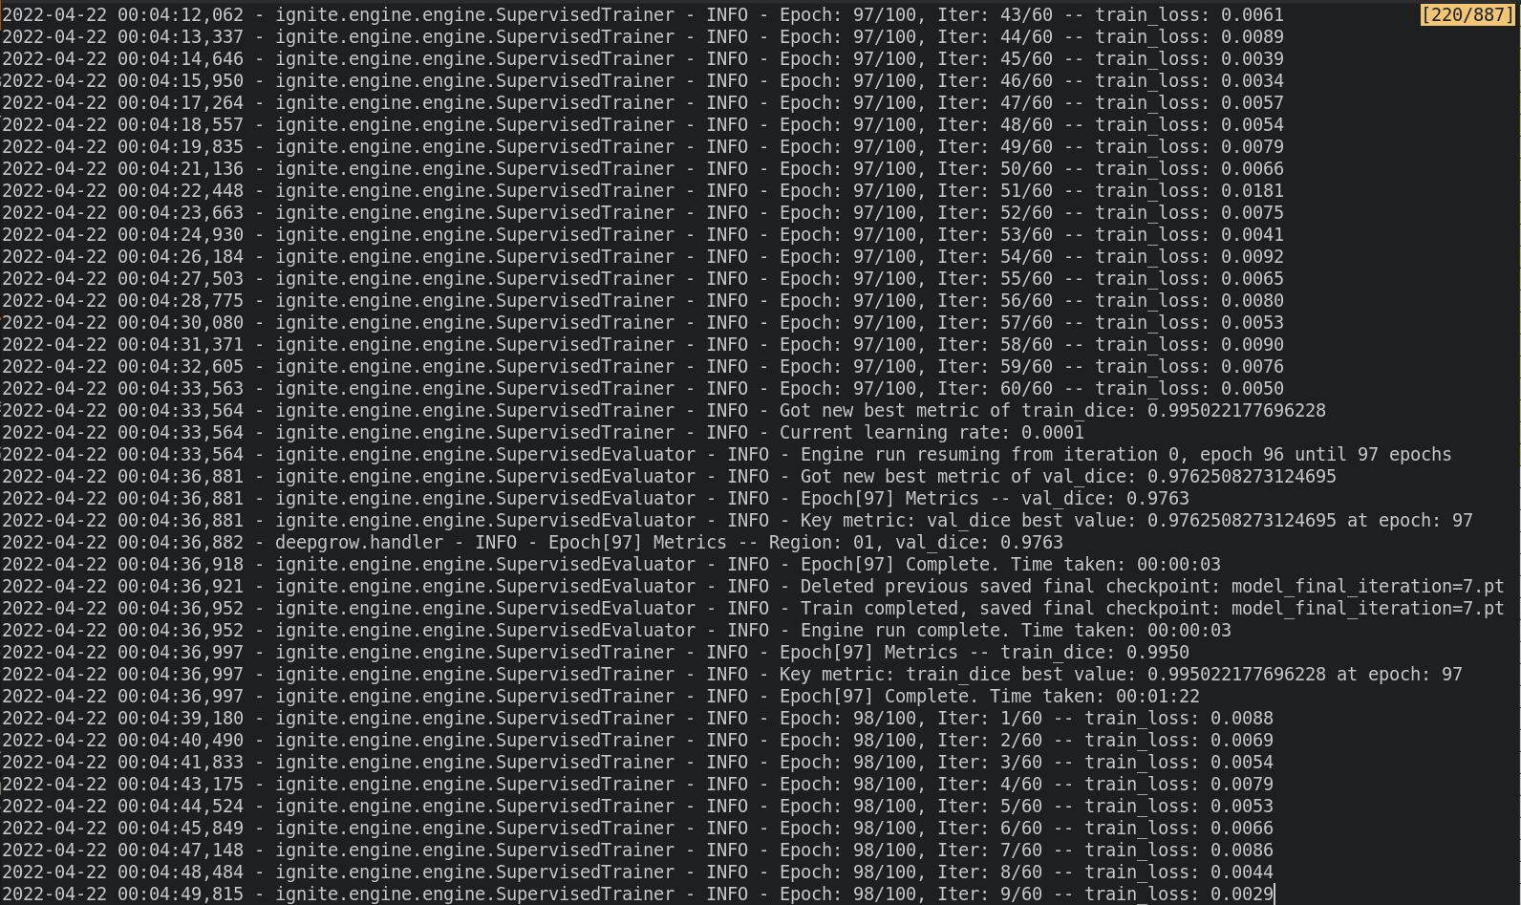
Training With Clara Train
The 3D DeepGrow MMAR provides scripts in the “commands” directory.
./train.sh is a script that begins the training work flow set up by the preceding configuration steps.
The configuration is also responsible for initializing any Monai components to be used throughout the training process.
Screenshot of the terminal during training process.
Sabino
Screenshot of environment.json config

Slide 27
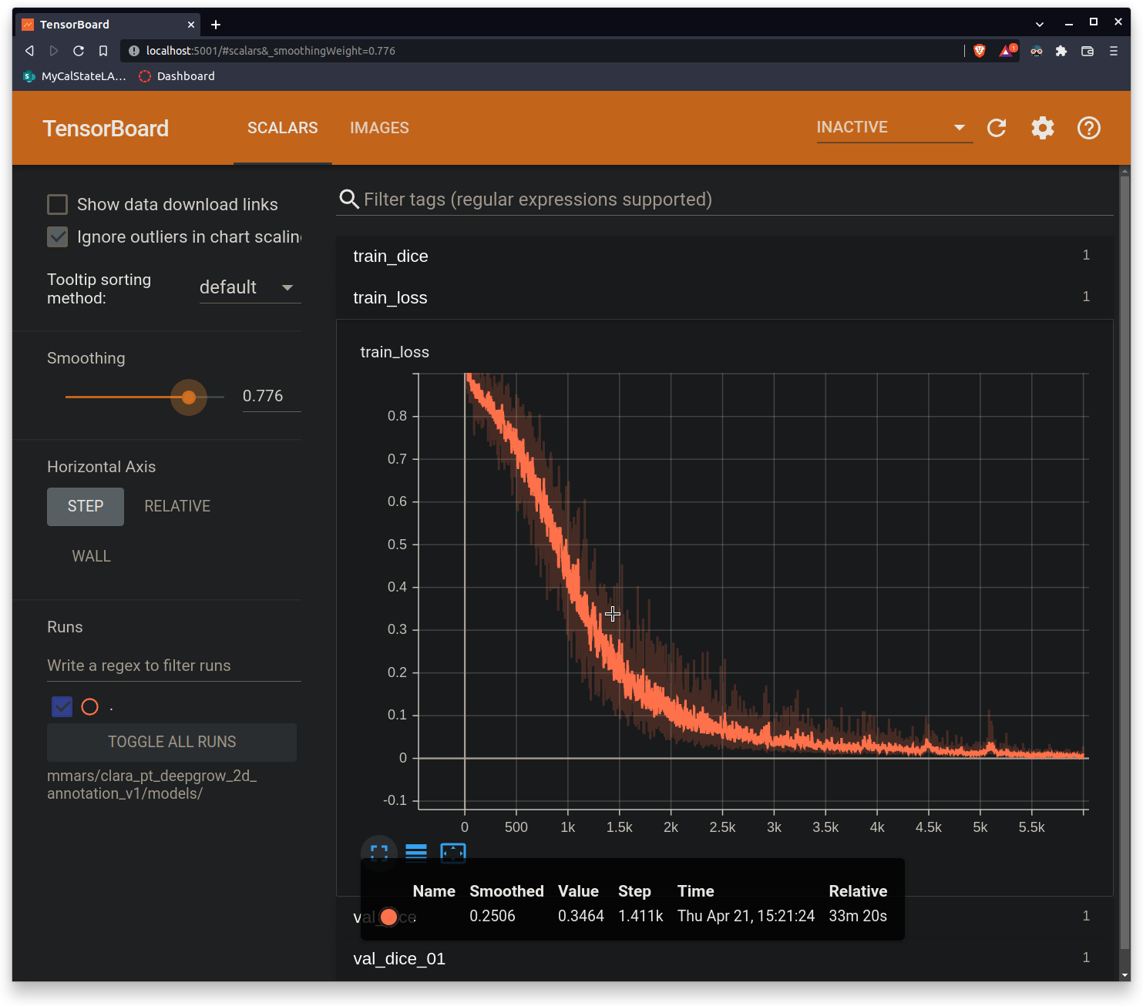
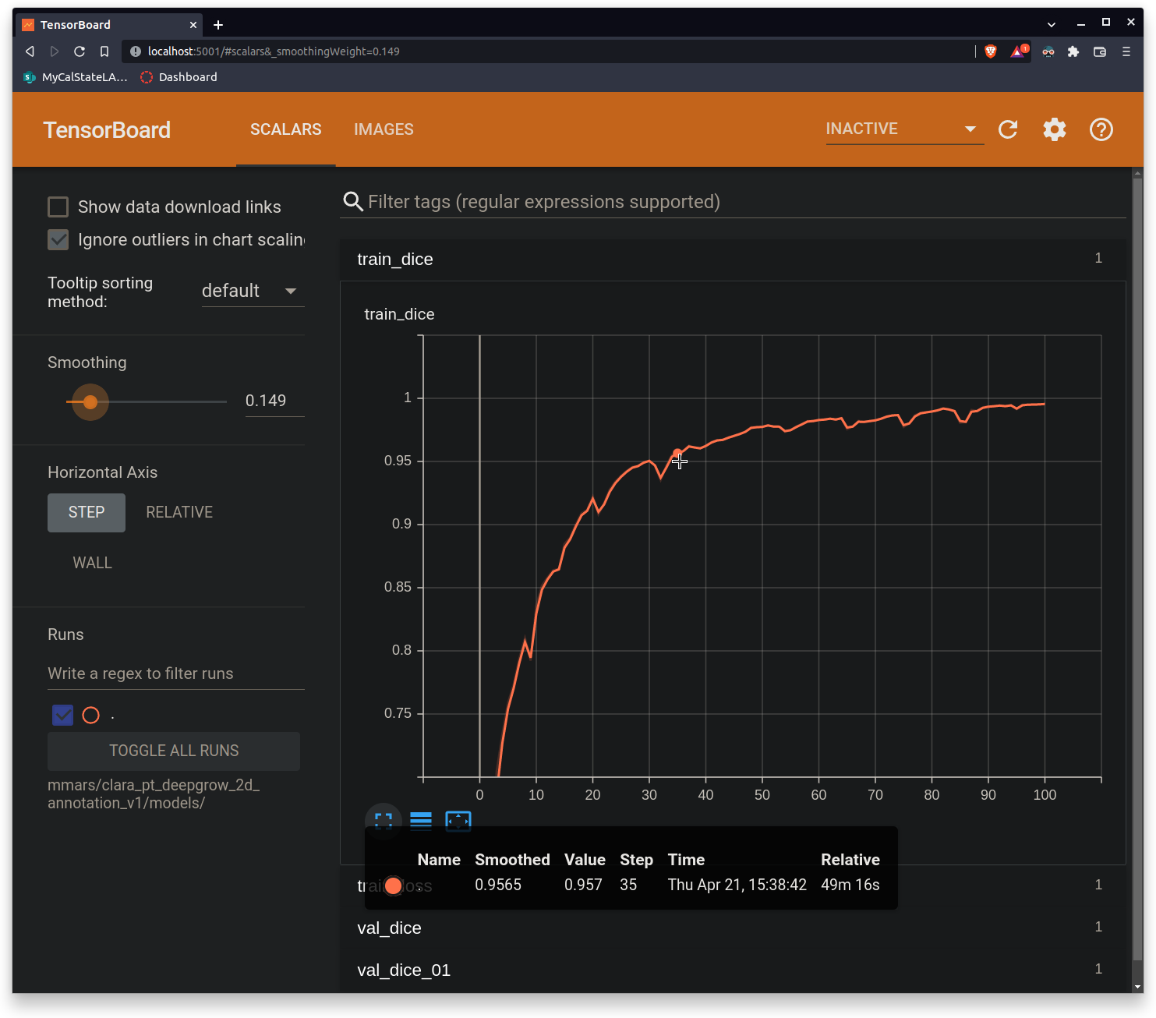
Results
Train_loss Train_dice
Robin M.

Slide 28
Spring Semester Challenges
Creating our own AI model
Since Nvidia AIAA doesn’t have any model trained with Pelvic organs (Nvidia has model for brain, lungs, spleen, etc.), we had to train our own models.

Slide 29
Spring Semester Challenges
Configuration
Masking
Training
Integration
to 3D Slicer
Local GPU
Virtual GPU

Slide 30
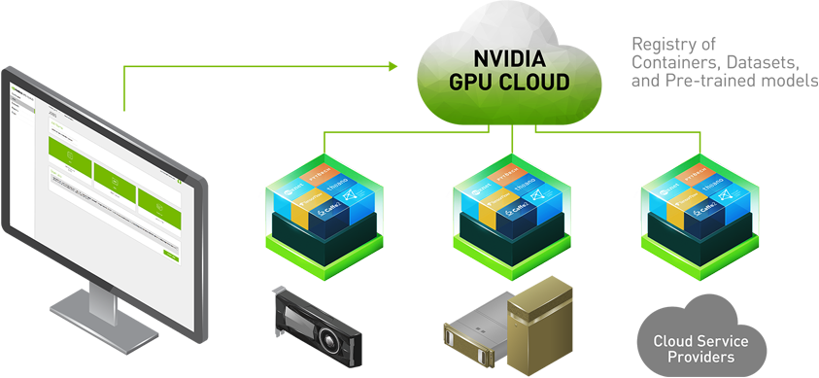
Cloud GPU
In order to use Clara Train SDK which is built on top of MONAI, we need and NVIDIA GPU.
The Cloud GPU is required for training and testing our data.
Requirements for GPU:
V100 Tensor Core
16GB or 32GB Memory
8 vCPU
Cloud GPU Diagram from NVIDIA Website
Alejandra O.
Notes:
We need it when training the data
Required for testing and training

Slide 31
Amazon Web Services
User 1
Launch a Virtual machine with EC2
Run Instance
Test and Train Data
…
User k
Deep Learning Base AMI
Instance:
P3.2xlarge
$3.06
Connect multiple users
in the instance
Alejandra O.

Slide 32
Amazon Web Services
User 1
Launch a Virtual machine with EC2
Run Instance
Test and Train Data
…
User k
Deep Learning Base AMI
Instance:
P3.2xlarge
$3.06
Connect multiple users
in the instance
Alejandra O.

Slide 33
Amazon Web Services
User 1
Launch a Virtual machine with EC2
Run Instance
Test and Train Data
…
User k
Deep Learning Base AMI
Instance:
P3.2xlarge
$3.06
Connect multiple users
in the instance
Alejandra O.

Slide 34
Amazon Web Services
User 1
Launch a Virtual machine with EC2
Run Instance
Test and Train Data
…
User k
Deep Learning Base AMI
Instance:
P3.2xlarge
$3.06
Connect multiple users
in the instance
Alejandra O.

Slide 35
Fall Semester
Achievements
Manual Thresholding
Researching & Understanding NVIDIA AIAA
Traditional approach
Decided to use NVIDIA AIAA to automate the modeling process
Needed a model trained on pelvic organ data points
DEXTR3D
DeepGrow
Jason T.

Slide 36
Spring Semester
Achievements
Binary labelmap for vagina
Configuration
Four Stages & New Model
Determine & Setup the right configuration
Creating binary masks
Training the model
Alternative to physical GPU
Masking
Training
Integration
to 3D Slicer
Jason T.

Slide 37
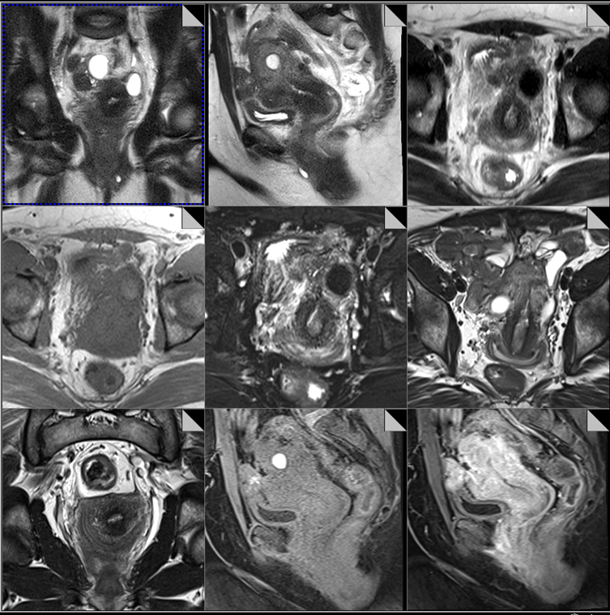
Next Steps
Short Term
Gather more MRI data
Improving our AI
Long Term
Create a Web Application
Silvano M.
Notes:
Gather more MRI data while continuing the AI training and integrate the model back into 3D Slicer.
Research on GANs in the future.

Slide 38
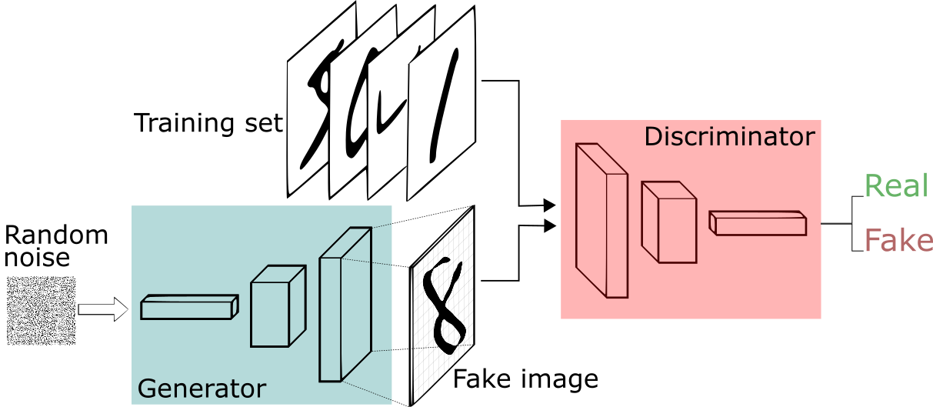
GANs
Generative Adversarial Network
Silvano M.

Slide 39
Works Cited
NVIDIA Clara Imaging.
https://developer.nvidia.com/clara-medical-imaging (2022).
Image Source: https://www.iinn.com/wp-content/uploads/sites/4/2019/10/Insight-Medical-Campus-_-Blog-Difference-Between-MRI-and-CT.jpg
Pelvic Fracture
X-ray of the pelvis, pre-operative, displaying a variety of pelvic fractures by Dr. Brent Burbridge MD, FRCPC, University Medical Imaging Consultants, College of Medicine, University of Saskatchewan is used under a CC-BY-NC-SA 4.0 license.
https://www.freecodecamp.org/news/an-intuitive-introduction-to-generative-adversarial-networks-gans-7a2264a81394
Thalles Silva
Image Source: https://www.iinn.com/wp-content/uploads/sites/4/2019/10/Insight-Medical-Campus-_-Blog-Difference-Between-MRI-and-CT.jpg

Slide 40
Thank you for listening!
Any Questions?

