Slide 1
NASA ROBOTICS COMPETITION
CS MEMBERS:
Christian Soltero
Christopher Portugal
Jonathan Sahagun
Jose Ambrosio
Mikey Thong
ME/EE MEMBERS:
Daniel Solis
Doroteo Alvarado
Juan Leguizamon
Sonia Onofua
ADVISORS:
Dr. Jose Macias
Richard Cross

Slide 2
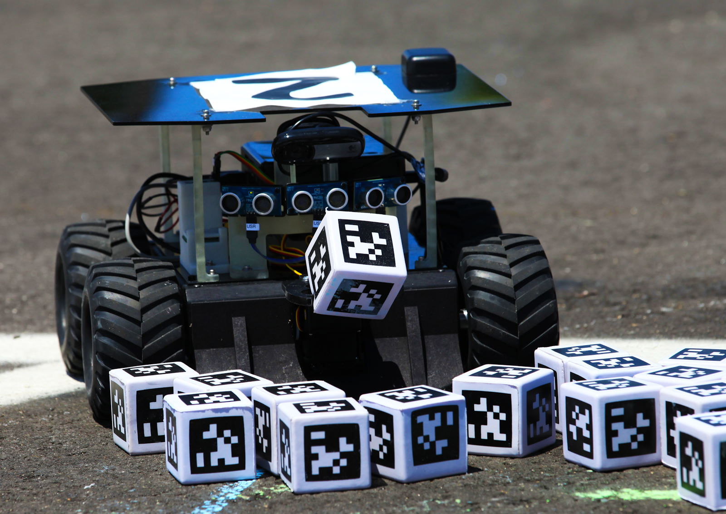
AGENDA
Introduction and Overview
Rover
ROS
Localization
Mapping
Search
Conclusion

Slide 3
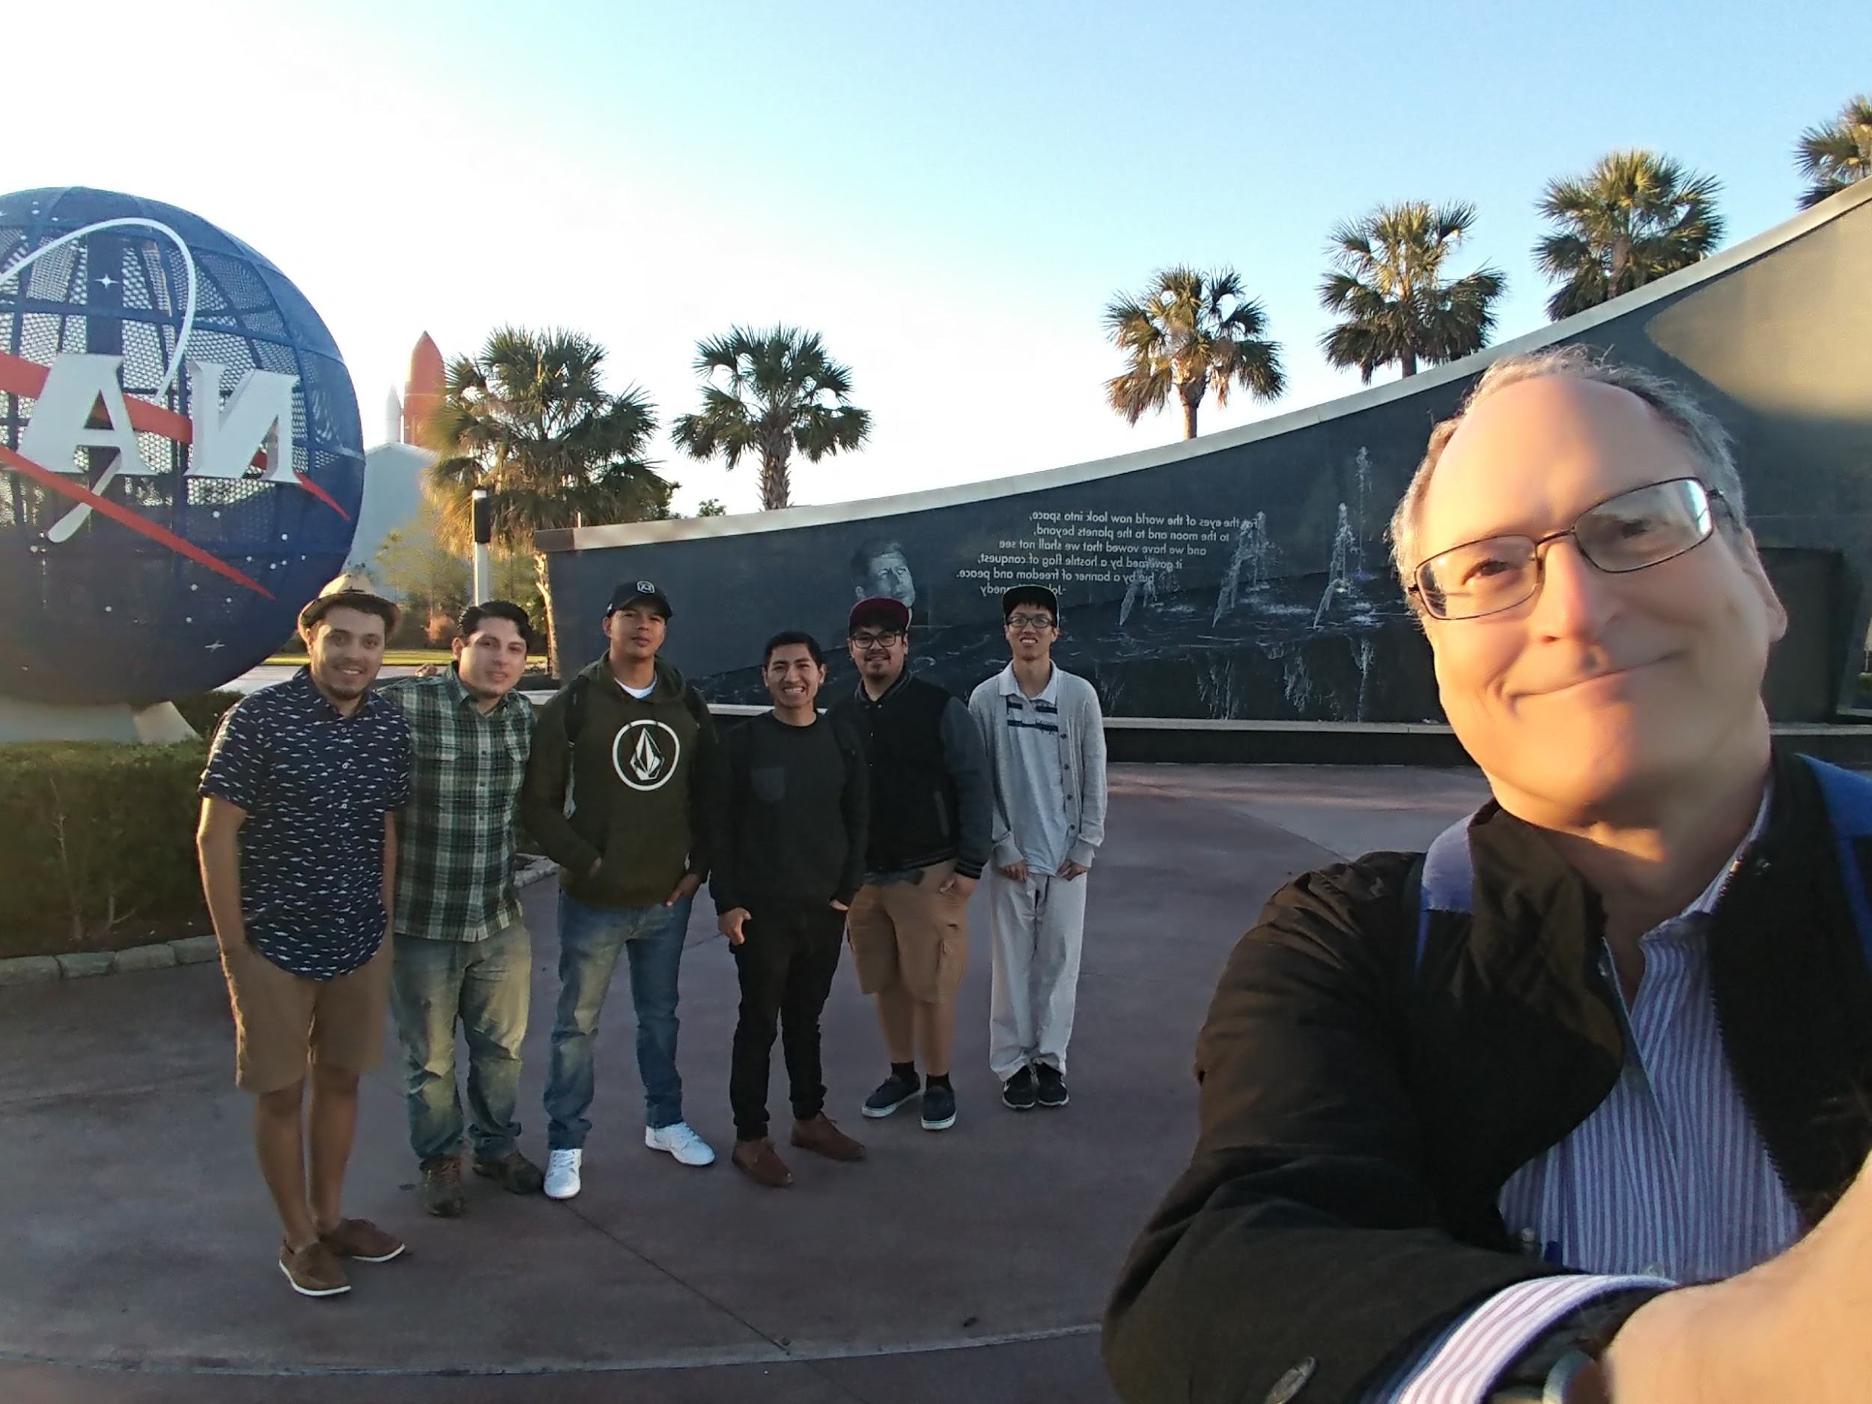
SWARMATHON BACKGROUND
A robotics competition hosted by University of New Mexico and sponsored by NASA
First held in 2016.
CSULA participated in 2016 and 2017
We participated in the 2018
Swarmathon is held at Kennedy Space Center
21 Schools across the nation will compete

Slide 4
REQUIREMENTS
Requirement | Performance Objective | Source of Requirements | Method of Verification
Operation Time | Prelim – 30 min Semi Final – 30 min Final – 60 mins | Competition | Design
Search Dimensions | Prelim – 15x15 m Semi Final – 22x22 m Final – 22x22 m | Competition | Design
Language | C++ | Customers | Design
Communication | ROS | Competition | Design
Search Objective | Find and as many collect resources in allotted time | Competition | Test
Rover Max Velocity | 1 m/s | Competition | Design

Slide 5
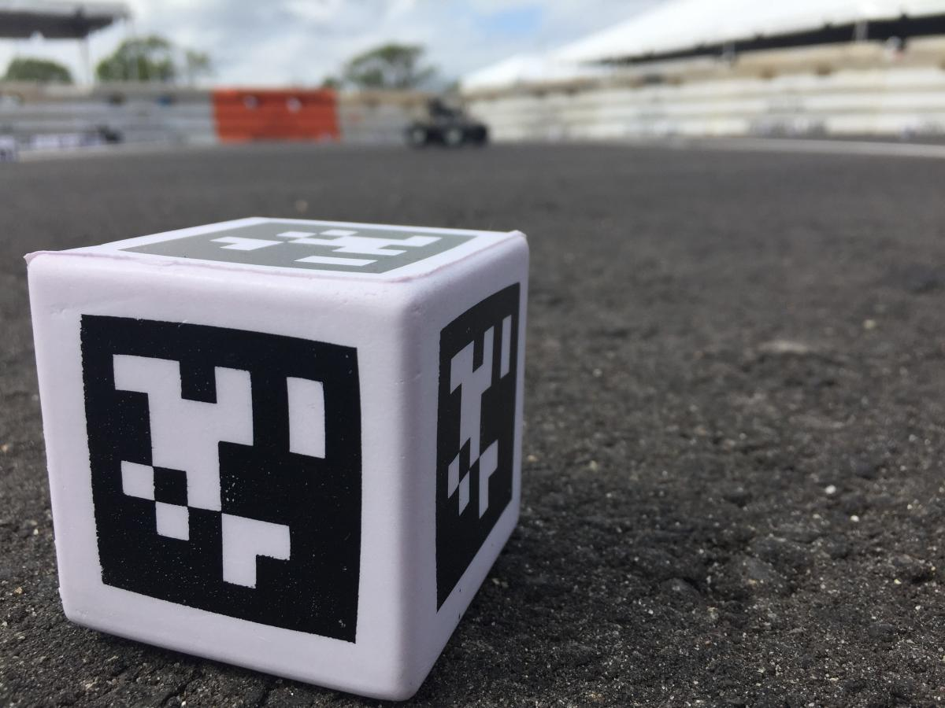
SWARMATHON GOALS
Program rovers to:
run autonomously
avoid obstacles
search, collect, and drop-off as many April Cubes into the collection zone

Slide 6
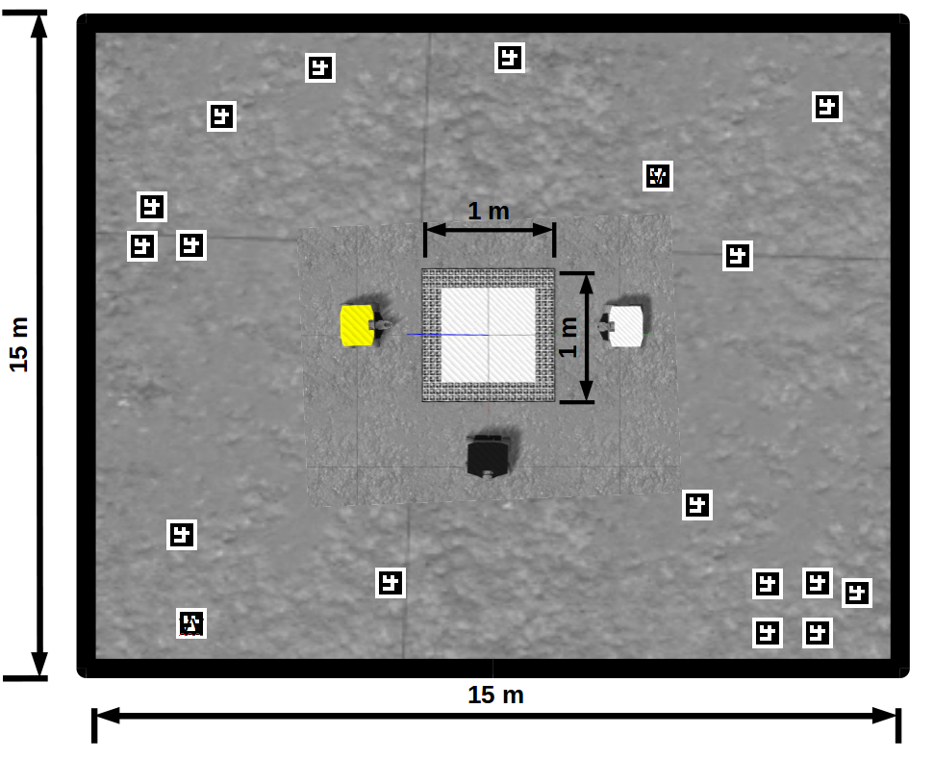
COMPETITION RULES AND SCOPE
Teams are given 3 Rover
Physical rovers can not be modified
Parts of the given code cannot be modified
Autonomous rovers
Teams have no control over the rover during the competition
The team with the most cubes win
Each round has different amount of rovers, time, and size in a tournament

Slide 7
DELIVERABLES AND DEADLINES
Category | Deliverable Description | Delivery Date
Report | Senior Design Report | 12/06/2017
Technical Check in | GitHub Upload, Form Submission, Video Upload | 12/11/2018
Technical Check in | GitHub Upload, Form Submission, Video Upload | 3/01/2018
Reports Due | Technical And Outreach Reports | 3/15/2018
Activity | Final Code Submission | 3/20/2018
Competition | 2018 Nasa Swarmathon at Kennedy Space Center | 4/17/2018-4/19/2018

Slide 8
SWARMIE (ROVERS)
Swarmies are small robotic vehicles
Programmed to communicate and interact as a collective swarm, operate autonomously
Equipped with a computer webcam, ultrasonic sensors, GPS system, motor encoders and servo motors

Slide 9
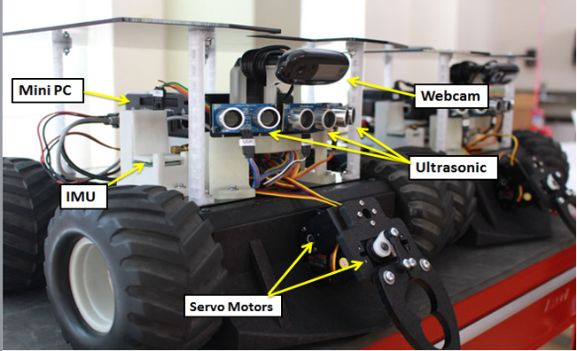
FRONT OF THE ROVER

Slide 10
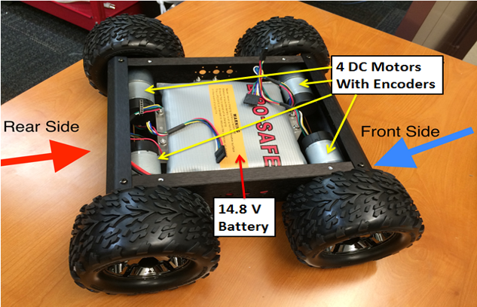
INTERNALS OF THE CHASSIS

Slide 11
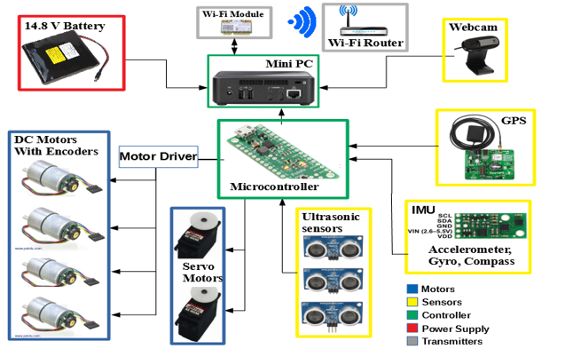
ROVERS CONNECTION

Slide 12
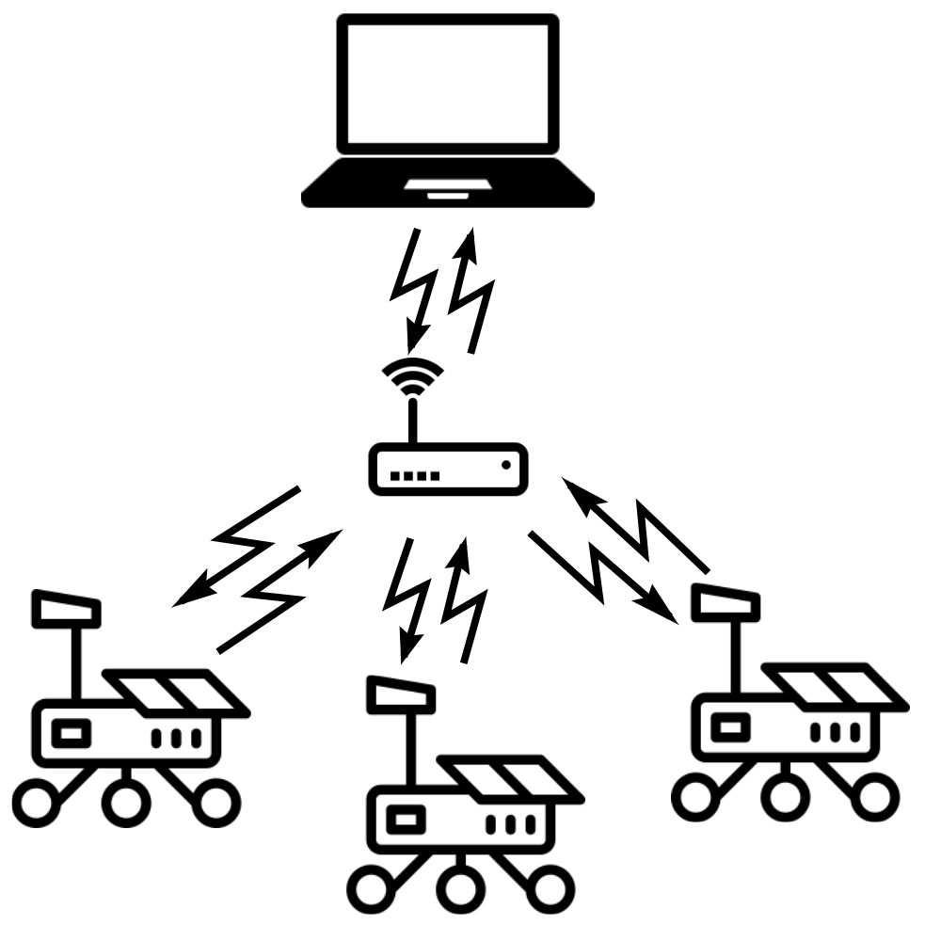
ROVER COMMUNICATION
Communication is done over Wi-Fi using a router.
The rovers connect to a laptop that acts as the master
The software that allows communication is ROS

Slide 13
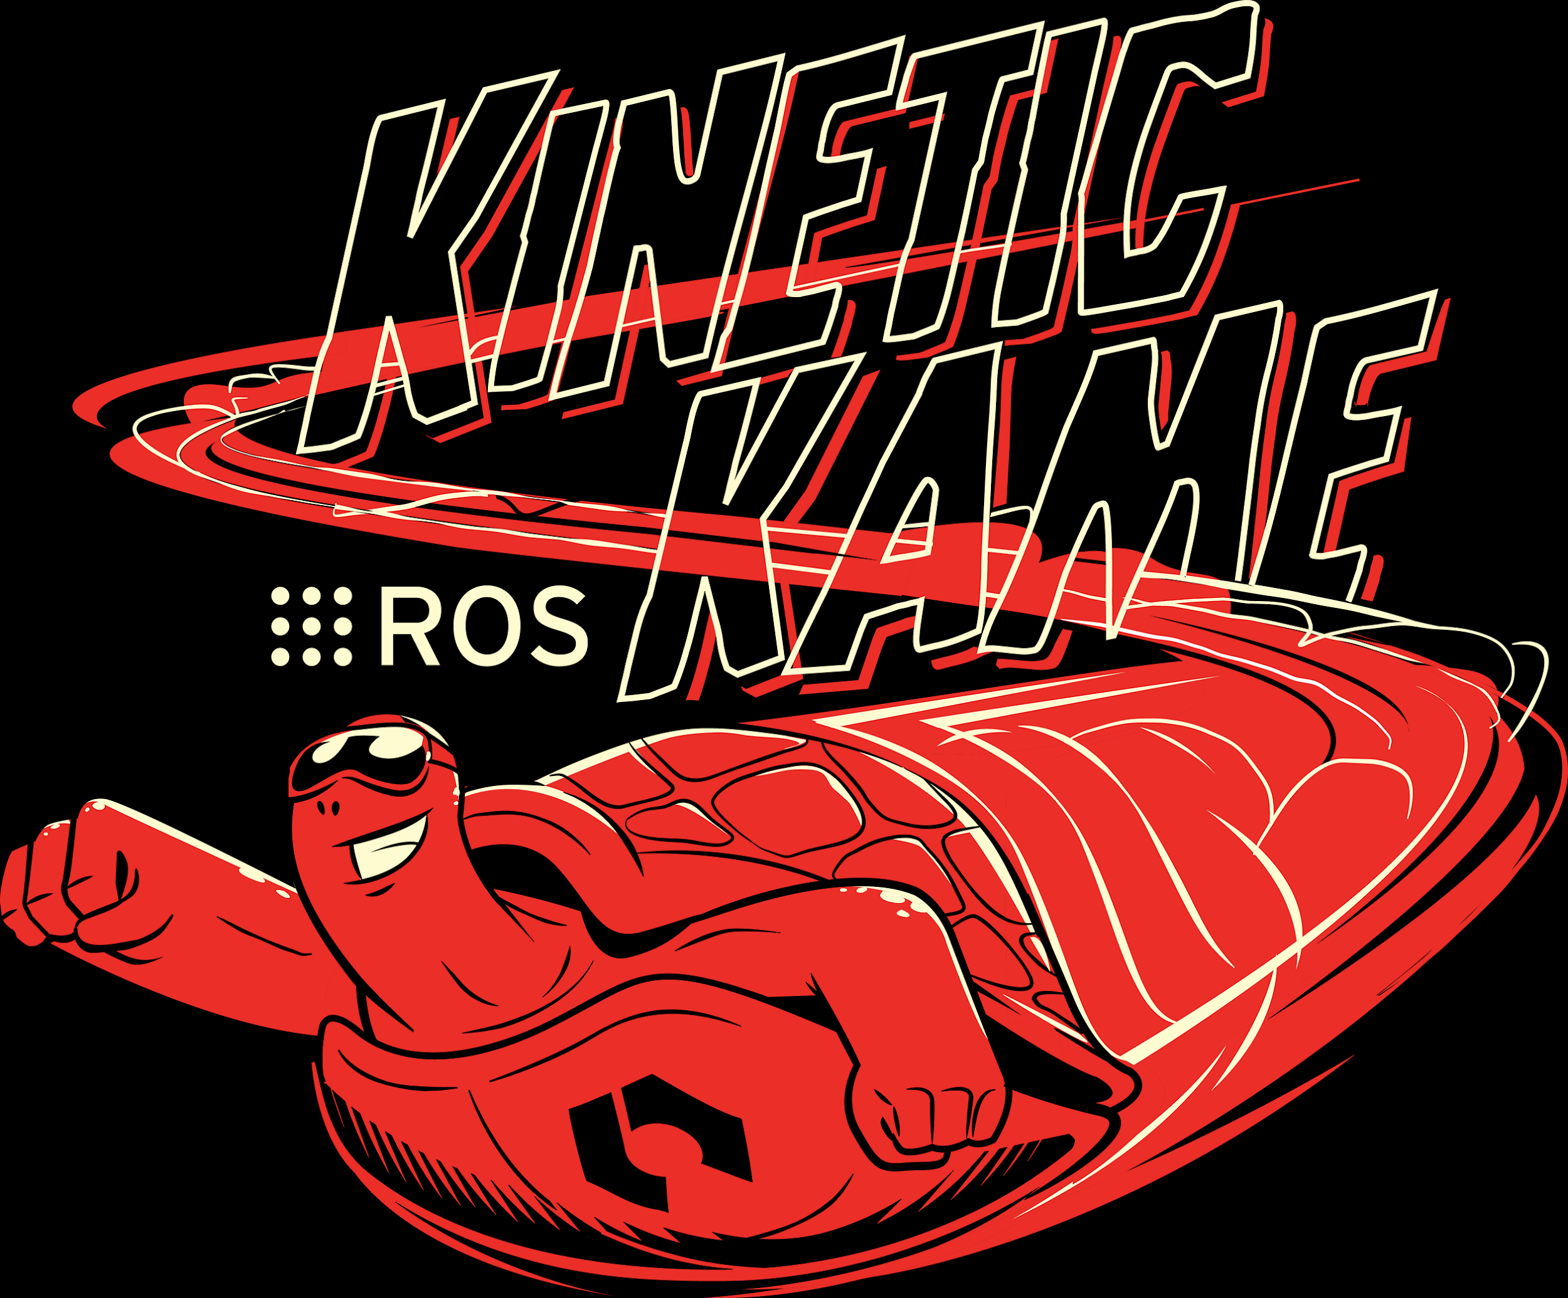
ROS (ROBOT OPERATING SYSTEM)
Not an operating system.
It’s a collection of software frameworks for robot software developers.
It is called Robot Operating System because it provides many similar services.
The rovers use roscpp which is a c++ implementation of ROS.

Slide 14
BENEFITS OF USING ROS
Services provided by ROS to diverse computer clusters:
Hardware Abstraction
Low-level device control
Implementation of commonly used functionality
Message passing
Package management

Slide 15
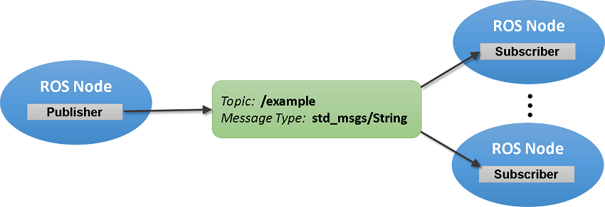
MESSAGE PASSING - ROS TOPICS

Slide 16
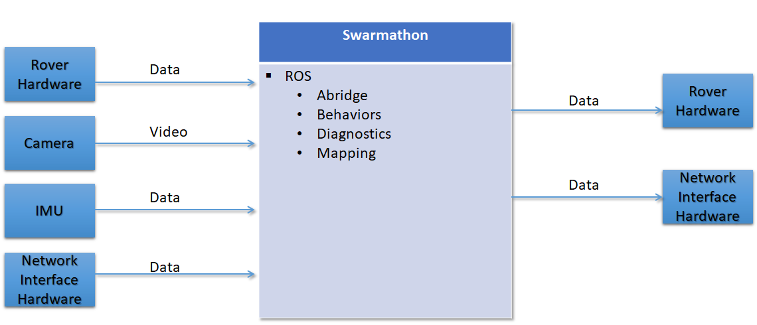
CONTEXT FREE DIAGRAM

Slide 17
CONTEXT FREE DIAGRAM

Slide 18
AREAS OF FOCUS
Localization
Most Important
Without cannot trust rovers to know where they are
Mapping
Map the area
Help to avoid obstacle seen by any rover
Search
Main meat of the project
Heavily relies on Localization and Mapping

Slide 19
LOCALIZATION
Using an odometer and an IMU
Calibrating using raw encoder data
Finding the measurement of error after testing
How many radians per second in each encoder?
Using GPS and actual data measurement for the location
Determining where the rover should be in
Determining if the rover is inside or outside of the GPS area

Slide 20
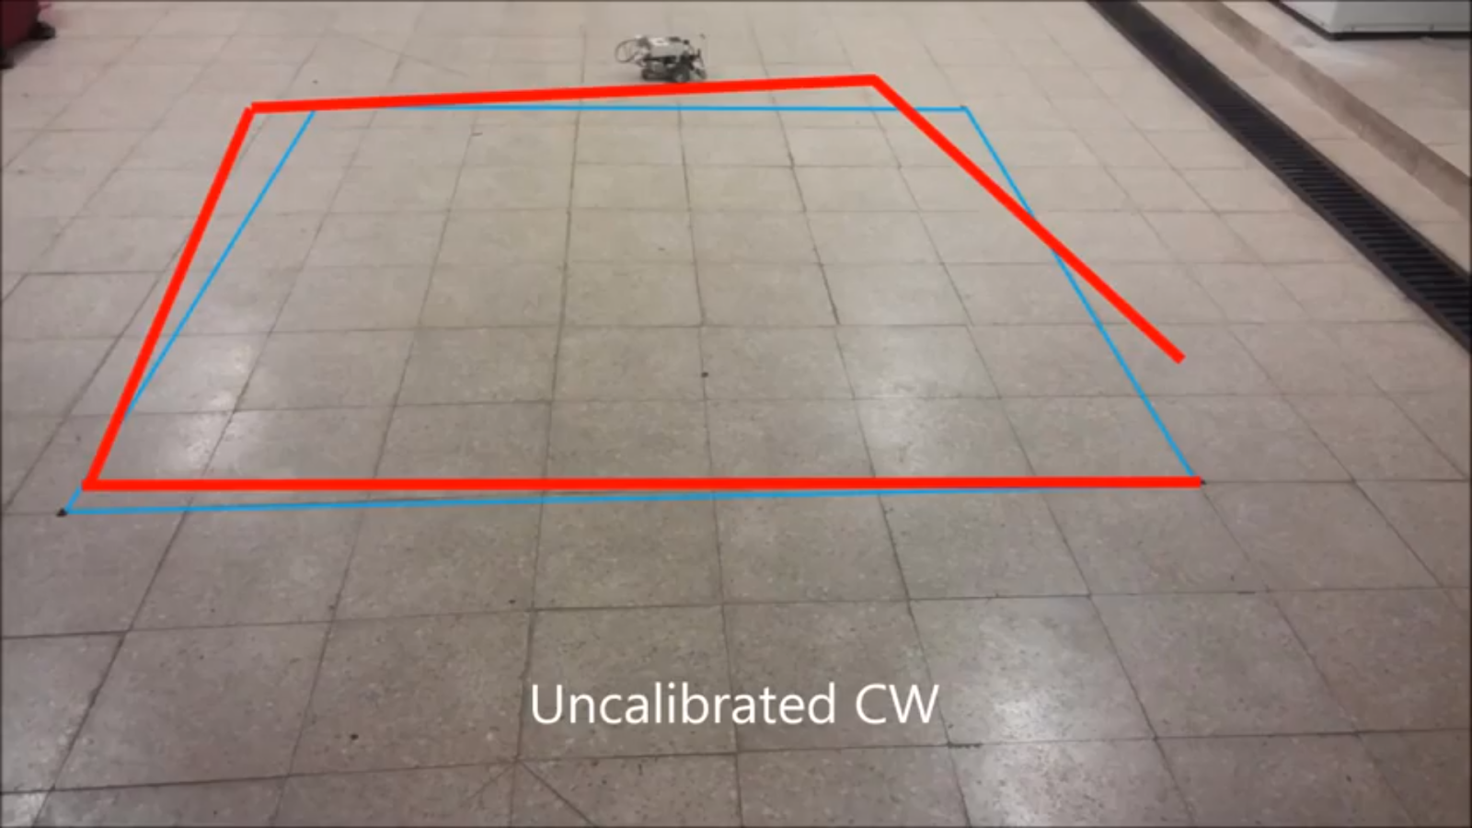
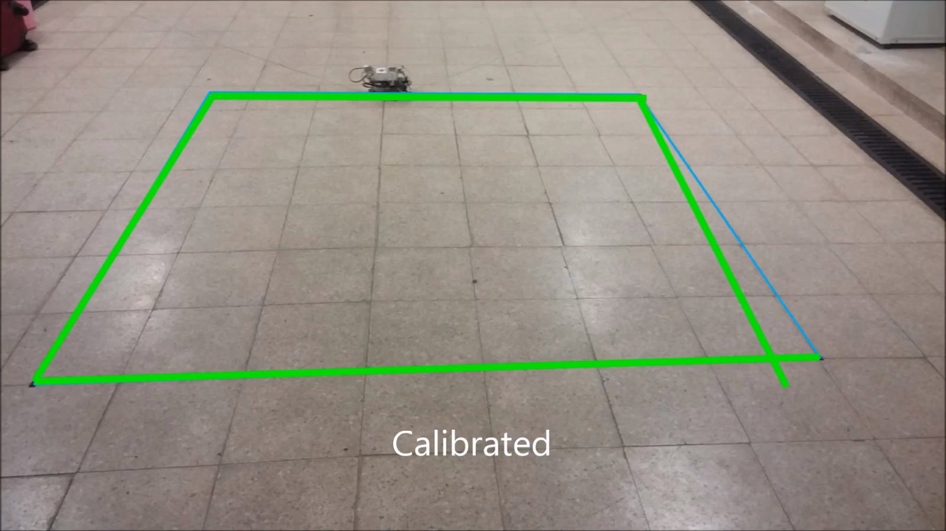
ODOMETER CALIBRATION IN 2X2M SQUARE

Slide 21
MAP
Using grid_map ROS package
Creates multiple 2D arrays
Take ultrasonic data to make map of what is in front of a rover
Walls
Bufferzone
Rovers
Previous Location

Slide 22
MAP
Using ROS messages gather all individual data and location data to make a map of the area
Use Rviz to read Grid_Map and create a visualization
This will be used when plotting a path in a known area to take account of obstacle before moving.

Slide 23
SIMULTANEOUS LOCALIZATION AND MAPPING
What is SLAM?
A concept designed to aid autonomous robots become more situated with their surroundings
Builds a map of an unknown environment while simultaneously navigating through the map
How did we implement SLAM into our project?
Through the proper utilization of:
Localization
Mapping

Slide 24
LOCALIZATION AND MAPPING
Localization
The estimated orientation of our robot
Our values for orientation included values such as:
Location on a XY plane
Angle it is facing on our grid map
Landmarks in the immediate vicinity of the robot
Mapping
Dynamically building a model of the environment
We built our map by:
Having input from localization, estimation of the surroundings, keeping tracks of landmarks

Slide 25
RESULTS OF LOCALIZATION AND MAPPING
State Estimation
We are given the robot’s present state and with that information, we can estimate the state of the world
Motion Planning
In relation to navigation, this is the algorithm the robot refers to when deciding on the most efficient algorithm to get from Point A to Point B
Navigation
This refers to the robot making its own decisions when a command needs to be fulfilled such as going to a desired location

Slide 26
THE SLAM PROBLEM
Given:
Robot Controls, Observations
Wanted:
Map of the Environment, Path of the robot
SLAM is an implementation for autonomous robots, however it has issues
Implementation
There is no one formula to implement SLAM. Rather, it must be seen as a concept.
A map is needed for localization and localization is needed for mapping
Dynamic algorithm

Slide 27
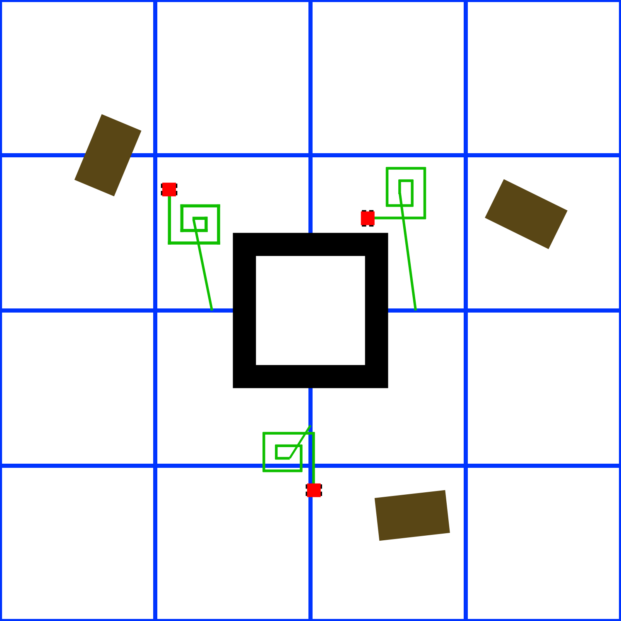
SEARCH
Divide and Conquer
Divide arena into 3.75 x 3.75 m²
Priority is given to those closest to the center
Choose a random point in a section and start a small spiral at that point
Continue in that section until about 80% coverage has been obtained, then choose a new section

Slide 28
RESULTS
Placed 10th place out of 21
beating 7 other schools, including last years runner up
tying with 3 other schools
a mass improvement of the previous last two years
Swarmies now have a have a mapping module to record obstacles and Swamie locations
Swamies also have increased reliability in localization

Slide 29
IMPROVEMENTS FOR NEXT YEAR
Implement Dead Reckoning
Compare location of IMU with GPS
Improve localization by lowering speed
Look into computer vision for localization
Test at different times of day for lighting issues

Slide 30
TOOLS USED

Slide 31
THANK YOU

