Slide 1
Salesforce Database Migration /
Digitizing the Employee Onboarding Process
Presented by: Rawad Moussa, Tabassuma Torosa, Adrian Palomares, Paul Clef Ube, Audelia Valdovinoz, Javier Garcia, Pierce Wei, Marlito Refuerzo, Christopher Rodriguez
Sponsored by: Los Angeles County Public Defender
Liaisons: Mohammed Al Rawi & Gratia Dsouza
Project Advisor: Dr. Chengyu Sun

Slide 2
Los Angeles County Public Defender’s Office
Pierce Wei
Widely considered the finest client-centered criminal defense firm in the nation, working to reduce incarceration and the collateral consequences of contact by 2025
Provides treatment courts, juvenile advocacy, immigration, mental health assistance mainly for criminals
Giving back to community and representing minorities that are often overlooked

Slide 3
Los Angeles County Public Defender’s Background
Pierce Wei
32 offices located throughout the country, team of more than 1,200 employees, 700 attorneys, and more staff composed of:
Paralegals, investigators, psychiatric social workers, and admin/support staff
Shows that there is a need for a good IT system for people doing important work

Slide 4
Project Overview
Pierce Wei
Project 1 (HOLD): Migrate legacy content management system and databases to Salesforce.
Currently this project is on hold because the PD IT staff are busy with a new system going online.
Project 2 (CURRENT): Online Employee/Contractor Enrollment Application
Allow users to request forms that will be generated via back-end communication with BOX and Adobe API; saved in BOX when signed

Slide 5
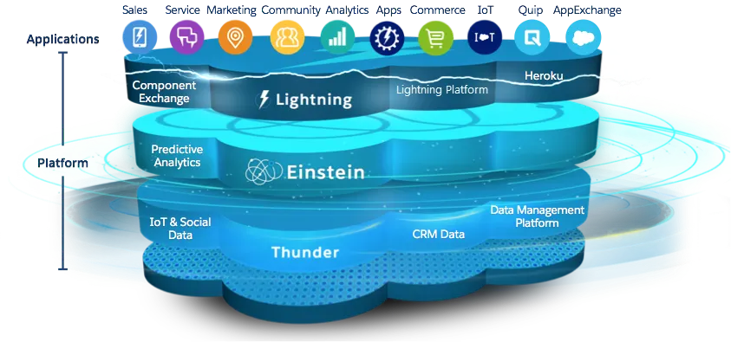
Introduction to Salesforce
Presenter: Tabassuma Torosa
Salesforce - Cloud based platform that provides multiple services to customers
Focuses on managing company’s interactions with customers
Notes:
-overview
-dont say brand names

Slide 6
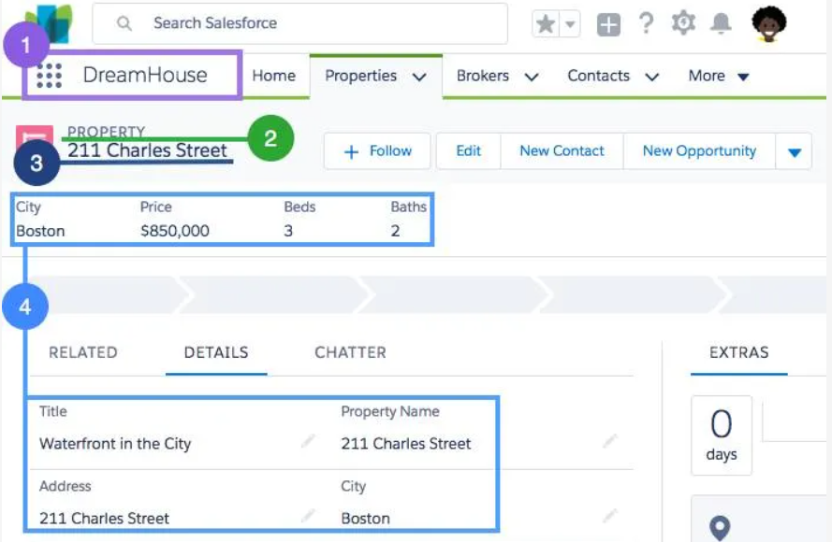
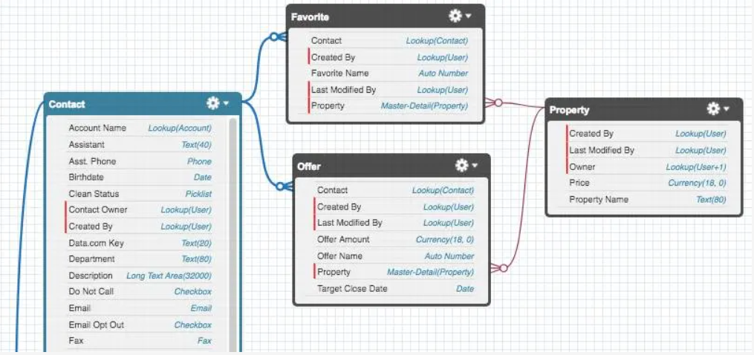
Our Progress with Salesforce
Presenter: Tabassuma Torosa
Export and import data
Create schema to model data
Install apps/packages
Deploy customized app in Salesforce app store
Notes:
-less details, more what we learned

Slide 7
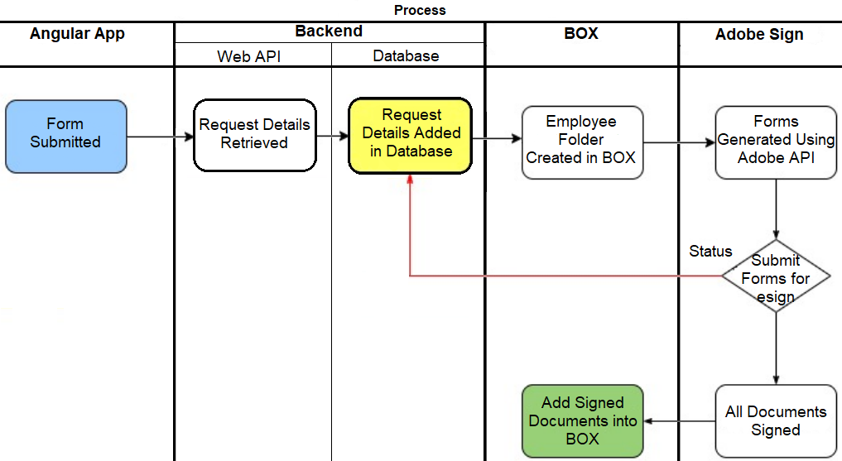
Enrollment Application Project
Presenter: Audelia Valdovinoz
Angular app is used to submit employee & contractor requests.
Includes Request Status page where the user can search by certain fields
Requestor is sent a RequestID
Backend retrieves and stores request details to database.
Notes:
Notes:
Angular App
Develop Custom Form using Angularjs to capture employee/contractor form specific info
Request Status pg + Searchable [Request ID • EmployeeID • Contracting Company • FirstName • LastName]
Form Submission
Request recorded. Entry added to database. Status → "Initial Request Sent". “RequestID” sent to requestor.
Generate folder in BOX for employee under In Progress folder.
Template generation
PDF templates provided. For empl/contr type, generate specific forms & input data captured in forms.
Send generated docs to Requestor for review (esign)
Requestor reviews docs & sends forms to parties for review
Successful completion → docs parked in BOX

Slide 8
Enrollment Application Project (cont.)
Presenter: Audelia Valdovinoz
BOX is a cloud storage service.
Corresponding forms are generated and filled with requestor provided data.
Generated documents are sent to the requestor for review and to be esigned.
Notes:
Notes:
Angular App
Develop Custom Form using Angularjs to capture employee/contractor form specific info
Request Status pg + Searchable [Request ID • EmployeeID • Contracting Company • FirstName • LastName]
Form Submission
Request recorded. Entry added to database. Status → "Initial Request Sent". “RequestID” sent to requestor.
Generate folder in BOX for employee under In Progress folder.
Template generation
PDF templates provided. For empl/contr type, generate specific forms & input data captured in forms.
Send generated docs to Requestor for review (esign)
Requestor reviews docs & sends forms to parties for review
Successful completion → docs parked in BOX

Slide 9
Enrollment Application Project (cont.)
Presenter: Audelia Valdovinoz
The requestor then sends the forms to the appropriate parties for review.
Once successfully completed, the documents are added to the employee’s folder in BOX.

Slide 10
Project Requirements
Presenter: Marlito Refuerzo
Developed w/ a Custom Form using Angularjs for specific form information
Request Status page w/ specific searchable fields via Angular App
Request (through Form Submission) is recorded and adds an entry to the database
Values inputted in specific PDF templates (based on type) generates the specific forms and inputs the data into the new forms
Sends generated and filled out form to the Requestor for review
Allows Requestor to review, prep, and send forms to others for review
Upon completion, stores document

Slide 11
Employee Fields
Contractor Fields
Searchable Fields
First Name
Last Name
Telephone
Address (Street, City, State, Zip)
Email ID
Employee Type (Defaults to Employee)
Employee ID
Submission Date (Defaults to Current Date)
Requestor Name
Requestor Email
Approvers
Department Number
Department Name
First Name
Last Name
Contracting Company
Telephone
Address (Street, City, State, Zip)
Company Email ID
Employee Type (Defaults to Contractor)
Employee ID (Only Available if Type is set to Employee)
Submission Date (Defaults to Current Date)
Requestor Name
Requestor Email
Approvers
Department Number
Contract Work Order Number
Contract Expiration Date
Business Street Address
Department Name
Request ID
Employee ID
Contracting Company
First Name
Last Name

Slide 12
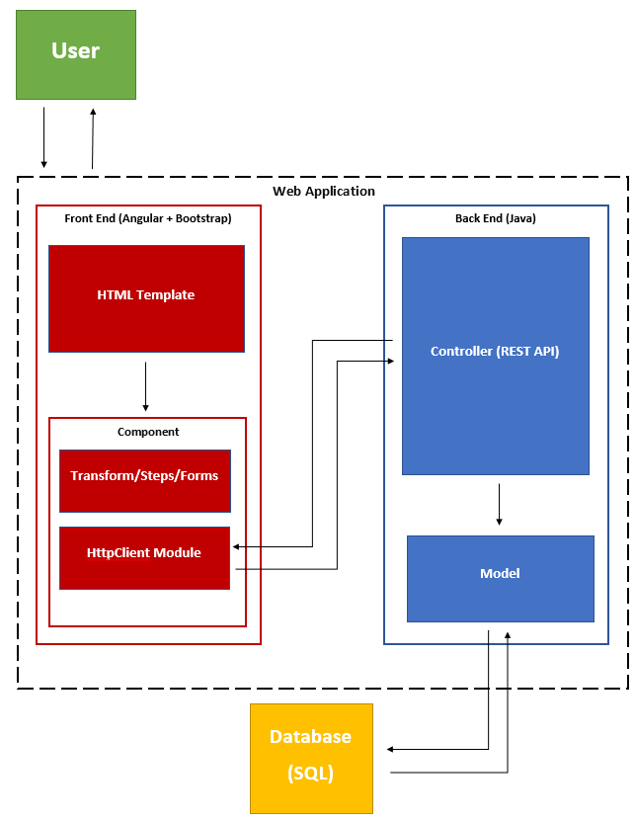
Overall System Architecture Diagram
Presenter: Paul Clef Ube

Slide 13
Overall System Architecture
Presenter: Paul Clef Ube
User: Make requests and receive responses to the Web Application
Web Application: Contains a Front End and Back End. The web application sends the HTML template (user interface) to the user to interact and fill out forms.
Front End: Has an HTML template that interacts with Angular components. The HttpClient Module then sends service requests and receive responses from the Back End controller.
Back End: Receives service requests from Front End, models data in Java, stores in relational database.
Database: Keeps data in storage. It sends requested data to the model of the Back End.

Slide 14
Backend Operations
Presenter: Javier Garcia
Technologies
The backend infrastructure uses the following Java-based frameworks:
Spring Boot: A streamlined extension of the Spring application framework. The built-in libraries and server functionalities lead to greater efficiency as many low-level configurations are already accounted for.
Hibernate: An object-relational mapping framework. Provides an intuitive interface between the object-oriented Java and relational SQL data models via the intermediary language HQL (Hibernate Query Language).

Slide 15
Backend Operations
Presenter: Javier Garcia
PDF Handling
Information stored in the backend database directly populates the PDF forms used for the onboarding process.
Fields in the web form are mapped to their corresponding fields in the PDF forms.
Account for shared fields across multiple PDF forms, each one mapping back to the same web field.
Field socialNetworkingTwitter
Mapping #185
Mapping #186
PDF Form 5
PDF Form 6

Slide 16
Backend Operations
Presenter: Javier Garcia
API Design (REST model)
Resource | GET (Read) | POST (Create) | PUT (Update) | DELETE (Delete)
/service_requests | Returns a list of Service Requests. | Creates a new Service Request. | Method not allowed (405). | Method not allowed (405).
/service_requests/{id} | Returns a specific Service Request. | Method not allowed (405). | Updates a specific Service Request. | Deletes a specific Service Request.
/forms | Returns a list of Forms. | Creates a new Form. | Method not allowed (405). | Method not allowed (405).
/forms/{id} | Returns a specific Form. | Method not allowed (405). | Updates a specific Form. | Deletes a specific Form.
/fields | Returns a list of Fields. | Creates a new Field. | Method not allowed (405). | Method not allowed (405).
/fields/{id} | Returns a specific Field. | Method not allowed (405). | Updates a specific Field. | Deletes a specific Field.
/mappings | Returns a list of Mappings. | Creates a new Mapping. | Method not allowed (405). | Method not allowed (405).
/mappings/{id} | Returns a specific Mapping. | Method not allowed (405). | Updates a specific Mapping. | Deletes a specific Mapping.

Slide 17
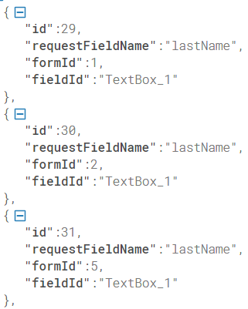
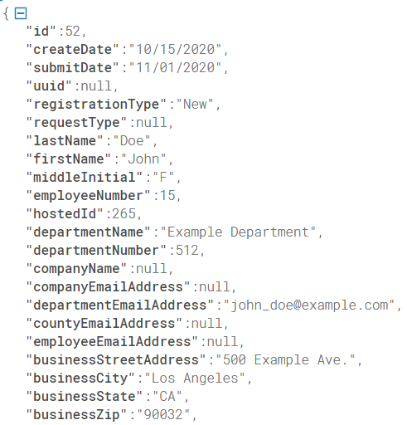
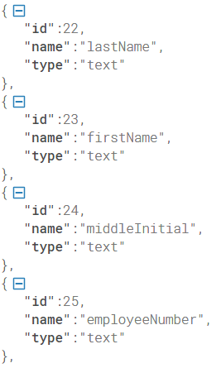
Backend Operations
Presenter: Javier Garcia
Current API (REST Model)
/forms
/fields
/mappings
/service_requests
{
"id" : 1,
"name" : "ISD Active Directory
Hosted Registration Forms
Contractor and Vendors",
"fields":[
{
"id" : 22,
"name" : "lastName",
"type" : "text"
},
{
"id" : 23,
"name" : "firstName",
"type" : "text"
},
{
"id" : 24,
"name" : "middleInitial",
"type" : "text"
},
...
...
...
...

Slide 18
Front End Operations
Built with Angular
Easy to build user interfaces
Reusable code
Material UI
Styled with Bootstrap
Adrian Palomares

Slide 19
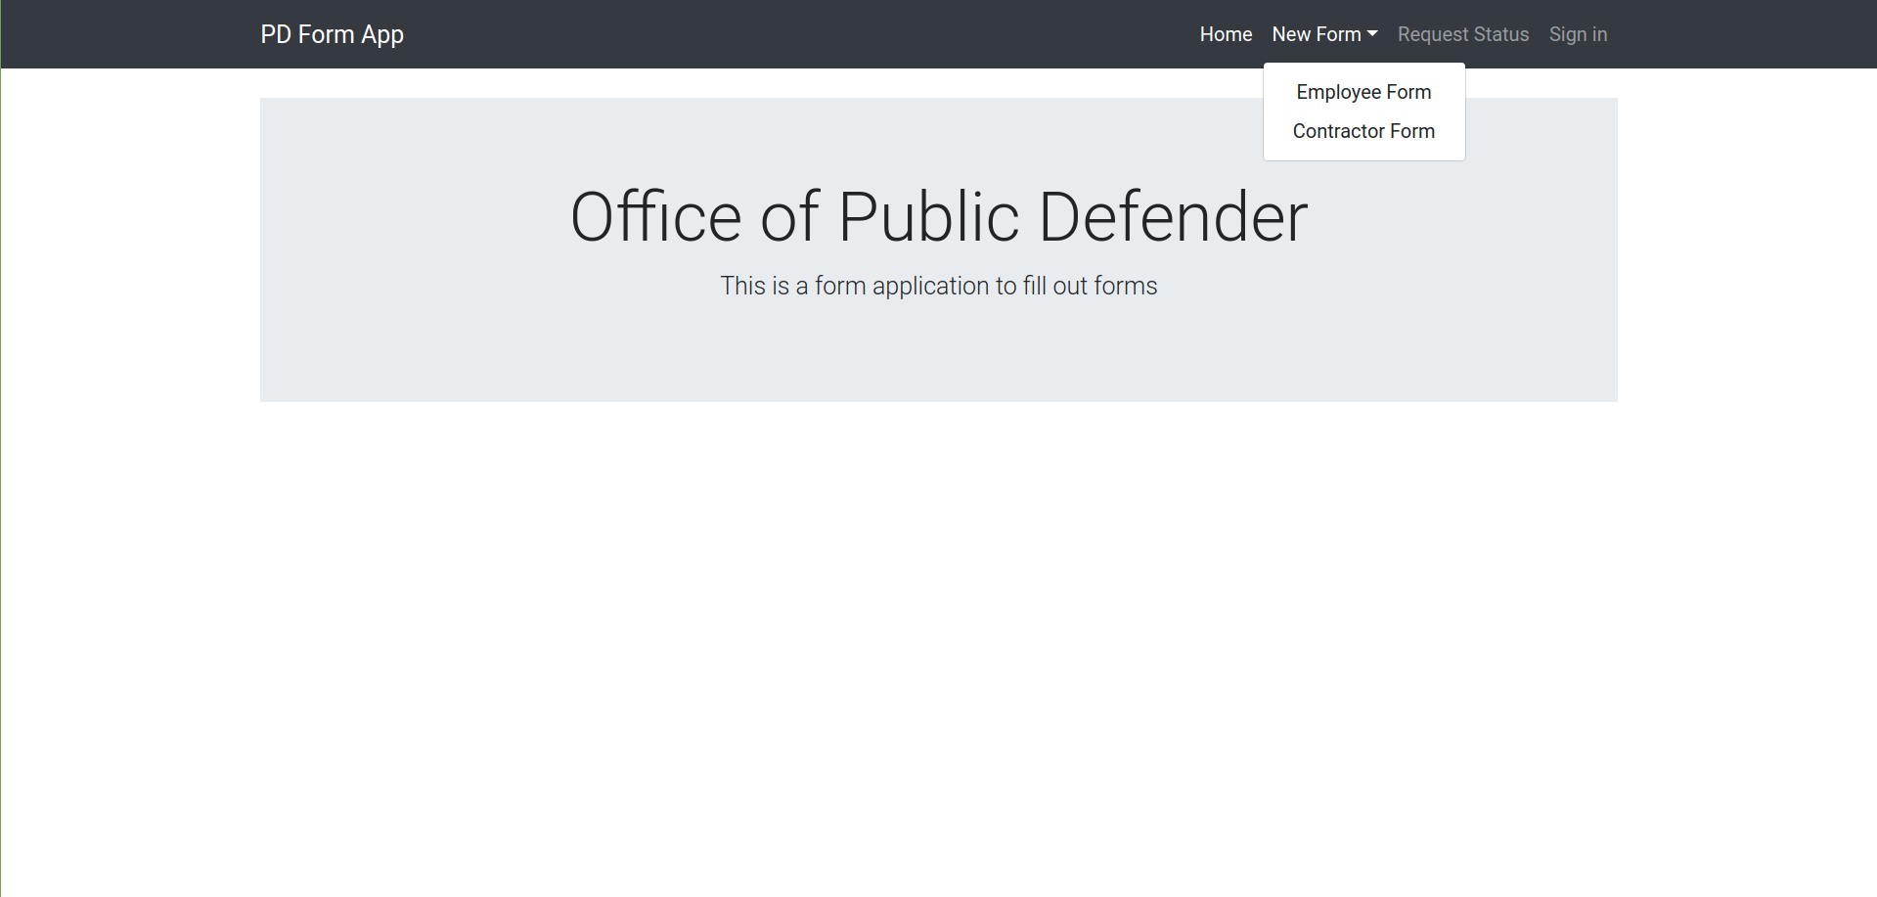
User Interface
Adrian Palomares

Slide 20
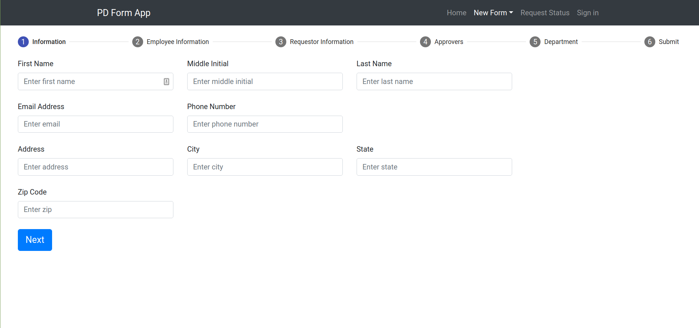
User Interface
Adrian Palomares

Slide 21
Current Progress & Achievements
Rawad Moussa
Initial Project: Migrate PD systems and databases to Salesforce.
Salesforce: platform development, data modeling, data management, data security, and building apps using cloud technologies.
New Project: Online employee enrollment application.
Frontend team: web form user interface
Backend team: backend API
PDF team: PDF API

Slide 22
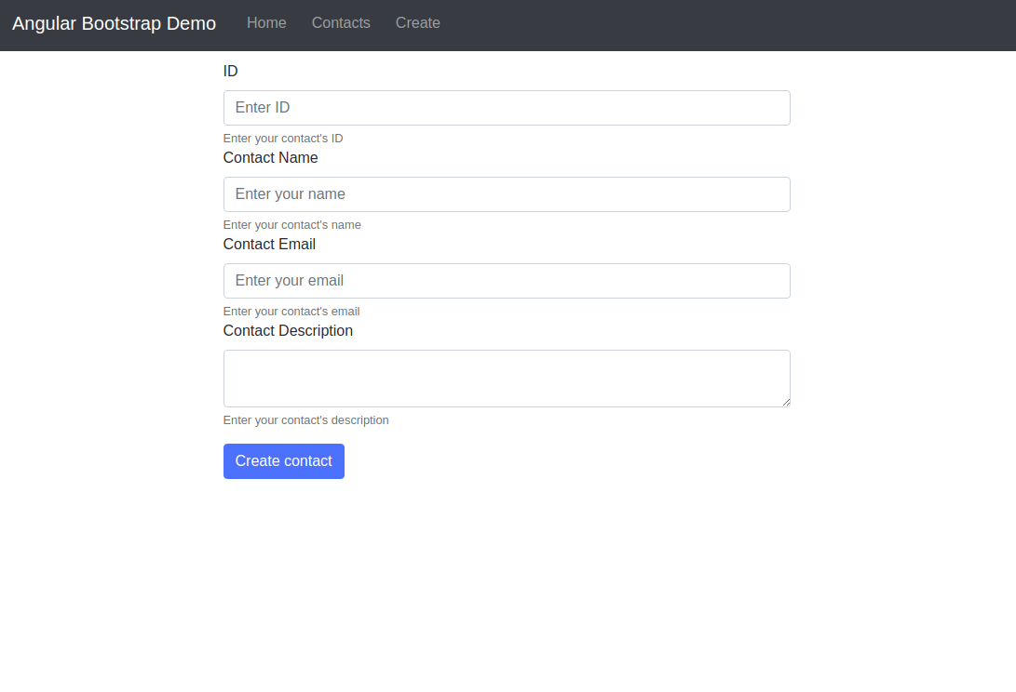
Current Progress & Achievements (cont.)
Rawad Moussa
Frontend team: Designing the web form user interface.
Learning Angular
Designing Web forms with Bootstrap
Submitting requests to the backend API

Slide 23
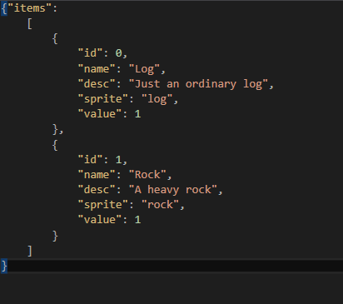
Current Progress & Achievements (cont.)
Rawad Moussa
Backend team: Developing the backend REST API system using Spring Boot
Learning Spring Boot, Hibernate, and data modeling
Creating data models
Storing data in the database

Slide 24
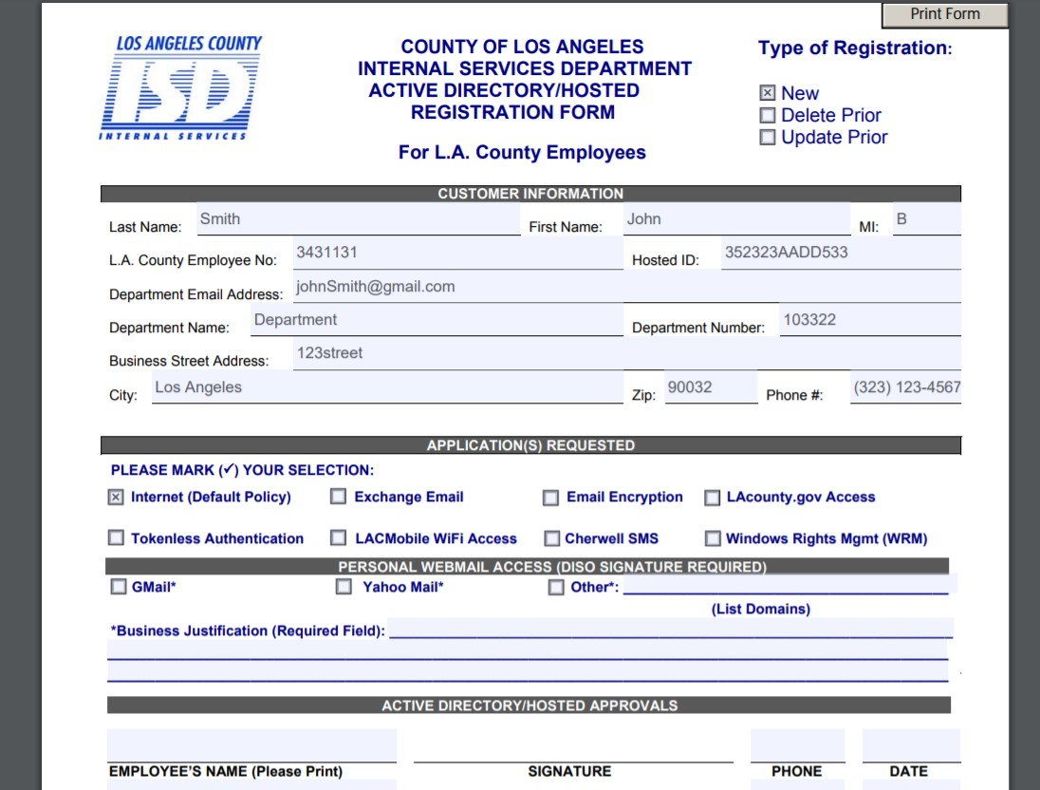
Current Progress & Achievements (cont.)
Rawad Moussa
PDF team: Using PDF libraries to fill out PDF forms.
Using PDFBox to fill PDF forms
Designing spreadsheet for the PDF fields
Building the database schema

Slide 25
Current Progress & Achievements (cont.)
Rawad Moussa
Challenges & Overcomes:
Challenge #1: Keeping the teams on the same page.
Overcome: Weekly meetings, messaging, and screen sharing.
Challenge#2: Learning new platforms and languages without prior experience.
Overcome: Using the same tutorials and answering questions on Discord.

Slide 26
Plan For Next Semester
Christopher Rodriguez
Finished functional project
Project tasks
Request status page
Database entry
BOX folder
Generated PDF forms
Connecting the components
Testing
Documentation

Slide 27
Plan For Next Semester
Christopher Rodriguez
Far future implementations
Secondary components
Login component
Email component
Website
Mobile App

