Slide 1
Presented By:
Patrick Flinner
Ken Shimauchi
Benjamin Valadez
Robert Karapetyan
Aaron Romero
Avik Ghazarian
Notes:
To change the image on this slide, select the picture and delete it. Then click the Pictures icon in the placeholder to insert your own image.

Slide 2
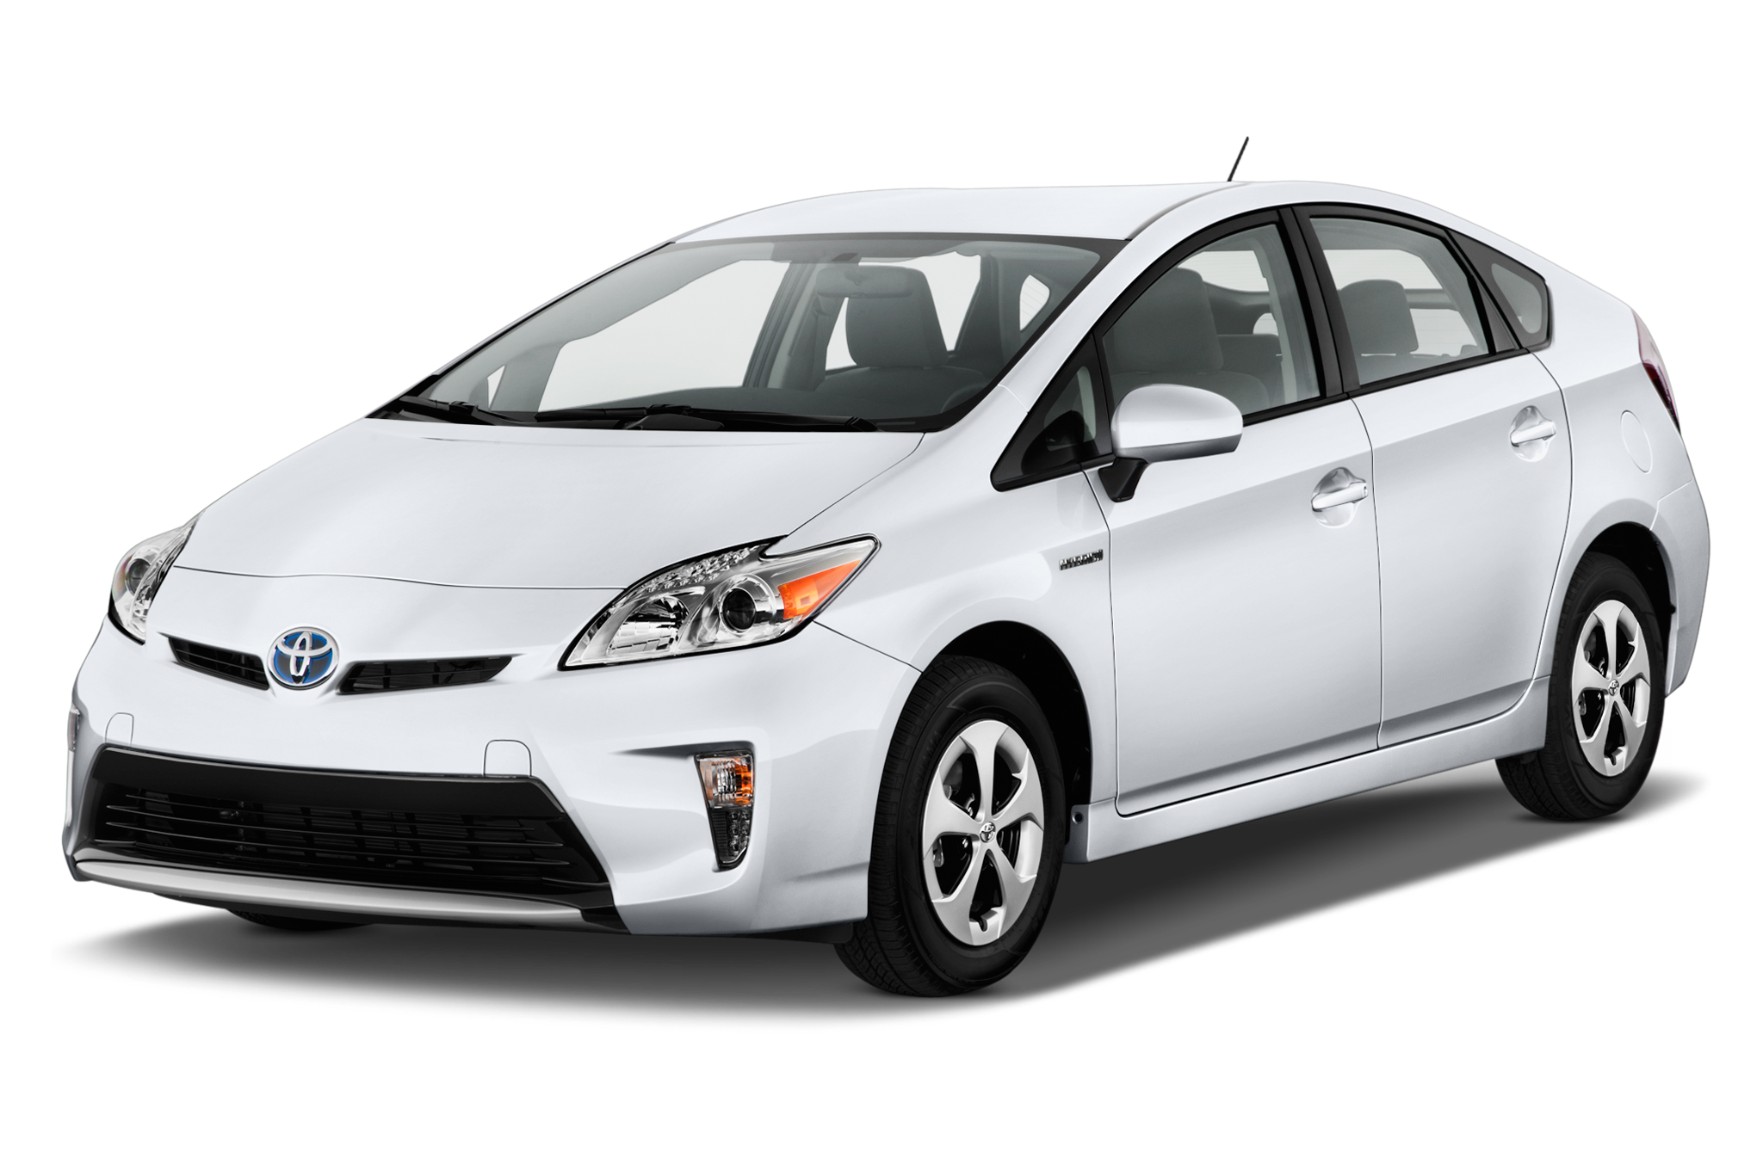
About the Project Patrick Flinner
Project for Los Angeles County Department of Parks and Recreation
500+ Vehicles
Hard to maintain
Difficult to schedule repairs
Control unauthorized vehicle usage

Slide 3
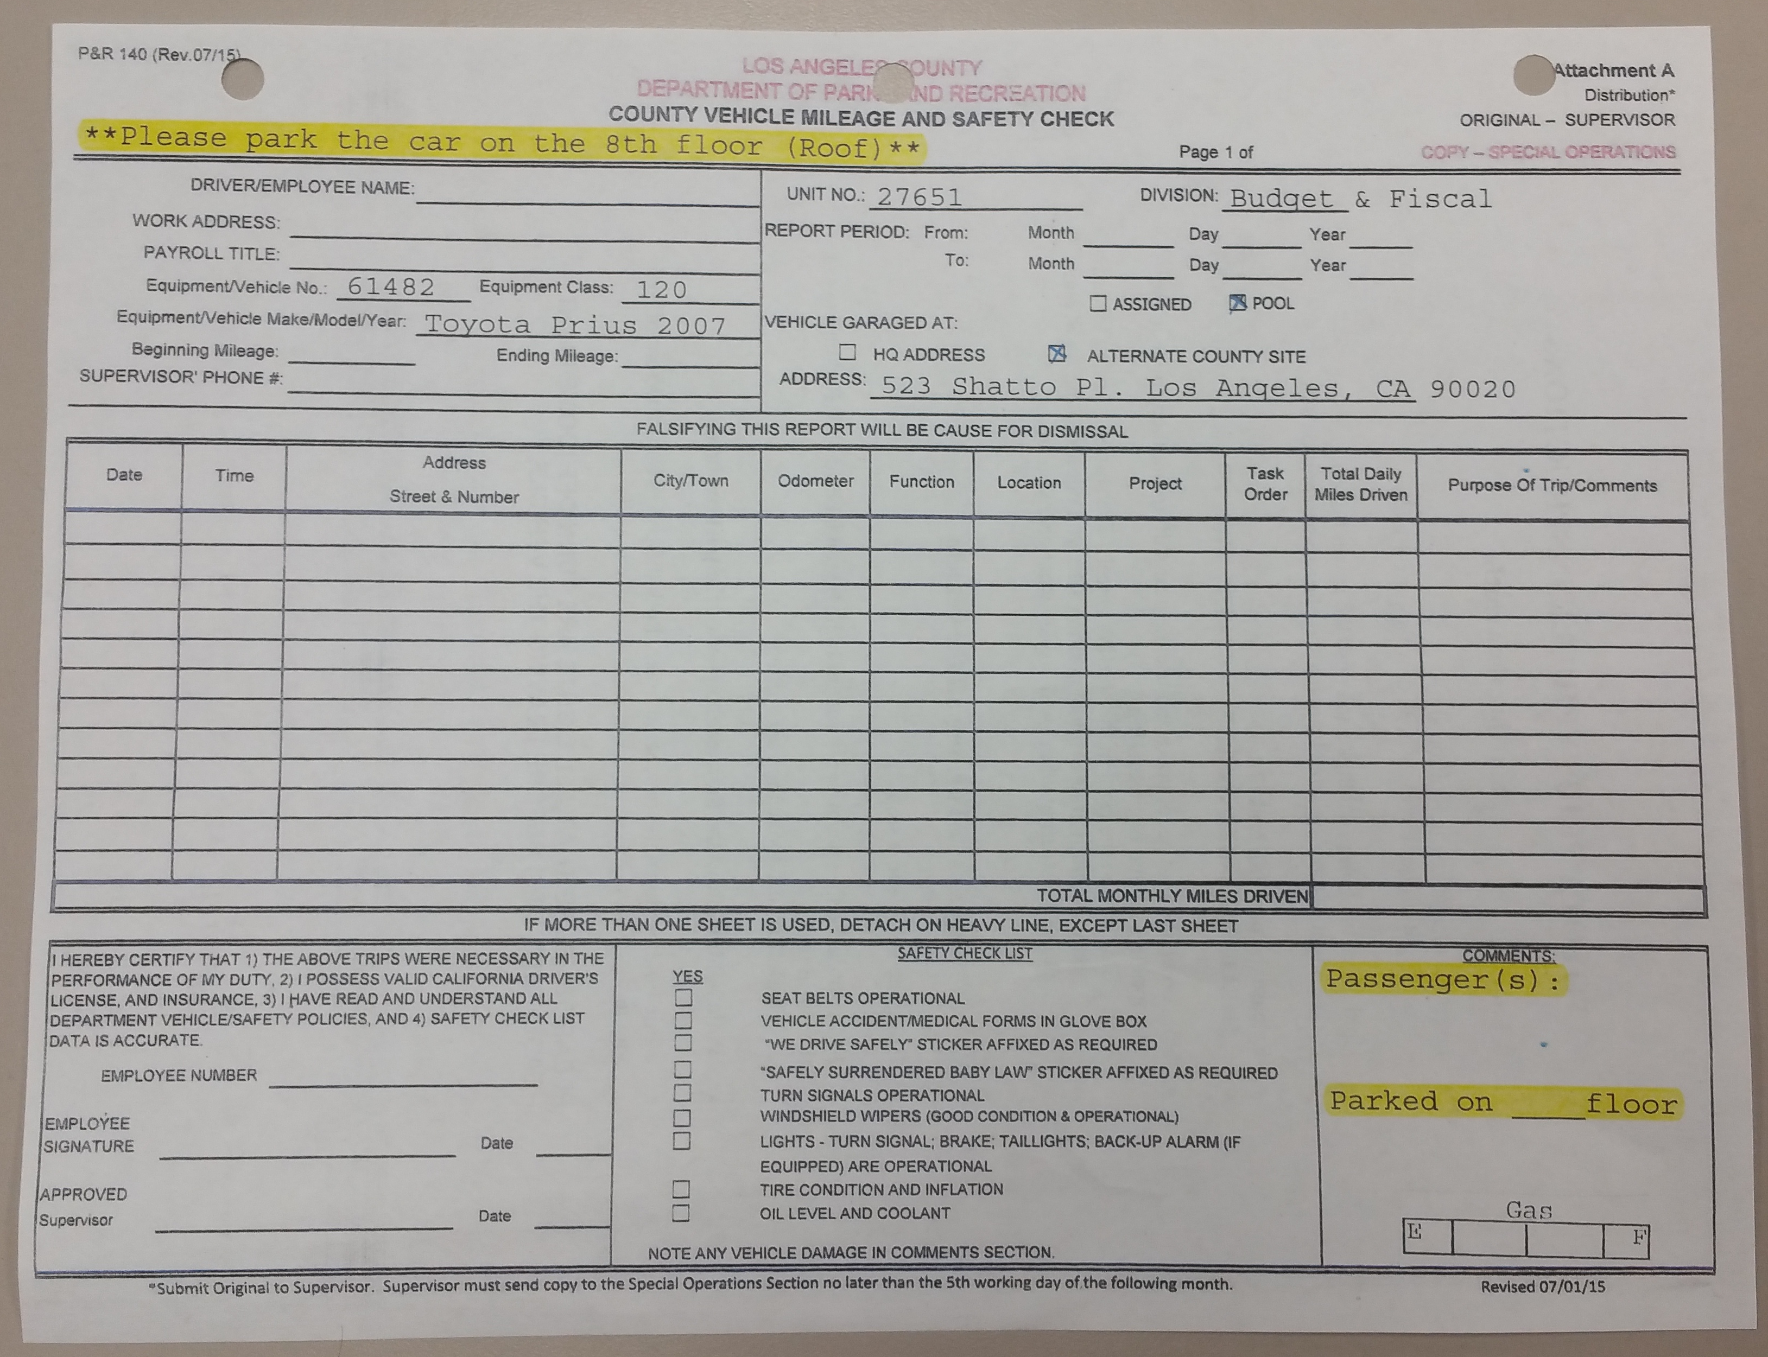
Project Overview Patrick Flinner
Collect Data from County Vehicles
Diagnostic Data from Car Sensors
Route Data
Driver Information using Employee ID
Automate and Digitize the County Vehicle Mileage and Safety Check Form

Slide 4
Project Overview Ken Shimauchi
Data will be sent from Edge to Platform through gateway
Data will be captured while vehicle is in use.
Cars are parked in County Facilities.
Data is encrypted in a secure messaging protocol.
Data will be stored within persistent storage
Relational
Data Lake

Slide 5
Project Overview Ken Shimauchi
Web Application for Vehicle Mileage and Safety Check Form
Employee Completion
Viewable by managers
Map Visualization
Completed Vehicle Mileage and Safety Check Form

Slide 6
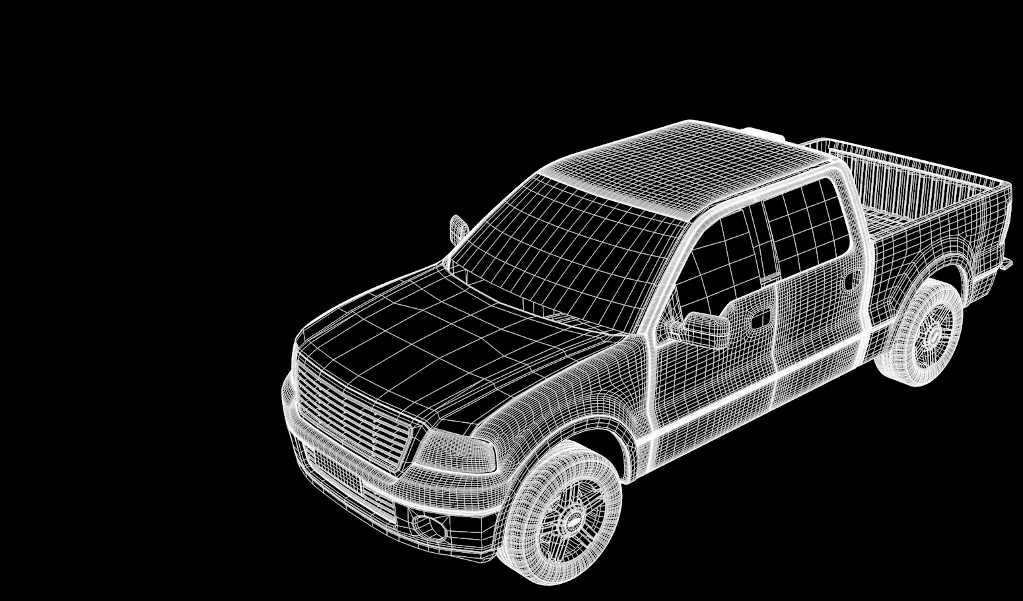
Bluetooth connection
Internet connection

Slide 7
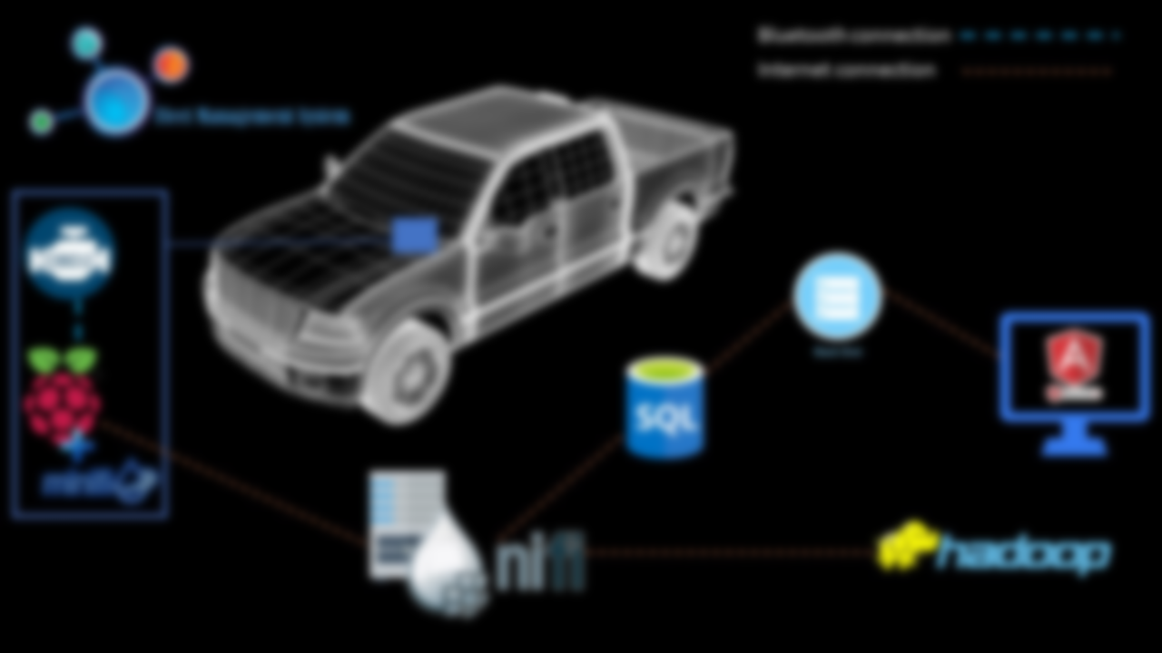
Edge Benjamin Valadez
Vehicle Electronic Control Unit(ECU) - On board computer controls engine and other components
On Board Diagnostics (OBD-II) became Standard in 1996
Standard Digital Communication
Features 16 Pin Connector that links Scanners/Adapters with ECU
User-Vehicle Communication
Wireless OBD-II Scanner
Bluetooth Low Energy “BLE”

Slide 8
Edge Benjamin Valadez
Raspberry PI 3
Small single board computer
Modules used: USB, Wi-Fi, and BLE.
External PI Hardware
GPS-Module
Apache MiNiFi
Subproject of NiFi
Sends Sensory Data
Simplify flow of data from edge to platform

Slide 9
NiFi and Back End Robert Karapetyan
NIFI - An easy to use, powerful, and reliable system to process and distribute data
NiFi is built to help tackle modern dataflow challenges:
1. System Failure
2. Insufficient Data Capacity in the Processing Chain
3. Enabling new Flows and Changing Existing Ones
4. Compliance and Security
NiFi has a web-based user interface for design, control, feedback, and monitoring of dataflows.

Slide 10
NiFi and Back End Robert Karapetyan
Back End Server - an interface between the SQL database and the Front End
SQL Database contains data pertaining to the safety check form
The Back End Server is capable of:
1. Responding to http requests from the front end
2. Retrieving data from the SQL database

Slide 11
Why create the FMS website Aaron Romero
More Efficiency and less tedious busy work
Driver Portal Usage
Manager Portal Usage

Slide 12
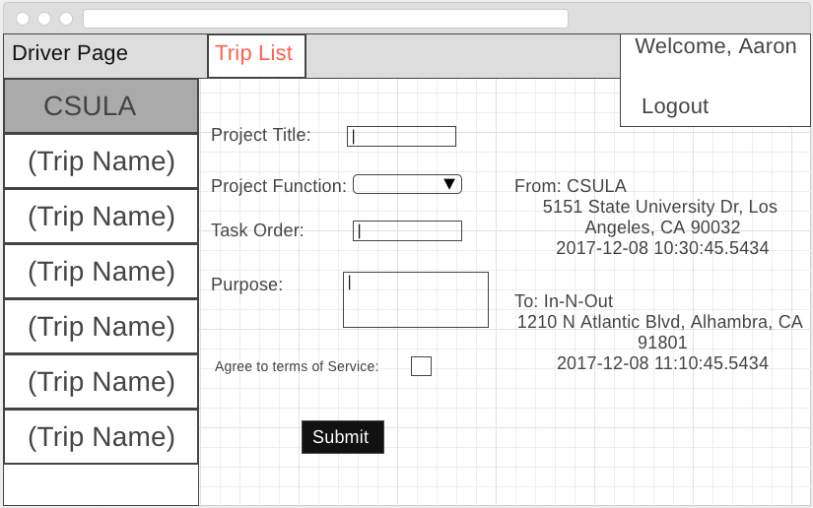
Front End – Functionality (Driver) Aaron Romero
Login Page:
Sign Up Page:
If Logged in as an Employee:
The user shall be redirected to the “Driver Page”
They shall see their list of trips taken for that specific day

Slide 13
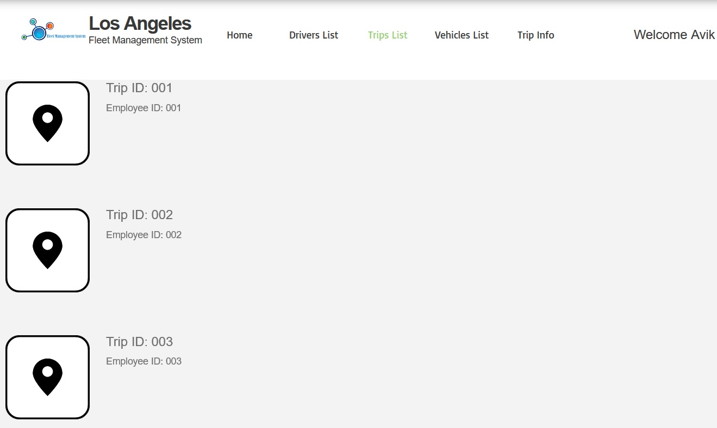
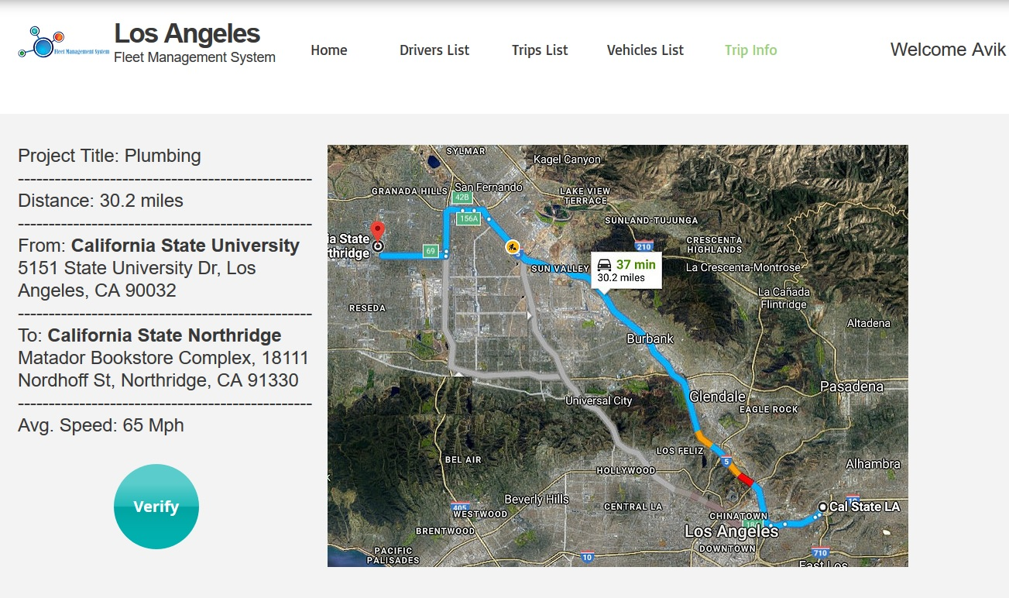
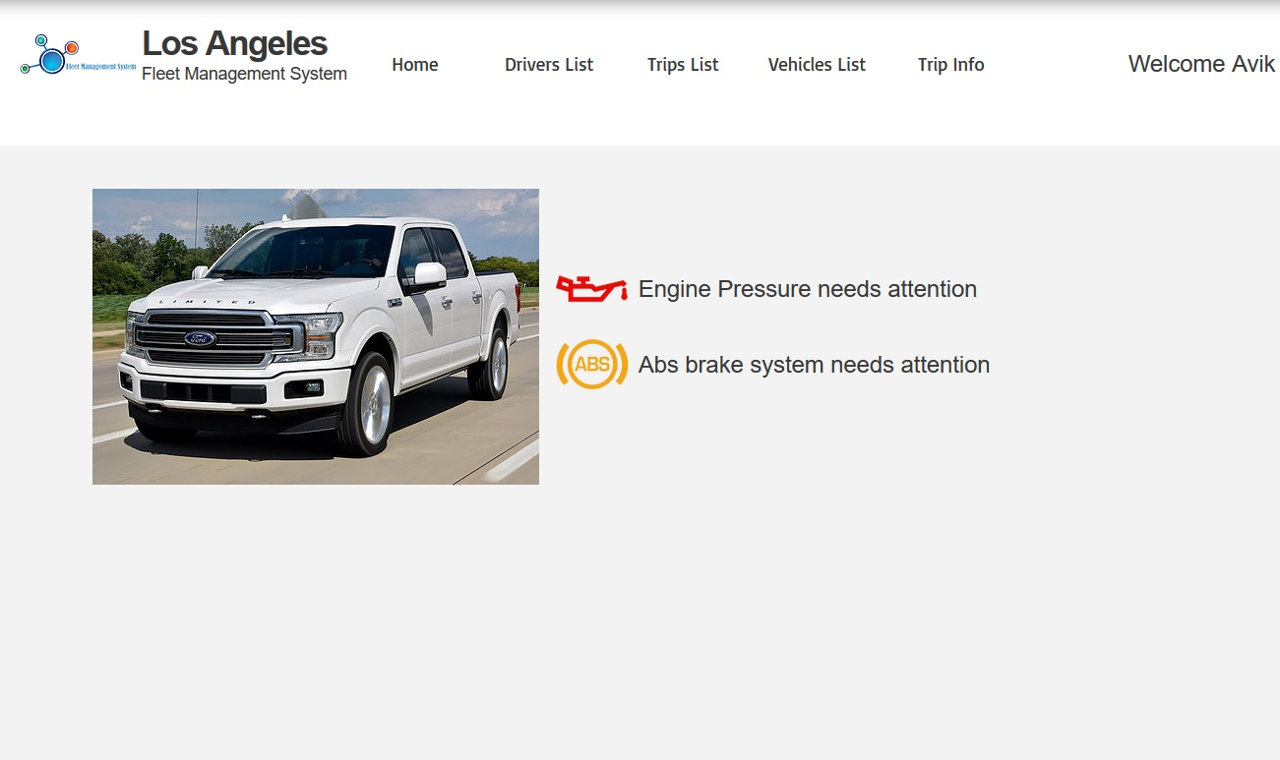
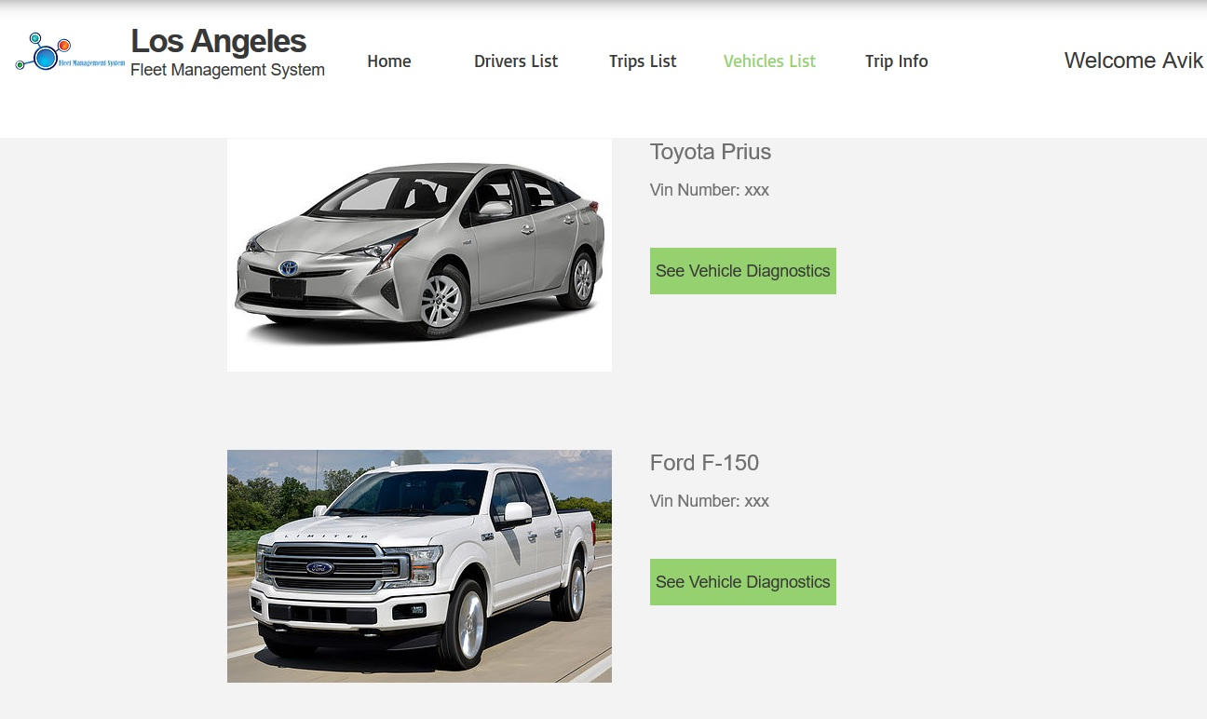
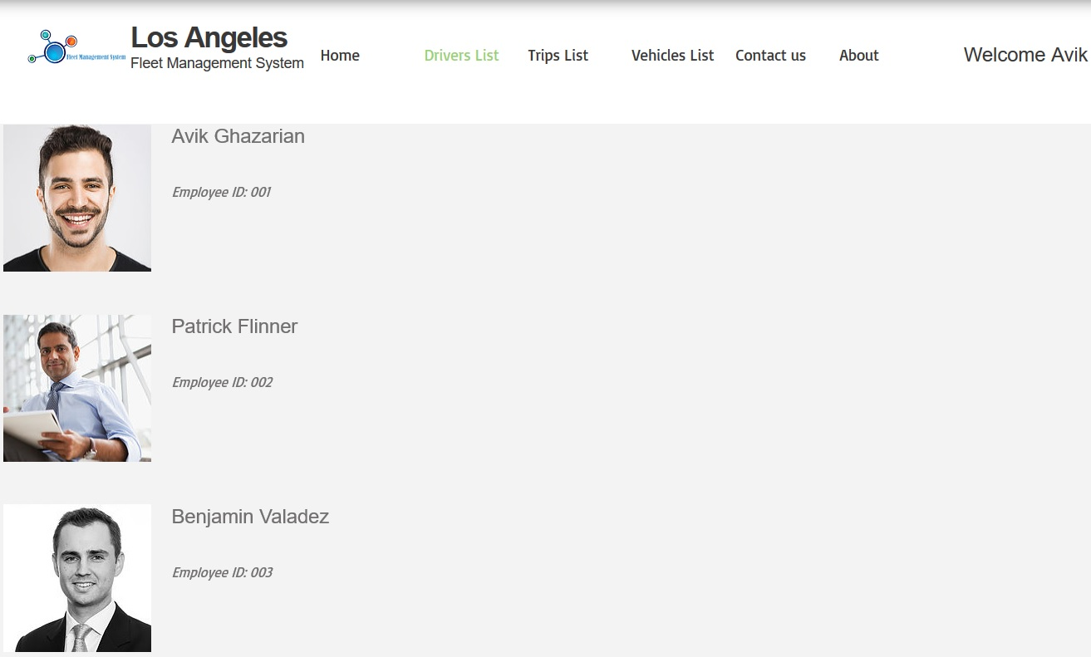
Avik Ghazarian
Front End Functionality cont. (Manager)

Slide 14
Accomplishments Avik Ghazarian
Basic Prototype Created
Created a web application and hardware prototype
Ability to retrieve data from car and send to a server
Ability to Read and Write to a database through the server
Ability to authenticate Users

Slide 15
Future Plans (Spring 2018) Avik Ghazarian
Fully Complete the edge portion of the project
Automate the Raspberry Pi
Connects to OBD-II without user intervention
Route data records properly
RFID Employee Scan
Send data to NiFi
Have a complete functioning web application for Los Angeles County Parks and Recreation.

Slide 16
Questions?
Comments?
Thoughts?

