Slide 1
Salient Feature Extraction from Planetary Images
Adam Berman, Kevin Casado, Benjamin Evans, Lineli Hairapetian, Bruno Recillas, Andy Tong
Sponsor: Jet Propulsion Laboratory (JPL)
Advisors: E. Y. Elaine Kang, Natalie Gallegos
JPL Liaisons: Emily S. Law, Shantanu Malhotra, George W. Chang

Slide 2
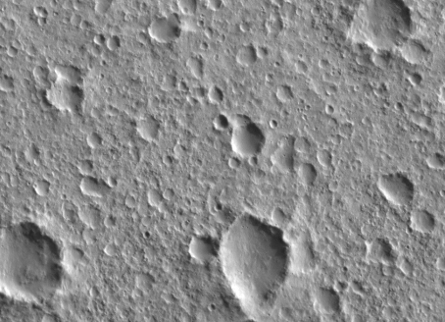
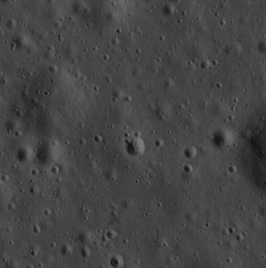
Objective
To detect and recognize Mars craters by extending the functionalities of an existing System called Ringtoss
Mars
Moon

Slide 3
Ringtoss: Crater Detection System
Previously only detected craters for Lunar Images
Image results: Hazard Map, Crater Recognition Results
Notes:
Add “animation” for the hazard map to appear
Increase border for highlighted boxes

Slide 4
Ringtoss: Crater Detection System
Previously only detected craters for Lunar Images
Image results: Hazard Map, Crater Recognition Results
Notes:
Add “animation” for the hazard map to appear
Increase border for highlighted boxes

Slide 5
Project Configuration (Setting up Ringtoss)
We were given Ringtoss’ source code
In order to get it running we had to install:
Java 8, Python 2.7, GDAL, MySQL, OpenCV
In order to get Ringtoss running with mars images:
Install USGS ISIS to convert Mars .IMG files into a pixel readable format like .tiff
Update input module to be compatible with Mars image metadata
Notes:
Add image of the ring toss pipeline highlighting the input module

Slide 6
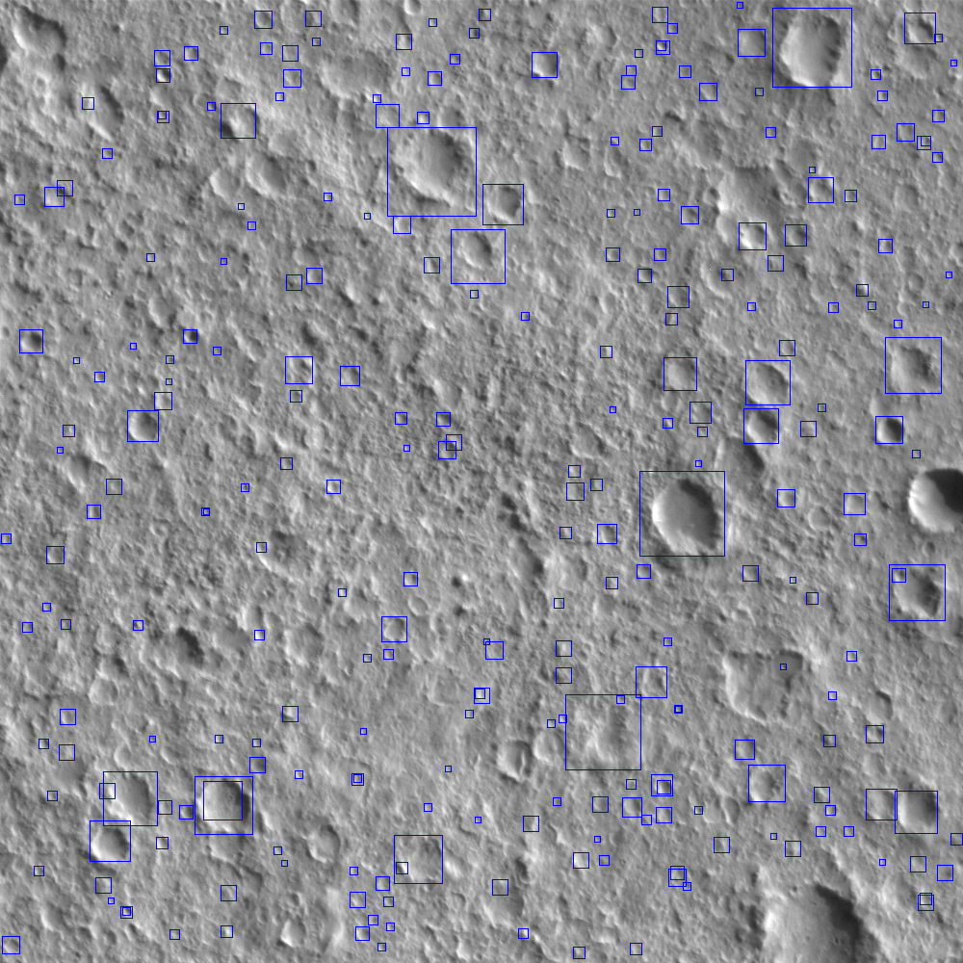
Initial Results
We gathered several Mars images as our test dataset
We ran portions of the images through Ringtoss
Results could be better

Slide 7
Project Focus
Improve detection results
Improve recognition results
Produce general hazard map
Detections are not perfect but pick up general hazards
This can be utilizes to create hazard map
To improve we had to get familiar with the system

Slide 8
Ellipse Fitting Algorithm

Slide 9
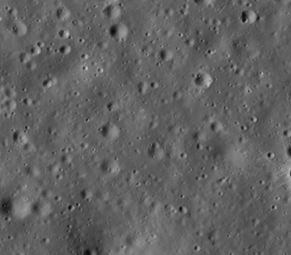
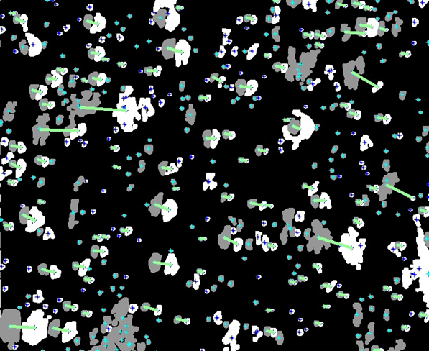
Ellipse Fitting Algorithm
After Thresholding
Erosion and Dilation
Original image
Centroid Detection

Slide 10
Ellipse Fitting Algorithm Improvements
Experimented with different amounts of erosion and dilation to determine which ones produced better results
Removed unnecessary sun angle conversion
Refactor algorithm implementation to improve the performance of the results and be able to display the results on a shorter amount of time on an image

Slide 11
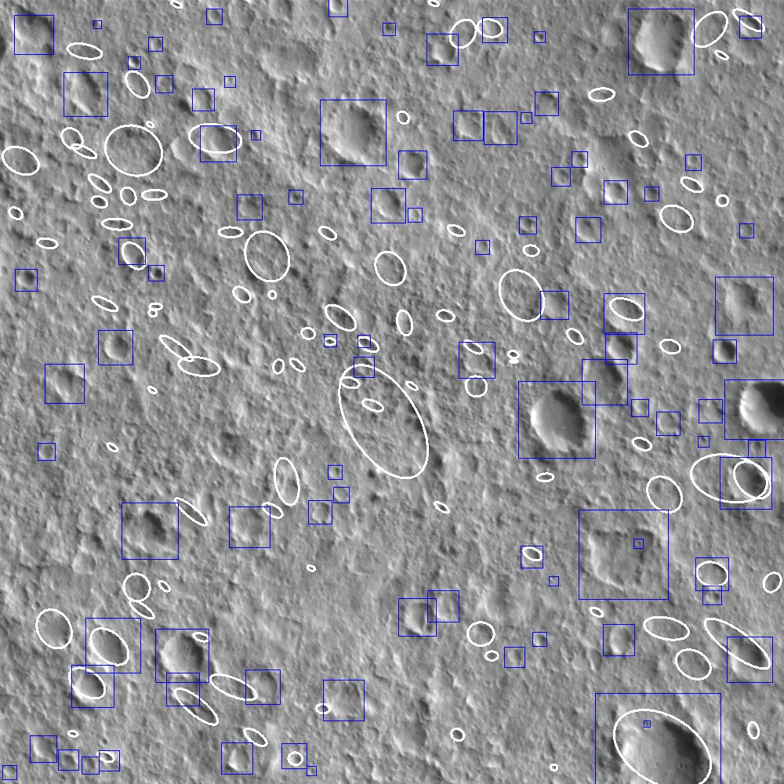
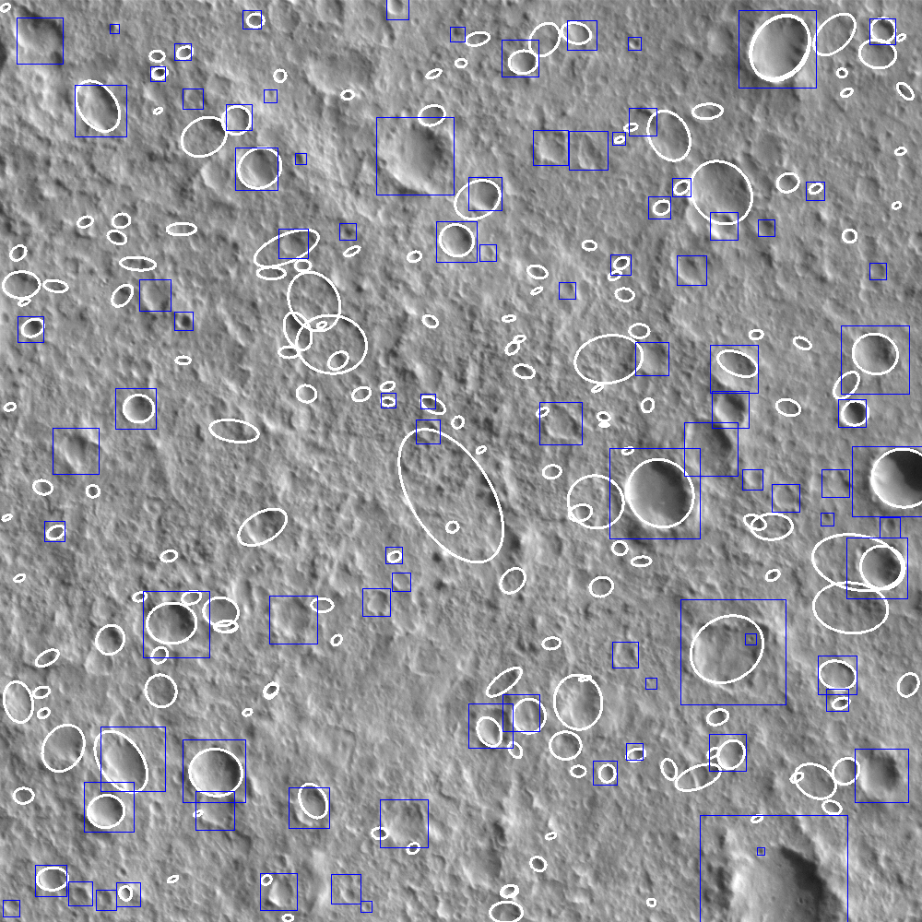
Results
Before
After
Notes:
Hightlight the craters that we pick up

Slide 12
Results
Before
After
Notes:
Hightlight the craters that we pick up

Slide 13
Circle Hough Algorithm

Slide 14
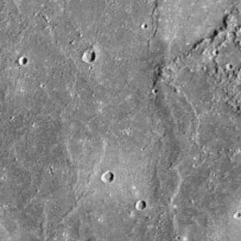
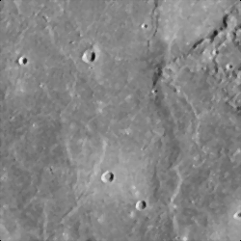
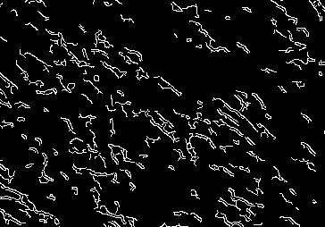
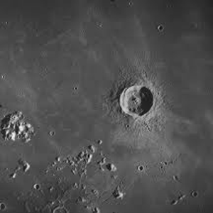
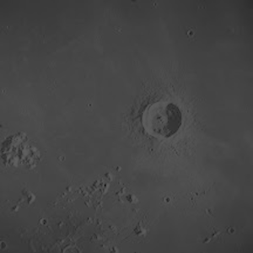
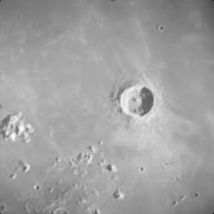
Circular Hough Algorithm
Image
With Detected Craters
and list of Crater information
Median and Gaussian Filters
Canny Edge Detector
Circular Hough Transform
Image
Retinex
Original Image
Single Scale Retinex
Median and Gaussian Filter
Canny Edge Detection

Slide 15
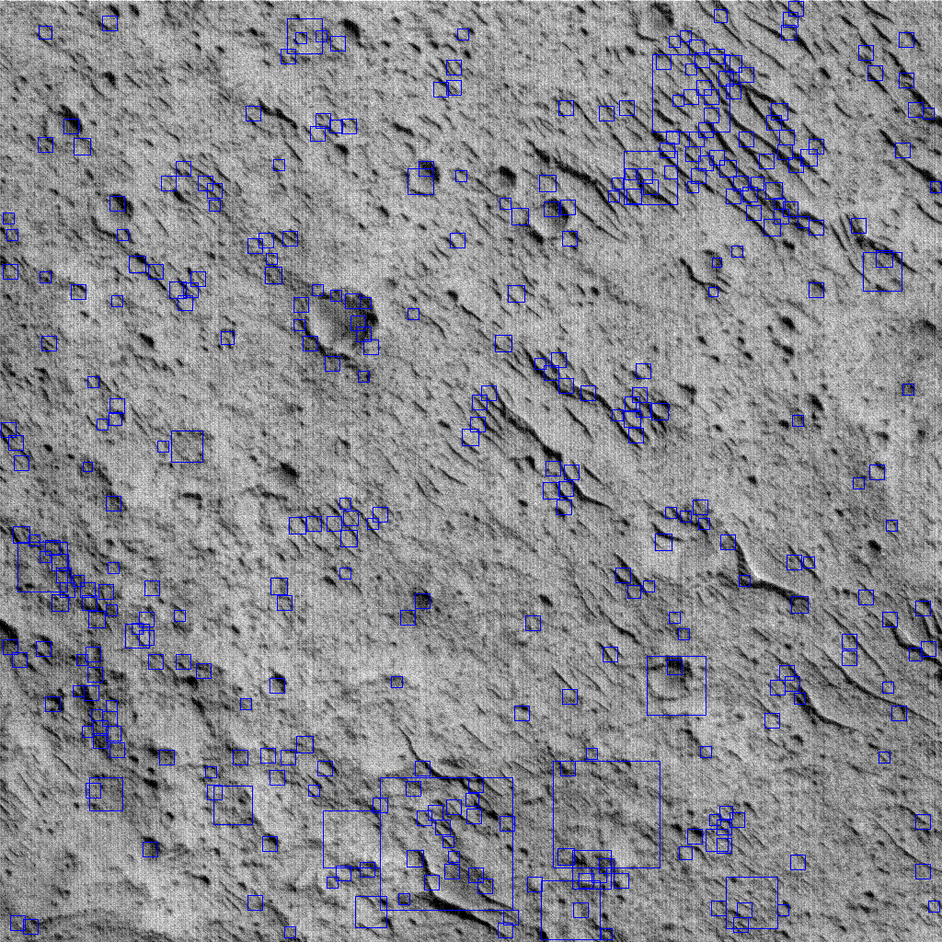
Improve Detection Results
Circle Hough
Analyzing result by:
Eliminating filters
Changing kernel size of filters
Tweaking other variables used in Circle Hough

Slide 16
Template Matching Algorithm

Slide 17
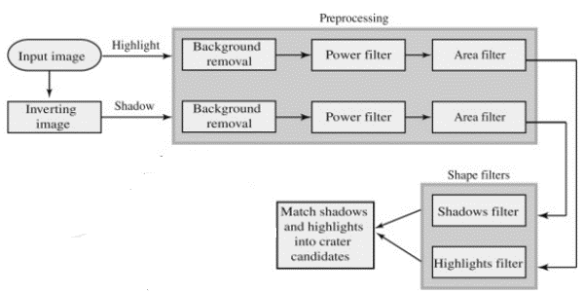
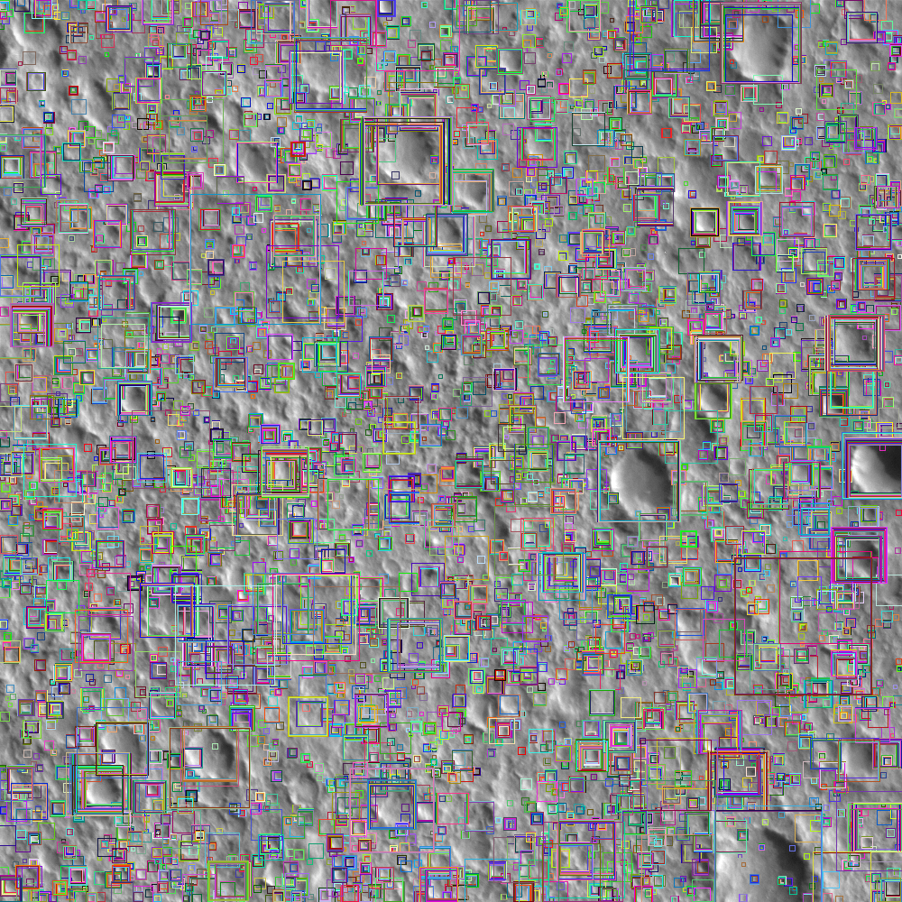
Template Matching Algorithm
Highlight
Shadow

Slide 18
Template Matching Algorithm Improvements
We tried a number of tweaks to improve Template Matching, including adding new templates generated from Martian imagery.
Numerical representations of these shapes, invariant of rotation, translation, or scaling (the math behind this is pretty cool), are generated and compared to the shapes found in the source images.
The algorithm was complex and seemed to work well, and so we avoided making major changes to it.
Highlight Templates
Shadow Templates

Slide 19
Duplicate Removal

Slide 20
Duplicate Removal
Redesigned duplicate removal
Before
50% overlap
After
If center of two craters are near the same location
If they are similar in size
If they cover same general area
Example of bad duplicate removal
Notes:
Add pictures if any here or make a new slide

Slide 21
Convolutional Neural Network (CNN)

Slide 22
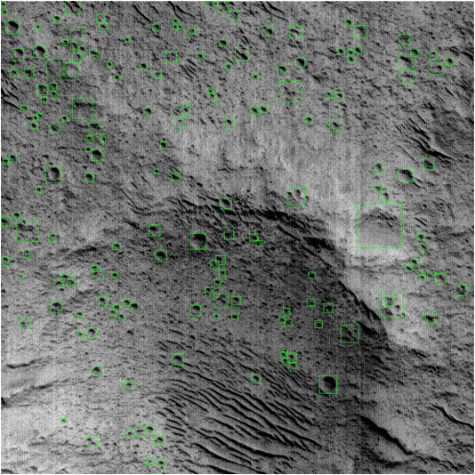
Training Data Classification Methods
Classifying craters and non-craters from detection results:
Ground Truth Generated by hand:

Slide 23
Convolutional Neural Network (CNN)
Neural Network from last year worked well. Most of the effort was placed into training.
We implemented a 2-phase recognition process, as well as expanding it from 2 classes to 3.
accepted
Craters
accepted
NN trained from last year
rejected
rejected
Non-Craters
Input Images
New NN

Slide 24
Produce General Hazard Map

Slide 25
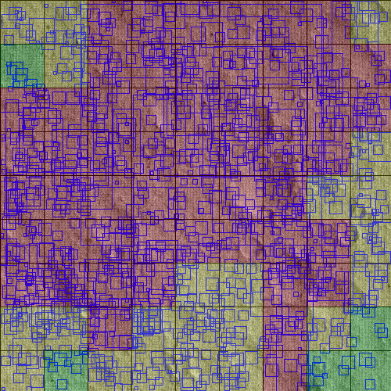
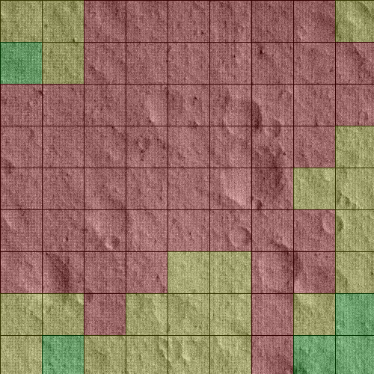
Producing General Hazard Map
The image is split into a per hectare grid (10,000 square meters )
For each hectare feature density is calculated
Hectare Coloring Red = >80% covered Yellow = 50%-79% covered Green = <50% covered

Slide 26
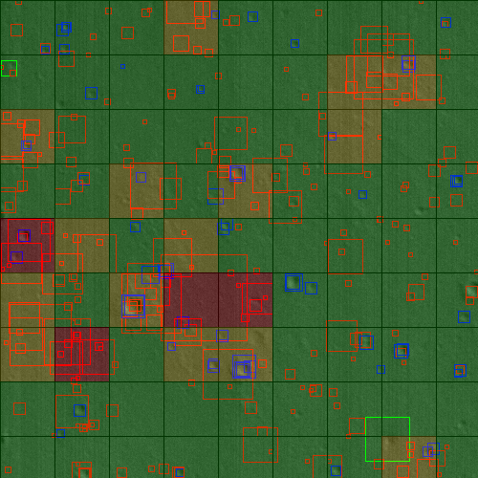
Producing General Hazard Map
Recognition module assigns confidence values to craters
Based on confidence values detection is categorized as crater or non-crater
Hazard map with recognition results superimposed Blue = Recognized Crater Green = Slightly below confidence value Red = Well below confidence value

Slide 27
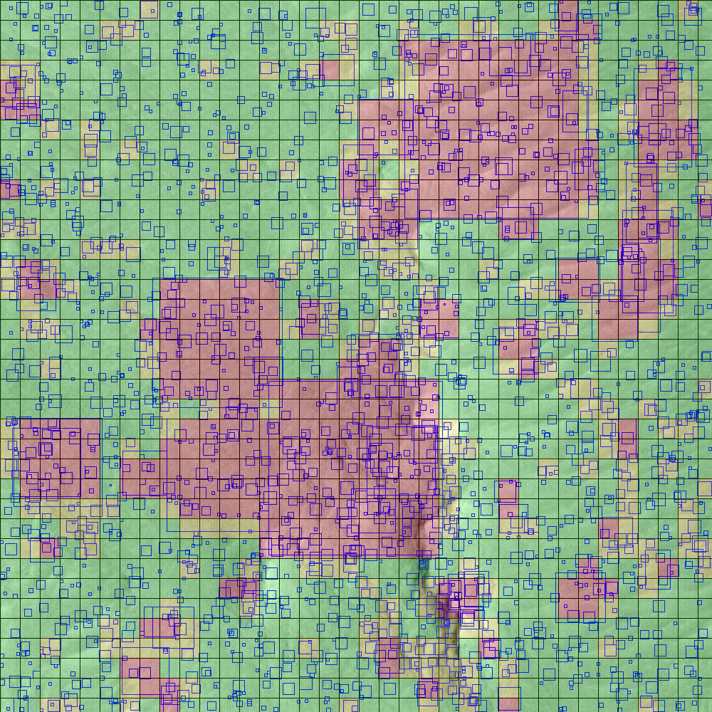
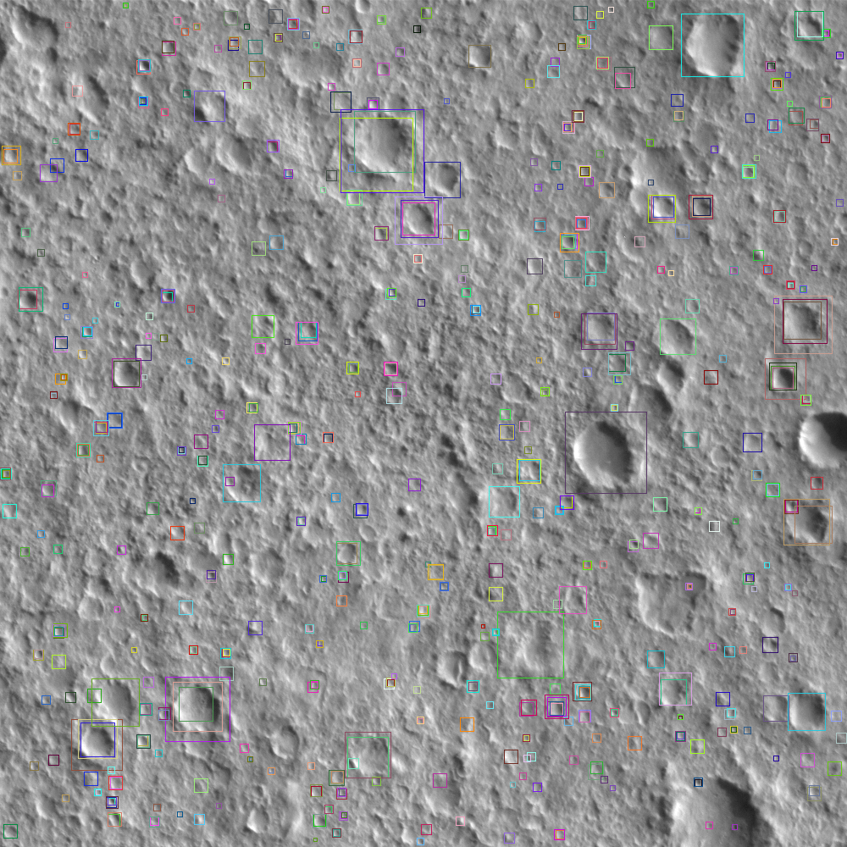
Results
Hazard Map
Final Results
Results metadata
Notes:
Need to included Initial results compared to final Results

Slide 28
Summary
Our results were not a great leap forward
We found incremental gains
This is common with research
There’s often no single change which will offer an order of magnitude improvement
negative results are still valuable
We did still find some positive outcomes
The hazard map is potentially useful
The Neural Network does seem better trained now
Notes:
Add section for “possible future work”

Slide 29
Future Work?
Migrate Neural Network to Caffe
Add a GUI
Speed up template matching (GPU? Distributed?)

Slide 30
Q&A

